Slide 1
Systems / Real-time / ProcessorExpert
Roman Stutz and Florian Bucher
INTRO FS15

Slide 2
Agenda
System types
Real-time
Hard / Soft
ProcessorExpert
Lab – Questions

Slide 3
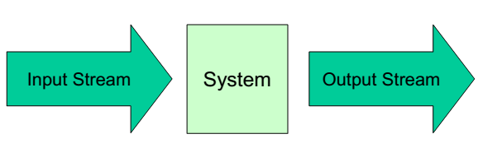
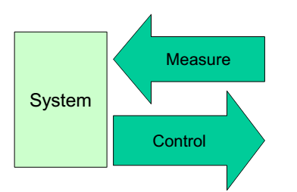
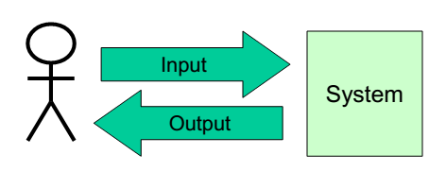
Systemtypes
Transforming Systems
Reactive Systems
Interactive Systems
Notes:
Transforming Systems
- e.g. Parser
Data processing quality (no latency, no data loss)
Huge Throughput
Optimization for system load and memory usage
Reactive Systems
e.g. Thermostat: Measures temperature and reacts with powering up the fan if the cpu is going to overheat
Control loop for external event
Guaranteed response time
Real-time
Interactive System
e.g. common calculator: Takes input, applies some magic and returns an output
Short response time
High system load
HMI (Human Maschine Interface)

Slide 4
Real-time
React to real word ....
.... With the correct result
.... At the correct time
.... Independent of system load
.... In a deterministic and foreseeable way
Example:
Platform announcements at the train station as soon as you exit the train.

Slide 5
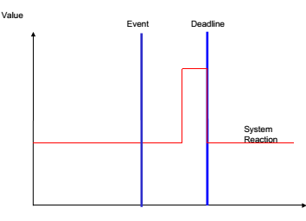
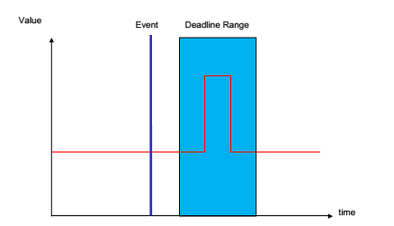
Hard- / Soft real-time
Hard
Reaction always at the same time
No deviation allowed
Soft
Reaction within time span
Little deviation allowed

Slide 6
ProcessorExpert
Code generator for hardware component drivers
Each component consists of three parts
Methods
Events
Properties
Notes:
Methods
-Procedures that can be executed
-Function calls
Events
-Indication of state changing
-Usually implementation of ISRs
Properties
-Modify/Customize object behavior
-Set during design-time

Slide 7
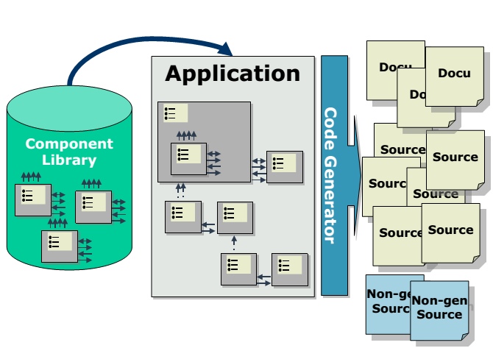
ProcessorExpert: Flow

Slide 8
LabQuestions

Slide 9
What is the advantage of using *.PEupd compared to use the files in the repository? What are advantages and disadvantages of using the Git repository files?
LabQuestion #1
Depends on context:
If components are used in multiple projects, a git repo will share fix/adjustments to all other projects.
But it is easer and more user-friendly to import just a file into the ProcessorExpert then specifying and configure the git repo.

Slide 10
You could use either BitIO or the LED component: What are the pros and cons of each approach?
LabQuestion #2
LED is wrapper for BitIO
Better abstraction for LED component(+)
Additional access to pwm and anode/cathode
Code overhead (-)
Notes:
BitIO: just named signal

Slide 11
What are the advantages of using a tool like Processor Expert? What could be the disadvantages?
LabQuestion #3
Less code writing
Focus on more important problems
General code, not always optimized

Slide 12
What would be a typical method for an character display component? What would be a typical property or event?
LabQuestion #4
Method: WriteLine()
Event: OnError
Notes:
WriteLine(): Writes a line of characters to the display
OnError: If display could not be accessed for writing.

Slide 13
From the GitHub you could download the repository as zip file and then unpack it at the right location. What is the advantage of cloning it instead?
LabQuestion #5
If there is a change in the repo, with the zip method, you have to redownload the repo and copy / replace / merge the file by hand. With the cloned repo git will do most of the work for you.
Notes:
See LabQuestion #1

