Slide 1
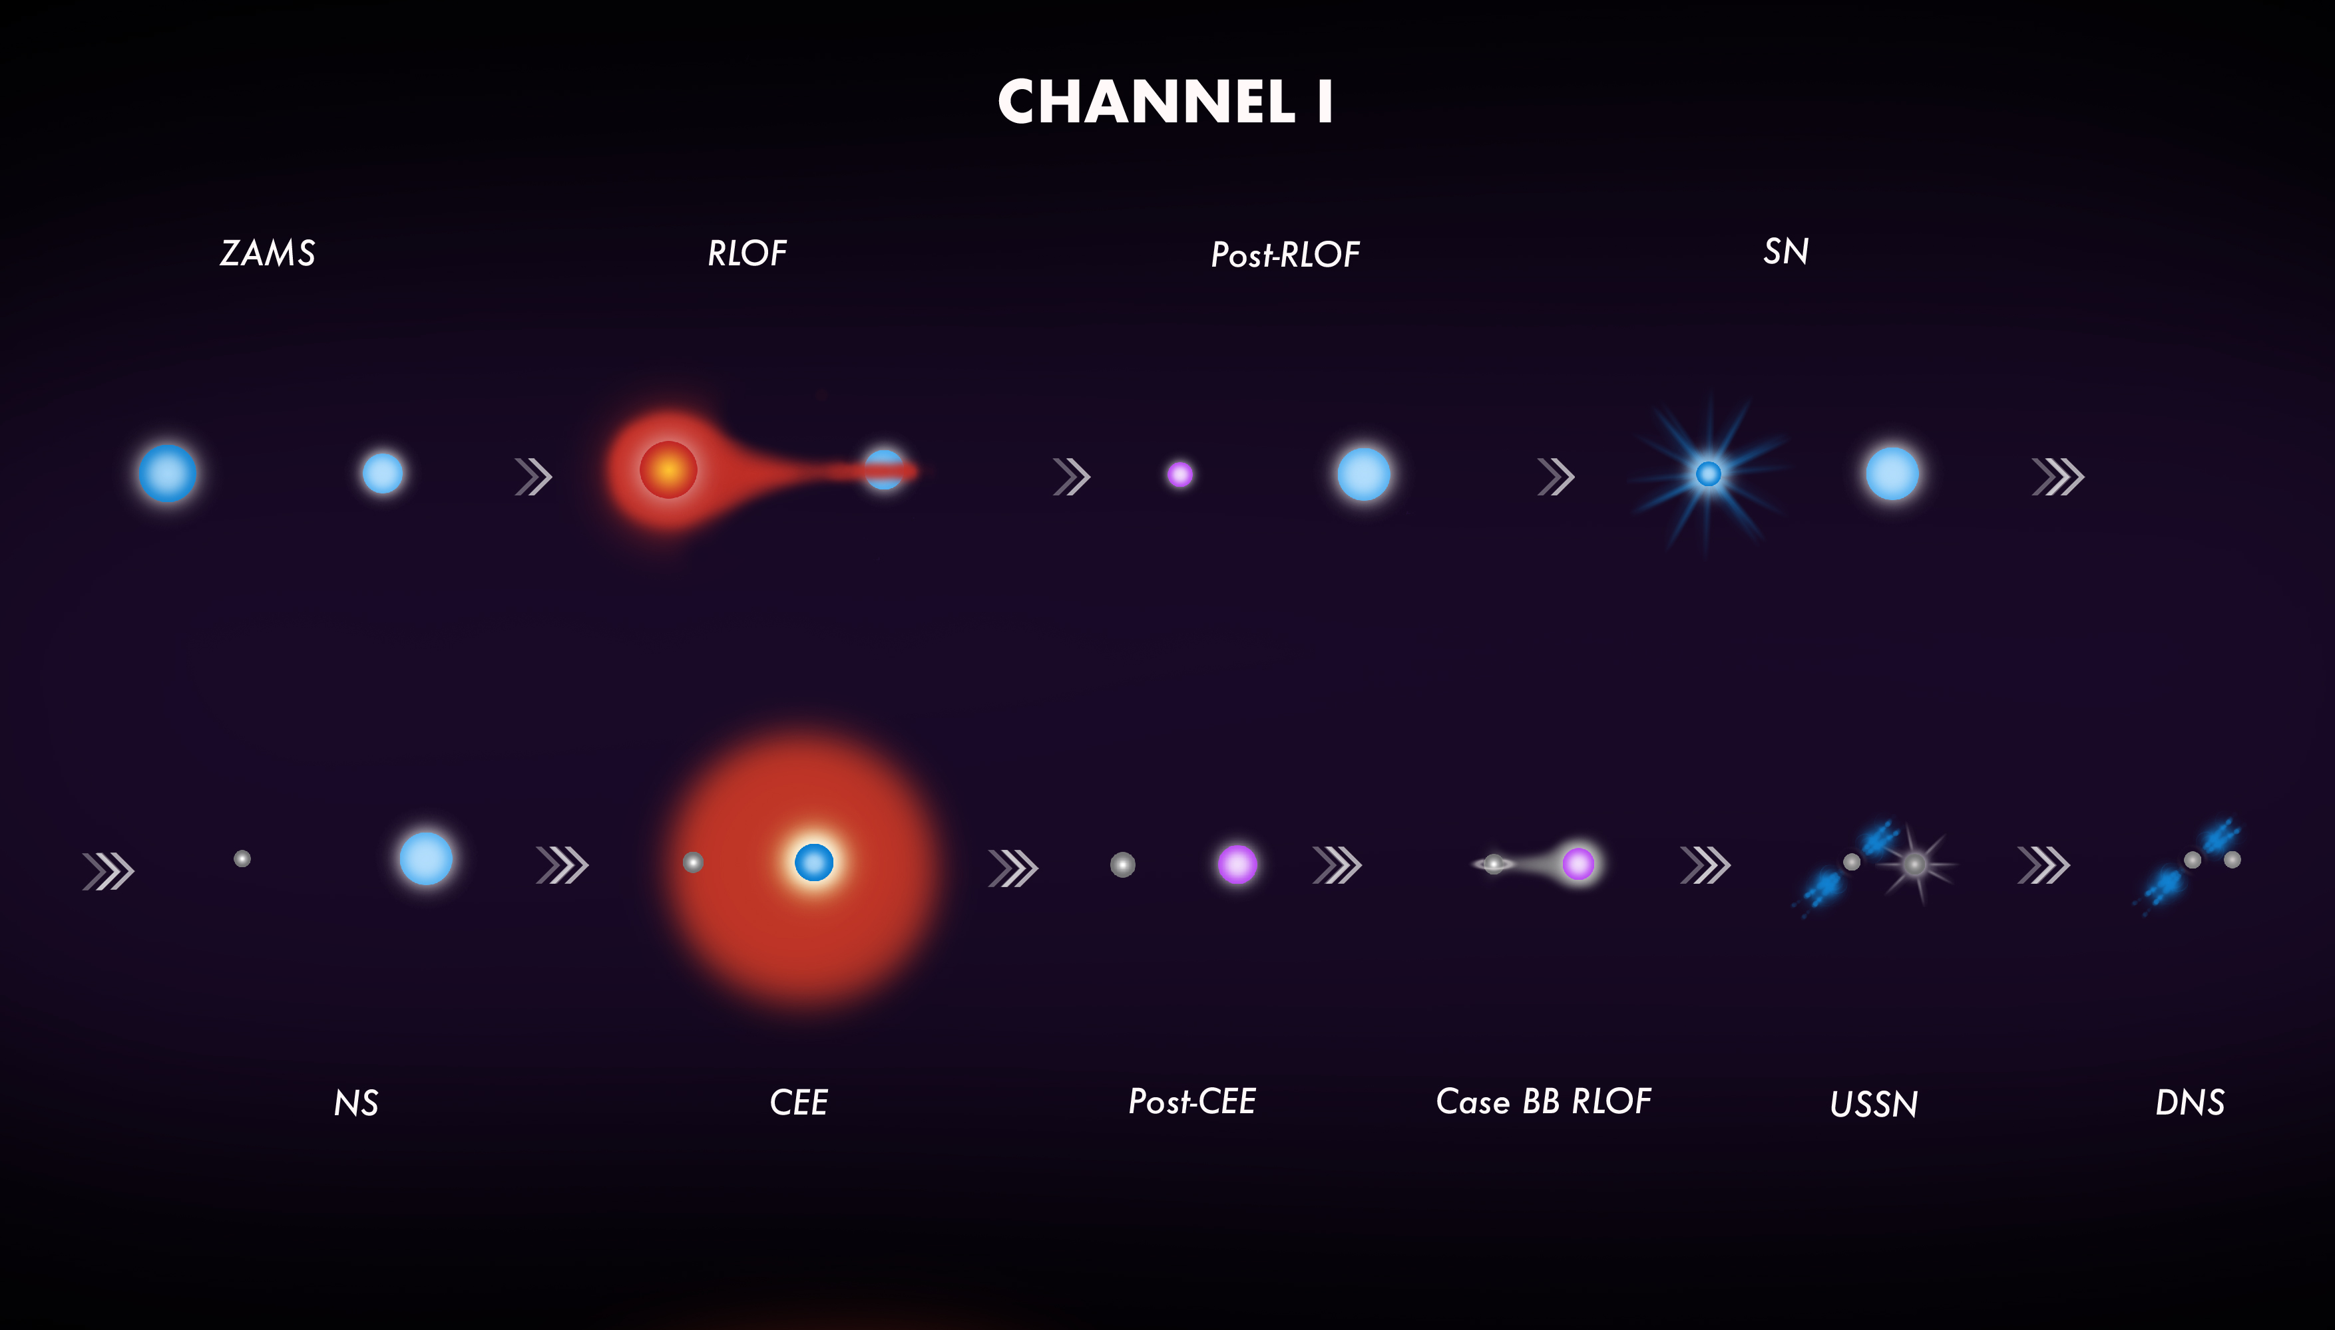

CHANNEL I: classic CE channel
BH
SN
BHNS

Slide 2
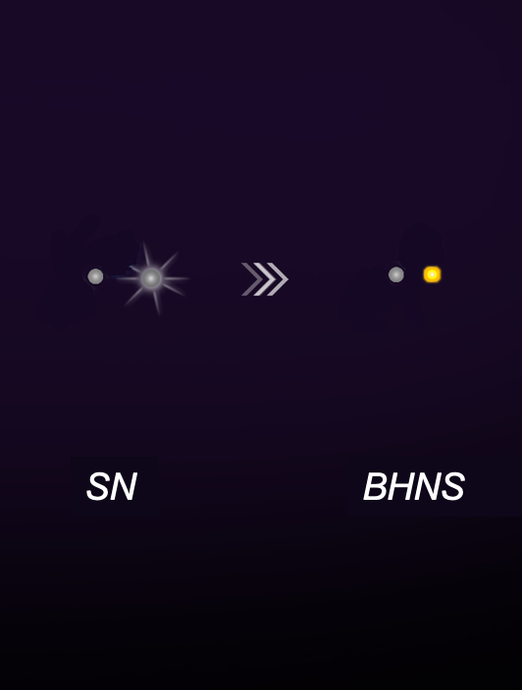
CHANNEL II: only stable mass transfer
BH
BHNS
SN

Slide 3
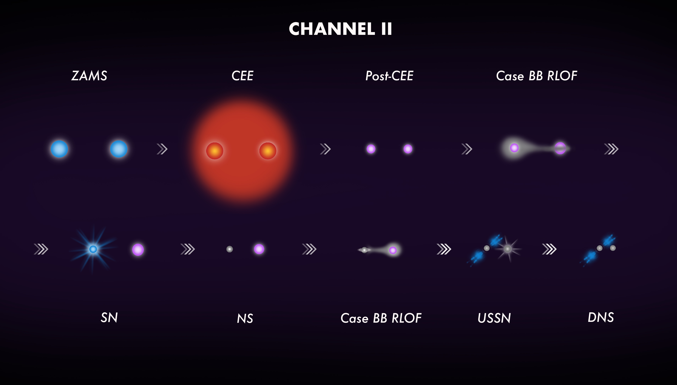

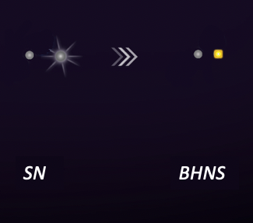
CHANNEL III: immediate single-core CE
CHANNEL IV
BH
BHNS
BH
BHNS

Slide 4
CHANNEL IV: immediate double-core CE
CHANNEL IV
BH
BHNS
BH
BHNS

Slide 6
BHNS
BH
SN
BHNS

Slide 7
BH
SN
BHNS

