Slide 1
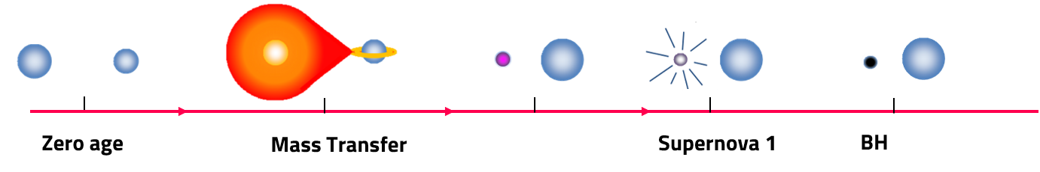
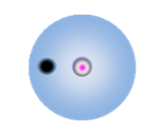
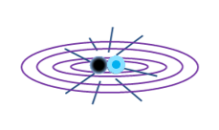
Isolated binary evolution Formation Channels
Unstable MT
double core CE
Stable MT
Unstable MT
Unstable MT
Stable MT
(I): Classic CE
(II): Only Stable Mass Transfer (OSMT)
(III): single-core CE
as 1st MT
(IV): double-core CE
as 1st MT

