Slide 1
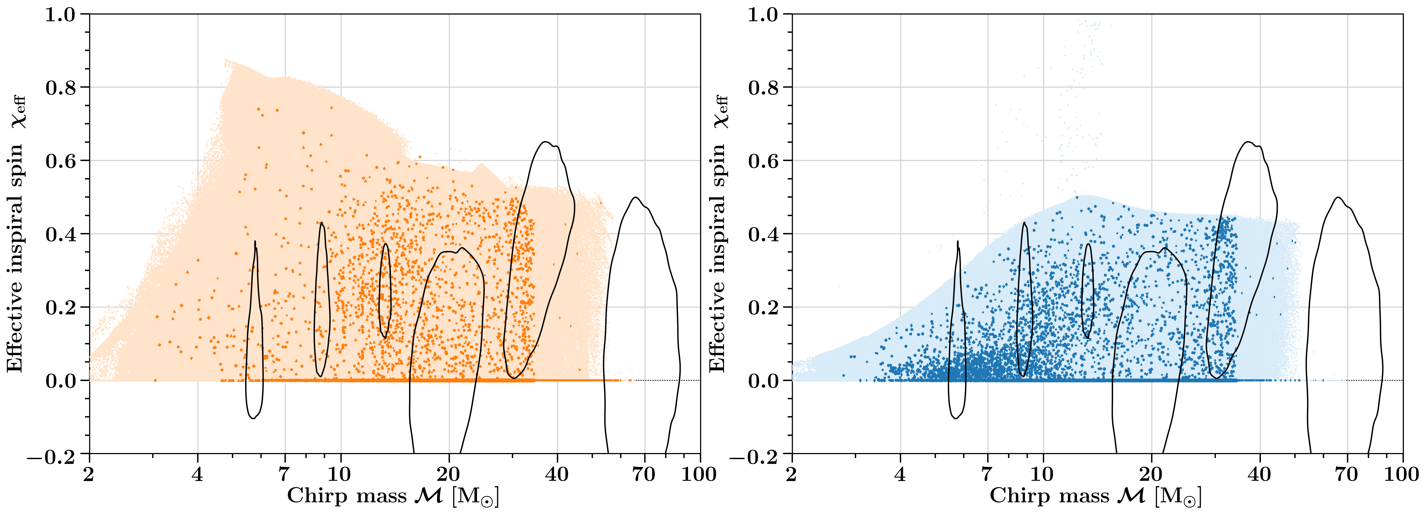
MRR
non-MRR
GW170729
GW170729
GW190521
GW190521
GW190412
GW151226
GW190924_021846
GW191204_110529
Notes:
GWhighlight = [r'GW151226', r'GW170729', r'GW190412', 'GW191204_110529', 'GW190924_021846', 'GW190521’]. GW191204$\_$110529 is an example of a system with one of the highest MRR fractions ($\gtrsim 0.5$) in Fig.~\ref{fig:MRR-fraction-per_GW-observation} for all model realizations, making it a likely MRR candidate. On the other hand, GW190924$\_$021846 is a system with one of the lowest MRR fractions ($\lesssim 0.5$) making it a likely non-MRR candidate.

