Slide 1
Basics of algorithm evaluation
Florian Polster--Prieto

Slide 2
TABLE OF CONTENTS
01
02
04
Evaluation databases
Evaluation Metrics
03
Evaluated Algorithms
Bibliography

Slide 3
01
Evaluation Databases

Slide 4











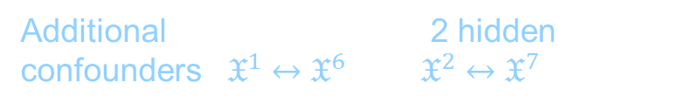









Artificial time series
https://dataverse.harvard.edu/dataverse/basic_causal_structures_additive_noise
Contains 6 different architectures, with at most 7 time series:
Fork structure
V-structure
Mediator structure
Diamond structure
7 time series structure
$$𝔛^{1}$$
$$𝔛^{1}$$
$$𝔛^{1}$$
$$𝔛^{1}$$
$$𝔛^{1}$$
$$𝔛^{2}$$
$$𝔛^{3}$$
$$𝔛^{2}$$
$$𝔛^{2}$$
$$𝔛^{2}$$
$$𝔛^{2}$$
$$𝔛^{3}$$
$$𝔛^{4}$$
$$𝔛^{5}$$
$$𝔛^{3}$$
$$𝔛^{3}$$
$$𝔛^{3}$$
$$𝔛^{4}$$
$$𝔛^{6}$$
$$𝔛^{7}$$
Additional 7ts structure with 2 hidden confounders : $𝔛^{1}↔𝔛^{6}$ and $𝔛^{2}↔𝔛^{7}$

Slide 5
The data is generated using nonlinear functions (chosen uniformly between absolute value, tanh, sine and cosine) between time series and linear functions for self causation, with random coefficient.
The generated data is stationary
Use Cases | Number of datasets | Number of samples | Number of observed variables | Number hidden variables | Number of relations | Lag
Fork | 10 with 3 TS | 4000 | 3 | 0 | 5 | 1
V-structure | 10 | 4000 | 3 | 0 | 5 | 1
Mediator | 10 | 4000 | 3 | 0 | 6 | 1
Diamond | 10 | 4000 | 4 | 0 | 8 | 1
7TS | 10 | 4000 | 7 | 0 | 13 | 1
7TS2H | 10 | 4000 | 7 | 2 | 15 | 1

Slide 6
Papers using the dataset
Survey and Evaluation of Causal Discovery Methods for Time Series,
Charles K. Assad , Emilie Devijver, Eric Gaussier
February 28, 2022 – Journal of Artificial Intelligence Research

Slide 7
Tennessee Eastman simulation dataset (TE)
https://ieee-dataport.org/documents/tennessee-eastman-simulation-dataset
Simulation of actual chemical processes, which are nonlinear.
Number of multivariate TS | Number of samples | Number of observed variables
22 | 500-1000 | 52

Slide 8
Papers using the TE dataset
Causal Discovery from Sparse Time-Series Data Using Echo State Network
Haonan Chen, Bo Yuan Chang, Mohamed A. Naiel, Georges Younes, Steven Wardell, Stan Kleinikkink, John S. Zelek
January 01, 2022 – DeepAI
Probability Density Estimation and Bayesian Causal Analysis Based Fault Detection and Root Identification
Xiaolu Chen, Jing Wang, JingLin Zhou
October 10, 2018 – ACS Publications
Root Cause Diagnosis of Process Fault Using KPCA and Bayesian Network
H. Gharahbagheri, S. A. Imtiaz, and F. Khan
January 30, 2017 – ACS Publications

Slide 9
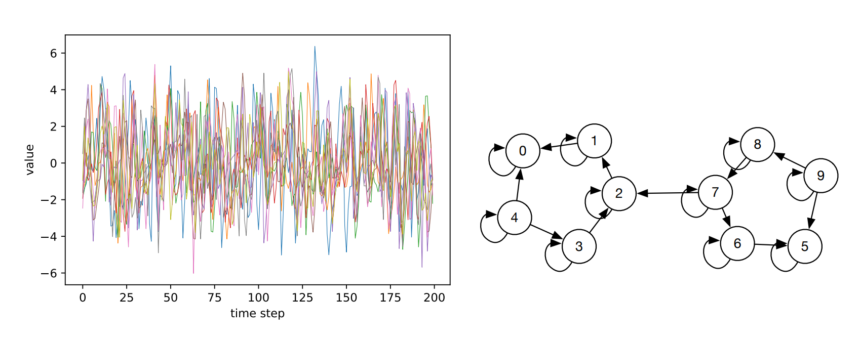
Functional Magnetic Resonance Imaging
https://www.fmrib.ox.ac.uk/datasets/netsim/index.html (simulated dataset)
28 datasets containing simulated neural activity, with non-linear relations between the variables.
The data is supposed to be causally sufficient (all common causes of all variables are observed), stationary, and it contains the ground truth network for each different dataset.
Simulation 17 of the dataset

Slide 10
Number of multivariate TS | Number of samples | Architecture | Number of observed variables | Number hidden variables | Number of relations | Lag
28 | 50-5000 | Cycles of 5 connected variables | {5,10,15} | 0 | {10,12,13,21,33} | Unknown

Slide 11
Papers using the FMRI dataset
Survey and Evaluation of Causal Discovery Methods for Time Series
Charles K. Assad , Emilie Devijver, Eric Gaussier
February 28, 2022 – Journal of Artificial Intelligence Research
Causal Discovery with Attention-Based Convolutional Neural Networks
Meike Nauta, Doina Bucur, Christin Seifert
January 07, 2019 – MDPI

Slide 12
FINANCE dataset
http://www.skleinberg.org/data.html
Contains 10 different stationary datasets, each having 25 time series :
Number of multivariate TS | Number of samples | Number of observed variables | Number hidden variables | Number of random relations | Lag
1 | 4000 | 25 | 0 | 0 | No lag
5 | 4000 | 25 | 0 | 20 | 1
1 | 4000 | 25 | 0 | 40 | 1
1 | 4000 | 25 | 0 | 20 | 1-3
1 | 4000 | 25 | 0 | 40 | 1-3
1 | 4000 | 25 | 0 | 7 | 1
(1)
(2) to (6)
(7)
(8)
(9)
(10)

Slide 13
Papers using the FINANCE dataset
Causality, Probability, and Time
Samantha Kleinberg | November 12, 2012 – Cambridge University Press
Causal Discovery with Attention-Based Convolutional Neural Networks
Meike Nauta, Doina Bucur, Christin Seifert | January 07, 2019 – MDPI
Note: the dataset is used in this paper to evaluate the discovery of hidden confounders by setting some common causes to 0
Causal Inference for Time series Analysis: Problems, Methods and Evaluation
Raha Moraffah, Paras Sheth, Mansooreh Karami, Anchit Bhattacharya, Qianru Wang, Anique Tahir, Adrienne Raglin, Huan Liu | November 23, 2021 – Springer Link
Fast and Accurate Causal Inference from Time Series Data
Yuxiao Huang and Samantha Kleinberg | FLAIRS Conference 2015
Temporal Causal Discovery and Structure Learning with Attention-Based Convolutional Neural Networks
Meike Nauta | January 7, 2019 – MDPI

Slide 14
Dataset used in [3]
Prices of Dairy product in different European countries
https://ec.europa.eu/info/food-farming-fisheries/farming/facts-and-figures/markets/prices/price-monitoring-sector/
Multiple datasets containing weekly reports of the price of dairy products over the last decade in different european countres
Real data implies that we can not be certain of the real causal relations in the dataset.
However, by supposing that only the price of raw milk has an effect on the price of butter (in this data), we can test if the algorithms can detect these dependencies.
Some countries do not provide the data over raw milk: can be used to test the consistency of the algorithms to detect hidden variables

Slide 15
Papers using the dataset
Determining causality in correlated time series
Atalanti Mastakouri, Dominik Janzing | August 18, 2021 – Amazon science
Necessary and Sufficient Conditions for Causal Feature Selection in Time Series with Latent Common Causes
Atalanti A. Mastakouri, Bernhard Schölkopf, Dominik, Janzing | ICML 2021
Temporal Causal Discovery and Structure Learning with Attention-Based Convolutional Neural Networks
Meike Nauta | January 7, 2019 – MDPI

Slide 16
02
Evaluation Metrics

Slide 17

Precision and recall
Precision is defined as $precision=\frac{number of correct assumptions made}{number of assumptions made}$ and is the fraction of relevant instances among the retrieved instances
Recall is defined as $recall=\frac{number of correct assumptions made}{number of relations in the true graph }$ and is the fraction of relevant instances that where retrieved.
The evaluated assumptions are on the edges as additional hidden confounders are discovered as dobble arrowed edges with a lag of 0

Slide 18

[2], page 36
F1-Scores
The F1-score is defines as $F1=\frac{2TP}{(2TP+FP+FN)}$
TP are the true positives: edges that are both on the predicted graph and on the true graph
FP are the false positives: edges on the predicted graph that are not on the true graph
FN are the false negatives: edges that are not predicted but are represented on the true graph
In the evaluation, we will denote $F1$ the score of the skeleton of the graph (evaluation of the connections between the vertices), and $\vec{F1}$ the score of the whole graph (evaluation of the directed edges) as the latter is supposed to be inferior in practice.

Slide 19
[1], page 32
Structural Hamming Distance (SHD)
Method that counts the number of steps needed to obtain the true partially directed acyclic graph (PDAG), where the steps can be edge removal/addition or orientation changes.
Useful to asses the precision of the algorithms
The DAG can be converted in PDAG by replacing directed edges with non directed edges for Markov equivalent classes (set of edges containing the same conditional independencies)

Slide 20
03
Evaluated Algorithms

Slide 21

TCDF
We will focus on our study on algorithms capable of detecting hidden confounders. As such, we start testing the TCDF method, which consists in a certain number of convolutional networks in parallel
The hyperparameters used are the one given by the authors of the method:
Kernel K of size 4
Dilatation coefficient c equal to 4
1 hidden layer L
Learning rate of 0,01
5000 epochs
This gives us a maximum lag value $τ_{max}=1+(K−1)\sum_{l=0}^{L}{c^{l}}$ of 16

Slide 22
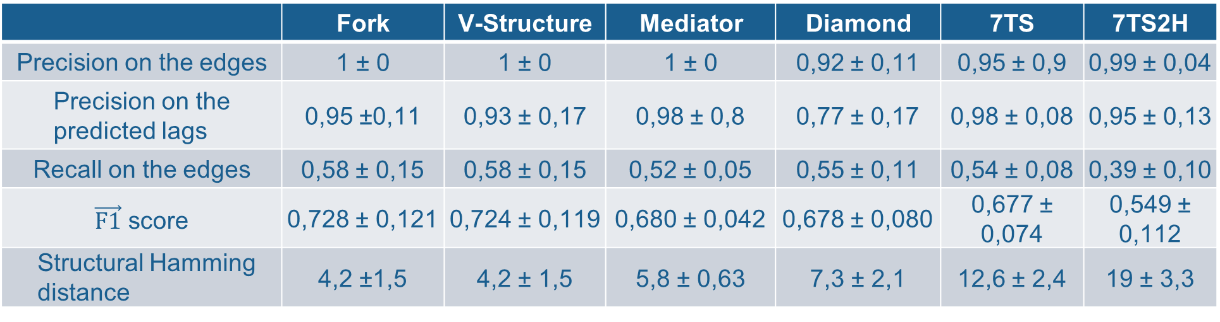
The algorithm outputs a window causal graph, meaning it shows the different lag values for each dependency.
Evaluations on the artificial dataset with equal sampling rate for each variable and all lags equal to 1:
Each value is the mean over the 10 datasets ± the standard deviation of the retrieved data
 | Fork | V-Structure | Mediator | Diamond | 7TS | 7TS2H
Precision on the edges | 1 ± 0 | 1 ± 0 | 1 ± 0 | 0,92 ± 0,11 | 0,95 ± 0,9 | 0,99 ± 0,04
Precision on the predicted lags | 0,95 ±0,11 | 0,93 ± 0,17 | 0,98 ± 0,8 | 0,77 ± 0,17 | 0,98 ± 0,08 | 0,95 ± 0,13
Recall on the edges | 0,58 ± 0,15 | 0,58 ± 0,15 | 0,52 ± 0,05 | 0,55 ± 0,11 | 0,54 ± 0,08 | 0,39 ± 0,10
$\vec{F1}$ score | 0,728 ± 0,121 | 0,724 ± 0,119 | 0,680 ± 0,042 | 0,678 ± 0,080 | 0,677 ± 0,074 | 0,549 ± 0,112
Structural Hamming distance | 4,2 ±1,5 | 4,2 ± 1,5 | 5,8 ± 0,63 | 7,3 ± 2,1 | 12,6 ± 2,4 | 19 ± 3,3

Slide 23
Bibliography
04

Slide 24
Bibliography
[1] Tuning Causal Discovery algorithms, Konstantina Biza
[2] Survey and Evaluation of Causal Discovery Methods for Time Series
Charles K. Assad , Emilie Devijver, Eric Gaussier

