Slide 1
Algorithms Evaluation
Florian Polster--Prieto

Slide 2
TABLE OF CONTENTS
01
02
03
TCDF
PCMCI+
Bibliography

Slide 3
01
TCDF

Slide 4

TCDF
We will focus on our study on algorithms capable of detecting hidden confounders. As such, we start testing the TCDF method, which consists in a certain number of convolutional networks in parallel
The hyperparameters used are the one given by the authors of the method for the first results:
Kernel K of size 4
Dilatation coefficient c equal to 4
1 hidden layer L
Learning rate of 0,01
5000 epochs
Significance of 0,05
This gives us a maximum lag value $τ_{max}=1+(K−1)\sum_{l=0}^{L}{c^{l}}$ of 16

Slide 5
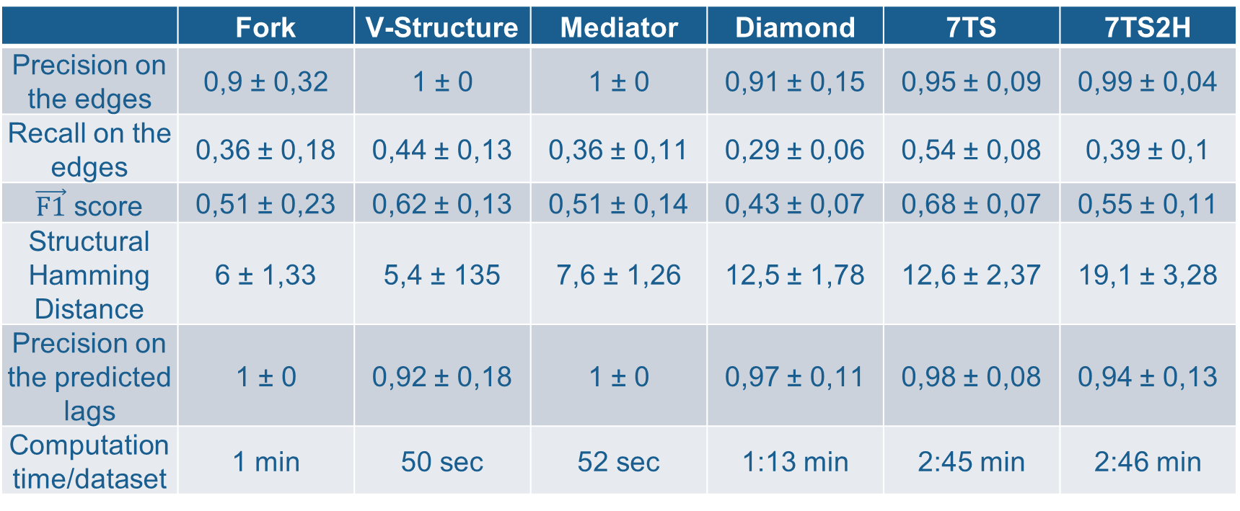
The algorithm outputs a window causal graph, meaning it shows the different lag values for each dependency.
Evaluations on the artificial dataset with equal sampling rate for each variable and all lags equal to 1:
Each value is the mean over the 10 datasets ± the standard deviation of the retrieved data
 | Fork | V-Structure | Mediator | Diamond | 7TS | 7TS2H
Precision on the edges | 0,9 ± 0,32 | 1 ± 0 | 1 ± 0 | 0,91 ± 0,15 | 0,95 ± 0,09 | 0,99 ± 0,04
Recall on the edges | 0,36 ± 0,18 | 0,44 ± 0,13 | 0,36 ± 0,11 | 0,29 ± 0,06 | 0,54 ± 0,08 | 0,39 ± 0,1
$\vec{F1}$ score | 0,51 ± 0,23 | 0,62 ± 0,13 | 0,51 ± 0,14 | 0,43 ± 0,07 | 0,68 ± 0,07 | 0,55 ± 0,11
Structural Hamming Distance | 6 ± 1,33 | 5,4 ± 135 | 7,6 ± 1,26 | 12,5 ± 1,78 | 12,6 ± 2,37 | 19,1 ± 3,28
Precision on the predicted lags | 1 ± 0 | 0,92 ± 0,18 | 1 ± 0 | 0,97 ± 0,11 | 0,98 ± 0,08 | 0,94 ± 0,13
Computation time/dataset | 1 min | 50 sec | 52 sec | 1:13 min | 2:45 min | 2:46 min
We obtain here the same results as the experiment made in [2] (pages 38, 44 and 45)

Slide 6
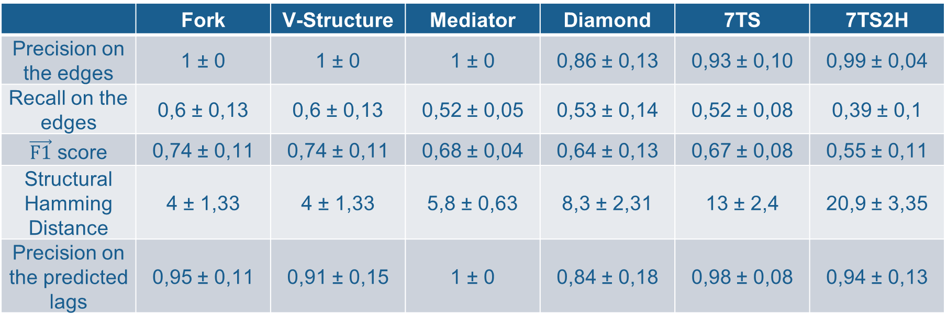
By setting the significance parameter to 0,8 (following a remark in [1], page 14), we obtain better results in term of average recall, $\vec{F1}$ score and SHD
 | Fork | V-Structure | Mediator | Diamond | 7TS | 7TS2H
Precision on the edges | 1 ± 0 | 1 ± 0 | 1 ± 0 | 0,86 ± 0,13 | 0,93 ± 0,10 | 0,99 ± 0,04
Recall on the edges | 0,6 ± 0,13 | 0,6 ± 0,13 | 0,52 ± 0,05 | 0,53 ± 0,14 | 0,52 ± 0,08 | 0,39 ± 0,1
$\vec{F1}$ score | 0,74 ± 0,11 | 0,74 ± 0,11 | 0,68 ± 0,04 | 0,64 ± 0,13 | 0,67 ± 0,08 | 0,55 ± 0,11
Structural Hamming Distance | 4 ± 1,33 | 4 ± 1,33 | 5,8 ± 0,63 | 8,3 ± 2,31 | 13 ± 2,4 | 20,9 ± 3,35
Precision on the predicted lags | 0,95 ± 0,11 | 0,91 ± 0,15 | 1 ± 0 | 0,84 ± 0,18 | 0,98 ± 0,08 | 0,94 ± 0,13

Slide 7

The TCDF method was also tested on the FINANCE dataset to reproduce the experiment made in [1](page 20, Table 4).
In this experiment, the hyperparameters are set to:
Kernel K of size 4
Dilatation coefficient c equal to 4
{0,1,2} hidden layer(s) L
Learning rate of 0,01
5000 epochs
Significance of 0,8
Leading to 3 different maximum lag values $τ_{max}$:
$4$ for L=0, 16 for L=1 and 64 for L=2

Slide 8



The evaluation is made on the whole dataset except the Multivariate Time Series (1) as it does not contain causal relations.
F1’ represents the F1 score over indirect relations :
5
The orange edge is not on the ground truth graph and is therefore considered as an indirect relation
$$X^{p}$$
$$X^{r}$$
$$X^{q}$$
3
2
 | F1 score | F1’ score | Computation time
L=0 | 0,68 ± 0,09 | 0,78 ± 0,12 | 11-14 min
L=1 | 0,62 ± 0,08 | 0,75 ± 0,14 | 16-22 min
L=2 | 0,62 ± 0,1 | 0,75 ± 0,13 | 23-29 min

Slide 9
02
PCMCI+

Slide 10





PCMCI+
This method does not allow to discover hidden confounders, but is able to identify the full window causal graph given $τ_{min}$ and $τ_{max}$
It also takes a $pc_{α}$ parameter, which is the significance level of the conditional independence test in the first phase of the algorithm. This parameter is chosen in our experiment through an optimization step, and is one of the following value [0.001, 0.005, 0.01, 0.025, 0.05]
The method can remain uncertain on contemporaneous lags ($τ=0$), and will denote them as undirected: o-o, o-- or o->
In this case, we replace the undirected edges with edges respectively maximizing and minimizing the evaluation metrics
$$𝔛_{t−1}^{r}$$
$$𝔛_{t}^{r}$$
$$𝔛_{t−1}^{q}$$
$$𝔛_{t}^{q}$$

Slide 11
 | Fork |  | V-structure |  | Mediator |  | Diamond | 7TS
 | Worst case | Best case | Worst case | Best case | Worst case | Best case | No undirected edges | Worst case | Best case
FPR | 0,025 ± 0,08 | 0 ± 0 | 0,05 ± 0,1 | 0,025 ± 0,08 | 0,033 ± 0,1 | 0 ± 0 | 0,2 ± 0,63 | 0,05 ± 0,09 | 0,02 ± 0,03
Precision | 0,98 ± 0,05 | 1 ± 0 | 0,96 ± 0,1 | 0,98 ± 0,06 | 0,99 ± 0,04 | 1 ± 0 | 1 ± 0 | 0,94 ± 0,08 | 0,96 ± 0,06
Recall | 0,9 ± 0,14 | 0,9 ± 0,14 | 0,82 ± 0,18 | 0,84 ± 0,16 | 0,813 ± 0,13 | 0,813 ± 0,13 | 0,83 ± 0,13 | 0,86 ± 0,08 | 0,86 ± 0,08
(F1)→ score | 0,93 ± 0,08 | 0,94 ± 0,09 | 0,87 ± 0,13 | 0,9 ± 0,1 | 0,89 ± 0,07 | 0,9 ± 0,07 | 0,9 ± 0,08 | 0,9 ± 0,06 | 0,9 ± 0,04
Precision on the predicted lags | 0,78 ± 0,18 | 0,78 ± 0,18 | 0,92 ± 0,1 | 0,9 ± 0,1 | 0,92 ± 0,1 | 0,92 ± 0,1 | 0,86 ± 0,05 | 0,98 ± 0,07 | 0,98 ± 0,07
Frobenius Norm | 1,22 ± 0,21 | 1,22 ± 0,21 | 1,12 ± 0,2 | 1,12 ± 0,2 | 1,2 ± 0,27 | 1,2 ± 0,27 | 1,48 ± 0,32 | 1,39 ± 0,42 | 1,39 ± 0,42
MSE | 0,53 ± 0,17 | 0,53 ± 0,17 | 0,43 ± 0,16 | 0,43 ± 0,16 | 0,5 ± 0,24 | 0,5 ± 0,24 | 0,58 ± 024 | 0,3 ± 0,21 | 0,3 ± 0,21
Structural Hamming distance | 1 ± 1,41 | 1 ± 1,41 | 1,8 ± 1,69 | 1,7 ± 1,6 | 2,3 ± 1,34 | 2,2 ± 1,48 | 2,8 ± 2,15 | 4,6 ± 2,12 | 4 ± 2

Slide 12
Bibliography
03

Slide 13
Bibliography
[1] Causal Discovery with Attention-Based Convolutional Neural Networks, Meike Nauta , Doina Bucur, Christin Seifert
[2] Survey and Evaluation of Causal Discovery Methods for Time Series
Charles K. Assad , Emilie Devijver, Eric Gaussier

