Slide 1
Algorithms Evaluation
Florian Polster--Prieto

Slide 2
TABLE OF CONTENTS
01
02
03
TCDF
Metrics used
04
PCMCI+
LPCMCI

Slide 3
01
Metrics used

Slide 4

Mean squared error (MSE)
Measures the difference between two adjacency matrices $B=\left\{b_{ij}\right\}$, with $x_{i}=\sum{b_{ij}x_{j}+e_{i}}$
This works only for linear relations.
Can also be expressed in a binary way: $b_{ij}=1$ represents $i→j$, and $b_{ij}=0$ if there is no connection, or with weights (the amount of lag in our case)
As we use weighted adjacency matrices for this metric, a lag of 0 is represented by a -1 to make a distinction between a connection of lag 0 and no connection
We have
$$MSE=\frac{1}{N}\sum{{\left(B_{true}−\hat{B}\right)}^{2}}$$
With $B_{true}$ and $\hat{B}$ the true and predicted adjacency matrices and N the number of variables

Slide 5
Structural Intervention Distribution (SID)
Numbers of intervention distributions falsely estimated from i to j $(i≠j)$ by $\hat{G}$ with respect to $G$
The intervention distribution from Y to X is defined as:
$$p\left(Y | do(X=\hat{x}\right))=p(y)$$
If Y is a parent of X
$$p\left(Y | do(X=\hat{x}\right))=\sum_{pa_{X}}{p\left(y | \hat{x},pa_{X}\right)p(pa_{X})}$$
If Y is not a parent of X, with $pa_{X}$the set of parents of X
The SID is equal to 0 for an isolated edge if the intervention distribution is correctly predicted

Slide 6
01
Metrics used

Slide 7

TCDF
We will focus on our study on algorithms capable of detecting hidden confounders. As such, we start testing the TCDF method, which consists in a certain number of convolutional networks in parallel, on the artificial database containing 6 different architectures
The hyperparameters used are the one given by the authors of the method for the first results:
Kernel K of size 4
Dilatation coefficient c equal to 4
1 hidden layer L
Learning rate of 0,01
5000 epochs
Significance of 0,8
This gives us a maximum lag value $τ_{max}=1+(K−1)\sum_{l=0}^{L}{c^{l}}$ of 16

Slide 8

Fork
The worst predictions regarding the metrics are on set 6 and 9, which are depicted below
 | Set 0 | Set 1 | Set 2 | Set 3 | Set 4 | Set 5 | Set 6 | Set 7 | Set 8 | Set 9
MSE | 0,67 | 0,67 | 0,67 | 0,67 | 0,67 | 0,67 | 1 | 0,67 | 0,67 | 1
SID | 4 | 2 | 2 | 4 | 2 | 4 | 4 | 0 | 2 | 4

Slide 9

V-structure
The worst predictions regarding the metrics are on set 2,7,8 and 9, which are depicted below
 | Set 0 | Set 1 | Set 2 | Set 3 | Set 4 | Set 5 | Set 6 | Set 7 | Set 8 | Set 9
MSE | 0,33 | 1 | 0,67 | 1 | 1 | 1 | 0,67 | 0,67 | 0,67 | 0,67
SID | 1 | 1 | 2 | 1 | 2 | 2 | 1 | 2 | 2 | 2

Slide 10
Mediator
The worst predictions regarding the metrics are on set 0,1,2,3,4,7 and 9, which are depicted below
 | Set 0 | Set 1 | Set 2 | Set 3 | Set 4 | Set 5 | Set 6 | Set 7 | Set 8 | Set 9
MSE | 1 | 1 | 1 | 1 | 1 | 0,67 | 1 | 1 | 1 | 1
SID | 4 | 4 | 4 | 4 | 4 | 3 | 3 | 4 | 3 | 4

Slide 11
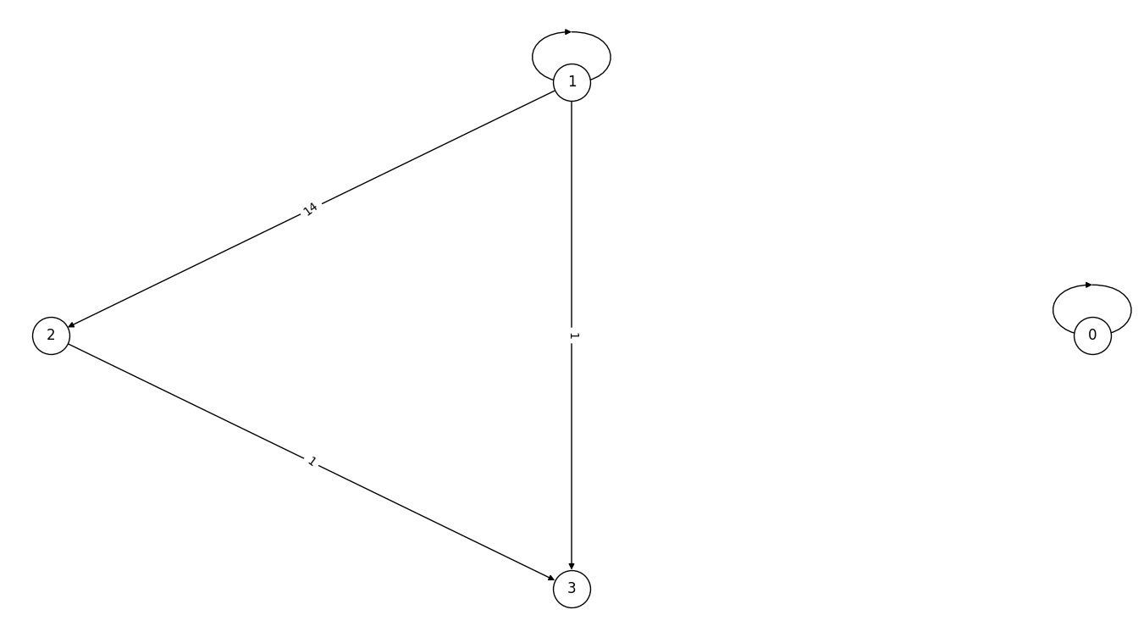
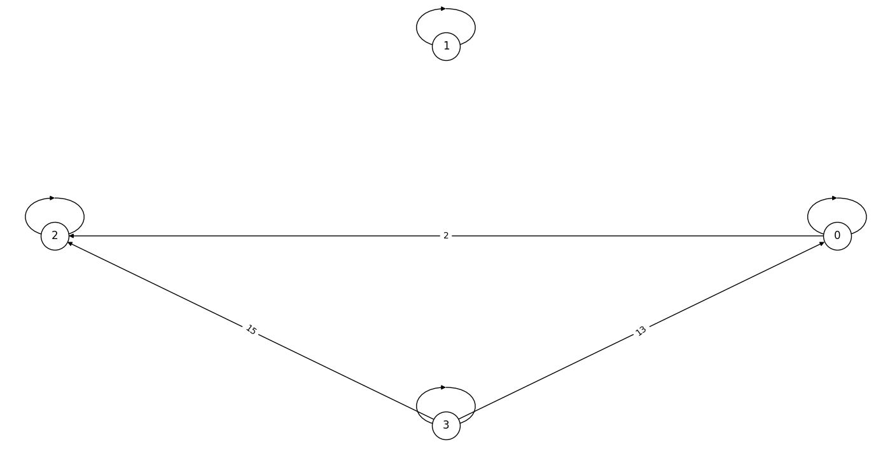
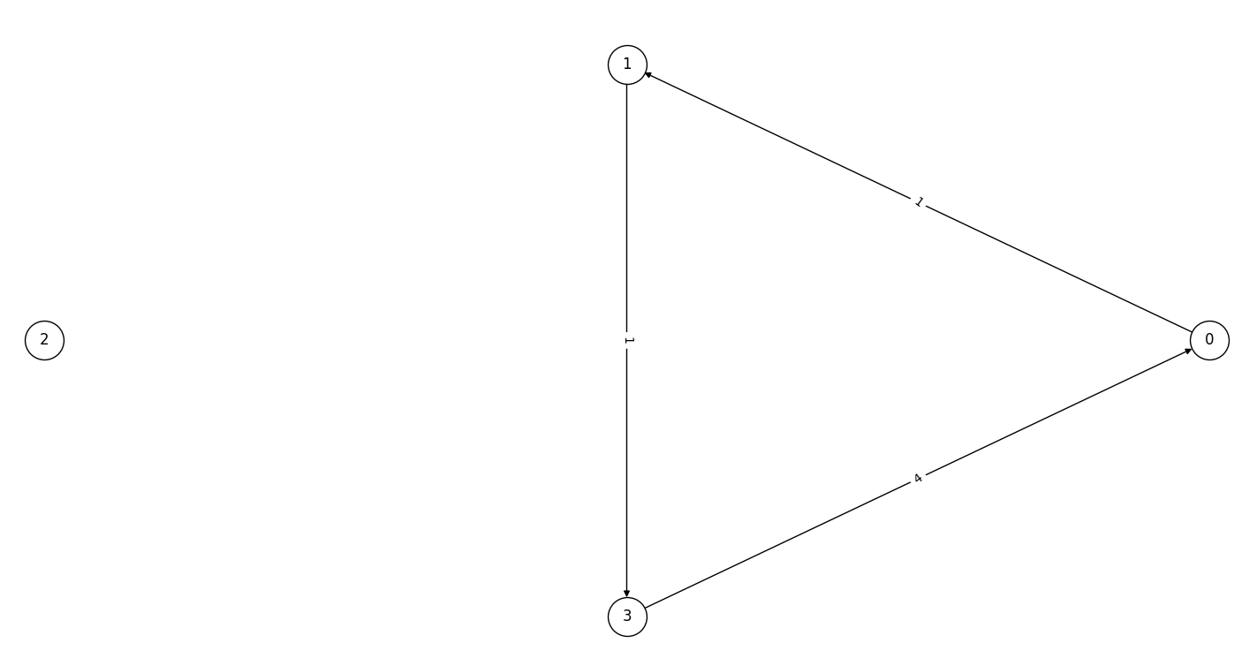
Diamond
The worst predictions regarding MSE are on set 7 (left) and 8 (middle), and on 3 (right) and 8 regarding SID
 | Set 0 | Set 1 | Set 2 | Set 3 | Set 4 | Set 5 | Set 6 | Set 7 | Set 8 | Set 9
MSE | 1,5 | 1,5 | 1,25 | 5,5 | 27 | 1,5 | 1,25 | 50,25 | 99,5 | 1,25
SID | 7 | 6 | 9 | 11 | 5 | 9 | 6 | 6 | 11 | 9

Slide 12
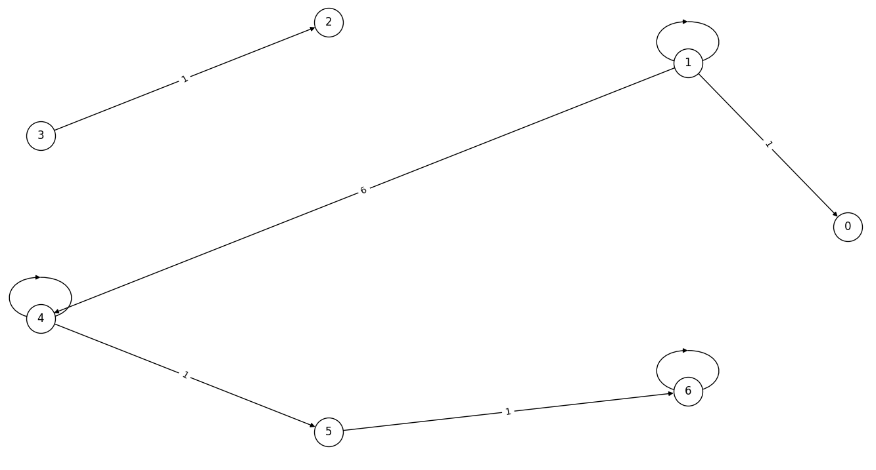
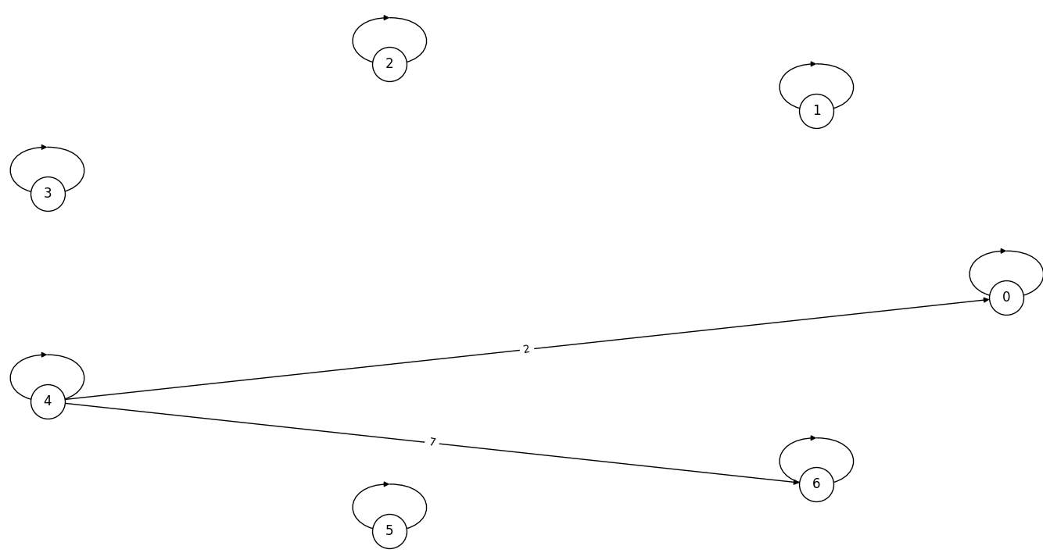
7TS
The worst predictions regarding MSE are on set 1 (left) and 3 (right)
 | Set 0 | Set 1 | Set 2 | Set 3 | Set 4 | Set 5 | Set 6 | Set 7 | Set 8 | Set 9
MSE | 1,14 | 6,14 | 1 | 8,43 | 0,71 | 1 | 0,57 | 1 | 3,43 | 0,86
SID | 16 | 11 | 24 | 22 | 13 | 15 | 20 | 24 | 24 | 24

Slide 13
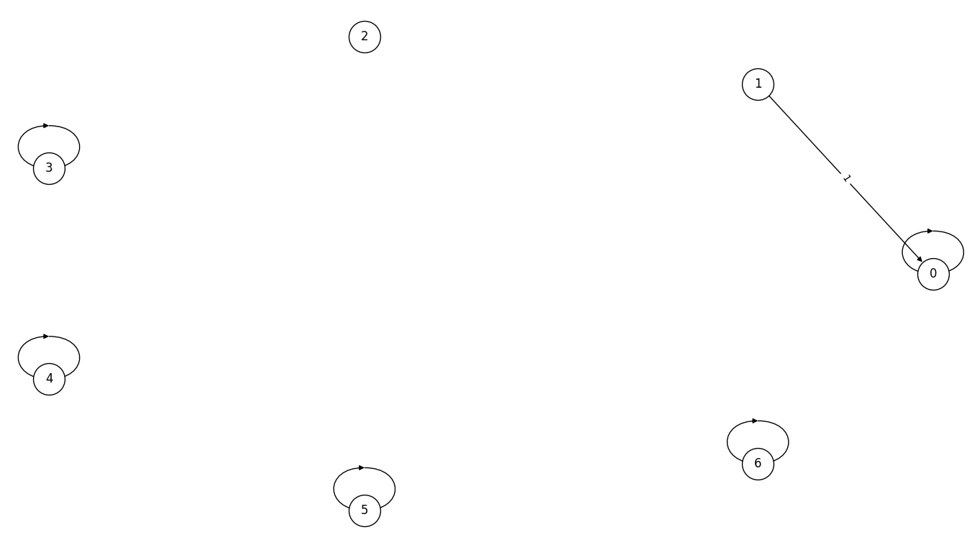
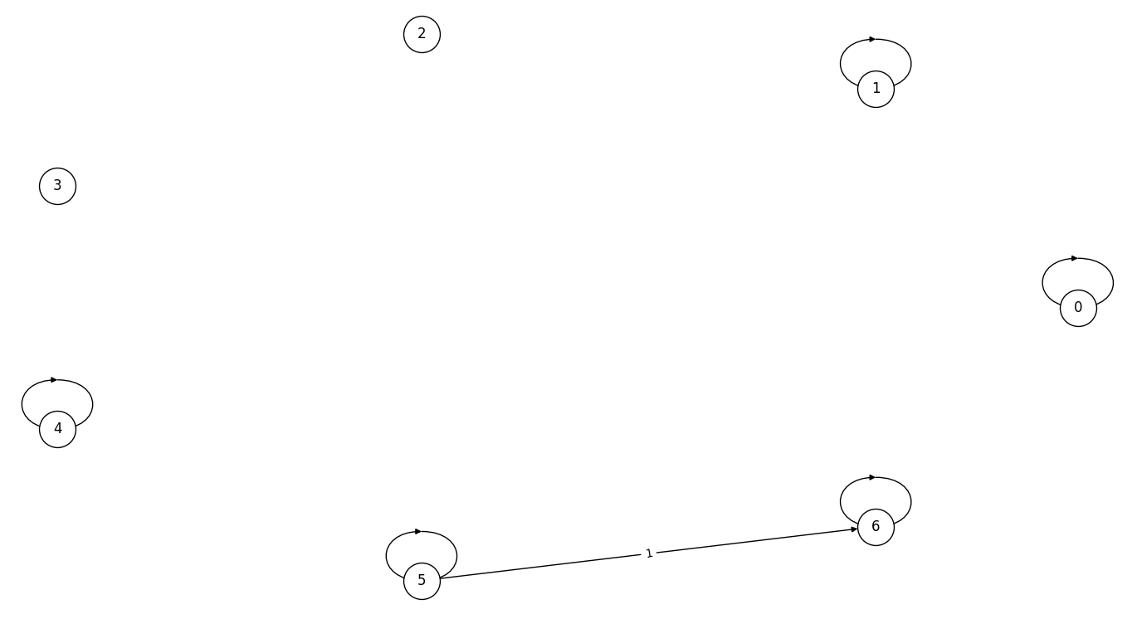
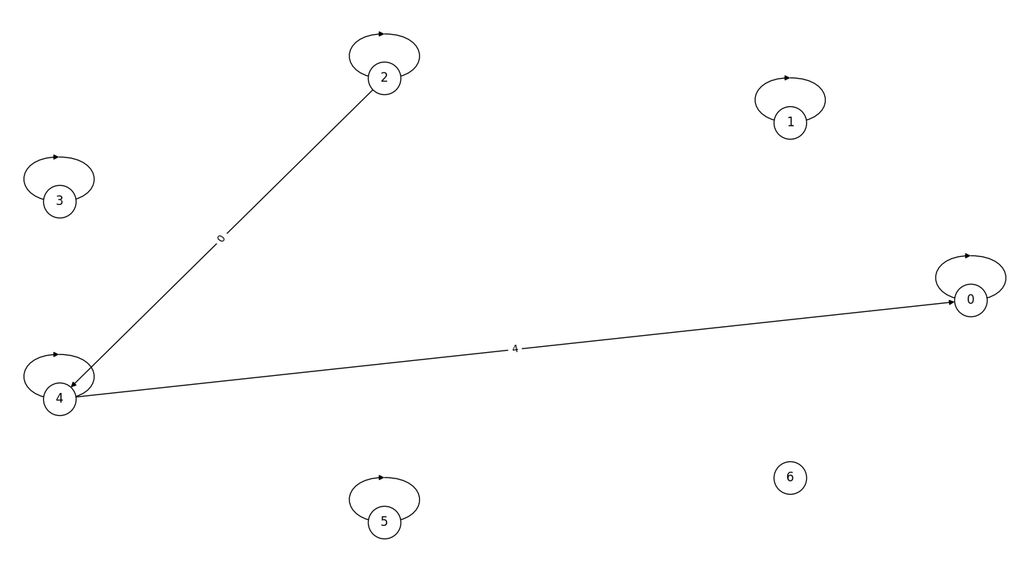
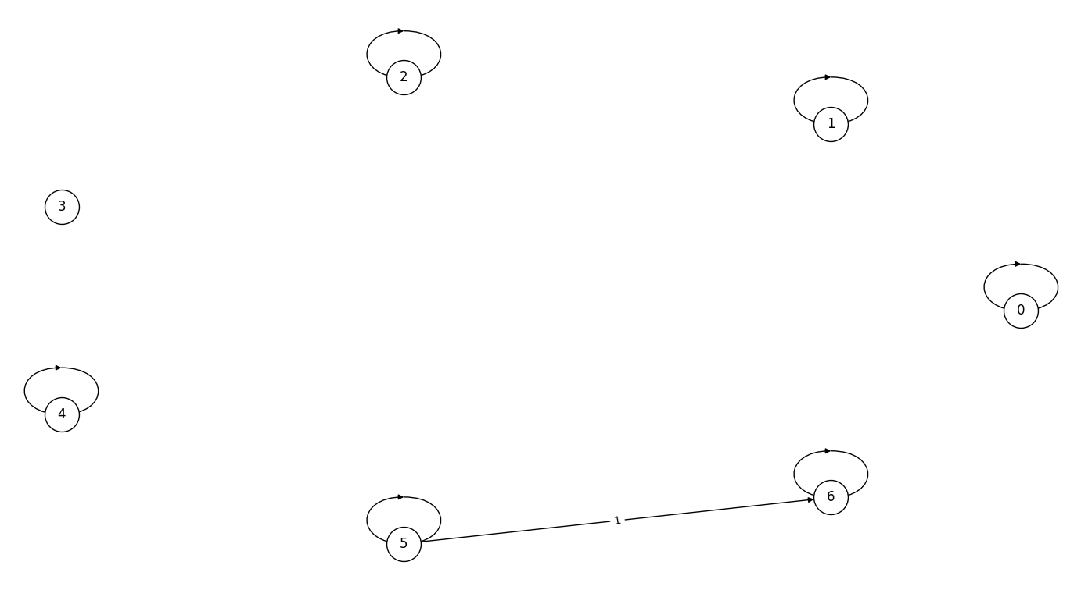
The worst predictions regarding SID are on set 2 (upper left), set 7 (upper right, set 8 (bottom left) and set 9 (bottom right)

Slide 14
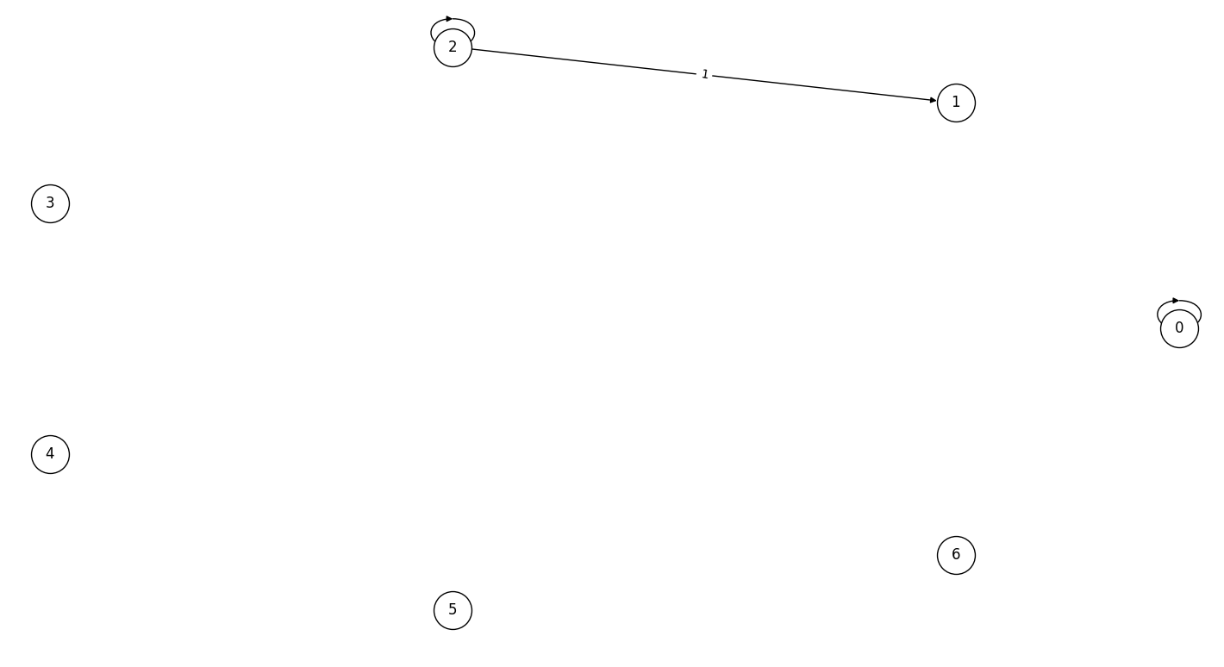
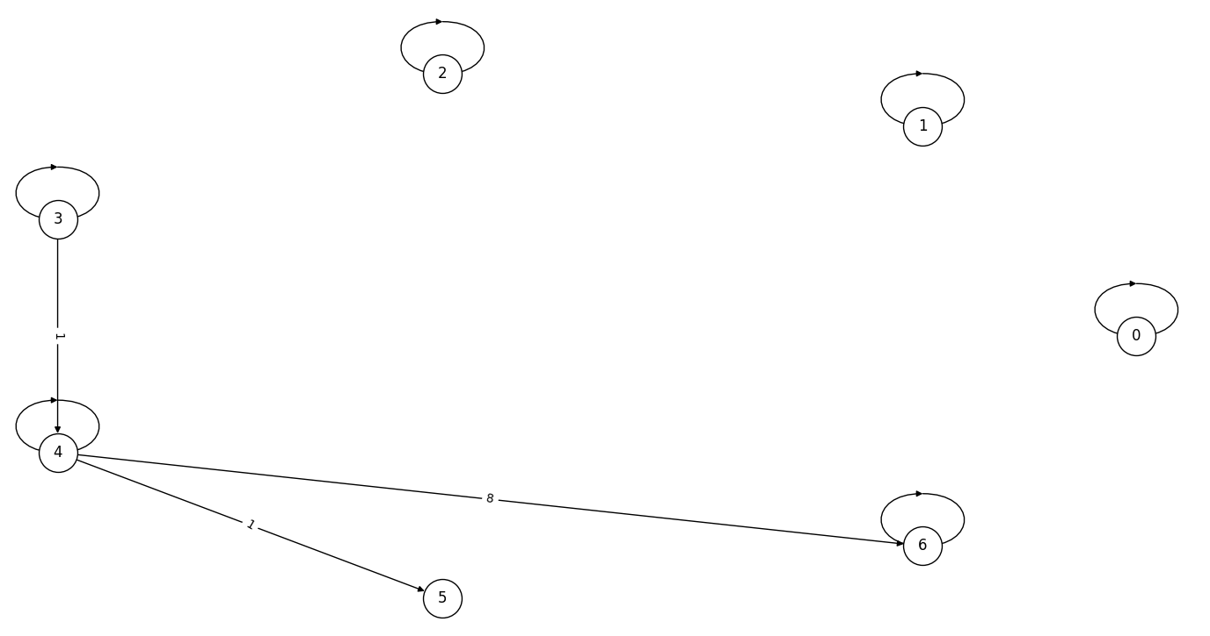
7TS2H
The worst predictions regarding MSE are on set 1 (left) and 9 (right)
 | Set 0 | Set 1 | Set 2 | Set 3 | Set 4 | Set 5 | Set 6 | Set 7 | Set 8 | Set 9
MSE | 1,43 | 2 | 1,29 | 1,29 | 1,29 | 1,71 | 1,71 | 1,43 | 1,43 | 10,43
SID | 35 | 35 | 35 | 29 | 30 | 36 | 35 | 30 | 30 | 28

Slide 15
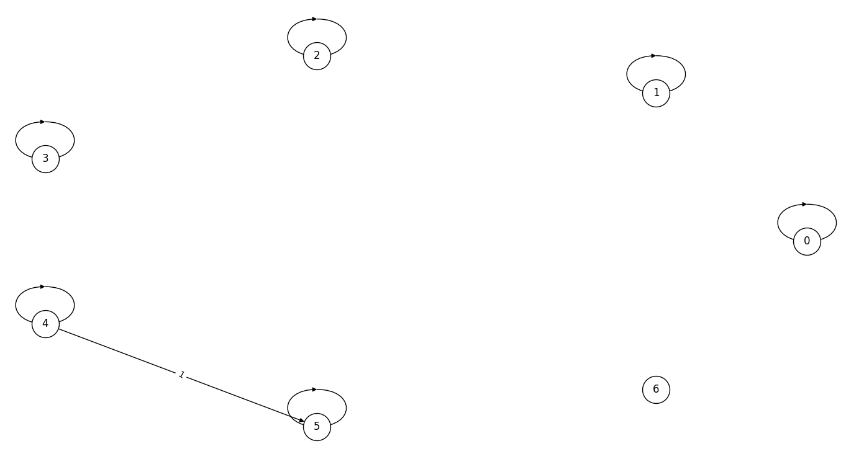
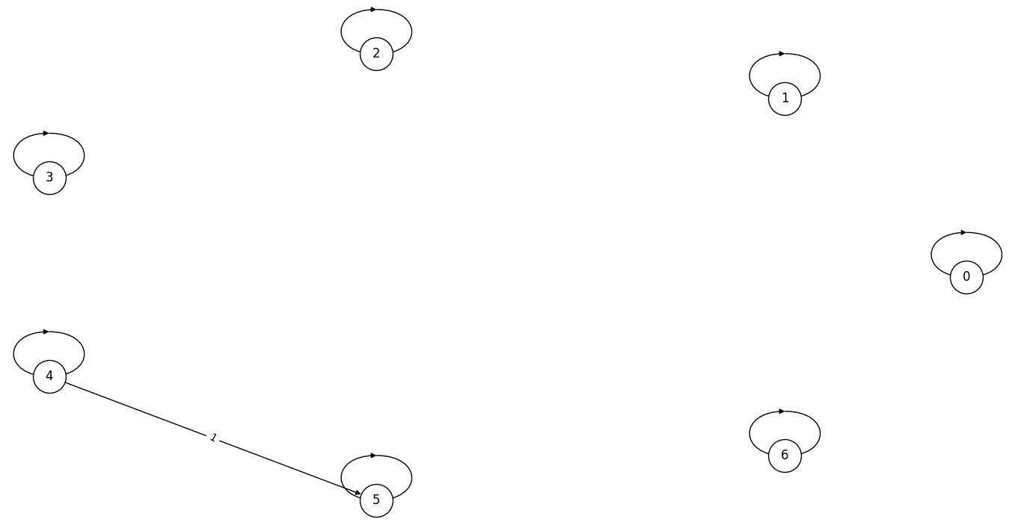
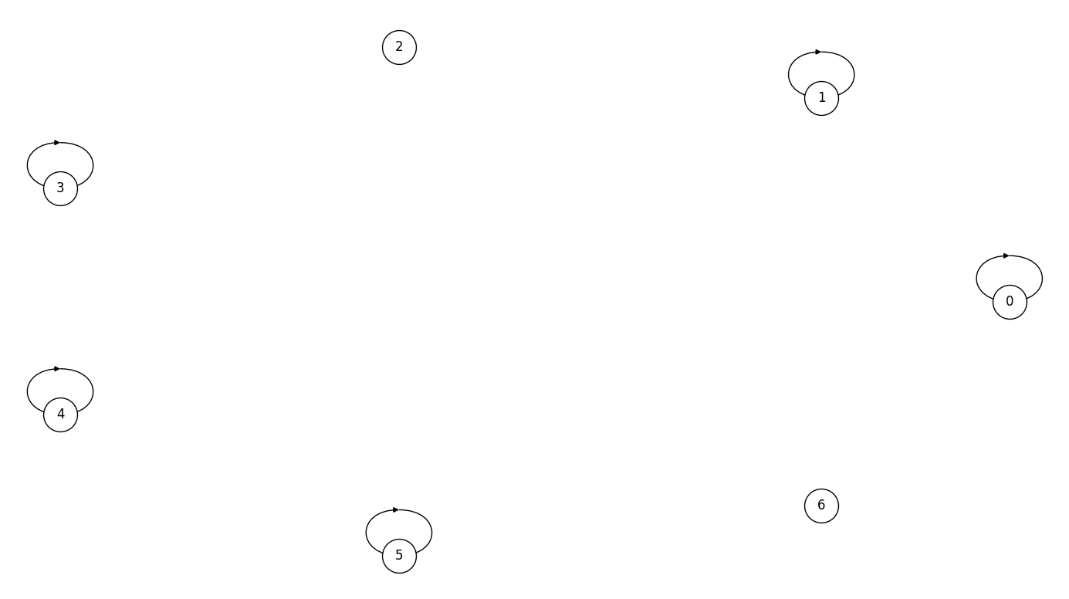
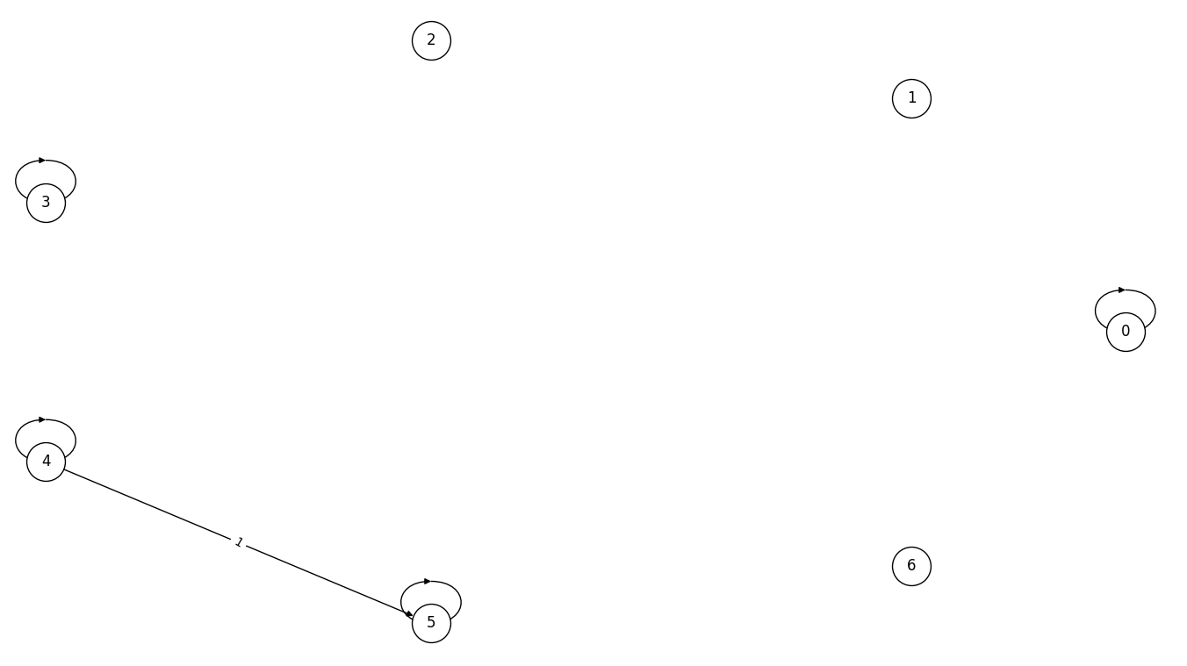
The worst predictions regarding SID are on set 0 (upper left), set 2 (upper right, set 5 (bottom left) and set 6 (bottom right)

Slide 16
02
PCMCI+

Slide 17





PCMCI+
This method does not allow to discover hidden confounders, but is able to identify the full window causal graph given $τ_{min}$ and $τ_{max}$
It also takes a $pc_{α}$ parameter, which is the significance level of the conditional independence test in the first phase of the algorithm. This parameter is chosen in our experiment through an optimization step, and is one of the following value [0.001, 0.005, 0.01, 0.025, 0.05]
The method can remain uncertain on contemporaneous lags ($τ=0$), and will denote them as undirected: o-o, o-- or o->
In this case, we replace the undirected edges with edges respectively maximizing and minimizing the evaluation metrics
$$𝔛_{t−1}^{r}$$
$$𝔛_{t}^{r}$$
$$𝔛_{t−1}^{q}$$
$$𝔛_{t}^{q}$$

Slide 18
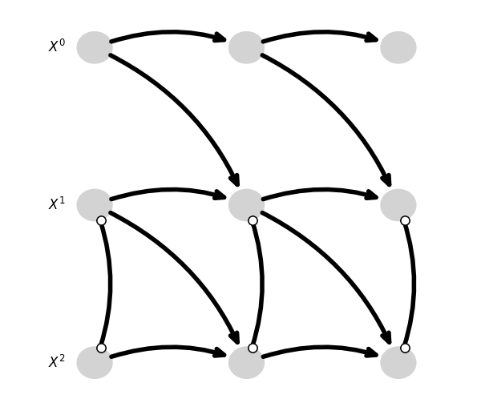
Fork
The worst predictions regarding the metrics are on the worst case on set 7 (considering the undirected edges as variables)
 | Set 0 | Set 1 worst | Set 1 best | Set 2 worst | Set 2 best | Set 3 | Set 4 | Set 5 | Set 6 | Set 7 worst | Set 7 best | Set 8 | Set 9
MSE | 0,33 | 0,66 | 0,33 | 0,66 | 0,33 | 0,33 | 0,66 | 0,66 | 0,66 | 1 | 0,66 | 0,33 | 0,66
SID | 0 | 3 | 0 | 3 | 0 | 2 | 0 | 0 | 2 | 2 | 1 | 2 | 4

Slide 19
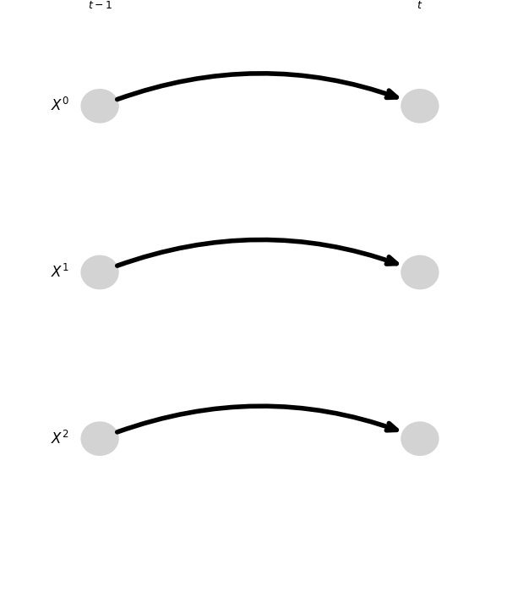
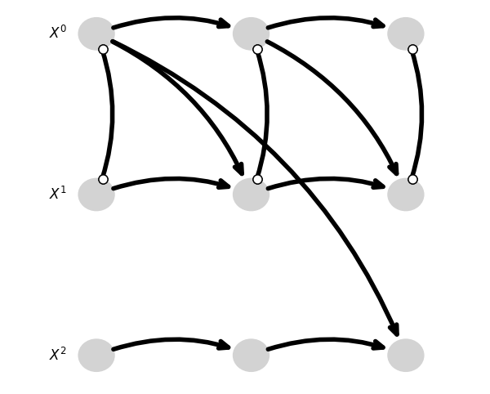
The worst predictions regarding SID are on set 9 (left), set 1 and set 2 (both right)

Slide 20
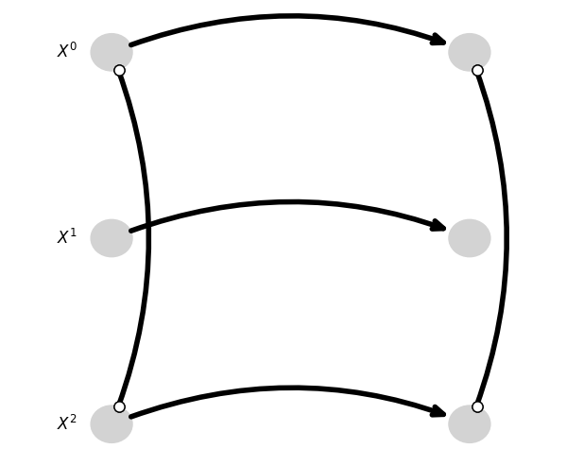
V-structure
The worst predictions regarding MSE are on set 7, both on the best and worst cases of the predicted graph
 | Set 0 | Set 1 | Set 2 | Set 3 | Set 4 | Set 5 | Set 6 | Set 7 worst | Set 7 best | Set 8 | Set 9
MSE | 0,66 | 0,66 | 0,33 | 0,33 | 0,33 | 0,33 | 0,33 | 1 | 1,66 | 0,33 | 0,66
SID | 1 | 2 | 0 | 0 | 1 | 1 | 0 | 4 | 1 | 0 | 2

Slide 21
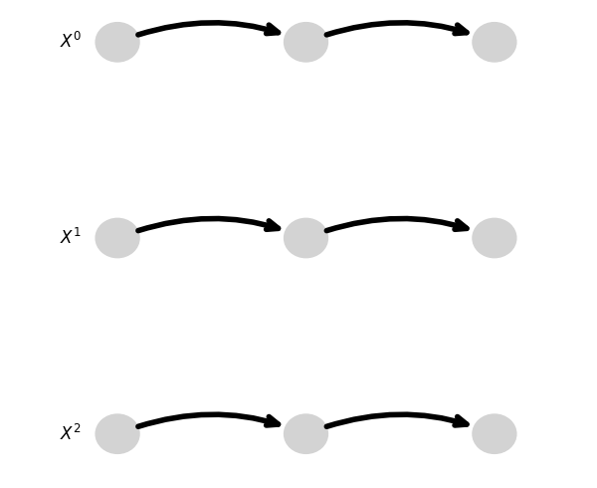
The worst predictions regarding SID are on set 7 (last slide), set 1 (left) and set 9 (right), which are the same prediction

Slide 22
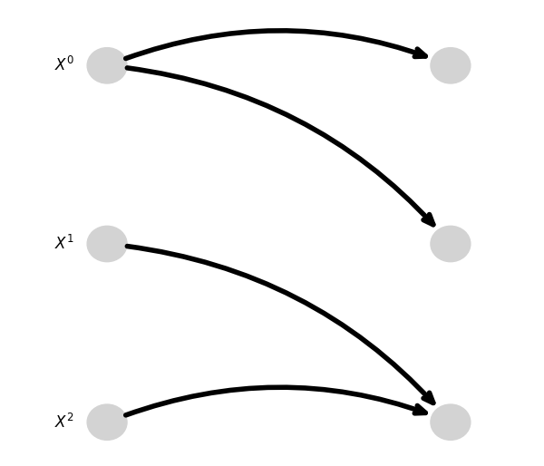
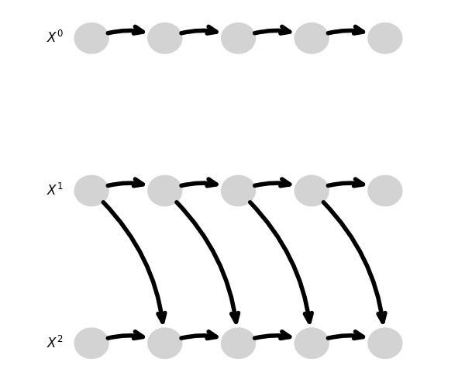
Mediator
The worst predictions regarding MSE are on set 2 (left) and set 4 (right)
 | Set 0 | Set 1 | Set 2 | Set 3 | Set 4 | Set 5 | Set 6 | Set 7 worst | Set 7 Best | Set 8 | Set 9
MSE | 0,33 | 0,33 | 1,66 | 0,66 | 0,66 | 1 | 0,33 | 0,66 | 0,33 | 0,33 | 0,33
SID | 1 | 1 | 1 | 1 | 3 | 3 | 1 | 6 | 0 | 0 | 1

Slide 23
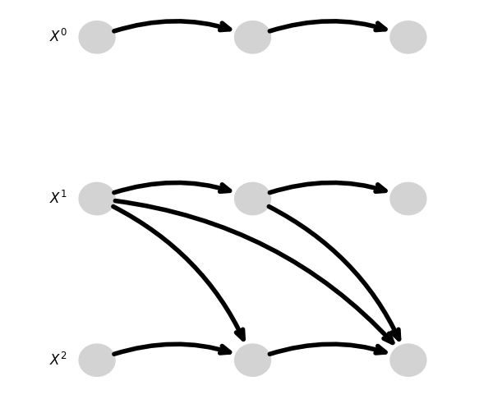
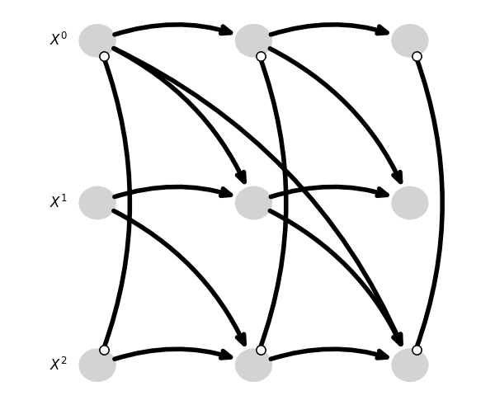
The worst predictions regarding SID are on set 4 (previous slide), set 5 (left) and set 7 (right)

Slide 24
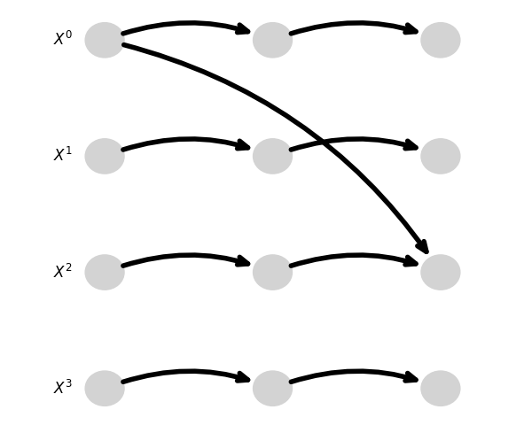
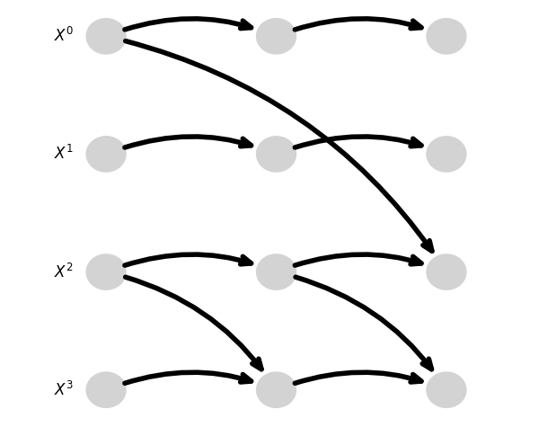
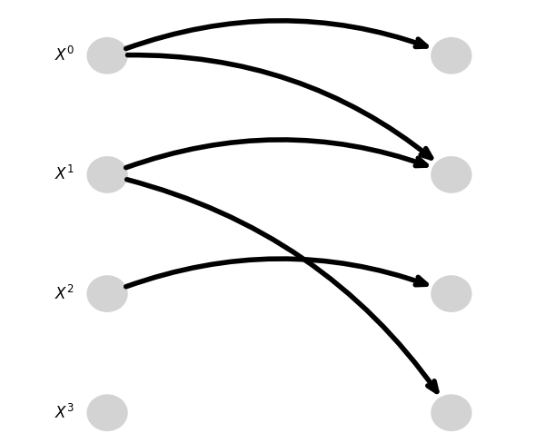
Diamond
The worst predictions regarding both metrics are on set 9 (left) set 7 and 8 (both middle), and on 3 (right)
 | Set 0 | Set 1 | Set 2 | Set 3 | Set 4 | Set 5 | Set 6 | Set 7 | Set 8 | Set 9
MSE | 0,5 | 0,5 | 0,25 | 0,75 | 0,5 | 0,5 | 0,25 | 0,75 | 0,75 | 1
SID | 2 | 2 | 0 | 5 | 3 | 2 | 0 | 5 | 5 | 6

Slide 25
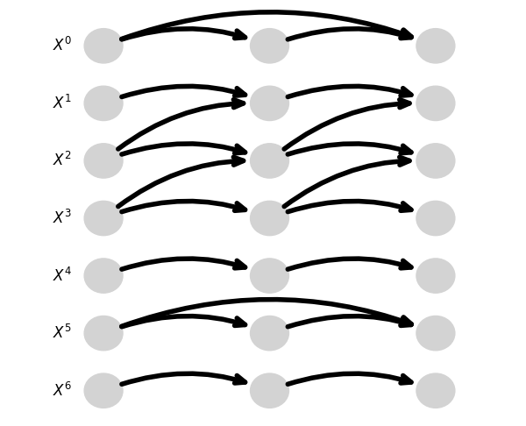
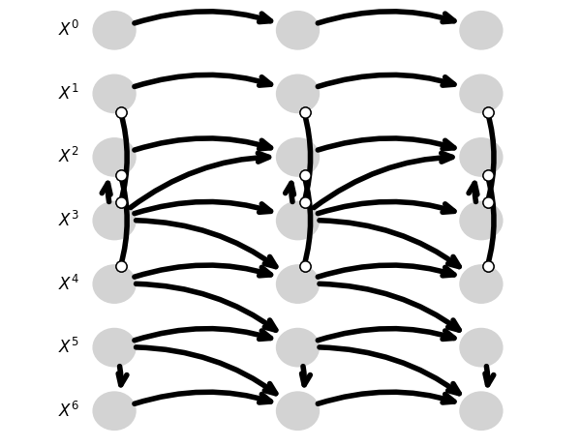
7TS
The worst predictions regarding both metrics are on set 3 (right) and set 6 (left)
 | Set 0 worst | Set 0 best | Set 1 | Set 2 | Set 3 | Set 4 | Set 5 | Set 6 worst | Set 6 best | Set 7 | Set 8 | Set 9
MSE | 0,43 | 0,14 | 0,29 | 0,14 | 0,86 | 0,14 | 0,29 | 0,86 | 0,29 | 0,43 | 0,43 | 0,43
SID | 8 | 0 | 5 | 5 | 21 | 5 | 12 | 10 | 11 | 12 | 17 | 12

Slide 26
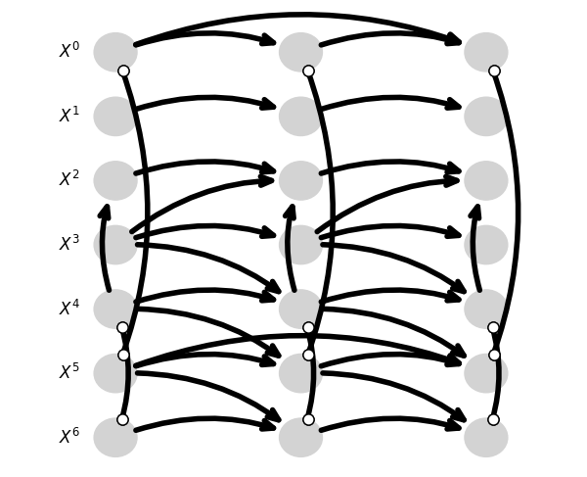
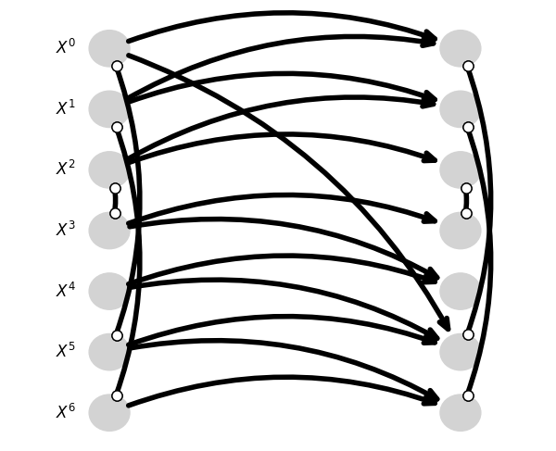
7TS2H
The worst predictions regarding MSE are on set 2 (left) and 7 (right)
 | Set 0 worst | Set 0 best | Set 1 worst | Set 1 best | Set 2 worst | Set 2 best | Set 3 | Set 4 | Set 5 worst | Set 5 best | Set 6 | Set 7 worst | Set 7 best | Set 8 | Set 9
MSE | 0,57 | 0,29 | 0,71 | 0,43 | 1,57 | 1 | 0,71 | 1 | 0,86 | 0,86 | 0,86 | 1,14 | 1,29 | 0,86 | 0,43
SID | 22 | error | 22 | error | error | error | 29 | error | error | error | 28 | error | error | 23 | 22

Slide 27
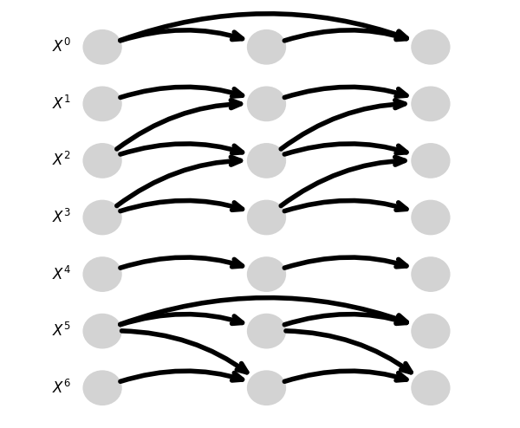
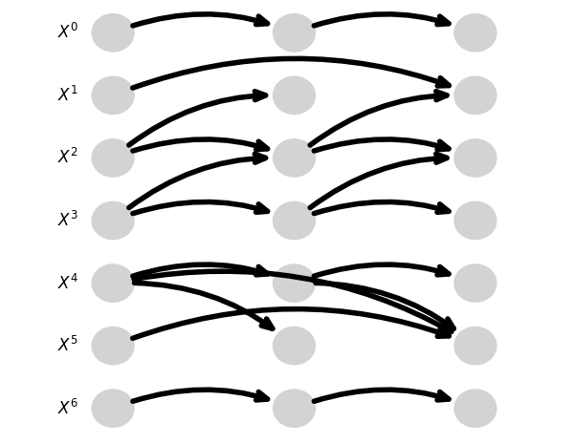
The worst predictions regarding SID so far are on set 3 (left) and set 6 (right)

Slide 28
01
LPCMCI

Slide 29

LPCMCI
This method follows the same principle as PCMCI+, and is also able to discover hidden confounders.
The hyperparameters are selected the same way as PCMCI+, except for $pc_{α}$, which is set at 0,01.
The method can remain uncertain and will denote these edges as undirected: o-o, o-- or o->
In this case, we replace the undirected edges with edges respectively maximizing and minimizing the evaluation metrics
$$𝔛_{t−1}^{r}$$
$$𝔛_{t}^{r}$$
$$𝔛_{t−1}^{q}$$
$$𝔛_{t}^{q}$$

Slide 30
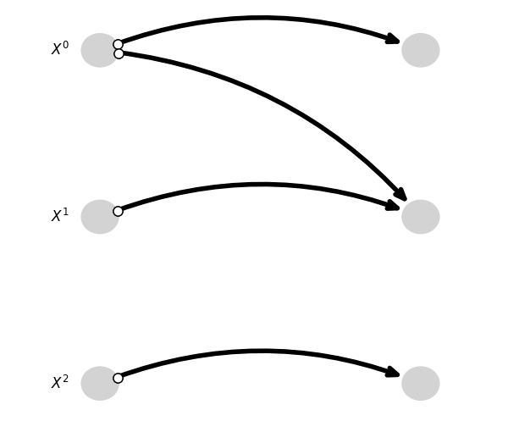


Fork
The worst predictions regarding the MSE are on the worsts cases on set 8 (left) and 9 (right) with $MSE_{8worst}={MSE}_{9worst}=1,67$

Slide 31
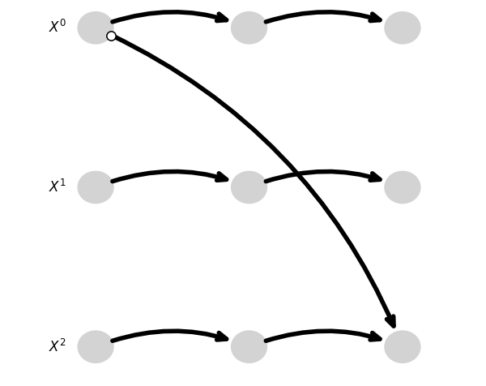

The worst predictions regarding SID are on set 0, set 6 (both left) and set 9 (right), on their worst cases with $SID_{0worst}=SID_{6worst}=SID_{9worst}=4$

Slide 32
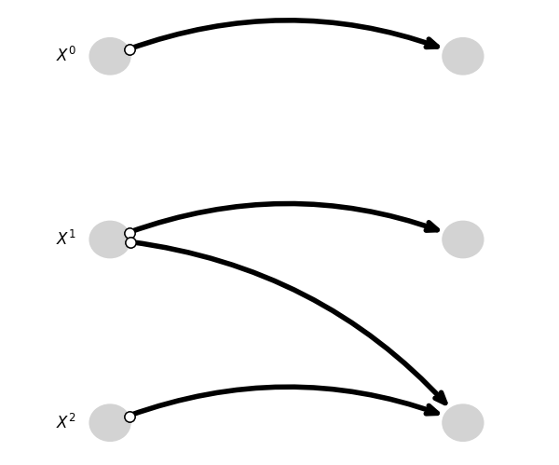

V-structure
The worst predictions regarding MSE are on set 0, set 9 (both left), set 4 and set 7 (both right)
With $MSE_{0worst}=MSE_{9worst}=MSE_{4worst}=MSE_{7worst}=1,67$

Slide 33
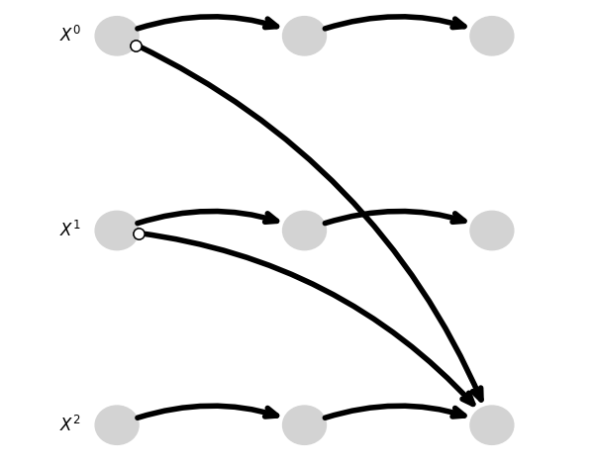
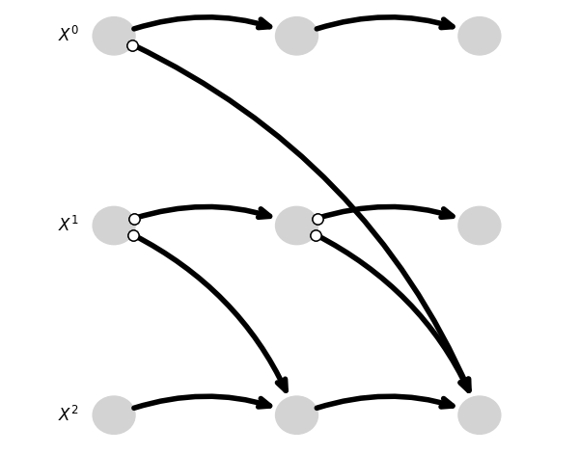

The worst predictions regarding SID are on set 4, set 7 on their best cases (both last slide), set 1 (left) and set 3(right) on their worst cases with
$$SID_{4best}=SID_{7best}=SID_{1worst}=SID_{3worst}=2$$

Slide 34
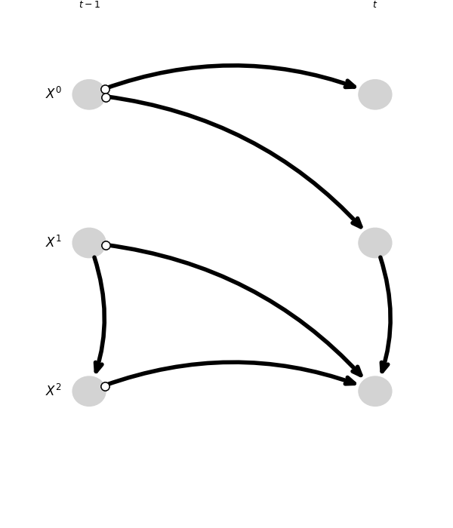
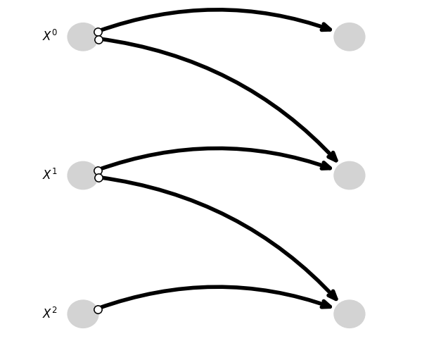

Mediator
The worst predictions regarding MSE are on set 2 (left), set 6 and set 9 (both right)
With $MSE_{2worst}=3 and MSE_{9worst}=MSE_{6worst}=2$

Slide 35
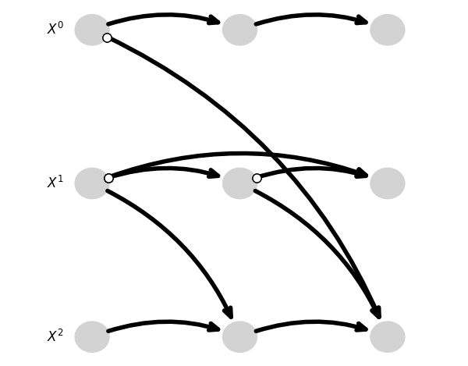
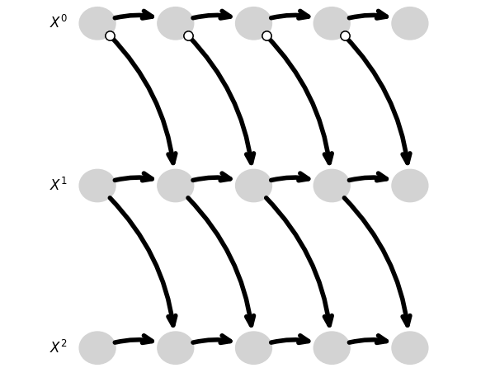
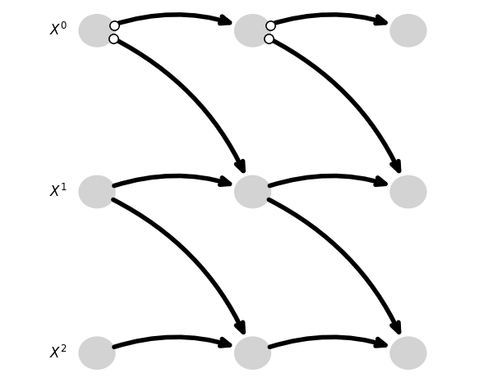

The worst predictions regarding SID are on set 0 (upper left), set 2 (upper right), set 4 (bottom left) and set 5 (bottom right) on their worst cases with
$$SID_{0worst}=SID_{2worst}=SID_{4worst}=SID_{5worst}=3$$

Slide 36
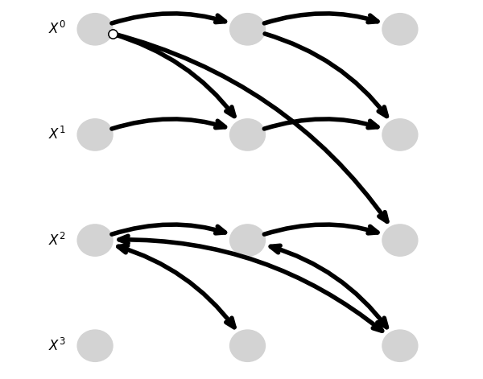
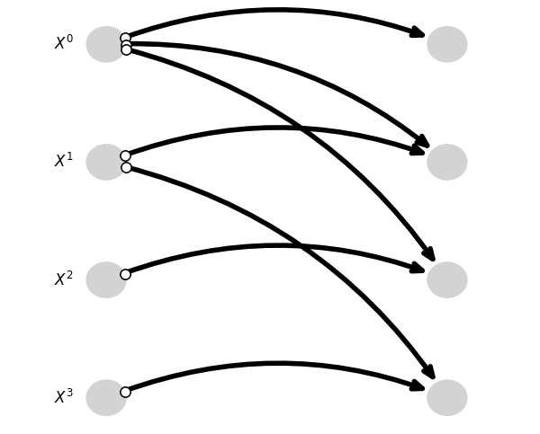

Diamond
The worst predictions regarding MSE are on set 0 (left)and set 9 (both right)
With $MSE_{0best}=MSE_{0worst}=MSE_{9best}=2$

Slide 37
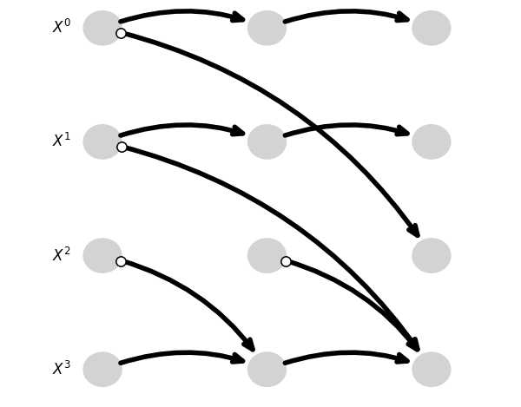
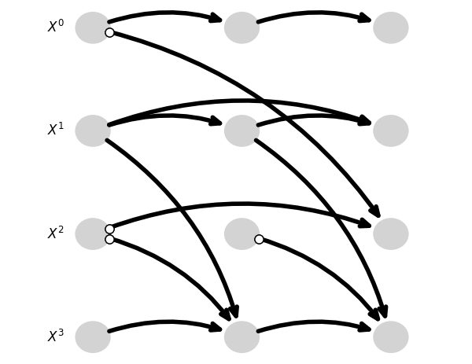
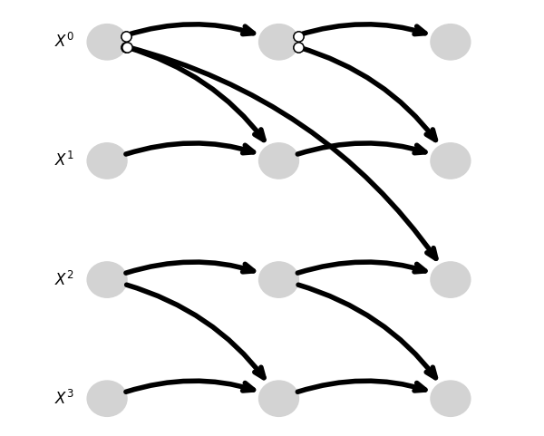

The worst predictions regarding SID are on set 7 (upper left), set 4 (upper right) and set 8 (bottom left) on their worst cases with
$$SID_{7worst}=9 and SID_{4worst}=SID_{7worst}=8$$

Slide 38
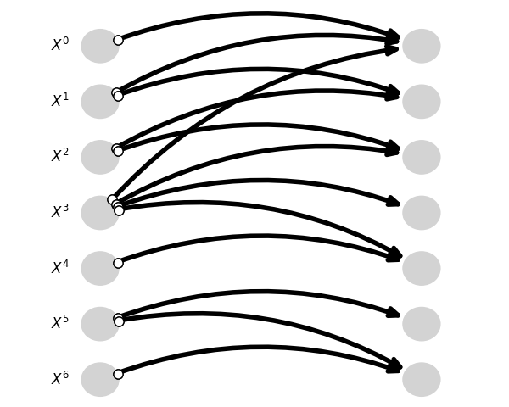
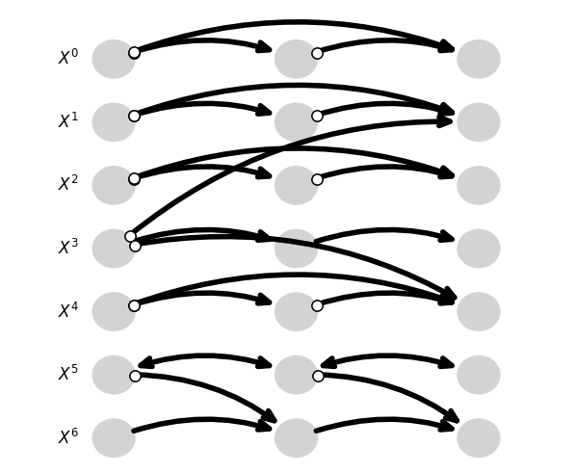

7TS
The worst predictions regarding both metrics are on set 0 (left)and set 3 (both right)
With $MSE_{0worst}=MSE_{3worst}=2$
And $SID_{0worst}=SID_{3worst}=26$

Slide 39



7TS2H
The worst predictions regarding MSE metrics are on set 1 (left)and set 7 (both right)
With $MSE_{1}=3,57 and MSE_{7worst}=3,14$

Slide 40



The worst predictions regarding SID are on set 3 (left), set 6 (right
with
$$SID_{3worst}=30 and SID_{6worst}36$$

Slide 41
Bibliography
03

Slide 42
Bibliography
[1] Causal Discovery with Attention-Based Convolutional Neural Networks, Meike Nauta , Doina Bucur, Christin Seifert
[2] Survey and Evaluation of Causal Discovery Methods for Time Series
Charles K. Assad , Emilie Devijver, Eric Gaussier

