Slide 1
Temporal causal relations dicovery
Florian Polster--Prieto

Slide 2
TABLE OF CONTENTS
01
02
03
Basic Notations
DAG & definitions
Causal Graphs for time series
04
05
MAGS
Granger Causality
06
07
08
09
Neural Network for Causal Discovery
Structural Equation Model
Dynamic Bayesian Networks
Bibliography

Slide 3
Basic Notation
01

Slide 4





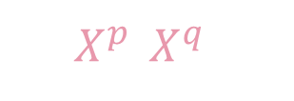



Basic Notations
INDEPENDANCE
RANDOM VARIABLES
CAUSALITY
TIME SERIES
[2], [3]
$$⊨$$
$$X$$
$$a⫫b$$
$$a⫫b$$
$$X^{p},X^{q}$$
$$→$$
$$𝔛$$
$$X→Y$$
$$X↛Y$$
$𝔛$ : Multivariate time series {𝔛¹,…, 𝔛^{d}}
${𝔛 }^{p}$: $p$-th time series of 𝔛
${𝔛 }_{t}^{p}$: $p$-th time series of $𝔛$ at time $t$
$X$ is a cause of $Y$
$Y$ is an effect of $X$

Slide 5
DAG & definition
02

Slide 6








Directed Acyclic Graphs (noted DAG)
[2], page 3
Can be represented under the assumption of causal sufficiency:
A set of variables is causally sufficient if all common causes of all variables are observed
Introduces the concept of cofounder and collider:
$$X^{p}$$
$$X^{p}$$
$$X^{r}$$
$$X^{q}$$
$$X^{r}$$
$$X^{q}$$
$X^{p}$ is a cofounder of $X^{q}$ and $X^{r}$ as it is a common cause of the variables
$X^{q}$ is a collider of $X^{p}$ and $X^{r}$ as it is caused by two uncorrelated variables

Slide 7
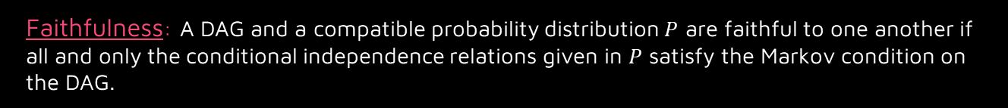
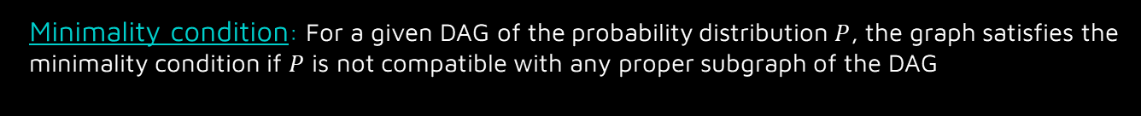
Definitions
[2], page 4 & 5
Markov Condition: Necessary and sufficient condition for a random distribution to be compatible with a DAG
Every variable is independent of all of its non-descendants (in the DAG), and conditionally independent on its parents.
Minimality condition: For a given DAG of the probability distribution $P$, the graph satisfies the minimality condition if $P$ is not compatible with any proper subgraph of the DAG
Faithfulness: A DAG and a compatible probability distribution $P$ are faithful to one another if all and only the conditional independence relations given in $P$ satisfy the Markov condition on the DAG.
Faithfulness is stronger than minimality but may not be achievable by some methods

Slide 8







D-connection and d-separation
[1],
[2], page 4
Two disjoint sets of vertices $X$ and $Y$ are said to be d-connected by $Z$ (a set of vertices disjoint from $X$ and $Y$) in a graph $G$ if and only if it exists an undirected path $U$ between $X$ and $Y$ such that every collider $C$ (or a descendent of $C$) on $U$ is in $Z$, and no non-collider on $U$ is in $Z$.
If $X$ and $Y$ are not d-connected by $Z$, they are d-separated by $Z$ in $G$.
$$A$$
Here, $A$ and $B$ are not d-connected by the set of vertices $\{C,D\}$ : they are d-separated by $\{C,D\}$
$$C$$
$$B$$
$C$ and $B$ can be considered as d-connected by $D$ as $D$ is a collider on the path between $C$ and $B$
$$D$$

Slide 9
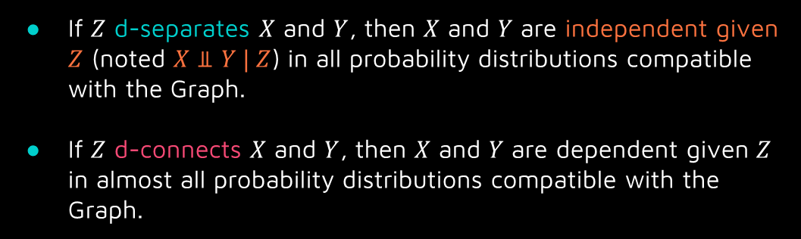
Implications of d-separation
[1],
[2], page 4
If $Z$ d-separates $X$ and $Y$, then $X$ and $Y$ are independent given $Z$ (noted $X⫫Y | Z$) in all probability distributions compatible with the Graph.
If $Z$ d-connects $X$ and $Y$, then $X$ and $Y$ are dependent given $Z$ in almost all probability distributions compatible with the Graph.

Slide 10
MAGS
03

Slide 11











Maximal Ancestral Graphs (noted MAGS)
[2], page 5
Used when the causal sufficiency condition is not satisfied
A hidden cofounder of two variables is noted as a double arrowed edge:
$$X^{r}$$
Hidden cofounder $X^{r}$
$$X^{p}$$
$$X^{q}$$
$$X^{p}$$
$$X^{q}$$
A hidden effect is represented as an undirected edge:
$$X^{p}$$
$$X^{q}$$
$$X^{q}$$
$$X^{p}$$
$$X^{r}$$
Hidden collider $X^{r}$
The hidden effect is not necessarily a collider

Slide 12
Causal Graphs for time series
04

Slide 13
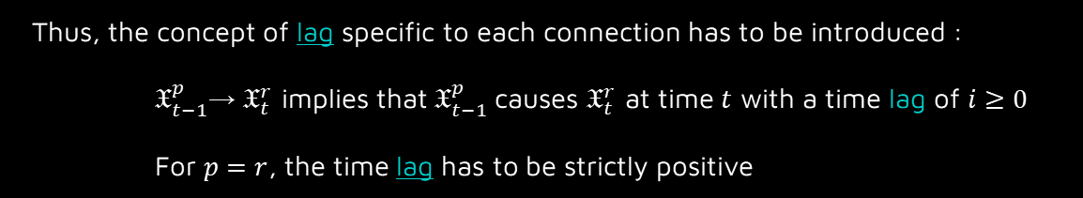
[2], page 6
Temporal causal graph need to satisfy the Temporal priority condition:
The graph is oriented in a way that the case occurred before its effect.
However, due to the sampling frequency of the data, it is possible that two events that occurred at two different time instants will be seen as simultaneous in the observational data.
Thus, the concept of lag specific to each connection has to be introduced :
$𝔛_{t−1}^{p}$→ $𝔛_{t}^{r}$ implies that $𝔛_{t−1}^{p}$causes $𝔛_{t}^{r}$ at time $t$ with a time lag of $i≥0$
For $p=r$, the time lag has to be strictly positive

Slide 14




















Full Time Causal Graph
[2], page 6 & 7
$$𝔛_{t−2}^{r}$$
$$𝔛_{t−1}^{r}$$
$$𝔛_{t}^{r}$$
$$𝔛_{t+1}^{r}$$
$$𝔛_{t+2}^{r}$$
$$𝔛_{t−2}^{q}$$
$$𝔛_{t−1}^{q}$$
$$𝔛_{t}^{q}$$
$$𝔛_{t+1}^{q}$$
$$𝔛_{t+2}^{q}$$
$$𝔛_{t−2}^{p}$$
$$𝔛_{t−1}^{p}$$
$$𝔛_{t}^{p}$$
$$𝔛_{t+1}^{p}$$
$$𝔛_{t+2}^{p}$$
$$𝔛_{t−2}^{s}$$
$$𝔛_{t−1}^{s}$$
$$𝔛_{t}^{s}$$
$$𝔛_{t+1}^{s}$$
$$𝔛_{t+2}^{s}$$
Represents the entirety of the data for $t∈ℤ$
Full time causal graphs have the same structure as DAGs (and if there are hidden cofounders)
It is usually impossible to represent such graphs because of the lack of data on multiple instants.

Slide 15








Window Causal Graph
[2], page 6 & 7
This graph can be represented under the assumption of Consistency Throughout Time:
All the causal relationships remain constant in direction throughout time
$$𝔛_{t−1}^{r}$$
$$𝔛_{t}^{r}$$
$$𝔛_{t−1}^{q}$$
$$𝔛_{t}^{q}$$
It is a representation of the Full Time Causal Graph over a time window equal to the size of the maximal lag relating two time series.
$$𝔛_{t−1}^{p}$$
$$𝔛_{t}^{p}$$
$$𝔛_{t−1}^{s}$$
$$𝔛_{t}^{s}$$
The vertices are between the instants $t$ and $t+τ$, leading to a maximal lag of $τ$ in the graph

Slide 16




Summary Causal Graph
[2], page 6 & 7
When the relations between time instants is not important, the Window Causal Graph can be further compressed:
$$𝔛^{s}$$
$$𝔛^{p}$$
$$𝔛^{q}$$
$$𝔛^{r}$$
As this kind of Graph holds no time information, it is less sensitive to possible variations in time and errors due to lag estimations.

Slide 17
Granger Causality
05

Slide 18

[2], page 8,9 & 10
Granger Causality: A time series $𝔛^{p}$ Granger causes $𝔛^{r}$ if past values of $𝔛^{p}$ provide unique, statistically significant information about future values of $𝔛^{r}$.
Principle: $𝔛_{t}^{r}$ is predicted in two different ways:
$$𝔛_{t}^{r}=a_{r,0}+\sum_{i=1}^{τ}{a_{r,i}}𝔛_{t−i}^{r}+ξ_{t}^{r}$$
$$𝔛_{t}^{r}=a_{r,0}+\sum_{i=1}^{τ}{a_{p,i}}𝔛_{t−i}^{p}+\sum_{i=1}^{τ}{a_{r,i}}𝔛_{t−i}^{r}+ξ_{t}^{r}$$
Both models are then compared through a statistical test to determine which model is better, with the null hypothesis being that $𝔛^{p}$ does not Granger cause $𝔛^{r}$ (Mres fits better)
This approach can be extended to Multivariate time series $𝔛=(𝔛^{1},𝔛^{2},…,𝔛^{d})$, obtaining better results but extremely costly.
Noted Mres (restricted model)
Noted Mfull (full model)

Slide 19
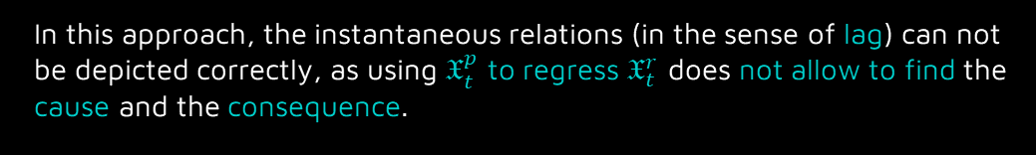
[2], page 8,9 & 10
In this approach, the instantaneous relations (in the sense of lag) can not be depicted correctly, as using $𝔛_{t}^{p}$ to regress $𝔛_{t}^{r}$ does not allow to find the cause and the consequence.
Furthermore, it is not able to deal with non-stationary processes or non-linear processes.
However, Granger causality is able to improve the performance of predictions and is thus considered as a helpful tool.

Slide 20
Neural Network for Causal Discovery
06

Slide 21
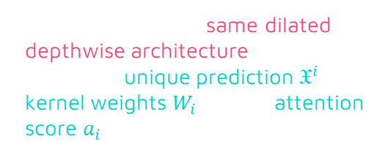





[2], page 10 & 13
$$𝔛^{1},𝔛^{2},…,𝔛^{d}$$
$$𝔛^{1},𝔛^{2},…,𝔛^{d}$$
Each CNN has the same dilated depthwise architecture, but outputs a unique prediction $𝔛^{i}$, its kernel weights $W_{i}$ and its attention score $a_{i}$ (vector of size $d$)
CNN $N_{1}$
CNN $N_{d}$
$$𝔛^{1}pred,W_{1},a_{1}$$
$$𝔛^{d}pred,W_{d},a_{d}$$
A high attention score value indicates a causal relation between time series, and the two other outputs can lead to the construction of a temporal causal graph, as used in the TCFD algorithm.

Slide 22

[2], page 10 & 13
This approach (TCFD) allows to determine the time delay in addition to the causal graph and can also detect hidden cofounders.
The main drawback of this method is the computational cost: it relies on a high number of parameters due to the convolutional layers.
It is also not possible to set the maximum number of lag as $τ_{max}$ depends on the number of hidden layers, the kernel size and the dilatation coefficient.

Slide 23
Structural Equation Model
07

Slide 24
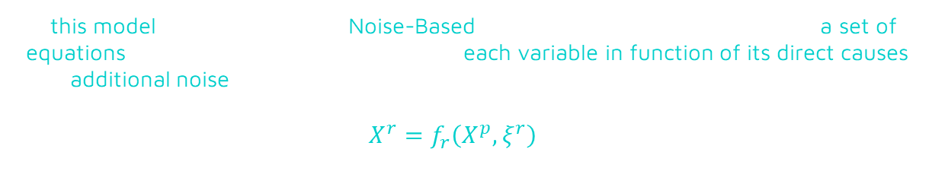
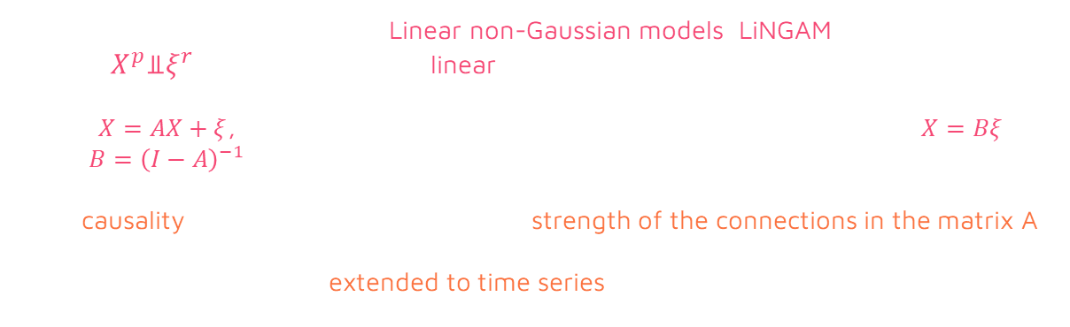
[2], page 24 & 25
In this model (also described as Noise-Based), a causal system is described by a set of equations where each equation represents each variable in function of its direct causes and additional noise:
$$X^{r}=f_{r}\left(X^{p},ξ^{r}\right)$$
We focus in this model, called Linear non-Gaussian models (LiNGAM), on the case where $X^{p}$⫫$ξ^{r}$ and the function is linear.
From $X=AX+ξ$, representing the whole system in matrix form, we obtain $X=Bξ$ with $B={\left(I−A\right)}^{−1}$
The causality is then deduced through the strength of the connections in the matrix A.
This method can then be extended to time series, covered on the next slide.

Slide 25
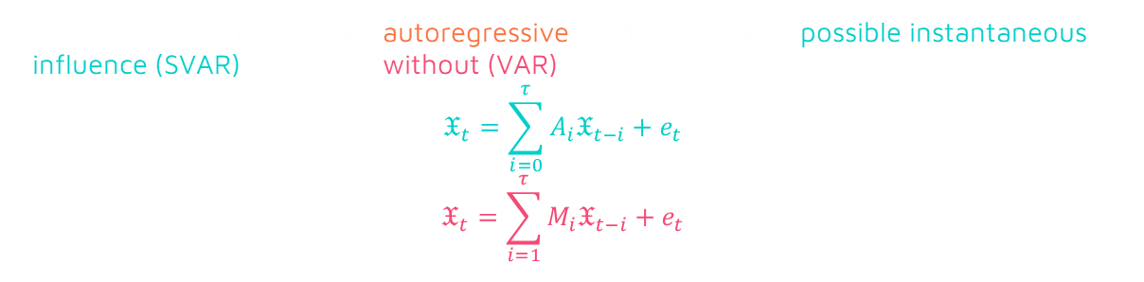
[2], page 24 & 25
This method computes two autoregressive models, one with possible instantaneous influence (SVAR), the other without (VAR):
$$𝔛_{t}=\sum_{i=0}^{τ}{A_{i}𝔛_{t−i}+e_{t}}$$
$$𝔛_{t}=\sum_{i=1}^{τ}{M_{i}𝔛_{t−i}+e_{t}}$$
(SVAR)
(VAR)
$A_{0}$ is deduced with the LiNGAM method, and the $A_{i}$ are deduced with the help of
$A_{i}=(I−A_{0})M_{i}$ for all $i∈(1,…,d)$
This method is capable of learning instantaneous causal relation without a high computational cost, but relies on strong assumptions and can not discover hidden cofounders.

Slide 26
Dynamic Bayesian Networks
08

Slide 27

[2], page 28,29 & 30
This method is a score based approach: the goal is to find the network that best matches the data, using a score related to the likelihood and a penalty term (related to the complexity of the network).
This goal is achieved by maximizing over every possible graph
$$\frac{1}{S}\sum_{k=1}^{K}{log}{ℙ\left(D^{k} | 𝒢,\hat{θ}\right)}$$
where $D$ is the data, $𝒢$ is the associated graph and $\hat{θ}$ the maximum likelihood.
As it is computationally impossible to explore every graph in practice, algorithms proceed in general step by step (adding/removal of a single edge) to find a maximum.
This method have no guarantee to find the associated DAG as it tries to best explain the data structure, but it has the advantage of assigning a score to the system that can be used to express the consistency of the network.

Slide 28
Bibliography
09

Slide 29
Bibliography
[1]D-separation
[3]Determining causality in correlated time series
[2]Survey and Evaluation of Causal Discovery Methods for Time Series
https://www.andrew.cmu.edu/user/scheines/tutor/d-sep.html#formaldef
https://www.amazon.science/blog/determining-causality-in-correlated-time-series
Charles K. Assad , Emilie Devijver, Eric Gaussier

