Slide 1
Algorithms for Temporal causal relations discovery
Florian Polster--Prieto

Slide 2
TABLE OF CONTENTS
01
03
Granger Causality Algorithms
02
Constraint Based Algorithms
Score Based Algorithm
05
Noise Based Algorithm
Comparison of the Algorithms
04
06
Bibliography

Slide 3
Granger Causality Algorithms
01

Slide 4
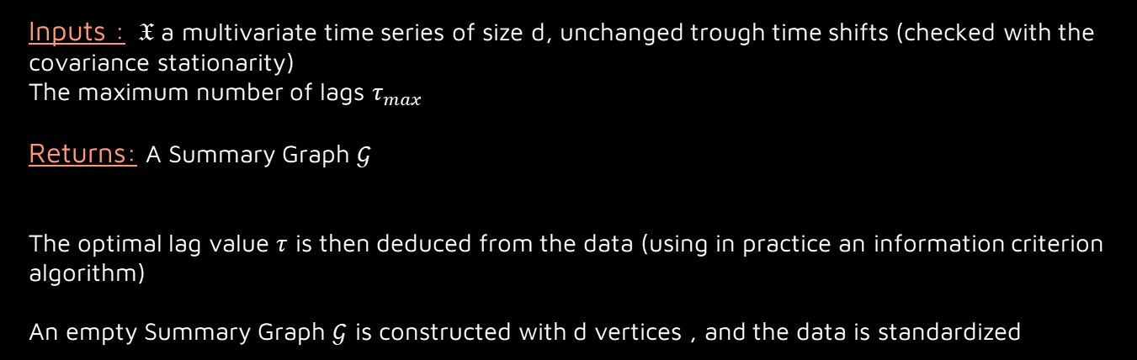
[2], page 9-10
Pairwise Granger Causality (PWGC)
Inputs : $𝔛$ a multivariate time series of size d, unchanged trough time shifts (checked with the covariance stationarity)
The maximum number of lags $τ_{max}$
Returns: A Summary Graph $𝒢$
The optimal lag value $τ$ is then deduced from the data (using in practice an information criterion algorithm)
An empty Summary Graph $𝒢$ is constructed with d vertices , and the data is standardized

Slide 5
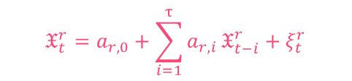

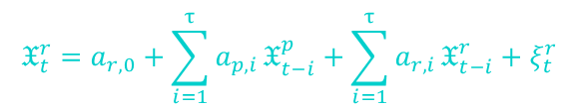
[2], page 9-10
For each $𝔛^{p}$ in $𝔛$:
Fit $𝔛_{t}^{p}$ with Mres and compute its residuals ${{(a}_{p,i})}_{1≤i≤τ}$
For each $𝔛^{r}$ in $𝔛∖\{𝔛^{p}\}$:
Fit $𝔛_{t}^{p}$ with Mfull and compute its residuals ${{(a}_{p,i})}_{1≤i≤τ}$ and ${{(a}_{r,i})}_{1≤i≤τ}$
Do a statistical test to compare Mres and Mfull
If Mfull fits better than Mres:
Add an edge on $𝒢$ such as $𝔛^{r}→𝔛^{p}$
$$𝔛_{t}^{r}=a_{r,0}+\sum_{i=1}^{τ}{a_{r,i}}𝔛_{t−i}^{r}+ξ_{t}^{r}$$
With Mres:
$$𝔛_{t}^{r}=a_{r,0}+\sum_{i=1}^{τ}{a_{p,i}}𝔛_{t−i}^{p}+\sum_{i=1}^{τ}{a_{r,i}}𝔛_{t−i}^{r}+ξ_{t}^{r}$$
And Mfull:

Slide 6
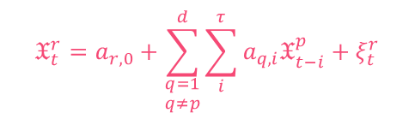
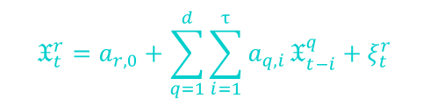
[2], page 10-11
Multivariate Granger Causality (MVGC)
Same architecture as PWGC, but uses different equations:
$$𝔛_{t}^{r}=a_{r,0}+\sum_{\begin{aligned}q=1 \\ q≠p\end{aligned}}^{d}{\sum_{i}^{τ}{a_{q,i}𝔛_{t−i}^{p}}}+ξ_{t}^{r}$$
mvMres:
$$𝔛_{t}^{r}=a_{r,0}+\sum_{q=1}^{d}{\sum_{i=1}^{τ}{a_{q,i}}𝔛_{t−i}^{q}}+ξ_{t}^{r}$$
mvMfull:
MVGC is able to detect confounders, wich PWGC can not, but at the cost of a computation overload in most cases. Both can not detect hidden confounders, nor have a lag equal to zero in the computations.

Slide 7







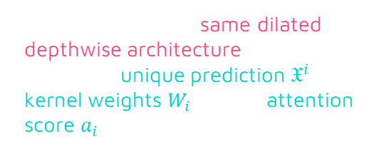
[1], [2] page 12-13
Temporal Causal Discovery Framework (TCDF)
$$𝔛^{1},𝔛^{2},…,𝔛^{d}$$
$$𝔛^{1},𝔛^{2},…,𝔛^{d}$$
Each CNN has the same dilated depthwise architecture, but outputs a unique prediction $𝔛^{i}$, its kernel weights $W_{i}$ and its attention score $a_{i}$ (vector of size $d$)
CNN $N_{1}$
CNN $N_{2}$
$$𝔛^{1}pred,W_{1},a_{1}$$
$$𝔛^{d}pred,W_{d},a_{d}$$
The input is thus $𝔛$ a d-dimensional time series of length T, L the number of hidden layers, the kernel size K, the dillatation coefficient c, the number of epochs, the loss function and the learning rate. $τ_{max}$ is then computed such as $τ_{max}=1+(K−1)\sum_{l=0}^{L}{c^{l}}$

Slide 8

[2], page 12-13
An empty Window Causal Graph of size ${d∗τ}_{max}$ is then constructed.
For $q∈\{1,…,d\}$:
Fit the CNN $N_{q}$ and compute $𝔛^{d},W_{d} and a_{d}$
Sort the attention scores $a_{q,i}$ in b and find the biggest attention score $s_{q}$ (largest gap in b)
For $p∈\{1,…,d\}$:
If $Softmax\left(a_{q,p}\right)>s_{q}$:
$i=Argmax(W_{q,p})$
Add an edge such as $𝔛_{t−i}^{p}→𝔛_{t}^{q}$ and for all homologous edges
For each $𝔛_{t−i}^{p}$ a parent of $𝔛_{t}^{q}$
$𝔛_{t−i}^{p}$ is replaced with a random variable of same mean and same variance If the loss of $N_{q}$ increases, the edge $𝔛_{t−i}^{p}→𝔛_{t}^{q}$ is removed

Slide 9

[2], page 12-13
This algorithm allows to determine the time delay in addition to the causal graph and can also detect hidden cofounders. It is capable to detect instantaneous time dependencies aswell.
The main drawback of this method is the computational cost: it relies on a high number of parameters due to the d convolutional neural networks.
It is also not possible to set the maximum number of lag as $τ_{max}$ depends on the number of hidden layers, the kernel size and the dilatation coefficient.

Slide 10
Constraint based algorithms
02

Slide 11
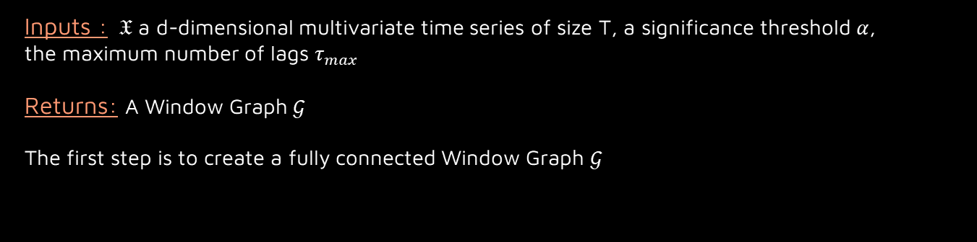
Peter-Clarck with Momentary Conditional Independence test (PCMCI)
[2], page 16-17
Inputs : $𝔛$ a d-dimensional multivariate time series of size T, a significance threshold $α$,
the maximum number of lags $τ_{max}$
Returns: A Window Graph $𝒢$
The first step is to create a fully connected Window Graph $𝒢$

Slide 12

For $𝔛_{t}^{q}$in $𝒢$:
n=0
While $Card(Par(𝔛_{t}^{q},𝒢))≥n+1$:
For $𝔛_{t−1}^{p}∈Par(𝔛_{t}^{q}\text{, }𝒢)$ with $Card\left(Par\left(𝔛_{t}^{q},𝒢\right)∖𝔛_{t−1}^{p}\right)=n$ :
Independence test to check $\left(𝔛_{t−1}^{p}⫫𝔛_{t}^{q}\right)|(Par\left(𝔛_{t}^{q},𝒢\right)∖𝔛_{t−1}^{p})$
Remove the associated edges if the independence is valid (and all homologous edges)
n=n+1
For $𝔛_{t}^{q}$in $𝒢$:
For $𝔛_{t−1}^{p}∈Par(𝔛_{t}^{q}\text{, }𝒢)$ with $Card\left(Par\left(𝔛_{t}^{q},𝒢\right)\right)>0$ :
Independence test to check $\left(𝔛_{t−1}^{p}⫫𝔛_{t}^{q}\right)|(Par\left(𝔛_{t}^{q},𝒢\right)∖\left(\left\{𝔛_{t−1}^{p}\right\}∪Par\left(𝔛_{t−1}^{p},𝒢\right)\right))$
Remove the associated edges if the independence is valid (and all homologous edges)
This algorithm can not capture instantaneous causal relations, but is able to detect confounders, while having a d-polynomial computation time (can however be infeasible for large networks).
[2], page 16-17

Slide 13

Optimal Causation entropy (oCSE)
[2], page 17-18
Inputs : $𝔛$ a d-dimensional multivariate time series of size T, a significance threshold $α$
Returns: A Summary Graph $𝒢$
This algorithm uses the causation entropy CE to test causal relations with:
$$CE\left(𝔛_{t}^{P}→𝔛_{t+1}^{Q} | 𝔛_{t}^{R}\right)=h\left(𝔛_{t+1}^{Q} | 𝔛_{t}^{R}\right)−h\left(𝔛_{t+1}^{Q} | 𝔛_{t}^{R},𝔛_{t}^{P}\right)$$
Where $h\left(. | .\right)$ is the conditional entropy
The first step is to build an empty Summary Graph $𝒢$ with d vertices.

Slide 14

For $𝔛^{q}$in $𝒢$:
$z=∞$
While $z>0 and Card(Par\left(𝔛^{q},𝒢\right)<d$:
For $𝔛^{p}∈𝒢∖Par\left(𝔛^{q}\text{, }𝒢\right)$ :
Compute $z_{p}$ the result of the test $CE(𝔛_{t}^{p}→𝔛_{t+1}^{q}|Par\left(𝔛^{q},𝒢\right))>0$
Select $p=argmax_{r}\left(z_{r}\right)$
If $z_{p}>α$, add an edge such as $𝔛^{p}→𝔛^{q}$
For $𝔛^{p}∈Par\left(𝔛^{q}\text{, }𝒢\right)$ :
Compute $z$ the result of the test $CE\left(𝔛_{t}^{p}→𝔛_{t+1}^{q} | Par\left(𝔛^{q},𝒢\right)∖\left\{𝔛_{t}^{p}\right\}\right)=0$
If $z>α$ remove the edge $𝔛^{p}→𝔛^{q}$
In comparison to PCMCI, oCSE has a much shorter computational time, but this is a tradeoff with efficiency: the result may vary if the parents are treated in a different order
[2], page 17-18

Slide 15
Noise Based Algorithm
03

Slide 16

Linear Non-Gaussian Acyclic Model (VarLiNGAM)
[2], page 25-26
Inputs : $𝔛$ a d-dimensional multivariate time series of size T, a significance threshold $α$,
the maximum number of lags $τ_{max}$
Returns: A Window Graph $𝒢$
The first step is to build an empty Window Graph $𝒢$ with d* $τ_{max}$ vertices.
Compute ${(M_{τ})}_{1≤τ≤τ_{max}}$ and $e_{t}$ with the VAR equation
Create a list S containing every from 1 to d

Slide 17

While $Card\left(S\right)>1$ :
For $p ε S$ :
For $q ε S∖\{p\}$ :
Fit $e_{p}→e_{q}$ with the least squares regression and compute its residuals $ε^{p,q}$
Compute the result of the independence test $ε^{p}⫫e_{p}$, noted $y_{p}$
Select $p^{∗}={argmin}_{qεS}(y_{p})$ and delete p from S
Add every edge $𝔛_{t−i}^{p^{∗}}→𝔛_{t}^{q}$ to the Graph
We then build $A_{0}$ a lower triangular matrix by estimating the connection strenghts
For $iε\{1,…,τ\}$ :
A_i$=\left(I−A_{0}\right)∗M_{i}$
We then remove every edge $𝔛_{t−i}^{p}→𝔛_{t}^{q}$ for every ${[A_{i}]}_{p,q}=0$
This algorithm is able to detect instantaneous relations, confounders and self causes.
It is however based on a linear model, and can not detect hidden confounders.
[2], page 25-26

Slide 18
Score Based Algorithm
04

Slide 19

DYNOTEARS Algorithm
[2], page 28-30
Inputs : $𝔛$ a d-dimensional multivariate time series of size T, the maximum number of lags $τ_{max}$
$λ_{A}$, $λ_{W}$, $α$
Returns: A Window Graph $𝒢$
The Score (or loss function to minimize) is set as :
$$f\left(W,A\right)=\frac{1}{2d\left(T+1−τ_{max}\right)}∥𝔛_{t}^{ }−𝔛_{t}^{T}W−𝔛_{\left(t+1:t+τ_{max}\right)}^{T}A∥_{F}^{2}+λ_{W}∥W∥_{1}+λ_{A}∥A∥_{1}$$
Where W is a matrix representing the instantaneous relations, and ${\left(A_{i}\right)}_{1≤i≤τ_{max}}$ the lagged relations with respective time lag $i$.
The first step is to build an empty Window Graph $𝒢$ with d* $τ_{max}$ vertices.

Slide 20

The Matrixes $W$ and $A$ are deduced from the minimisation of the Score $f\left(W,A\right)$
For every coefficient $w_{p,q} ε W$ :
If $w_{p,q}≥α$ :
Add an edge such as $𝔛_{t}^{p}→𝔛_{t}^{q}$ and to every homologous edge
For $i∈\{1,…,τ_{max}\}$ :
For every coefficient $a_{p,q}∈A_{i}$ :
If $a_{p,q}≥α$ :
Add an edge such as $𝔛_{t−i}^{p}→𝔛_{t}^{q}$ and to every homologous edge
This algorithm is not guaranteed to find the real Window Graph of the probability distribution, as it uses a minimization step to compute the temporal dependencies.
However, it is capable of detecting instantaneous relations, and its computation time can be reduced on assumptions such as the decomposition of the score over the data.
[2], page 28-30

Slide 21
Comparison of the Algorithms
05

Slide 22
 | Type of Causal Graph | Instantaneous relations discovery | Hidden confounders discovery
PWGC | Summary | No | No
MVGC | Summary | No | No
TCFD | Window | Yes | Yes
PCMCI | Window | No | No
oCSE | Summary | No | No
VarLINGAM | Window | Yes | No
DYNOTEARS | Window | Yes | No

Slide 23
Bibliography
06

Slide 24
Bibliography
[1] Master’s Thesis on TCFD
[2] Survey and Evaluation of Causal Discovery Methods for Time Series
https://essay.utwente.nl/76360/1/Nauta_MA_EEMCS.pdf
Charles K. Assad , Emilie Devijver, Eric Gaussier

