Slide 1
Evaluation Methods for Causal Graphs

Slide 2








In the following definitions, both graph (the ground truth graph $G$ end the predicted $\hat{G}$) are supposed to have the same set of vertices to be comparable.
This leads to evaluations of the edges on the graphs only.
To depict hidden confounders, we use a double arrowed edges with a lag of 0
$$X^{p}$$
$$⟺$$
0
$$X^{q}$$
$$X^{r}$$
$$X^{q}$$
$$X^{r}$$
Indirect evaluations are denoted as $Mesure^{′}$, and depicts a measure considering additional edges that entangle other paths with the same amount of total lag
5
The orange edge is not on the ground truth graph and is therefore considered as an indirect relation
$$X^{p}$$
$$X^{r}$$
$$X^{q}$$
3
2

Slide 3

Precision and Recall
Precision is defined as $precision=\frac{TP}{TP+FP}$ and is the fraction of relevant instances among the retrieved instances
Recall is defined as $recall=\frac{TP}{TP+FN}$ and is the fraction of relevant instances that where retrieved.
TP are the true positives: edges that are both on the predicted graph and on the true graph
FP are the false positives: edges on the predicted graph that are not on the true graph
FN are the false negatives: edges that are not predicted but are represented on the true graph

Slide 4

[2], page 36
F1-Scores
The F1-score is the mean of precision and recall and is defined as
$F1=\frac{2TP}{(2TP+FP+FN)}$
In the evaluation, we will denote $F1$ the score of the skeleton of the graph (evaluation of the connections between the vertices), and $\vec{F1}$ the score of the whole graph (evaluation of the directed edges) as the latter is supposed to be inferior in practice.

Slide 5

[1]
False Positive Rate (FPR) and True Positive Rate (TPR)
FPR: ratio of the edges that are in the predicted graph ($E_{M}$) but not present in the ground truth over the difference between ground truth edges ($E_{GT}$) and all possible edges ($E$)
$$FPR=\sum_{i}{\frac{e_{i}}{\left|E−E_{GT}\right|}, e_{i}∈E_{M}}\backslash E_{GT}$$
TPR: ratio of the edges beetween the ground truth ($E_{GT}$) and predicted causal graph ($E_{M}$) over the number of edges in the ground truth graph
$$TPR=\sum_{i}{\frac{e_{i}}{\left|E_{GT}\right|}, e_{i}∈E_{M}}∩E_{GT}$$

Slide 6

[1]
[2]
Mean squared error (MSE) and Frobenius Norm
Measures the difference between two adjacency matrices $B=\left\{b_{ij}\right\}$, with $x_{i}=\sum{b_{ij}x_{j}+e_{i}}$
This works only for linear relations.
Can also be expressed in a binary way: $b_{ij}=1$ represents $i→j$, and $b_{ij}=0$ if there is no connection, or with weights (the amount of lag in our case)
The Frobenius Norm is defined as
$$\sqrt{trace\{{\left(B_{true}−\hat{B}\right)}^{T}\left(B_{true}−\hat{B}\right)\}}$$
And MSE as
$$MSE=\frac{1}{N}\sum{{\left(B_{true}−\hat{B}\right)}^{2}}$$
With $B_{true}$ and $\hat{B}$ the true and predicted adjacency matrices and N the number of variables

Slide 7
[1], page 32
Structural Hamming Distance (SHD)
Method that counts the number of steps needed to obtain the true directed acyclic graph (DAG), where the steps can be edge removal/addition or orientation changes.
Useful to asses the precision of the algorithms
The SHD can also be computed to compare two PDAG (partially directed acyclic graph), where the DAGs are converted in PDAGs by replacing directed edges with non directed edges for Markov equivalent classes (set of edges containing the same conditional independencies)

Slide 8

[1]
[3]
Structural Intervention Distance (SID)
Numbers of intervention distributions falsely estimated from i to j $(i≠j)$ by $\hat{G}$ with respect to $G$
The intervention distribution from Y to X is defined as:
$$p\left(Y | do(X=\hat{x}\right))=p(y)$$
If Y is a parent of X
$$p\left(Y | do(X=\hat{x}\right))=\sum_{pa_{X}}{p\left(y | \hat{x},pa_{X}\right)p(pa_{X})}$$
If Y is not a parent of X, with $pa_{X}$the set of parents of X
The SID is equal to 0 for an isolated edge if the intervention distribution is correctly predicted

Slide 9
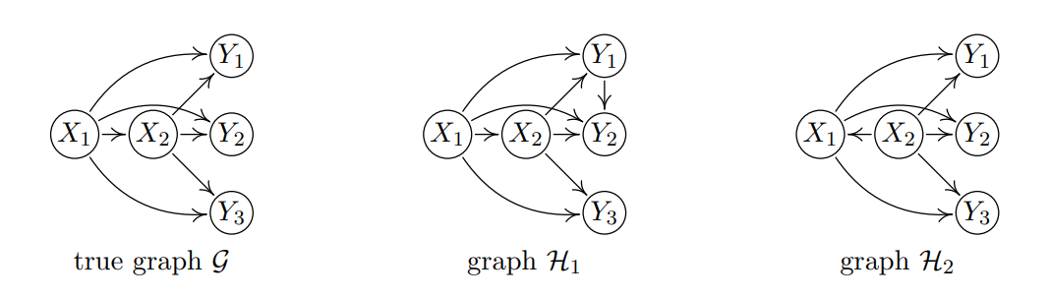
Comparison of the metrics with an example
[3]
We have here $SID\left(H_{1}\right)=0$ and $SID\left(H_{2}\right)=8$ as $H_{2}$ has a different set of parents for $X_{1}$ and $X_{2}$

Slide 10
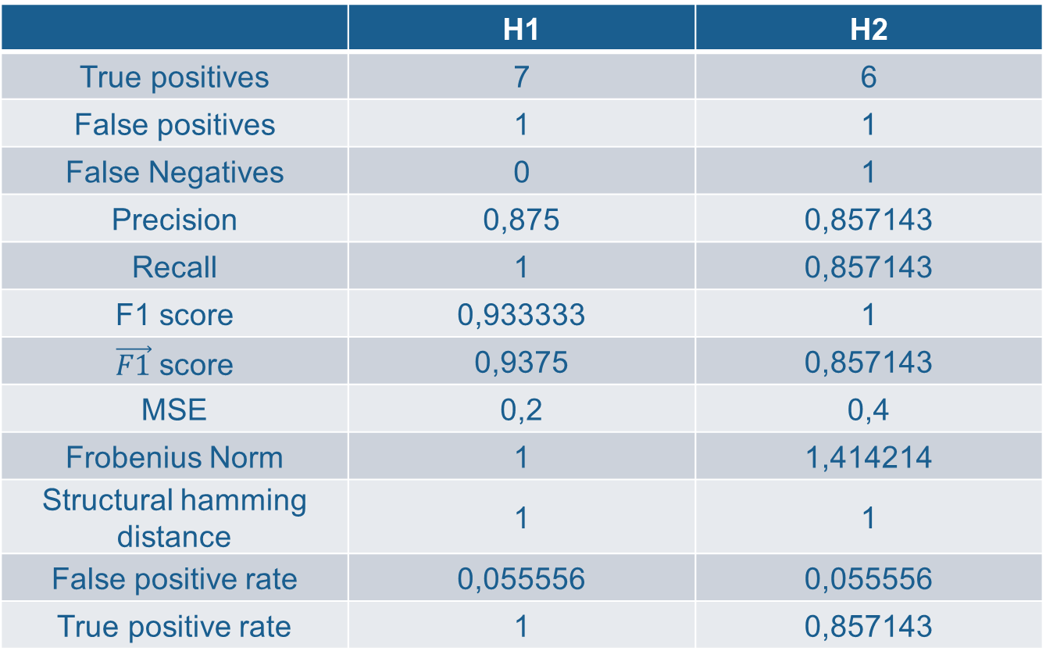
[3]
 | H1 | H2
True positives | 7 | 6
False positives | 1 | 1
False Negatives | 0 | 1
Precision | 0,875 | 0,857143
Recall | 1 | 0,857143
F1 score | 0,933333 | 1
$\vec{F1}$ score | 0,9375 | 0,857143
MSE | 0,2 | 0,4
Frobenius Norm | 1 | 1,414214
Structural hamming distance | 1 | 1
False positive rate | 0,055556 | 0,055556
True positive rate | 1 | 0,857143

Slide 11
Bibliography
[2]https://en.wikipedia.org/wiki/Adjacency_matrix
[1] Evaluation Methods and Measures for Causal Learning Algorithms, Lu Cheng, Ruocheng Guo, Raha Moraffah, Paras Sheth, K. Selc¸uk Candan, and Huan Liu Fellow
[3]Structural Intervention Distance (SID) for Evaluating CausalGraphs
Jonas Peters, Peter Bühlmann

