Slide 1
Algorithms Evaluation
Florian Polster--Prieto

Slide 2
TABLE OF CONTENTS
01
02
03
PCMCI+
Metrics used
04
LPCMCI
TCDF

Slide 3
01
Metrics used

Slide 4

Mean squared error (MSE)
Measures the difference between two adjacency matrices $B=\left\{b_{ij}\right\}$, with $x_{i}=\sum{b_{ij}x_{j}+e_{i}}$
This works only for linear relations.
Can also be expressed in a binary way: $b_{ij}=1$ represents $i→j$, and $b_{ij}=0$ if there is no connection, or with weights (the amount of lag in our case)
As we use weighted adjacency matrices for this metric, a lag of 0 is represented by a -1 to make a distinction between a connection of lag 0 and no connection
We have
$$MSE=\frac{1}{N}\sum{{\left(B_{true}−\hat{B}\right)}^{2}}$$
With $B_{true}$ and $\hat{B}$ the true and predicted adjacency matrices and N the number of variables

Slide 5
Structural Intervention Distribution (SID)
Numbers of intervention distributions falsely estimated from i to j $(i≠j)$ by $\hat{G}$ with respect to $G$
The intervention distribution from Y to X is defined as:
$$p\left(Y | do(X=\hat{x}\right))=p(y)$$
If Y is a parent of X
$$p\left(Y | do(X=\hat{x}\right))=\sum_{pa_{X}}{p\left(y | \hat{x},pa_{X}\right)p(pa_{X})}$$
If Y is not a parent of X, with $pa_{X}$the set of parents of X
The SID is equal to 0 for an isolated edge if the intervention distribution is correctly predicted

Slide 6
 | Type of Causal Graph | Instantaneous relations discovery | Hidden confounders discovery | Stationarity of the input data
PCMCI+ | Window | Yes but unoriented | No | Yes
LPCMCI | Window | Yes | Yes | Yes
TCFD | Summary with lags | Yes | Yes | The method shows better results on stationary data

Slide 7
02
PCMCI+

Slide 8





PCMCI+
This method does not allow to discover hidden confounders, but is able to identify the full window causal graph given $τ_{min}$ and $τ_{max}$
It also takes a $pc_{α}$ parameter, which is the significance level of the conditional independence test in the first phase of the algorithm. This parameter is chosen in our experiment through an optimization step, and is one of the following value [0.001, 0.005, 0.01, 0.025, 0.05]
The method can remain uncertain on contemporaneous lags ($τ=0$), and will denote them as unoriented: o-o, o-- or o->
In this case, we replace the unoriented edges with undirected edges, inducing a connection where the edge was initially unoriented
$$𝔛_{t−1}^{r}$$
$$𝔛_{t}^{r}$$
$$𝔛_{t−1}^{q}$$
$$𝔛_{t}^{q}$$

Slide 9
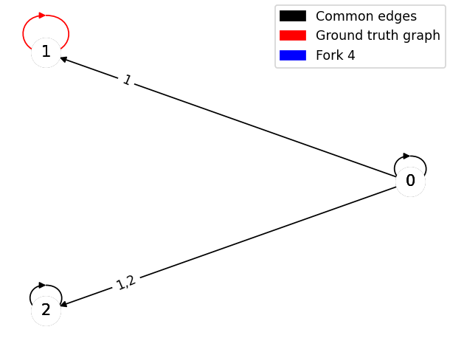
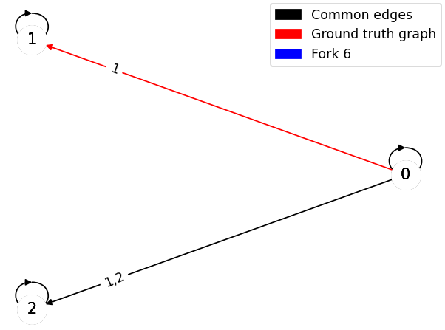
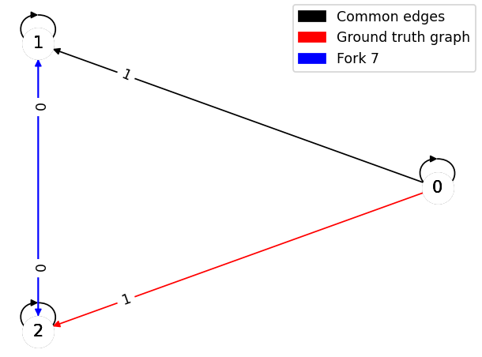
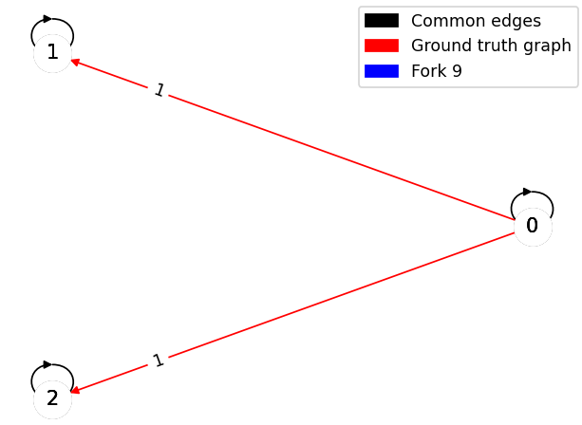
Fork
The worst predictions regarding MSE are on set 4(upper left), set 6(upper right), set 7 (bottom left and set 9 (bottom right)
 | Set 0 | Set 1 | Set 2 | Set 3 | Set 4 | Set 5 | Set 6 | Set 7 | Set 8 | Set 9
MSE | 0,33 | 0,5 | 0,5 | 0,33 | 0,66 | 0,33 | 0,66 | 0,66 | 0,33 | 0,66
SID | 0 | error | error | 2 | 0 | 0 | 2 | error | 2 | 4

Slide 10
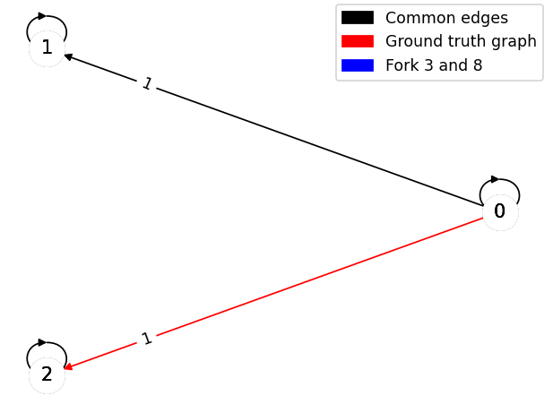
The worst predictions regarding SID are on set 3 (middle), set 6 (left), set 8 (middle) and set 9 (right)

Slide 11
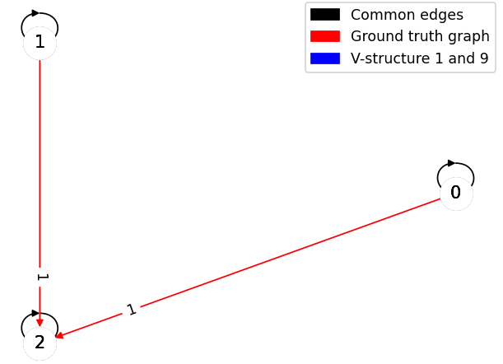
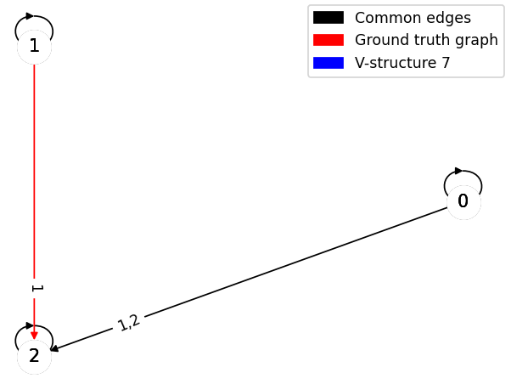
V-structure
The worst predictions regarding MSE are on set 1(left), set 7 (right) and set 9 (left)
The worst predictions regarding SID are on set 1 and set 9 (both left)
 | Set 0 | Set 1 | Set 2 | Set 3 | Set 4 | Set 5 | Set 6 | Set 7 | Set 8 | Set 9
MSE | 0,42 | 0,66 | 0,33 | 0,33 | 0,33 | 0,33 | 0,33 | 0,66 | 0,33 | 0,66
SID | 1 | 2 | 0 | 0 | 1 | 1 | 1 | 1 | 0 | 2

Slide 12
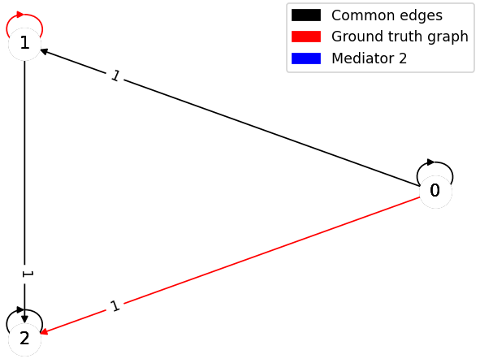
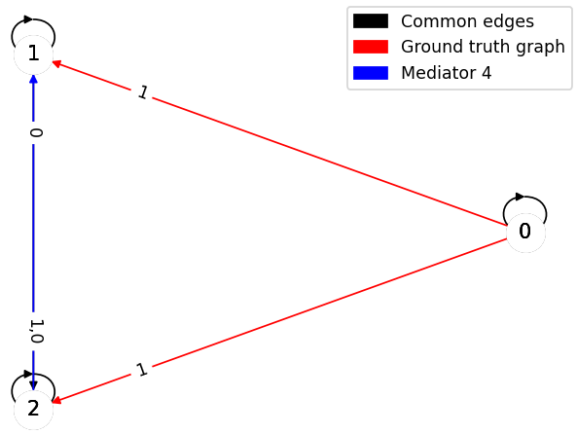
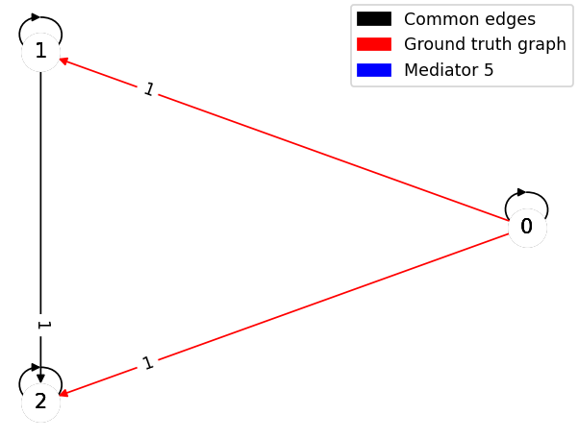
Mediator
The worst predictions regarding MSE are on set 2 (left) and set 4 (middle) and set 5 (right)
The worst prediction regarding SID is on set 5 (right)
 | Set 0 | Set 1 | Set 2 | Set 3 | Set 4 | Set 5 | Set 6 | Set 7 | Set 8 | Set 9
MSE | 0,33 | 0,33 | 0,66 | 0,42 | 0,83 | 0,66 | 0,33 | 0,5 | 0,33 | 0,33
SID | 1 | 1 | 1 | 1 | error | 3 | 1 | error | 0 | 1

Slide 13
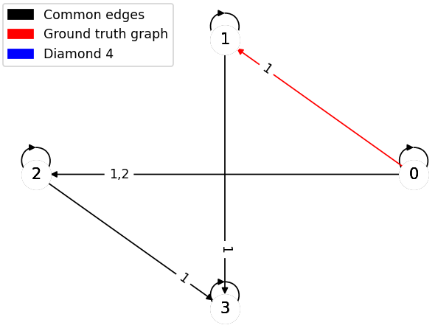
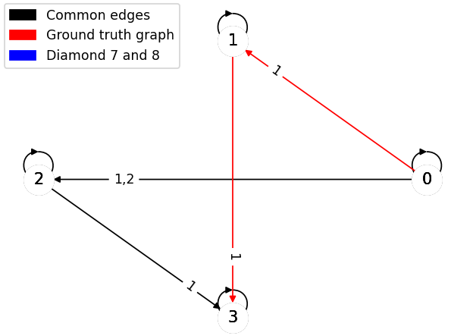
Diamond
The worst predictions regarding MSE are on set 4 (left) set 7 and 8 (both right)
 | Set 0 | Set 1 | Set 2 | Set 3 | Set 4 | Set 5 | Set 6 | Set 7 | Set 8 | Set 9
MSE | 0,5 | 0,5 | 0,25 | 0,5 | 0,75 | 0,5 | 0,25 | 0,75 | 0,75 | 1
SID | 2 | 2 | 0 | 2 | 3 | 2 | 0 | 5 | 5 | 6

Slide 14
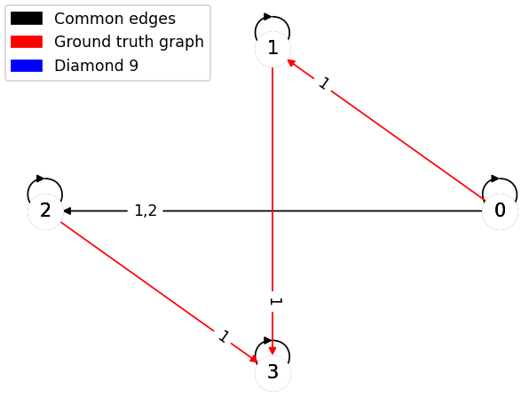
The worst predictions regarding SID are on set and set 8 (both left) and set 9 (right)

Slide 15
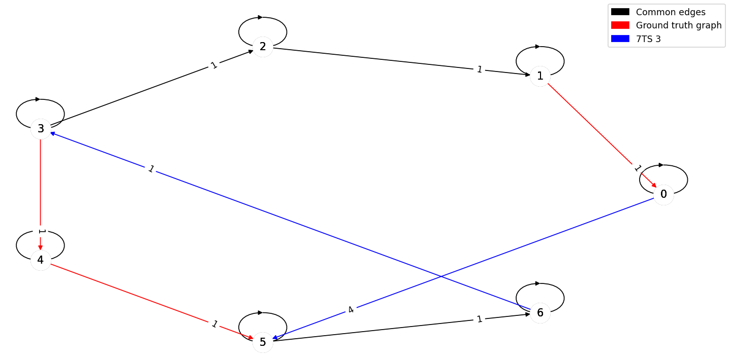
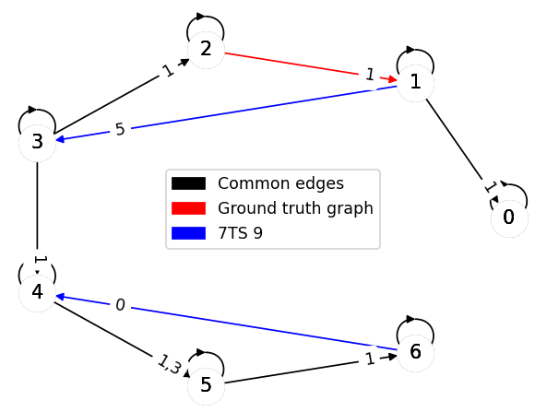
7TS
The worst predictions regarding both metrics are on set 3 (left) and set 9 (right)
 | Set 0 | Set 1 | Set 2 | Set 3 | Set 4 | Set 5 | Set 6 | Set 7 | Set 8 | Set 9
MSE | 2,43 | 1,22 | 0,04 | 2,86 | 0,14 | 1 | 0,29 | 0,29 | 0,36 | 4,32
SID | error | error | 0 | 20 | 5 | 12 | 11 | 10 | error | 13

Slide 16
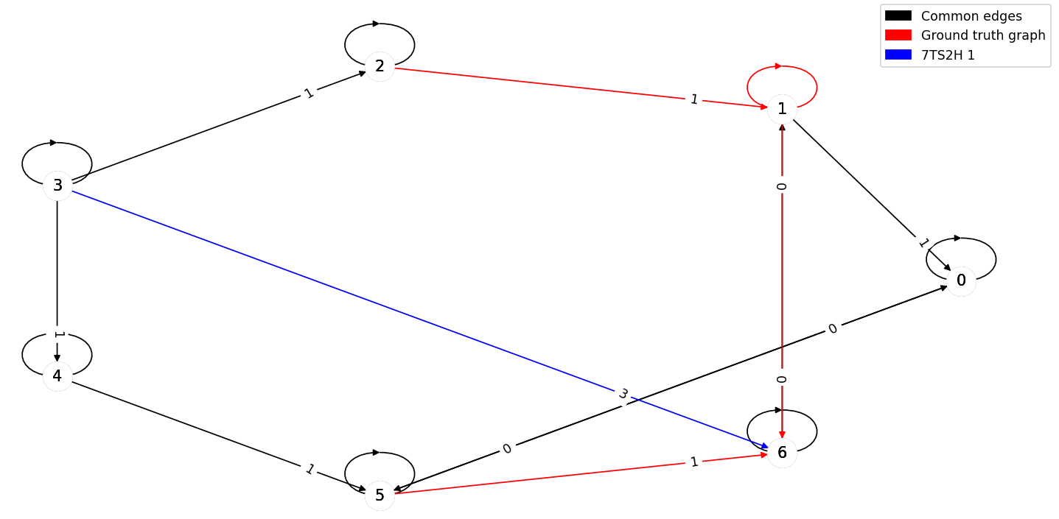
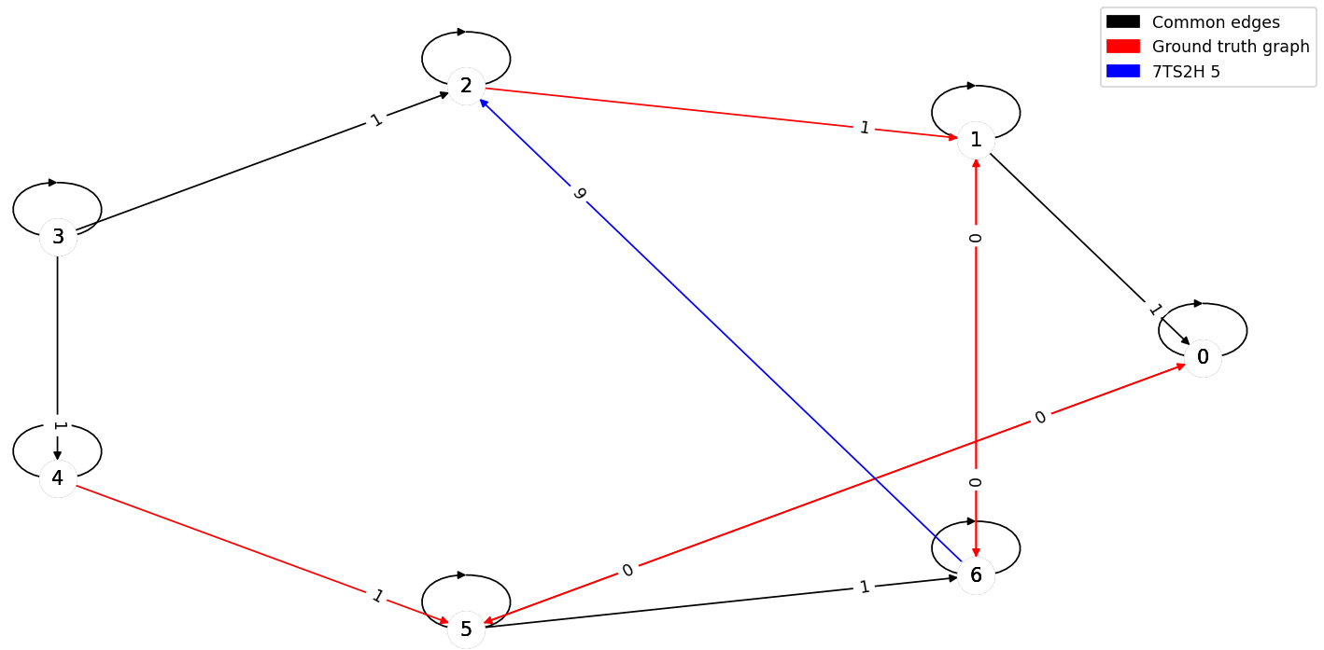
7TS2H
The worst predictions regarding MSE are on set 1 (left) and 5 (right)
 | Set 0 | Set 1 | Set 2 | Set 3 | Set 4 | Set 5 | Set 6 | Set 7 | Set 8 | Set 9
MSE | 0,18 | 1,75 | 0,43 | 0,57 | 0,25 | 12,14 | 0,86 | 0,11 | 0,43 | 0,89
SID | error | error | 23 | 29 | 28 | 29 | 28 | error | 23 | error

Slide 17
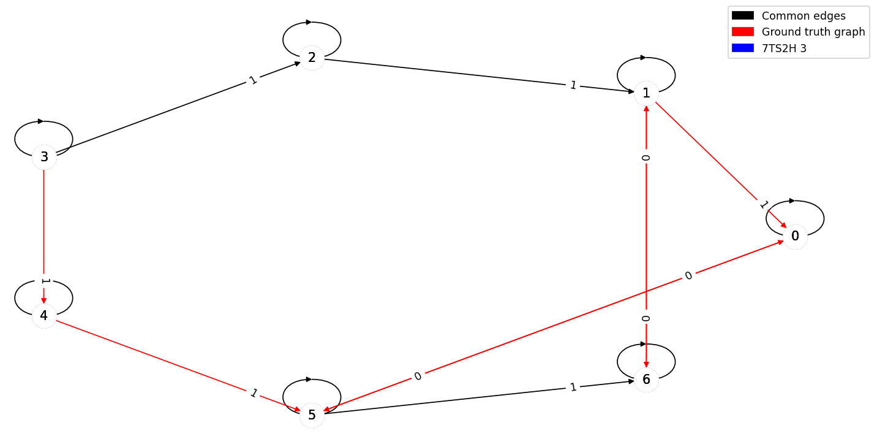
The worst predictions regarding SID so far are on set 3 (left) and set 5 (right)

Slide 18
LPCMCI
03

Slide 19

LPCMCI
This method follows the same principle as PCMCI+, and is also able to discover hidden confounders.
The hyperparameters are selected the same way as PCMCI+, except for $pc_{α}$, which is set at 0,01.
The method can remain uncertain and will denote these edges as undirected: o-o, o-- or o->
In this case, we replace the undirected edges with edges respectively maximizing and minimizing the evaluation metrics
$$𝔛_{t−1}^{r}$$
$$𝔛_{t}^{r}$$
$$𝔛_{t−1}^{q}$$
$$𝔛_{t}^{q}$$

Slide 20
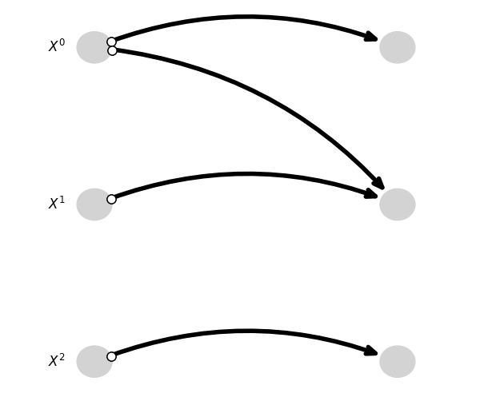
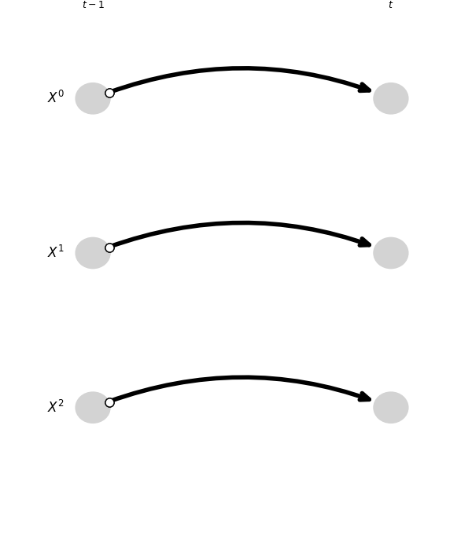

Fork
The worst predictions regarding the MSE are on the worsts cases on set 8 (left) and 9 (right) with $MSE_{8worst}={MSE}_{9worst}=1,67$

Slide 21
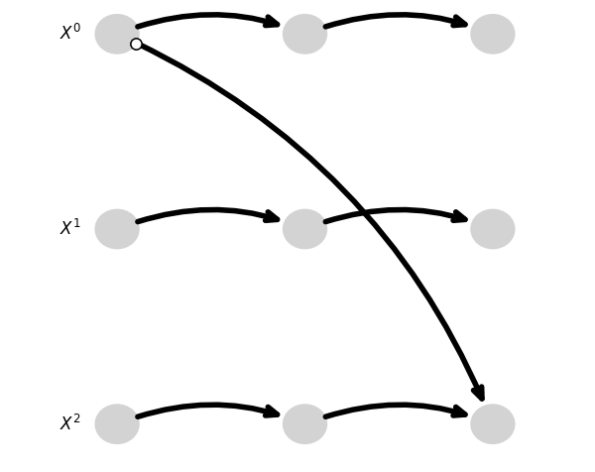

The worst predictions regarding SID are on set 0, set 6 (both left) and set 9 (right), on their worst cases with $SID_{0worst}=SID_{6worst}=SID_{9worst}=4$

Slide 22
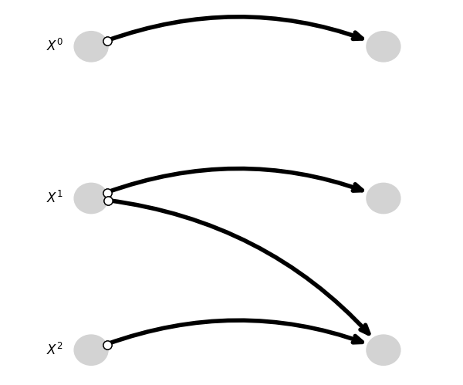

V-structure
The worst predictions regarding MSE are on set 0, set 9 (both left), set 4 and set 7 (both right)
With $MSE_{0worst}=MSE_{9worst}=MSE_{4worst}=MSE_{7worst}=1,67$

Slide 23
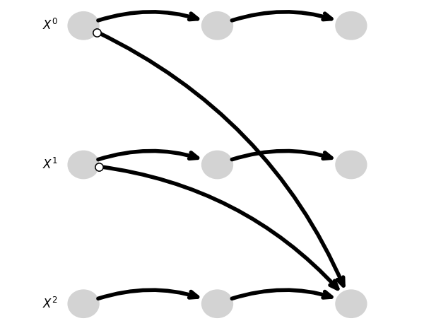
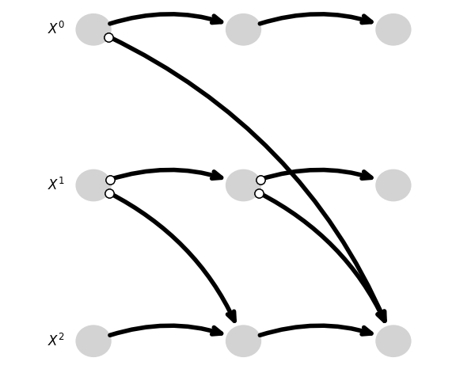

The worst predictions regarding SID are on set 4, set 7 on their best cases (both last slide), set 1 (left) and set 3(right) on their worst cases with
$$SID_{4best}=SID_{7best}=SID_{1worst}=SID_{3worst}=2$$

Slide 24
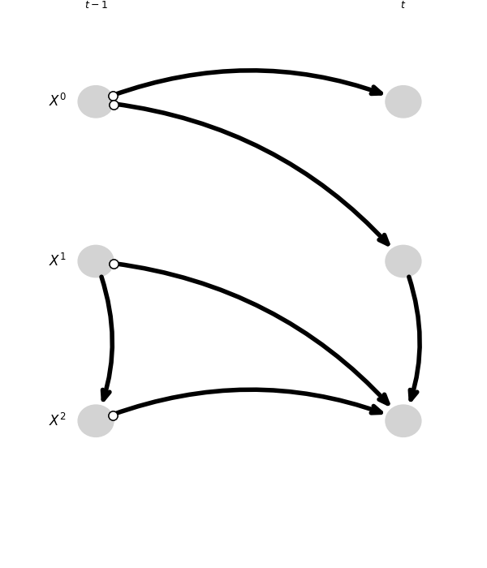
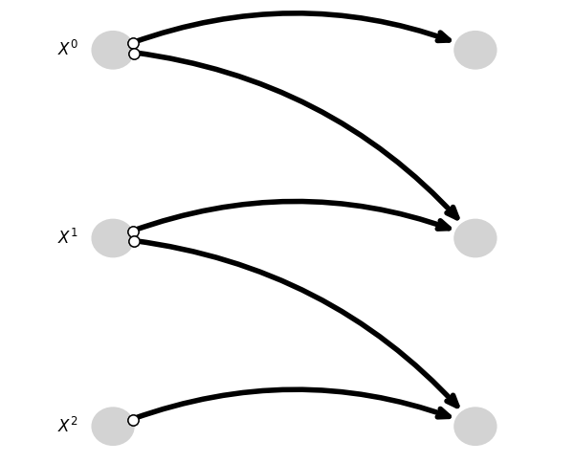

Mediator
The worst predictions regarding MSE are on set 2 (left), set 6 and set 9 (both right)
With $MSE_{2worst}=3 and MSE_{9worst}=MSE_{6worst}=2$

Slide 25
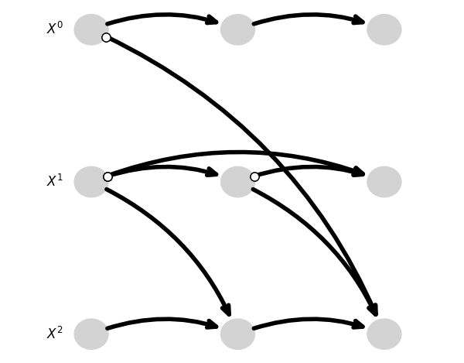
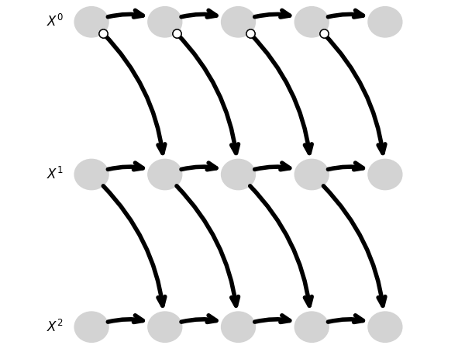
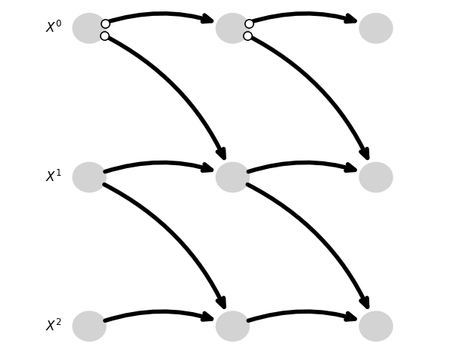

The worst predictions regarding SID are on set 0 (upper left), set 2 (upper right), set 4 (bottom left) and set 5 (bottom right) on their worst cases with
$$SID_{0worst}=SID_{2worst}=SID_{4worst}=SID_{5worst}=3$$

Slide 26
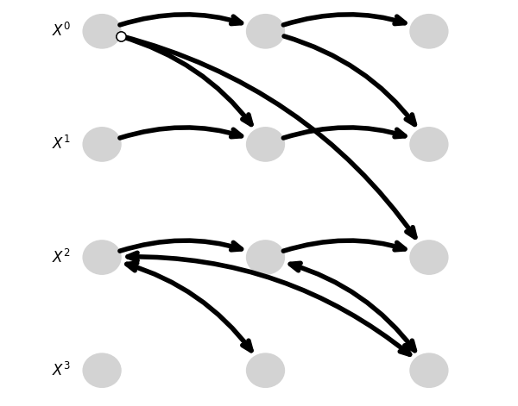
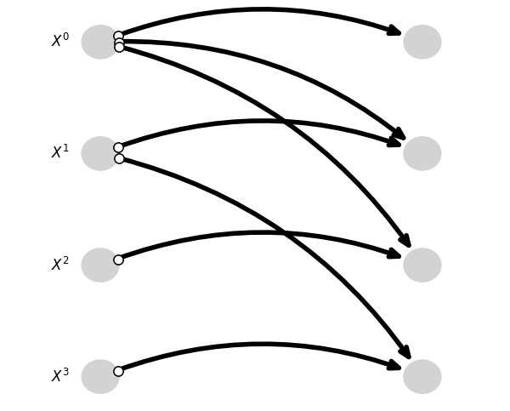

Diamond
The worst predictions regarding MSE are on set 0 (left)and set 9 (both right)
With $MSE_{0best}=MSE_{0worst}=MSE_{9best}=2$

Slide 27
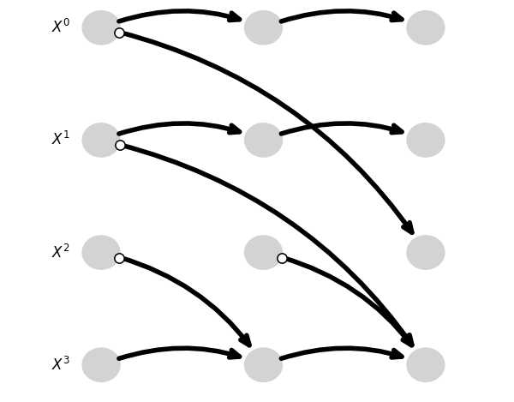
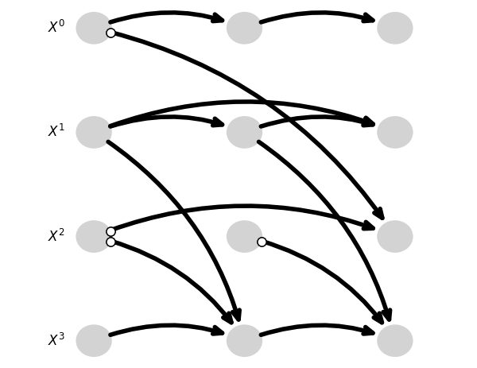
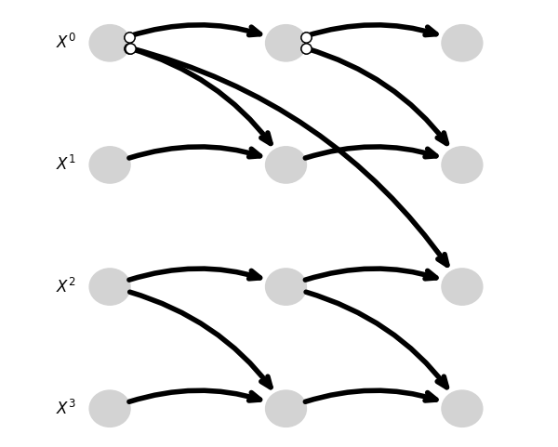

The worst predictions regarding SID are on set 7 (upper left), set 4 (upper right) and set 8 (bottom left) on their worst cases with
$$SID_{7worst}=9 and SID_{4worst}=SID_{7worst}=8$$

Slide 28
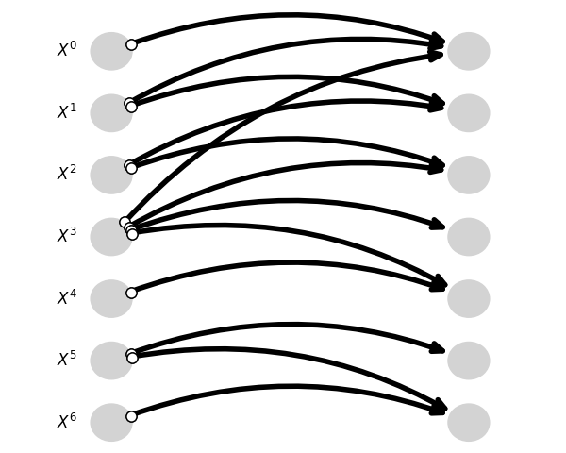
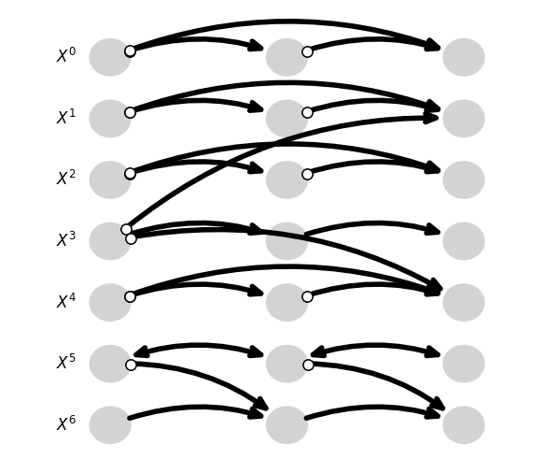

7TS
The worst predictions regarding both metrics are on set 0 (left)and set 3 (both right)
With $MSE_{0worst}=MSE_{3worst}=2$
And $SID_{0worst}=SID_{3worst}=26$

Slide 29
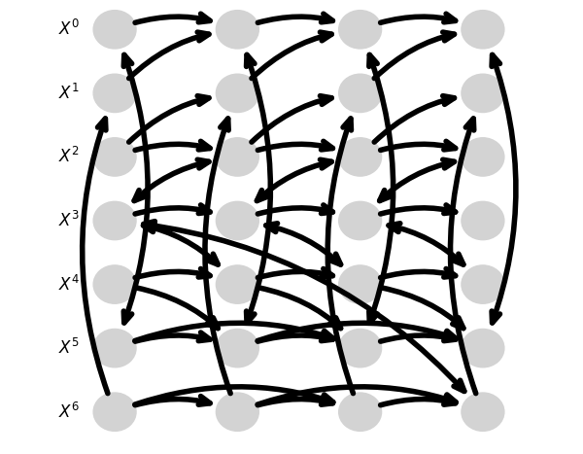
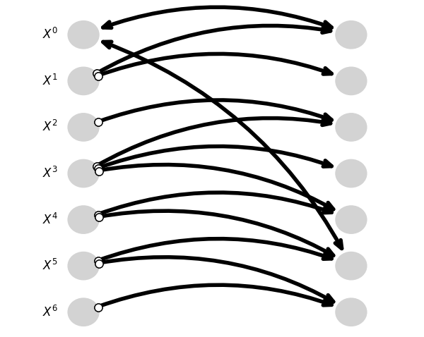

7TS2H
The worst predictions regarding MSE metrics are on set 1 (left)and set 7 (both right)
With $MSE_{1}=3,57 and MSE_{7worst}=3,14$

Slide 30
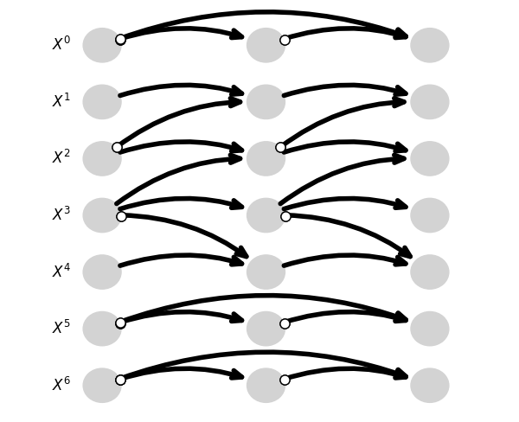
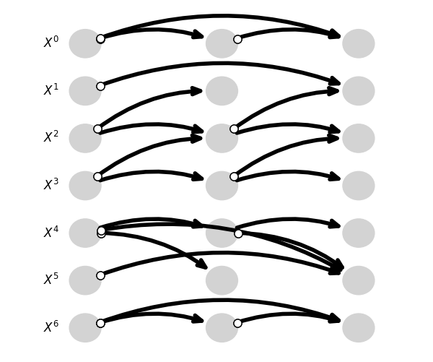

The worst predictions regarding SID are on set 3 (left), set 6 (right
with
$$SID_{3worst}=30 and SID_{6worst}36$$

Slide 31
04
TCDF

Slide 32

TCDF
We will focus on our study on algorithms capable of detecting hidden confounders. As such, we start testing the TCDF method, which consists in a certain number of convolutional networks in parallel, on the artificial database containing 6 different architectures
The hyperparameters used are the one given by the authors of the method for the first results:
Kernel K of size 4
Dilatation coefficient c equal to 4
1 hidden layer L
Learning rate of 0,01
5000 epochs
Significance of 0,8
This gives us a maximum lag value $τ_{max}=1+(K−1)\sum_{l=0}^{L}{c^{l}}$ of 16

Slide 33
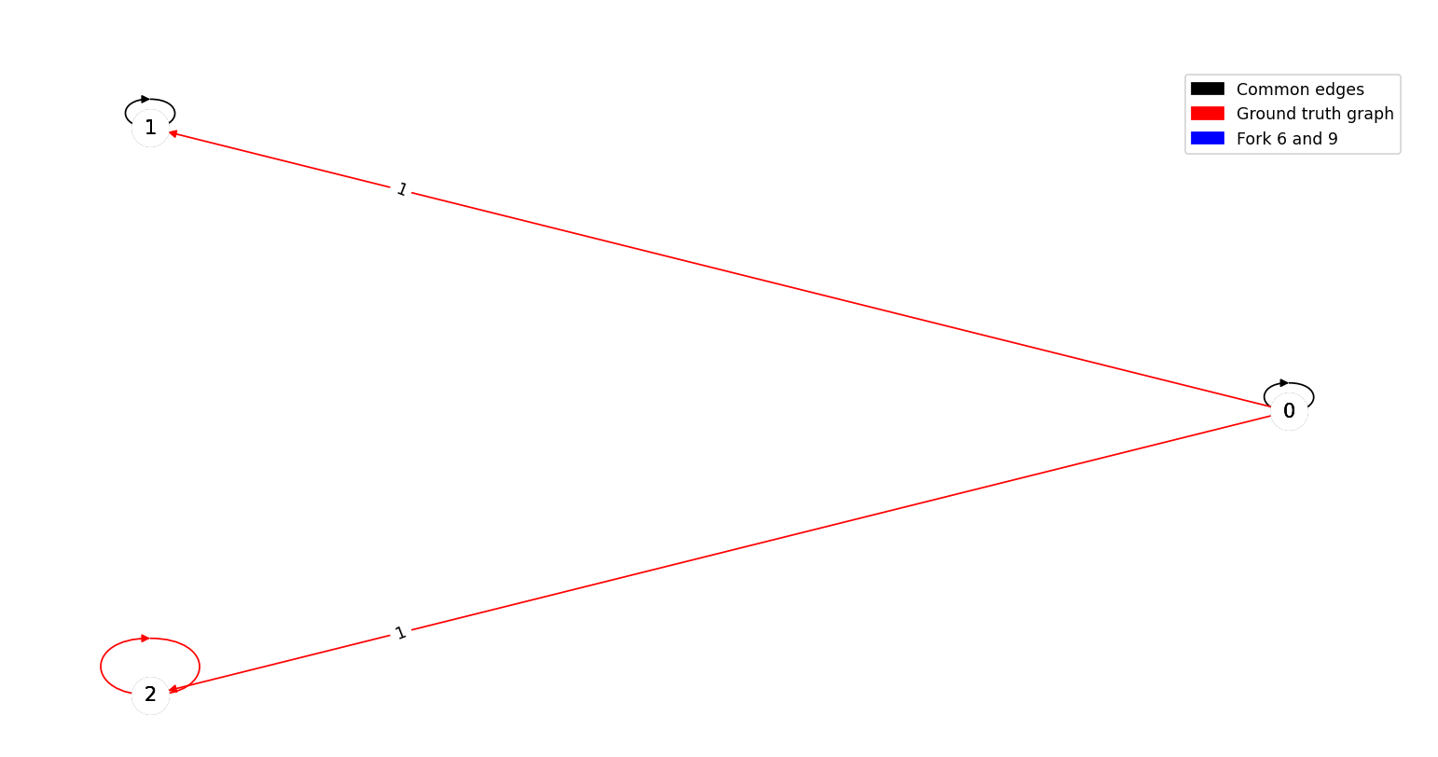
Fork
The worst predictions regarding the metrics are on set 6 and 9, which are depicted below
 | Set 0 | Set 1 | Set 2 | Set 3 | Set 4 | Set 5 | Set 6 | Set 7 | Set 8 | Set 9
MSE | 0,67 | 0,67 | 0,67 | 0,67 | 0,67 | 0,67 | 1 | 0,67 | 0,67 | 1
SID | 4 | 2 | 2 | 4 | 2 | 4 | 4 | 0 | 2 | 4

Slide 34
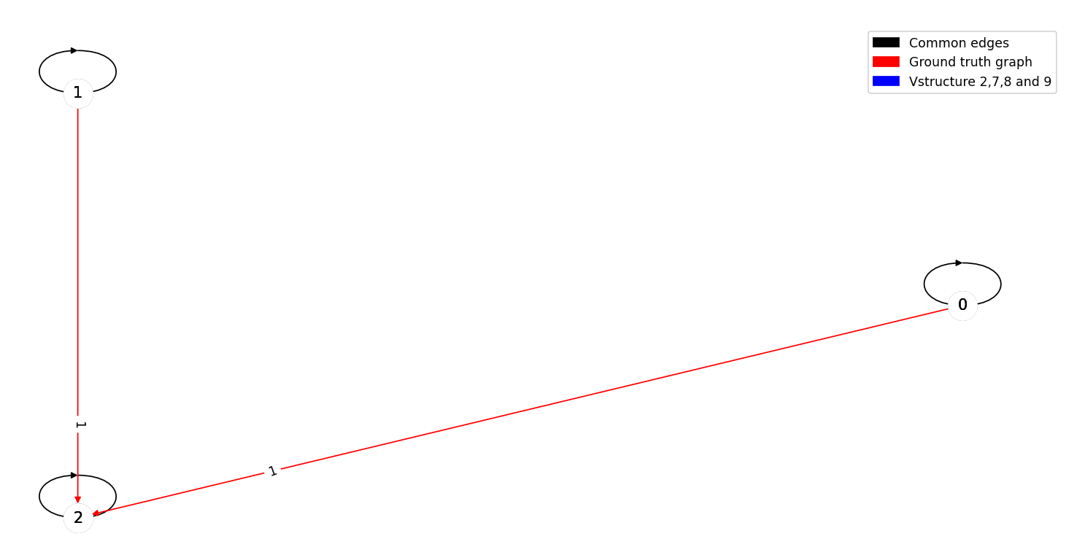
V-structure
The worst predictions regarding the metrics are on set 2,7,8 and 9, which are depicted below
 | Set 0 | Set 1 | Set 2 | Set 3 | Set 4 | Set 5 | Set 6 | Set 7 | Set 8 | Set 9
MSE | 0,33 | 1 | 0,67 | 1 | 1 | 1 | 0,67 | 0,67 | 0,67 | 0,67
SID | 1 | 1 | 2 | 1 | 2 | 2 | 1 | 2 | 2 | 2

Slide 35
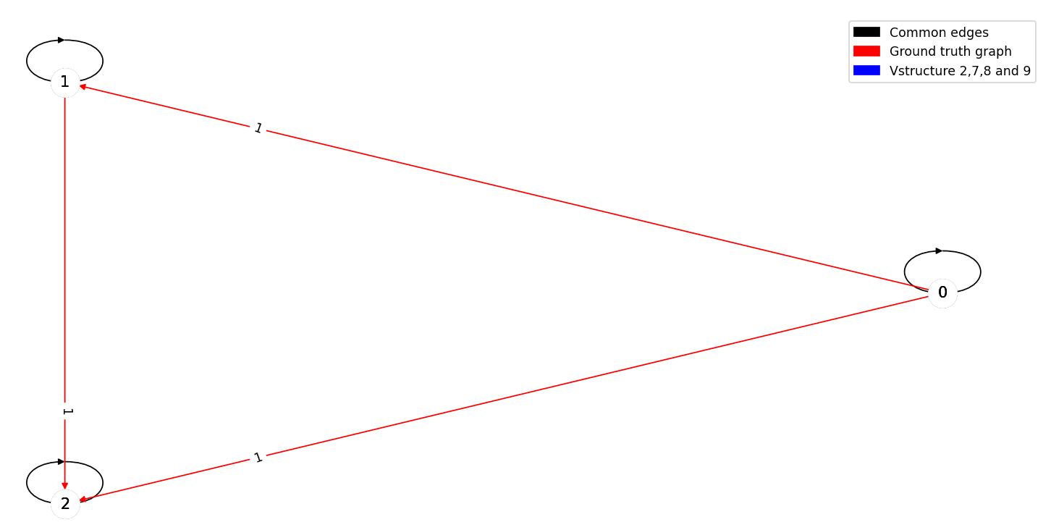
Mediator
The worst predictions regarding the metrics are on set 0,1,2,3,4,7 and 9, which are depicted below
 | Set 0 | Set 1 | Set 2 | Set 3 | Set 4 | Set 5 | Set 6 | Set 7 | Set 8 | Set 9
MSE | 1 | 1 | 1 | 1 | 1 | 0,67 | 1 | 1 | 1 | 1
SID | 4 | 4 | 4 | 4 | 4 | 3 | 3 | 4 | 3 | 4

Slide 36
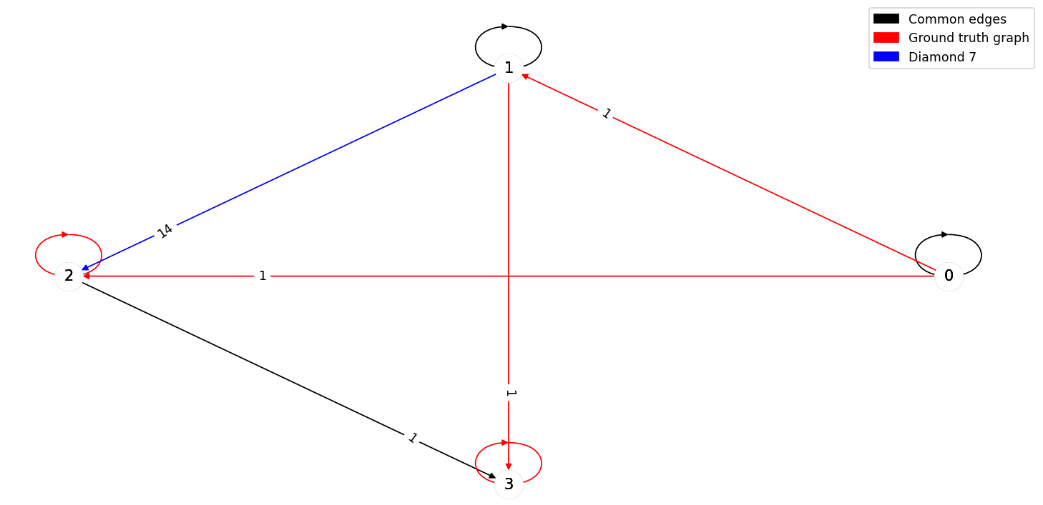
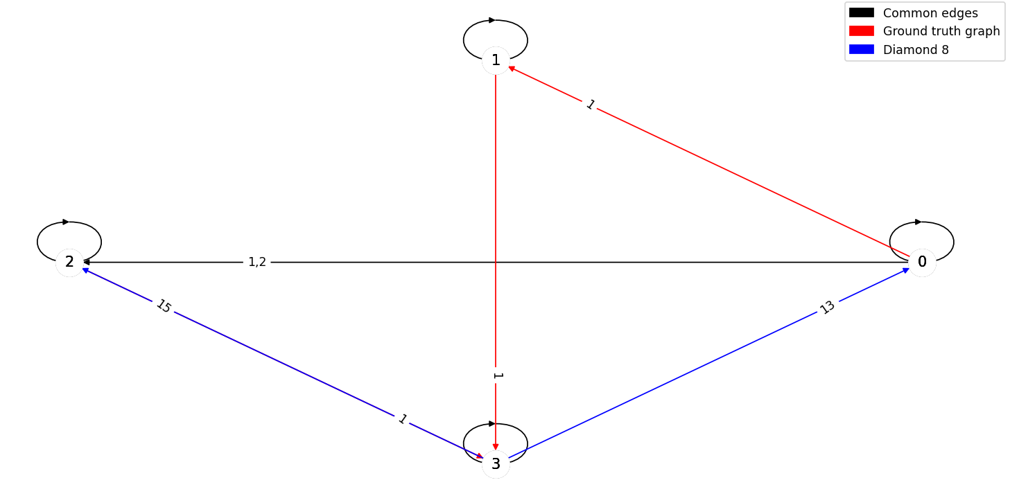
Diamond
The worst predictions regarding MSE are on set 7 (left) and 8 (right)
 | Set 0 | Set 1 | Set 2 | Set 3 | Set 4 | Set 5 | Set 6 | Set 7 | Set 8 | Set 9
MSE | 1,5 | 1,5 | 1,25 | 5,5 | 27 | 1,5 | 1,25 | 50,25 | 99,5 | 1,25
SID | 7 | 6 | 9 | 11 | 5 | 9 | 6 | 6 | 11 | 9

Slide 37
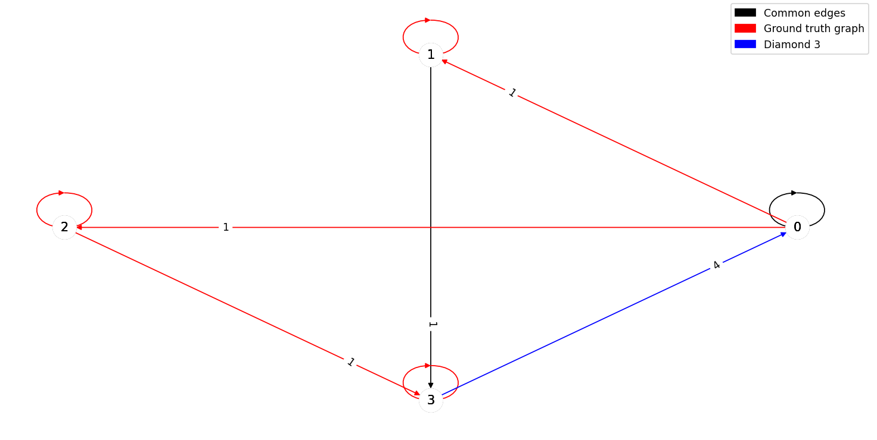
The worst predictions regarding SID are on set 3 (left) and 8 (right) regarding SID

Slide 38
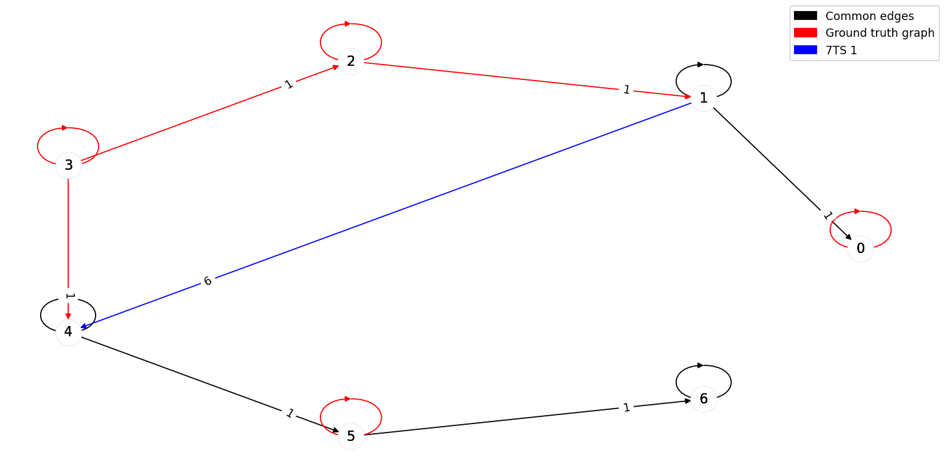
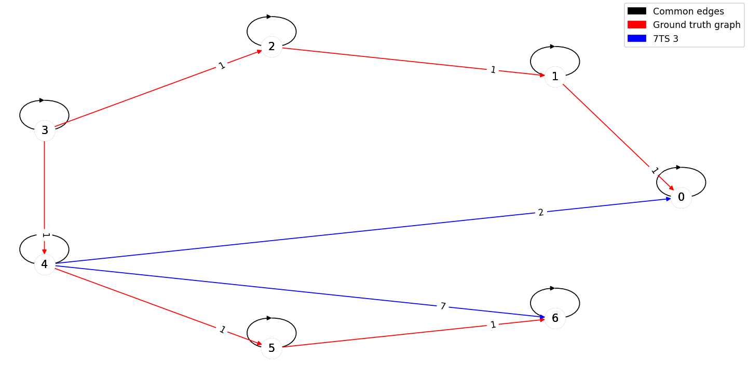
7TS
The worst predictions regarding MSE are on set 1 (left) and 3 (right)
 | Set 0 | Set 1 | Set 2 | Set 3 | Set 4 | Set 5 | Set 6 | Set 7 | Set 8 | Set 9
MSE | 1,14 | 6,14 | 1 | 8,43 | 0,71 | 1 | 0,57 | 1 | 3,43 | 0,86
SID | 16 | 11 | 24 | 22 | 13 | 15 | 20 | 24 | 24 | 24

Slide 39
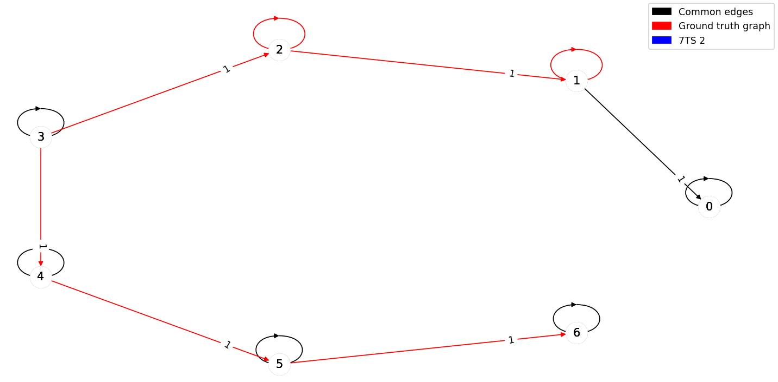
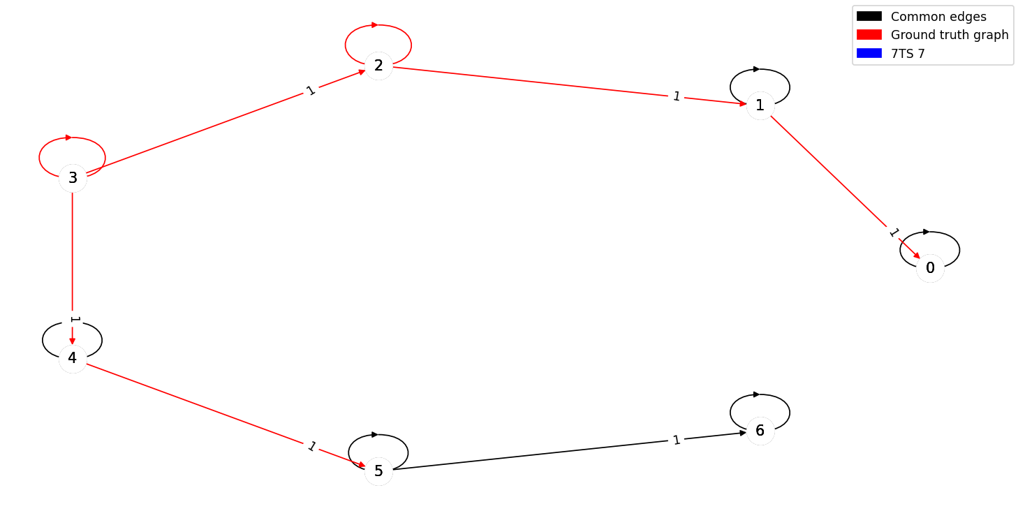


The worst predictions regarding SID are on set 2 (upper left), set 7 (upper right, set 8 (bottom left) and set 9 (bottom right)

Slide 40


7TS2H
The worst predictions regarding MSE are on set 1 (left) and 9 (right)
 | Set 0 | Set 1 | Set 2 | Set 3 | Set 4 | Set 5 | Set 6 | Set 7 | Set 8 | Set 9
MSE | 1,43 | 2 | 1,29 | 1,29 | 1,29 | 1,71 | 1,71 | 1,43 | 1,43 | 10,43
SID | 35 | 35 | 35 | 29 | 30 | 36 | 35 | 30 | 30 | 28

Slide 41




The worst predictions regarding SID are on set 0 (upper left), set 2 (upper right, set 5 (bottom left) and set 6 (bottom right)

