Slide 1
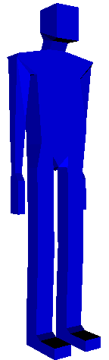
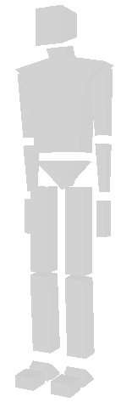
VRML Browser
VRML World
Java Script
Body
Model
Reconstruction
Animation
Sequence
Coordinates
Transformation
& Deformation
Coordinates
Vertex assignments
Event
Processing
Joint animation
Skeleton

