Slide 1
Learning decision trees
Derived from
Hwee Tou Ng, slides for Russell & Norvig, AI a Modern Approach
Tom Carter, “An introduction to information theory and Entropy”
Roger Cheng, Karrie Karahalios, Brian Bailey, “Noise, Information Theory, and Entropy”

Slide 2
Learning decision trees
Problem: decide whether to wait for a table at a restaurant, based on the following attributes:
  Alternate: is there an alternative restaurant nearby?
  Bar: is there a comfortable bar area to wait in?
  Fri/Sat: is today Friday or Saturday?
  Hungry: are we hungry?
  Patrons: number of people in the restaurant (None, Some, Full)
  Price: price range ($, $$, $$$)
  Raining: is it raining outside?
  Reservation: have we made a reservation?
  Type: kind of restaurant (French, Italian, Thai, Burger)
  WaitEstimate: estimated waiting time (0-10, 10-30, 30-60, >60)

Slide 3
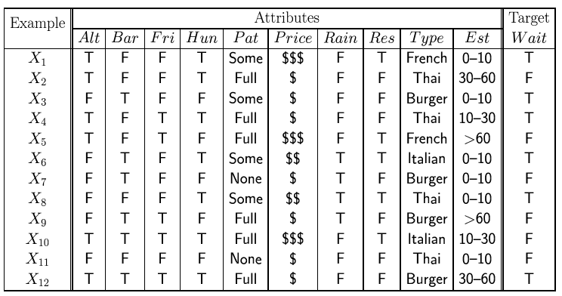
Attribute-based representations
Examples described by attribute values (Boolean, discrete, continuous)
E.g., situations where I will/won't wait for a table:
Classification of examples is positive (T) or negative (F)

Slide 4
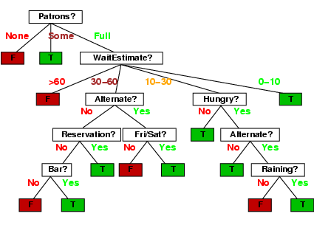
Decision trees
One possible representation for hypotheses
E.g., here is the “true” tree for deciding whether to wait:
Note that type is not considered

Slide 5
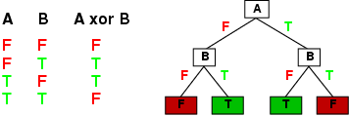
Expressiveness
Decision trees can express any function of the input attributes.
E.g., for Boolean functions, truth table row → path to leaf:
Trivially, there is a consistent decision tree for any training set with one path to leaf for each example (unless f nondeterministic in x) but it probably won't generalize to new examples
Prefer to find more compact decision trees

Slide 6
Hypothesis spaces
How many distinct decision trees with n Boolean attributes?
= number of Boolean functions of n arguments
= number of distinct truth tables with 2^{n} rows
= 2^{2n} truth tables (since each row has 2 possible function values)
E.g., with 6 Boolean attributes, there are
2²⁶ = 2⁶⁴ = 18,446,744,073,709,551,616 possible functions/trees

Slide 7
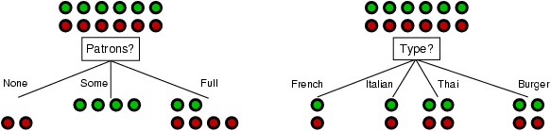
Choosing an attribute
Aim: find a small tree consistent with the training examples by looking at attributes in sequence.
Approach: (recursively) choose "most significant" attribute as root of (sub)tree, i.e., next attribute to consider.
Idea: a good attribute splits the examples into subsets that are (ideally) all positive or all negative
Patrons? is a better choice than Type?

Slide 8
Choosing an attribute (at a node)
Cases
There are no examples left. No such combination of attributes has been observed. Return a value calculated from the majority classification at the node’s parent.
All the remaining examples are positive (or all negative). We are done; can answer Yes or No.
There are examples (both positive and negative) left but no attributes. The remaining examples are identical (according to the available attributes). So these attributes are insufficient to answer the question.
The main case: there are some positive and some negative examples, choose the best attribute to split them, e.g., Patrons?

Slide 9
Decision tree learning
function DTL(examples, attributes) returns a decision tree
best  Choose-Attribute(attributes, examples)
tree  a new decision tree with root best
for each value v_{i} of best do
examples_{i}  { elements of examples with best = v_{i} }
if examples_{i} is empty then
add a leaf to tree with branch label v_{i} with value Mode(examples)
attributes_{i}  attributes – {best}
If attributes_{i} is empty or all examples_{i} have the same classification then
add a leaf to tree with branch label v_{i} with value Mode(examples_{i})
else
add DTL(examples_{i}, attributes_{i}) as a child of tree with label v_{i}
return tree
How to choose the best attribute on which to split?
Choose the one that provides the most information.
How to measure information?

Slide 10
Information theory
We want an information measure I(p) to have these properties:
Information is a non-negative quantity: I(p) ≥ 0.
If an event has probability 1, we get no information from the occurrence of the event: I(1) = 0.
If two independent events occur (whose joint probability is the product of their individual probabilities), then the information we get from observing the events is the sum of the two informations: I(p1 ∗ p2) = I(p1) + I(p2). (This is the critical property.)
We want our information measure to be a continuous (and, in fact, monotonic) function of the probability. Slight changes in probability should result in slight changes in information.

Slide 11
Information theory
The preceding implies that:
I(pª) = a ∗ I(p)
From this, we can derive the nice property:
I(p) = − log_{b}(p) = log_{b} (1/p)
for some base b.
Since p ≤ 1, log_{b}(p) < 0.
So1/p ≥ 1 and, log_{b}(1/p) ≥ 0.
If b = 2, then the value is in bits.

Slide 12
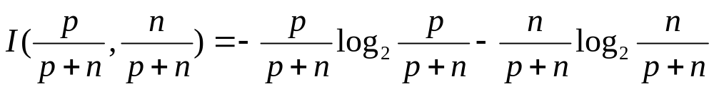
Use information theory to implement Choose-Attribute
Information content (also known as entropy):
I(p(v₁), … , p(v_{n})) = Σ_{i=1} -p(v_{i}) log₂ p(v_{i})
where p(v_{i}) is the probability of value v_{i}
For a training set containing p positive examples and n negative examples:
Note: since p/(p+n) < 1, log₂ p/(p+n) < 0.
Note: if either p or n is zero, the other is 1 (no information).
  Hence I(p/(p+n), n/(p+n)) = 0.
Note: if p = n, I(½, ½) = 2*(½)*log₂(2) = 1.

Slide 13
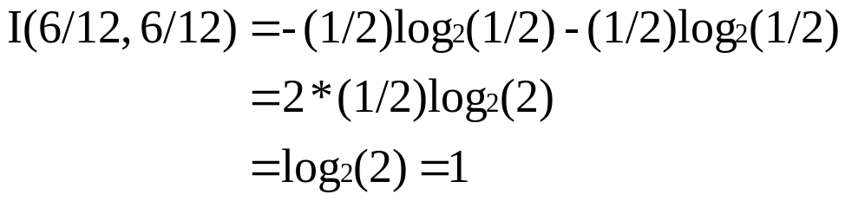
Use information theory to implement Choose-Attribute
I(p(v₁), … , p(v_{n})) is the number of bits needed to characterize the typical element. In our case: yes or no.
For the training set, p = n = 6,

Slide 14
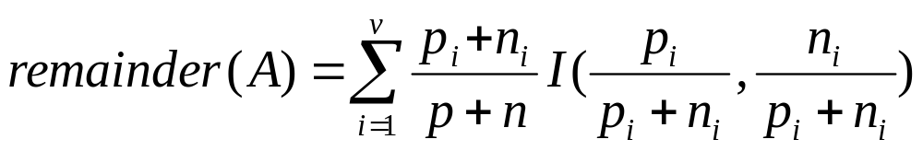
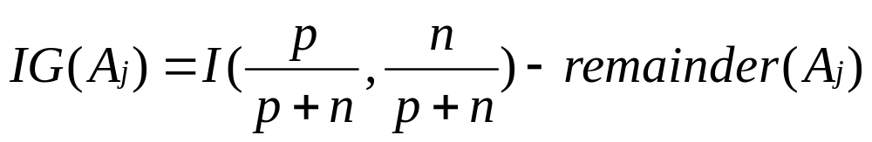
Information gain
A chosen attribute A_{j} divides the training set E into subsets E₁, … , E_{v} according to their values for A_{j}, where A_{j} has v distinct values.
This is the weighted sum of the information in the subnodes.
Information Gain (IG) (or reduction in entropy) from the attribute test: entropy of node – entropy of subnodes
Choose the attribute A_{j} with the largest IG, i.e., where the weighted sum of the entropies in the remaining subnodes is smallest, i.e., least amount of entropy left.
_{j}

Slide 15
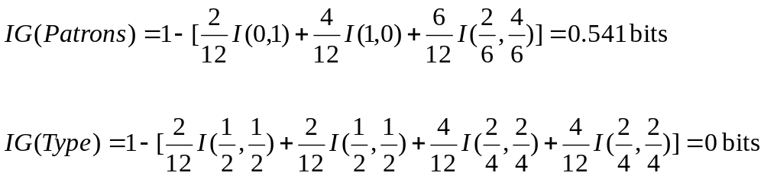
Information gain
For the training set, p = n = 6,
Consider the attributes Patrons and Type (and others too):
Patrons has the highest IG of all attributes and so is chosen by the DTL algorithm as the root

Slide 16
Attribute-based representations
Examples described by attribute values (Boolean, discrete, continuous)
E.g., situations where I will/won't wait for a table:
Classification of examples is positive (T) or negative (F)

Slide 17
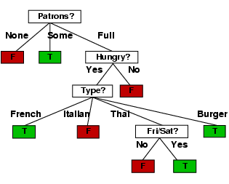
Example contd.
Decision tree derived from the 12 examples:
Substantially simpler than the “true” tree. A more complex hypothesis isn’t justified by the small amount of data
Not a very logical tree!
Overfits the data!

Slide 18
Original “true” tree
13 leaves but only 12 example instances. Some of the leaves must be empty!

Slide 19
Extras

Slide 20
Summary
Learning needed for unknown environments, lazy designers
Learning agent = performance element + learning element
For supervised learning, the aim is to find a simple hypothesis approximately consistent with training examples
Decision tree learning using information gain
Learning performance = prediction accuracy measured on test set

Slide 21
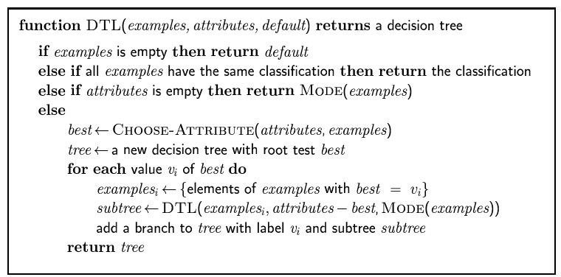
Decision tree learning
How to choose the best attribute on which to split?
Choose the one that gives us the most information.
How to measure information?

Slide 22
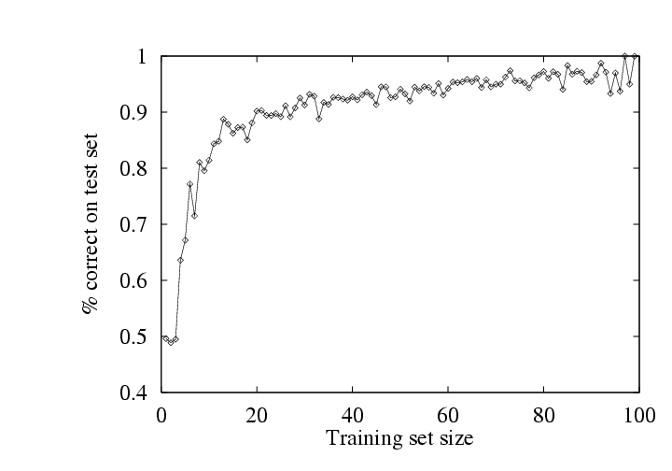
Performance measurement
How do we know that h ≈ f ?
  Use theorems of computational/statistical learning theory
  Try h on a new test set of examples
    (use same distribution over example space as training set)
Learning curve = % correct on test set as a function of training set size

Slide 23
Example
Assume alphabet K of
{A, B, C, D, E, F, G, H}
In general, if we want to distinguish n different symbols, we will need to use, log2n bits per symbol, i.e. 3 since there are 8 symbols.
Can code alphabet K as:
A 000 B 001 C 010 D 011
E 100 F 101 G 110 H 111

Slide 24
Example
“BACADAEAFABBAAAGAH” is encoded as the string of 54 bits
001000010000011000100000101000001001000000000110000111
(fixed length code)

Slide 25
Example
But since the letters don’t appear equally often, can create a more efficient code.
A (8), B (3), C(1), D(1), E(1), F(1), G(1), H(1)
With this coding:
A 0 B 100 C 1010 D 1011
E 1100 F 1101 G 1110 H 1111
100010100101101100011010100100000111001111
42 bits, saves more than 20% in space

Slide 26
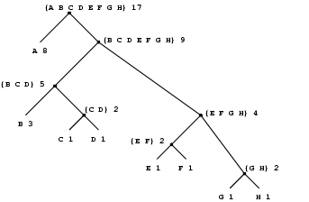
Huffman Tree
A (8), B (3), C(1), D(1), E(1), F(1), G(1), H(1)

