Slide 1
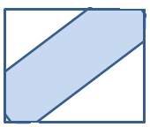
(1,0,1,1,1)
(1,0,1,0,0)
L, C, X
L,X
L,
L,K
C
C,O,B
(0,0,0)
(0,1,0)
O
(1,0,1,1,1)
(1,1,0,1,1)
(0,1,0,0,0)
(0,1,0,1,1)
L,K,C,B
L,O,C,B
O
O, C,B
O
K
K,L,C,B
K,L
(0,0,0,0,0)
K,L,O,C,B

