Slide 1
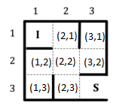
I
(2,1)
(2,2)
I
(3,2)
(2,3)
(2,1)
(1,2)
(2,2)
(3,1)
S
(2,2)
I
(2,2)
(1,3)

