Slide 1
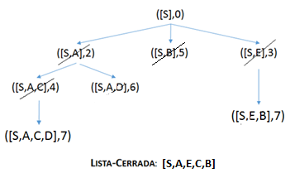
([S],0)
([S,A],2)
([S,B],5)
([S,E],3)
LISTA-CERRADA: [S]
([S,A,C],4)
([S,A,D],6)
[S,A]
[S,A,C]
([S,E,B],7)
[S,A,C,B]
([S,A,C,D],7)
([S,B,D],6)
([S,B,G],10)
[S,A,C,B,D]
([S,A,D,G],8)

