Slide 1


Deep Learning Theory and Applications Universality of Neural Networks
CPSC/AMTH 663

Slide 2
Outline
Universality with one input and one output
Many inputs
Wrap-up
Beyond sigmoid functions
Fixing step functions
The Johnson-Lindenstrauss lemma

Slide 3
Neural Networks
We’ve seen them used in translating language, generating music, dance, understanding dynamic systems, interpreting images
Is this real? Can neural networks really learn all of these things?

Slide 4
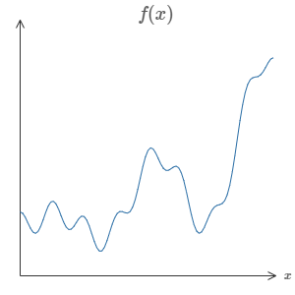
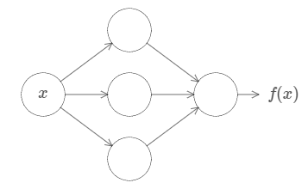

Universality of neural networks
Neural networks can compute (almost) any function
No matter the function, there is guaranteed to be a neural network that for every possible input $x$, the network closely approximates $f(x)$

Slide 5
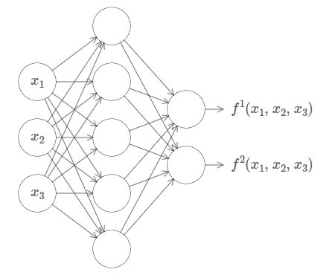
Universality of neural networks
Also applies to functions with many inputs and many outputs

Slide 6
Universality of neural networks
In other words, neural networks have a universality
No matter what function we want to compute, there is a neural network that can do it
This is true for networks with only a single hidden layer
Today, we’ll give a simple and visual explanation of the universality theorem

Slide 7
A note on universality
Almost any process can be thought of as function computation
Examples:
Name a piece of music based on a short sample
Translate Chinese text to English
There may be many possible functions
Generate a plot description from a movie file
Universality means that neural networks can do all of these things and more
However, this doesn’t mean that we have good techniques for constructing or even recognizing such a network
SGD may not easily get to the solution
Notes:
But the combination of learning algorithms we’ve covered and universality is an attractive mix

Slide 8
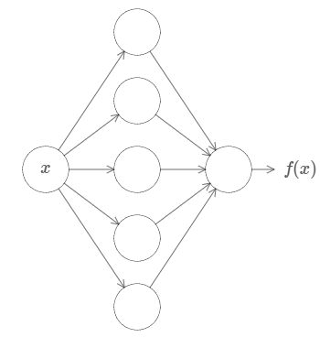
Approximation
Neural networks can’t exactly compute any function
Rather we can get an approximation that is as good as we want
Increasing the number of hidden neurons can improve the approximation
Can do better with even more hidden neurons
Poor approximation
Better approximation

Slide 9
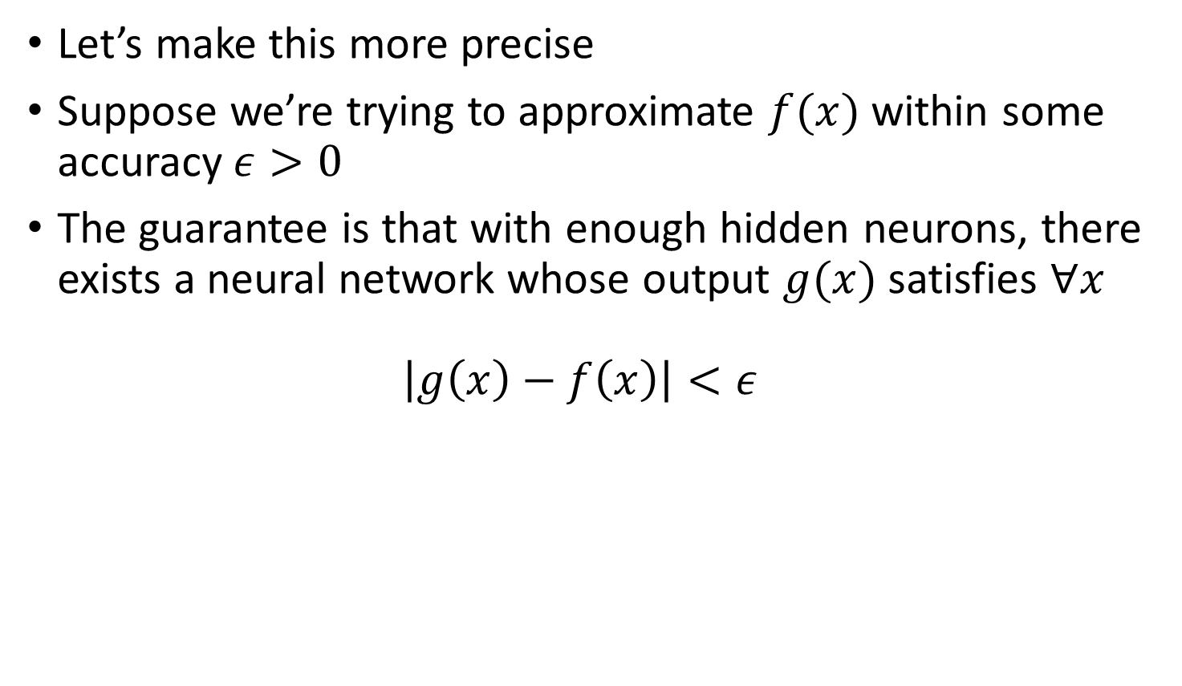
Within epsilon threshold
Let’s make this more precise
Suppose we’re trying to approximate $f(x)$ within some accuracy $ε>0$
The guarantee is that with enough hidden neurons, there exists a neural network whose output $g(x)$ satisfies $∀x$ $\left|g\left(x\right)−f\left(x\right)\right|<ε$

Slide 10
Continuous functions
Second, we can only guarantee this accuracy for continuous functions
If a function is discontinuous, then it won’t be generally possible to approximate it at each point since the neural network output is continuous
However, often a continuous approximation of a discontinuous function is good enough

Slide 11
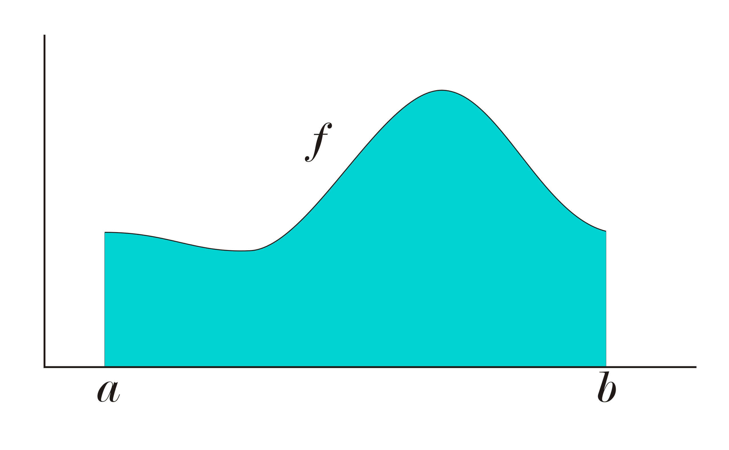
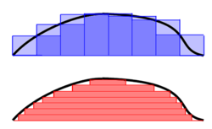

Lebesgue Integrable
Consider the $L^{1}\left(\left(a,b\right)\right)$ space: the set of functions that are absolutely (Lebesgue) integrable on the interval $\left(a,b\right)$
I.e. $f∈L^{1}\left(\left(a,b\right)\right)⇒$ $\int_{a}^{b}{\left|f\left(x\right)\right|dx}<∞$
This includes some functions that are nowhere continuous
Reimann Integral
Lebesgue Integral

Slide 12
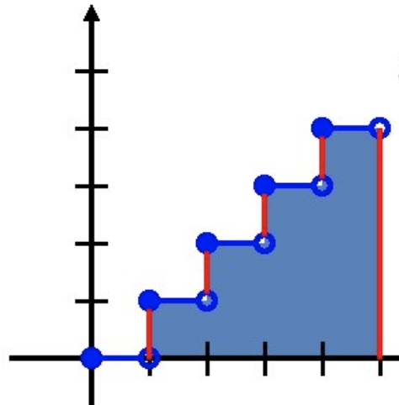
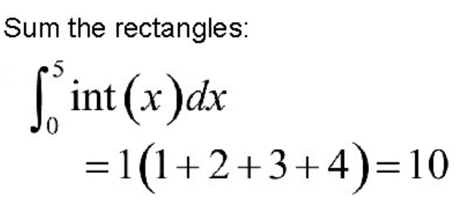
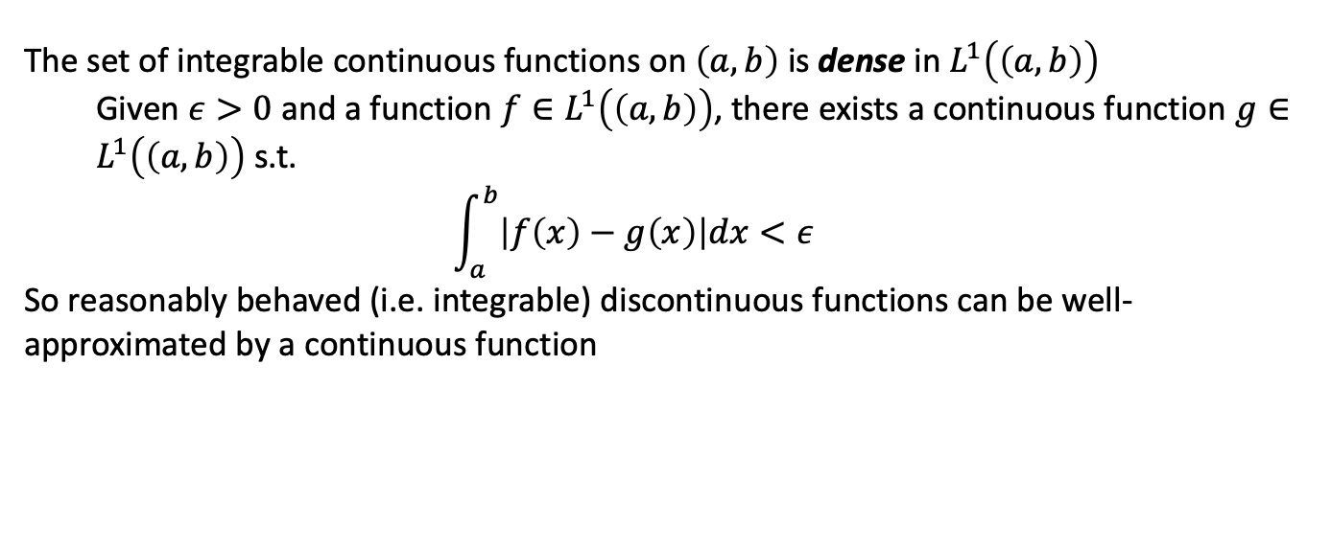
Discontinuous integrable function
The set of integrable continuous functions on $\left(a,b\right)$ is dense in $L^{1}\left(\left(a,b\right)\right)$
Given $ε>0$ and a function $f∈L^{1}\left(\left(a,b\right)\right)$, there exists a continuous function $g∈L^{1}\left(\left(a,b\right)\right)$ s.t. $$\int_{a}^{b}{\left|f\left(x\right)−g\left(x\right)\right|dx}<ε$$
So reasonably behaved (i.e. integrable) discontinuous functions can be well-approximated by a continuous function

Slide 13
Cybenko’s theorem 1989
Neural networks with a single hidden layer can be used to approximate any continuous function to any desired precision
Analogy to logic functions
Two layered logic functions can compute any logic given the right logic gate set (i.e. non-linear activation)

Slide 14
Logic Proof Idea
Look at truth table
Have to be able to make arbitrary inputs 0 and 1
INPUT | OUTPUT
000 | 0
001 | 1
010 | 0
001 | 1
100 | 0
101 | 1
110 | 1
111 | 1

Slide 15
Universality with one input and one output
Notes:
Once we understand this special case, it’s pretty easy to extend to functions with many inputs and outputs

Slide 16
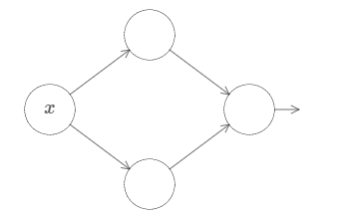
One input, one output
Start simple
Notes:
We’ll start with this simple network with two hidden neurons and a single output neuron

Slide 17
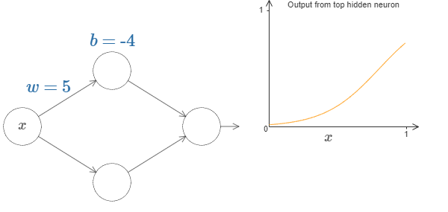
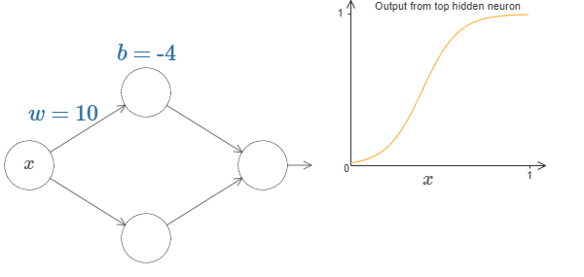

One input, one output
Increase $w$
Notes:
Increasing w changes the shape of the output of the neuron

Slide 18
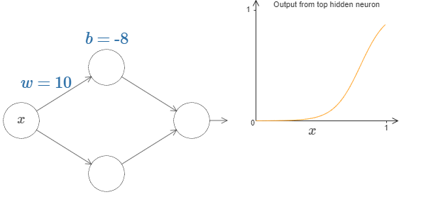

One input, one output
Decrease $b$
Notes:
Decreasing b only shifts the output around but doesn’t change the shape

Slide 19
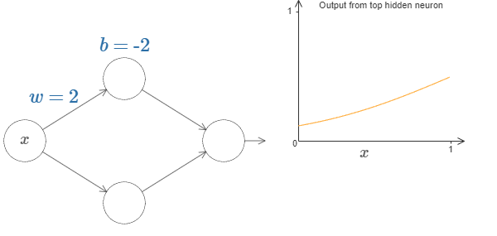

One input, one output
Decrease $w$
Notes:
Decreasing w broadens the curve

Slide 20
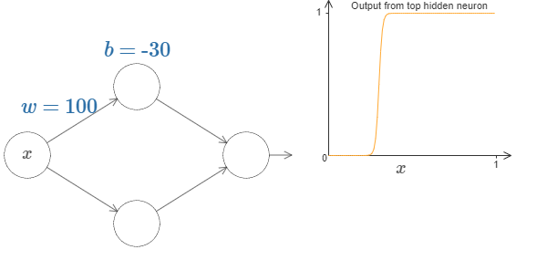

One input, one output
Increase $w$
Notes:
It starts to look like a step function

Slide 21
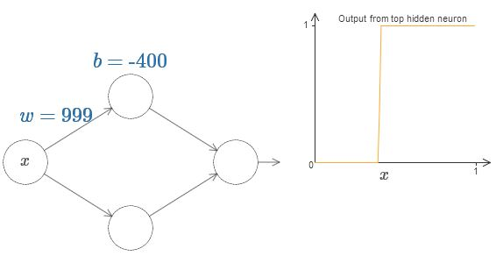
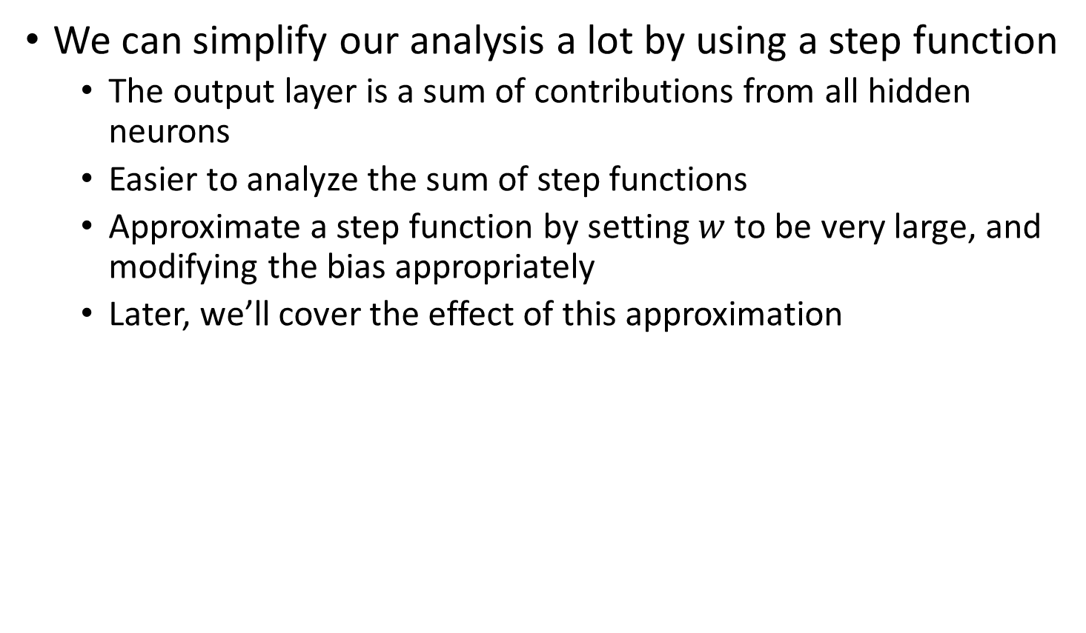
One input, one output
We can simplify our analysis a lot by using a step function
The output layer is a sum of contributions from all hidden neurons
Easier to analyze the sum of step functions
Approximate a step function by setting $w$ to be very large, and modifying the bias appropriately
Later, we’ll cover the effect of this approximation

Slide 22
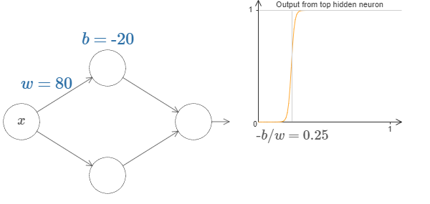
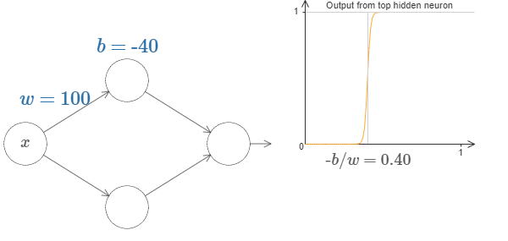

One input, one output
Where does the step occur?
The position of the step is proportional to $b$ and inversely proportional to $w$
The step is at position $s=−\frac{b}{w}$

Slide 23
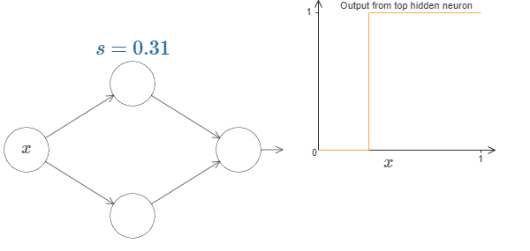
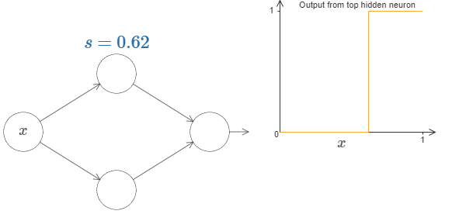

One input, one output
We can simplify things by using a step function with parameter $s$
I.e., we set $w$ to be some very large value and then adjust $b$
Recover $b=−ws$

Slide 24
One input, one output
Let’s add the bottom node now
http://neuralnetworksanddeeplearning.com/chap4.html#universality_with_one_input_and_one_output

Slide 25

One input, one output
Challenge: approximate this function
$$f\left(x\right)=0.2+0.4x^{2}+0.3x\sin\left(15x\right)+0.05\cos\left(50x\right)$$
Range and domain are $\left[0,1\right]$

Slide 26
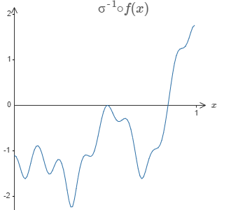
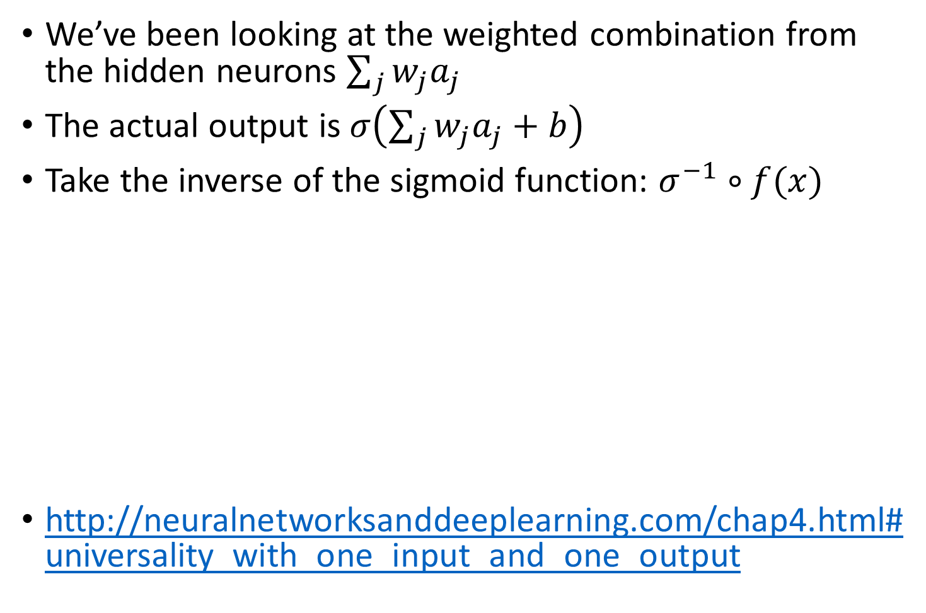
One input, one output
We’ve been looking at the weighted combination from the hidden neurons $\sum_{j}{w_{j}a_{j}}$
The actual output is $σ\left(\sum_{j}{w_{j}a_{j}}+b\right)$
Take the inverse of the sigmoid function: $σ^{−1}∘f(x)$
http://neuralnetworksanddeeplearning.com/chap4.html#universality_with_one_input_and_one_output

Slide 27
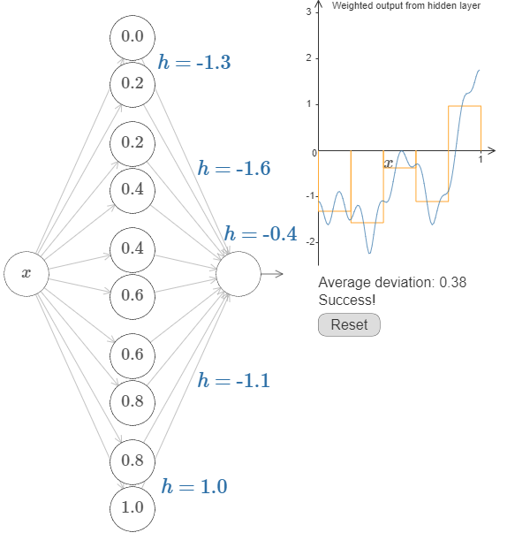
One input, one output

Slide 28

One input, one output
How do we convert back to standard parameterization?
Set $w=1000$ for first layer of weights
Biases on hidden neurons are $b=−ws$
Final layer of weights come from the $±h$ values
Bias on the output neuron is 0
Notes:
Maybe do this on the board for the previous slide

Slide 29
Many inputs

Slide 30
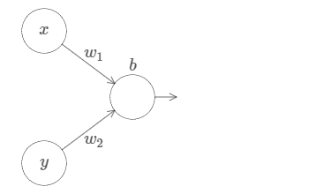
Two inputs
http://neuralnetworksanddeeplearning.com/chap4.html#many_input_variables

Slide 31
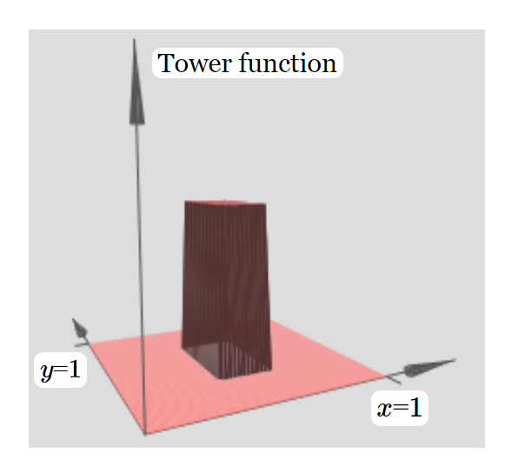
Two inputs
We’ve built something that looks a little like a tower function

Slide 32
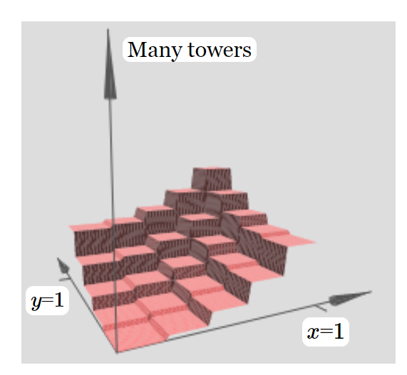
Two inputs
We can approximate arbitrary functions by adding towers of different heights in different locations

Slide 33
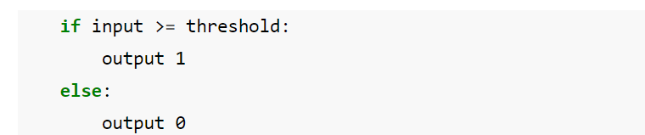
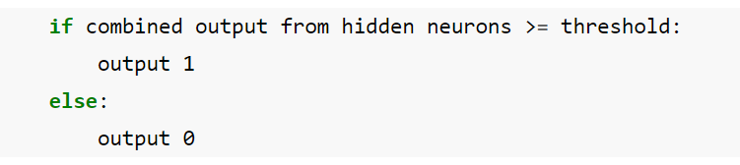
Two inputs
With step functions, we’ve been implementing an if-then-else statement with neurons:
We can generalize this for multiple inputs:
If we choose an appropriate threshold, we can squash the plateau down and leave only the tower

Slide 34
Two inputs
Let’s make a tower
http://neuralnetworksanddeeplearning.com/chap4.html#many_input_variables
Notes:
Choose about b=-3h/2

Slide 35
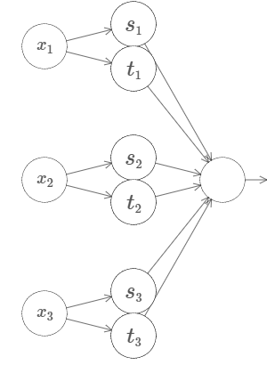
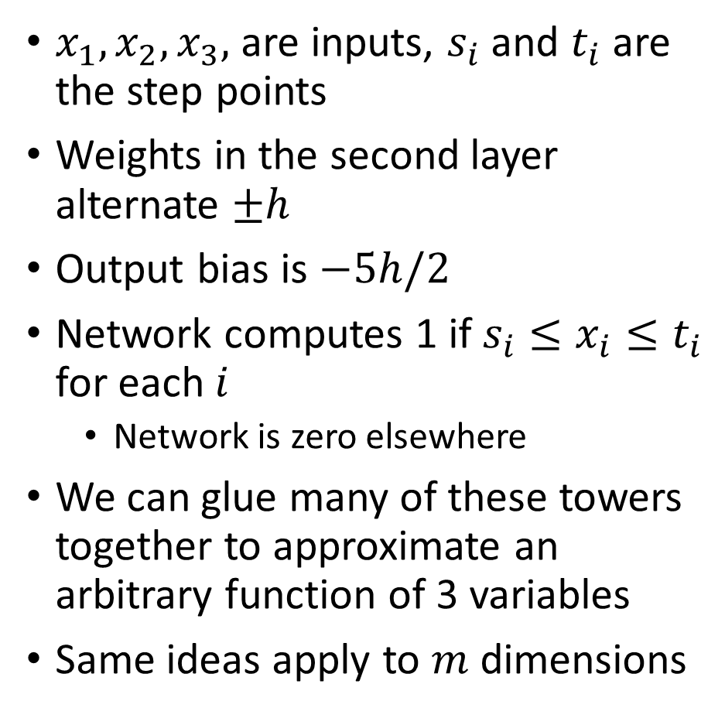
Three inputs
$x_{1}, x_{2}, x_{3},$ are inputs, $s_{i}$ and $t_{i}$ are the step points
Weights in the second layer alternate $±h$
Output bias is $−5h/2$
Network computes 1 if $s_{i}≤x_{i}≤t_{i}$ for each $i$
Network is zero elsewhere
We can glue many of these towers together to approximate an arbitrary function of 3 variables
Same ideas apply to $m$ dimensions

Slide 36
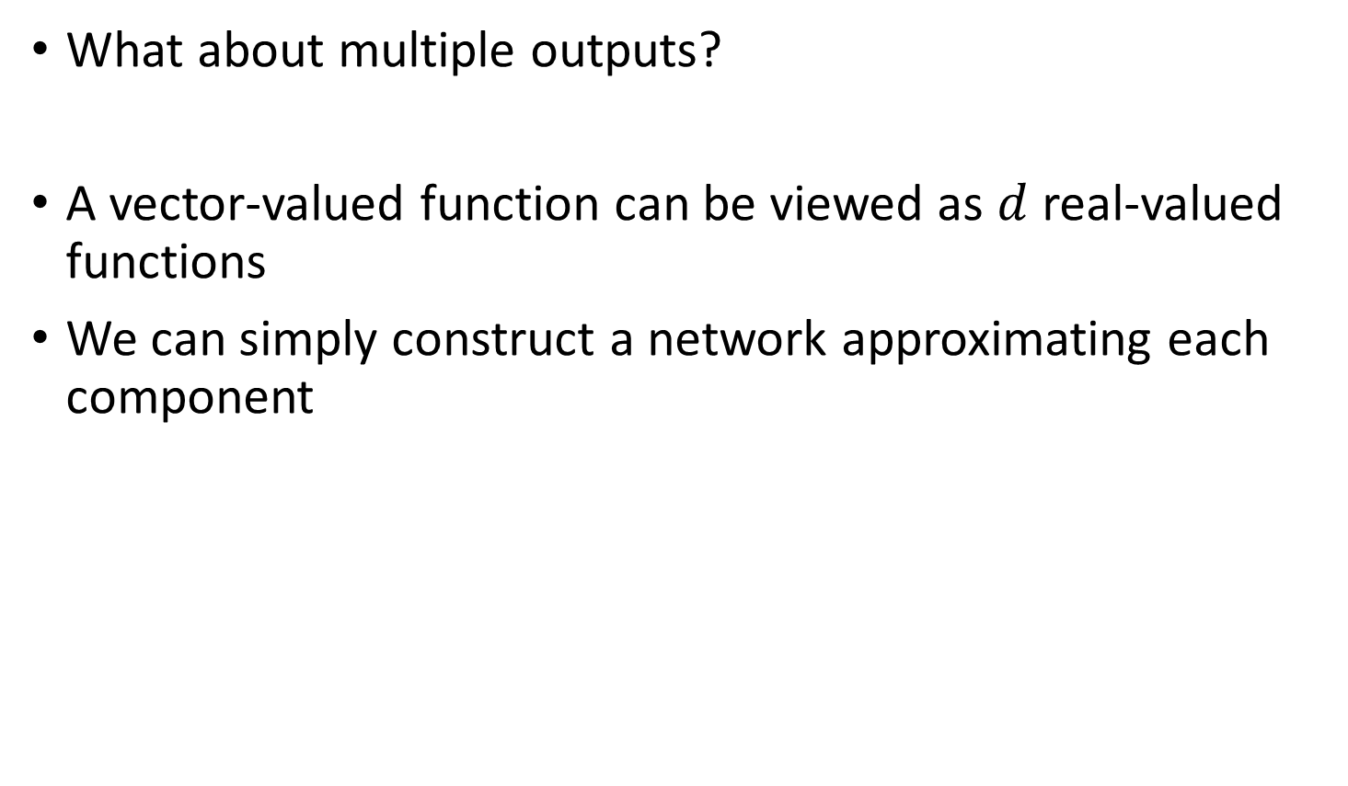
Multiple outputs
What about multiple outputs?
A vector-valued function can be viewed as $d$ real-valued functions
We can simply construct a network approximating each component

Slide 37
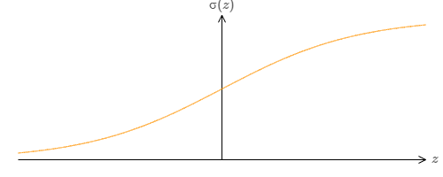
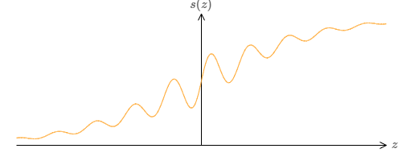
Beyond sigmoid neurons
What if we used this instead:

Slide 38
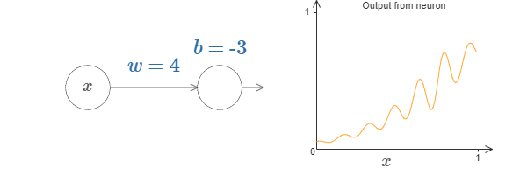
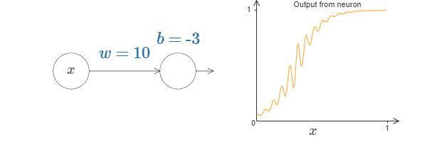
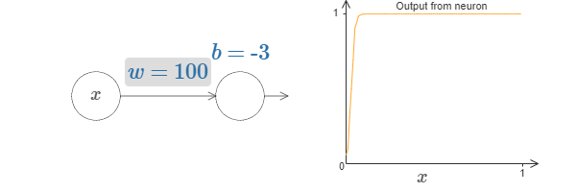
Beyond sigmoid neurons
Increasing the weight gives an approximation of a step function
Changing the bias changes the position of the step

Slide 39
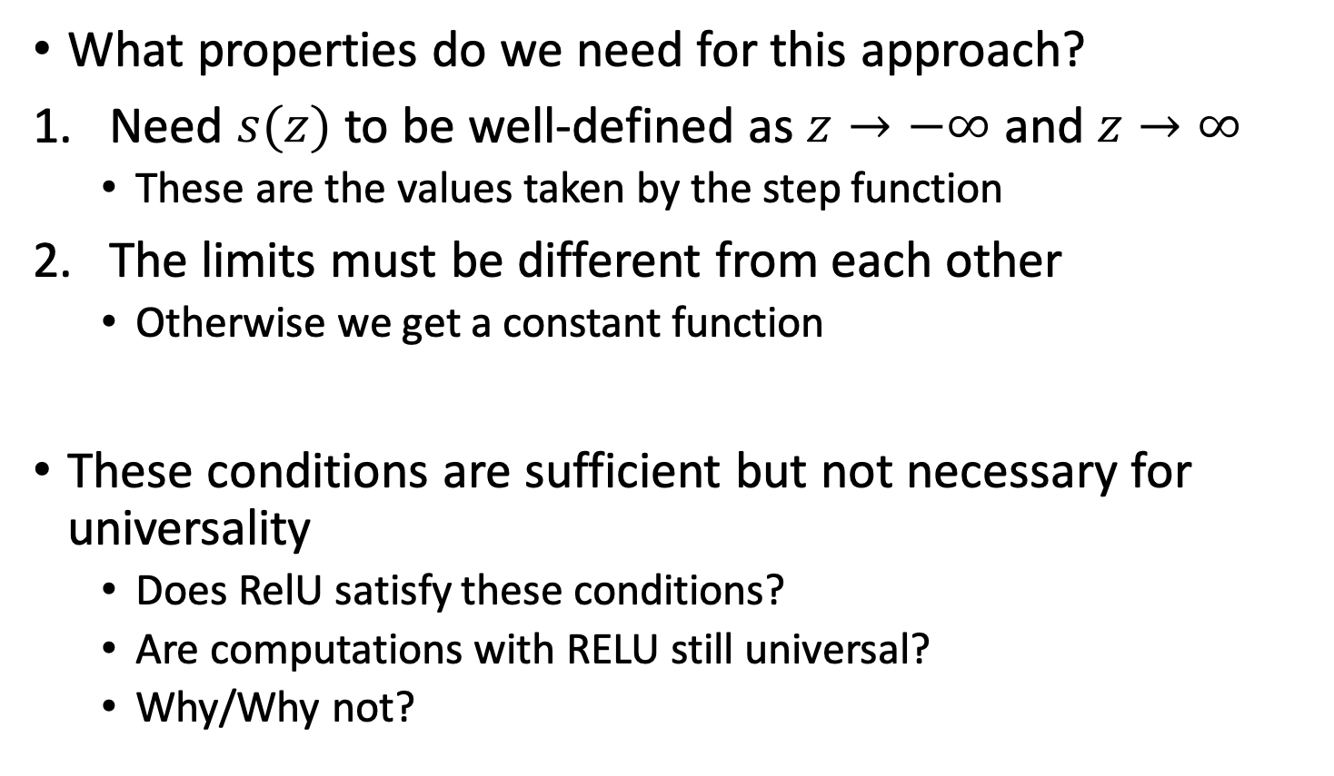
Beyond sigmoid neurons
What properties do we need for this approach?
Need $s(z)$ to be well-defined as $z→−∞$ and $z→∞$
These are the values taken by the step function
The limits must be different from each other
Otherwise we get a constant function
These conditions are sufficient but not necessary for universality
Does RelU satisfy these conditions?
Are computations with RELU still universal?
Why/Why not?

Slide 40
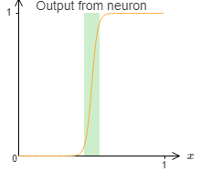
Fixing the step functions
We’ve been assuming our neurons produce exact step functions
We actually only get an approximation
There’s a narrow window of failure
We can increase the weights to make the window small
But is there a better way?

Slide 41
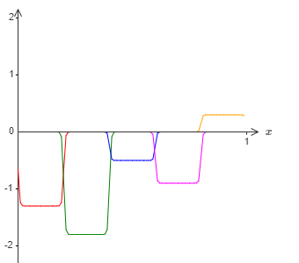
Fixing the step functions
Consider the function from before
We can approximate it with a sequence of bump functions
Windows of failure have been exaggerated for demonstration
We get a reasonable approximation except within the windows of failure

Slide 42
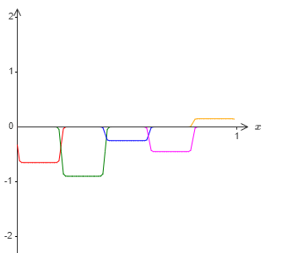
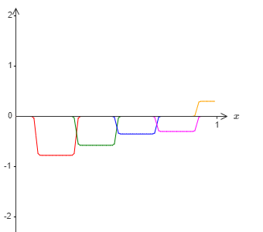
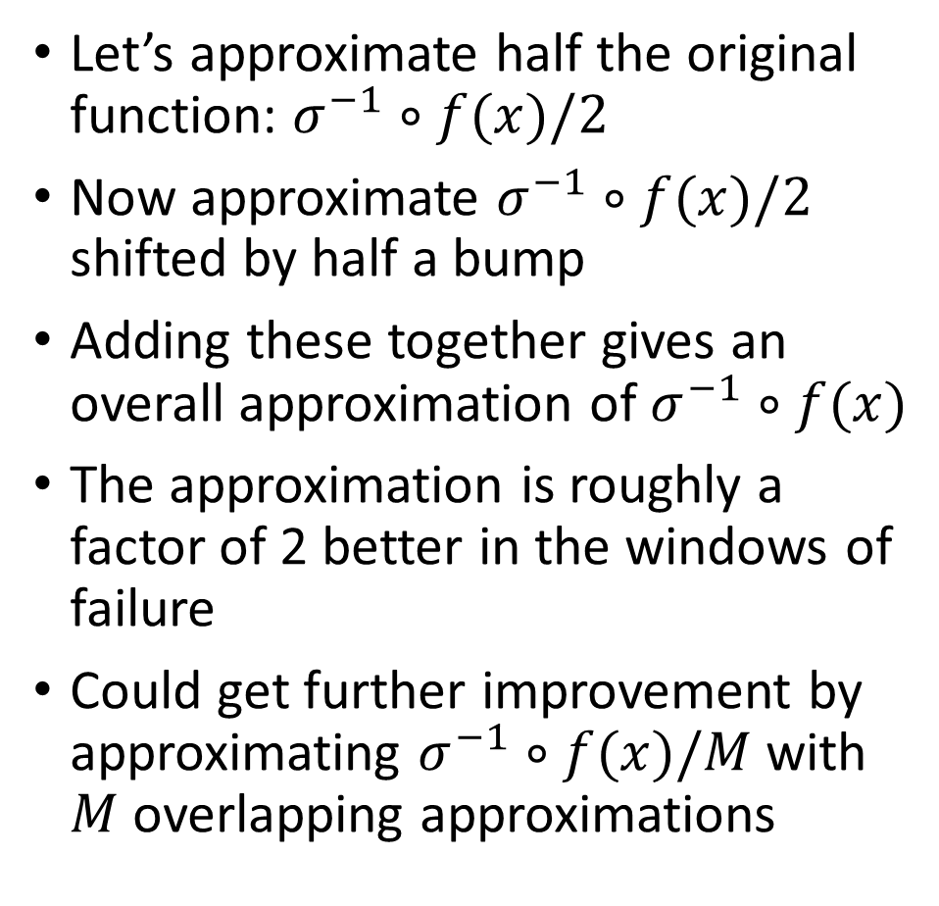
Fixing the step functions
Let’s approximate half the original function: $σ^{−1}∘f(x)/2$
Now approximate $σ^{−1}∘f(x)/2$ shifted by half a bump
Adding these together gives an overall approximation of $σ^{−1}∘f(x)$
The approximation is roughly a factor of 2 better in the windows of failure
Could get further improvement by approximating $σ^{−1}∘f(x)/M$ with $M$ overlapping approximations

Slide 43
Computability not design
This explanation does not give a good prescription for designing neural networks!
Thus the result isn’t directly useful for constructing networks
However, universality answers the question of whether any particular function is computable with a neural network
This changes the question to whether there is a good way to compute the function

Slide 44
Universal Approximation Theorem
Case of single hidden layer neural networks with sigmoidal activations proven by Cybenko in 1989 (sometimes called Cybenko’s Theorem)
Later generalized to other non-linearities in 1991
A neural network with one hidden layer containing a sufficient but finite number of neurons can approximate any continuous function to a reasonable accuracy, under certain conditions for activation functions (namely, that they must be sigmoid-like).

Slide 45
Wrap-up
If single layer network is universal, why use deep networks?
Note that our universality explanation required many hidden neurons
Earlier in the class, we argued that the hierarchical structure of deep networks is also helpful
Summary:
Universality tells us neural networks can compute any function
Empirical evidence suggests deep networks are best adapted to learn those functions in practice

Slide 46
Further reading
Nielsen book, chapter 4
https://www.mathematik.uni-wuerzburg.de/fileadmin/10040900/2019/Seminar__Artificial_Neural_Network__24_9__.pdf

