Slide 1


Deep Learning Theory and Applications Gradient Descent
CBB/AMTH 663
CPSC 452/552

Slide 2
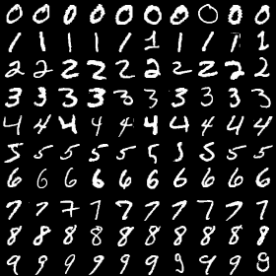
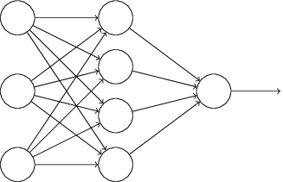
Classifying handwritten digits
Goal: learn the weights and biases in a network to perform handwritten digit recognition
Input
Digit Classification

Slide 3
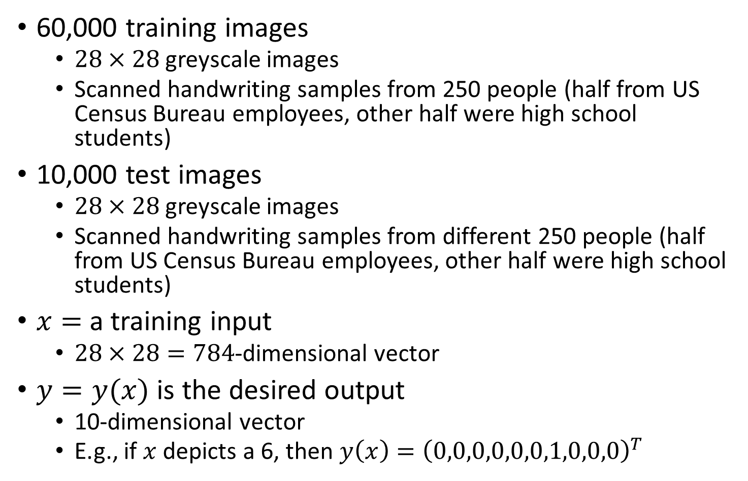
MNIST data set
60,000 training images
$28×28$ greyscale images
Scanned handwriting samples from 250 people (half from US Census Bureau employees, other half were high school students)
10,000 test images
$28×28$ greyscale images
Scanned handwriting samples from different 250 people (half from US Census Bureau employees, other half were high school students)
$x=$ a training input
$28×28=784$-dimensional vector
$y=y(x)$ is the desired output
10-dimensional vector
E.g., if $x$ depicts a 6, then $y\left(x\right)={\left(0,0,0,0,0,0,1,0,0,0\right)}^{T}$

Slide 4
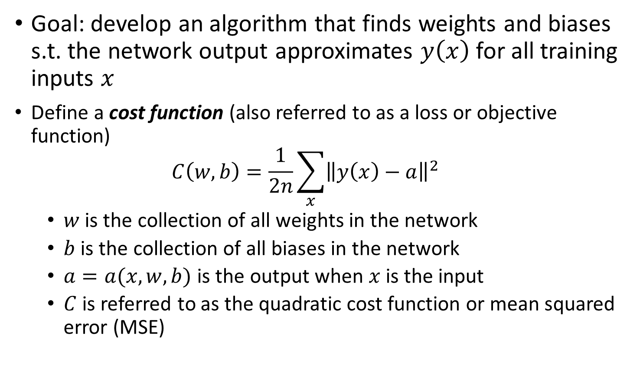
Cost function
Goal: develop an algorithm that finds weights and biases s.t. the network output approximates $y\left(x\right)$ for all training inputs $x$
Define a cost function (also referred to as a loss or objective function)
$$C\left(w,b\right)=\frac{1}{2n}\sum_{x}{{\left\|y\left(x\right)−a\right\|}^{2}}$$
$w$ is the collection of all weights in the network
$b$ is the collection of all biases in the network
$a=a(x,w,b)$ is the output when $x$ is the input
$C$ is referred to as the quadratic cost function or mean squared error (MSE)

Slide 5
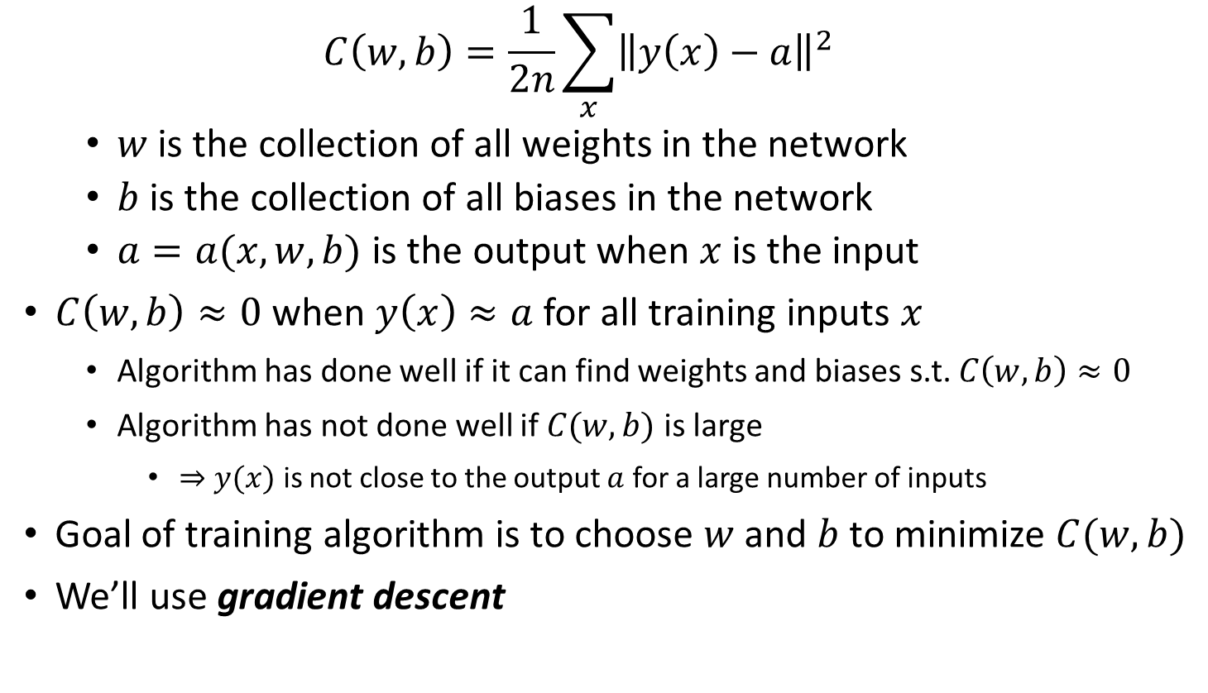
Cost function
$$C\left(w,b\right)=\frac{1}{2n}\sum_{x}{{\left\|y\left(x\right)−a\right\|}^{2}}$$
$w$ is the collection of all weights in the network
$b$ is the collection of all biases in the network
$a=a(x,w,b)$ is the output when $x$ is the input
$C\left(w,b\right)≈0$ when $y\left(x\right)≈a$ for all training inputs $x$
Algorithm has done well if it can find weights and biases s.t. $C\left(w,b\right)≈0$
Algorithm has not done well if $C(w,b)$ is large
$⇒y(x)$ is not close to the output $a$ for a large number of inputs
Goal of training algorithm is to choose $w$ and $b$ to minimize $C(w,b)$
We’ll use gradient descent

Slide 6
Cost function
Why use MSE?
Why not use 0-1 loss or average probability of error?
0-1 loss is not a smooth function of the weights and biases
Difficult to change weights and biases to improve performance as measured by this loss
Small changes in weights and biases can result in small improvements to MSE
We can figure out which direction to go
Notes:
For the most part, making small changes to the weights and biases won't cause any change at all in the number of training images classified correctly. That makes it difficult to figure out how to change the weights and biases to get improved performance.

Slide 7
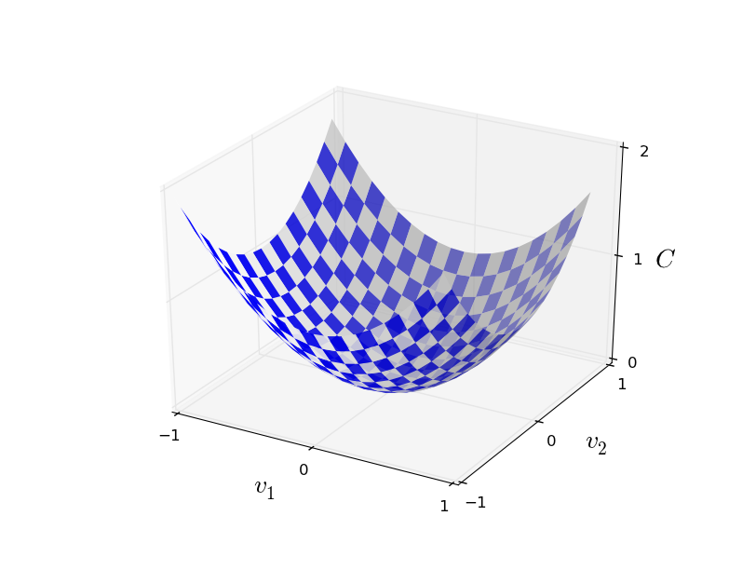

Gradient descent
How do we minimize a cost function in general?
Suppose we want to minimize some function $C\left(v\right)$
$v=v_{1},v_{2},…$
Minimum
Notes:
Goal is to find the minimum of the cost function. In this case, if we only have two variables, then it’s pretty easy to eyeball it.

Slide 8

Gradient descent
What if we have more variables?
Could try calculus to find extremum of $C$
Difficult when we have lots of variables
Largest neural networks have billions of weights and biases

Slide 9

Rolling ball analogy
Choose a random start point
Ball rolls to the bottom of the valley
Can simulate this by computing 1st and 2nd derivatives of $C$
Notes:
These derivatives tell us about the shape of the valley and how the ball should roll

Slide 10
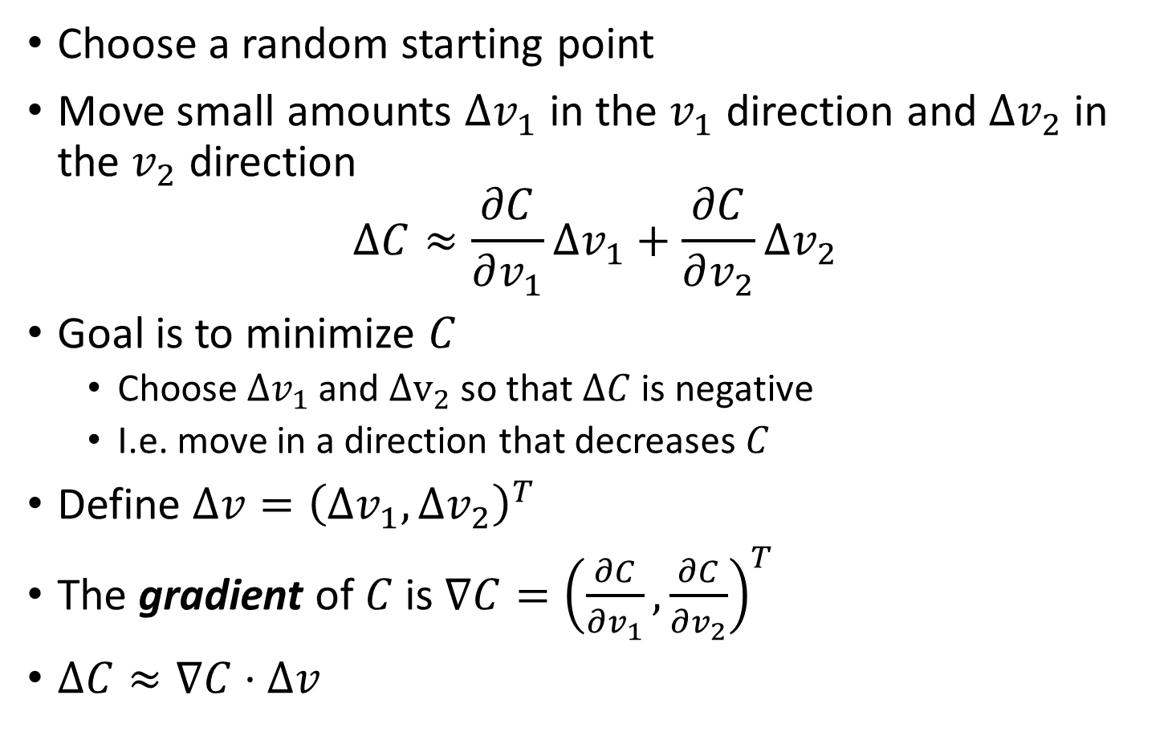
The gradient
Choose a random starting point
Move small amounts $Δv_{1}$ in the $v_{1}$ direction and $Δv_{2}$ in the $v_{2}$ direction
$$ΔC≈\frac{∂C}{∂v_{1}}Δv_{1}+\frac{∂C}{∂v_{2}}Δv_{2}$$
Goal is to minimize $C$
Choose $Δv_{1}$ and $Δv_{2}$ so that $ΔC$ is negative
I.e. move in a direction that decreases $C$
Define $Δv={\left(Δv_{1},Δv_{2}\right)}^{T}$
The gradient of $C$ is $∇C={\left(\frac{∂C}{∂v_{1}},\frac{∂C}{∂v_{2}}\right)}^{T}$
$ΔC≈∇C⋅Δv$
Notes:
Pause here for a minute

Slide 11
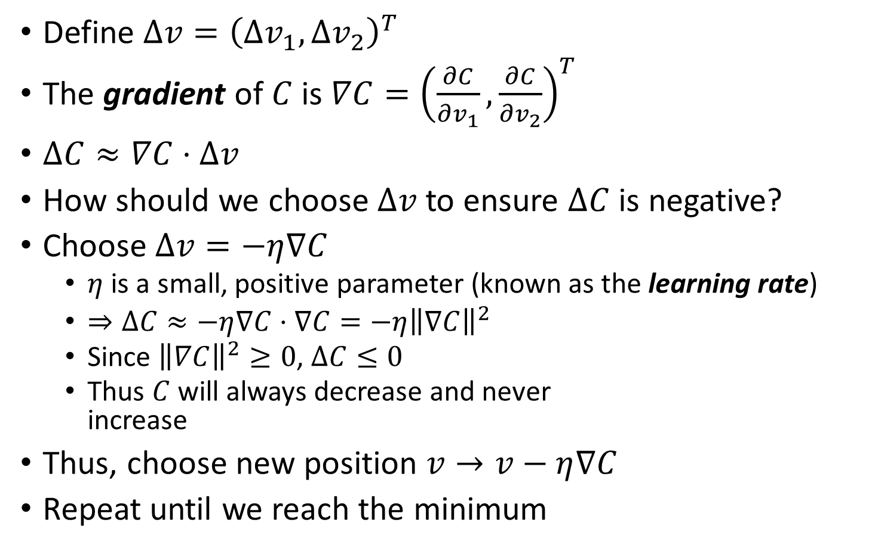
The gradient
Define $Δv={\left(Δv_{1},Δv_{2}\right)}^{T}$
The gradient of $C$ is $∇C={\left(\frac{∂C}{∂v_{1}},\frac{∂C}{∂v_{2}}\right)}^{T}$
$ΔC≈∇C⋅Δv$
How should we choose $Δv$ to ensure $ΔC$ is negative?
Choose $Δv=−η∇C$
$η$ is a small, positive parameter (known as the learning rate)
$⇒ΔC≈−η∇C⋅∇C=−η{\left\|∇C\right\|}^{2}$
Since ${\left\|∇C\right\|}^{2}≥0$, $ΔC≤0$
Thus $C$ will always decrease and never increase
Thus, choose new position $v→v−η∇C$
Repeat until we reach the minimum

Slide 12
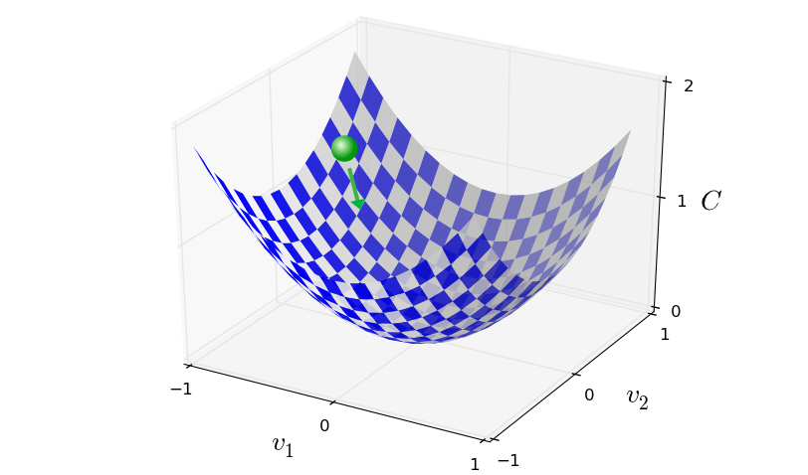

Summary of gradient descent
Compute the gradient $∇C$
Move in the opposite direction
It’s like falling down the slope of the valley

Slide 13
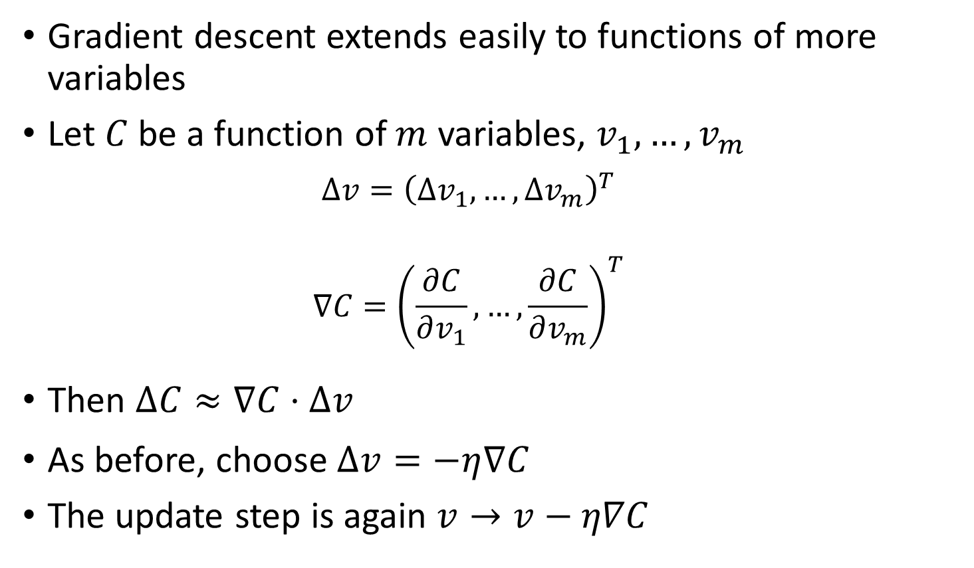
Gradient descent with more variables
Gradient descent extends easily to functions of more variables
Let $C$ be a function of $m$ variables, $v_{1},…,v_{m}$
$$Δv={\left(Δv_{1},…,Δv_{m}\right)}^{T}$$
$$∇C={\left(\frac{∂C}{∂v_{1}},…,\frac{∂C}{∂v_{m}}\right)}^{T}$$
Then $ΔC≈∇C⋅Δv$
As before, choose $Δv=−η∇C$
The update step is again $v→v−η∇C$

Slide 14
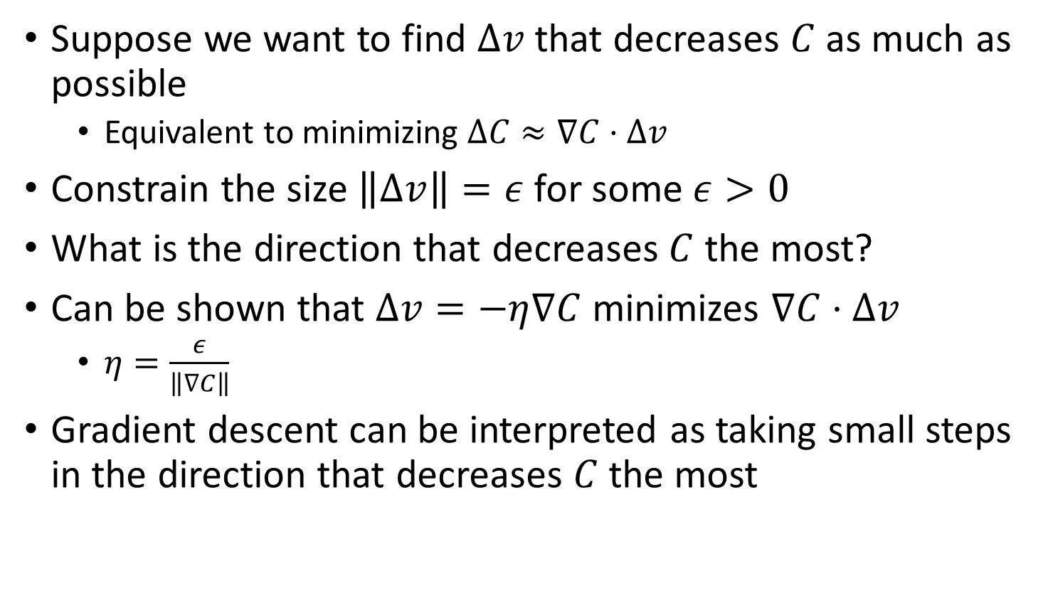
Gradient descent is optimal in some sense
Suppose we want to find $Δv$ that decreases $C$ as much as possible
Equivalent to minimizing $ΔC≈∇C⋅Δv$
Constrain the size $\left\|Δv\right\|=ε$ for some $ε>0$
What is the direction that decreases $C$ the most?
Can be shown that $Δv=−η∇C$ minimizes $∇C⋅Δv$
$η=\frac{ε}{\left\|∇C\right\|}$
Gradient descent can be interpreted as taking small steps in the direction that decreases $C$ the most

Slide 15
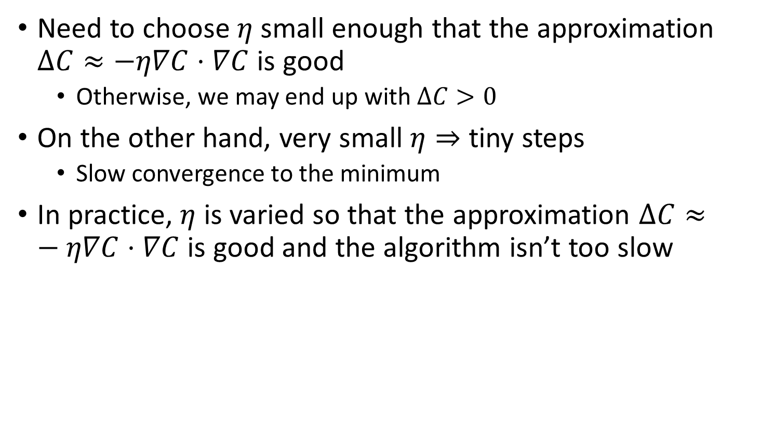
Choosing the learning rate
Need to choose $η$ small enough that the approximation $ΔC≈−η∇C⋅∇C$ is good
Otherwise, we may end up with $ΔC>0$
On the other hand, very small $η⇒$ tiny steps
Slow convergence to the minimum
In practice, $η$ is varied so that the approximation $ΔC≈−η∇C⋅∇C$ is good and the algorithm isn’t too slow
Notes:
More later on?

Slide 16
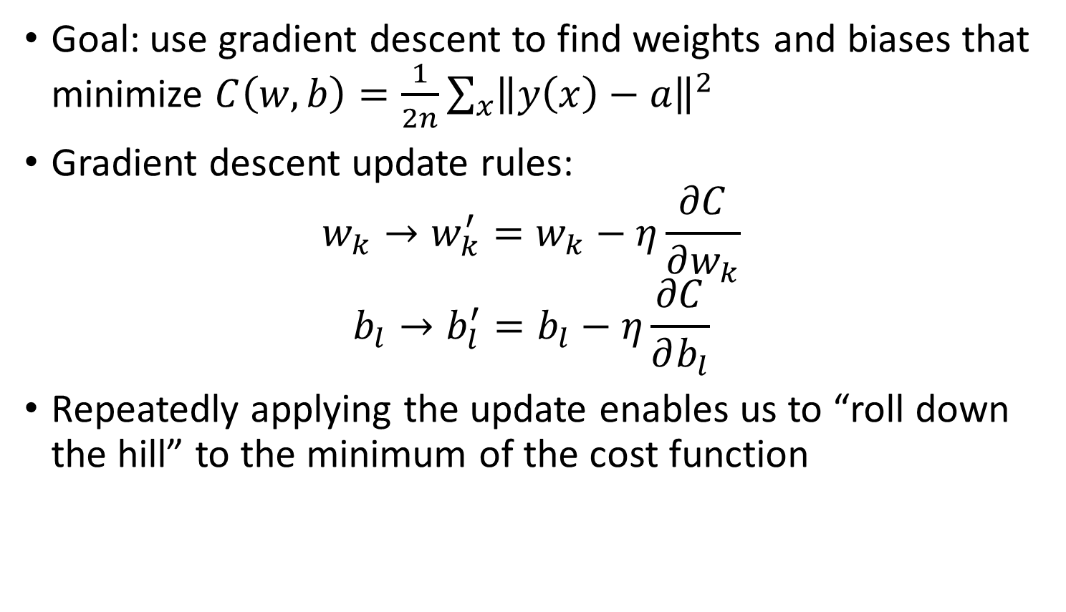
Gradient descent in neural networks
Goal: use gradient descent to find weights and biases that minimize $C\left(w,b\right)=\frac{1}{2n}\sum_{x}{{\left\|y\left(x\right)−a\right\|}^{2}}$
Gradient descent update rules:
$$w_{k}→w_{k}^{′}=w_{k}−η\frac{∂C}{∂w_{k}}$$
$$b_{l}→b_{l}^{′}=b_{l}−η\frac{∂C}{∂b_{l}}$$
Repeatedly applying the update enables us to “roll down the hill” to the minimum of the cost function
Notes:
Take all of these slides slowly. Make pauses and make sure that students have time to absorb things

Slide 17
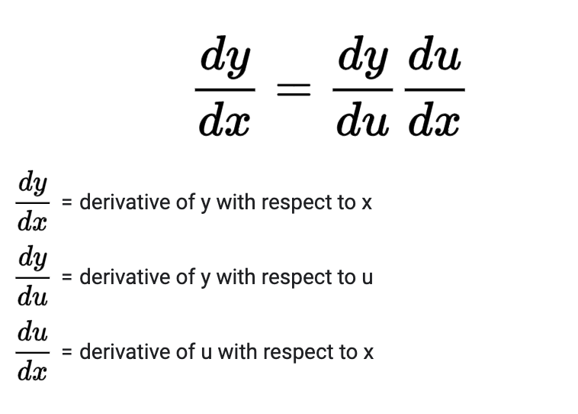
Our friend the chain rule

Slide 18

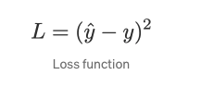
Gradient Descent with Linear Regression
Suppose you have a model that looks like this
In order to do SGD you need a loss function with the true labels y
Lets compute the relevant gradients!

Slide 19

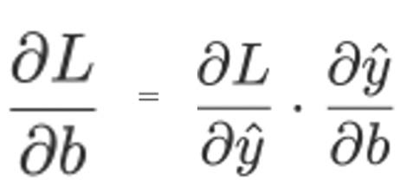



Gradient Descent with Linear Regression
Derivative of output wrt loss function
Derivative of bias wrt loss function (chain rule)
Learning new bias

Slide 20
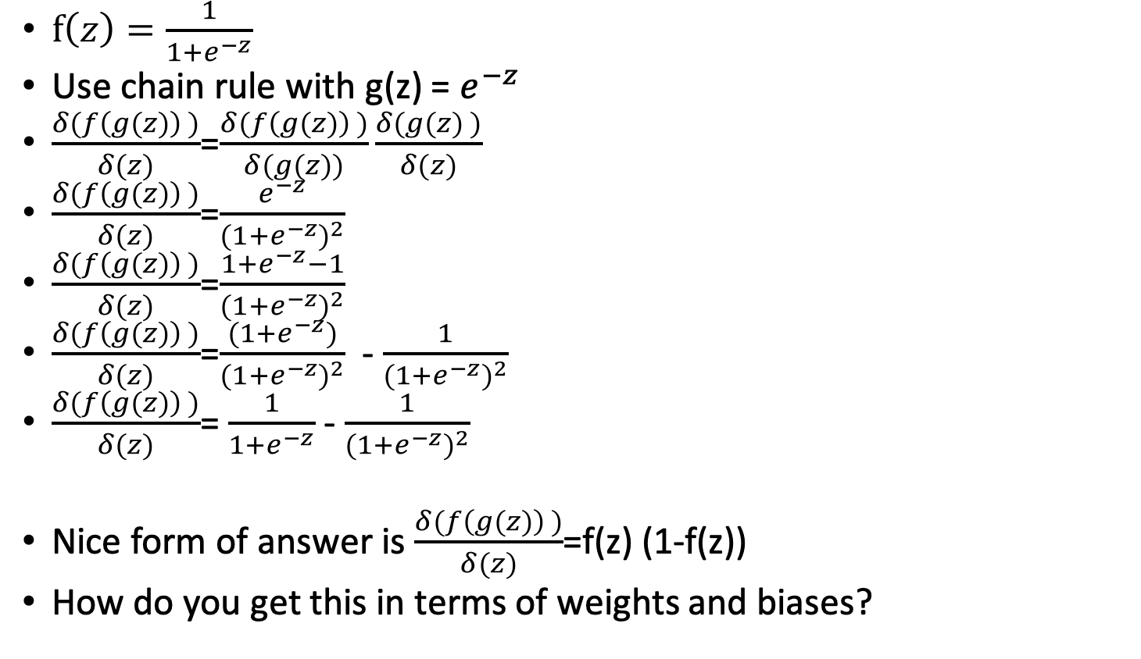
Gradient of a sigmoidal neuron
$f\left(z\right)=\frac{1}{1+e^{−z}}$
Use chain rule with g(z) = $e^{−z}$
$\frac{δ(f\left(g(z)\right) )}{δ(z)}$=$\frac{δ(f\left(g(z)\right) )}{δ(g(z))}\frac{δ(g(z) )}{δ(z)}$
$\frac{δ(f\left(g(z)\right) )}{δ(z)}$=$\frac{e^{−z}}{{(1+e^{−z})}^{2}}$
$\frac{δ(f\left(g(z)\right) )}{δ(z)}$=$\frac{1+e^{−z}−1}{{(1+e^{−z})}^{2}}$
$\frac{δ(f\left(g(z)\right) )}{δ(z)}$=$\frac{(1+e^{−z})}{{(1+e^{−z})}^{2}}$- $\frac{1}{{(1+e^{−z})}^{2}}$
$\frac{δ(f\left(g(z)\right) )}{δ(z)}$= $\frac{1}{1+e^{−z}}$ - $\frac{1}{{(1+e^{−z})}^{2}}$
Nice form of answer is $\frac{δ(f\left(g(z)\right) )}{δ(z)}$=f(z) (1-f(z))
How do you get this in terms of weights and biases?

Slide 21
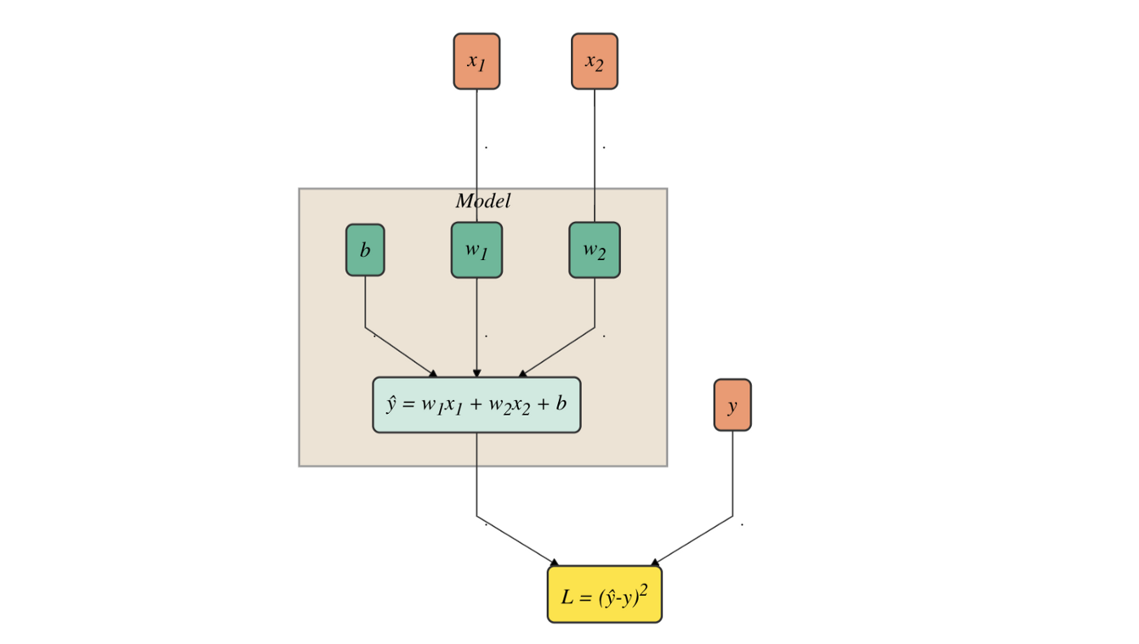

Gradient Descent with Linear Regression
https://towardsdatascience.com/step-by-step-tutorial-on-linear-regression-with-stochastic-gradient-descent-1d35b088a843

Slide 22
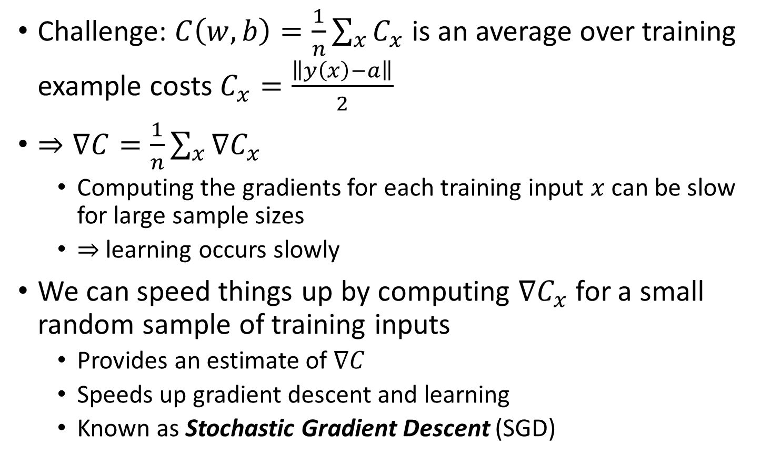
Large Sample Challenges
Challenge: $C\left(w,b\right)=\frac{1}{n}\sum_{x}{C_{x}}$ is an average over training example costs $C_{x}=\frac{\left\|y\left(x\right)−a\right\|}{2}$
$⇒∇C=\frac{1}{n}\sum_{x}{∇C_{x}}$
Computing the gradients for each training input $x$ can be slow for large sample sizes
$⇒$ learning occurs slowly
We can speed things up by computing $∇C_{x}$ for a small random sample of training inputs
Provides an estimate of $∇C$
Speeds up gradient descent and learning
Known as Stochastic Gradient Descent (SGD)

Slide 23
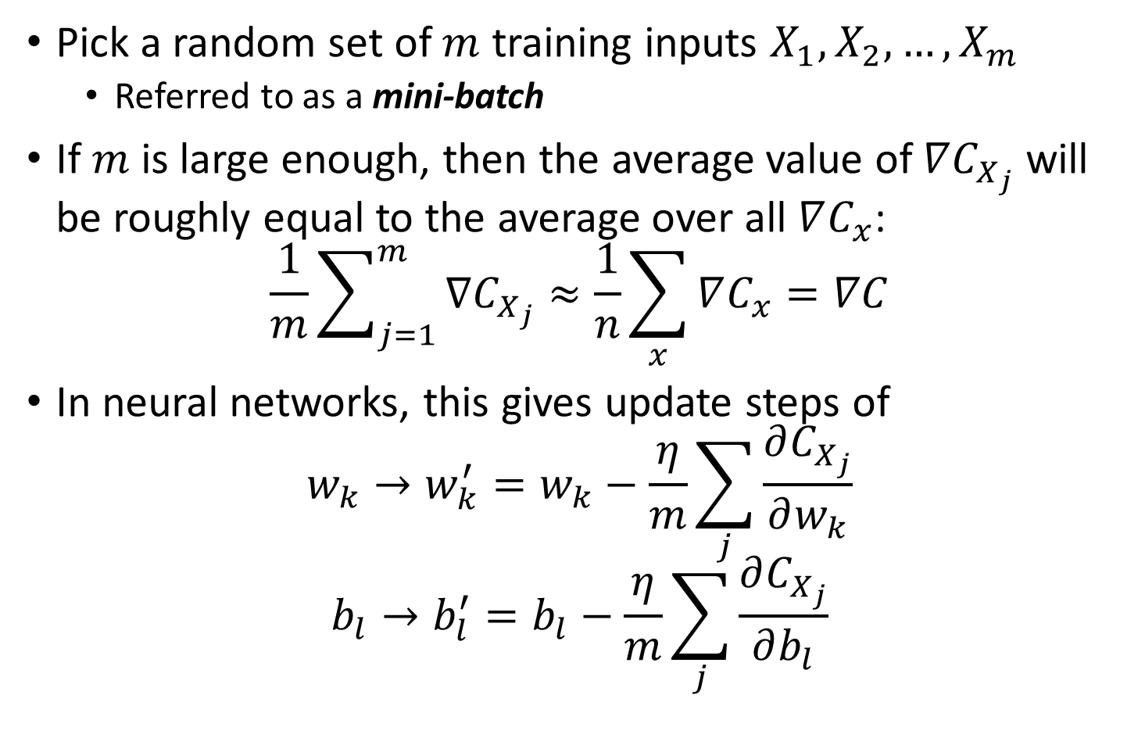
Stochastic Gradient Descent (SGD)
Pick a random set of $m$ training inputs $X_{1},X_{2},…,X_{m}$
Referred to as a mini-batch
If $m$ is large enough, then the average value of $∇C_{X_{j}}$ will be roughly equal to the average over all $∇C_{x}$:
$$\frac{1}{m}\sum_{j=1}^{m}{∇C_{X_{j}}}≈\frac{1}{n}\sum_{x}{∇C_{x}}=∇C$$
In neural networks, this gives update steps of
$$w_{k}→w_{k}^{′}=w_{k}−\frac{η}{m}\sum_{j}{\frac{∂C_{X_{j}}}{∂w_{k}}}$$
$$b_{l}→b_{l}^{′}=b_{l}−\frac{η}{m}\sum_{j}{\frac{∂C_{X_{j}}}{∂b_{l}}}$$
Notes:
Pause

Slide 24
Stochastic Gradient Descent Summary
A training epoch:
Pick a random subset of the training data
Referred to as a mini-batch
Update the weights and biases using the gradient estimates from the mini-batch
Pick another random mini-batch from remaining training points and repeat step 2
Repeat until all training inputs have been used
Repeat multiple epochs until stopping conditions

Slide 25
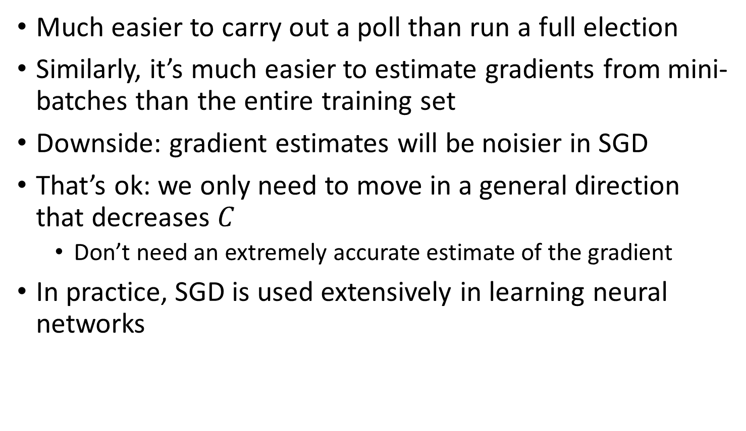
Analogy to political polling
Much easier to carry out a poll than run a full election
Similarly, it’s much easier to estimate gradients from mini-batches than the entire training set
Downside: gradient estimates will be noisier in SGD
That’s ok: we only need to move in a general direction that decreases $C$
Don’t need an extremely accurate estimate of the gradient
In practice, SGD is used extensively in learning neural networks

Slide 26
Back to MNIST
Goal: learn the weights and biases in a network to perform handwritten digit recognition
First split the training data into 2 parts
50,000 images for training
Referred to as the “MNIST training data”
10,000 images for validation
Used to set hyper-parameters
Not used today, but later
Notes:
Not actually going to run or show the code, you can take a look at the book. But I’ll show the results

Slide 27
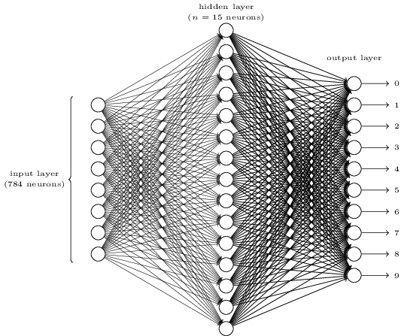
Our architecture
We will vary the number of neurons in the hidden layer

Slide 28
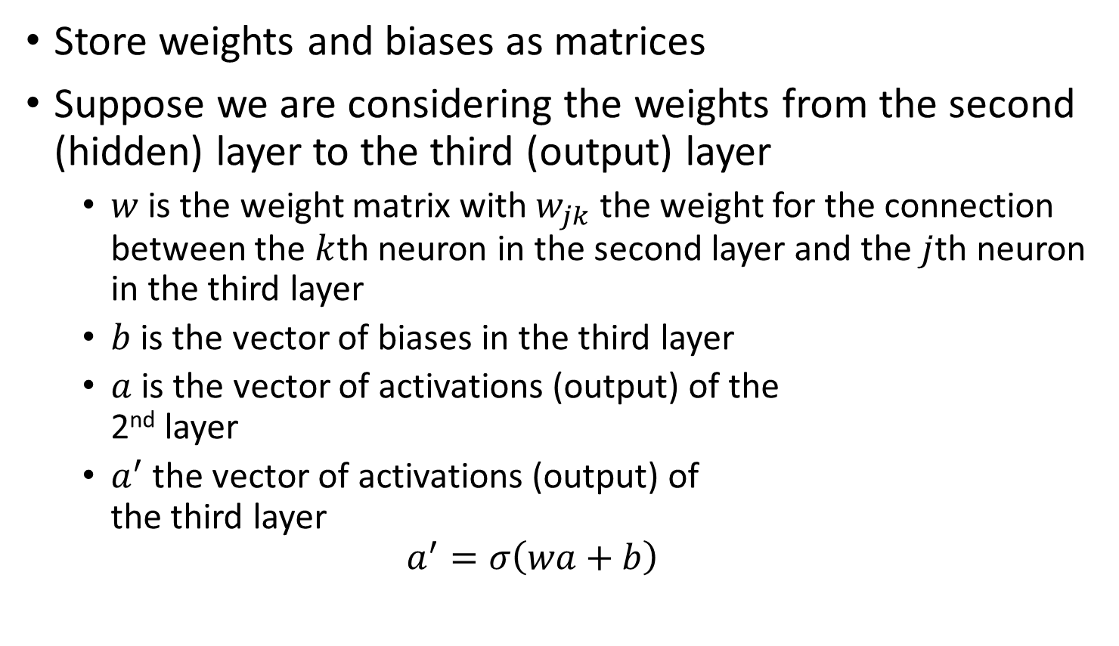
Vector notation
Store weights and biases as matrices
Suppose we are considering the weights from the second (hidden) layer to the third (output) layer
$w$ is the weight matrix with $w_{jk}$ the weight for the connection between the $k$th neuron in the second layer and the $j$th neuron in the third layer
$b$ is the vector of biases in the third layer
$a$ is the vector of activations (output) of the 2nd layer
$a^{′}$ the vector of activations (output) of the third layer
$$a^{′}=σ\left(wa+b\right)$$
Notes:
Note that we are applying the sigma function elementwise to every entry in the vector wa+b

Slide 29
Training Process
In each epoch, randomly shuffle the training data
Partition the shuffled training data into mini-batches
For each mini-batch, apply a single step of gradient descent
Gradients are calculated via backpropagation (the next topic)
Train for multiple epochs

Slide 30

Handwritten digit recognition
Two problems
Segmentation
Digit recognition

Slide 31

Handwritten digit recognition
Two problems
Segmentation
Digit recognition
Notes:
Segmentation is surprisingly challenging for computers to do although it is quite easy for us. Neural networks can accomplish it. However, We’ll focus on the 2nd problem. That’s because the first becomes easier after you solve the second

Slide 32
Image segmentation approach
Run digit classifier on multiple segmentations
High score if classifier is confident in all segments
Low score if the classifier fails in one or more segments
I.e., if the classifier is struggling, it’s due to a poor segmentation

Slide 33

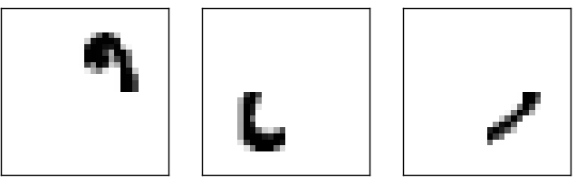
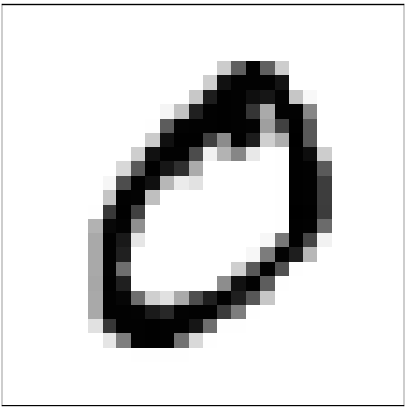

Number of output neurons
Possible heuristic:
$$=$$
Notes:
Suppose these parts result in the first four neurons of the hidden layer to be fired. The more neurons we have, the more likely these kinds of shapes will correspond to specific bits.
In contrast, if we only have four output neurons, then the first output neuron would try to decide what the most significant bit of the digit was, which isn’t easy to relate to the original image. However, it is possible that there is a 4 bit solution that works better. But generally, this parts-based representation heuristic seems to work well when designing neural networks

Slide 34
A simple network
Notes:
Describe the input (28 x 28 images, greyscale). Describe output (number the neurons 0 to 9, and choose the highest value as the classification)

Slide 35
Number of output neurons
Why use 10?
Four bits are enough to encode the answer
Using more seems inefficient
Empirically, 10 works better
Why?

Slide 36
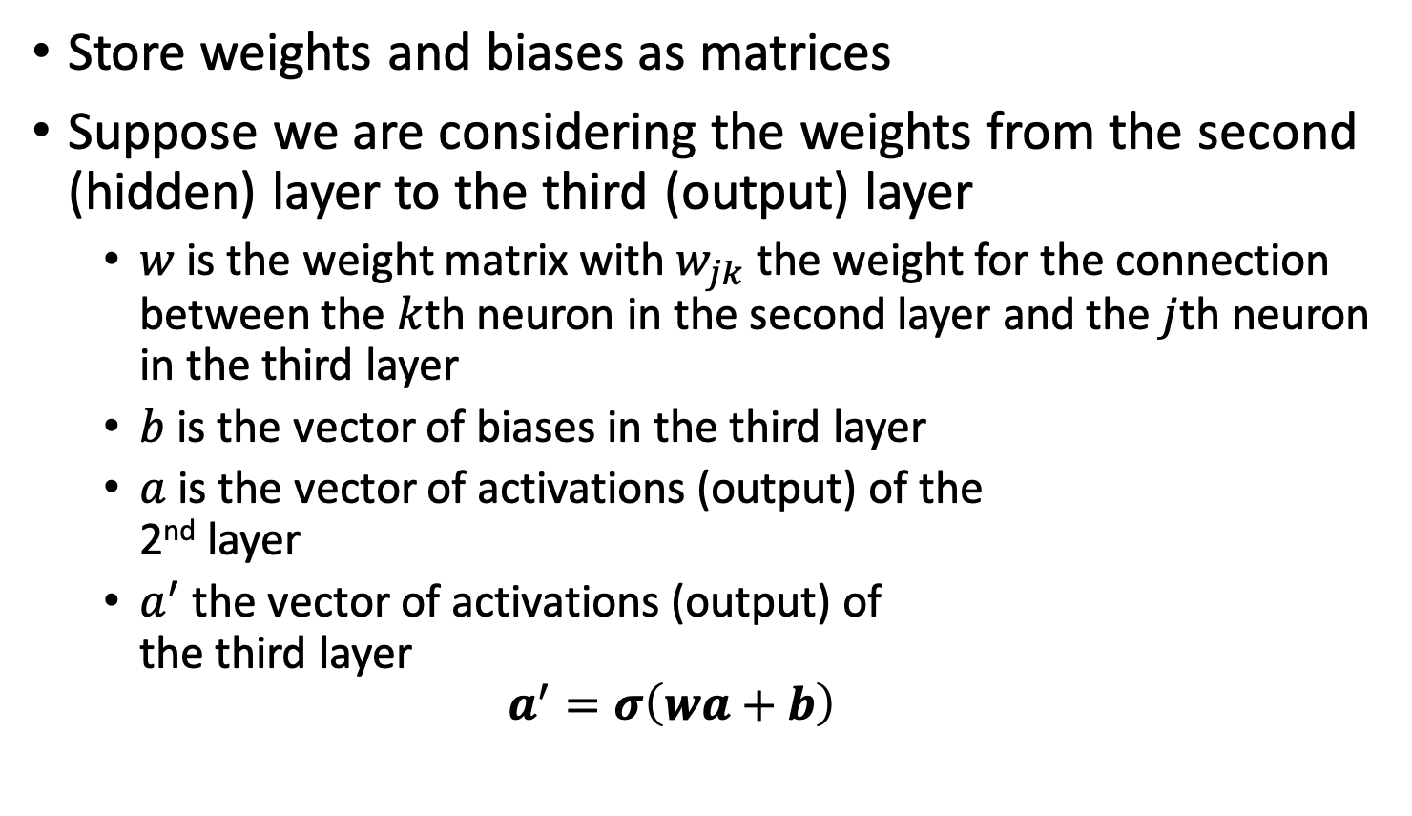
Forward Propagation
Store weights and biases as matrices
Suppose we are considering the weights from the second (hidden) layer to the third (output) layer
$w$ is the weight matrix with $w_{jk}$ the weight for the connection between the $k$th neuron in the second layer and the $j$th neuron in the third layer
$b$ is the vector of biases in the third layer
$a$ is the vector of activations (output) of the 2nd layer
$a^{′}$ the vector of activations (output) of the third layer
$$a^{′}=σ\left(wa+b\right)$$
Notes:
Note that we are applying the sigma function elementwise to every entry in the vector wa+b

Slide 37
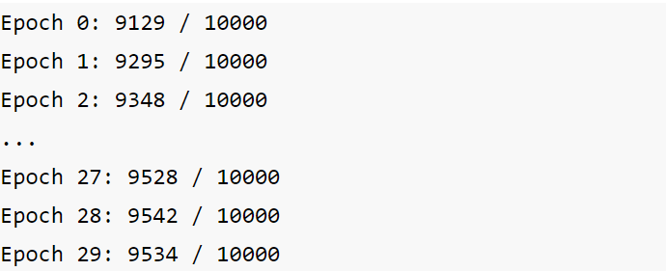

First attempt
30 nodes in hidden layer
30 epochs
Mini-batch size $=10$
Learning rate $η=3.0$
Best accuracy at epoch 28: 95.42%
Notes:
95.42% accuracy with a relatively simple network.

Slide 38
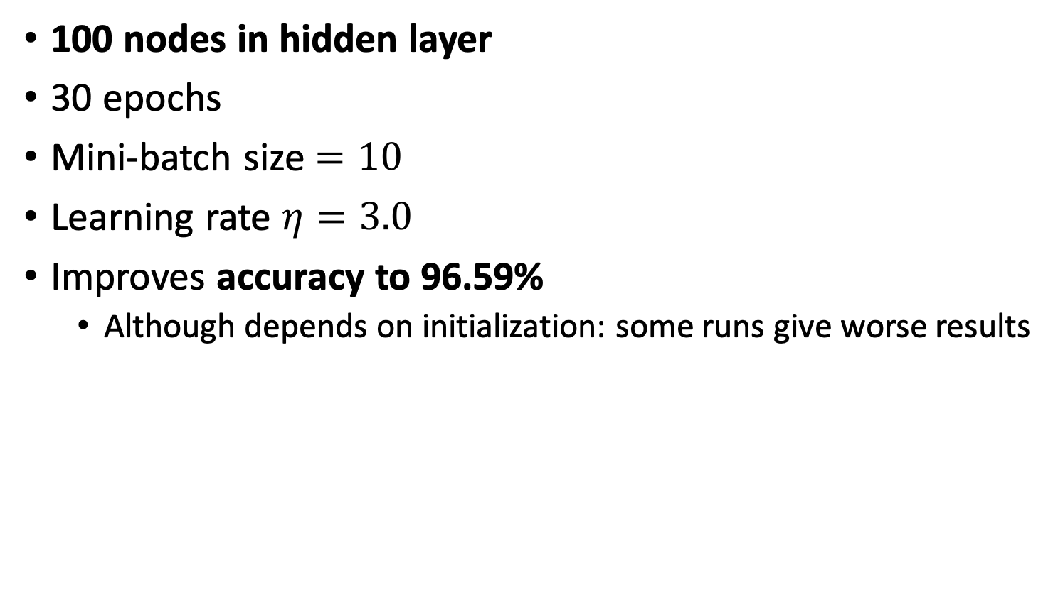
Second attempt
100 nodes in hidden layer
30 epochs
Mini-batch size $=10$
Learning rate $η=3.0$
Improves accuracy to 96.59%
Although depends on initialization: some runs give worse results

Slide 39
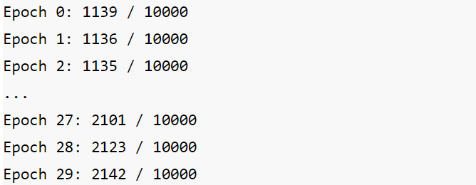

Third attempt
100 nodes in hidden layer
30 epochs
Mini-batch size $=10$
Learning rate $η=0.001$

Slide 40
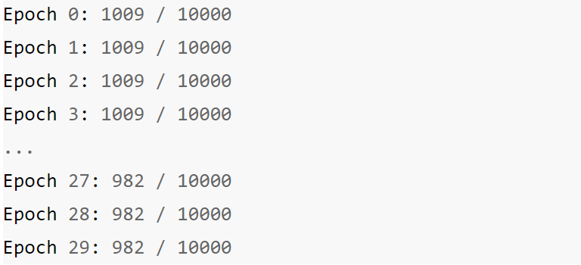
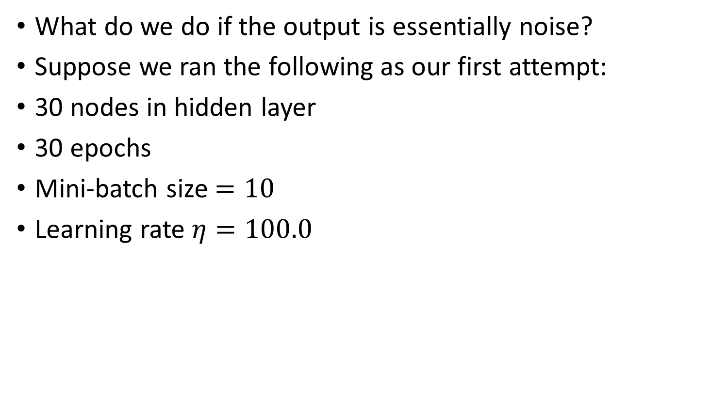
Debugging a neural network
What do we do if the output is essentially noise?
Suppose we ran the following as our first attempt:
30 nodes in hidden layer
30 epochs
Mini-batch size $=10$
Learning rate $η=100.0$
Notes:
What do we change?

Slide 41
Debugging a neural network
What can we do?
Should we change the learning rate?
Should we initialize differently?
Do we need more training data?
Should we change the architecture?
Should we run for more epochs?
Are the features relevant for the problem (i.e. is the Bayes error rate reasonable)?
Debugging is an art
We’ll develop good heuristics for choosing good architectures and hyper parameters

Slide 42

How well does our network do?
Need to compare to some baselines
Random guessing: 10% accuracy
Our network does much better
Simple idea: How dark is the image?
E.g. a 2 will typically be darker than a 1

Slide 43
Average darkness
Compute average darkness for each digit from the training data
Classify an image based on the digit with the closest average darkness
This gives 22.25% accuracy
Better than random guessing

Slide 44
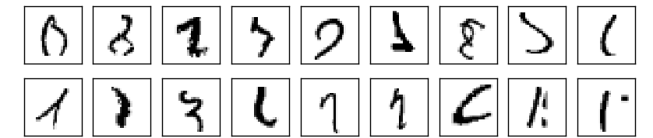
Support Vector Machine (SVM)
Using default settings in SVM scikit-learn (a Python library) gives 94.35% accuracy
It’s possible to optimize tuning parameters to achieve 98.5% accuracy
Can neural networks do better?
Yes!
Record set in 2013 was 99.79% accuracy (only 21 wrong in the test data)
Can you do better?

Slide 45
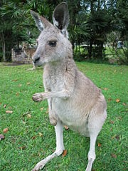
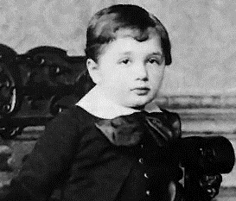
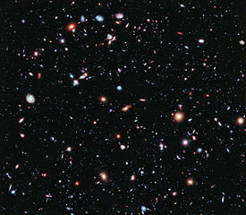
Why should networks be deep?
Suppose we want to detect a human face in images
How would we design a network by hand?

Slide 46
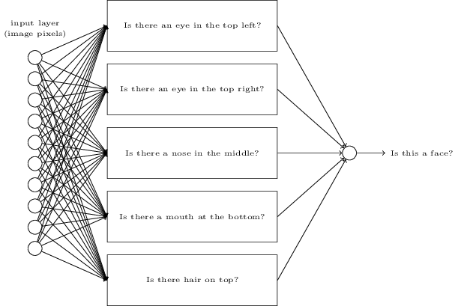
Some heuristics
Break the problem down into sub-problems

Slide 47
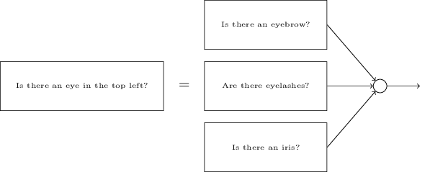
Some heuristics
Can break the sub-problems down further
Eventually, we deal with sub-problems at the pixel level

Slide 48
Towards Deep learning
The end result is a network that answers a complicated question
Uses a series of many layers
Early layers answer simple questions about input image
Later layers build up a hierarchy of complex and abstract concepts
Known as a deep neural network
Researchers tried to train deep neural networks in the 80’s and 90’s
Little luck
Breakthroughs since 2006 have made it much easier to train deep networks

Slide 49
Further Reading
Nielsen, chapter 1
Goodfellow et al., Section 5.9 and chapter 6

