Slide 1


Deep Learning Theory and Applications Variations on SGD
CPSC/CBB/AMTH 663
CPSC 452

Slide 2
Outline
Learning vs. pure optimization
2nd Order Methods
Momentum methods
Approximate 2nd order methods
Adaptive learning rates

Slide 3
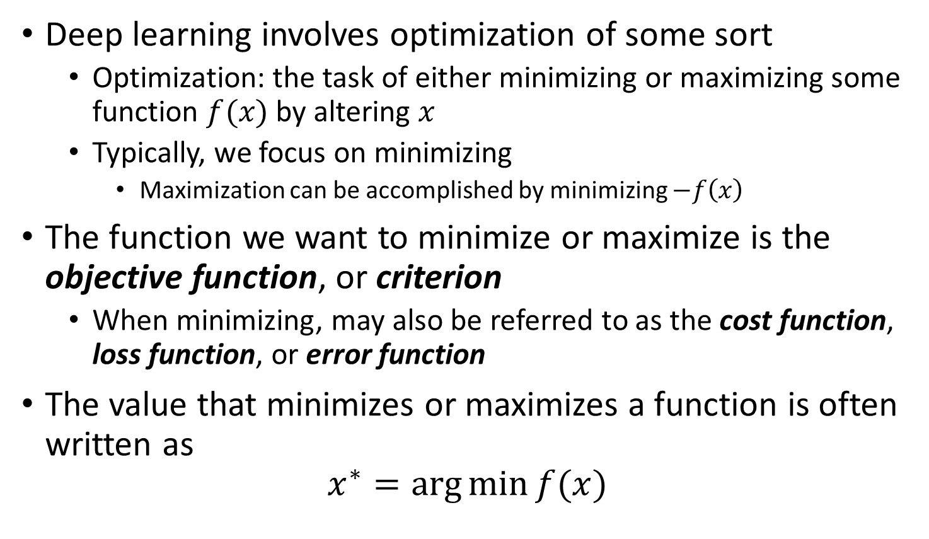
Gradient-based optimization revisited
Deep learning involves optimization of some sort
Optimization: the task of either minimizing or maximizing some function $f(x)$ by altering $x$
Typically, we focus on minimizing
Maximization can be accomplished by minimizing $−f\left(x\right)$
The function we want to minimize or maximize is the objective function, or criterion
When minimizing, may also be referred to as the cost function, loss function, or error function
The value that minimizes or maximizes a function is often written as
$$x^{∗}=\arg{\min{f(x)}}$$
Notes:
Lets revisit gradient-based optimization a bit. In deep learning we want to minimize or maximize an objective function, value that minimizes is is written as minimal.

Slide 4
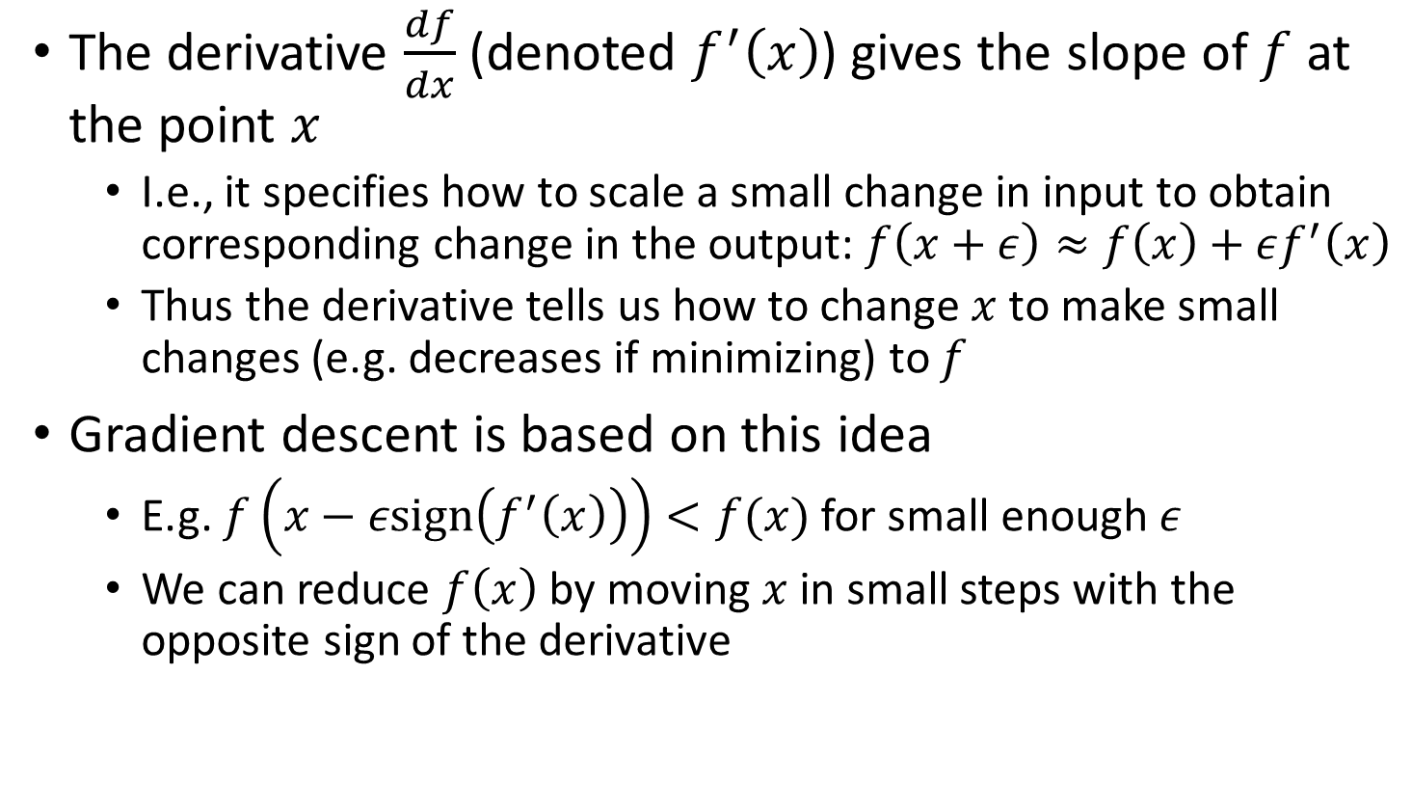
Gradient-based optimization revisited
The derivative $\frac{df}{dx}$ (denoted $f^{′}\left(x\right)$) gives the slope of $f$ at the point $x$
I.e., it specifies how to scale a small change in input to obtain corresponding change in the output: $f\left(x+ε\right)≈f\left(x\right)+εf^{′}\left(x\right)$
Thus the derivative tells us how to change $x$ to make small changes (e.g. decreases if minimizing) to $f$
Gradient descent is based on this idea
E.g. $f\left(x−ε\text{sign}\left(f^{′}\left(x\right)\right)\right)<f(x)$ for small enough $ε$
We can reduce $f\left(x\right)$ by moving $x$ in small steps with the opposite sign of the derivative
Notes:
The derivative of the function for a particular parameter x gives slope of f at point x, it specifies how to scale a small change in inptu to obtain corresponding change in output. Thus the derivative tells us how to make small changes, decrease if minimizing to f,

Slide 5
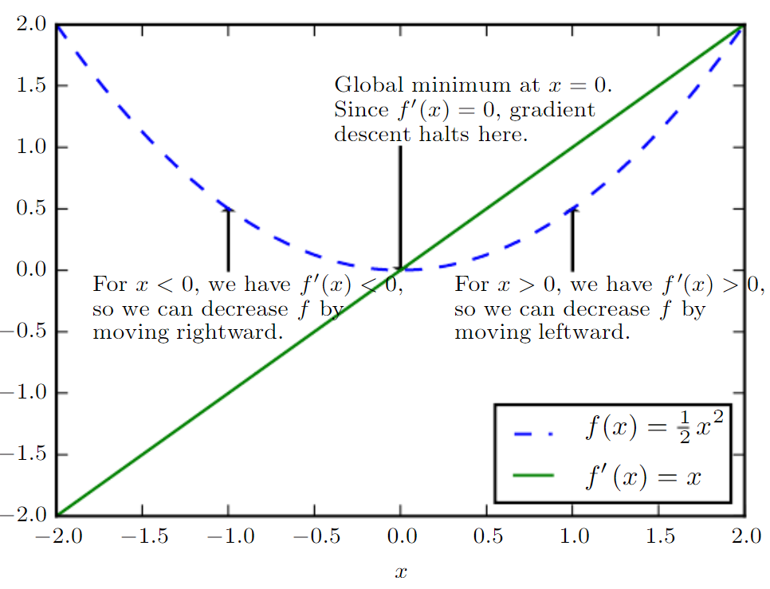
Gradient-based optimization revisited

Slide 6
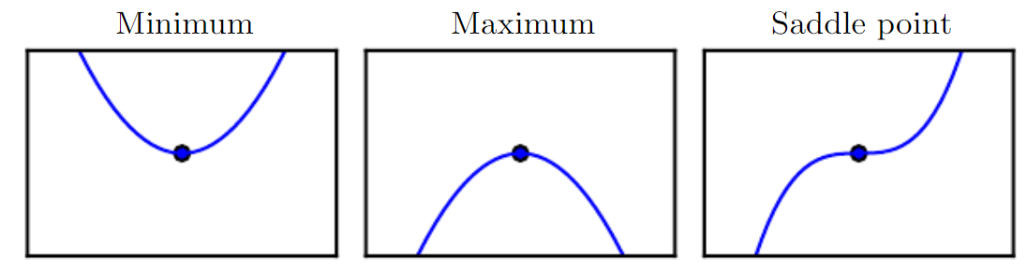

Gradient-based optimization revisited
What does $f^{′}\left(x\right)=0$ mean?
Corresponding points are critical points or stationary points
Local minimum is a point where $f(x)$ is lower than all neighboring points
Local maximum is a point where $f\left(x\right)$ is higher than all neighboring points
Saddle points are neither
Notes:
Ask the class this

Slide 7
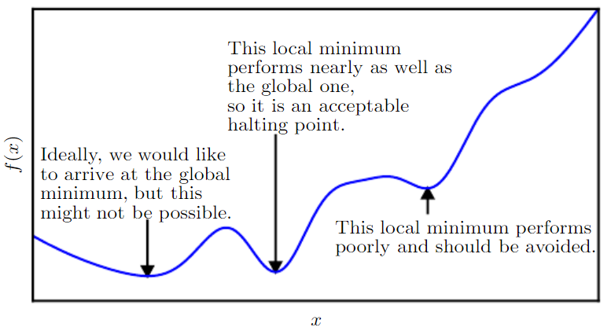
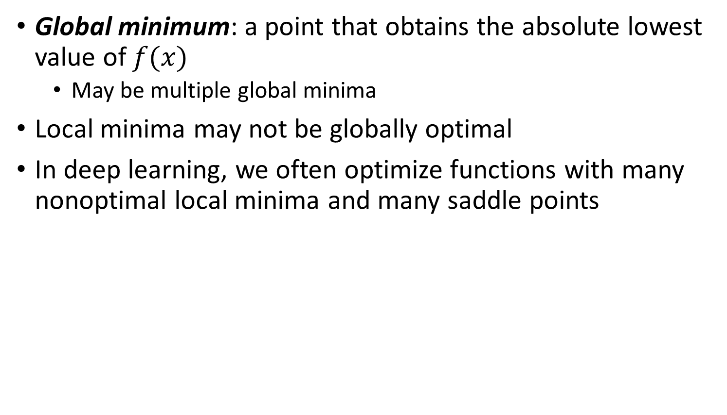
Gradient-based optimization revisited
Global minimum: a point that obtains the absolute lowest value of $f(x)$
May be multiple global minima
Local minima may not be globally optimal
In deep learning, we often optimize functions with many nonoptimal local minima and many saddle points

Slide 8
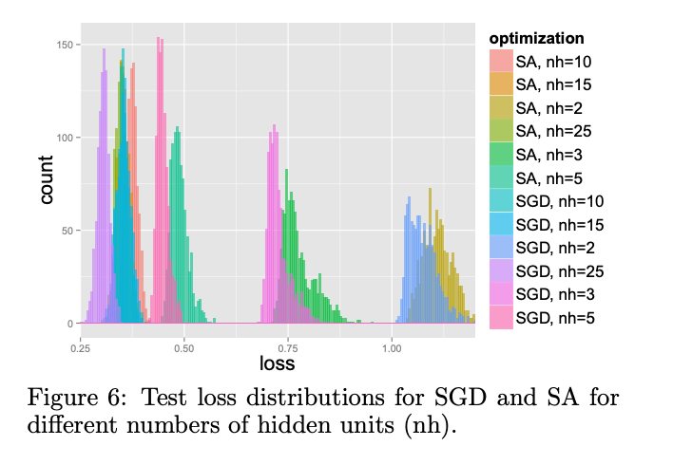
Are local minima a problem?
Results show that in large neural networks most local minima are close to the global minima! [Choromanska et al. 2014]
Why could this be?

Slide 9
Are local minima a problem?
Nearly any deep model is guaranteed to have a large number of local minima
This is due to weight space symmetry (we could modify the neural network by swapping order of hidden nodes)
Additionally, invariance to scale can result in an uncountably infinite number of local minima (increase all weights by x 10)
However, they all have the same cost
It’s possible to construct a small network with local minima higher than the global minimum
But current research suggests that in large networks, local minima typically have low cost function values
The probability of finding a non-optimal local minima diminishes with the size of the network.

Slide 10
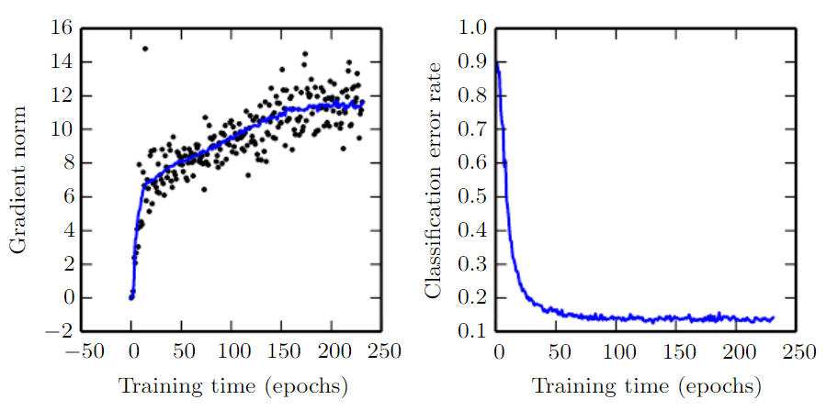
Can we actually find local minima?
Gradient is increasing and not decreasing during training, but cost is not improving.

Slide 11
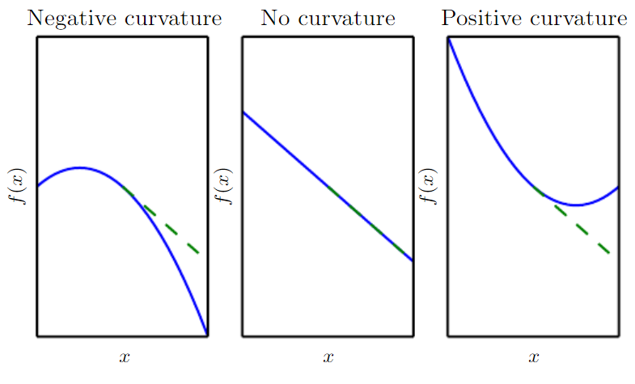
Curvature
Can we better approximate the actual change in the cost based on curvature?
Notes:
Suppose we’re doing gradient descent on these functions at the center points. The dashed line indicates the value of the cost function that we expect to go down to using vanilla gradient descent.
With negative curvature, the cost function actually decreases faster than predicted.
With no curvature, the gradient predicts the decrease correctly.
With positive curvature, the cost function decreases more slowly than expected and actually increases. So steps that are too large could cause us to over shoot the minimum

Slide 12
2nd Order Methods

Slide 13
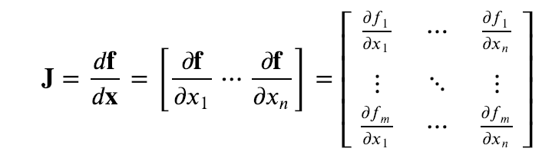
Jacobian
In normal gradient descent we compute a matrix of partial derivatives called the Jacobian

Slide 14
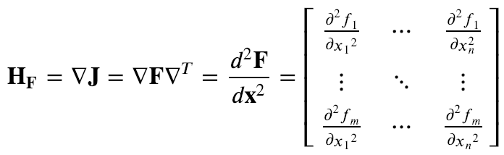
Hessian
The Hessian is a generalization of this to 2nd order

Slide 15
Hessian and Multidimensional Curvature
The Hessian matrix tells us about curvature in every direction
Eigendecomposition of the Hessian results in eigenvalues
If they are ALL positive then the curvature is positive everywhere (local maxima)
If they are mixed then it is a saddle point

Slide 16
Condition Number
The condition number of the Hessian measures how much the second derivatives diﬀer from each other
Condition number is ratio of the largest eigenvalue to the smallest
When the Hessian has high condition number, gradient descent performs poorly
The derivative increases rapidly, while in another direction, it increases slowly
Poor condition number also makes choosing a good step size diﬃcult
The step size must be small enough to avoid overshooting
Solution: Hessian matrix needs to be used for minima search
The simplest method for doing so is known as Newton’s method

Slide 17
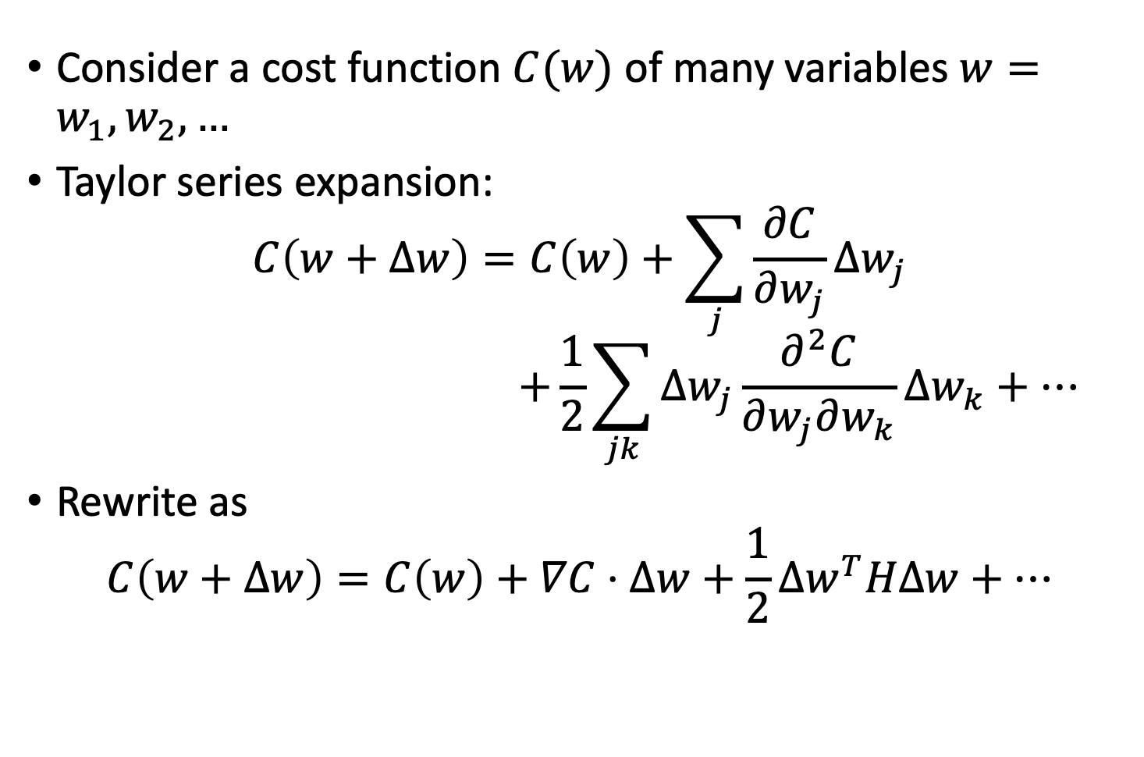
Taylor expansion
Consider a cost function $C(w)$ of many variables $w=w_{1}, w_{2},…$
Taylor series expansion:
$$C\left(w+Δw\right)=C\left(w\right)+\sum_{j}{\frac{∂C}{∂w_{j}}Δw_{j}}$$
$$+\frac{1}{2}\sum_{jk}{Δw_{j}\frac{∂^{2}C}{∂w_{j}∂w_{k}}Δw_{k}+…}$$
Rewrite as
$$C\left(w+Δw\right)=C\left(w\right)+∇C⋅Δw+\frac{1}{2}Δw^{T}HΔw+…$$

Slide 18
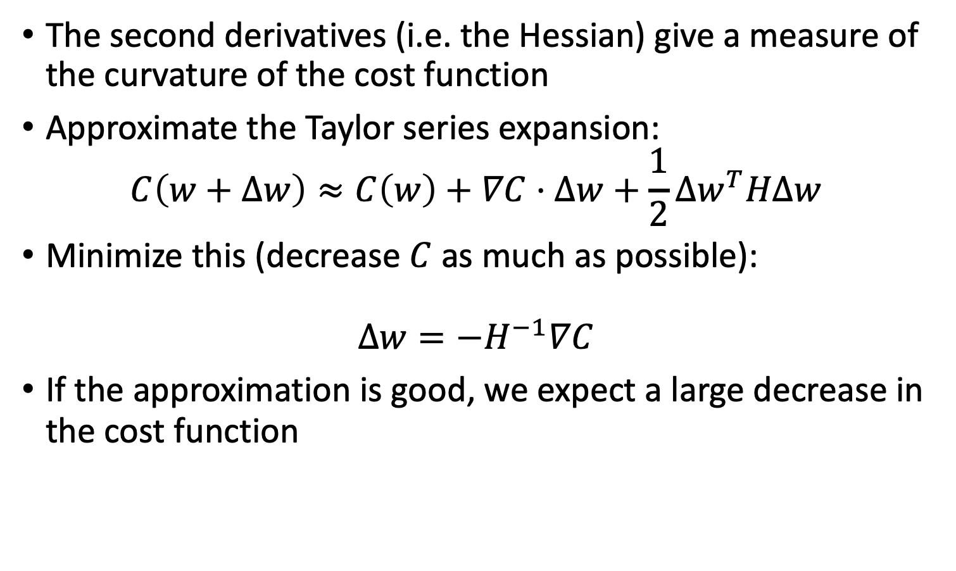
Taylor expansion
The second derivatives (i.e. the Hessian) give a measure of the curvature of the cost function
Approximate the Taylor series expansion:
$$C\left(w+Δw\right)≈C\left(w\right)+∇C⋅Δw+\frac{1}{2}Δw^{T}HΔw$$
Minimize this (decrease $C$ as much as possible):
$$Δw=−H^{−1}∇C$$
If the approximation is good, we expect a large decrease in the cost function
Notes:
Derive the $Δw$ expression (set delta. Cost =

Slide 19
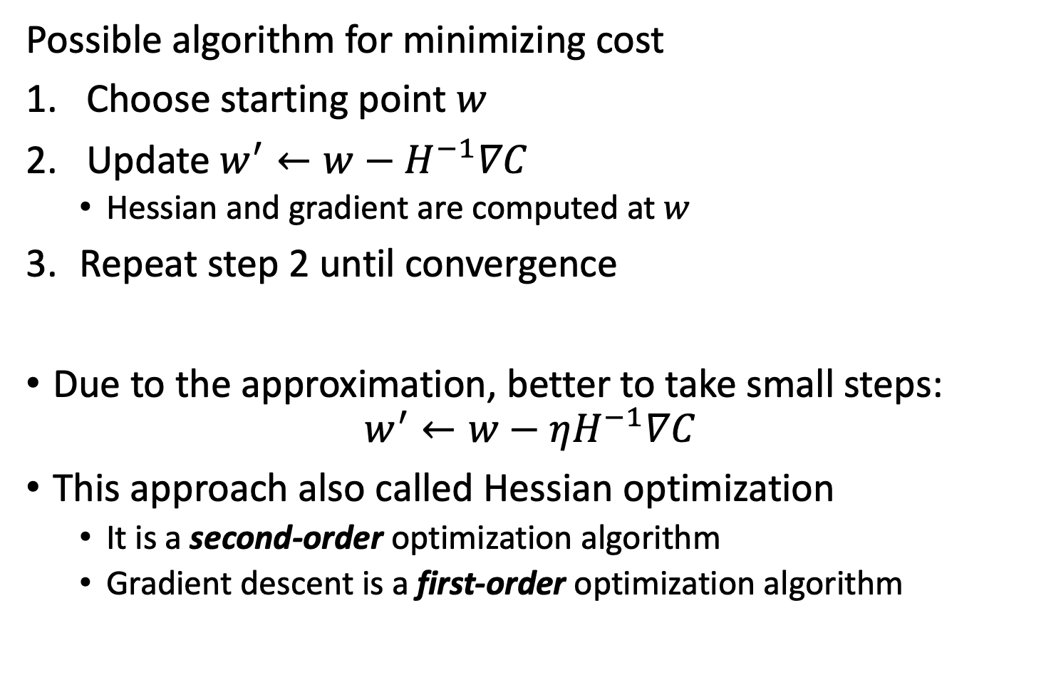
Newton’s Method
Possible algorithm for minimizing cost
Choose starting point $w$
Update $w^{′}←w−H^{−1}∇C$
Hessian and gradient are computed at $w$
Repeat step 2 until convergence
Due to the approximation, better to take small steps:
$$w^{′}←w−ηH^{−1}∇C$$
This approach also called Hessian optimization
It is a second-order optimization algorithm
Gradient descent is a first-order optimization algorithm

Slide 20
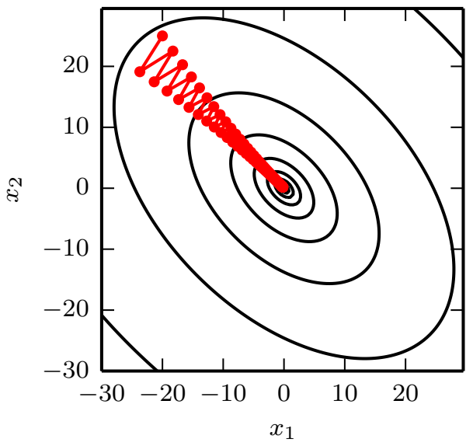
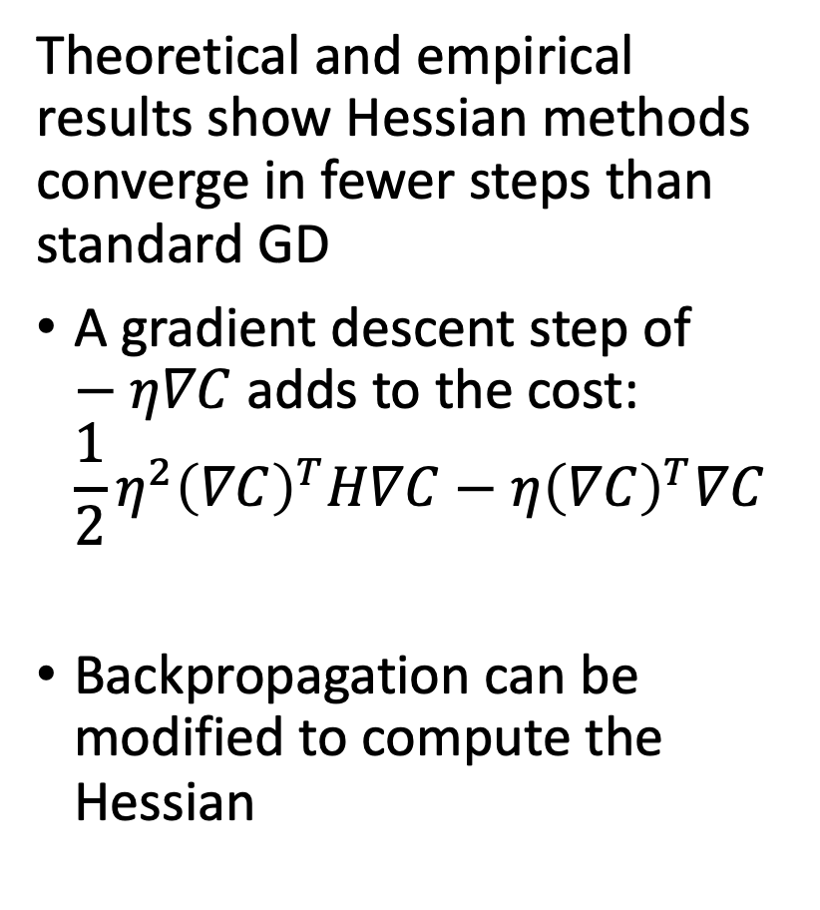
Advantages of Hessian methods
Theoretical and empirical results show Hessian methods converge in fewer steps than standard GD
A gradient descent step of $−η∇C$ adds to the cost:
$$\frac{1}{2}η^{2}{\left(∇C\right)}^{T}H∇C−η{\left(∇C\right)}^{T}∇C$$
Backpropagation can be modified to compute the Hessian
Notes:
In these cases, gradient descent can get stuck and take a long time to converge

Slide 21
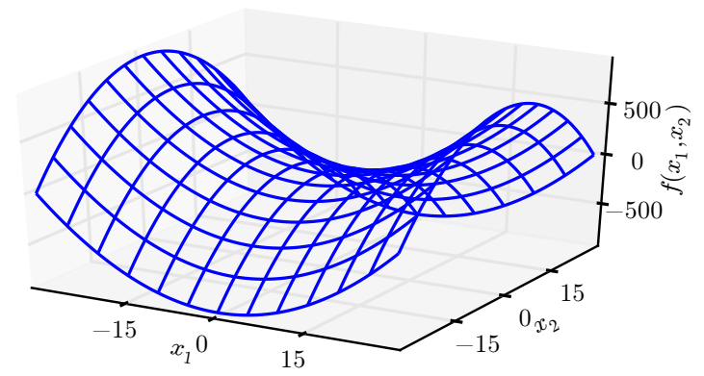
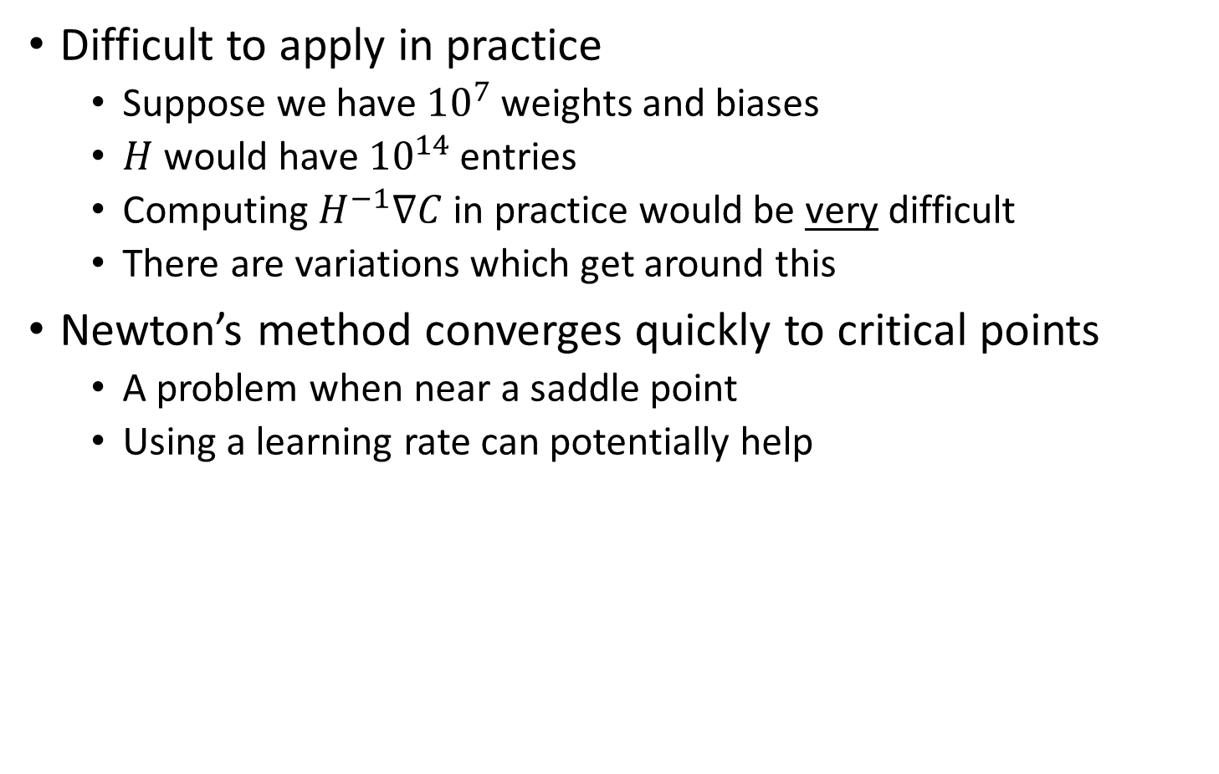
Disadvantages of Hessian methods
Difficult to apply in practice
Suppose we have ${10}^{7}$ weights and biases
$H$ would have ${10}^{14}$ entries
Computing $H^{−1}∇C$ in practice would be very difficult
There are variations which get around this
Newton’s method converges quickly to critical points
A problem when near a saddle point
Using a learning rate can potentially help
Notes:
We would have to invert this matrix at every training instance, both positive and negative eigenvalues in the hessian

Slide 22
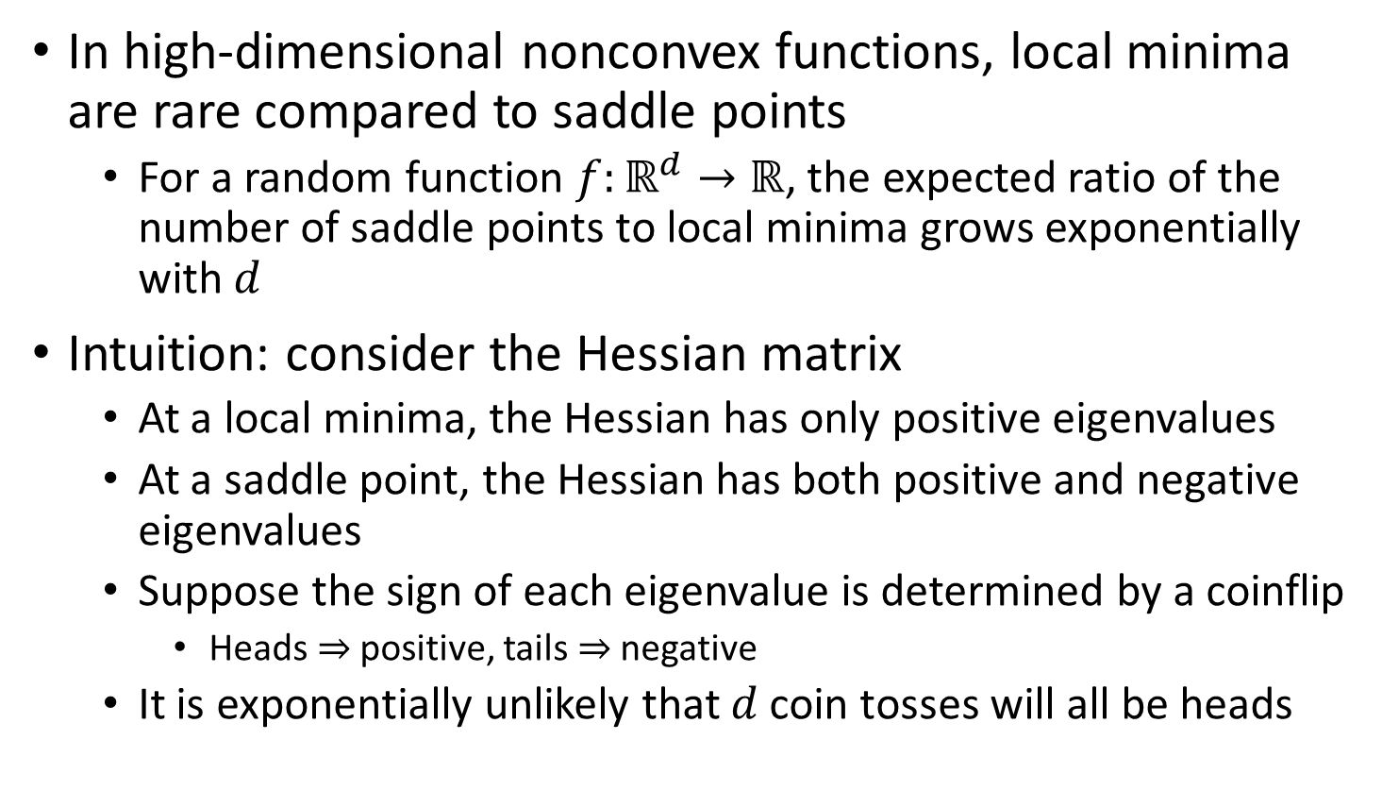
Are saddle points a problem?
In high-dimensional nonconvex functions, local minima are rare compared to saddle points
For a random function $f:ℝ^{d}→ℝ$, the expected ratio of the number of saddle points to local minima grows exponentially with $d$
Intuition: consider the Hessian matrix
At a local minima, the Hessian has only positive eigenvalues
At a saddle point, the Hessian has both positive and negative eigenvalues
Suppose the sign of each eigenvalue is determined by a coinflip
Heads $⇒$ positive, tails $⇒$ negative
It is exponentially unlikely that $d$ coin tosses will all be heads

Slide 23
Are saddle points a problem?
This is true for random functions; what about neural networks?
It’s been shown theoretically that shallow, linear autoencoders have global minima and saddle points, but no local minima with higher cost than the global minimum
It’s been shown experimentally that real neural networks have loss functions with many high-cost saddle points
See Goodfellow et al., section 8.2.3 for references

Slide 24
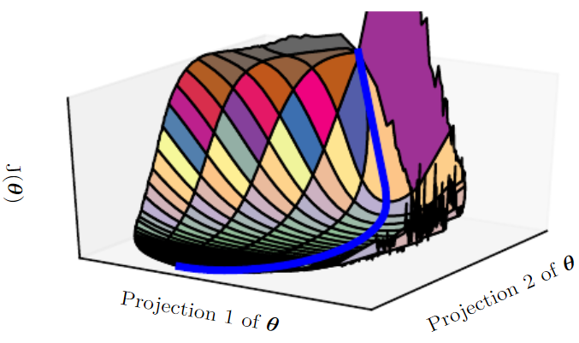
Are saddle points a problem?
How do these saddle points affect training?
Gradient descent seems to escape saddle points despite low gradients

Slide 25
Are saddle points a problem?
Why does gradient descent escape?
Gradient descent simply tries to move downhill
Not designed to explicitly find a critical point
In contrast, Newton’s method is designed to solve for a point where the gradient is zero
Thus without modification it can jump to a saddle point
A saddle-free Newton method has been developed that improves on this (Dauphin et al., 2014)
Scalability is still an issue

Slide 26
Approximate 2nd Order Methods

Slide 27
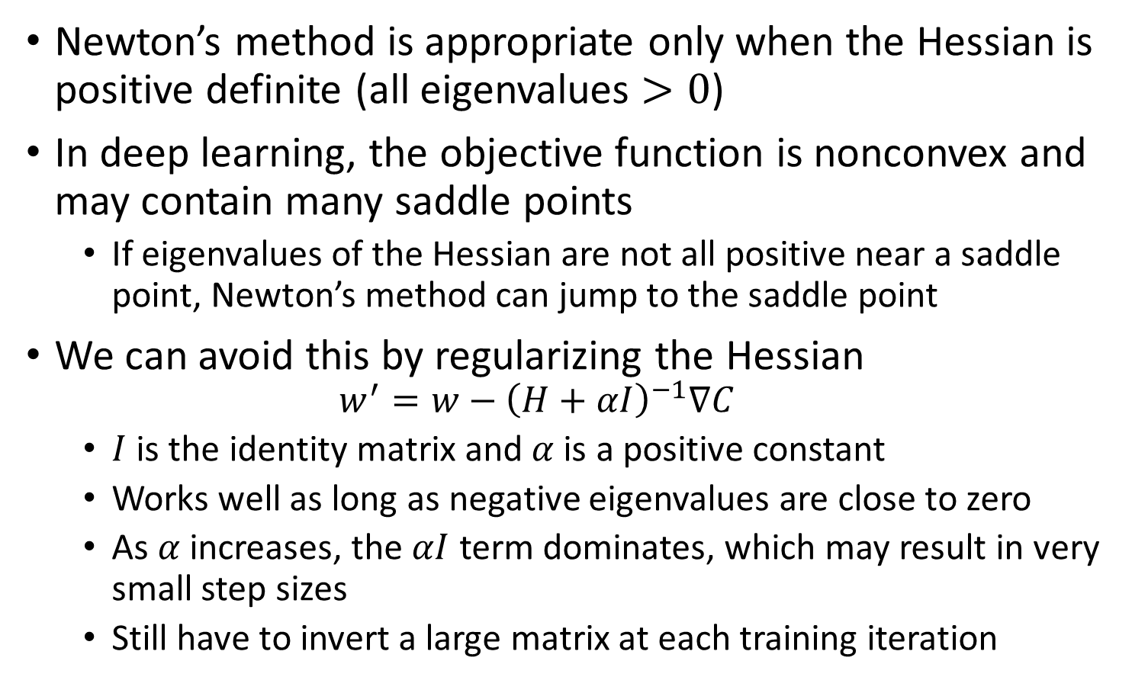
Newton’s method revisited
Newton’s method is appropriate only when the Hessian is positive definite (all eigenvalues $>0$)
In deep learning, the objective function is nonconvex and may contain many saddle points
If eigenvalues of the Hessian are not all positive near a saddle point, Newton’s method can jump to the saddle point
We can avoid this by regularizing the Hessian
$$w^{′}=w−{\left(H+αI\right)}^{−1}∇C$$
$I$ is the identity matrix and $α$ is a positive constant
Works well as long as negative eigenvalues are close to zero
As $α$ increases, the $αI$ term dominates, which may result in very small step sizes
Still have to invert a large matrix at each training iteration

Slide 28
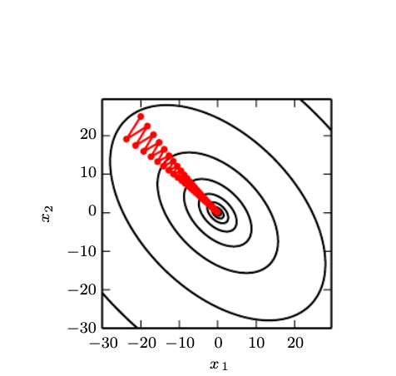
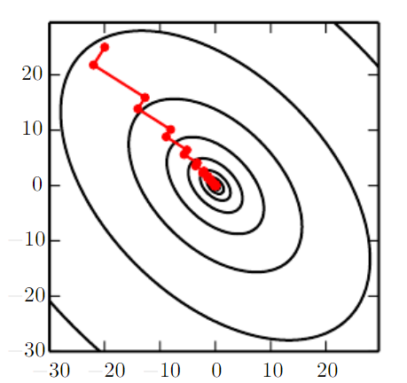
Line Search vs Conjugate Gradients
The gradient doesn’t point in the right direction when there is high curvature
Need to search directions conjugate to the gradient g, pick u s.t. uHg^t = 0

Slide 29
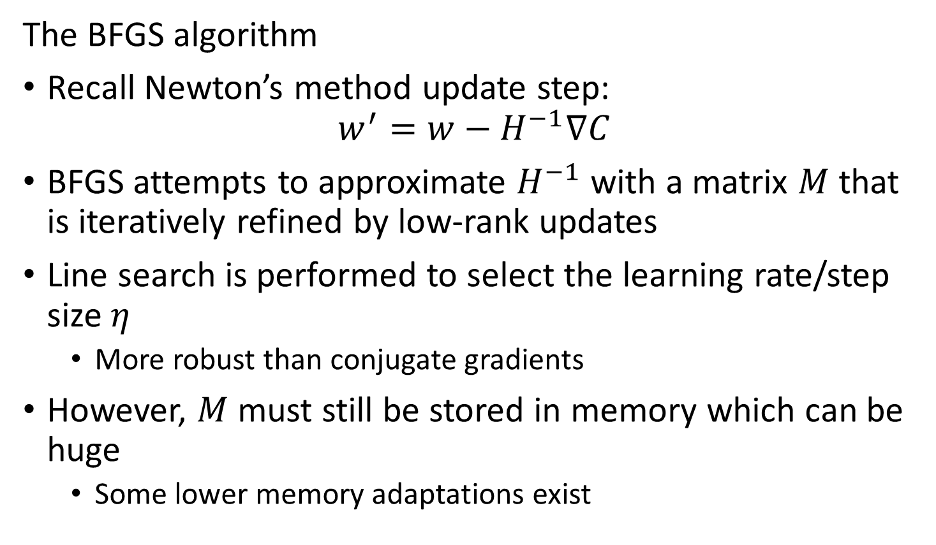
Broyden-Fletcher-Goldfarb-Shanno algorithm
The BFGS algorithm
Recall Newton’s method update step:
$$w^{′}=w−H^{−1}∇C$$
BFGS attempts to approximate $H^{−1}$ with a matrix $M$ that is iteratively refined by low-rank updates
Line search is performed to select the learning rate/step size $η$
More robust than conjugate gradients
However, $M$ must still be stored in memory which can be huge
Some lower memory adaptations exist

Slide 30
Momentum Methods

Slide 31
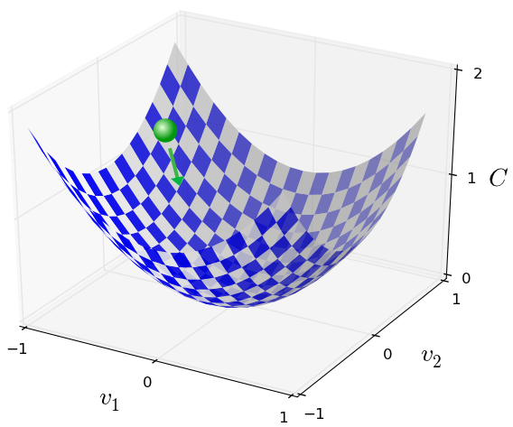
Momentum-based gradient descent
Momentum-based GD incorporates information about how the gradient is changing w/o requiring large matrices of 2nd derivatives
Momentum technique modifies GD to make it more similar to the physics

Slide 32
Momentum-based gradient descent
Two modifications to GD:
Change the “velocity” instead of the “position”
Introduce a friction term which gradually reduces velocity

Slide 33
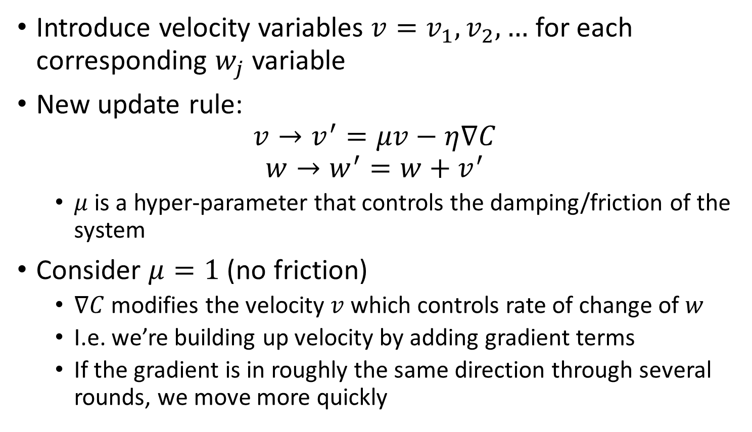
Momentum-based gradient descent
Introduce velocity variables $v=v_{1}, v_{2},…$ for each corresponding $w_{j}$ variable
New update rule:
$$v→v^{′}=μv−η∇C$$
$$w→w^{′}=w+v^{′}$$
$μ$ is a hyper-parameter that controls the damping/friction of the system
Consider $μ=1$ (no friction)
$∇C$ modifies the velocity $v$ which controls rate of change of $w$
I.e. we’re building up velocity by adding gradient terms
If the gradient is in roughly the same direction through several rounds, we move more quickly

Slide 34
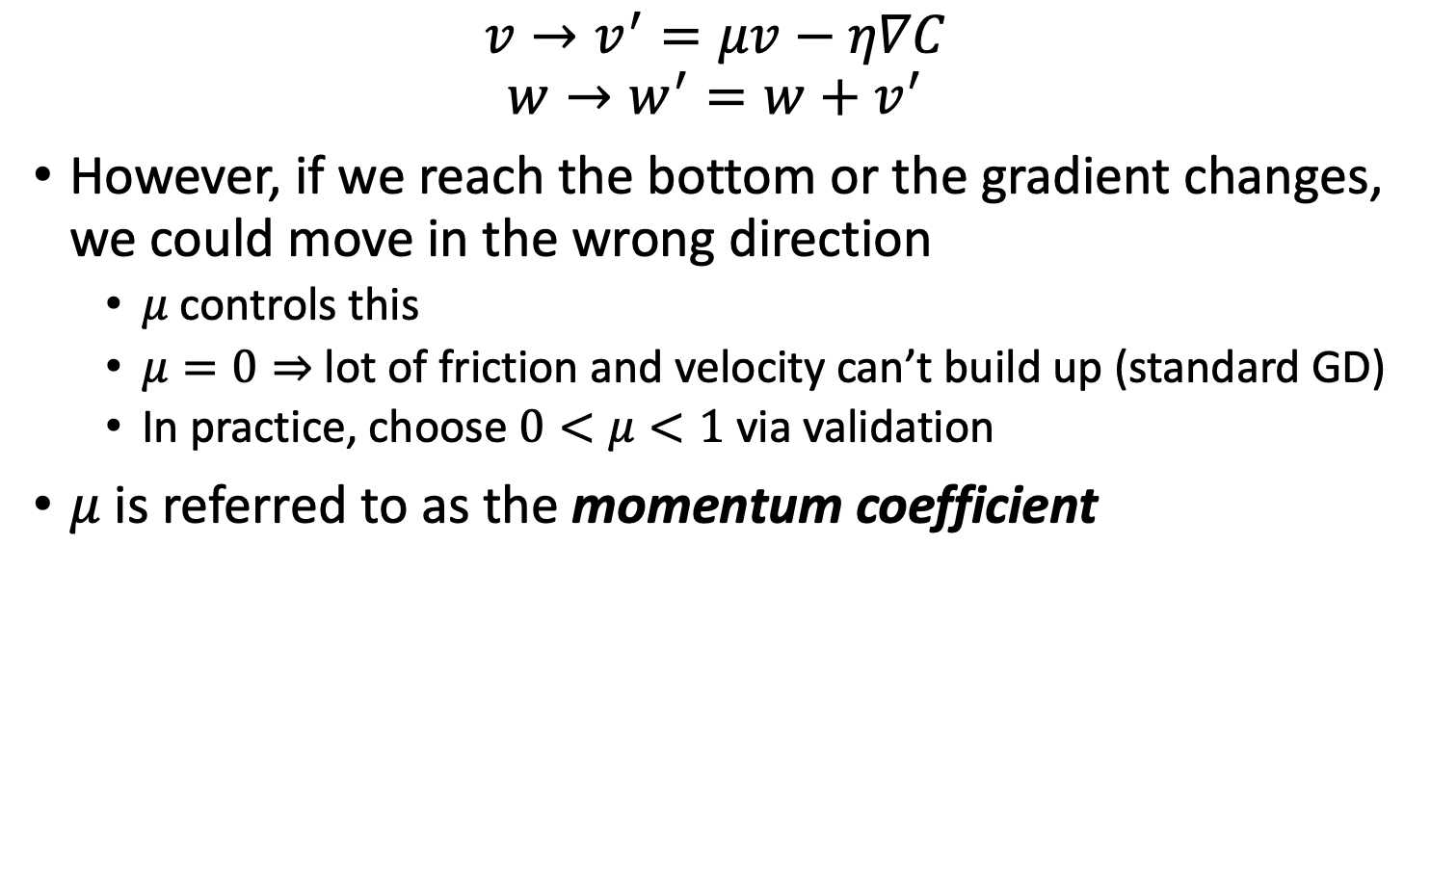
Momentum-based gradient descent
$$v→v^{′}=μv−η∇C$$
$$w→w^{′}=w+v^{′}$$
However, if we reach the bottom or the gradient changes, we could move in the wrong direction
$μ$ controls this
$μ=0⇒$ lot of friction and velocity can’t build up (standard GD)
In practice, choose $0<μ<1$ via validation
$μ$ is referred to as the momentum coefficient

Slide 35

Momentum-based gradient descent
If $∇C$ is the same always, the terminal velocity is
$$\frac{η\left\|∇C\right\|}{1−μ}$$
It can be helpful to think of the momentum coefficient in this context
Typical values include $0.5, 0.9,$and $0.99$

Slide 36
Advantages of momentum technique
Relatively simple to modify GD to incorporate momentum
Backpropagation and mini-batch sampling is the same
Much more computationally friendly than the Hessian technique
We obtain some of the advantages of the Hessian technique
Because of this, the momentum technique is commonly used to speed up learning

Slide 37
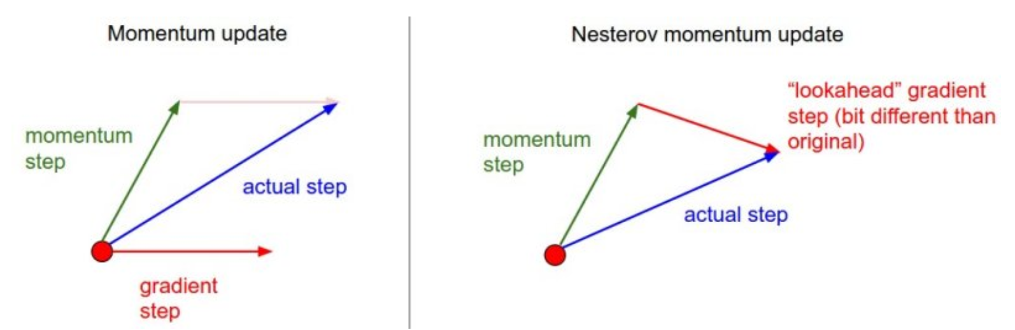
Nesterov Momentum

Slide 38
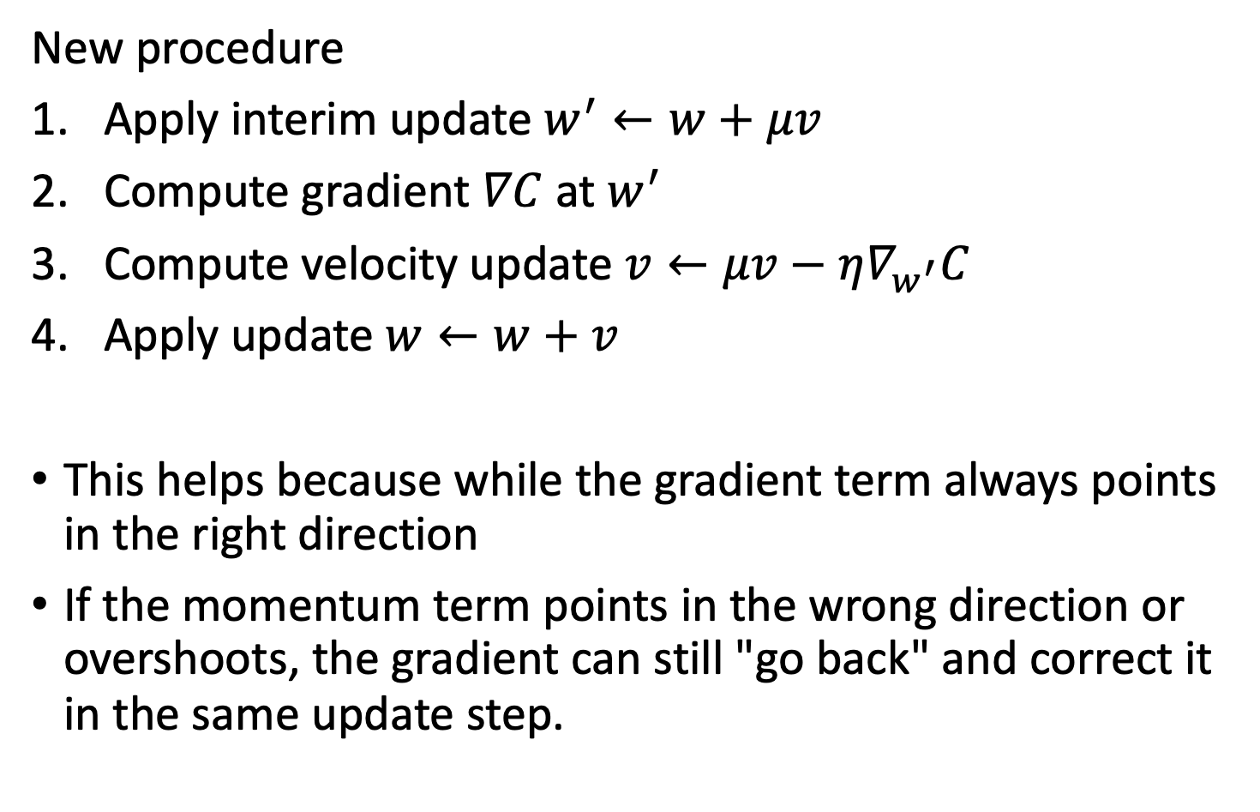
Nesterov momentum
New procedure
Apply interim update $w^{′}←w+μv$
Compute gradient $∇C$ at $w^{′}$
Compute velocity update $v←μv−η∇_{w^{′}}C$
Apply update $w←w+v$
This helps because while the gradient term always points in the right direction
If the momentum term points in the wrong direction or overshoots, the gradient can still "go back" and correct it in the same update step.

Slide 39
Adaptive Learning Rates
AdaGrad, RMSProp, Adam

Slide 40
Adaptive learning rates
The learning rate is one of the hardest hyper-parameter to tune
Cost functions are often highly sensitive to some directions in parameter space and insensitive to others
In this case, it makes sense to have separate learning rates for each parameter
Not more parameters!
Set these parameters adaptively
Early heuristic: delta-bar-delta algorithm (Jacobs, 1988)
If the partial derivative of the loss wrt to a parameter remains the same sign, then increase the learning rate
If the sign changes, decrease the learning rate
Only applies to batch optimization

Slide 41
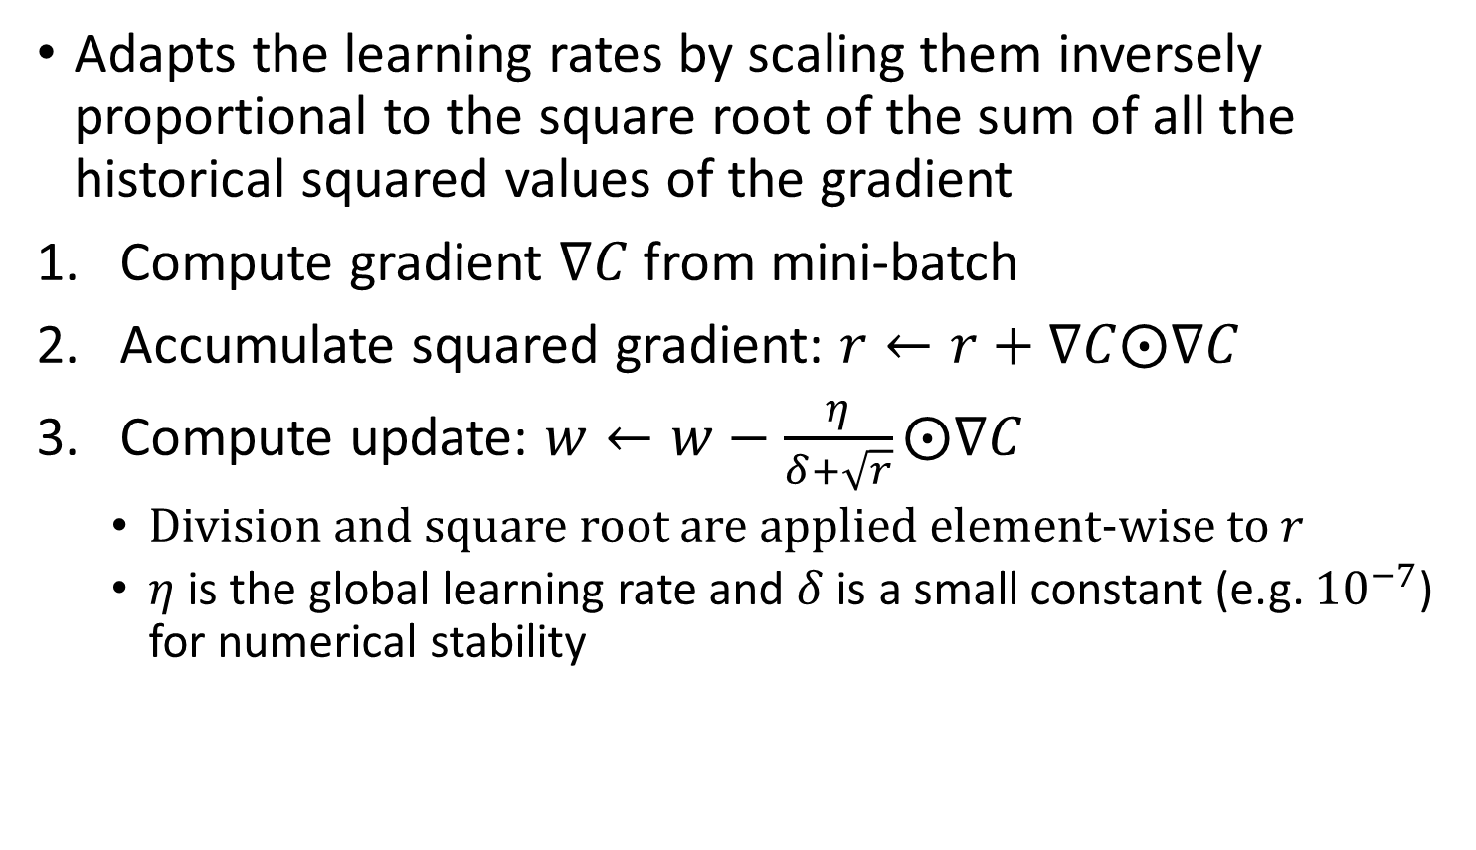
AdaGrad
Adapts the learning rates by scaling them inversely proportional to the square root of the sum of all the historical squared values of the gradient
Compute gradient $∇C$ from mini-batch
Accumulate squared gradient: $r←r+∇C⨀∇C$
Compute update: $w←w−\frac{η}{δ+\sqrt{r}}⨀∇C$
Division and square root are applied element-wise to $r$
$η$ is the global learning rate and $δ$ is a small constant (e.g. ${10}^{−7}$) for numerical stability

Slide 42
AdaGrad
Adapts the learning rates by scaling them inversely proportional to the square root of the sum of all the historical squared values of the gradient
Parameters with largest partial derivative have rapid decrease in their learning rate
Parameters with small partial derivatives have relatively small decrease in their learning rate
Net effect: greater progress in the more gently sloped directions
In convex optimization, AdaGrad has nice theoretical properties
But for neural networks, AdaGrad can result in premature and excessive decrease in the effective learning rate
Performs well for some but not all deep learning models

Slide 43
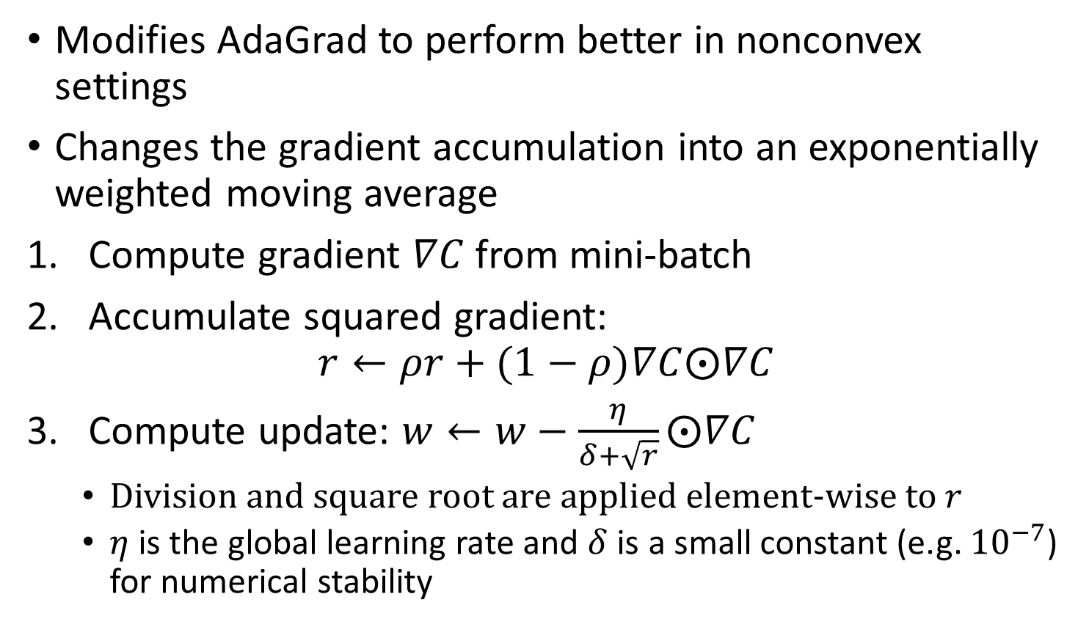
RMSProp
Modifies AdaGrad to perform better in nonconvex settings
Changes the gradient accumulation into an exponentially weighted moving average
Compute gradient $∇C$ from mini-batch
Accumulate squared gradient: $r←ρr+(1−ρ)∇C⨀∇C$
Compute update: $w←w−\frac{η}{δ+\sqrt{r}}⨀∇C$
Division and square root are applied element-wise to $r$
$η$ is the global learning rate and $δ$ is a small constant (e.g. ${10}^{−7}$) for numerical stability

Slide 44
RMSProp
AdaGrad is designed to converge rapidly for a convex function
When learning in a neural network, the learning trajectory may pass through many different structures and eventually arrive at a locally convex region
AdaGrad shrinks the learning rate according to the entire history of the trajectory
Learning rate may be too small before arriving at the convex structure
RMSProp use an exponentially decaying average to throw out history from the extreme past
Thus it converges quickly after finding a convex bowl
Similar to initializing AdaGrad within that bowl

Slide 45
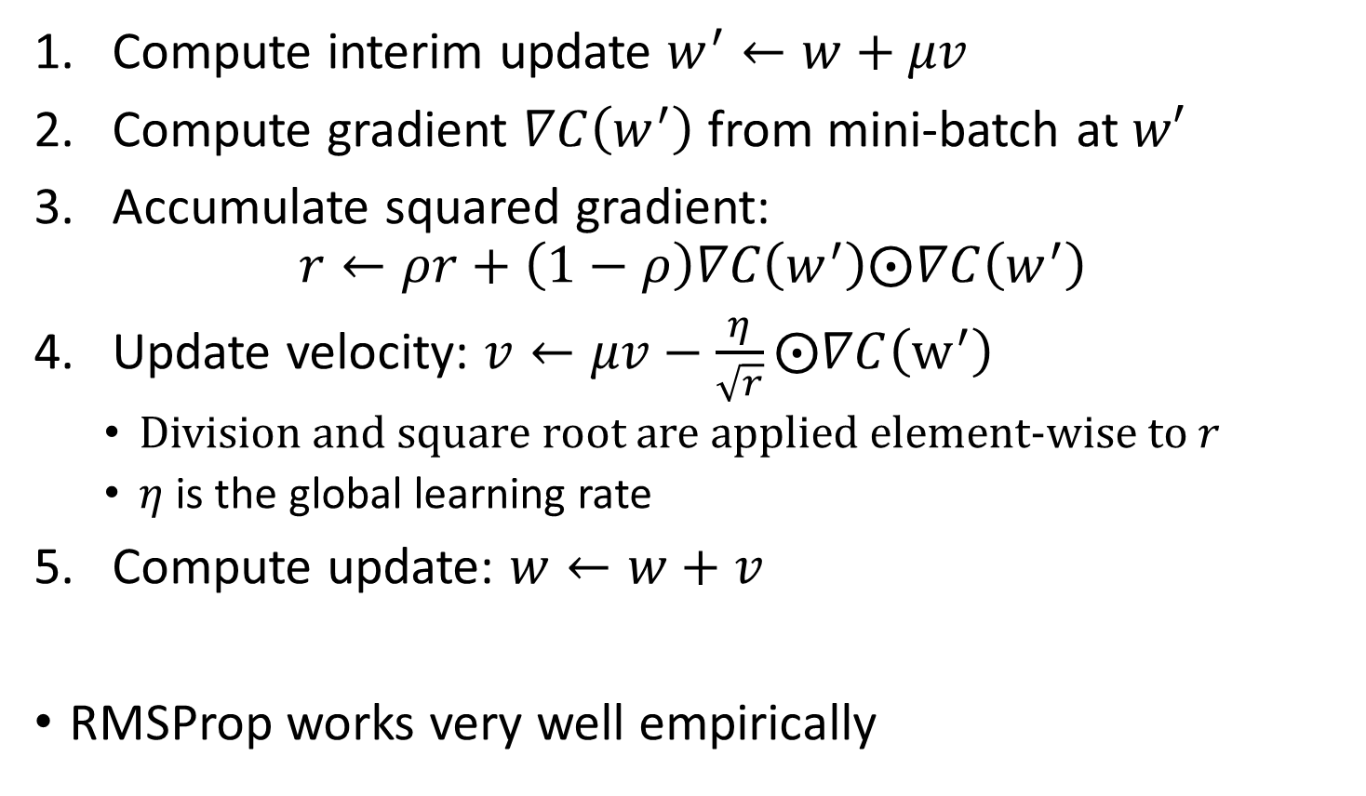
RMSProp with Nesterov Momentum
Compute interim update $w^{′}←w+μv$
Compute gradient $∇C\left(w^{′}\right)$ from mini-batch at $w′$
Accumulate squared gradient: $r←ρr+\left(1−ρ\right)∇C\left(w^{′}\right)⨀∇C\left(w^{′}\right)$
Update velocity: $v←μv−\frac{η}{\sqrt{r}}⨀∇C\left(w^{′}\right)$
Division and square root are applied element-wise to $r$
$η$ is the global learning rate
Compute update: $w←w+v$
RMSProp works very well empirically

Slide 46

Adam
Name derived from “adaptive moments”
Different moments for each parameter
A combination of RMSProp and momentum
RMSProp adjust learning rate based on average gradients
Momentum uses moving average of gradients to take a step
Adam uses first and 2nd moments
What is a moment?

Slide 47
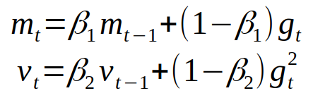
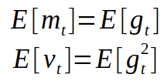
Moments of gradients
Gradients of cost function can be considered a random variable
Moving averages of gradient and squared gradient

Slide 48
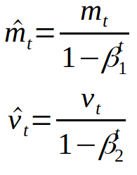
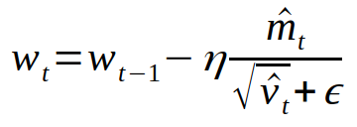
Correcting Bias in moments
It turns out that estimating moments from sampled data incurs bias
In statistics there is a way to correct for this bias with bias corrected estimators
Adam then applies these to obtain weights

Slide 49
Adam
Adam is fairly robust to hyper-parameters
Learning rate needs to be changed sometimes from suggested default
See Goodfellow et al., Section 8.5.3 for suggested initial parameters

Slide 50
Which method should I choose?
Good question…
Schaul et al. (2014) presented a large comparison
Algorithms with adaptive learning rates generally performed best and were robust
But no clear winner emerged
Popular choices are SGD, SGD with momentum, RMSProp, RMSProp with momentum, and Adam
In other words, you can choose one and become familiar with it and be relatively confident that there isn’t a universally better approach out there
Especially once you become familiar with how to tune hyper-parameters with your choice

Slide 51
Further reading
Goodfellow et al., Sections 4.3, 8.1-8.3, 8.5-8.6
Nielsen book, chapter 3
Choromanska et al, “The Loss Surfaces of Multilayer Neural Networks,” 2014.
https://towardsdatascience.com/adam-latest-trends-in-deep-learning-optimization-6be9a291375c

