Slide 1


Deep Learning Theory and Applications Backpropagation
CPSC/AMTH/CBB 663
CPSC 452/552

Slide 2
Calculating the gradients
We showed how neural networks can learn weights and biases
Gradient descent/stochastic gradient descent
How do we calculate the gradients at each node in each layer?
Answer: Backpropagation!
Notes:
Backpropagation was introduced in the 1970’s but not appreciated until 1986 in a paper by David Rumelhart, Geoffrey Hinton, and Ronald Williams.

Slide 3
Backpropagation history
Introduced in 1970’s
Unappreciated until 1986 paper by David Rumelhart, Geoffrey Hinton, and Ronald Williams
Described several neural networks where backpropagation works far faster than earlier learning approaches
Today, backpropagation is the “workhorse” of learning neural networks

Slide 4
Preliminaries

Slide 5
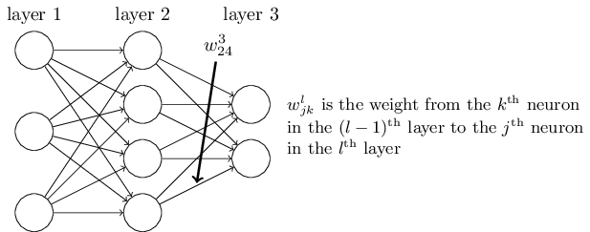

Matrix multiplication for computing activations
$w_{jk}^{l}=$ the weight for the connection from the $k$th neuron in the $(l−1)$th layer to the $j$th neuron in the $l$th layer
Question: why is $j$ the output neuron and $k$ the input neuron?
Answer: it simplifies the matrix notation for multiplication to he right Wx+b

Slide 6
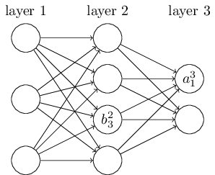

Matrix multiplication for computing activations
$b_{j}^{l}=$ bias of the $j$th neuron in the $l$th layer
$a_{j}^{l}=$ activation (output) of the $j$th neuron in the $l$th layer
Notes:
Take this slowly, note that the subscript gives the neuron while superscript gives the layer. Maybe write these all on the board.

Slide 7

Matrix multiplication for computing activations
The activation $a_{j}^{l}$ of the $j$th neuron the $l$th layer is related to the activations in the $(l−1)$th layer:
$$a_{j}^{l}=σ\left(\sum_{k}{w_{jk}^{l}a_{k}^{l−1}+b_{j}^{l}}\right)$$
Notes:
Note that the sum is over all k neurons in the (l-1)th layer. Write on board, the example of $a_{1}^{3}$ here. Write $a_{1}^{3}=σ(\sum_{k=1}^{4}{w_{1k}^{3}a_{k}^{2}+b_{1}^{3})}$

Slide 8
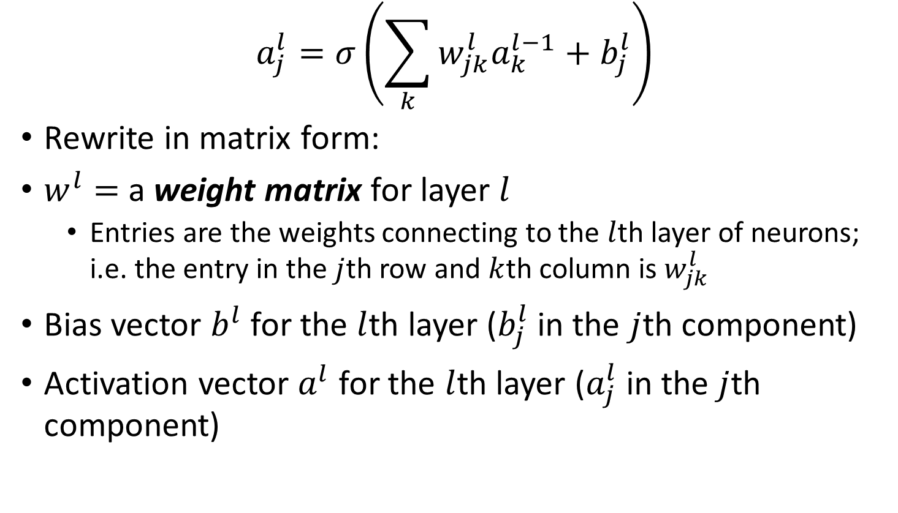
Matrix multiplication for computing activations
$$a_{j}^{l}=σ\left(\sum_{k}{w_{jk}^{l}a_{k}^{l−1}+b_{j}^{l}}\right)$$
Rewrite in matrix form:
$w^{l}=$ a weight matrix for layer $l$
Entries are the weights connecting to the $l$th layer of neurons; i.e. the entry in the $j$th row and $k$th column is $w_{jk}^{l}$
Bias vector $b^{l}$ for the $l$th layer ($b_{j}^{l}$ in the $j$th component)
Activation vector $a^{l}$ for the $l$th layer ($a_{j}^{l}$ in the $j$th component)

Slide 9
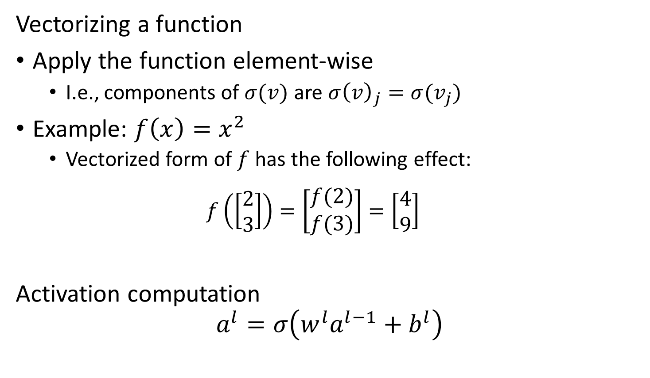
Matrix multiplication for computing activations
Vectorizing a function
Apply the function element-wise
I.e., components of $σ(v)$ are $σ{\left(v\right)}_{j}=σ(v_{j})$
Example: $f\left(x\right)=x^{2}$
Vectorized form of $f$ has the following effect:
$$f\left(\left[\begin{matrix}2 \\ 3\end{matrix}\right]\right)=\left[\begin{matrix}f(2) \\ f(3)\end{matrix}\right]=\left[\begin{matrix}4 \\ 9\end{matrix}\right]$$
Activation computation
$$a^{l}=σ\left(w^{l}a^{l−1}+b^{l}\right)$$

Slide 10
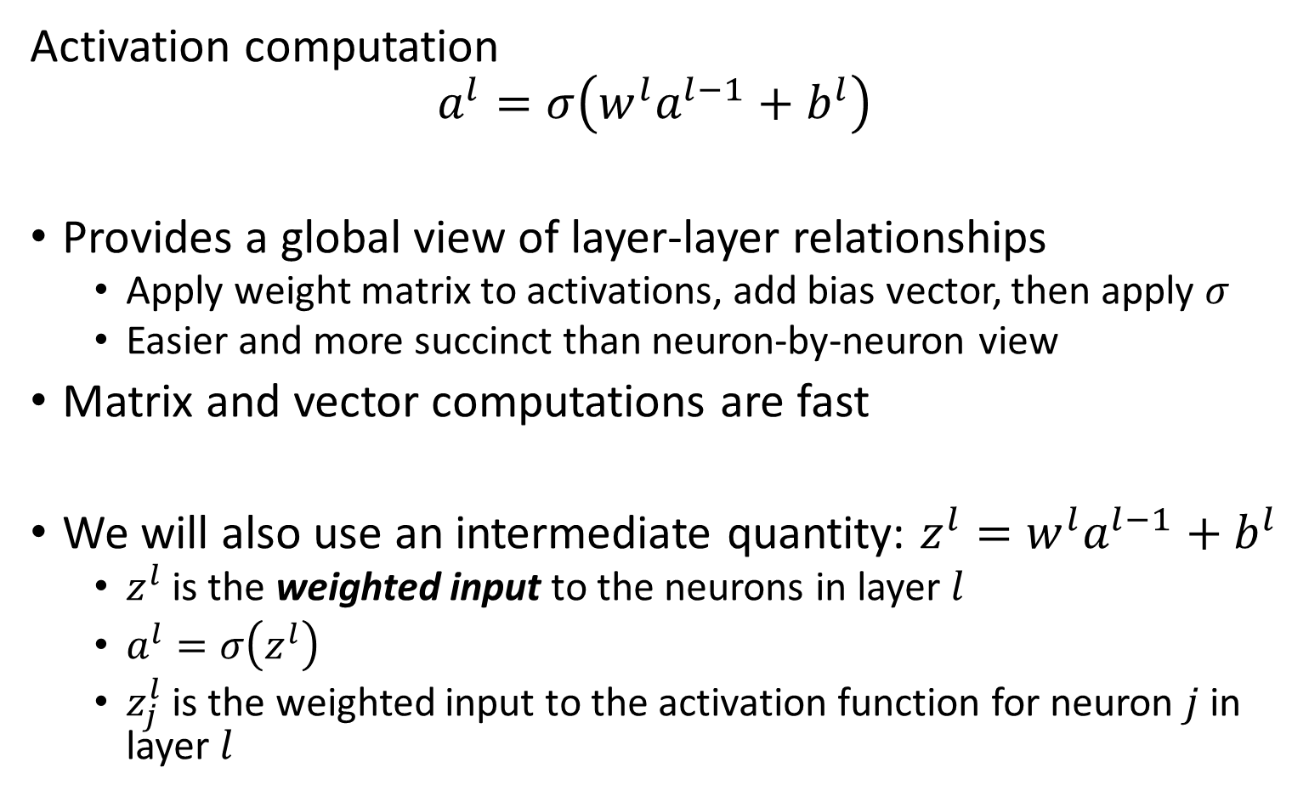
Matrix multiplication for computing activations
Activation computation
$$a^{l}=σ\left(w^{l}a^{l−1}+b^{l}\right)$$
Provides a global view of layer-layer relationships
Apply weight matrix to activations, add bias vector, then apply $σ$
Easier and more succinct than neuron-by-neuron view
Matrix and vector computations are fast
We will also use an intermediate quantity: $z^{l}=w^{l}a^{l−1}+b^{l}$
$z^{l}$ is the weighted input to the neurons in layer $l$
$a^{l}=σ\left(z^{l}\right)$
$z_{j}^{l}$ is the weighted input to the activation function for neuron $j$ in layer $l$

Slide 11
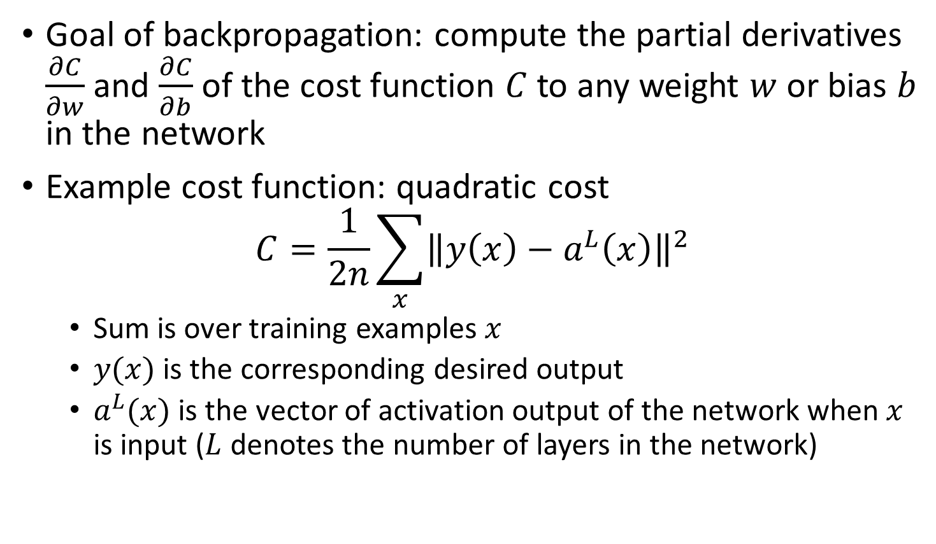
Cost function
Goal of backpropagation: compute the partial derivatives $\frac{∂C}{∂w}$ and $\frac{∂C}{∂b}$ of the cost function $C$ to any weight $w$ or bias $b$ in the network
Example cost function: quadratic cost
$$C=\frac{1}{2n}\sum_{x}{{\left\|y\left(x\right)−a^{L}\left(x\right)\right\|}^{2}}$$
Sum is over training examples $x$
$y(x)$ is the corresponding desired output
$a^{L}(x)$ is the vector of activation output of the network when $x$ is input ($L$ denotes the number of layers in the network)

Slide 12
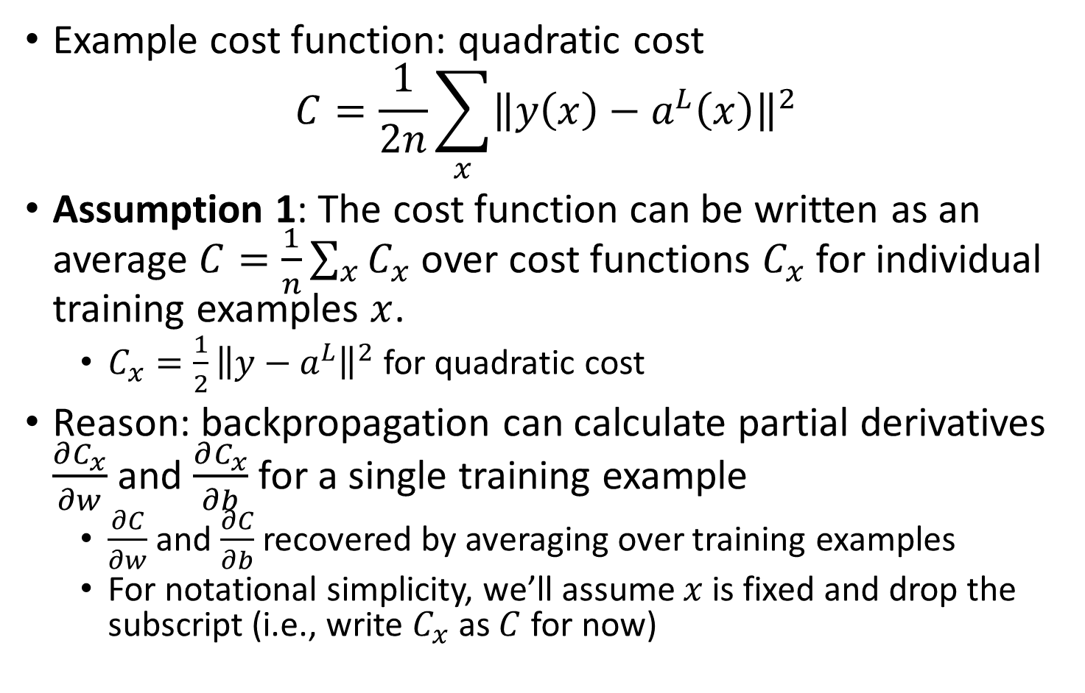
Cost function assumptions
Example cost function: quadratic cost
$$C=\frac{1}{2n}\sum_{x}{{\left\|y\left(x\right)−a^{L}\left(x\right)\right\|}^{2}}$$
Assumption 1: The cost function can be written as an average $C=\frac{1}{n}\sum_{x}{C_{x}}$ over cost functions $C_{x}$ for individual training examples $x$.
$C_{x}=\frac{1}{2}{\left\|y−a^{L}\right\|}^{2}$ for quadratic cost
Reason: backpropagation can calculate partial derivatives $\frac{∂C_{x}}{∂w}$ and $\frac{∂C_{x}}{∂b}$ for a single training example
$\frac{∂C}{∂w}$ and $\frac{∂C}{∂b}$ recovered by averaging over training examples
For notational simplicity, we’ll assume $x$ is fixed and drop the subscript (i.e., write $C_{x}$ as $C$ for now)
Notes:
Go slow here

Slide 13
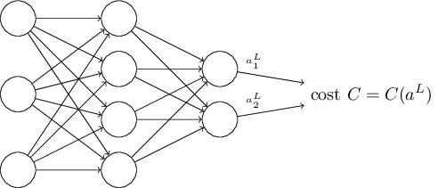

Cost function assumptions
Assumption 2: Cost can be written as a function of the neural network outputs
For quadratic cost:
$$C=\frac{1}{2}{\left\|y−a^{L}\right\|}^{2}=\frac{1}{2}\sum_{j}{{\left(y_{i}−a_{j}\right)}^{2}}$$
Notes:
Go slow here. Recall that C=C_x and that we’re assuming that x and therefore y are fixed.

Slide 14
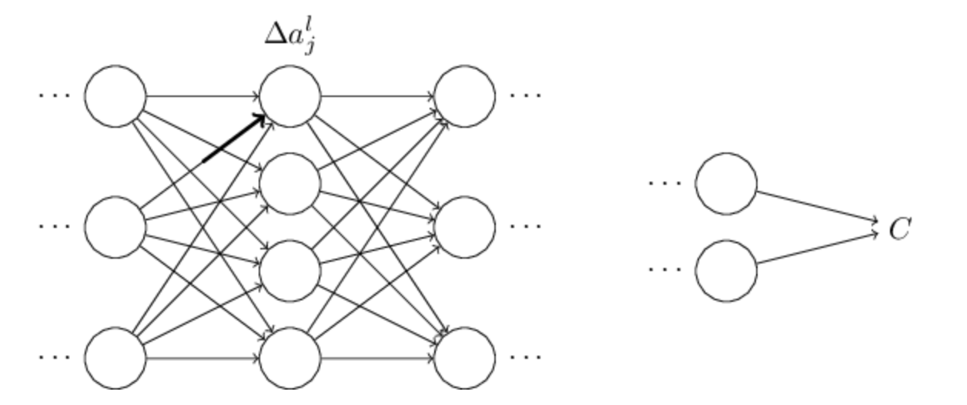
Backpropagation: Error forward
Suppose you made a small change to a weight
Causes a change in the activation of the output neuron

Slide 15
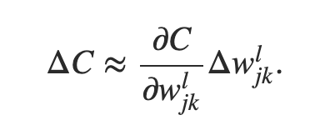
Change propagates…
Causes a change in all the activations in the next layer
Then moves to the next layer, next layer …to the output and then the cost fxn

Slide 16
Tracking the change
This suggests that if we track how a weight change propagates to change the cost function then we can compute the gradient of the weight wrt cost
Lets try it!

Slide 17
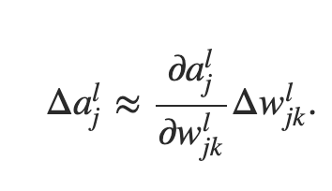
Weight → activation
Change in weight causes change in following activation

Slide 18
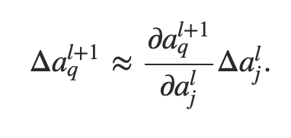
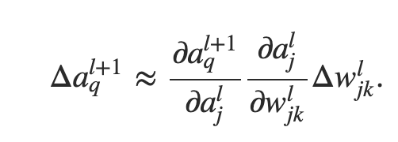
Activation→next layer Activation

Slide 19
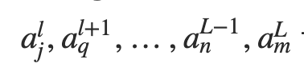
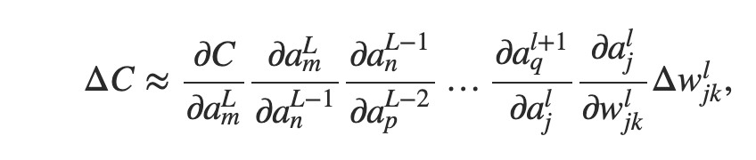
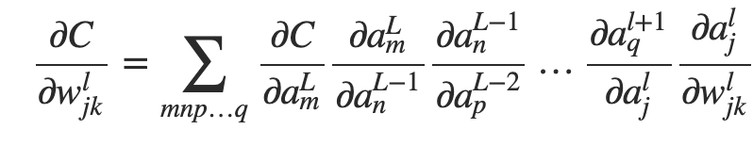
Next activation→Cost
Path through layers:
Summing over all paths:
Already computed proceeding backwards

Slide 20
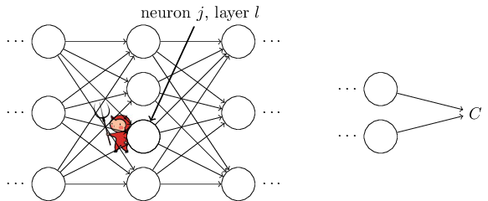

Preliminary: Error at the node
We first introduce an intermediate quantity $δ_{j}^{l}$
$δ_{j}^{l}$ is the error in the $j$th neuron and the $l$th layer
Backpropagation enables us to compute $δ_{j}^{l}$ which we will relate to $\frac{∂C}{∂w_{jk}^{l}}$ and $\frac{∂C}{∂b_{j}^{l}}$

Slide 21
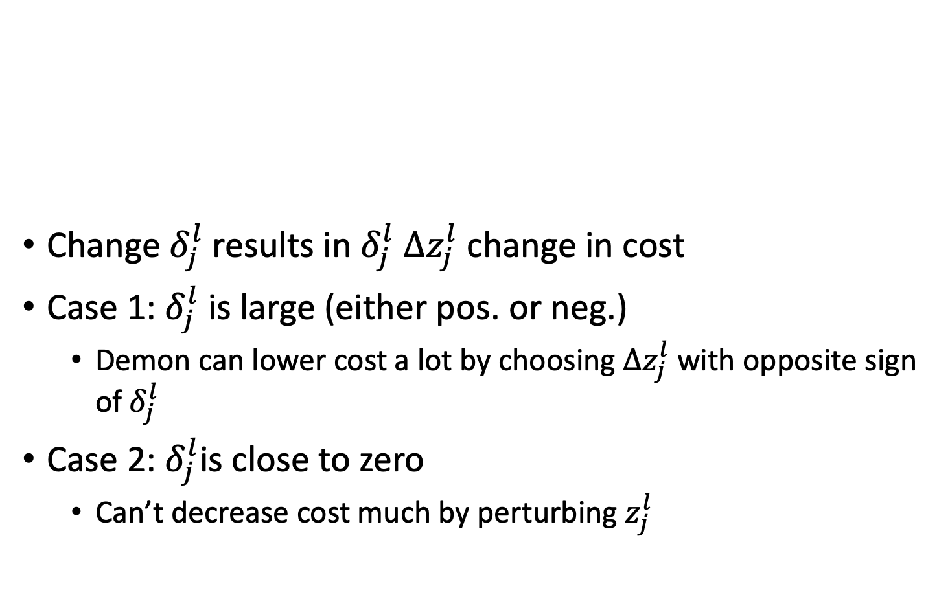
Error at the node
Change $δ_{j}^{l}$results in $δ_{j}^{l} Δz_{j}^{l}$ change in cost
Case 1: $δ_{j}^{l}$is large (either pos. or neg.)
Demon can lower cost a lot by choosing $Δz_{j}^{l}$ with opposite sign of $δ_{j}^{l}$
Case 2: $δ_{j}^{l}$is close to zero
Can’t decrease cost much by perturbing $z_{j}^{l}$
Notes:
Suppose the demon is good and wants to make the cost smaller

Slide 22
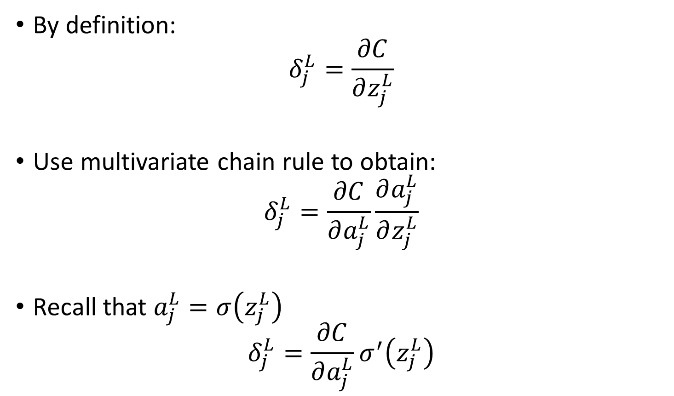
1st Equation Error at the Output
By definition:
$$δ_{j}^{L}=\frac{∂C}{∂z_{j}^{L}}$$
Use multivariate chain rule to obtain:
$$δ_{j}^{L}=\frac{∂C}{∂a_{j}^{L}}\frac{∂a_{j}^{L}}{∂z_{j}^{L}}$$
Recall that $a_{j}^{L}=σ\left(z_{j}^{L}\right)$
$$δ_{j}^{L}=\frac{∂C}{∂a_{j}^{L}}σ^{′}\left(z_{j}^{L}\right)$$
Notes:
Do details on board

Slide 23
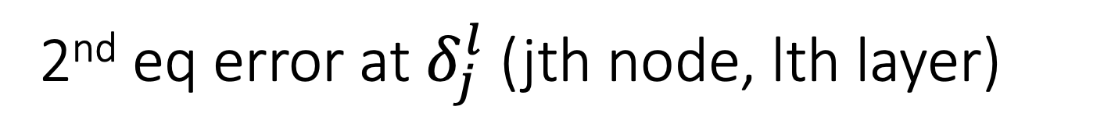
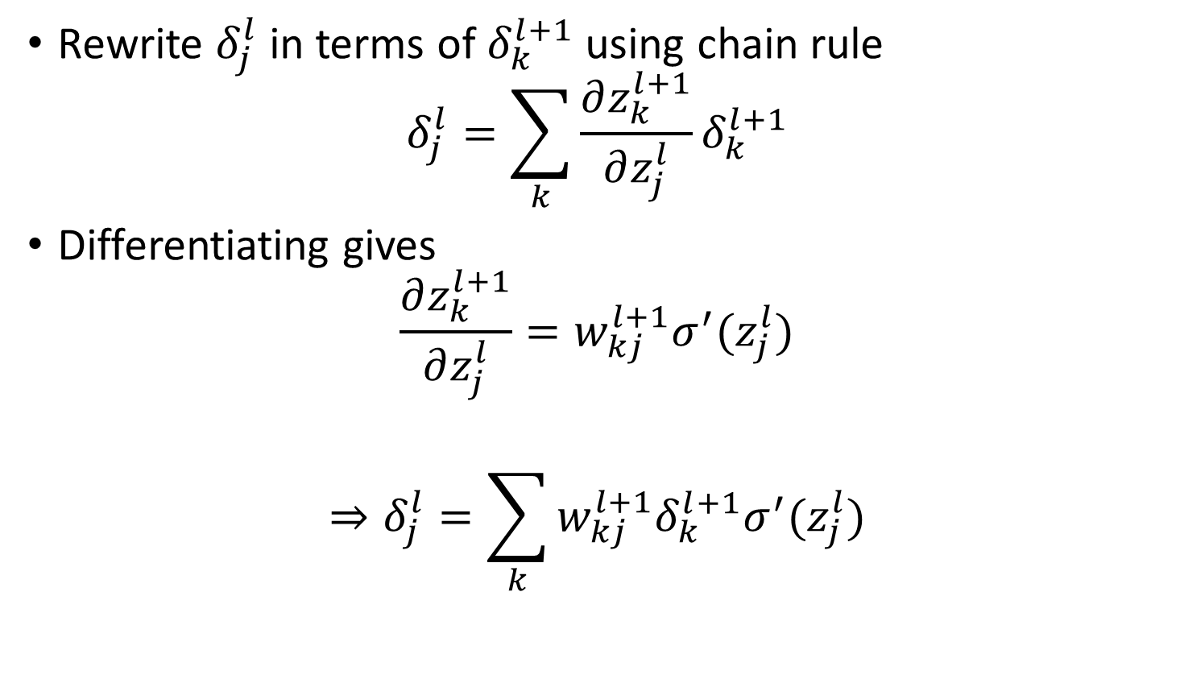
2nd eq error at $δ_{j}^{l}$ (jth node, lth layer)
Rewrite $δ_{j}^{l}$ in terms of $δ_{k}^{l+1}$ using chain rule
$$δ_{j}^{l}=\sum_{k}{\frac{∂z_{k}^{l+1}}{∂z_{j}^{l}}δ_{k}^{l+1}}$$
Differentiating gives
$$\frac{∂z_{k}^{l+1}}{∂z_{j}^{l}}=w_{kj}^{l+1}σ^{′}(z_{j}^{l})$$
$$⇒δ_{j}^{l}=\sum_{k}{w_{kj}^{l+1}δ_{k}^{l+1}σ^{′}(z_{j}^{l})}$$

Slide 24

3rd equation error of a bias
Use multivariate chain rule to obtain:
$$\frac{∂C}{∂b_{j}^{l}}=\frac{∂C}{∂z_{j}^{l}}\frac{∂z_{j}^{l}}{∂b_{j}^{l}}$$
$\frac{∂z_{j}^{l}}{∂b_{j}^{l}}=1$
$$⇒\frac{∂C}{∂b_{j}^{l}}=δ_{j}^{l}$$

Slide 25

4th equation error of weight
Use multivariate chain rule to obtain:
$$\frac{∂C}{∂w_{jk}^{l}}=\frac{∂C}{∂z_{j}^{l}}\frac{∂z_{j}^{l}}{∂w_{jk}^{l}}$$
$\frac{∂z_{j}^{l}}{∂w_{jk}^{l}}=a_{k}^{l−1}$
$$⇒\frac{∂C}{∂w_{jk}^{l}}=a_{k}^{l−1}δ_{j}^{l}$$
Notes:
Ask students to suggest how they would prove it

Slide 26
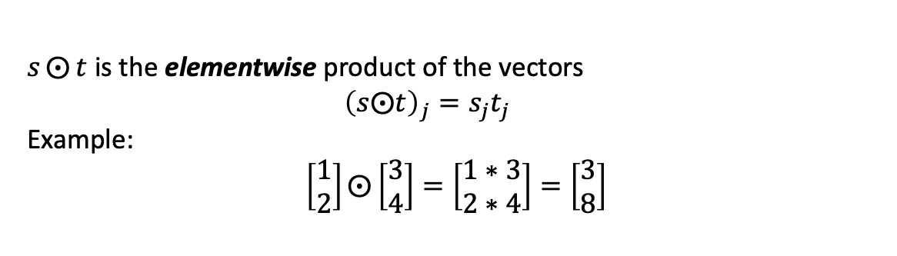

The 4 fundamental equations of backpropagation
$δ^{L}=∇_{a}C⨀σ^{′}\left(z^{L}\right)$
$δ^{l}=\left({\left(w^{l+1}\right)}^{T}δ^{l+1}\right)⨀σ^{′}(z^{l})$
$\frac{∂C}{∂b_{j}^{l}}=δ_{j}^{l}$
$\frac{∂C}{∂w_{jk}^{l}}=a_{k}^{l−1}δ_{j}^{l}$
$s⨀{t}$ is the elementwise product of the vectors
$${\left(s⨀t\right)}_{j}=s_{j}t_{j}$$
Example:
$$\left[\begin{matrix}1 \\ 2\end{matrix}\right]⨀\left[\begin{matrix}3 \\ 4\end{matrix}\right]=\left[\begin{matrix}1∗3 \\ 2∗4\end{matrix}\right]=\left[\begin{matrix}3 \\ 8\end{matrix}\right]$$

Slide 27
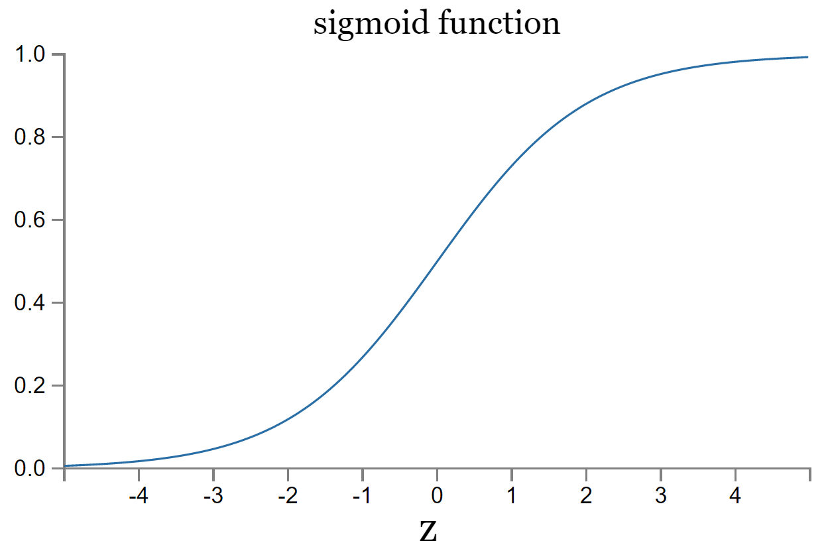
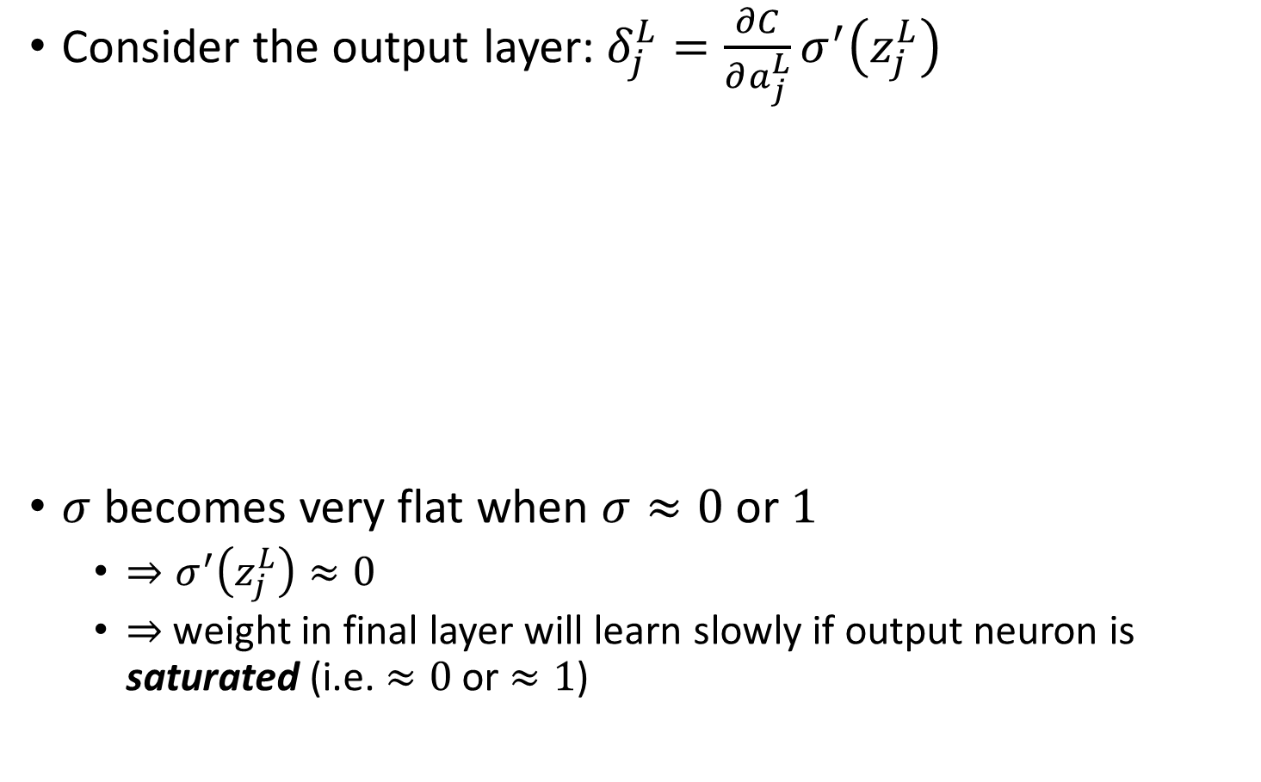
Insights from the 4 fundamental equations
Consider the output layer: $δ_{j}^{L}=\frac{∂C}{∂a_{j}^{L}}σ^{′}\left(z_{j}^{L}\right)$
$σ$ becomes very flat when $σ≈0$ or $1$
$⇒σ^{′}\left(z_{j}^{L}\right)≈0$
$⇒$ weight in final layer will learn slowly if output neuron is saturated (i.e. $≈0$ or $≈1$)

Slide 28
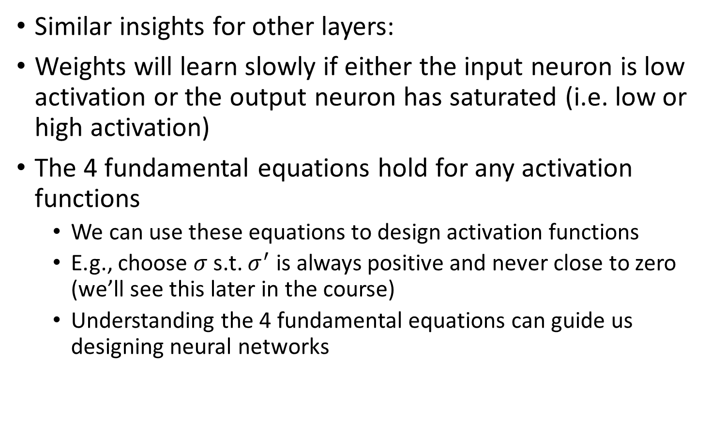
Insights from the 4 fundamental equations
Similar insights for other layers:
Weights will learn slowly if either the input neuron is low activation or the output neuron has saturated (i.e. low or high activation)
The 4 fundamental equations hold for any activation functions
We can use these equations to design activation functions
E.g., choose $σ$ s.t. $σ^{′}$ is always positive and never close to zero (we’ll see this later in the course)
Understanding the 4 fundamental equations can guide us designing neural networks

Slide 29
The backpropagation algorithm

Slide 30
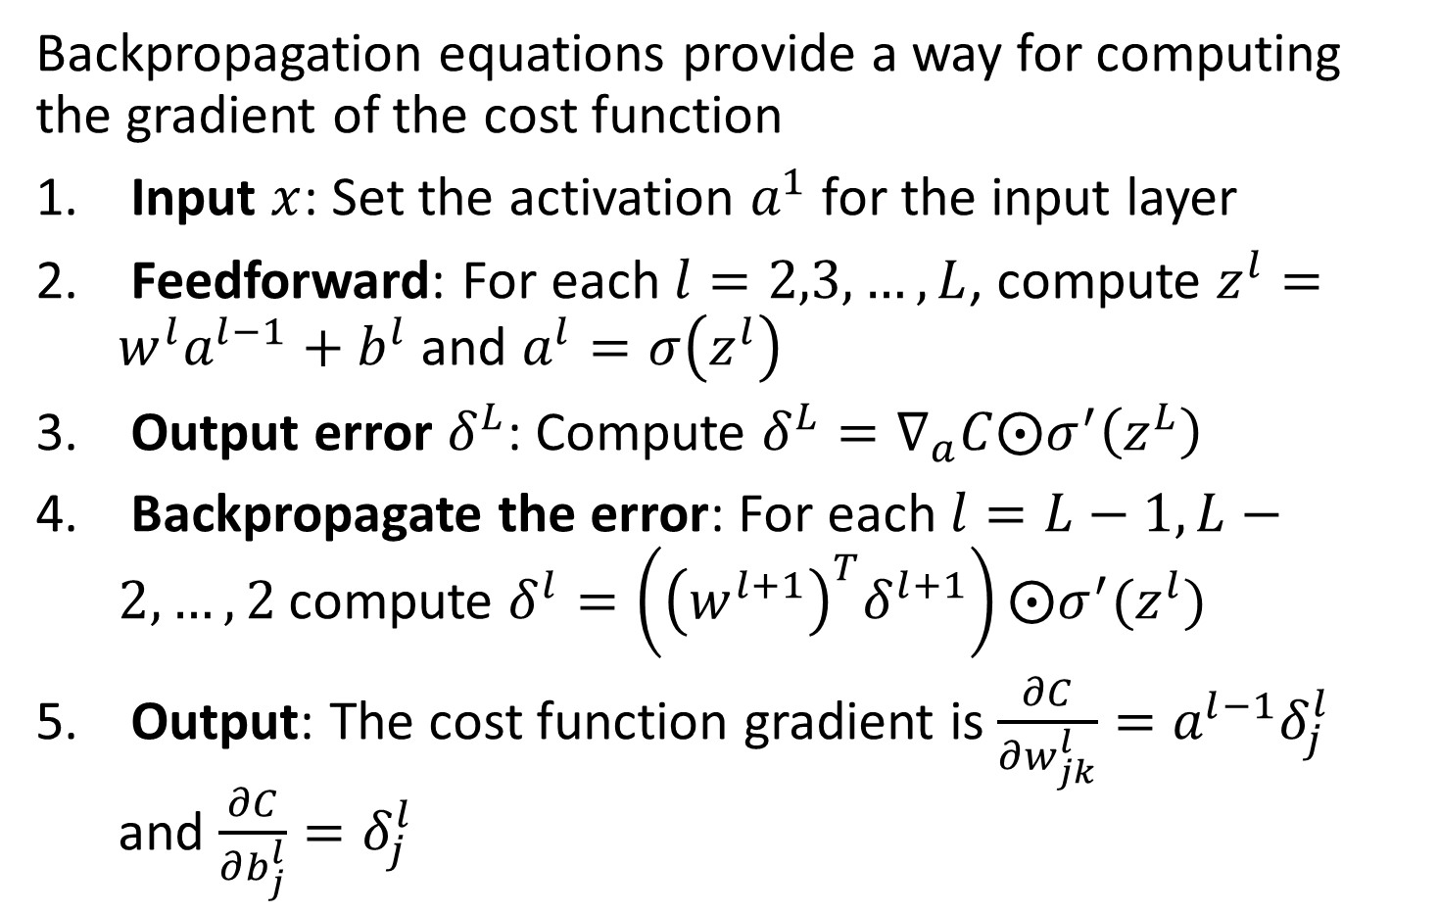
The backpropagation algorithm
Backpropagation equations provide a way for computing the gradient of the cost function
Input $x$: Set the activation $a^{1}$ for the input layer
Feedforward: For each $l=2,3,…,L$, compute $z^{l}=w^{l}a^{l−1}+b^{l}$ and $a^{l}=σ\left(z^{l}\right)$
Output error $δ^{L}$: Compute $δ^{L}=∇_{a}C⨀σ^{′}\left(z^{L}\right)$
Backpropagate the error: For each $l=L−1,L−2,…,2$ compute $δ^{l}=\left({\left(w^{l+1}\right)}^{T}δ^{l+1}\right)⨀σ^{′}(z^{l})$
Output: The cost function gradient is $\frac{∂C}{∂w_{jk}^{l}}=a^{l−1}δ_{j}^{l}$ and $\frac{∂C}{∂b_{j}^{l}}=δ_{j}^{l}$
Notes:
You can see why this is called backpropagation. We compute the error vectors backward, starting from the final layer. But from the proof of backpropagation, the backward movement is due to the fact that the cost is a function of outputs from the network. To understand how the cost varies with earlier weights and biases, we need to repeatedly apply the chain rule, working backward through layers to obtain usable expressions.

Slide 31

Backpropagation with SGD
Backpropagation computes the gradient of the cost function for a single training example $C=C_{x}$
Typically, backpropagation is combined with a learning algorithm such as stochastic gradient descent

Slide 32
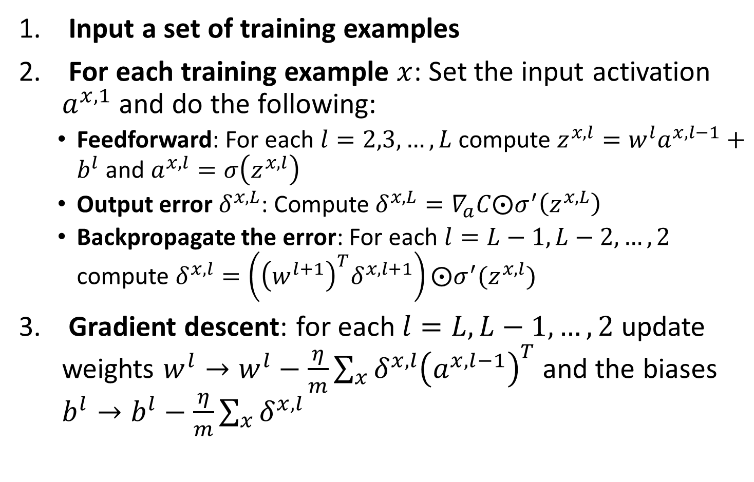
Backpropagation with SGD
Input a set of training examples
For each training example $x$: Set the input activation $a^{x,1}$ and do the following:
Feedforward: For each $l=2,3,…,L$ compute $z^{x,l}=w^{l}a^{x,l−1}+b^{l}$ and $a^{x,l}=σ\left(z^{x,l}\right)$
Output error $δ^{x,L}$: Compute $δ^{x,L}=∇_{a}C⨀σ^{′}\left(z^{x,L}\right)$
Backpropagate the error: For each $l=L−1,L−2,…,2$ compute $δ^{x,l}=\left({\left(w^{l+1}\right)}^{T}δ^{x,l+1}\right)⨀σ^{′}(z^{x,l})$
Gradient descent: for each $l=L,L−1,…,2$ update weights $w^{l}→w^{l}−\frac{η}{m}\sum_{x}{δ^{x,l}{\left(a^{x,l−1}\right)}^{T}}$ and the biases $b^{l}→b^{l}−\frac{η}{m}\sum_{x}{δ^{x,l}}$
Notes:
Note that to do this, we also need an outer loop that generates mini batches and an outer loop for multiple epochs of training which are omitted here

Slide 33
Is backpropagation fast?

Slide 34
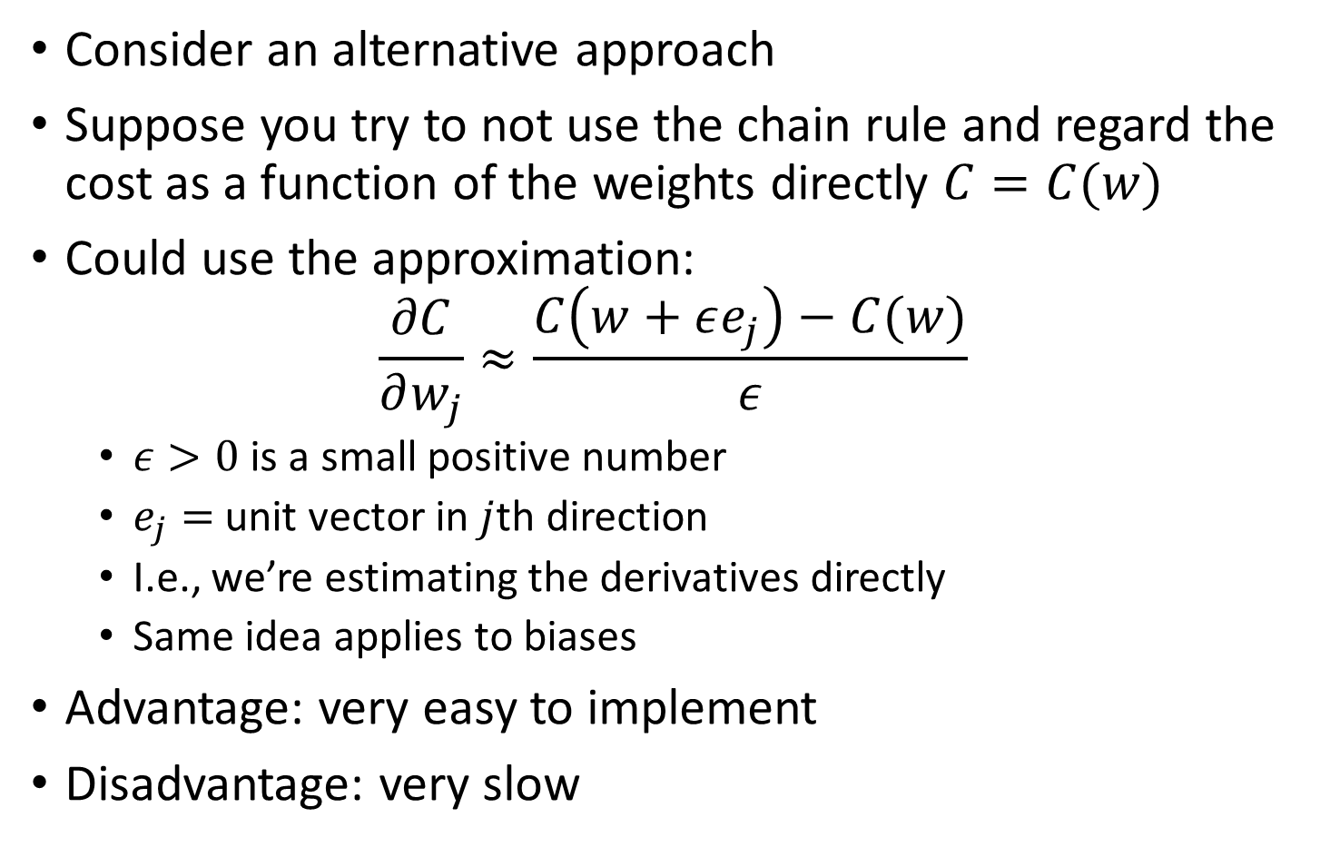
Is backpropagation fast?
Consider an alternative approach
Suppose you try to not use the chain rule and regard the cost as a function of the weights directly $C=C(w)$
Could use the approximation:
$$\frac{∂C}{∂w_{j}}≈\frac{C\left(w+εe_{j}\right)−C(w)}{ε}$$
$ε>0$ is a small positive number
$e_{j}=$ unit vector in $j$th direction
I.e., we’re estimating the derivatives directly
Same idea applies to biases
Advantage: very easy to implement
Disadvantage: very slow

Slide 35
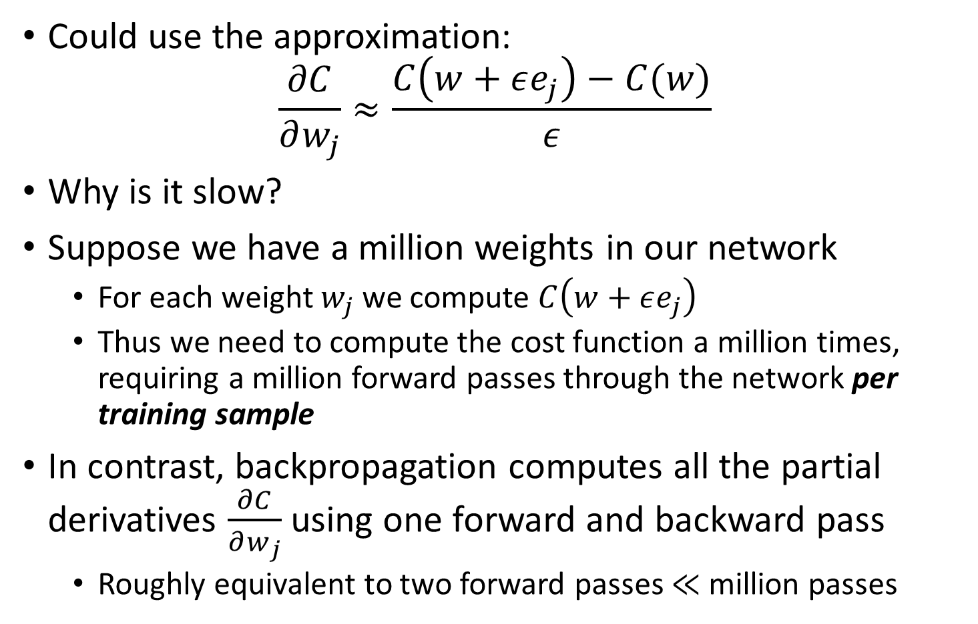
Is backpropagation fast?
Could use the approximation:
$$\frac{∂C}{∂w_{j}}≈\frac{C\left(w+εe_{j}\right)−C(w)}{ε}$$
Why is it slow?
Suppose we have a million weights in our network
For each weight $w_{j}$ we compute $C\left(w+εe_{j}\right)$
Thus we need to compute the cost function a million times, requiring a million forward passes through the network per training sample
In contrast, backpropagation computes all the partial derivatives $\frac{∂C}{∂w_{j}}$ using one forward and backward pass
Roughly equivalent to two forward passes $≪$ million passes
Notes:
This speedup was first fully appreciated in 1986 and it expanded the range of problems that NN could solve. This caused a rush of people using neural networks. However, people ran up against limits. We’ll see later how modern computers make it possible to get past these limits.

Slide 36
Further reading
Nielsen book, chapter 1, 2
Goodfellow et al., section 6.5

