Slide 1
BERT
Bidirectional Embedding Representations from Transformers
Encoder-only Transformer
Masked language model
Notes:
https://jalammar.github.io/illustrated-bert/

Slide 2
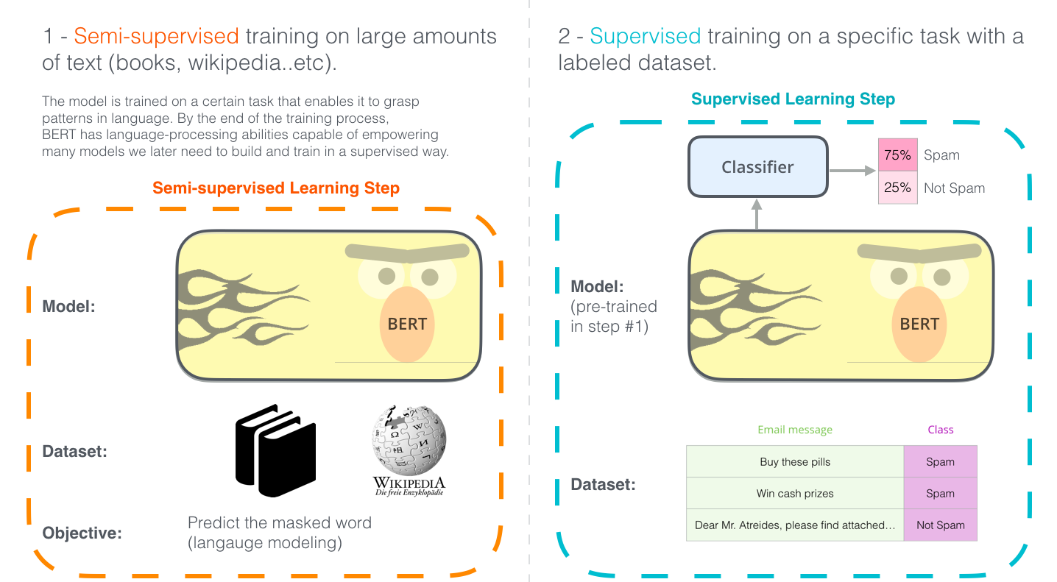
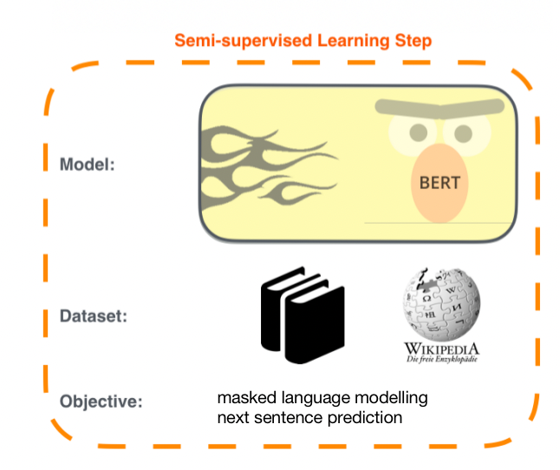

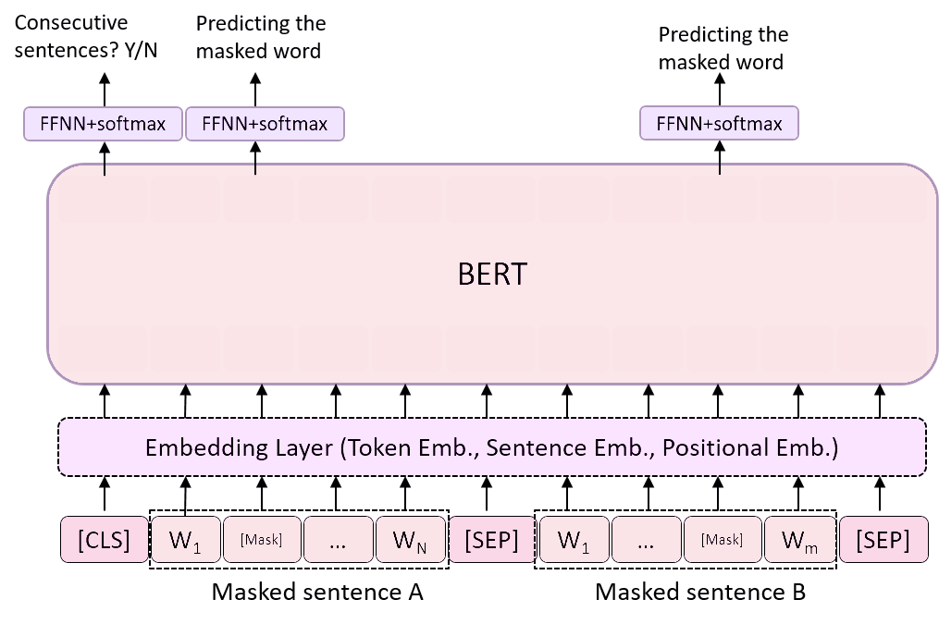
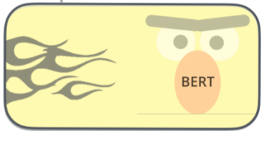


2-step training
3.3B
BooksCorpus
800M
English Wiki
2500M
Notes:
BERT-base and BERT-large. Both models were pre-trained on the same datasets, which include the BooksCorpus (800 million words) and English Wikipedia (2,500 million words). In total, BERT models were pre-trained on approximately 3,300 million (3.3 billion) words.

Slide 3
BERT is built on
Semi-supervised seq learning
ULMFiT: transfer learning
ElMo: contextualized word embedding
Transformer: encoder-decoder
GPT-1: decoder-only transformer

Slide 4
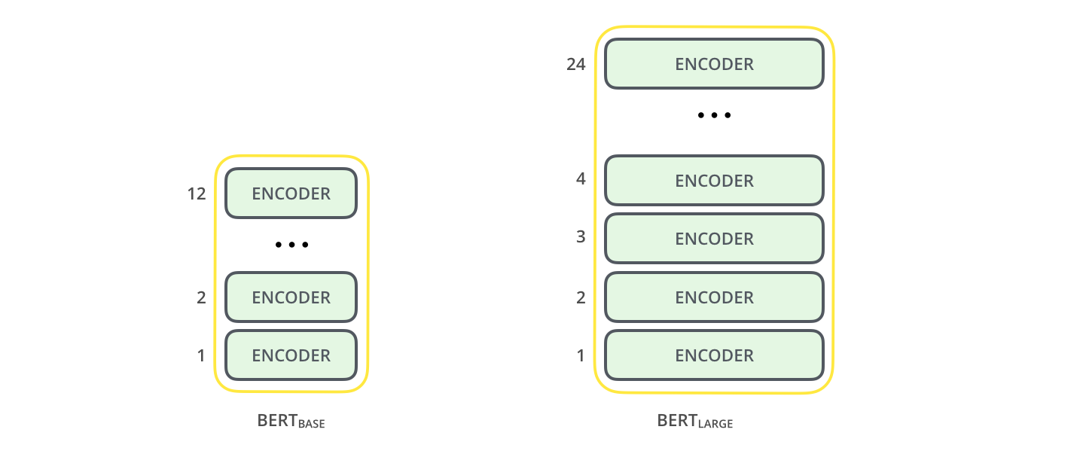
architecture: encoder-only transformer
 | BERT base | BERT large
encoder blocks | 12 | 24
Attention heads | 12 | 16
hidden size | 768 | 1024
# parameters | 110M | 340M
Training compute | 4 cloud TPUs, 4 days | 16 cloud TPUs, 4 days
Usage compute | 1GPU | 1TPU

Slide 5
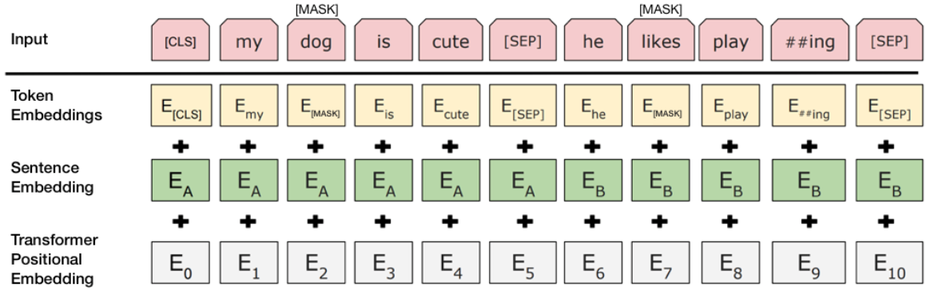
input
token embedding: first sentence start with [CLS], end with [SEP]
positional encoding
segment embedding

Slide 6
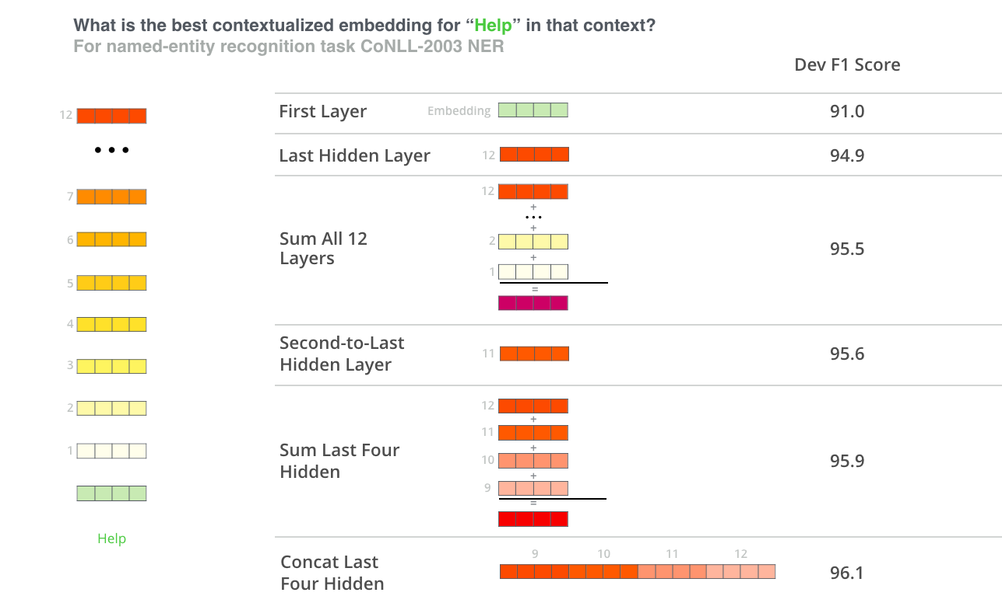
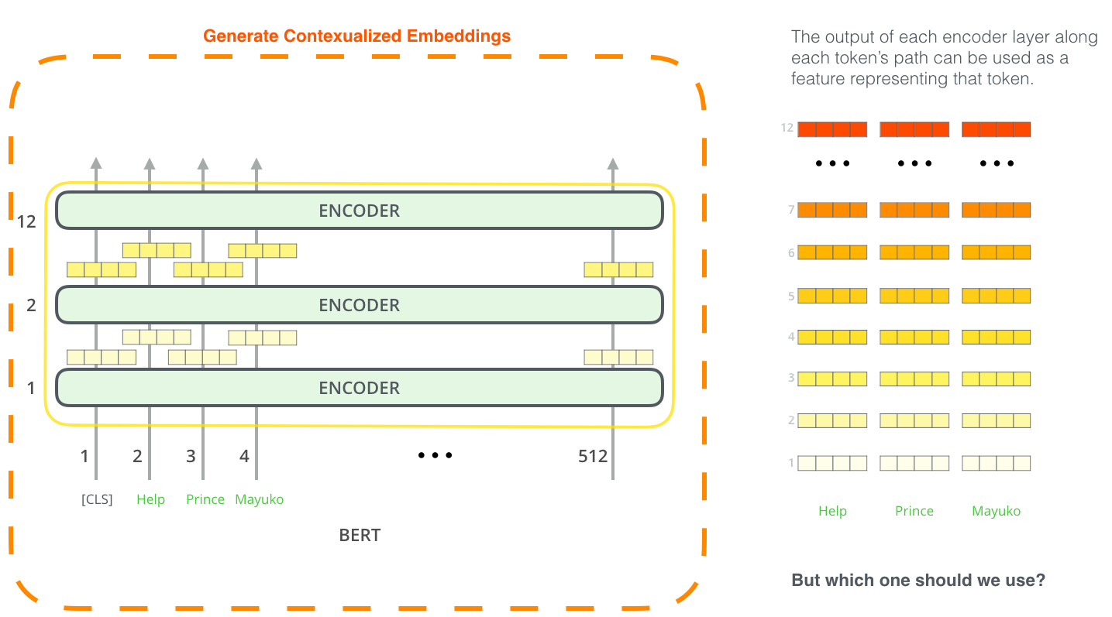
output: contextualized word/sentence embeddings
Which output to use depends on the task
token-level embedding:hidden state of each encoder layer along token path
sentence-level embedding: hidden state of [CLS]

Slide 7
Pretraining task
Notes:
Masked word prediction
masks 15% of words in the input and asks the model to predict the missing word.
randomly replaces a word with another word and asks the model to predict the correct word in that position.
2-sentence classification
Given two sentences A and B, is B likely to be the sentence that follows A, or not?
learn relationships between multiple sentences.

Slide 8
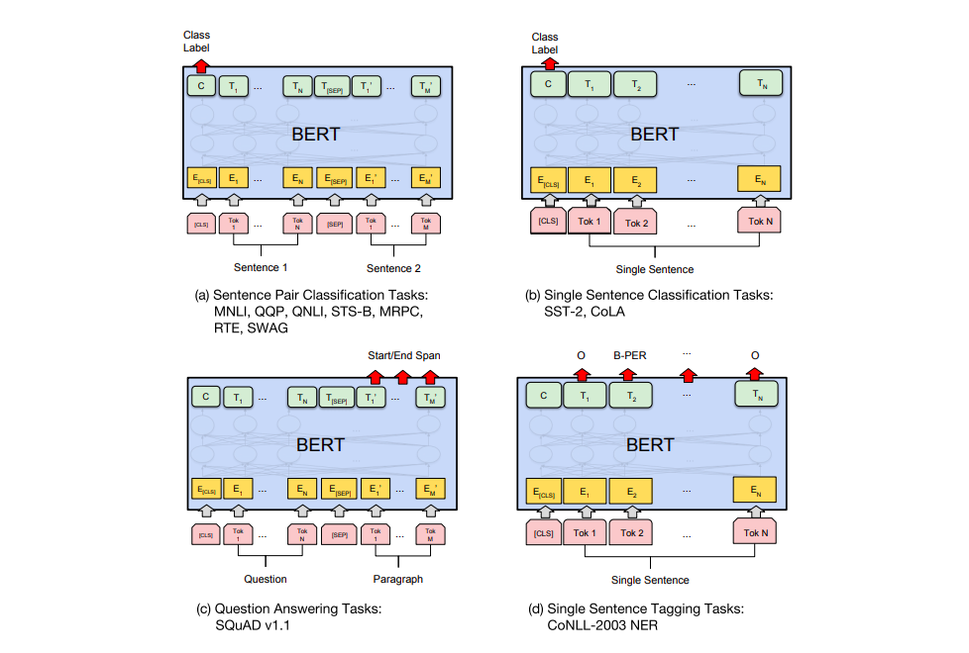
Fine-tuning tasks
download a pre-trained BERT and start training it on some task.
use [CLS] and [SEP] instead of [BOS] and [EOS]
For two-sentence inputs, put a [SEP] between the two sentences.

Slide 9
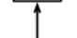
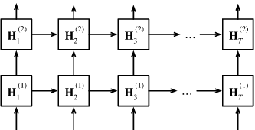
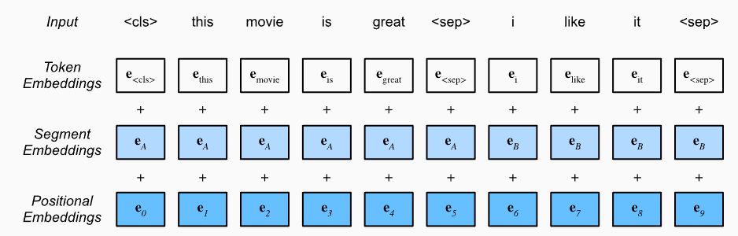
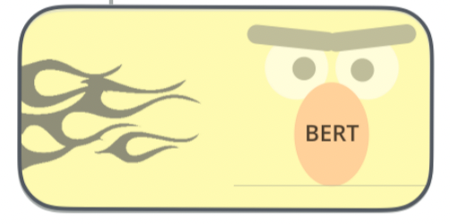
sentiment analysis
Positive
Feedforward network
MLP+sigmoid
Layer 2
H₀⁽²⁾ →
RNN
Layer 1
H₀⁽¹⁾ →
Pretrained BERT

Slide 10
implementation
BERT FineTuning with Cloud TPUs notebook
code in the BERT repo:
modeling.py constructed class BertModel, similar to a vanilla Transformer encoder.
run_classifier.py is an e.g of the fine-tuning. It also constructs the classification layer for the supervised model. check out the create_model() method in that file.
pre-trained models are available for download.
tokenization.py is the tokenizer. BERT look at words as WordPieces.
Huggingface: PyTorch implementation of BERT.
AllenNLP library allow using BERT embeddings with any model.

Slide 11
ELMo
Embeddings from Language Models
BiLSTM

Slide 12
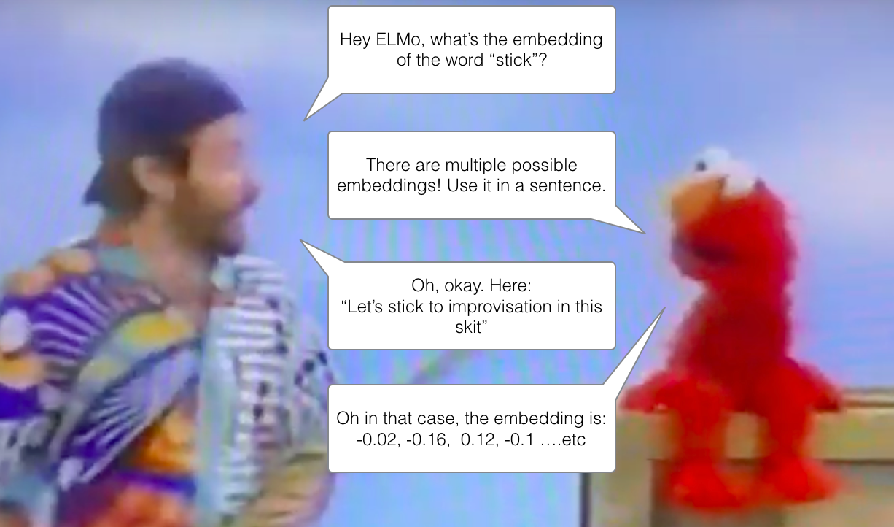
Contextualized word-embedding
Different from word2vec and GloVe, which give a fixed embedding for a word in different context
Contextualized word-embeddings can give different embeddings for a word based on the meaning they carry in the context

Slide 13
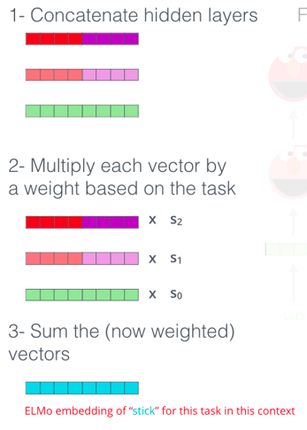
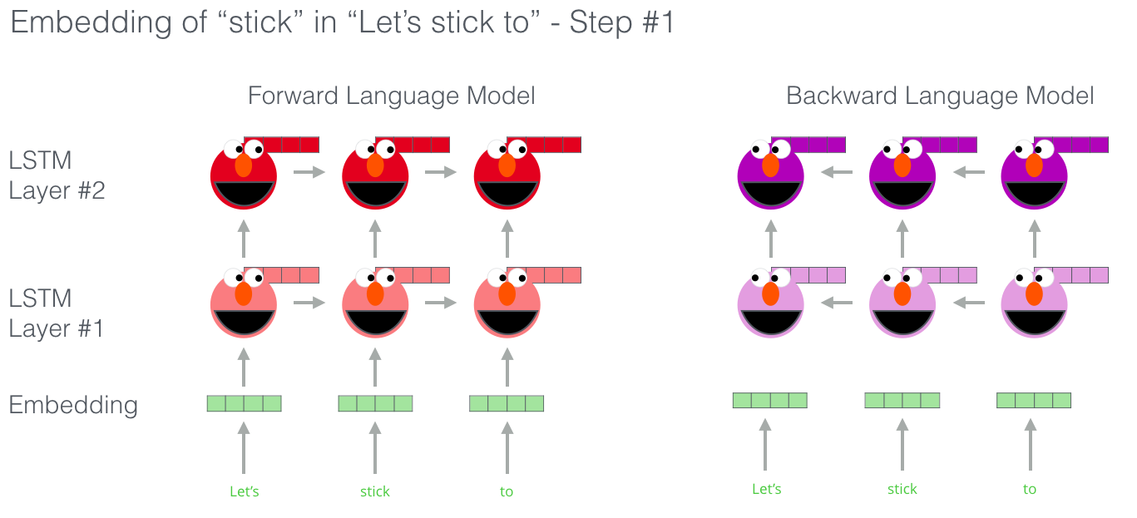
architecture: bi-directional LSTM
ELMo comes up with contextualized embedding for word 'stick' through grouping together the hidden states (context) and initial embedding of word 'stick' in by weighted summation of concatenation
Bidirectional: conditioned on both left and right context

