Slide 1
Representation Learning

Slide 2
Data as a Matrix
features
observations
Feature 1
Feature 3
Observation 1
d11
d12
Observation 2
d21
d22

Slide 3


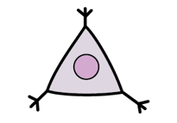
Running example: Single Cell Data
Each cell is a vector of measurements
e.g. Cell A = [40 0 20 18 5 0 …]
The whole data is a matrix with many observations (cells) and features (proteins, genes)
Features
(e.g. genes)
 | X | Y | Z
A | 10 | 20 | 70
B | 20 | 40 | 140
C | 20 | 0 | 80
Observations
(e.g. cells)

Slide 4
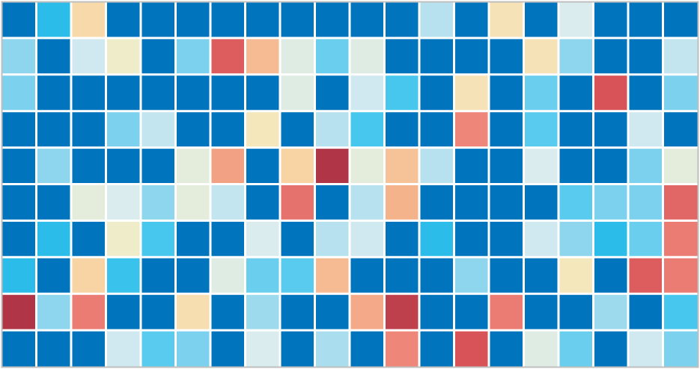
Data Tensors
Samples
(1-100+)
Cells
(1K – 10M)
Genes / Proteins
(10-10K)

Slide 5
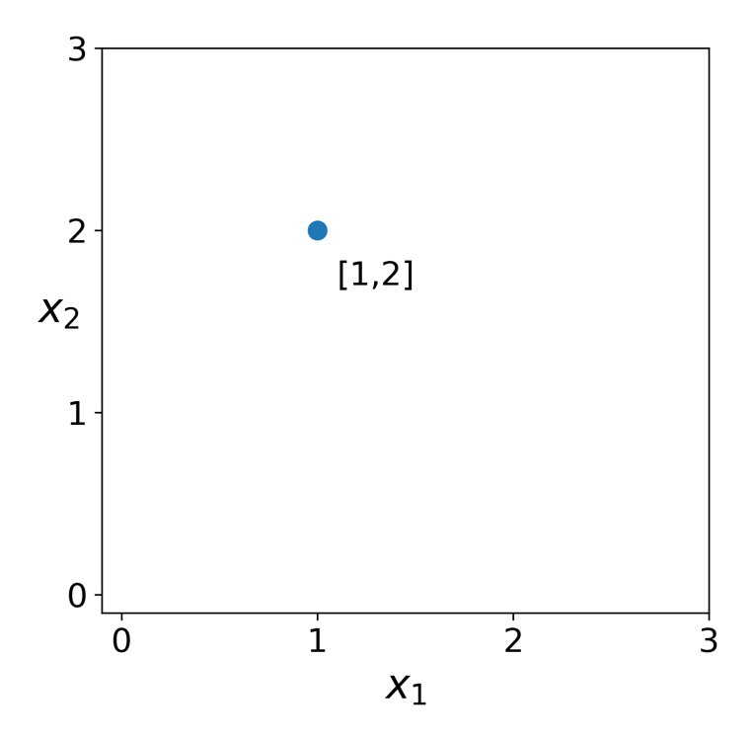
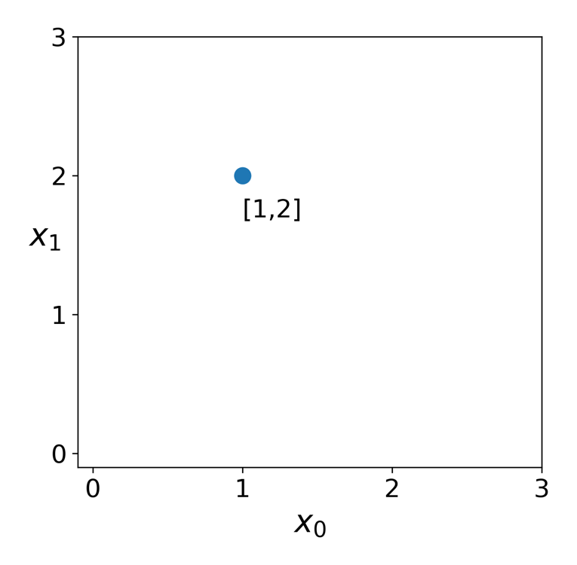

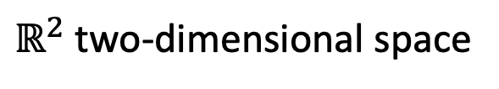
Spatial Representation of Data
$ℝ^{2}$ two-dimensional space
$$a$$

Slide 6




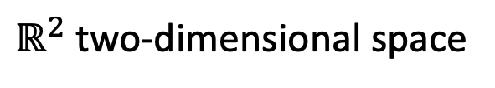

Spatial Representation of Data
$$a ε{ ℝ}^{2}$$
$ℝ^{2}$ two-dimensional space
$$a=[1,2]$$
$$x_{0}$$
$$x_{1}$$
$$a$$

Slide 7
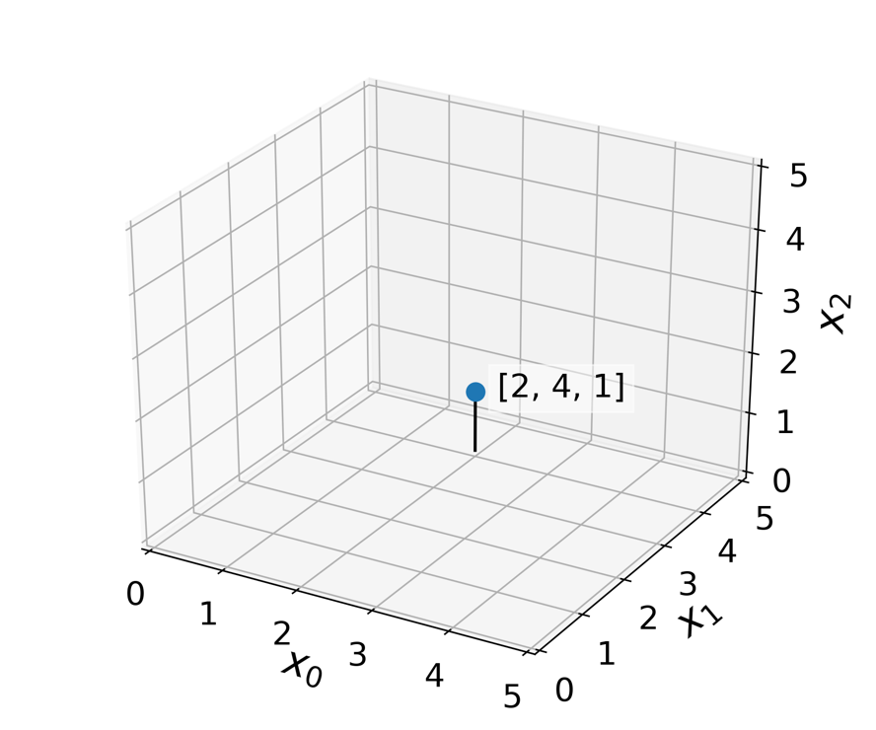





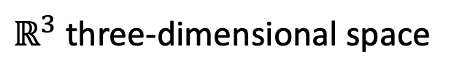

Features are dimensions
$$a ε{ ℝ}^{2}$$
$ℝ^{3}$ three-dimensional space
$$a=[1,2]$$
$$x_{0}$$
$$x_{1}$$
$$b ε{ ℝ}^{3}$$
$$b=[2,4,1]$$
$$b$$
$$x_{0}$$
$$x_{1}$$
$$x_{2}$$

Slide 8
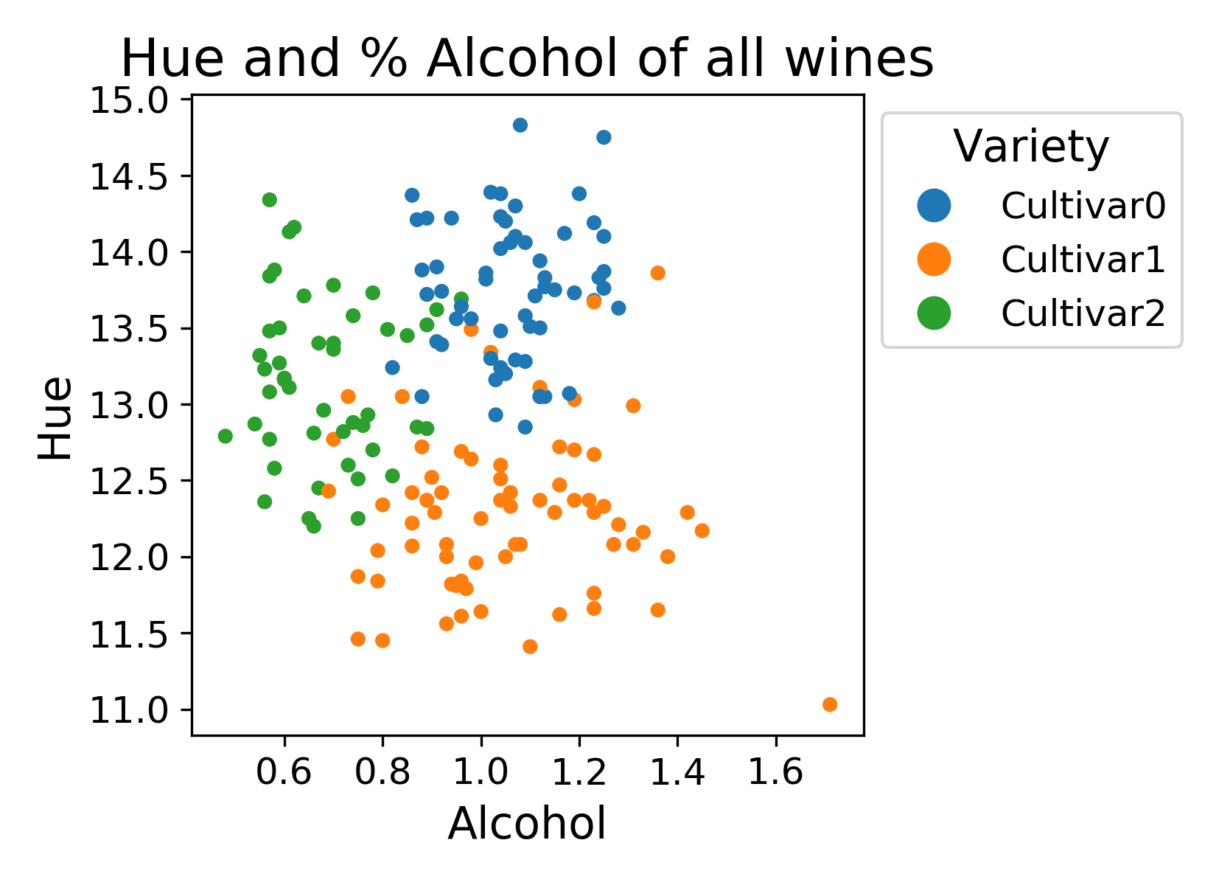
Features reveal structure
Feature 2
Feature 1

Slide 9
Many types of structures
Feature 2
Feature 1

Slide 10
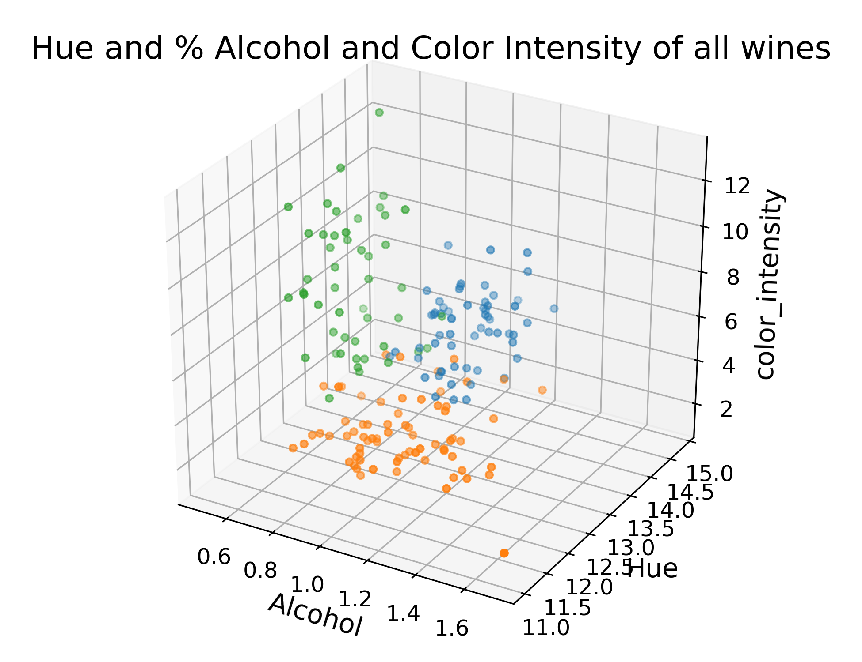
More Dimensions = More Accurate Structure

Slide 11



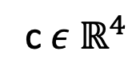



What if you have 4 dimensions ?
$ℝ^{3}$ three-dimensional space
c$ε{ ℝ}^{4}$
$$c=[2,4,1, 0]$$
$$b$$
$$x_{0}$$
$$x_{1}$$
$$x_{2}$$
$$x_{3}$$

Slide 12
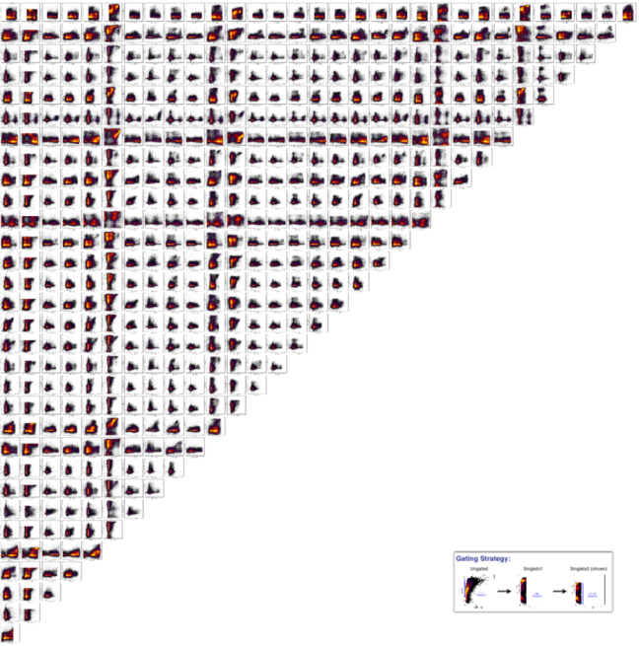
Problem: We can only see in 3D (not 20K D)
We could try all 2D pairs
but our brains can’t put this
together!
Notes:
Are the green and orange cultivars really different? How could we tell?

Slide 13
Can we represent data in other (simpler) ways?

Slide 14
Thought Exercise: Reduce this to 1D
Project this data to a line.
Which line?
Feature 2
Feature 1
Notes:
Are the green and orange cultivars really different? How could we tell?

Slide 15
Thought Exercise: Reduce this to 1D
Feature 2
Feature 1
Notes:
Are the green and orange cultivars really different? How could we tell?

Slide 16
Thought Exercise: Reduce this to 1D
Most distant points on top of each other !
Feature 2
Feature 1
Notes:
Are the green and orange cultivars really different? How could we tell?

Slide 17
Thought Exercise: Reduce this to 1D
Feature 2
Feature 1
Notes:
Are the green and orange cultivars really different? How could we tell?

Slide 18
Thought Exercise: Reduce this to 1D
What is special about
this line?
It explains most of the variance in the data
Feature 2
Feature 1
Notes:
Are the green and orange cultivars really different? How could we tell?

Slide 19
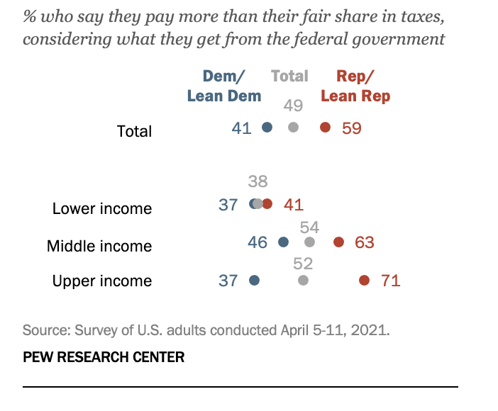
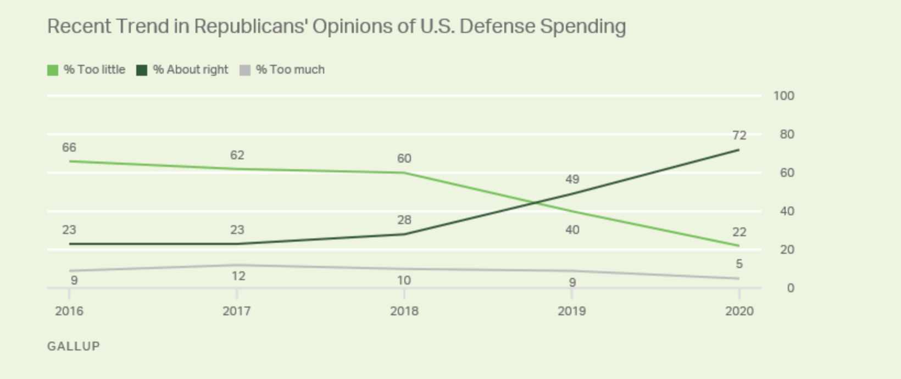
Survey information

Slide 20
Latent Variables
Which line would indicate likelihood of voting Republican?
A
B
C
%defense spending
D
% income tax

Slide 21
Dimensionality Reduction Methods Review
PCA
MDS
Kernel PCA
Diffusion MAPS
tSNE
PHATE
Others: Laplacian Eigenmaps, Isomap, UMAP, etc
Visualization tool:
https://krishnaswamylab.github.io/visualization_comparison/
password: w3@k

