Slide 1
Variational Autoencoders

Slide 2


Generative Models
NNet
Noise
Something “like” training sample
Notes:
Visualization of samples from the model. The rightmost column shows the nearest training example of the column just to the left.

Slide 3
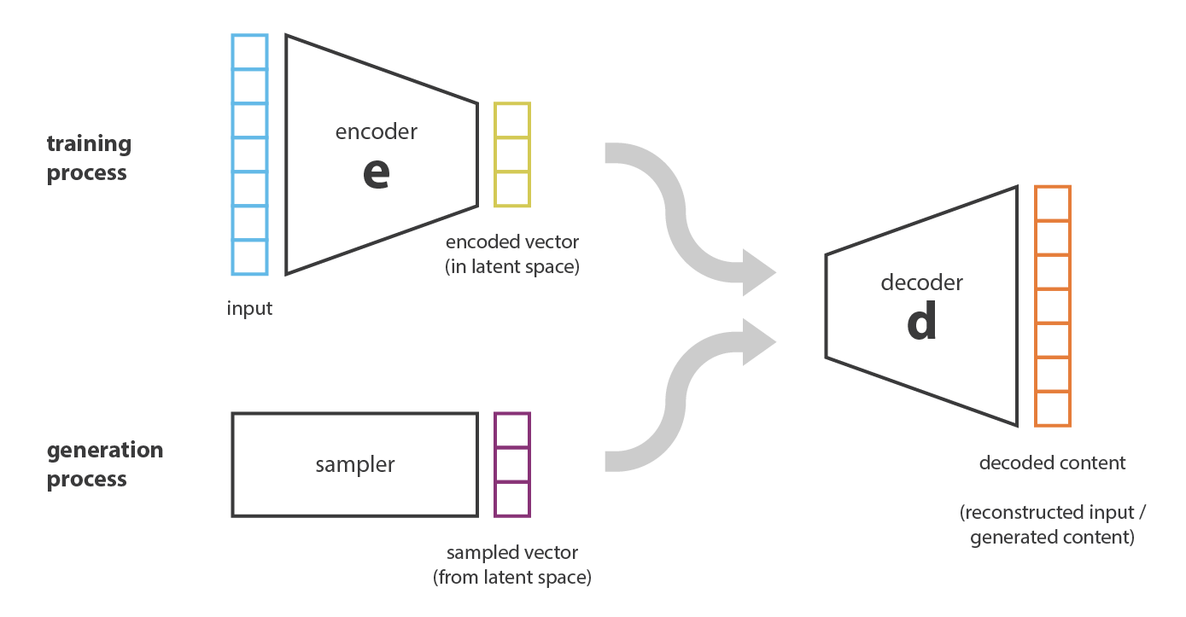
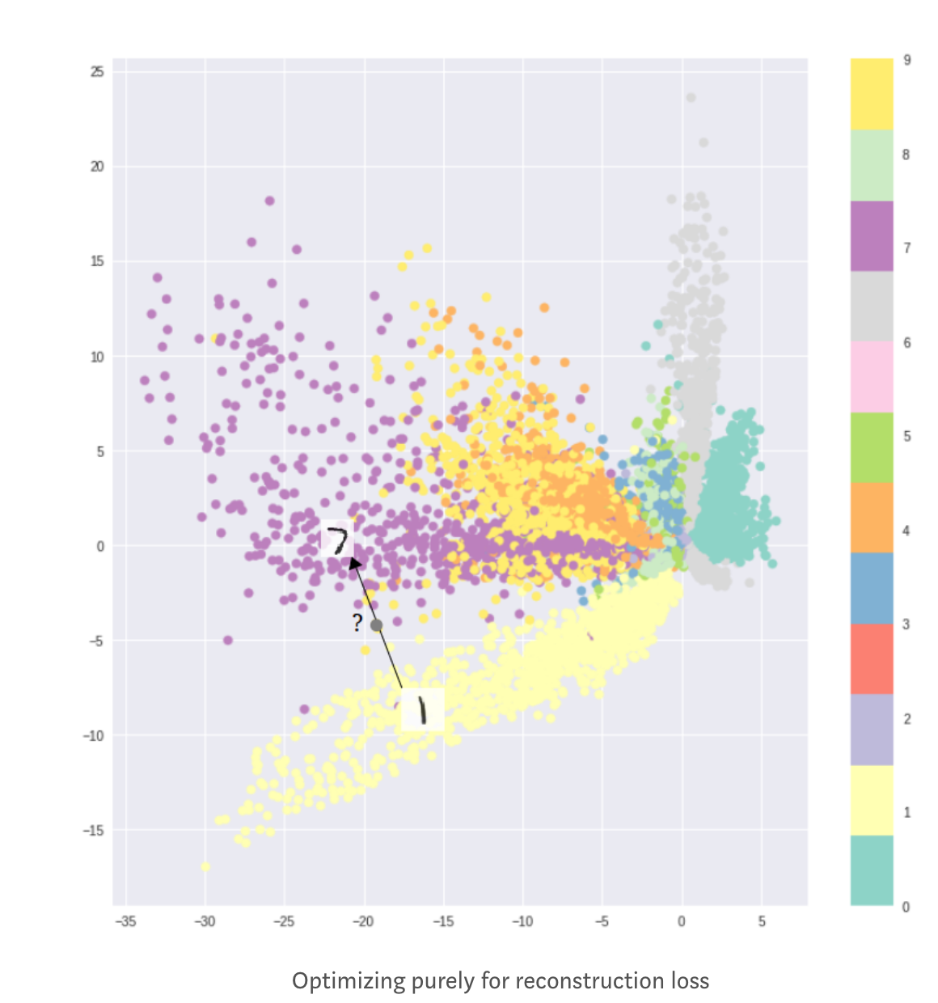
Can we use an autoencoder?
Autoencoder
latent space
can’t interpolate gap

Slide 4
Latent Space Not Optimize for Generation
Formation of clusters helps decoding
Does not help generation
Latent space cannot be interpolated
method to deal with discontinuous of latent space in Autoencoder: adversarial autoencoder: reshape latent layer to be convex to perform optimization on it

Slide 5
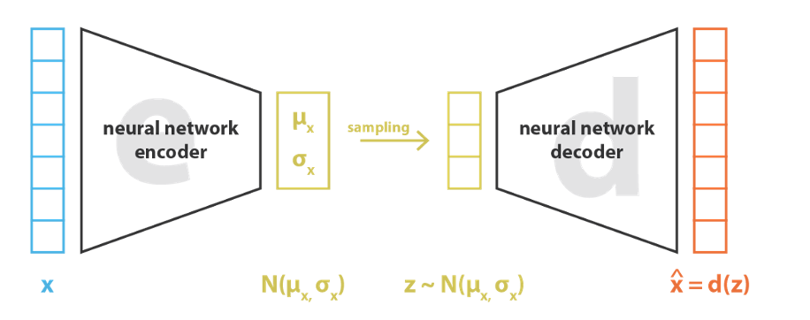

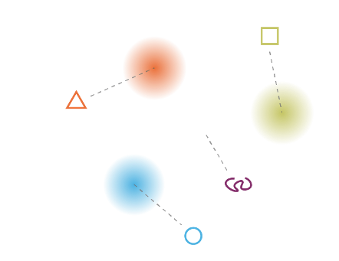

Each point encoded as a normal distribution
for each input, we have multiple samples from its normal distribution
reconstruction loss

Slide 6
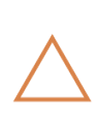

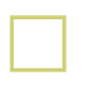


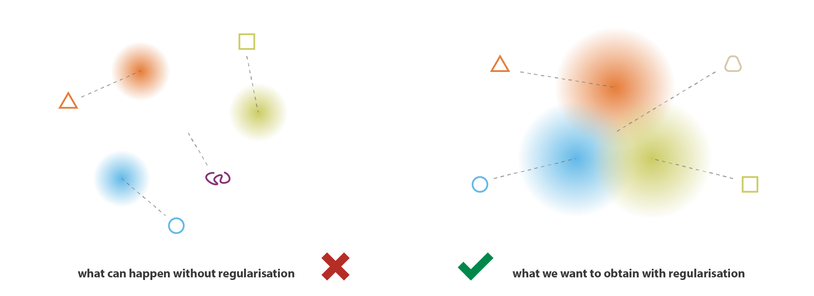

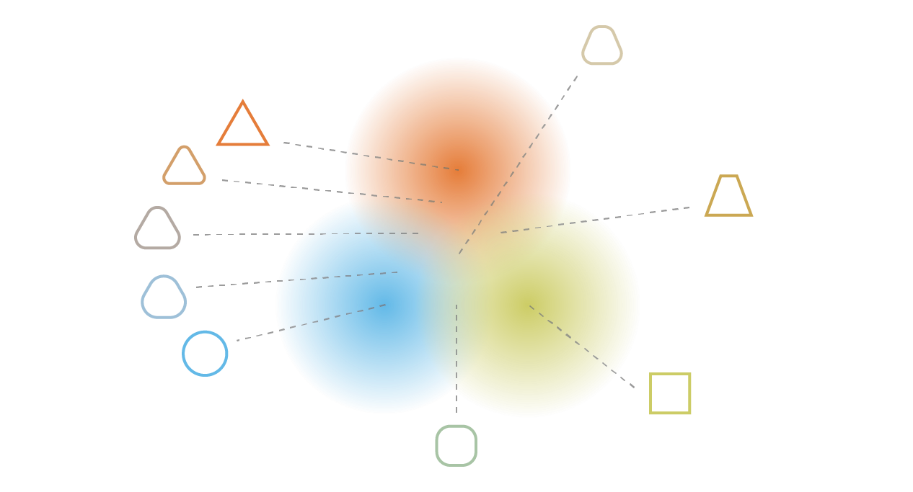
Need Regularization Discouraging Clusters
: original points
: interpolated points
Solution: Penalize the Gaussian balls if they don’t overlap!

Slide 7
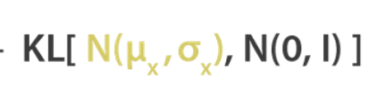
KL Divergence Penalty
: original points
: interpolated points
Penalizing distributions
In the latent space (red cluster, blue cluster green cluster) from being
too far from a standard normal
to have a contiguous latent space
N(0, 1)

Slide 8
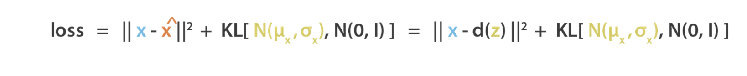
Loss Function of VAE
Reconstruction
Reshaping Latent Space

Slide 9
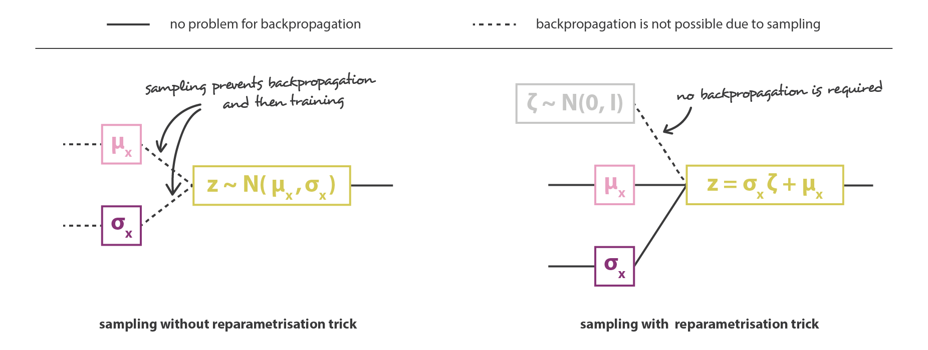
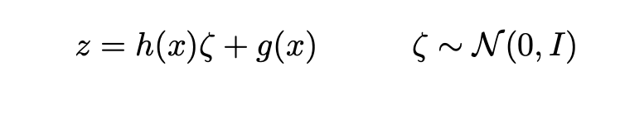
Reparameterization Trick
noisy input

Slide 10

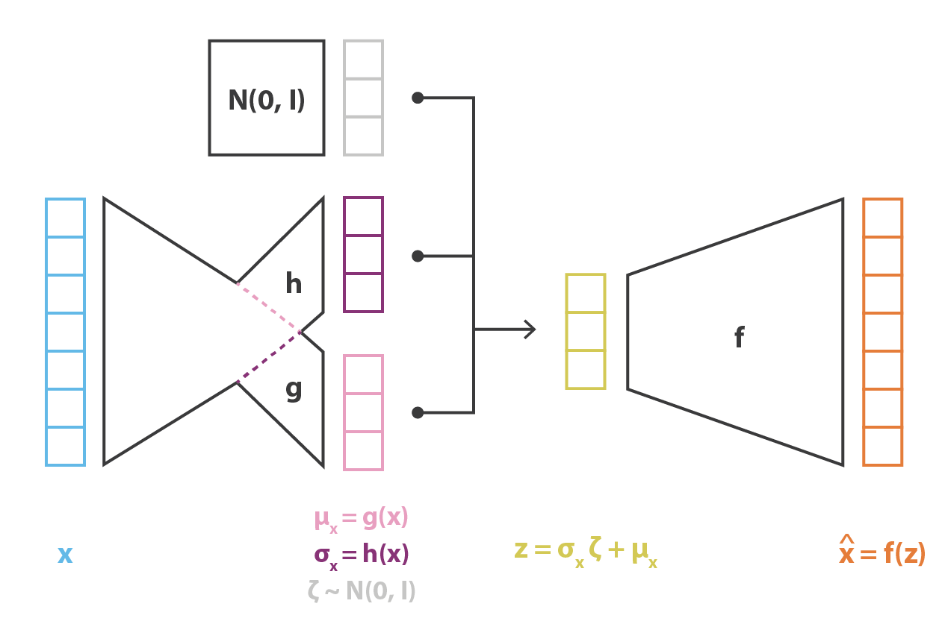
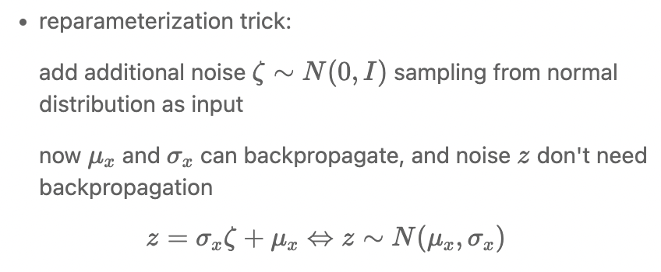
input
encoder
sampling
decoder
output
add noise as input

Slide 11
Exercise
How could you modify VAE to use different distributions for datapoints?
a different representation that is easy to interpolate
a different regularization term

