Slide 1
Lecture 24

Slide 2


Generative Models
NNet
Noise
Something “like” training sample
Notes:
Visualization of samples from the model. The rightmost column shows the nearest training example of the column just to the left.

Slide 3
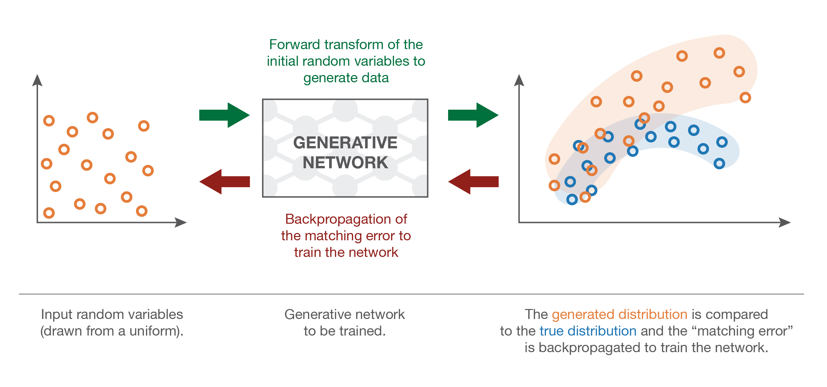
MMD Net

Slide 4
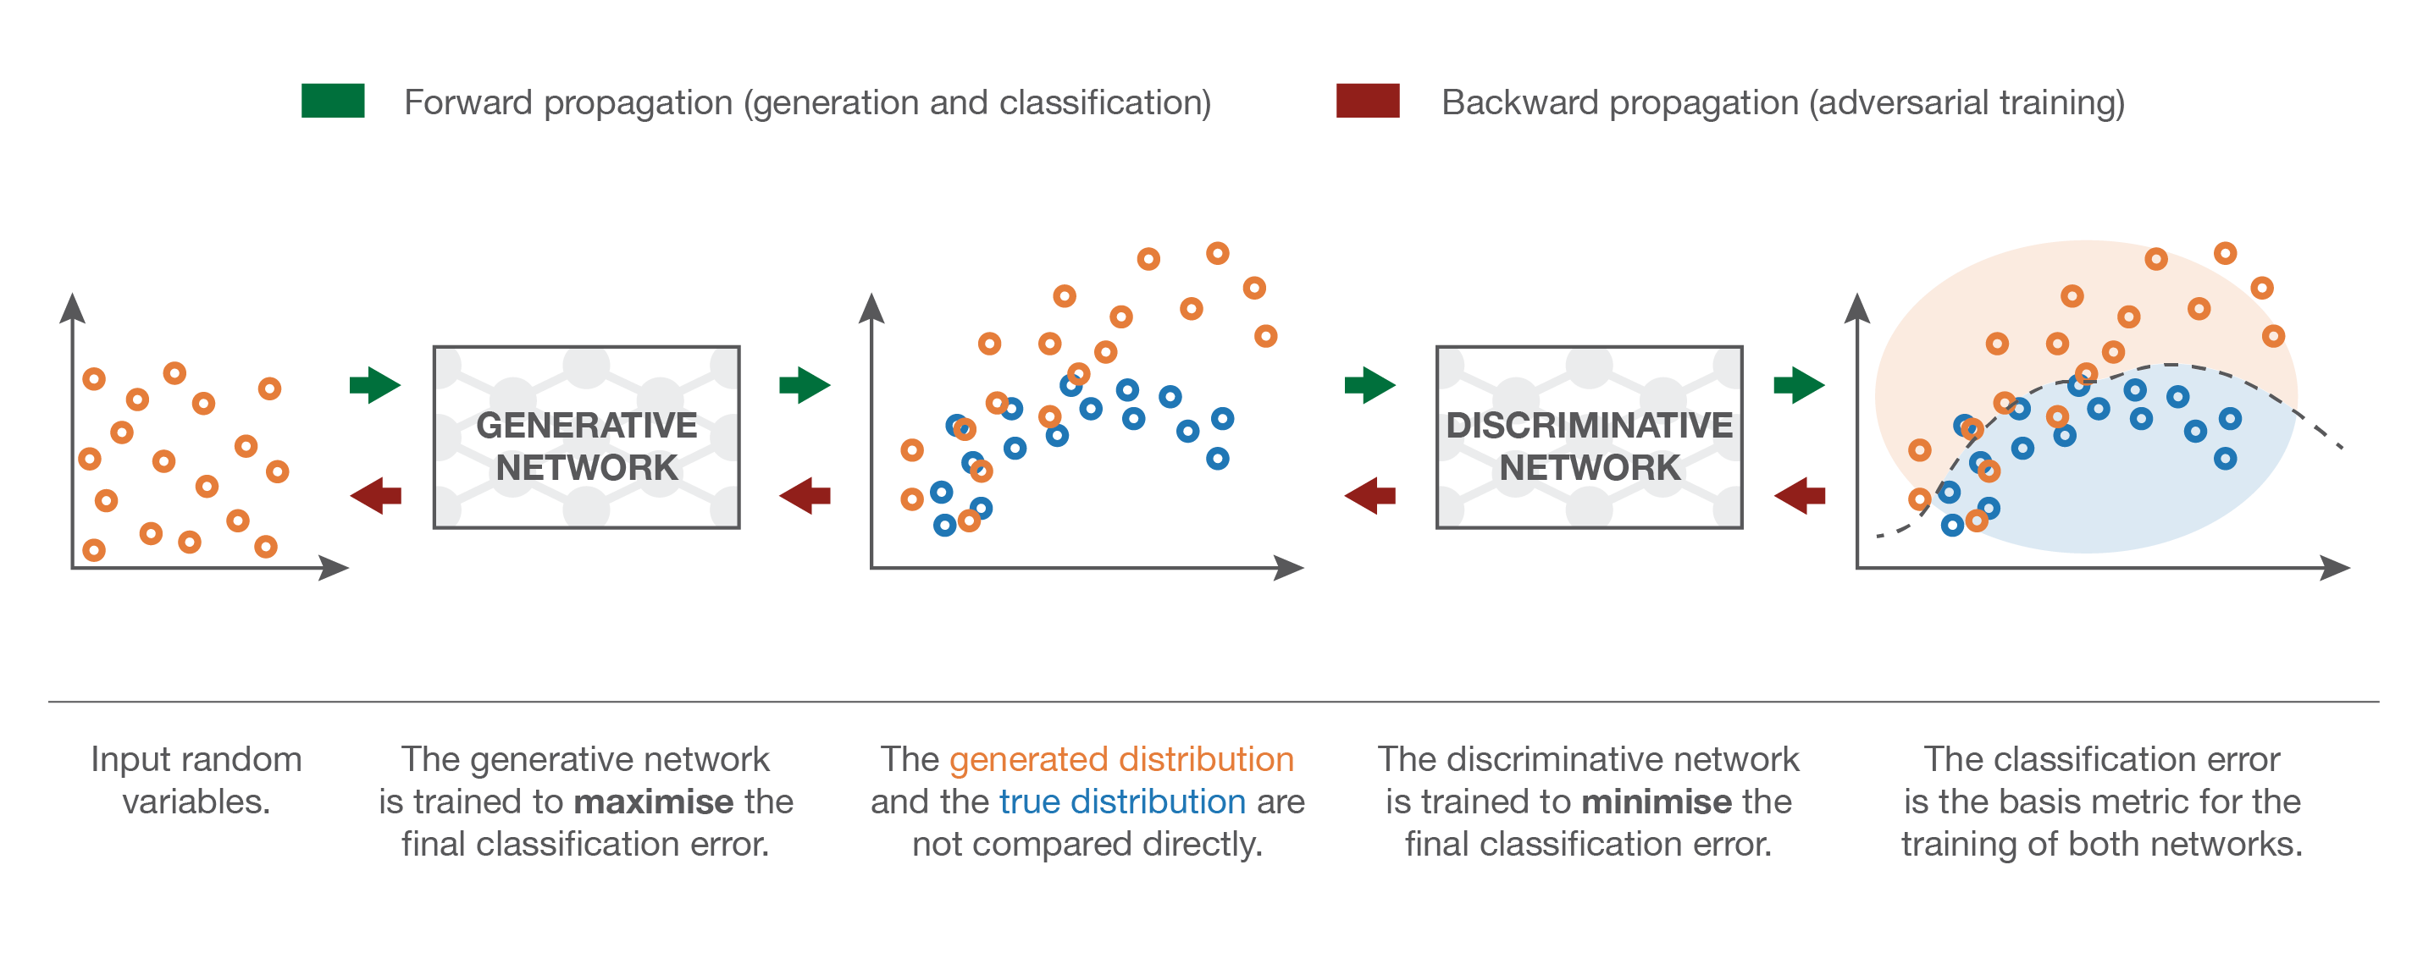
GAN
Discriminator classifies between real and fake examples

Slide 5
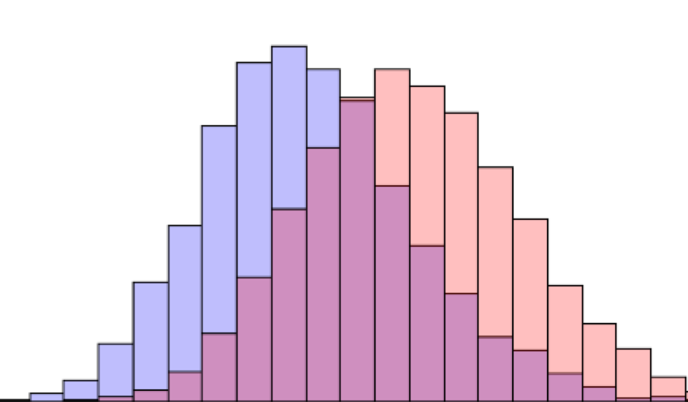
Maximum Mean Discrepancy (MMD)
[Gretton 2012]

Slide 6
MMD nets
Train the neural network to transmute noise into desired probability distribution using Maximum Mean Discrepancy optimization. [Dziugaite et al. 2015]
MMD is a kernel-based 2-sample distribution test for distribution similarity
This is a batch-level penalty, penalize a whole batch to look like the training distribution

Slide 7
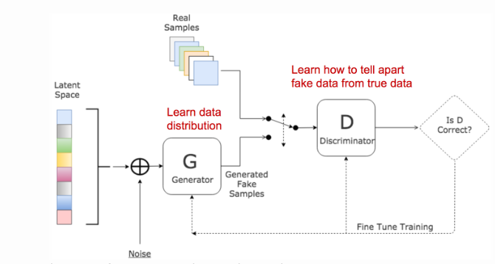
Generative Adversarial Network
Goodfellow et al. 2014

Slide 8
2 Networks
Generator: takes random noise and transforms into sample from target distribution
Discriminator: discriminates between generated (“fake”) examples and real examples
The two networks play a minimax game
Indirect way of matching distributions

Slide 9




GAN Loss function
Maximize Discriminator’s answer (1) on real samples
Maximize Discriminator’s answer (0) for fake samples
Minimax game: Generator wants discriminator to perform badly

Slide 10
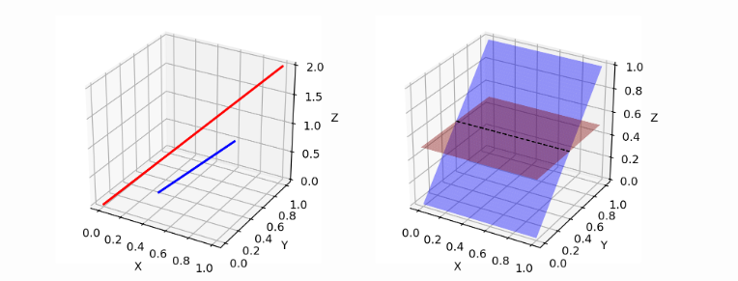
Problems with GANs 1: Small gradients when generator is bad
When generated data is very far from training data the two distributions are far away discriminator can be very good
Small gradients, generator does not know how to change itself to learn well

Slide 11
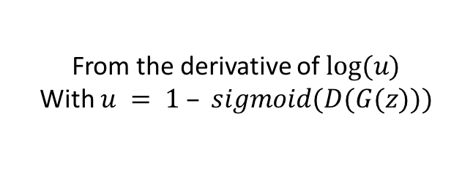
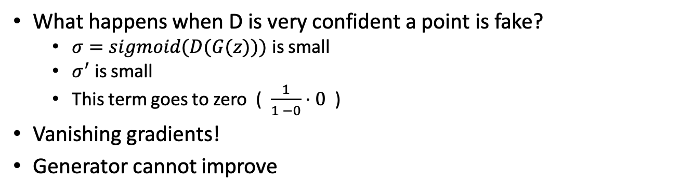
Vanishing Gradients
From the derivative of $log⁡(u)$
With $u = 1 – sigmoid(D(G(z)))$
What happens when D is very confident a point is fake?
$σ=sigmoid(D(G(z)))$ is small
$σ^{′}$ is small
This term goes to zero ( $\frac{1}{1 −0}⋅0$ )
Vanishing gradients!
Generator cannot improve

Slide 12
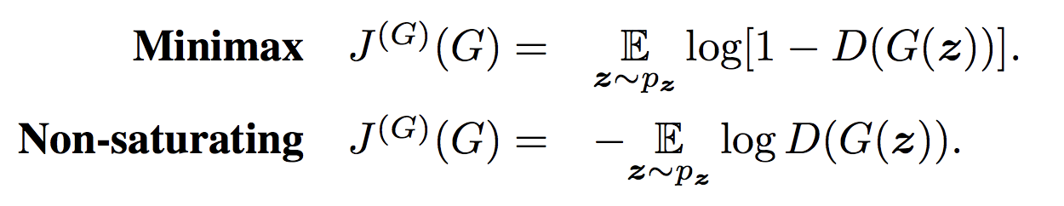
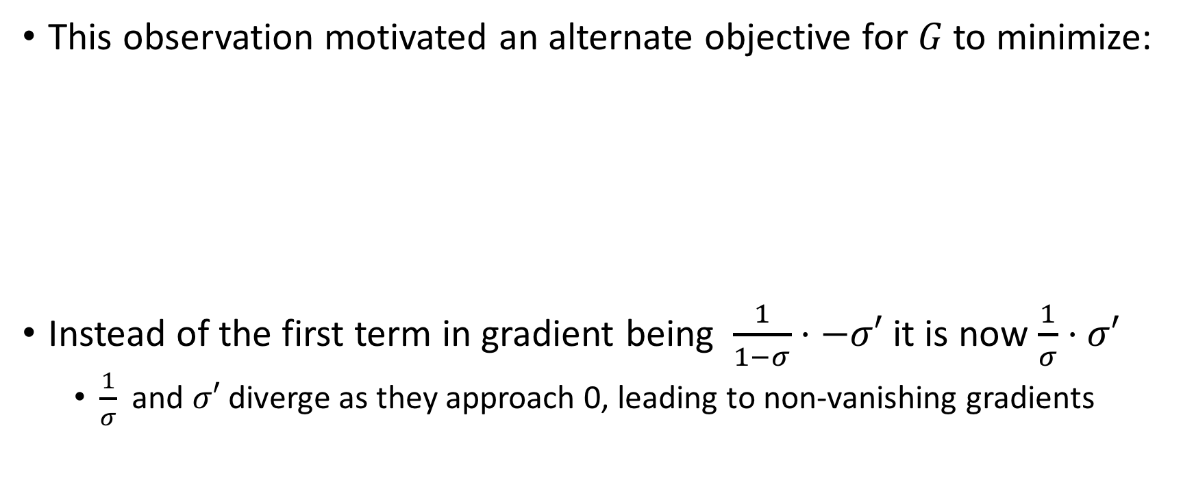
Alternative minimization
This observation motivated an alternate objective for $G$ to minimize:
Instead of the first term in gradient being $\frac{1}{1−σ}⋅−σ′$ it is now $\frac{1}{σ}⋅σ′$
$\frac{1}{σ}$ and $σ′$ diverge as they approach 0, leading to non-vanishing gradients

Slide 13
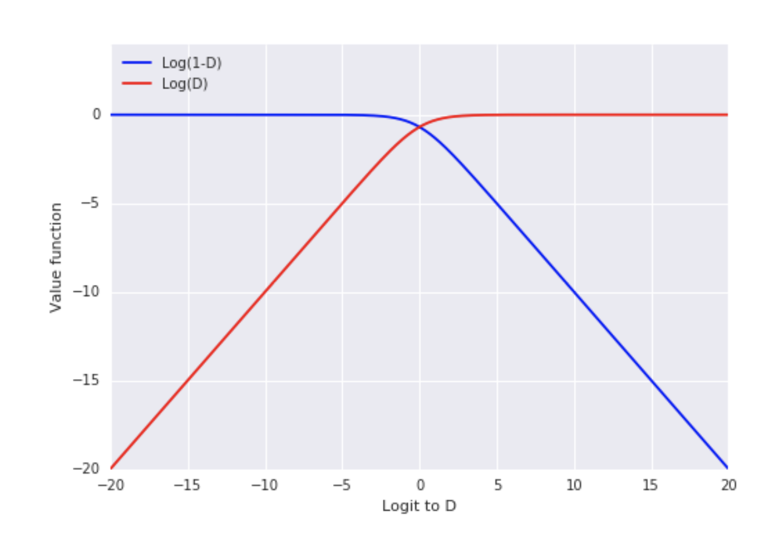
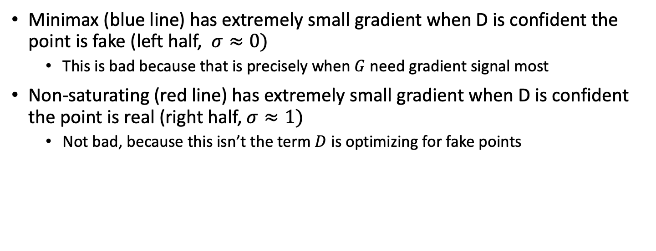
GANs
Minimax (blue line) has extremely small gradient when D is confident the point is fake (left half, $σ≈0)$
This is bad because that is precisely when $G$ need gradient signal most
Non-saturating (red line) has extremely small gradient when D is confident the point is real (right half, $σ≈1)$
Not bad, because this isn’t the term $D$ is optimizing for fake points

Slide 14
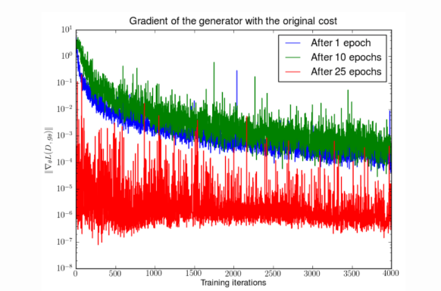
Problem 2: Vanishing gradient for generator when discriminator gets good

Slide 15
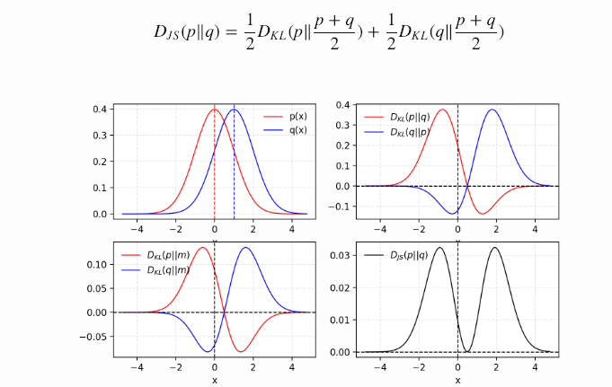
Jensen-Shannon Divergence

Slide 16
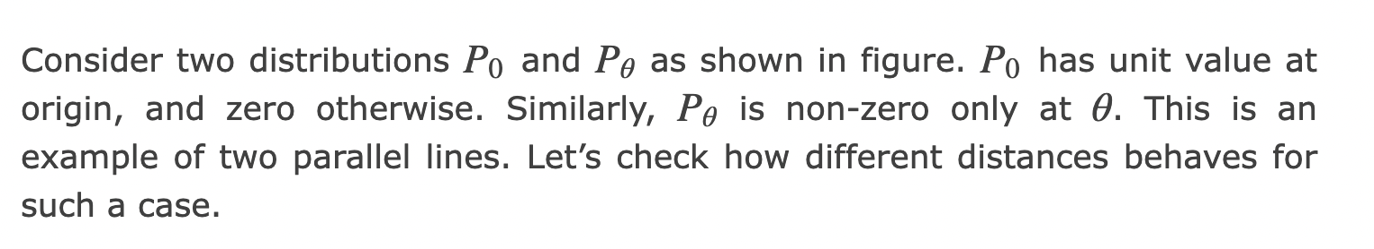
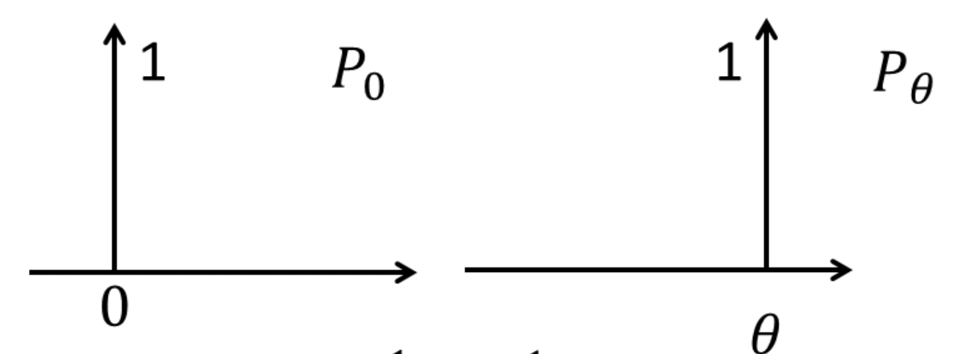
Wasserstein GAN [Arjovsky et al. 2017]
Uses Wasserstein metric instead of JS
Distance between manifolds with disjoint support

Slide 17
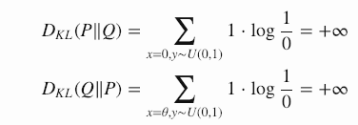


Distances on parallel lines
KL Divergence:
JS Divergence:
Same value independent of distance between lines!
Wasserstein distance
Matches with intuition of moving dirt.
can be better when the supports of the two probability distributions are far away. This can occur when generated data is far from training data

Slide 18

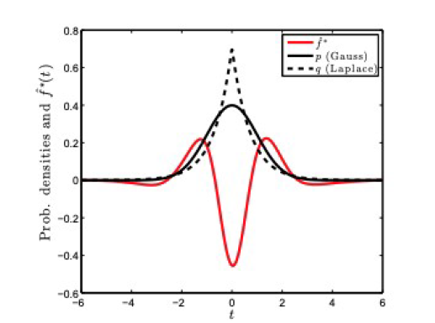
Rubenstein-Kantorovich Inequality
Kantorovich-Rubenstein duality:
Witness function f

Slide 19

Wasserstein Distance by Discriminator
Instead of the Discriminator giving a decision “0” for fake data but “1” for real data gives a value of a function f
The witness function f can be estimated by the Discriminator
The Discriminator would output a low value for fake samples and high value for real data
This function has to be lipschitz continous (can’t be jagged) has to vary smoothly
Kantorovich-Rubenstein duality:

Slide 20
WGAN In practice
Takes off sigmoidal decision layer
After every gradient update to the witness function f, clamp weights to a small fixed range
New loss function does not have logarithm, just difference of expected values

Slide 21
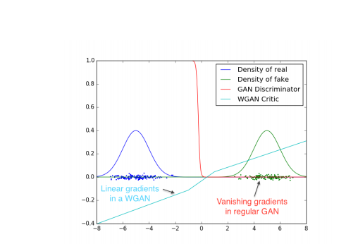
Improves vanishing Gradient

Slide 22
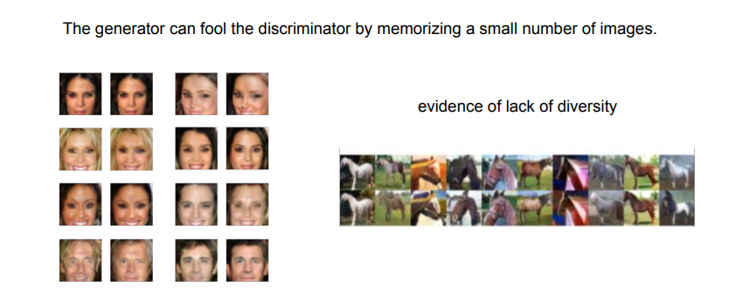
Problem 3: Mode Collapse

Slide 23


Improvements in Training GANs
Feature matching
Optimize the discriminator to inspect whether the generator’s output matches the statistics of real samples, i.e., does the generated mean equal the real mean?
Minibatch discrimination
Take the batch as a whole instead of one input at a time and learn relationships between pairs of samples

