Slide 1
Sequence Models (RNNs, LSTMs, and more)

Slide 2
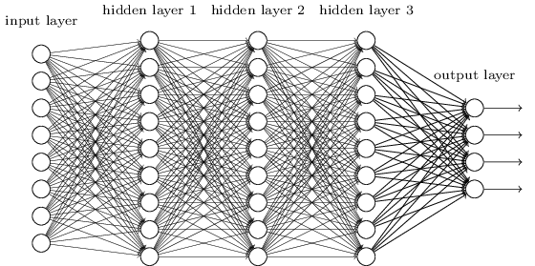
Fixed sized inputs
Fully connected neural networks have predetermined input size

Slide 3
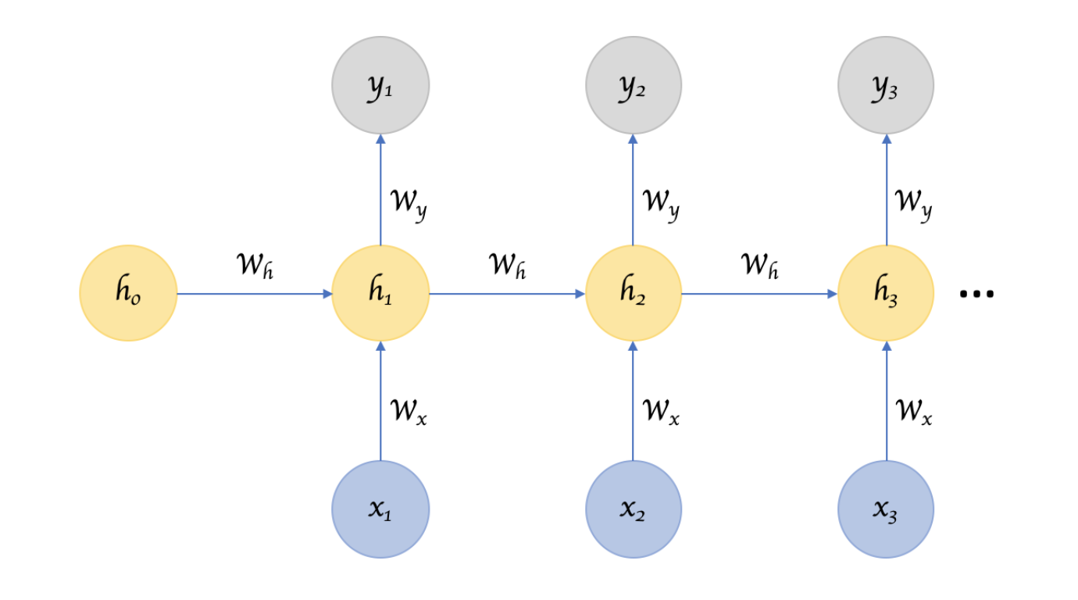
Recurrent Neural Networks
Takes arbitrarily sized inputs and
“remember” a hidden state of
information

Slide 4
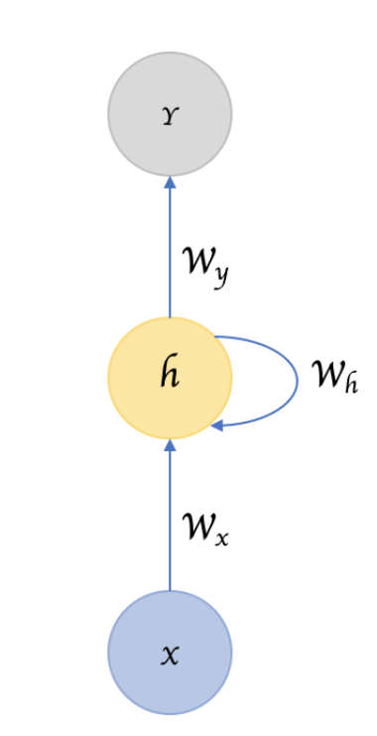
Feed forward vs Self-Loops

Slide 5
NLP Tasks
Speech recognition
Natural language generation
Natural language understanding
More specific tasks
Machine translation
Sentiment Analysis
Question Answering
Text generation

Slide 6
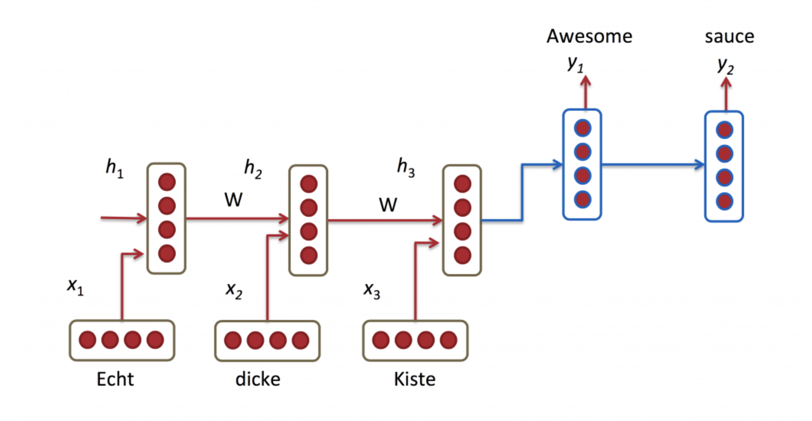
Processing Sequential Input
English Sentence
German Sentence

Slide 7
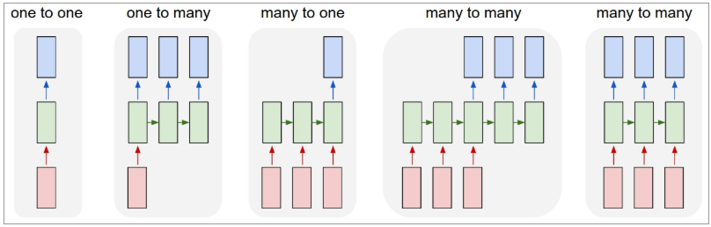
Sequence oriented tasks
Variable length inputs, variable length outputs, variable length computation
input | An image | An image | A sentence | first sentence | English sentence
output | A label | captions | A label (neg/pos) | next sentence | German sentence

Slide 8
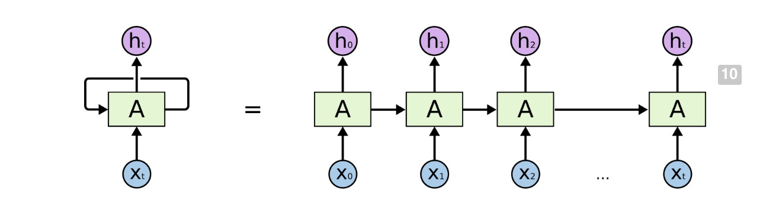
Backpropagation Through Time (BPTT)
self-loop
BPTT

Slide 9
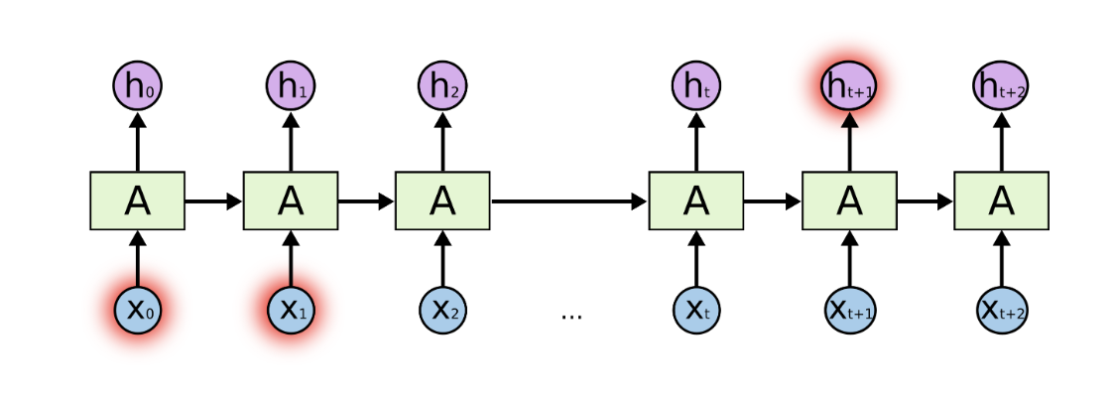
RNNs not good at handling long term dependencies

Slide 10
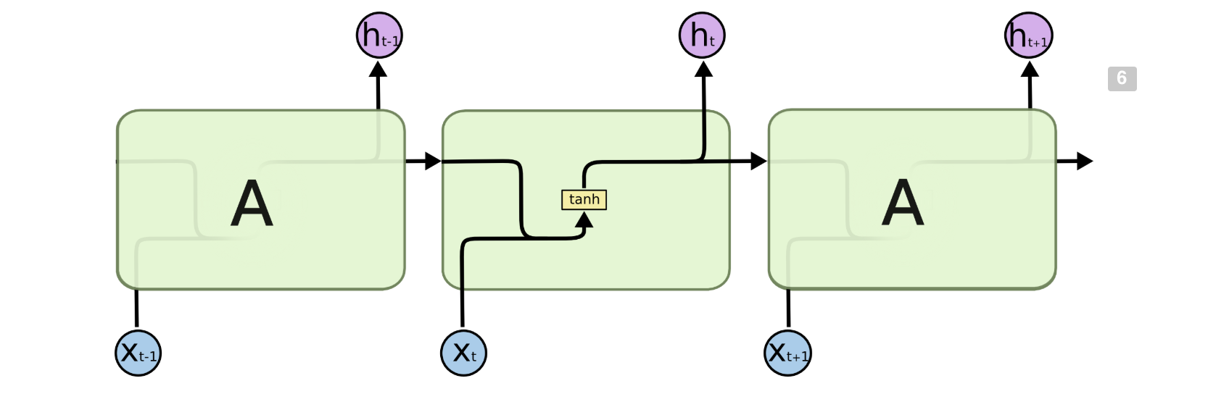
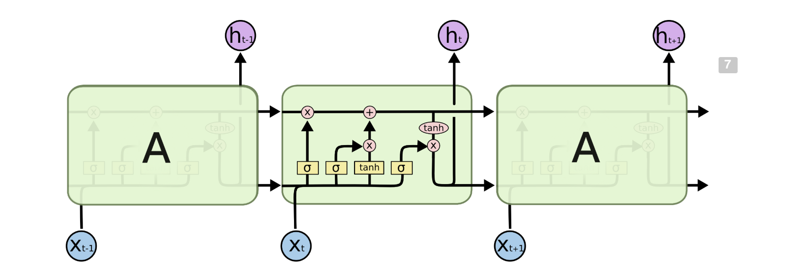
LSTMs

Slide 11
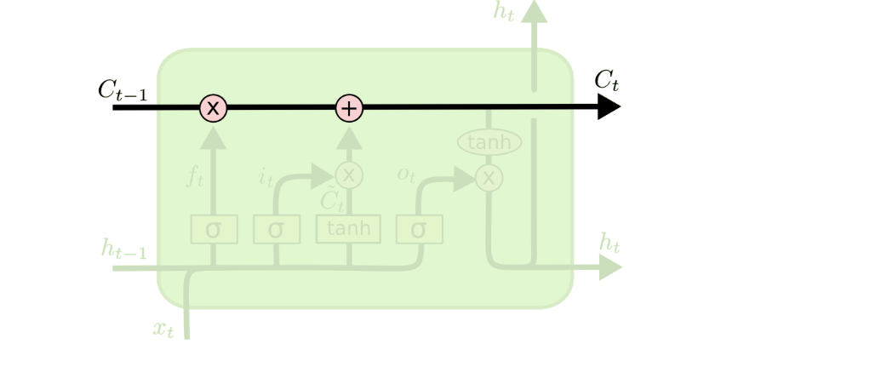
Running Cell State

Slide 12

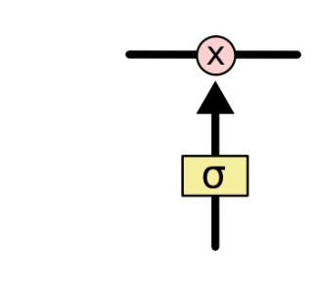
Gates modify hidden state
Indicates pointwise multiplication
A gate is implemented as a sigmoidal layer that outputs a value between 0 and 1 and controls how much of an input should be let through
0=don’t let anything through
1= let everything through

Slide 13
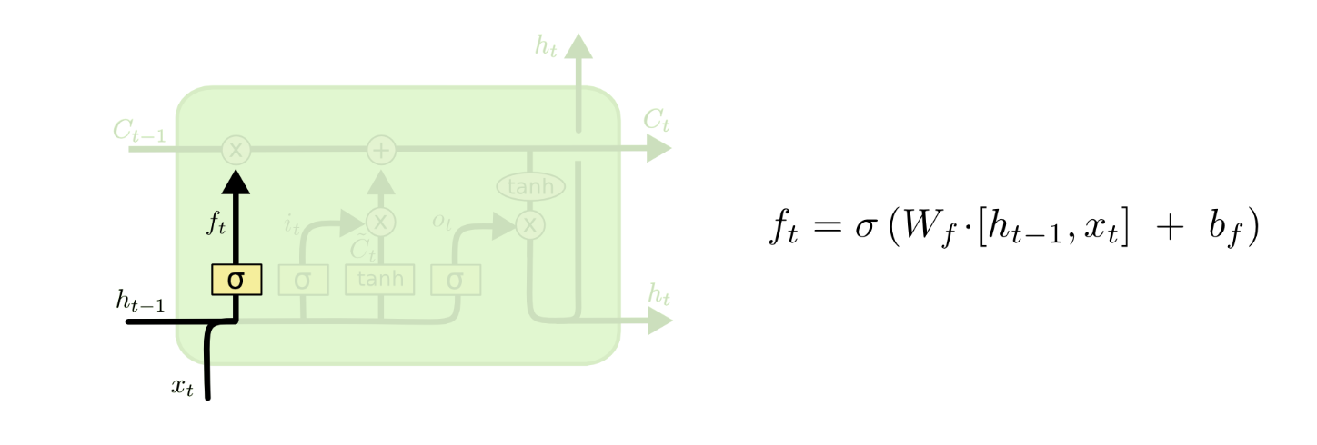
Forget Gate
How much of the previous hidden state should be forgotten?

Slide 14
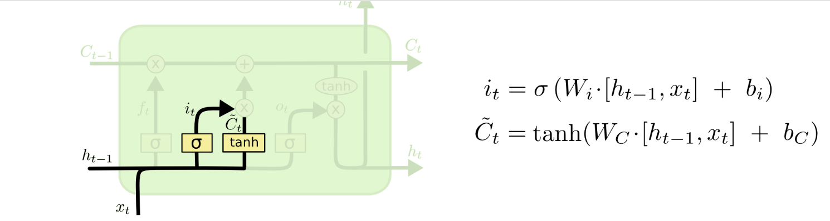
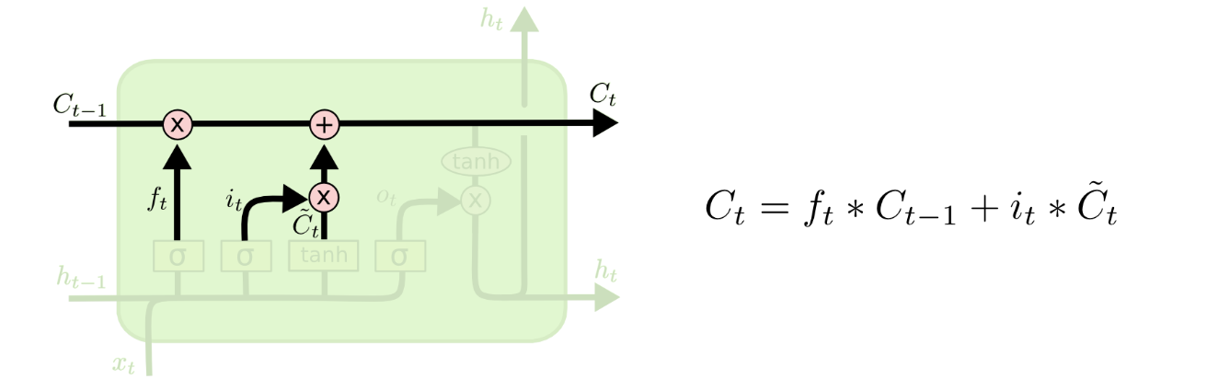
Creating New Hidden State

Slide 15
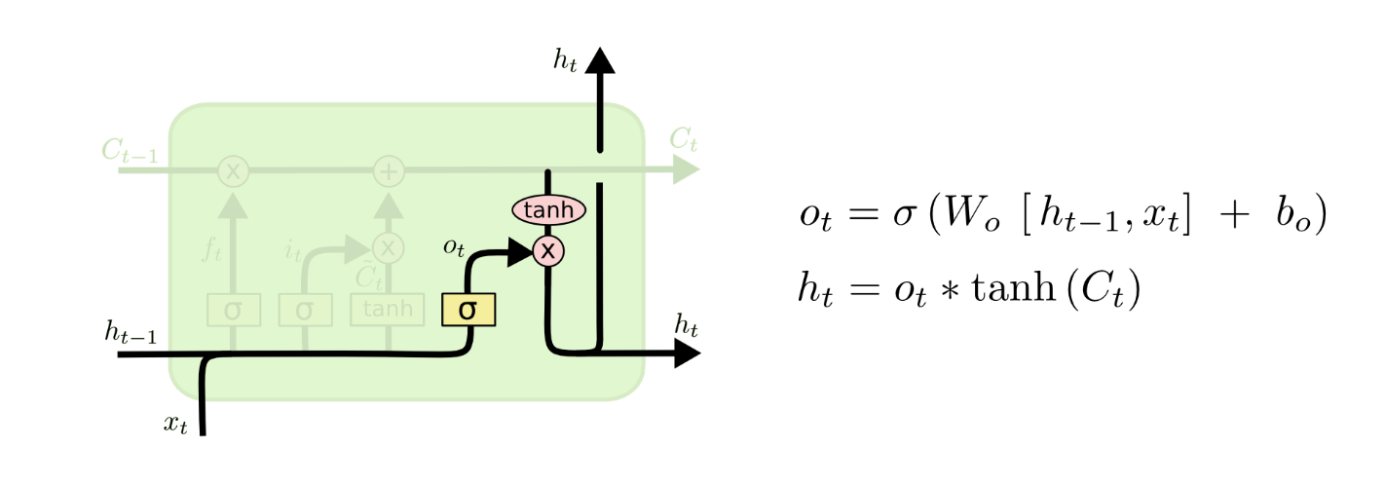
Output

Slide 16
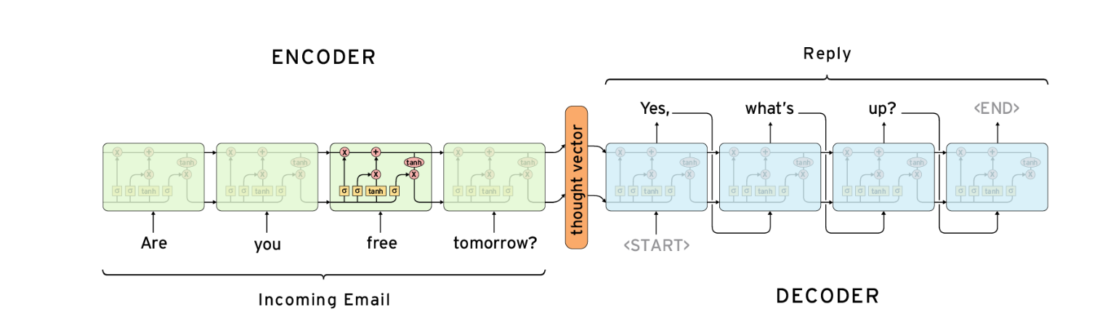
Implementation with LSTM
Problem: Intermediate states of the encoder are not visible to the decoder

Slide 17
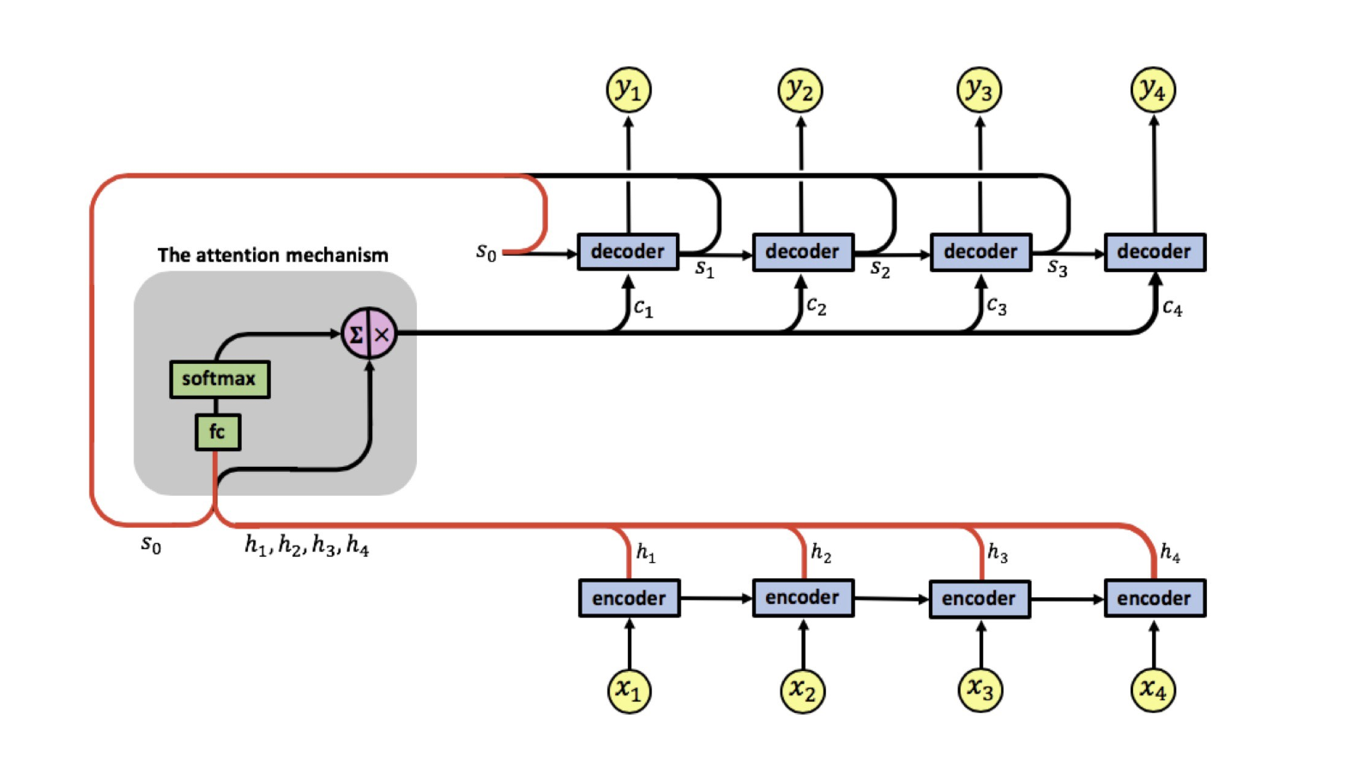
Adaptively Allows Decoder to Choose Inputs

Slide 18
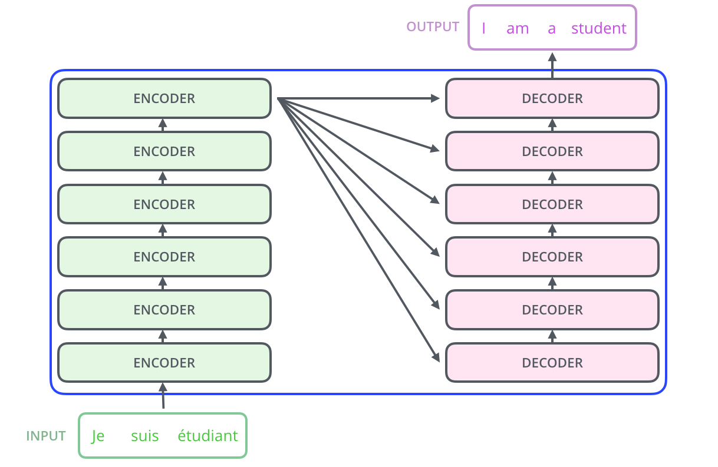
Transformer: CNN + Attention

Slide 19
Unsupervised Sequential Models
Frequent unsupervised training in language models uses masking
Mask parts of the input and fill it in
Mask the end of a sequence and complete this
Leads to text generation, music generation and much more

Slide 20
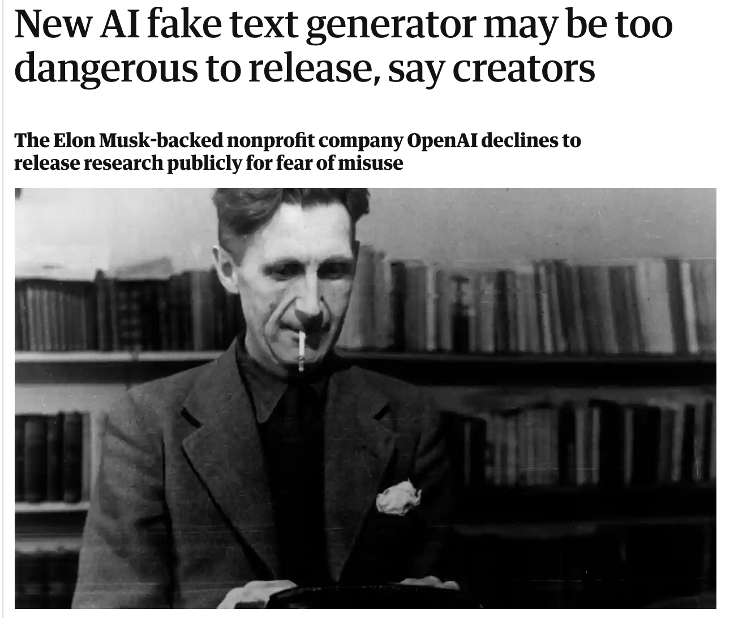

Slide 21
Reading list
Luong et al. Effective Approaches to Attention-based Neural Machine Translation 2015
Hochreiter & Schmidhuber Long Sort Term Memory, 1997
https://medium.com/datadriveninvestor/attention-in-rnns-321fbcd64f05
http://colah.github.io/posts/2015-08-Understanding-LSTMs/

