Slide 1
Word-to-Vector Embeddings

Slide 2

Language task example: Sentiment analysis

Slide 3
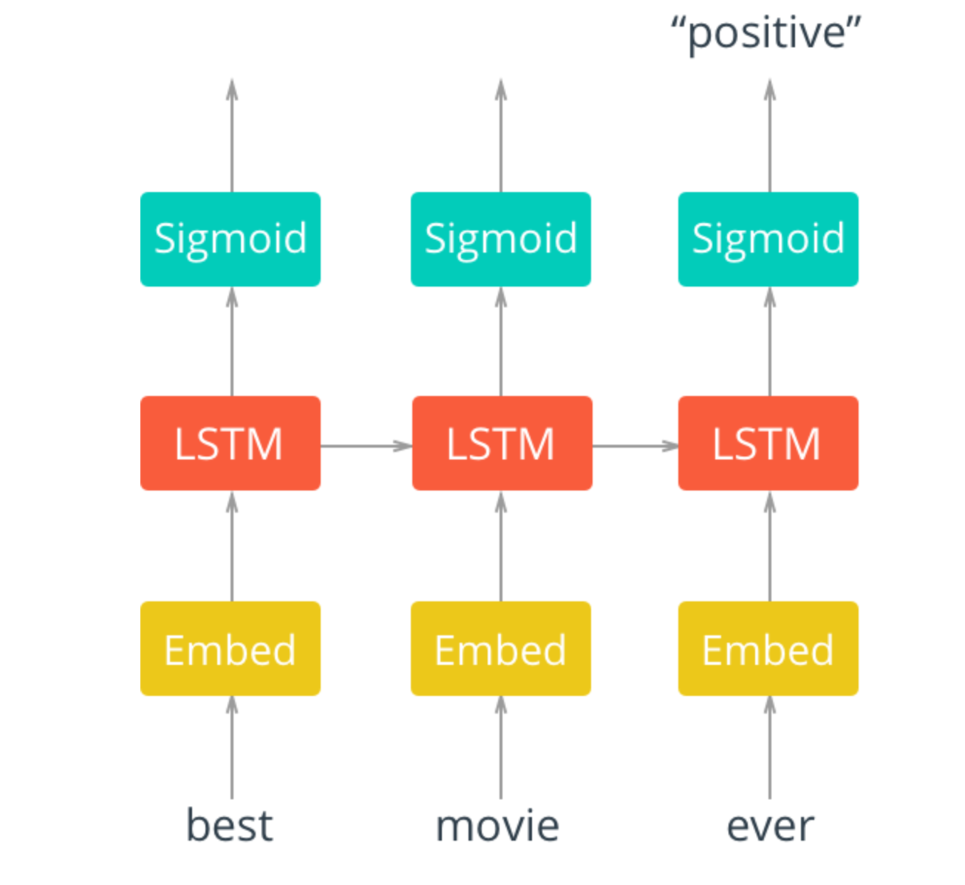

Slide 4
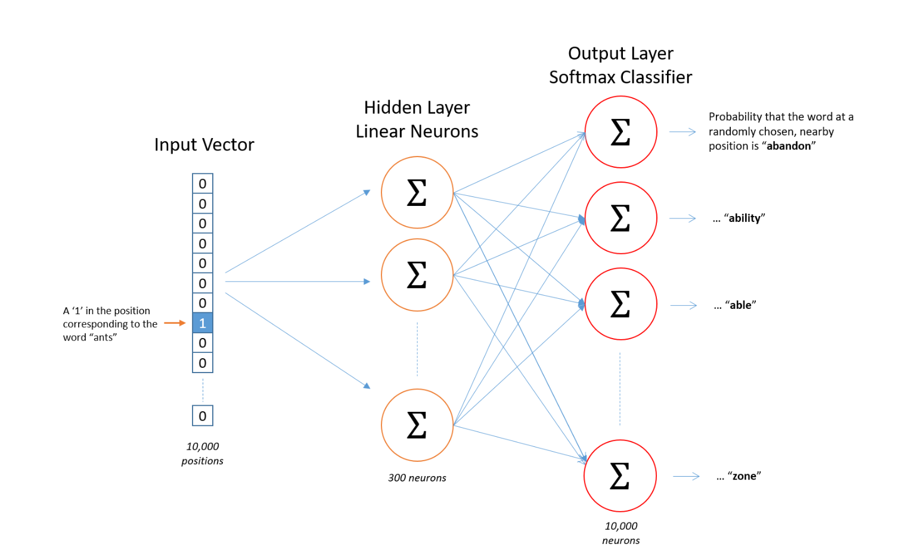
Word vector Embedding

Slide 5
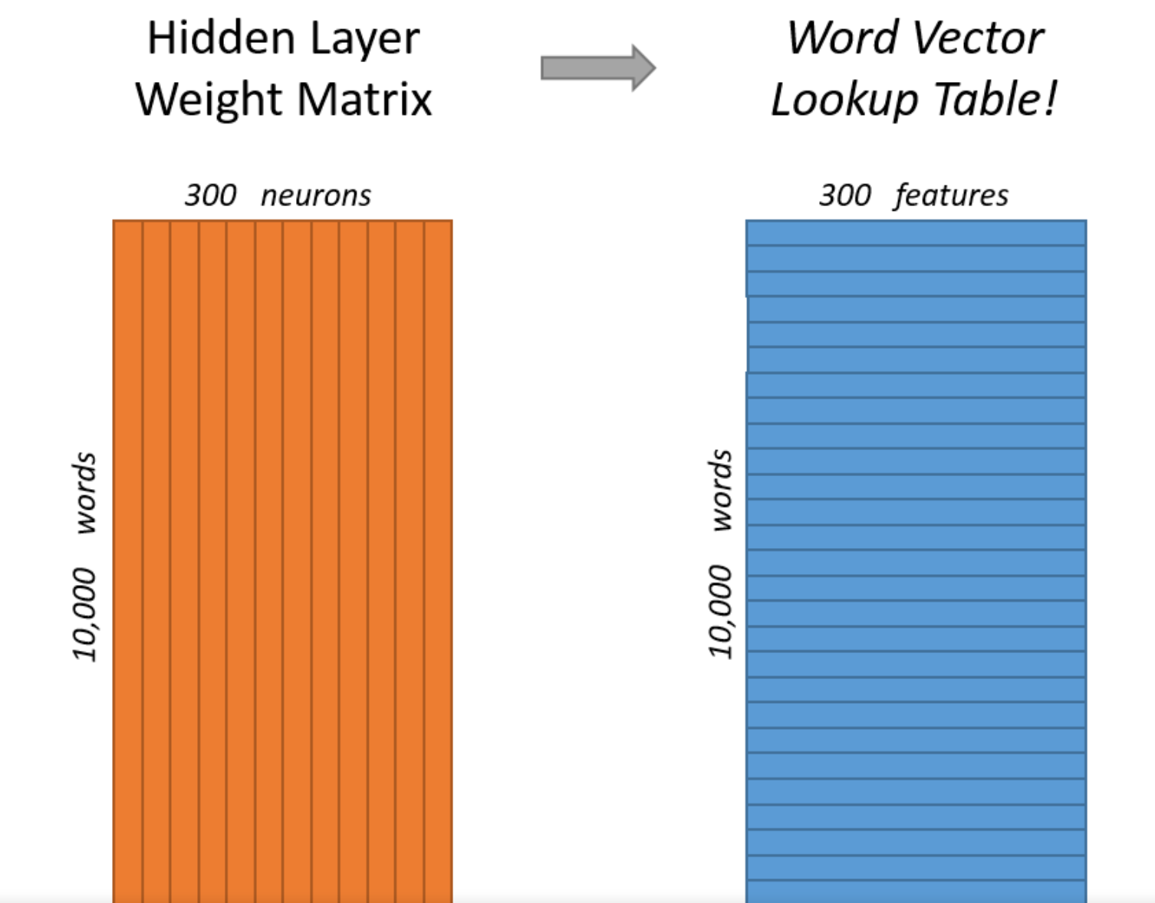
Word vectors

Slide 6
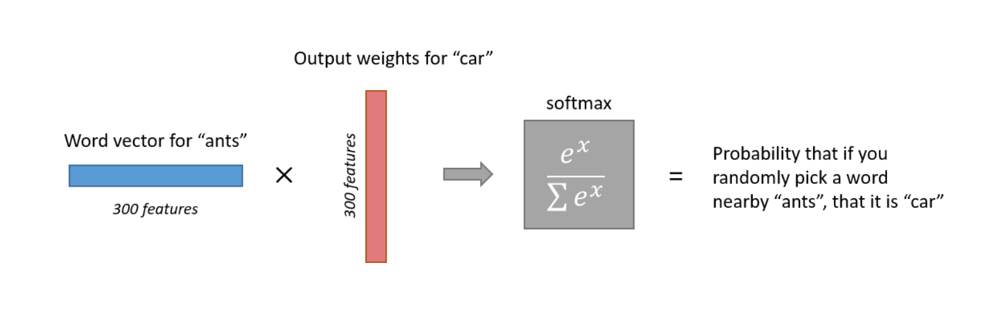
Contrastive Loss
Training on negative samples improves this.

Slide 7
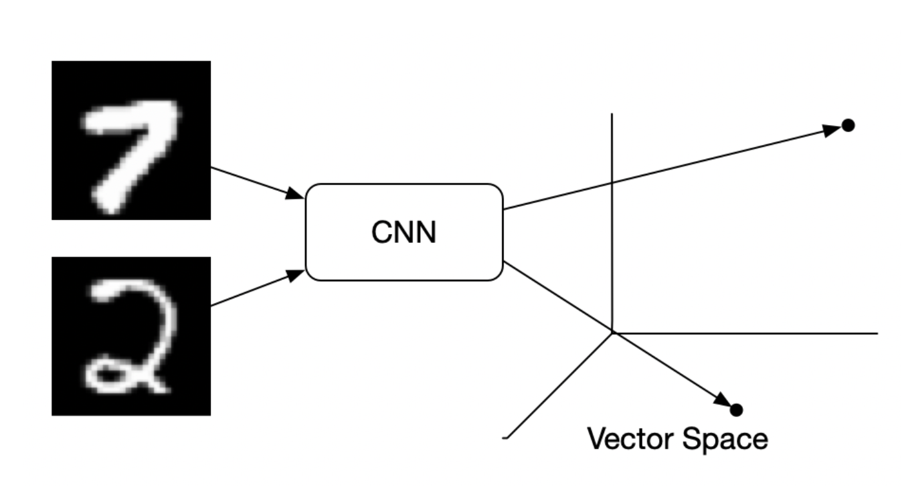
More General Contrastive Losses
Just decide on similarity vs dissimilarity

Slide 8
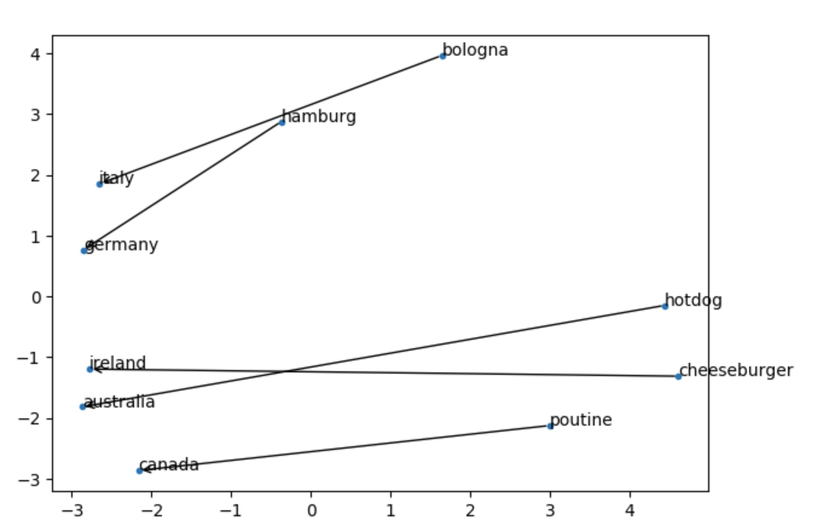
Geometric Latent Space for Analogies

Slide 9
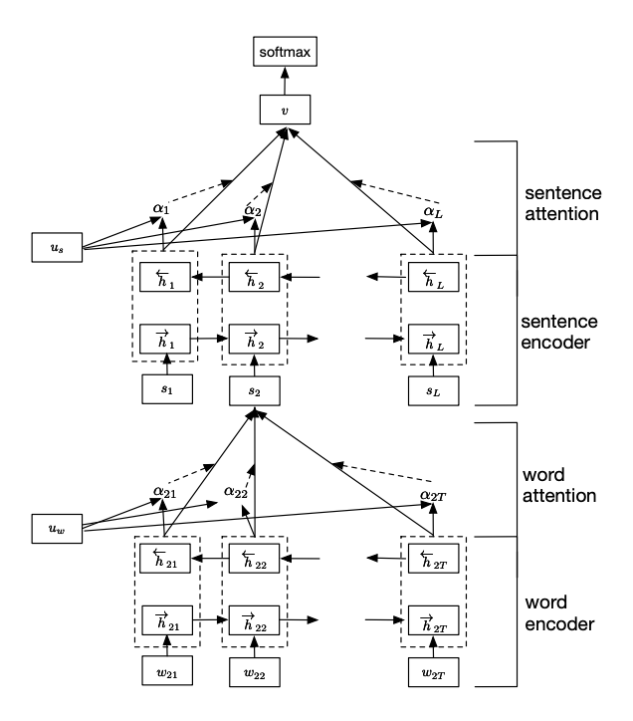
Hierarchical Model

