Slide 1
Lecture 26

Slide 2
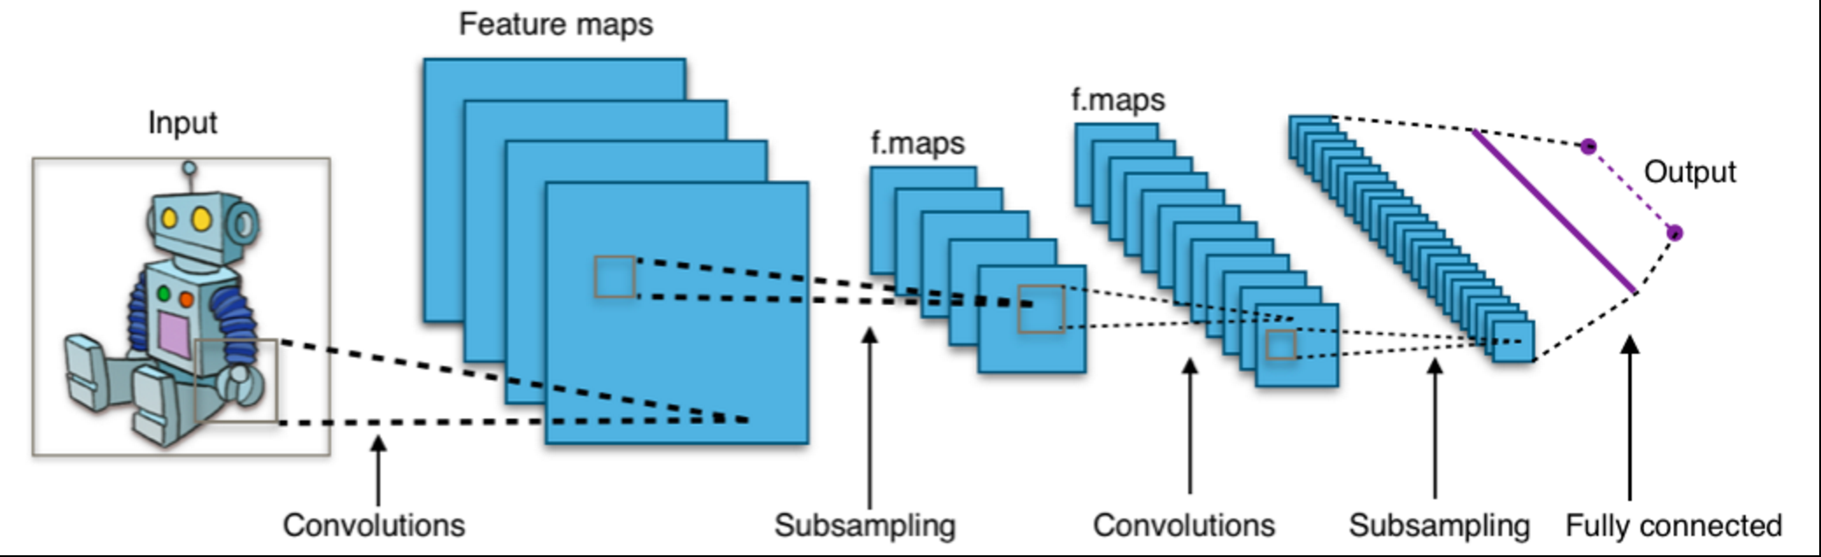
Recall CNNs
Design to account for image structure

Slide 3
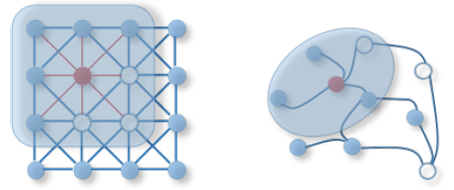
More general graph structures

Slide 4
Recall: CNNs use three basic ideas, Can graphs also?
Local receptive fields
Problem: There is no clearly defined direction or method of translation over a graph (cannot cleanly slide a convolution)
Apply the same operation to neighborhoods of a graph
Shared weights
Pooling
Could potentially be achieved with graph coarsening/pooling

Slide 5
Two Constructions
Spatial construction (Hamilton)
Apply the same operator and move over the graph space in some fashion
Notion of locality based on neighbors of a node
Spectral construction (Bruna, Defferard)
Define a convolutional operation in the graph spectral space
Uses signal processing theory to define filters in the graph Fourier domain
Notion of locality based on global properties of the filter

Slide 6
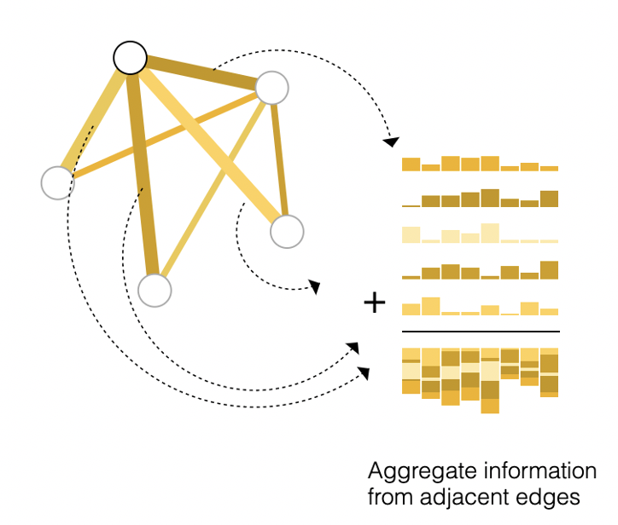


Spatial Setup: Graph and node features
$$G=(V,E)$$
Each node v has node features $x_{v}$
$$ne[v]$$
Connecting to neighbors
New node features are computed by neighbor aggregation:
$h_{v}=f(x_{v}$, $x_{ne[v]})$

Slide 7
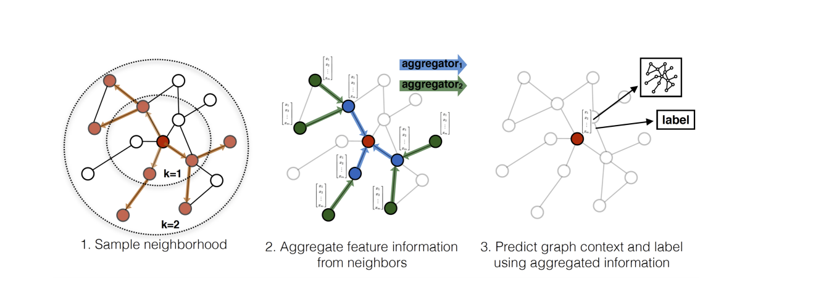
GraphSAGE Network [Hamilton et al 2017]

Slide 8
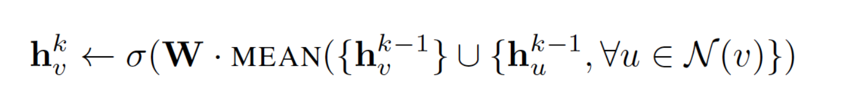
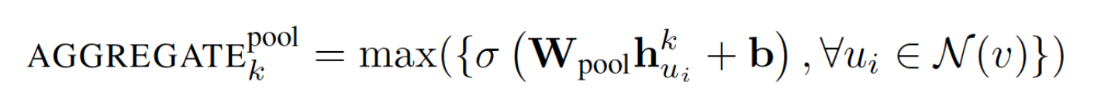
Aggregation
1. Mean aggregation:
Neighborhood aggregation based on the mean of all nodes in the neighborhood
2. Max-pooling aggregation:
3. LSTM aggregation

Slide 9
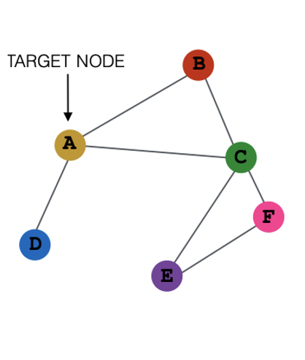
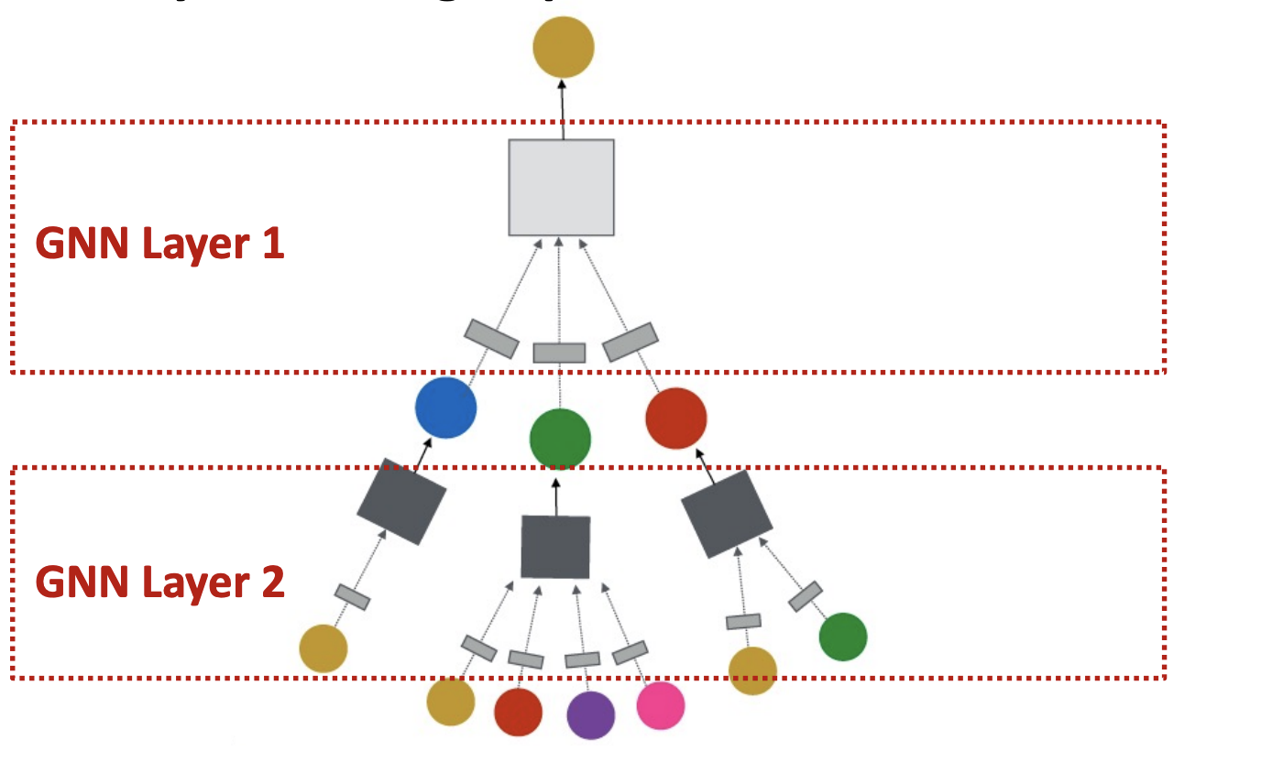
Multilayer GNNs

Slide 10
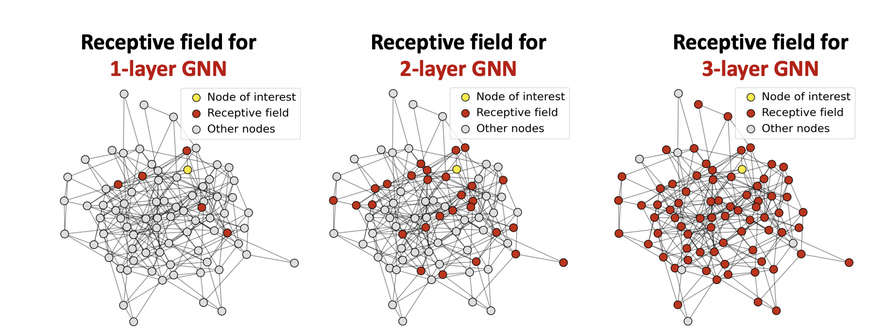
Aggregation and Layering
Slide from Jure Leskovic, Stanford

Slide 11
Issues, Exercise
Adding more layers can lead to over-smoothness in GNNs
How can we fix this architecturally?

Slide 12
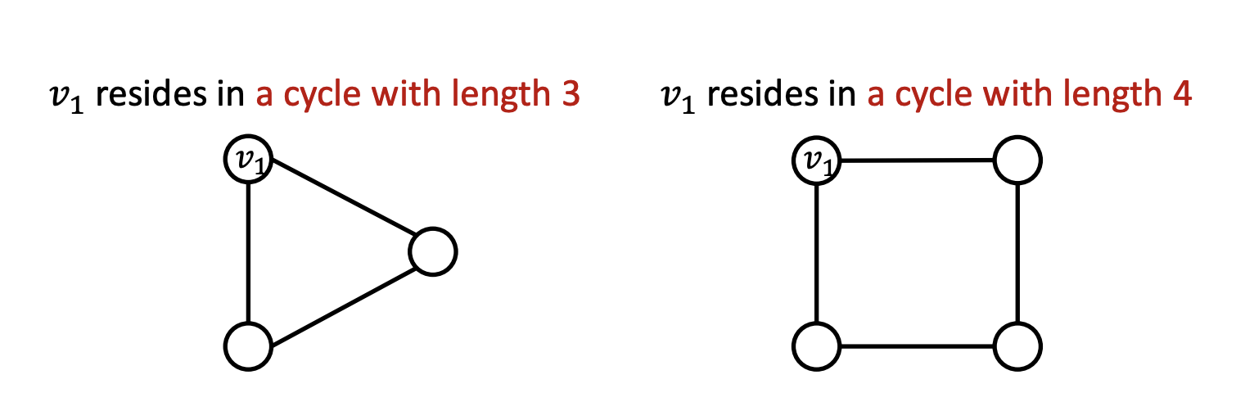
Whole Graph Representation
Typically, node features are concatenated to represent the entire graph (sometimes implicitly) in a graph neural network
Problem: Local aggregation does not define the whole graph

Slide 13
Exercise
How can we fix this issue?
Are there ways to augment graph features to do this?

Slide 14
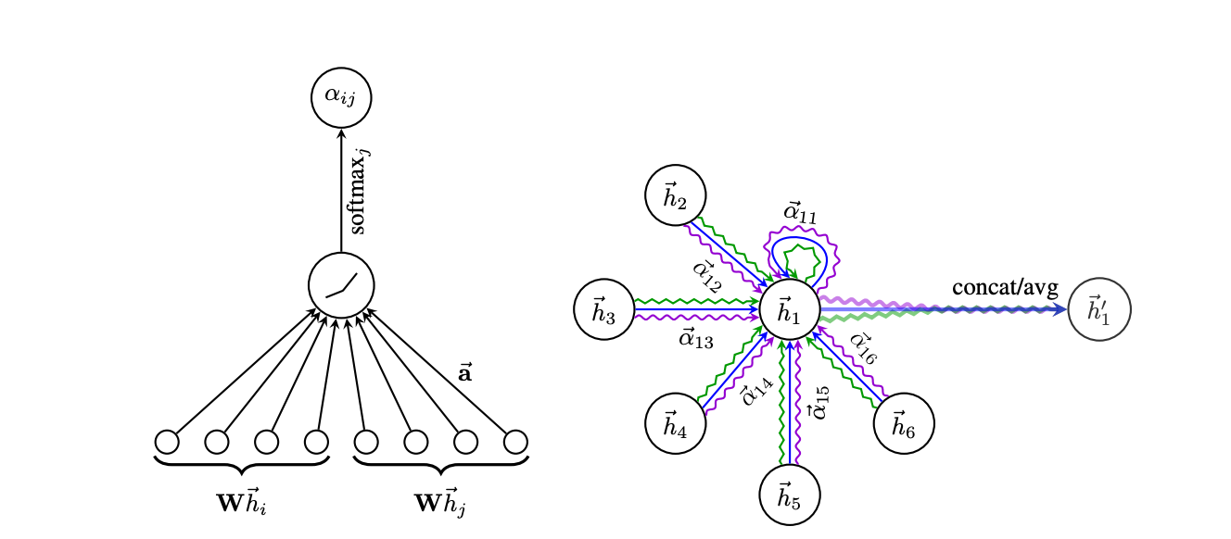
Graph Attention

Slide 15
Spectral Graph Convolutional Networks
Thus far we have been learning about graphs in the spatial domain, where we look at vertices, neighbors and edges
We can also regard features of vertices as graph signals
We can process the signals using graph signal processing
Recall: filters for graph signals rescale frequencies of the graph fourier transform of a graph signal

Slide 16
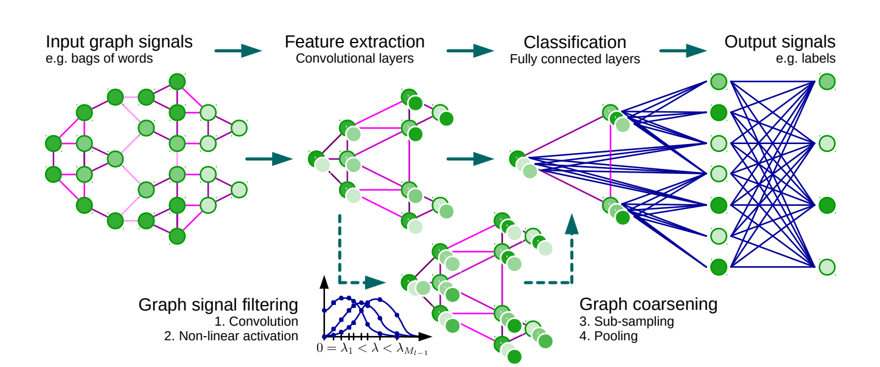
Summarized Architecture of GCN

Slide 17
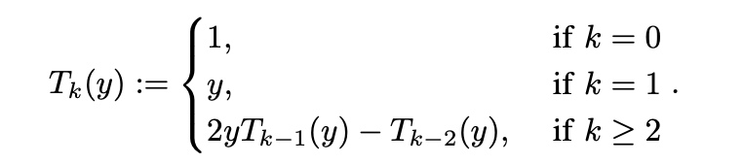


Chebyshev Polynomials
Avoiding eigendecomposition which is expensive
Chebyshev polynomials of the graph Laplacian defined recursively
Original Spectral Filters
Polynomial Filters
Chebyshev Filters

Slide 18
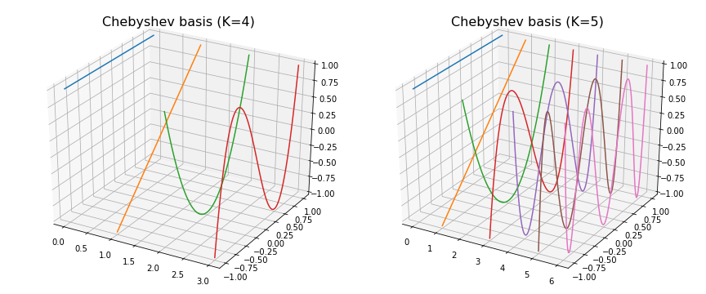
Chebyshev Basis

Slide 19
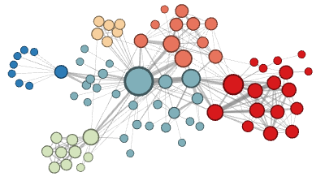
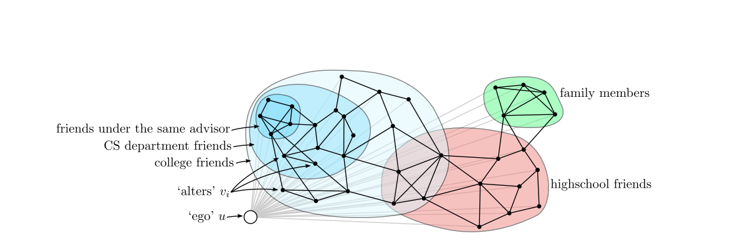
Applications Node Embeddings

Slide 20
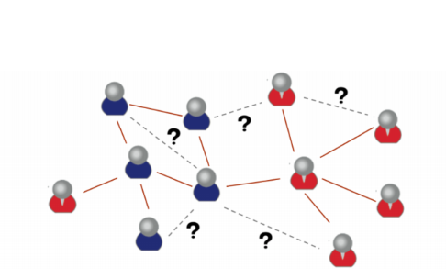
Social networks, link prediction

Slide 21
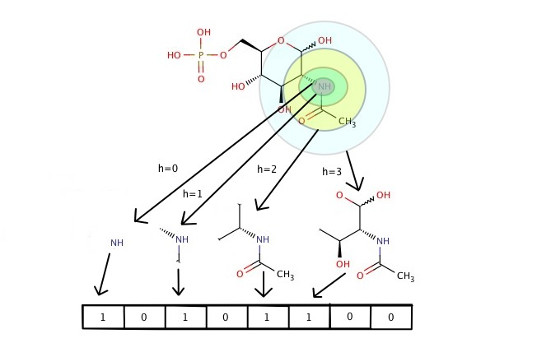
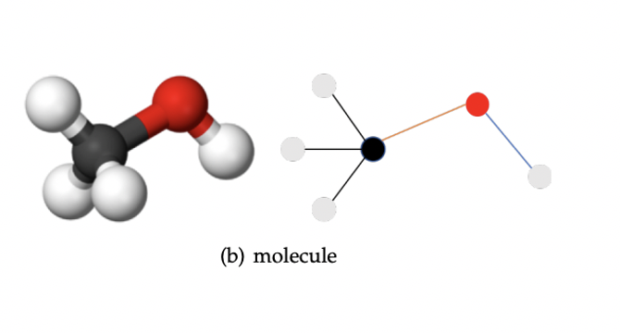
Applications: Graph regression/classification
Predicting Molecular properties by encoding molecules as graphs

Slide 22
Graph autoencoders?
Can graph neural networks autoencoder?
Do they autoencoder nodes or graphs?

