Slide 1
Hierarchical Clustering & Community Detection

Slide 2
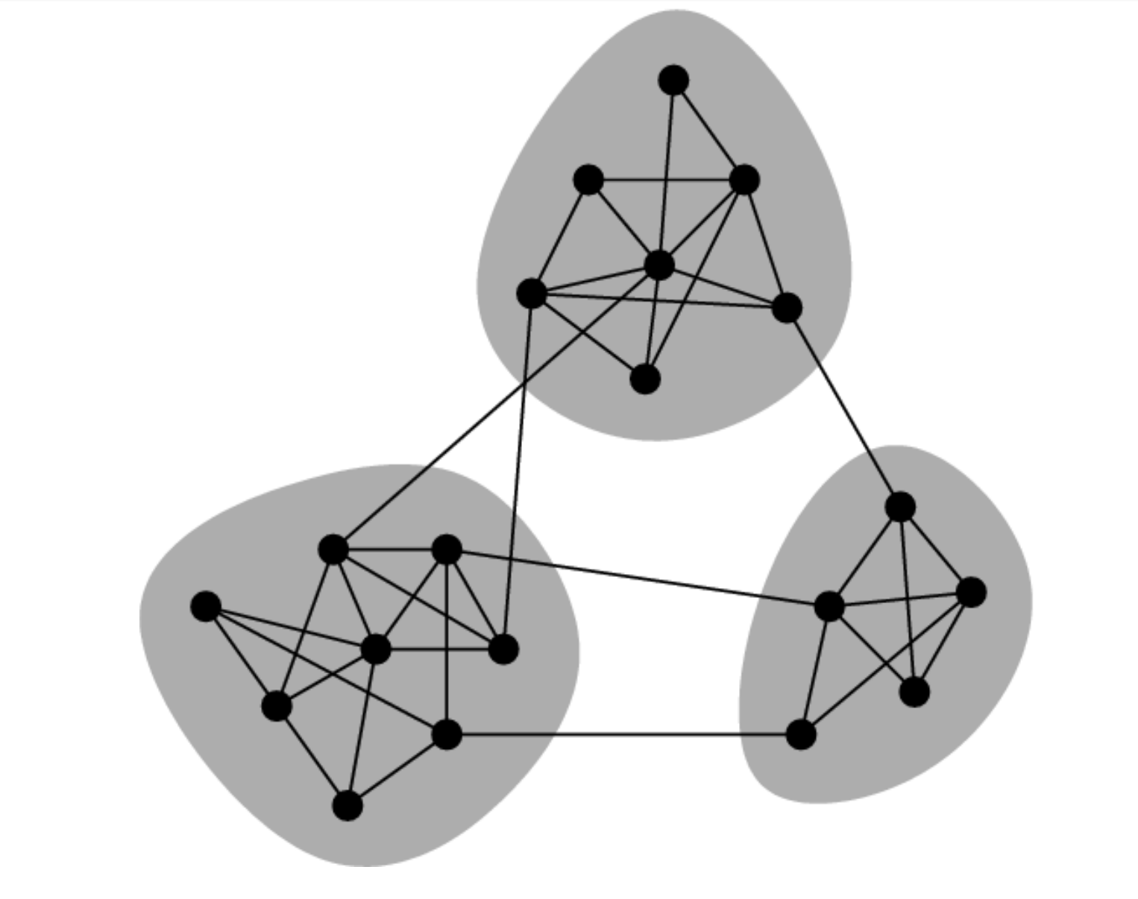
Graph-based Clusters

Slide 3
Agglomerating vs Splitting

Slide 4
Hierarchical Clustering
First level: link neighbors
Second level: Link clusters
How do you measure distance between clusters?

Slide 5
Single linkage
Average linkage
Complete Linkage
Min
Mean
Max

Slide 6
Single-Linkage clustering
Start with every point in its own cluster
Merge the two clusters that are closest together
Clusters with minimal closest distances
Find all pairwise distances between points and compute the minimum of that
Merge pair with closest distance
Recompute distances
If everything is in one cluster then stop, otherwise continue

Slide 7
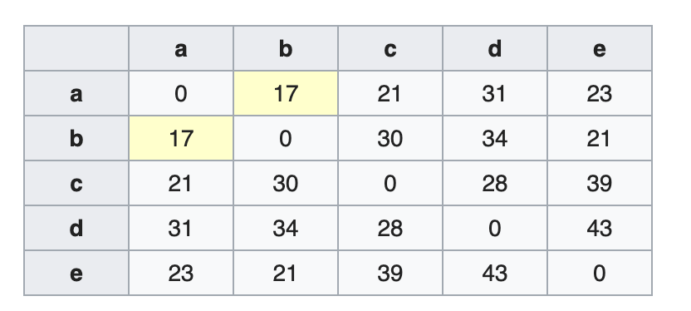
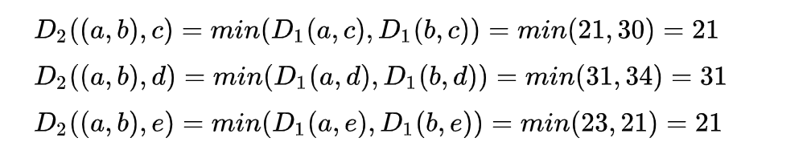
Example

Slide 8
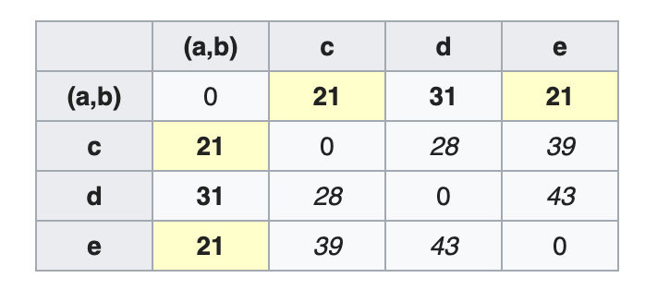
Second Step

Slide 9
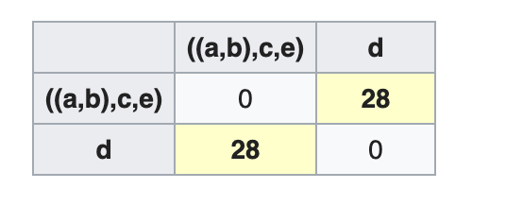
Final Step

Slide 10
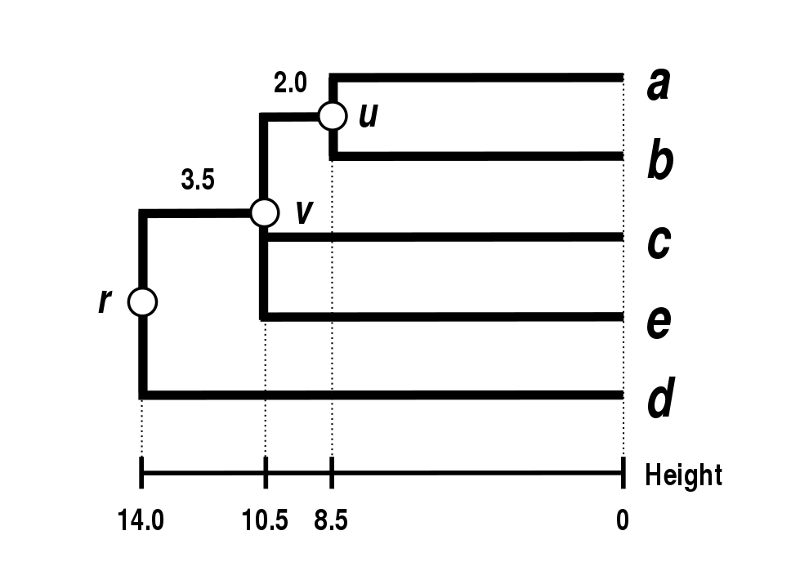
Dendogram Representation

Slide 11
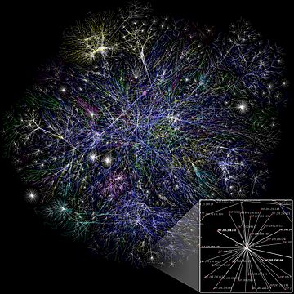
Community Detection

Slide 12
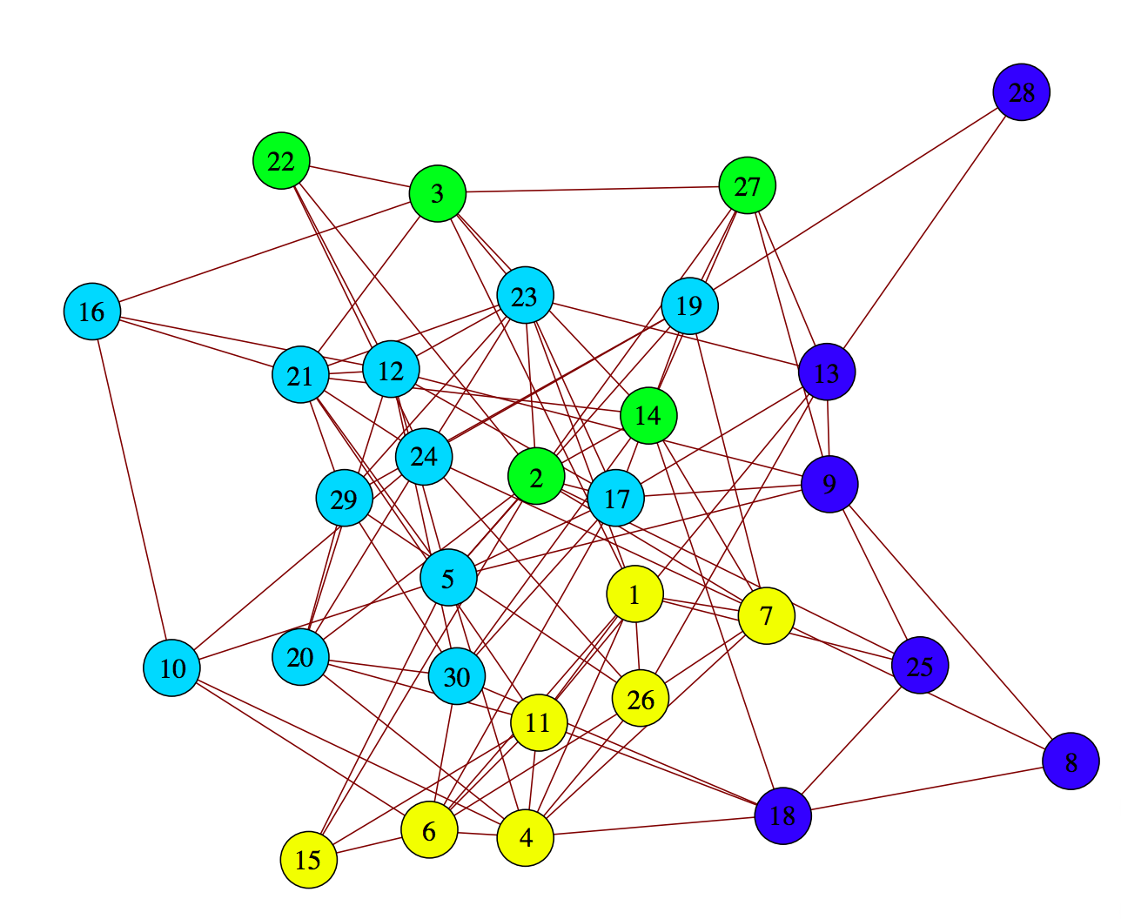
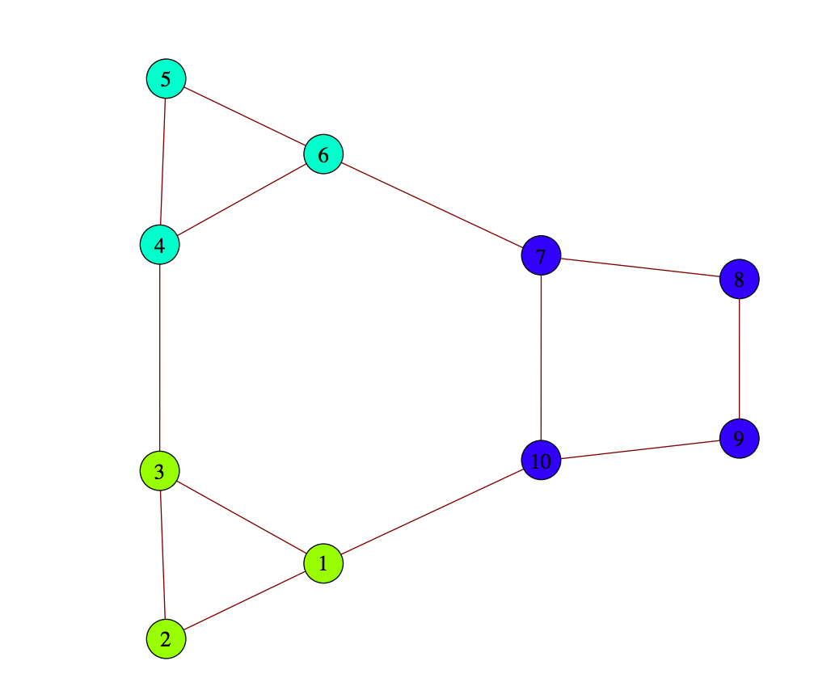
Modularity
Modular Graph
Random Graph

Slide 13
Modularity
A_{ij} = actual affinity between i and j
P_{ij} = probability of an edge between i and j
Generate random graphs of the same degrees
k_{i} *k_{j}/ 2m
m = total number of edges
Modularity is the sum of A_{ij}-P_{ij} over all

Slide 14
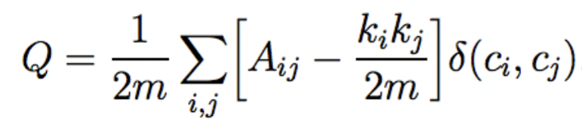



Modularity
A is the affinity matrix
K is the degree of the vertex
M is the sum of all degrees, i.e. volume of graph
This is a function that returns one if the
two vertices are in the same community
Modularity measures how densely edges within a cluster are connected compared
to what is expected at random.

Slide 15
Greedy Modularity Optimization (Newman 2003)
Start with each point in its own cluster
Merge two clusters that would increase modularity by the most
Stop when all merges reduce modularity
➔Not efficient, have to check all pairs of potential merges at each iteration

Slide 16
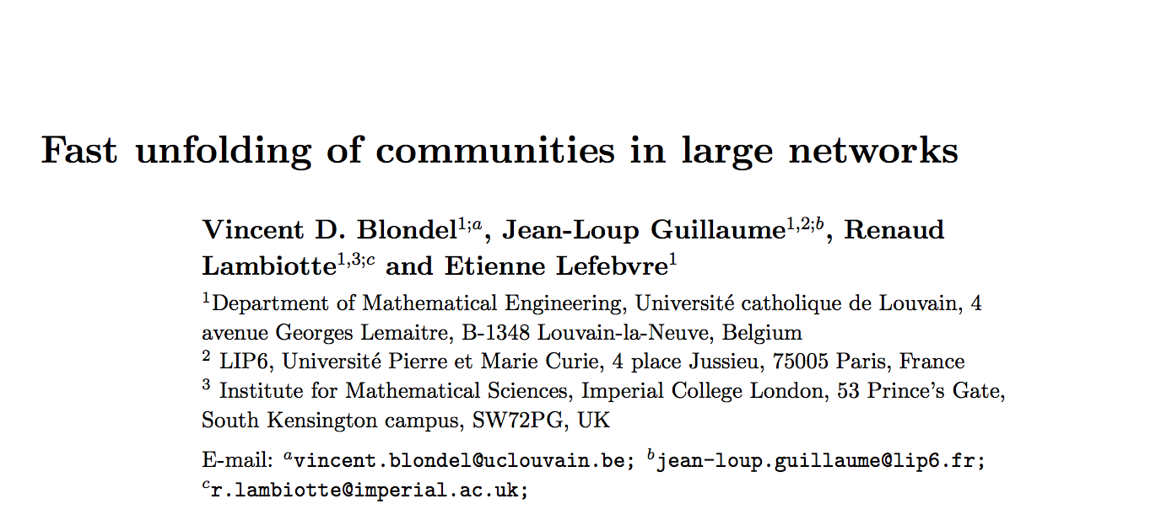
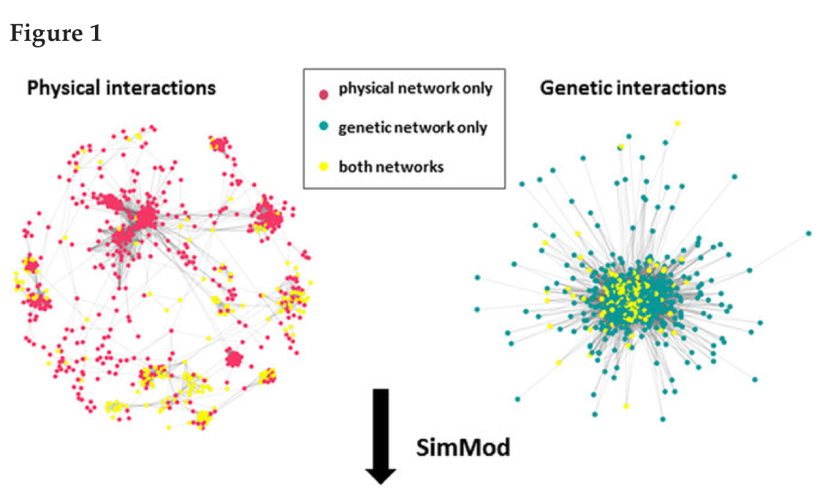
Faster Method: Louvain

Slide 17
2-Phase Method
Phase 1: Finding communities
consider each node individually
See if the node should be moved into a neighboring community
Check only K neighbors of the node
Phase 2: Coarse graining
Each community in Phase 1 becomes a node in Phase 2
Repeat Phase 1

Slide 18
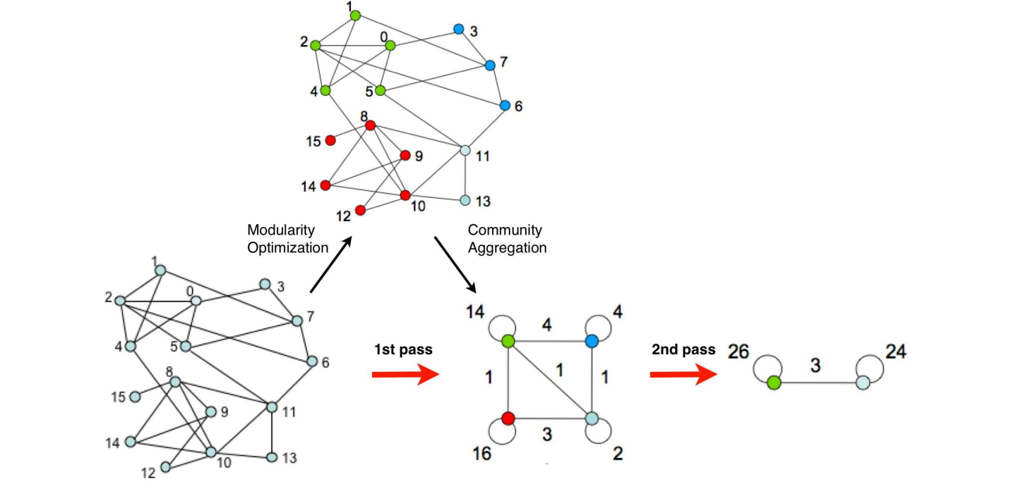
Edge between two communities is sum of the original links between them
Links between same community lead to self-loops

Slide 19
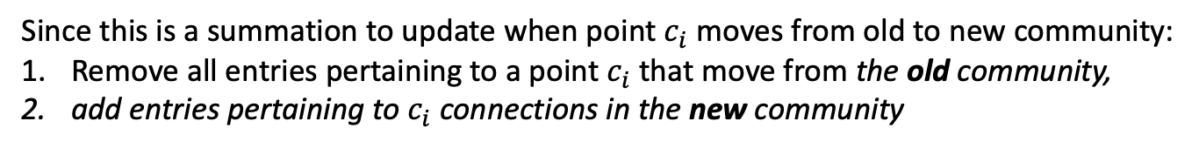
Incremental Update
Since this is a summation to update when point $c_{i}$ moves from old to new community:
Remove all entries pertaining to a point $c_{i}$ that move from the old community,
add entries pertaining to $c_{i}$ connections in the new community

Slide 20
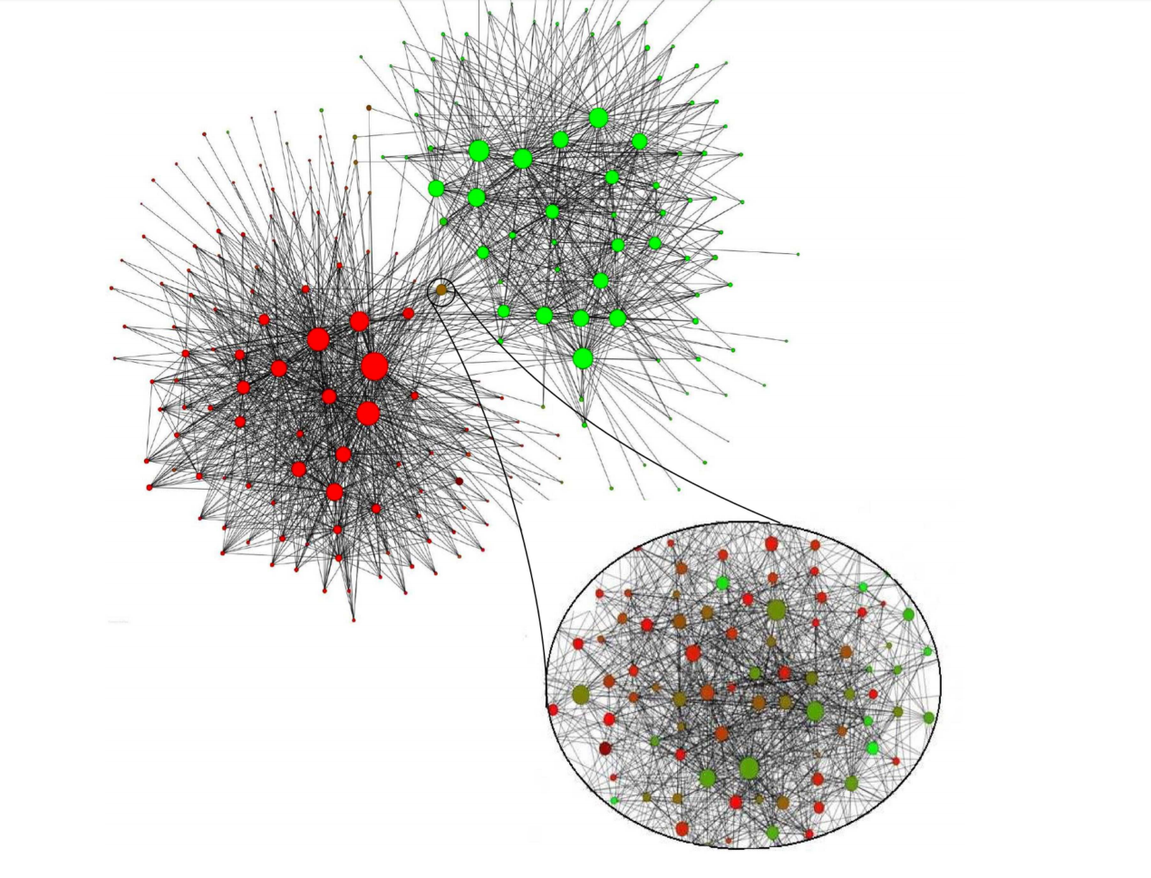
Belgian Telephone Exchange

