Slide 1
Kernels and the Kernel Trick

Slide 2
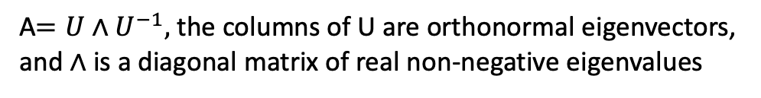
Positive semidefinite matrix
An $n×n$ symmetric real matrix A is positive semidefinite iff $x^{t}Ax≥0$ for all $x∈ℝ^{n}$
PSD matrices are eigendecomposable and have all real non-negative eigenvalues
A$=U∧U^{−1},$ the columns of U are orthonormal eigenvectors,
and $∧$ is a diagonal matrix of real non-negative eigenvalues

Slide 3
Kernel trick
This is a result in mathematics that connects positive semidefinite functions (or matrices) to kernels (inner products)
This trick allows linear methods that are designed on datapoint inner products to be applied to non-linear datapoint affinities
Ex: SVM→Kernel SVM
SVM Linear hyperplane boundaries between data classes
Nonlinear boundaries between data classes

Slide 4
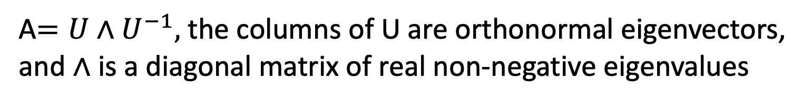
Positive semidefinite matrix
An $n×n$ symmetric real matrix A is positive semidefinite if $x^{t}Ax≥0$ for all $x∈ℝ^{n}$
PSD matrices are eigendecomposable and have all real non-negative eigenvalues
A$=U∧U^{−1},$ the columns of U are orthonormal eigenvectors,
and $∧$ is a diagonal matrix of real non-negative eigenvalues

Slide 5
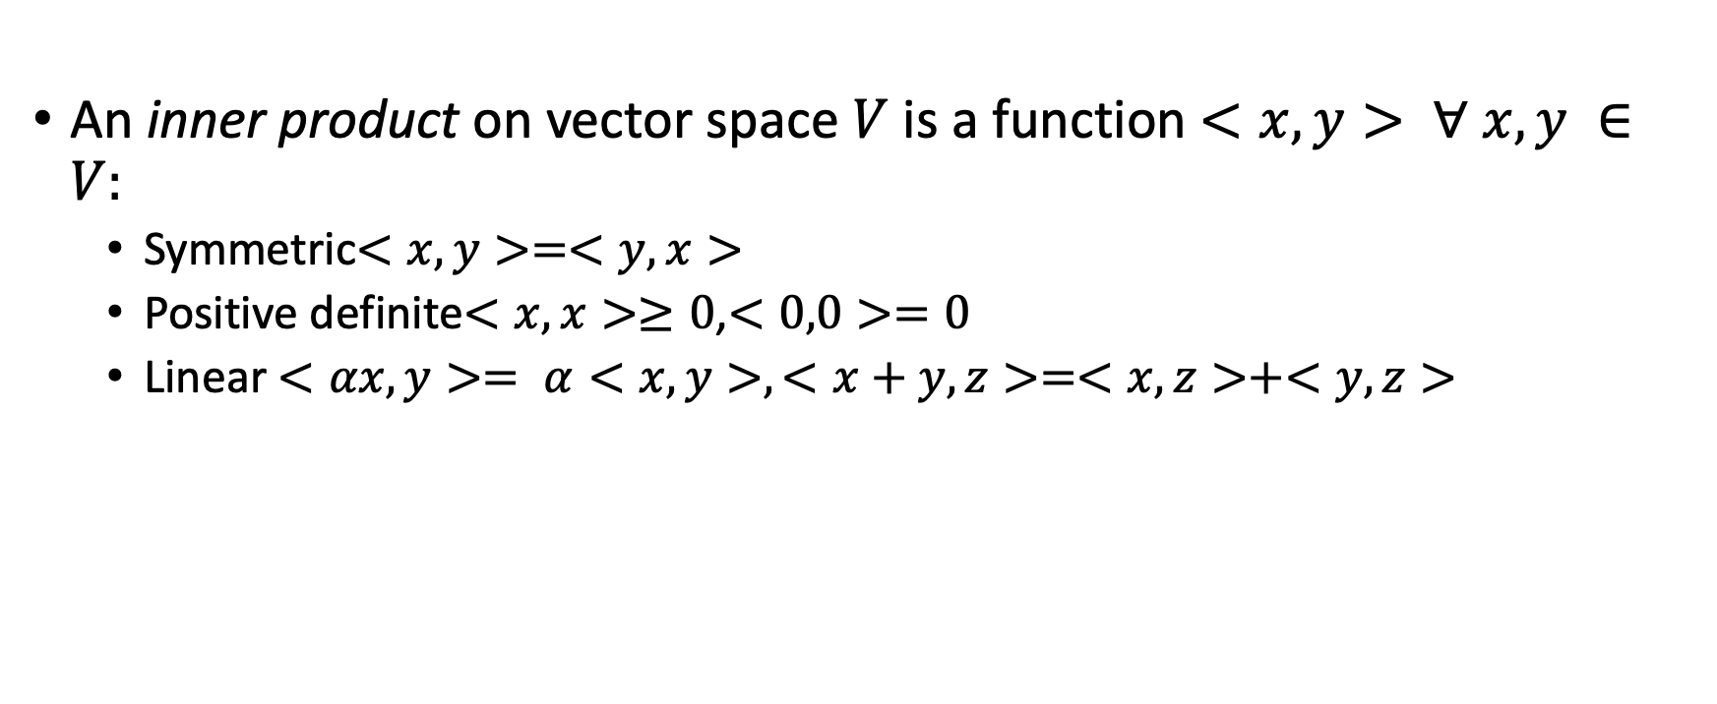
Inner products
An inner product on vector space $V$ is a function $<x,y> ∀ x,y ∈V:$
Symmetric$<x,y>=<y,x>$
Positive definite$<x,x>≥0$,$<0,0>=0$
Linear $<αx,y>= α<x,y>,<x+y,z>=<x,z>+<y,z>$

Slide 6
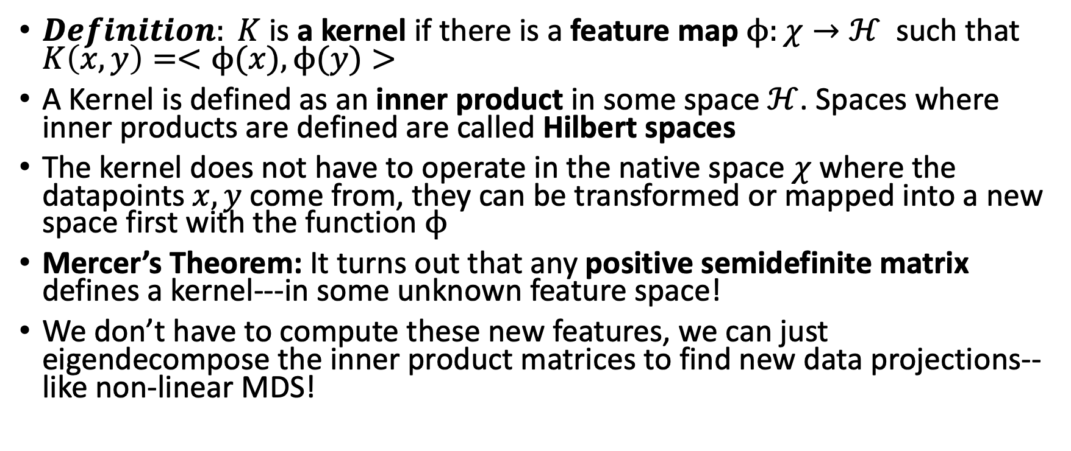
What is a Kernel?
$Definition: K$ is a kernel if there is a feature map$ϕ:χ→ℋ$ such that $K\left(x,y\right)=<ϕ(x),ϕ(y)>$
A Kernel is defined as an inner product in some space $ℋ$. Spaces where inner products are defined are called Hilbert spaces
The kernel does not have to operate in the native space $χ$ where the datapoints $x,y$ come from, they can be transformed or mapped into a new space first with the function$ϕ$
Mercer’s Theorem: It turns out that any positive semidefinite matrix defines a kernel---in some unknown feature space!
We don’t have to compute these new features, we can just eigendecompose the inner product matrices to find new data projections--like non-linear MDS!

Slide 7
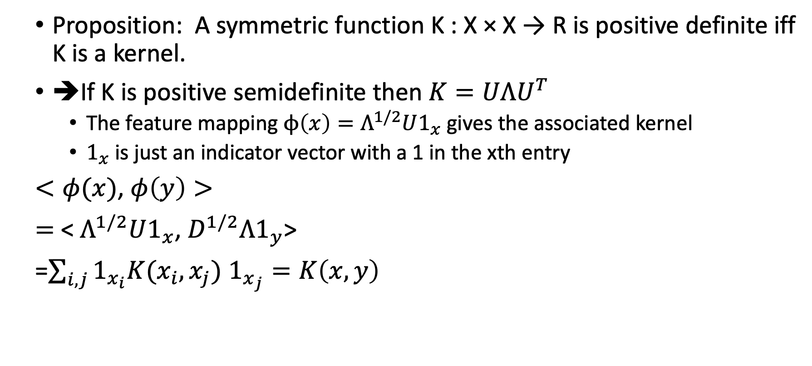
Positive semidefinite matrices define kernels
Proposition: A symmetric function K : X × X → R is positive definite iff K is a kernel.
➔If K is positive semidefinite then $K=UΛU^{T}$
The feature mapping $ϕ\left(x\right)=Λ^{1/2}U1_{x}$ gives the associated kernel
$1_{x}$ is just an indicator vector with a 1 in the xth entry
$<φ(x)$, $φ\left(y\right)>$
$=$ < $Λ^{1/2}U1_{x}$, $D^{1/2}Λ1_{y}$>
=$\sum_{i,j}{1_{x_{i}}K(x_{i},x_{j})}$ $1_{x_{j}}=K\left(x,y\right)$

Slide 8
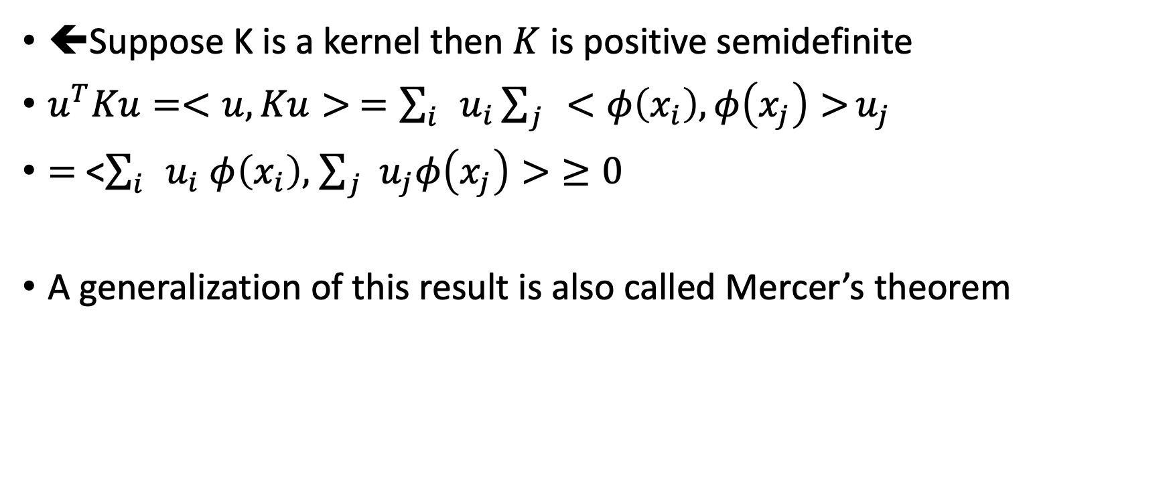
Kernels define positive semidefinite matrices
⬅Suppose K is a kernel then $K$ is positive semidefinite
$u^{T}Ku=<u,Ku> =\sum_{i}{u_{i}\sum_{j}{<φ\left(x_{i}\right),φ\left(x_{j}\right)>}}u_{j}$
$=$ <$\sum_{i}{u_{i}}$ $φ\left(x_{i}\right),$ $\sum_{j}{u_{j}φ\left(x_{j}\right)>}≥0$
A generalization of this result is also called Mercer’s theorem

Slide 9
Mercer+Spectral Theorem
Since and positive semidefinite matrix can be considered as an inner product matrix in high dimensions
It can also be diagonalized into eigenvectors, which give optimal coordinates that preserve/ maximize the inner products (like PCA)
For PCA the “inner product” was set up to be covariance, eigenvectors preserved maximal variance, CMDS had double centered distances as the “inner product”
But we can replace these with any affinity measure we want!

Slide 10
Kernel PCA

Slide 11
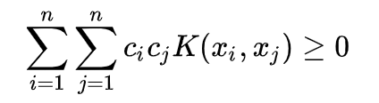
Kernel function
A Kernel function $X×X→ℝ$ is a symmetric function such that
This holds $∀ x_{i},x_{j}∈$ $X$, and given $c_{i},c_{j}∈ℝ$
This implies that the pairwise (affinity) matrix created by this kernel positive semi-definite symmetric matrices

Slide 12
Examples
Linear kernel $K\left(x,y\right)= x^{T}y$
Gaussian (RBF) kernel $K\left(x,y\right)=e^{−γ\frac{{|\left|x−y\right||}^{2}}{2}}$
Polynomial kernel $K\left(x,y\right)$=${(x^{T}y +r)}^{n}$
These define affinities between datapoints, often starting from distances as in the RBF

Slide 13
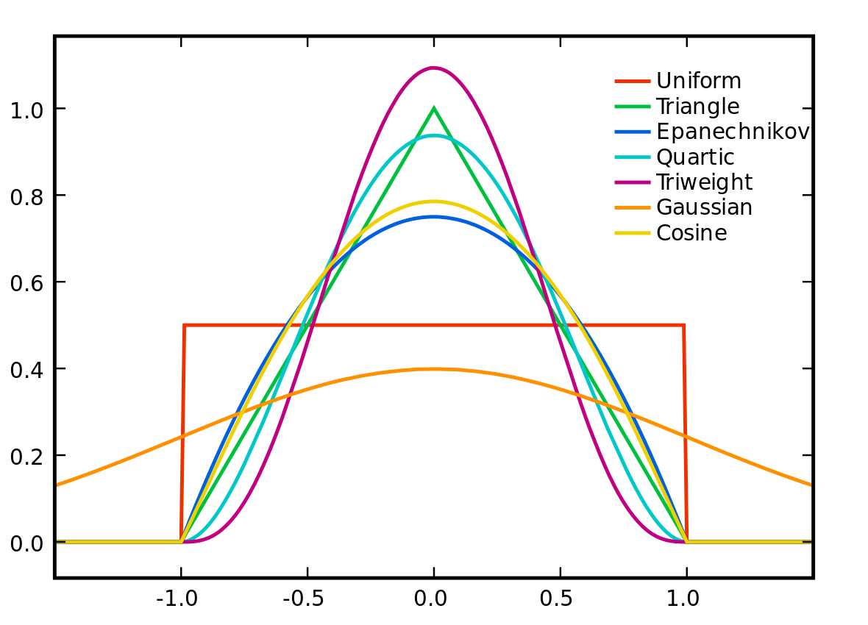
Distance to Affinity
properties of affinity matrix: Real-valued, Non-negative, Symmetric
Affinity
Distance between 2 data points

Slide 14
Kernel Matrices are Affinity matrices
Kernel matrices are positive semidefinite symmetric matrices that define the similarity between two sets of vectors
This basically gives a graph representation of the data where the weights are given by the affinity
But because they are PSD matrices they can be treated like any inner product matrix and eigendecomposed to find new data representations
These eigenvectors are actually data projections and not axes

Slide 15
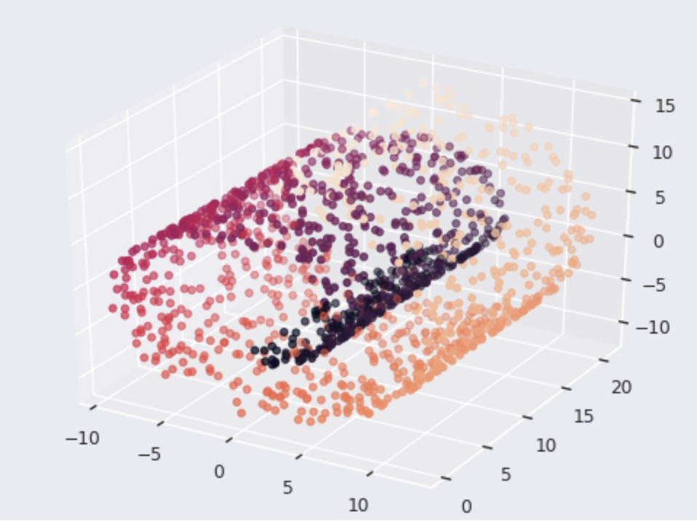
Swiss Roll Dataset

Slide 16
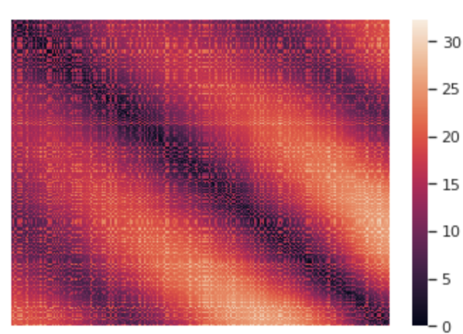
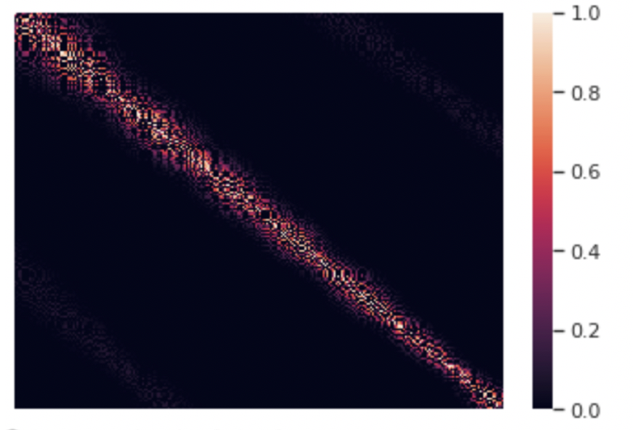
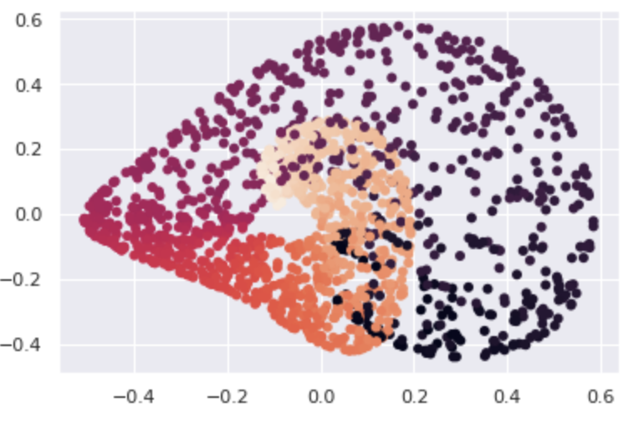
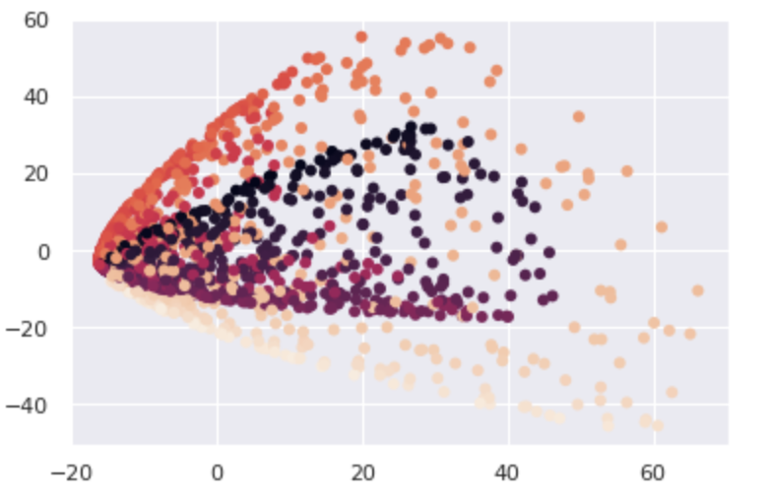
Data Pairwise distance matrix Affinity matrix
Eigendecompose affinity matrix
2D projection
2D projection
Gaussian kernel
Polynomial kernel

Slide 17
Data->Pairwise distances

Slide 18
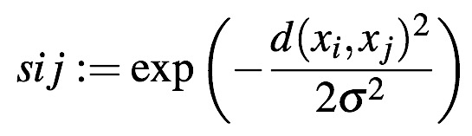
Distances->Affinities

Slide 19
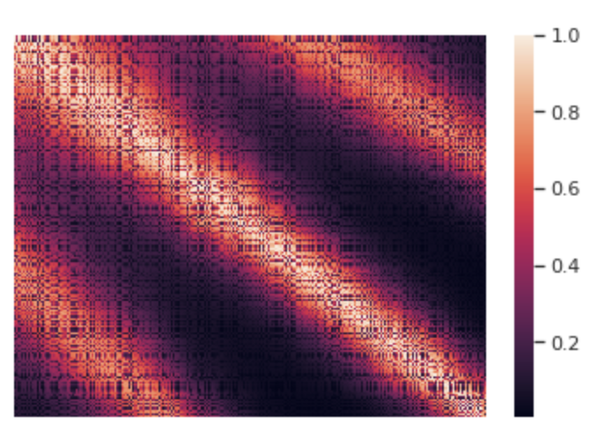
Effect of Changing Bandwidth

Slide 20
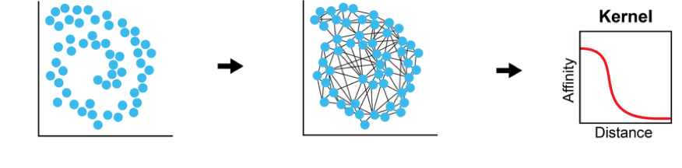
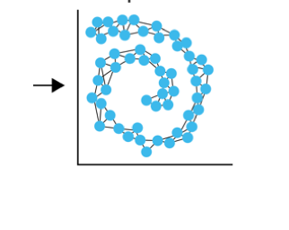
Algorithm of Kernel PCA
1. Compute distance matrix
2. Compute affinity matrix 𝑊
3. Eigendecompose
affinity matrix
𝑊 = 𝑈Λ𝑈⁻¹
data
distances
Affinities
The family of methods called kernel PCA:
Advanced variants include:
Laplacian Eigenmaps
Diffusion Maps

Slide 21
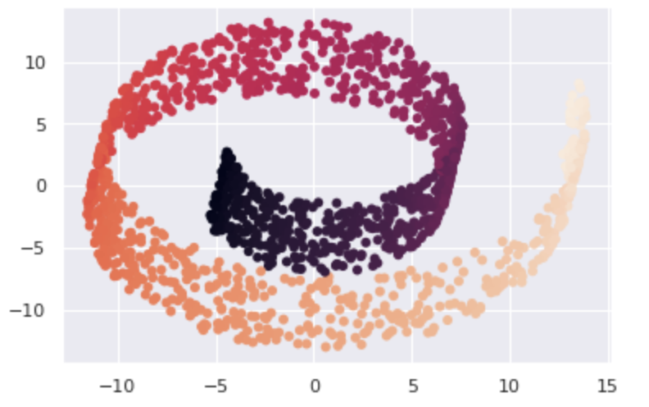
PCA vs Kernel PCA
PCA
Guassian kernel PCA
Polynomial kernel PCA

Slide 22
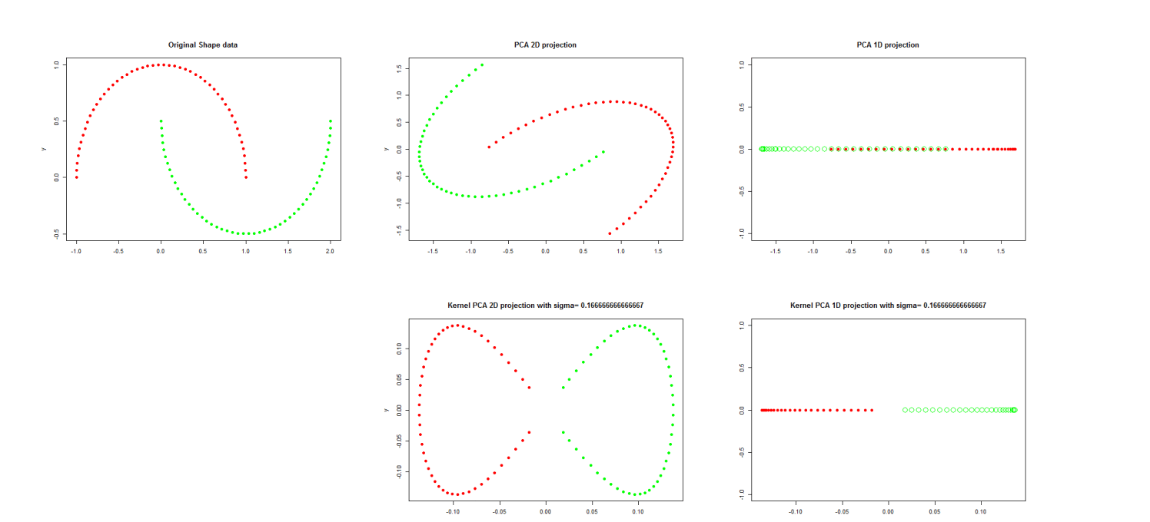
PCA vs Kernel PCA: two moon dataset
Original Data
2D
1D
PCA
Kernel PCA

Slide 23
Exercises
Try to change the gamma parameter on the swiss roll
Try to change the kernel type on the swiss roll, what works best?
Try to create a dataset that is better separated with KPCA

