Slide 1
Machine Translation
Phrase Based Translation

Slide 2
Phrase Alignment Example
Spanish to English
 | Maria | no | dio | una | bofetada | a | la | bruja | verde
Mary | XXXX
did |  | XX
not |  | XX
slap |  |  |  |  | XXXXXX
the |  |  |  |  |  |  | XX
green |  |  |  |  |  |  |  |  | XXXX
witch |  |  |  |  |  |  |  | XXXXX

Slide 3
Phrase Alignment Example
Spanish to English
 | Maria | no | dio | una | bofetada | a | la | bruja | verde
Mary | XXXX
did |  |  |  |  |  | XX
not |  | XX
slap |  |  | XXX | XXX | XXXXXX
the |  |  |  |  |  |  | XX
green |  |  |  |  |  |  |  |  | XXXX
witch |  |  |  |  |  |  |  | XXXXX

Slide 4
Phrase Alignment Example
Intersection
 | Maria | no | dio | una | bofetada | a | la | bruja | verde
Mary | XXXX
did
not |  | XX
slap |  |  |  |  | XXXXXX
the |  |  |  |  |  |  | XX
green |  |  |  |  |  |  |  |  | XXXX
witch |  |  |  |  |  |  |  | XXXXX

Slide 5
Phrase Alignment Example
Combine alignments from union
 | Maria | no | dio | una | bofetada | a | la | bruja | verde
Mary | XXXX
did |  | XX
not |  | XX
slap |  |  | XXX | XXX | XXXXXX
the |  |  |  |  |  | XX | XX
green |  |  |  |  |  |  |  |  | XXXX
witch |  |  |  |  |  |  |  | XXXXX

Slide 6
Search in Phrase Models
One segmentation out of 4096
Deshalb
haben
wir
allen
Grund
,
die
Umwelt
in
die
Agrarpolitik
zu
integrieren
One phrase translation out of 581
That is why we have
every reason
to
integrate
the environment
in
the
agricultural policy
One reordering out of 40,320
Translate in target language order to ease language modeling.

Slide 7
Search in Phrase Models
Deshalb | haben | wir | allen | Grund | , | die | Umwelt | in | die | Agrarpolitik | zu | integrieren
that is why we have |  |  | every reason |  | the environment |  |  | in | the | agricultural policy | to | integrate
therefore | have | we | every reason |  |  | the | environment | in the |  | agricultural policy , | to integrate
that is why | we have |  | all | reason | , | which | environment in |  | agricultural policy |  | parliament
have therefore |  | us | all the | reason |  | of the | environment into |  | the agricultural policy |  | successfully integrated
hence |  | , we | every | reason to make |  |  | environmental | on | the cap |  | be woven together
we have therefore |  |  | everyone | grounds for taking the |  |  | the environment | to the |  | agricultural policy is | on | parliament
so | , we |  | all of | cause | which |  | environment , | to | the cap , |  | for | incorporated
hence our |  |  | any | why | that |  | outside | at | agricultural policy |  | too | woven together
therefore , |  | it | of all | reason for | , the |  | completion | into | that agricultural policy |  | be
And many, many more…even before reordering

Slide 8
Search in Phrase Models
Many ways of segmenting source
Many ways of translating each segment
Restrict phrases > e.g. 7 words, long-distance reordering
Prune away unpromising partial translations or we’ll run out of space and/or run too long
How to compare partial translations?
Some start with easy stuff: “in”, “das”, ...
Some with hard stuff: “Agrarpolitik”, “Entscheidungsproblem”, …

Slide 9
Phrase-based Translation Models
Segmentation of the target sentence
Translation of each phrase
Rearrange the translated phrases

Slide 10
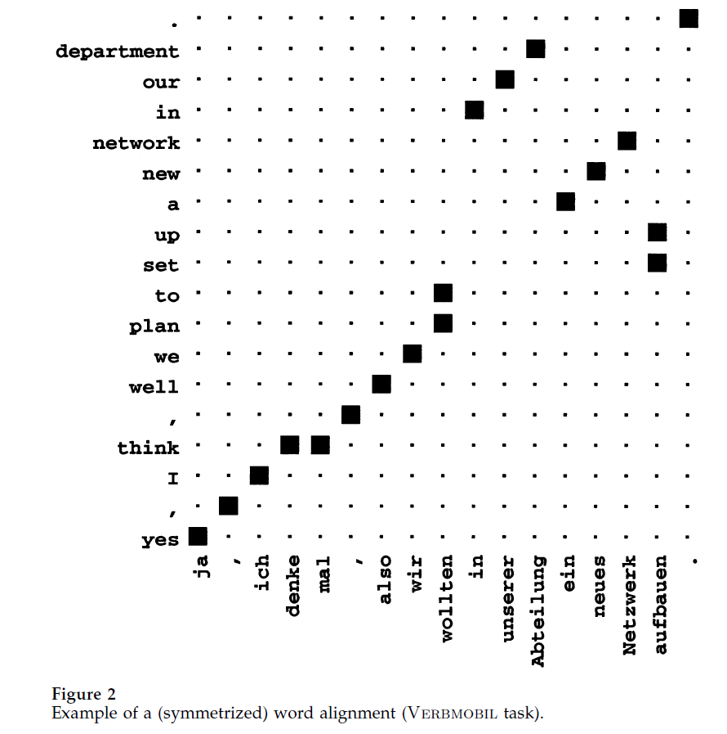
Alignment Templates

Slide 11
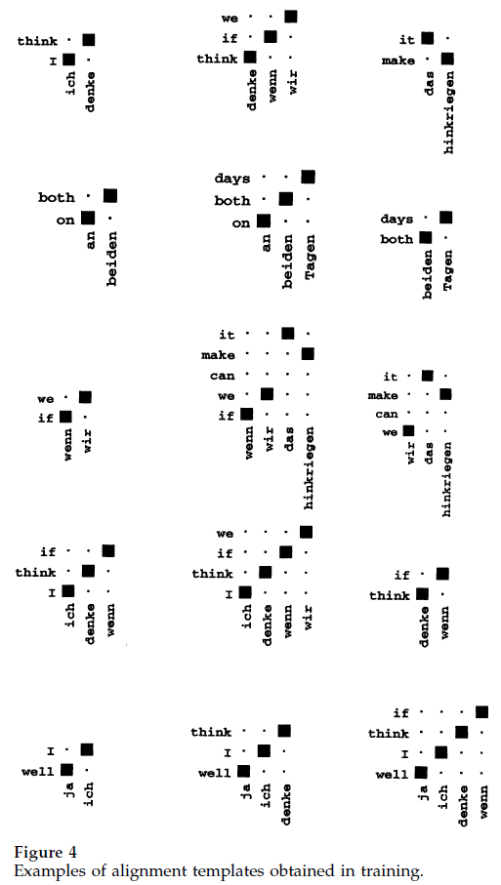
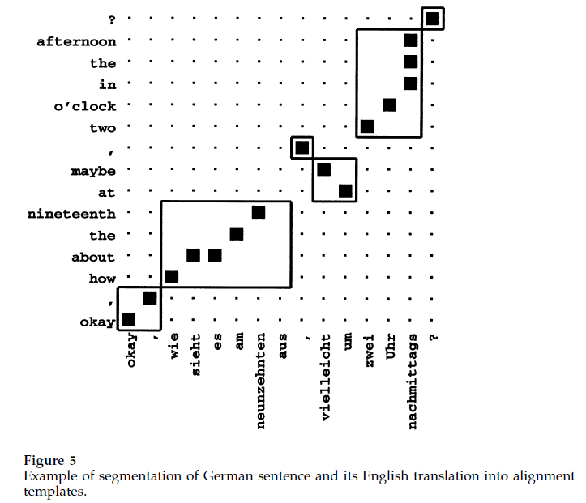
Alignment Templates
[Example from Och/Ney 2002]

