Slide 1
Context-free grammars

Slide 2
Context-free grammars
A context-free grammar is a 4-tuple (N,Σ,R,S)
N: non-terminal symbols
Σ: terminal symbols (disjoint from N)
R: rules (A → β), where β is a string from (Σ ∪ N)*
S: start symbol from N

Slide 3
Example
["the", "child", "ate", "the", "cake", "with", "the", "fork"]
S -> NP VP
NP -> DT N | NP PP
PP -> PRP NP
VP -> V NP | VP PP
DT -> 'a' | 'the'
N -> 'child' | 'cake' | 'fork'
PRP -> 'with' | 'to'
V -> 'saw' | 'ate'

Slide 4
Example
["the", "child", "ate", "the", "cake", "with", "the", "fork"]
S -> NP VP
NP -> DT N | NP PP
PP -> PRP NP
VP -> V NP | VP PP
DT -> 'a' | 'the'
N -> 'child' | 'cake' | 'fork'
PRP -> 'with' | 'to'
V -> 'saw' | 'ate'
Heads marked in bold face

Slide 5
Phrase-structure grammars (1/2)
Sentences are not just bags of words
Alice bought Bob flowers
Bob bought Alice flowers
Context-free view of language
A prepositional phrase looks the same whether it is part of the subject NP or part of the VP
Constituent order
SVO (subject verb object)
SOV (subject object verb)
Notes:
REPEATED?

Slide 6
Phrase-structure grammars (2/2)
Auxiliary verbs
The dog may have eaten my homework
Imperative sentences
Leave the book on the table
Interrogative sentences
Did the customer have a complaint?
Who had a complaint?
Negative sentences
The customer didn’t have a complaint
Notes:
REPEATED?

Slide 7
A longer example
S -> NP VP | Aux NP VP | VP
NP -> PRON | Det Nom
Nom -> N | Nom N | Nom PP
PP -> PRP NP
VP -> V | V NP | VP PP
Det -> 'the' | 'a' | 'this'
PRON -> 'he' | 'she'
N -> 'book' | 'boys' | 'girl'
PRP -> 'with' | 'in'
V -> 'takes' | 'take'
What changes were made to the grammar?

Slide 8
A longer example
S -> NP VP | Aux NP VP | VP
NP -> PRON | Det Nom
Nom -> N | Nom N | Nom PP
PP -> PRP NP
VP -> V | V NP | VP PP
Det -> 'the' | 'a' | 'this'
PRON -> 'he' | 'she'
N -> 'book' | 'boys' | 'girl'
PRP -> 'with' | 'in'
V -> 'takes' | 'take'

Slide 9
A longer example
S -> NP VP | Aux NP VP | VP
NP -> PRON | Det Nom
Nom -> N | Nom N | Nom PP
PP -> PRP NP
VP -> V | V NP | VP PP
Det -> 'the' | 'a' | 'this'
PRON -> 'he' | 'she'
N -> 'book' | 'boys' | 'girl'
PRP -> 'with' | 'in'
V -> 'takes' | 'take'

Slide 10
Penn Treebank Example
( (S
(NP-SBJ
(NP (NNP Pierre) (NNP Vinken) )
(, ,)
(ADJP
(NP (CD 61) (NNS years) )
(JJ old) )
(, ,) )
(VP (MD will)
(VP (VB join)
(NP (DT the) (NN board) )
(PP-CLR (IN as)
(NP (DT a) (JJ nonexecutive) (NN director) ))
(NP-TMP (NNP Nov.) (CD 29) )))
(. .) ))
( (S
(NP-SBJ (NNP Mr.) (NNP Vinken) )
(VP (VBZ is)
(NP-PRD
(NP (NN chairman) )
(PP (IN of)
(NP
(NP (NNP Elsevier) (NNP N.V.) )
(, ,)
(NP (DT the) (NNP Dutch) (VBG publishing) (NN group) )))))
(. .) ))

Slide 11
Center Embedding
Center Embedding
The rat ate the seed.
The rat that the cat ate ate the seed.
The rat that the cat that the dog ate ate ate the seed.
...
Is this language context-free?
Notes
CFG cannot describe bounded recursion
Competence vs. performance

Slide 12
CFGs are equivalent to PDAs
PDA = Pushdown Automata
Example: consider the language L={x^{n}y^{n}}
stack is empty, input=xxxyyy
push * onto stack, input=xxyyy
push * onto stack, input=xyyy
push * onto stack, input=yyy
pop * from stack, input=yy
pop * from stack, input=y
pop * from stack, input=“”
Notes:
Draw a picture

Slide 13
Leftmost derivation
A leftmost derivation is a sequence of strings s₁, s₂, ..., s_{n}
s₁ = S, the start symbol
s_{n} includes only terminal symbols
Example:
[S]
[S] [NP VP]
[S] [NP VP] [DT N VP]
…
[S] [NP VP] [DT N VP] ... [the child ate the cake with the fork]

Slide 14
Leftmost derivation
S
NP
VP
DT
N
VP
NP
NP
PP
DT
N
PRP
NP
the
child
ate
the
with
DT
N
cake
the
fork

Slide 15
Introduction to NLP
Issues with Context-free Grammars

Slide 16
Agreement
Number
Chen is/people are
Person
I am/Chen is
Tense
Chen was reading/Chen is reading/Chen will be reading
Case
not in English but in many other languages such as German, Russian, Greek
Gender
not in English but in many other languages such as German, French, Spanish

Slide 17
Combinatorial explosion
Many combinations of rules are needed to express agreement
S → NP VP
S → 1sgNP 1sgVP
S → 2sgNP 2sgVP
S → 3sgNP 3sgVP
…
1sgNP → 1sgN
...

Slide 18
Subcategorization frames
Direct object
The dog ate a sausage
Prepositional phrase
Mary left the car in the garage
Predicative adjective
The receptionist looked worried
Bare infinitive
She helped me buy this place
To-infinitive
The girl wanted to be alone
Participial phrase
He stayed crying after the movie ended
That-clause
Ravi doesn’t believe that it will rain tomorrow
Question-form clauses
She wondered where to go
Empty (φ)
She slept
Notes:
CHECK PROVENANCE

Slide 19
CFG independence assumptions
Non-independence
All NPs
11% NP PP, 9% DT NN, 6% PRP
NPs under S
9% NP PP, 9% DT NN, 21% PRP
NPs under VP
23% NP PP, 7% DT NN, 4% PRP
example from Dan Klein

Slide 20
Conclusions
Syntax helps understand the meaning of a sentence.
Bob gave Alice a flower
Who gave a flower to Alice?
What did Bob give to Alice?
Context-free grammars are an appopriate representation for syntactic information
Dynamic programming is needed for efficient parsing
Cubic time to find one parse
Still exponential time to find all parses
Why?

Slide 21
Answer
Why does it still take an exponential time to find all parses?
Very simple – because the number of parses can be exponential

Slide 22
Lexicalized Parsing

Slide 23
Limitations of PCFGs
The probabilities don’t depend on the specific words
E.g., give someone something (2 arguments) vs. see something (1 argument)
It is not possible to disambiguate sentences based on semantic information
E.g., eat pizza with pepperoni vs. eat pizza with fork
Lexicalized grammars - idea
Use the head of a phrase as an additional source of information
VP[ate] -> V[ate]
Fundamental idea in syntax, cf. X-bar theory, HPSG
Constituents receive their heads from their head child
Notes:
Combine with next slide and reorder the bullets

Slide 24
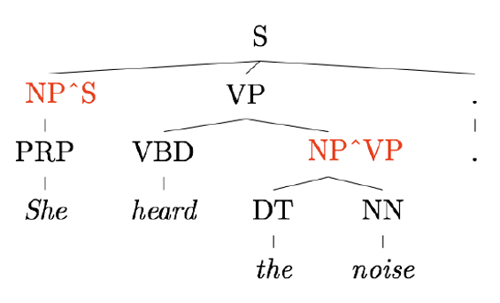
Parent Annotation
[Johnson 1998]

Slide 25
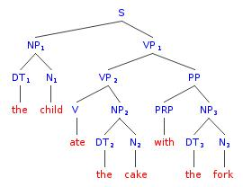
Lexicalization
ate
child
ate
ate
with
cake
fork

Slide 26
Head Extraction Example (Collins)
NP -> DT NNP NN (rightmost)
NP -> DT NN NNP (rightmost)
NP -> NP PP (leftmost)
NP -> DT JJ (rightmost)
NP -> DT (rightmost leftover child)
Notes:
Combine with next slide and reorder the bullets

Slide 27
Collins Parser 1/3
Generative, lexicalized model
Horizontal markovization
only condition on the head (also on the distance Δ from the head)
Types of rules
LHS → L_{n}L_{n−1}…L₁H R₁…R_{m−1}R_{m}
H gets generated first
L gets generated next
R gets generated last

Slide 28
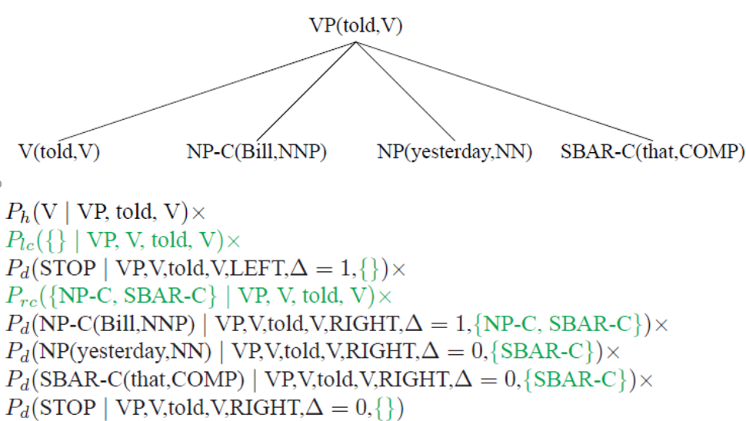
Collins Parser 2/3
Example from Michael Collins

Slide 29
Collins Parser 3/3
Maximum likelihood estimates
Smoothing (lexicalized, unlexicalized, “unheaded”)
P_{ML} (PPof-IN | VPthink-VB) =
Count (PPof-IN right of the head VPthink-VB) /
Count (symbols right of the head VPthink-VB)
P_{smoothed} (PPof-IN | VPthink-VB) =
λ₁ P (PPof-IN | VPthink-VB)
+ λ₂ P (PPof-IN | VP-VB)
+ (1−λ₁−λ₂) P (PPof-IN | VP))

Slide 30
Issues with Lexicalized Grammars
Sparseness of training data
Many probabilities are difficult to estimate from the Penn Treebank
E.g., WHADJP (when not “how much” or “how many” only appears 6 times out of 1M constituents)
Smoothing is essential
Combinatorial explosion
Parameterization is essential

Slide 31
Discriminative Reranking
Issues with statistical parsers
A parser may return many parses of a sentence, with small differences in probabilities
The top returned parse may not necessarily be the best because the PCFG may be deficient
Other considerations may need to be taken into account
parse tree depth
left attachment vs. right attachment
discourse structure
Can you think of others features that may affect the reranking?

Slide 32
Answer
Considerations that may affect the reranking
parse tree depth
left attachment vs. right attachment
discourse structure
Can you think of others?
consistency across sentences
or other stages of the NLU pipeline

Slide 33
Discriminative Reranking
n-best list
Get the parser to produce a list of n-best parses (where n can be in the thousands)
Reranking
Train a discriminative classifier to rerank these parses based on external information such as a bigram probability score or the amount of right branching in the tree

Slide 34
Statistical Parser Performance
F1 (sentences <= 40 words)
Charniak (2000) – 90.1%
Charniak and Johnson (2005) – 92% (discriminative reranking)
All words
Charniak and Johnson (2005) – 91.4%
Fossum and Knight (2009) – 92.4% (combining constituent parsers)

Slide 35
Notes
Complexity of lexicalized parsing
O(N⁵g³V³), instead of O(N³) because of the lexicalization
N = sentence length
g = number of non-terminals
V = vocabulary size
Use beam search (Charniak; Collins)
Sparse data
40,000 sentences; 12,409 rules (Collins)
15% of all test sentences contain a rule not seen in training (Collins)

Slide 36
Notes
Complements (arguments) vs. adjuncts (additional information)
NP-C (Collins)
Subcategorization
E.g., transitive vs. intransitive verbs
Parent annotation
NP^S (Johnson 1998)

Slide 37
Notes
Learning PCFG without an annotated corpus
Use EM (inside-outside) (Baker 1979), limited success
Summary
Lexicalization takes F1 from 75% to 90+%
Most errors come from attachment ambiguities: PP and CC
Markovization
Horizontal (forgetful binarization)
Vertical (generalized parent annotation)
Note: infinite vertical markovization is inefficient (Klein and Manning 2003)
Collins and Charniak are generative models
Reranking is a discriminative model

Slide 38
Probabilistic Parsing

Slide 39
Probabilistic Grammars

Slide 40
Need for Probabilistic Parsing
Time flies like an arrow
Many parses
Some (clearly) more likely than others
Need for a probabilistic ranking method

Slide 41
Probabilistic Context-Free Grammars
Just like (deterministic) CFG, a 4-tuple (N,Σ,R,S)
N: non-terminal symbols
Σ: terminal symbols (disjoint from N)
R: rules (A → β) [p]
β is a string from (Σ ∪ N)*
p is the probability P(β|A)
S: start symbol (from N)

Slide 42
Example
S -> NP VP
NP -> DT N | NP PP
PP -> PRP NP
VP -> V NP | VP PP
DT -> 'a' | 'the'
N -> 'child' | 'cake' | 'fork'
PRP -> 'with' | 'to'
V -> 'saw' | 'ate'

Slide 43
Example
S -> NP VP
NP -> DT N
NP -> NP PP
PP -> PRP NP
VP -> V NP
VP -> VP PP
DT -> 'a'
DT -> 'the'
N -> 'child'
N -> 'cake'
N -> 'fork'
PRP -> 'with'
PRP -> 'to'
V -> 'saw'
V -> 'ate'

Slide 44
Example
S -> NP VP
NP -> DT N
NP -> NP PP
PP -> PRP NP
VP -> V NP
VP -> VP PP
DT -> 'a'
DT -> 'the'
N -> 'child'
N -> 'cake'
N -> 'fork'
PRP -> 'with'
PRP -> 'to'
V -> 'saw'
V -> 'ate'

Slide 45
Example
S -> NP VP [p0=1]
NP -> DT N [p1]
NP -> NP PP [p2]
PP -> PRP NP [p3=1]
VP -> V NP [p4]
VP -> VP PP [p5]
DT -> 'a' [p6]
DT -> 'the' [p7]
N -> 'child' [p8]
N -> 'cake' [p9]
N -> 'fork' [p10]
PRP -> 'with' [p11]
PRP -> 'to' [p12]
V -> 'saw' [p13]
V -> 'ate' [p14]

Slide 46
Probability of a Parse Tree
The probability of a parse tree t given all n productions used to build it:
The most likely parse is determined as follows:
The probabilities are obtained using MLE from the training corpus
The probability of a sentence is the sum of the probabilities of all of its parses

Slide 47
Example
S -> NP VP [p0=1]
NP -> DT N [p1]
NP -> NP PP [p2]
PP -> PRP NP [p3=1]
VP -> V NP [p4]
VP -> VP PP [p5]
DT -> 'a' [p6]
DT -> 'the' [p7]
N -> 'child' [p8]
N -> 'cake' [p9]
N -> 'fork' [p10]
PRP -> 'with' [p11]
PRP -> 'to' [p12]
V -> 'saw' [p13]
V -> 'ate' [p14]

Slide 48
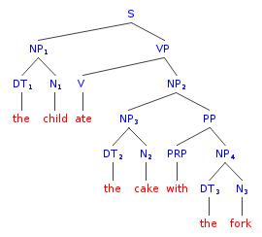
Example
S -> NP VP [p0=1]
NP -> DT N [p1]
NP -> NP PP [p2]
PP -> PRP NP [p3=1]
VP -> V NP [p4]
VP -> VP PP [p5]
DT -> 'a' [p6]
DT -> 'the' [p7]
N -> 'child' [p8]
N -> 'cake' [p9]
N -> 'fork' [p10]
PRP -> 'with' [p11]
PRP -> 'to' [p12]
V -> 'saw' [p13]
V -> 'ate' [p14]
t₁

Slide 49
Example
S -> NP VP [p0=1]
NP -> DT N [p1]
NP -> NP PP [p2]
PP -> PRP NP [p3=1]
VP -> V NP [p4]
VP -> VP PP [p5]
DT -> 'a' [p6]
DT -> 'the' [p7]
N -> 'child' [p8]
N -> 'cake' [p9]
N -> 'fork' [p10]
PRP -> 'with' [p11]
PRP -> 'to' [p12]
V -> 'saw' [p13]
V -> 'ate' [p14]
t₁
t₂

Slide 50
Example
S -> NP VP [p0=1]
NP -> DT N [p1]
NP -> NP PP [p2]
PP -> PRP NP [p3=1]
VP -> V NP [p4]
VP -> VP PP [p5]
DT -> 'a' [p6]
DT -> 'the' [p7]
N -> 'child' [p8]
N -> 'cake' [p9]
N -> 'fork' [p10]
PRP -> 'with' [p11]
PRP -> 'to' [p12]
V -> 'saw' [p13]
V -> 'ate' [p14]
t₁
t₂

Slide 51
Example
S -> NP VP [p0=1]
NP -> DT N [p1]
NP -> NP PP [p2]
PP -> PRP NP [p3=1]
VP -> V NP [p4]
VP -> VP PP [p5]
DT -> 'a' [p6]
DT -> 'the' [p7]
N -> 'child' [p8]
N -> 'cake' [p9]
N -> 'fork' [p10]
PRP -> 'with' [p11]
PRP -> 'to' [p12]
V -> 'saw' [p13]
V -> 'ate' [p14]
t₁
t₂

Slide 52
Example
S -> NP VP [p0=1]
NP -> DT N [p1]
NP -> NP PP [p2]
PP -> PRP NP [p3=1]
VP -> V NP [p4]
VP -> VP PP [p5]
DT -> 'a' [p6]
DT -> 'the' [p7]
N -> 'child' [p8]
N -> 'cake' [p9]
N -> 'fork' [p10]
PRP -> 'with' [p11]
PRP -> 'to' [p12]
V -> 'saw' [p13]
V -> 'ate' [p14]
t₁
t₂

Slide 53
Example
S -> NP VP [p0=1]
NP -> DT N [p1]
NP -> NP PP [p2]
PP -> PRP NP [p3=1]
VP -> V NP [p4]
VP -> VP PP [p5]
DT -> 'a' [p6]
DT -> 'the' [p7]
N -> 'child' [p8]
N -> 'cake' [p9]
N -> 'fork' [p10]
PRP -> 'with' [p11]
PRP -> 'to' [p12]
V -> 'saw' [p13]
V -> 'ate' [p14]
t₁
t₂

Slide 54
Main Tasks with PCFGs
Given a grammar G and a sentence s, let T(s) be all parse trees that correspond to s
Task 1
find which tree t among T(s) maximizes the probability p(t)
Task 2
find the probability of the sentence p(s) as the sum of all possible tree probabilities p(t)

Slide 55
Probabilistic Parsing Methods
Probabilistic Earley algorithm
Top-down parser with a dynamic programming table
Probabilistic Cocke-Kasami-Younger (CKY) algorithm
Bottom-up parser with a dynamic programming table

Slide 56
Probabilistic Grammars
Probabilities can be learned from a training corpus
Treebank
Intuitive meaning
Parse #1 is twice as probable as parse #2
Possible to do reranking
Possible to combine with other stages
E.g., speech recognition, translation

Slide 57
Maximum Likelihood Estimates
Use the parsed training set for getting the counts
P_{ML}(α→β) = Count (α→β)/Count(α)
Example:
P_{ML}(S→NP VP) = Count (S→NP VP)/Count(S)
Notes:
Example

Slide 58
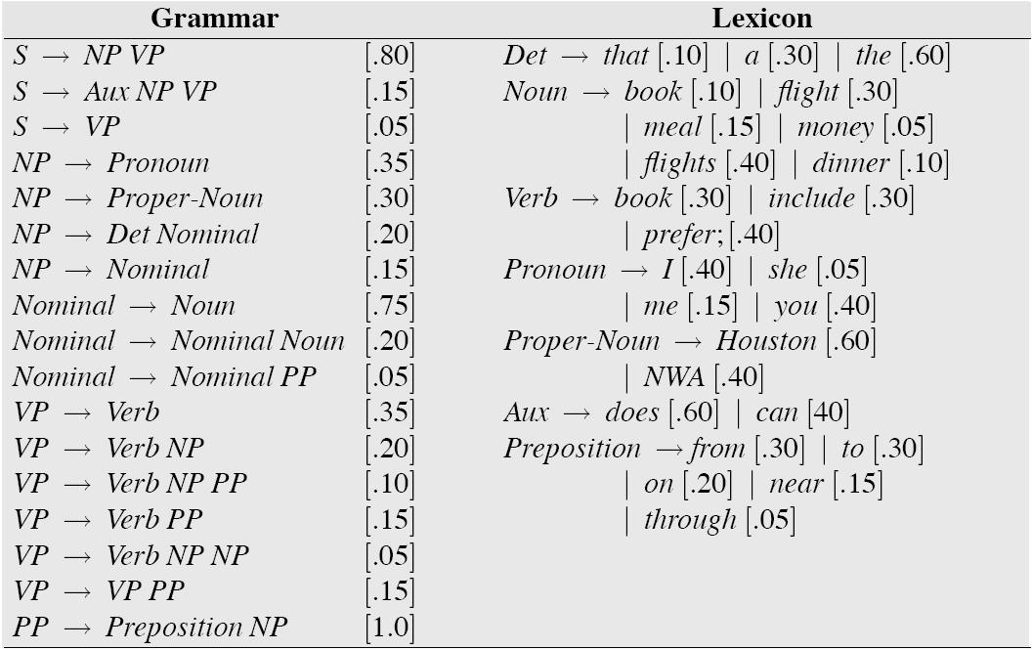
Sample Probabilistic Grammar
Example from Jurafsky and Martin
Notes:
Replace!!!

Slide 59
Example
S -> NP VP [p0=1]
NP -> DT N [p1=.8]
NP -> NP PP [p2=.2]
PP -> PRP NP [p3=1]
VP -> V NP [p4=.7]
VP -> VP PP [p5=.3]
DT -> 'a' [p6=.25]
DT -> 'the' [p7=.75]
N -> 'child' [p8=.5]
N -> 'cake' [p9=.3]
N -> 'fork' [p10=.2]
PRP -> 'with' [p11=.1]
PRP -> 'to' [p12=.9]
V -> 'saw' [p13=.4]
V -> 'ate' [p14=.6]

Slide 60
the
child
ate
the
cake
with
the
fork

Slide 61
the
DT
.75
child
ate
the
cake
with
the
fork

Slide 62
the
DT
.75
child
N
.5
ate
the
cake
with
the
fork

Slide 63
the
DT
.75
NP
.8
child
N
.5
ate
the
cake
with
the
fork

Slide 64
the
DT
.75
NP
.8*.5*.75
child
N
.5
ate
the
cake
with
the
fork

Slide 65
the
DT
.75
NP
.8*.5*.75
child
N
.5
ate
the
cake
with
the
Keep only the highest score in each cell
fork

Slide 66
Exercise
Now, on your own, compute the probability of the entire sentence using Probabilistic CKY.
Don’t forget that there may be multiple parses, so you will need to add the corresponding probabilities.

Slide 67
Notes
Stanford Demo
http://nlp.stanford.edu:8080/parser/
PTB statistics
50,000 sentences (40,000 training; 2,400 testing)
PTB peculiarities
includes traces and other null elements
Flat NP structure (e.g., NP -> DT JJ JJ NNP NNS)
Parent transformation
Subject NPs are more likely to be modified than object NPs
E.g., replace NP with NP^S
Notes:
Some of these sentences are repeated in other slides.

