Slide 1
Introduction to Natural Language Processing
Introduction to NLP

Slide 2
Introduction to NLP
Background for NLP

Slide 3
Language and Communication
Speaker
Intention (goals, shared knowledge and beliefs)
Generation (tactical)
Synthesis (text or speech)
Listener
Perception
Interpretation (syntactic, semantic, pragmatic)
Incorporation (internalization, understanding)
Both
Context (grounding)

Slide 4
Basic NLP Pipeline
(U)nderstanding and (G)eneration
(U)
Computer
(G)
Language
Language

Slide 5
Linguistic Knowledge
Constituents:
Children eat pizza.
They eat pizza.
My cousin’s neighbor’s children eat pizza.
Eat pizza!
Collocations:
Strong beer but *powerful beer
Big sister but *large sister
Stocks rise but ?stocks ascend
How to get this knowledge in the system:
Manual rules
Automatically acquired from large text collections (corpora)
Notes:
成分，部分。
搭配，词组。

Slide 6
Areas of Linguistics
Phonetics and phonology
the study of sounds
Morphology
the study of word components
Syntax
the study of sentence and phrase structure
Lexical semantics
the study of the meanings of words
Compositional semantics
how to combine words
Pragmatics
how to accomplish goals
Discourse conventions
how to deal with units larger than utterances

Slide 7
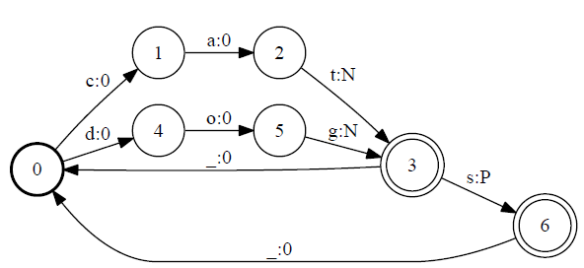
Finite-state Automata
Notes:
REPLACE THIS FIGURE!

Slide 8
Theoretical Computer Science
Automata
Deterministic and non-deterministic finite-state automata
Push-down automata
Grammars
Regular grammars
Context-free grammars
Context-sensitive grammars
Complexity
Algorithms
Dynamic programming

Slide 9
Artificial Intelligence
Logic
First-order logic
Agents
Speech acts
Search
Planning
Constraint satisfaction
Machine learning
Neural Networks
Reinforcement Learning

Slide 10
Mathematics and Statistics
Statistics
Probabilities
Statistical models
Hypothesis testing
Mathematics
Linear algebra (e.g., vectors)
Multivariate calculus (e.g., gradients)
Optimization
Numerical methods

Slide 11
Mathematical and Computational Tools
Language models
Estimation methods
Context-free grammars (CFG)
for trees
Hidden Markov Models (HMM)
for sequences
Conditional Random Fields (CRF)
Optimization

Slide 12
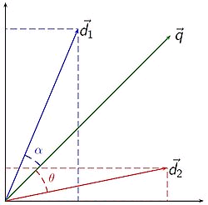
Statistical Techniques
Vector space representation for WSD
Noisy channel models for MT
Random walk methods for sentiment analysis

Slide 13
Introduction to NLP
Brief History of NLP

Slide 14
The Turing Test
Alan Turing: the Turing test
language as test for intelligence
Three participants
a computer and two humans (one is an interrogator)
Interrogator’s goal
to tell the machine and human apart
Machine’s goal
to fool the interrogator into believing that a person is responding
Other human’s goal
to help the interrogator reach his goal
Q: Please write me a sonnet on the topic of the Forth Bridge.
A: Count me out on this one. I never could write poetry.
Q: Add 34957 to 70764.
A: 105621 (after a pause)

Slide 15
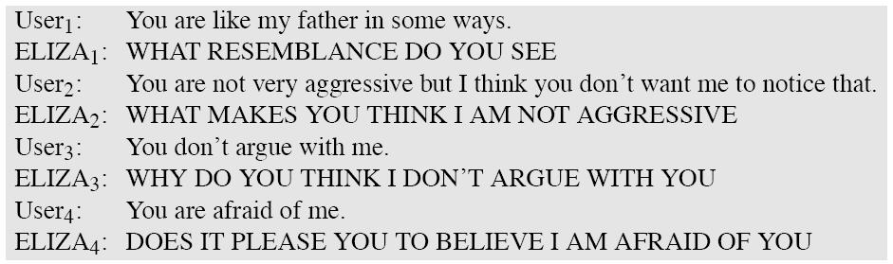
Eliza
Longer example here:
http://thoughtcatalog.com/oliver-miller/2012/08/a-conversation-with-eliza

Slide 16
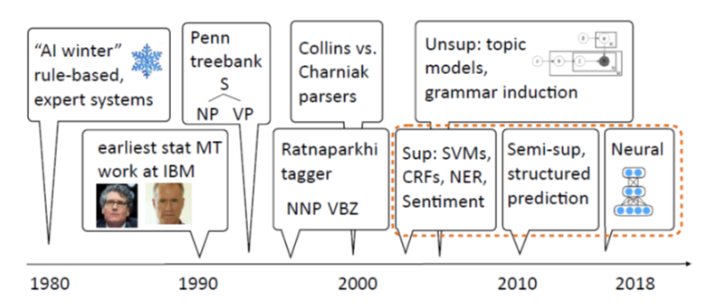
A Brief History of NLP
[Slide from Greg Durrett]

Slide 17
Some Brief History
Foundational insights (1940’s and 1950’s)
automaton (Turing)
probabilities
information theory (Shannon)
formal languages (Backus and Naur)
noisy channel and decoding (Shannon)
first systems (Davis et al., Bell Labs)
Two camps (1957-1970): symbolic and stochastic
Transformation Grammar (Harris, Chomsky)
Artificial Intelligence (Minsky, McCarthy, Shannon, Rochester)
automated theorem proving and problem solving (Newell and Simon)
Bayesian reasoning (Mosteller and Wallace)
Corpus work (Kučera and Francis)

Slide 18
Some Brief History
Four paradigms (1970-1983)
stochastic (IBM)
logic-based (Colmerauer, Pereira and Warren, Kay, Bresnan)
nlu (Winograd, Schank, Fillmore)
discourse modelling (Grosz and Sidner)
Empiricism and finite-state models redux (83-93)
Kaplan and Kay (phonology and morphology)
Church (syntax)
Late years (1994-2010)
integration of different techniques
different areas (including speech and IR)
probabilistic models
machine learning
structured prediction
topic models

Slide 19
The Most Recent Years
Machine learning methods
SVM, logistic regression (maxent), CRFs
Shared tasks
TREC, DUC, TAC, *SEM
Semantic tasks
RTE, SRL
Semi-supervised and unsupervised methods
Zero-shot learning, transfer learning
Deep Learning
Embeddings, LSTM, CNN, Attention, GANs, Transformers

Slide 20
Summarizing 30 years of ACL Discoveries Using Citing Sentences
1979 | Carbonell (1979) discusses inferring the meaning of new words.
1980 | Weischedel and Black (1980) discuss techniques for interacting with the linguist/developer to identify insufficiencies in the grammar.
1981 | Moore (1981) observed that determiners rarely have a direct correlation with the existential and universal quantifiers of first-order logic.
1982 | Heidorn (1982) provides a good summary of early work in weight-based analysis, as well as a weight-oriented approach to attachment decisions based on syntactic considerations only.
1983 | Grosz et al. (1983) proposed the centering model which is concerned with the interactions between the local coherence of discourse and the choices of referring expressions.
1984 | Karttunen (1984) provides examples of feature structures in which a negation operator might be useful.
1985 | Shieber (1985) proposes a more efficient approach to gaps in the PATR-II formalism, extending Earley’s algorithm by using restriction to do top-down filtering.
1986 | Kameyama (1986) proposed a fourth transition type, Center Establishment (EST), for utterances. e.g., in Bruno was the bully of the neighborhood.
1987 | Brennan et al. (1987) propose a default ordering on transitions which correlates with discourse coherence.
1988 | Whittaker and Stenton (1988) proposed rules for tracking initiative based on utterance types; for example, statements, proposals, and questions show initiative, while answers and acknowledgements do not.
1989 | Church and Hanks (1989) explored tile use of mutual information statistics in ranking co-occurrences within five-word windows.

Slide 21
Summarizing 30 years of ACL Discoveries Using Citing Sentences
1990 | Hindle (1990) classified nouns on the basis of co-occurring patterns of subject verb and verb-object pairs.
1991 | Gale and Church (1991) extract pairs of anchor words, such as numbers, proper nouns (organization, person, title), dates, and monetary information.
1992 | Pereira and Schabes (1992) establish that evaluation according to the bracketing accuracy and evaluation according to perplexity or cross entropy are very different.
1993 | Pereira et al. (1993) proposed a soft clustering scheme, in which membership of a word in a class is probabilistic.
1994 | Hearst (1994) presented two implemented segmentation algorithms based on term repetition, and compared the boundaries produced to the boundaries marked by at least 3 of 7 subjects, using information retrieval metrics.
1995 | Yarowsky (1995) describes a ’semi-unsupervised’ approach to the problem of sense disambiguation of words, also using a set of initial seeds, in this case a few high quality sense annotations.
1996 | Collins (1996) proposed a statistical parser which is based on probabilities of dependencies between head-words in the parse tree.
1997 | Collins (1997)’s parser and its re-implementation and extension by Bikel (2002) have by now been applied to a variety of languages: English (Collins, 1999), Czech (Collins et al., 1999), German (Dubey and Keller, 2003), Spanish (Cowan and Collins, 2005), French (Arun and Keller, 2005), Chinese (Bikel, 2002) and, according to Dan Bikels web page, Arabic.
1998 | Lin (1998) proposed a word similarity measure based on the distributional pattern of words which allows to construct a thesaurus using a parsed corpus.
1999 | Rapp (1999) proposed that in any language there is a correlation between the cooccurrences of words which are translations of each other.

Slide 22
Summarizing 30 years of ACL Discoveries Using Citing Sentences
2000 | Och and Ney (2000) introduce a NULL-alignment capability to HMM alignment models.
2001 | Yamada and Knight (2001) used a statistical parser trained using a Treebank in the source language to produce parse trees and proposed a tree to string model for alignment.
2002 | BLEU (Papineni et al., 2002) was devised to provide automatic evaluation of MT output.
2003 | Och (2003) developed a training procedure that incorporates various MT evaluation criteria in the training procedure of log-linear MT models.
2004 | Pang and Lee (2004) applied two different classifiers to perform sentiment annotation in two sequential steps: the first classifier separated subjective (sentiment-laden) texts from objective (neutral) ones and then they used the second classifier to classify the subjective texts into positive and negative.
2005 | Chiang (2005) introduces Hiero, a hierarchical phrase-based model for statistical machine translation.
2006 | Liu et al. (2006) experimented with tree-to-string translation models that utilize source side parse trees.
2007 | Goldwater and Grifﬁths (2007) employ a Bayesian approach to POS tagging and use sparse Dirichlet priors to minimize model size.
2008 | Huang (2008) improves the re-ranking work of Charniak and Johnson (2005) by re-ranking on packed forest, which could potentially incorporate exponential number of k-best list.
2009 | Mintz et al. (2009) uses Freebase to provide distant supervision for relation extraction.
2010 | Chiang (2010) proposes a method for learning to translate with both source and target syntax in the framework of a hierarchical phrase-based system.

Slide 23
Introduction to NLP
NACLO

Slide 24
NACLO and IOL
The North American Computational Linguistics Olympiad
Competition held since 2007 in the USA and Canada
http://www.nacloweb.org
Best individual US performers so far:
Adam Hesterberg (2007)
Rebecca Jacobs (2007-2009) – 3 team golds + 2 individual medals
Ben Sklaroff (2010)
Morris Alper (2011)
Alex Wade (2012, 2013) – 2 team golds + 2 individual golds + 1 individual silver
Tom McCoy (2013) – Yale grad
Darryl Wu (2012, 2014)
James Wedgwood (2015, 2016) – Yale junior
Brian Xiao (2017), Swapnil Garg (2018)
Other strong countries:
Russia, UK, Netherlands, Poland, Bulgaria, South Korea, Canada, China, Sweden
IOL – the International contest
Since 2003
2013 in the UK, 2014 in China, 2015 in Bulgaria, 2016 in India, 2017 in Ireland, 2018 in Czechia
http://www.ioling.org

Slide 25
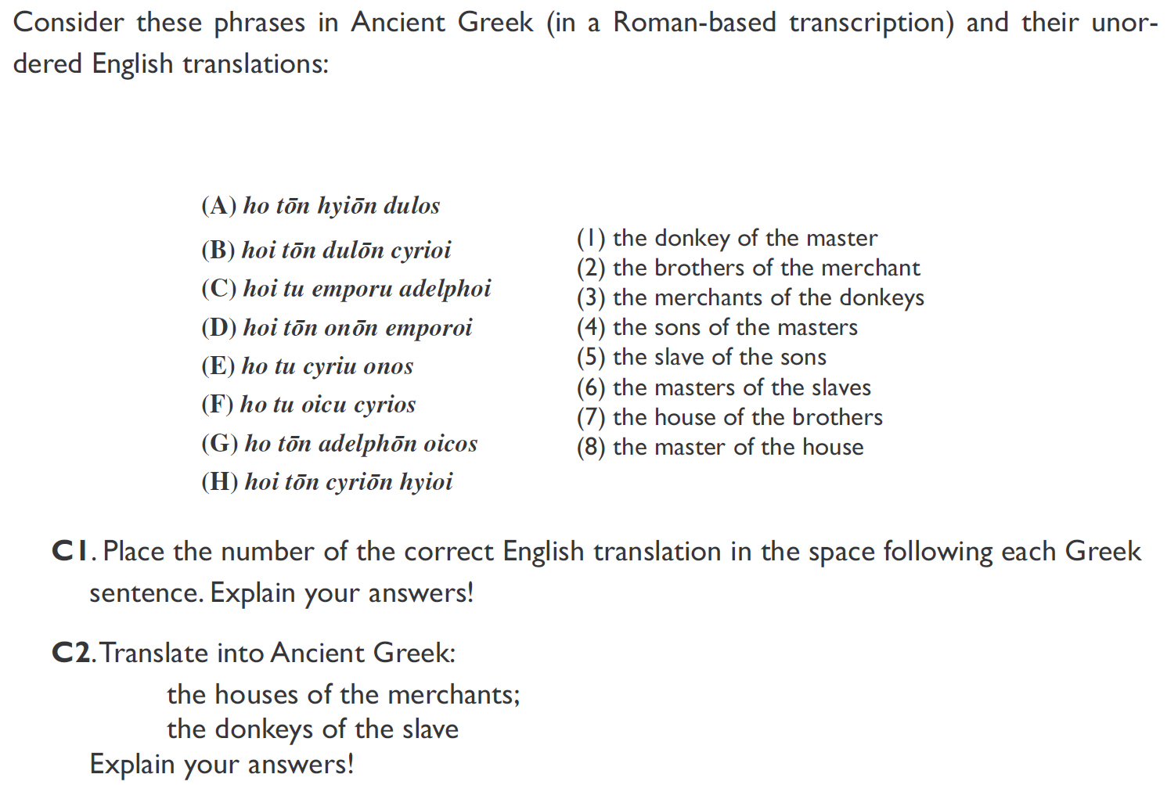
[A Donkey in Every House, by Todor Tchervenkov, NACLO 2007]

Slide 26
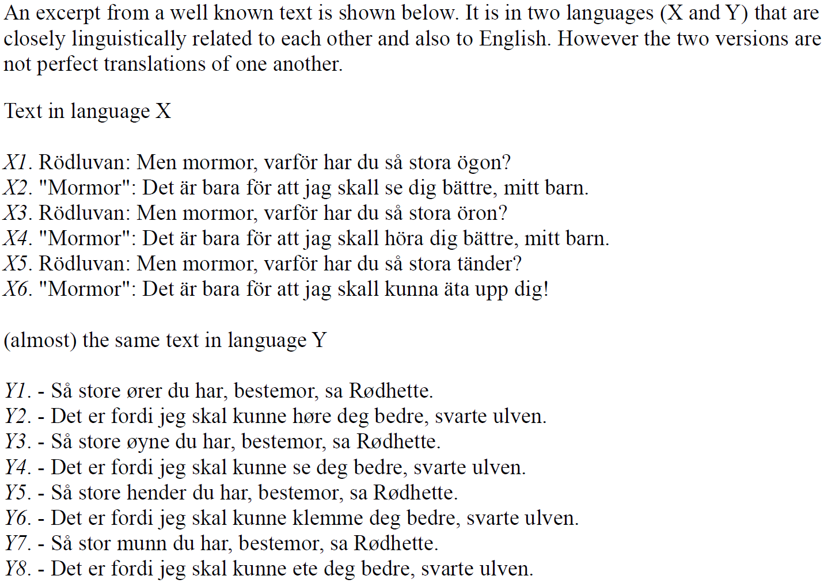
[Spare the Rod, by Dragomir Radev, NACLO 2008]

Slide 27
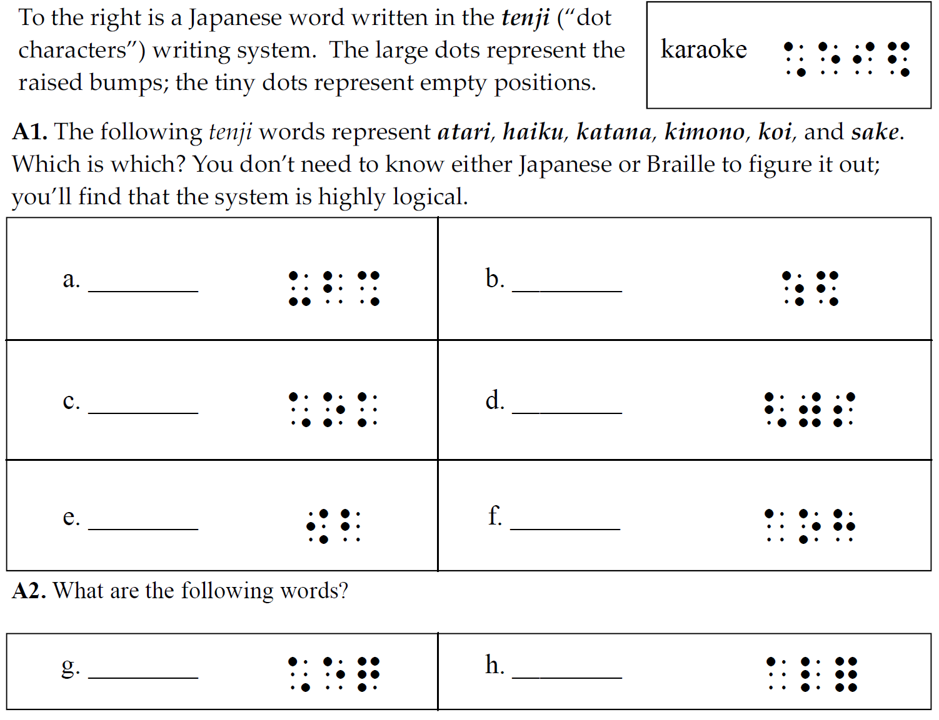
[Tenji Karaoke, by Patrick Littell, NACLO 2009]

Slide 28
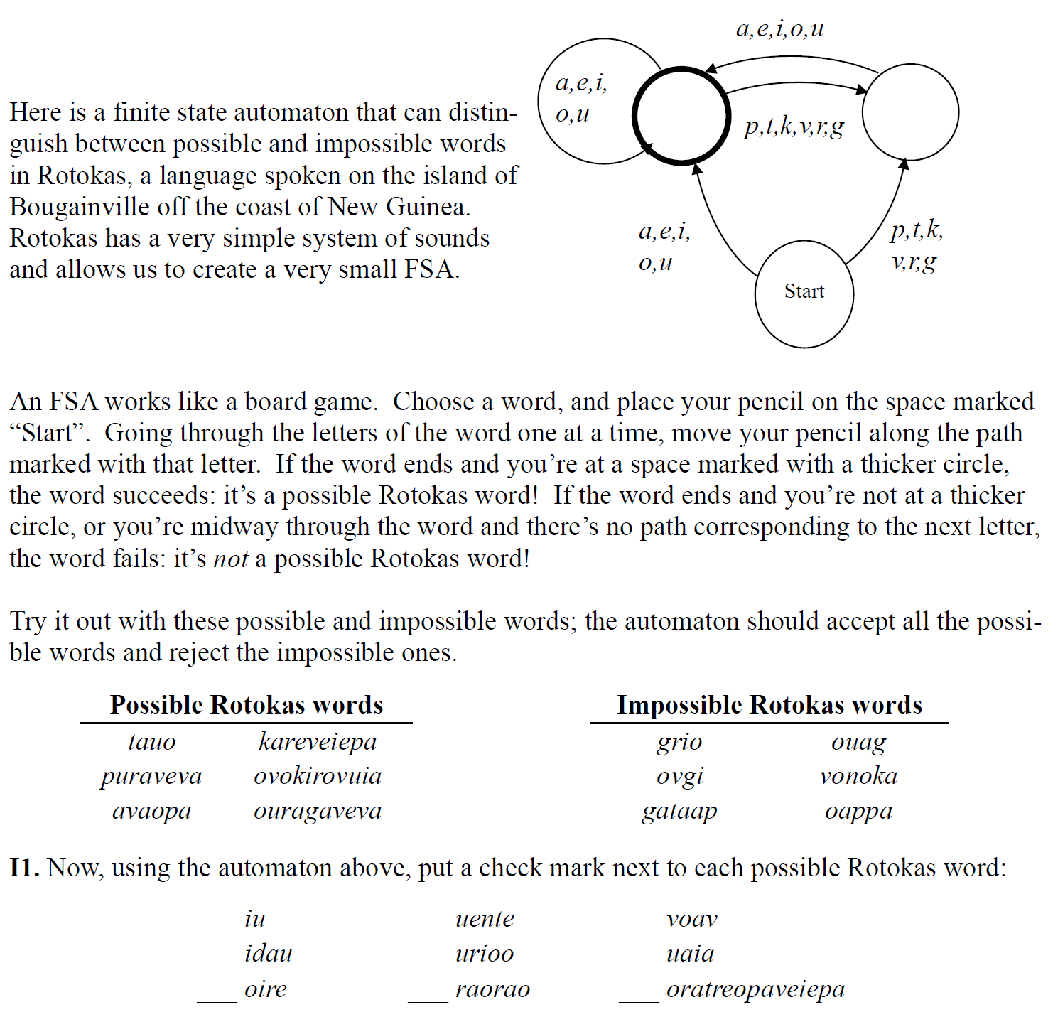
[aw-TOM-uh-tuh, by Patrick Littell, NACLO 2008]

Slide 29
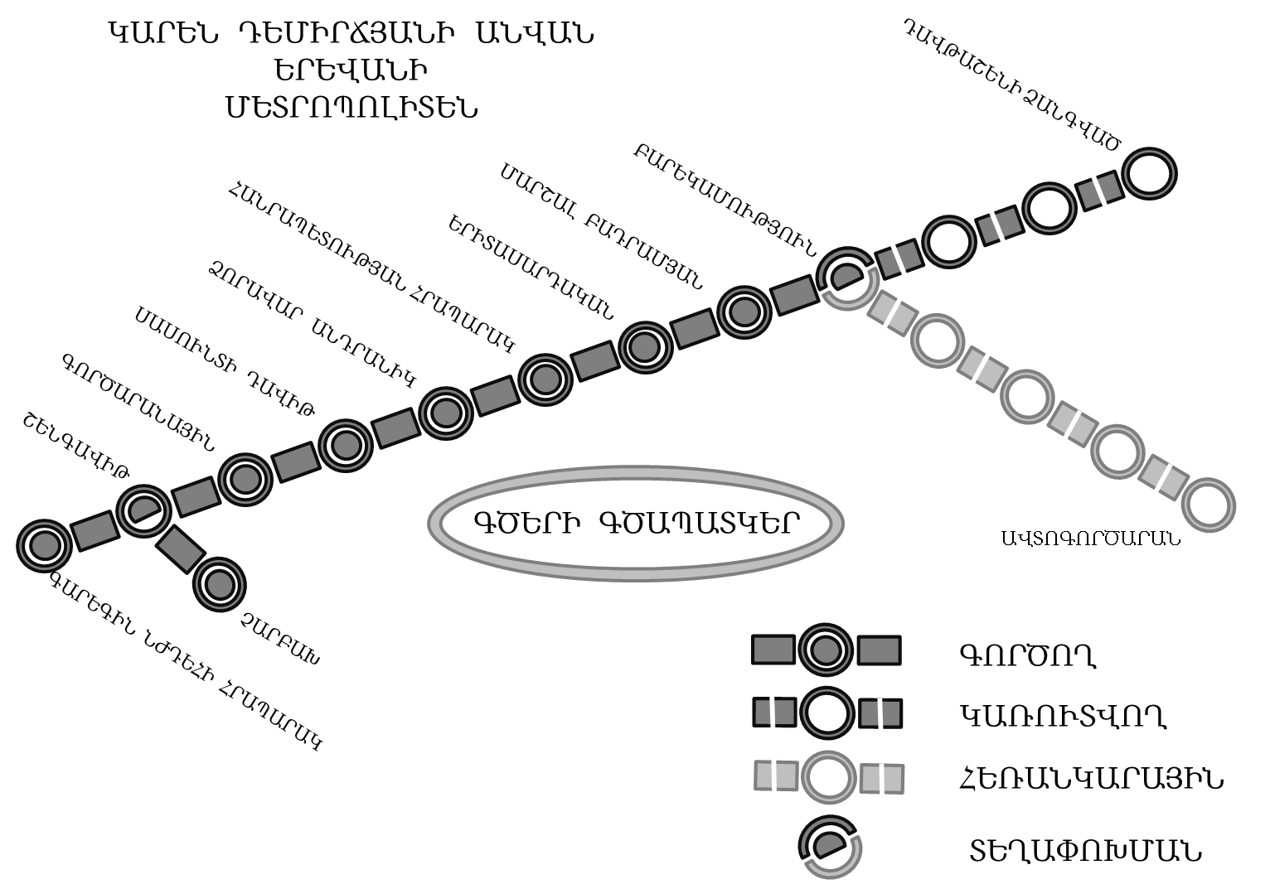
On her visit to Armenia, Millie has gotten lost in Yerevan, the nation’s capital. She is now at the Metropoliten (subway) station named Shengavit, but her friends are waiting for her at the station named Barekamutyun. Can you help Millie meet up with her friends?
1. Assuming Millie takes a train in the right direction,
which will be the first stop after Shengavit?
Note that all names of stations listed below appear on the map.
a. Gortsaranayin
b. Zoravar Andranik
c. Charbakh
d. Garegin Njdehi Hraparak
e. none of the above
2. After boarding at Shengavit, how many stops will it take Millie to get to Barekamutyun (don’t include Shengavit itself in the number of stops)?
[Lost in Yerevan, by Dragomir Radev, NACLO 2010]

Slide 30
NACLO: Computational Problems
http://www.nacloweb.org/resources/problems/2016/N2016-B.pdf
http://www.nacloweb.org/resources/problems/2016/N2016-H.pdf
http://www.nacloweb.org/resources/problems/2016/N2016-K.pdf
http://www.nacloweb.org/resources/problems/2016/N2016-P.pdf
http://www.nacloweb.org/resources/problems/2015/N2015-E.pdf
http://www.nacloweb.org/resources/problems/2015/N2015-K.pdf
http://www.nacloweb.org/resources/problems/2015/N2015-M.pdf
http://www.nacloweb.org/resources/problems/2015/N2015-P.pdf
http://www.nacloweb.org/resources/problems/2015/N2015-G.pdf
http://www.nacloweb.org/resources/problems/2014/N2014-O.pdf
http://www.nacloweb.org/resources/problems/2014/N2014-P.pdf
http://www.nacloweb.org/resources/problems/2014/N2014-C.pdf
http://www.nacloweb.org/resources/problems/2014/N2014-J.pdf
http://www.nacloweb.org/resources/problems/2014/N2014-H.pdf
http://www.nacloweb.org/resources/problems/2014/N2014-L.pdf
http://www.nacloweb.org/resources/problems/2013/N2013-C.pdf
http://www.nacloweb.org/resources/problems/2013/N2013-F.pdf
http://www.nacloweb.org/resources/problems/2013/N2013-H.pdf
http://www.nacloweb.org/resources/problems/2013/N2013-L.pdf
http://www.nacloweb.org/resources/problems/2012/N2012-C.pdf
http://www.nacloweb.org/resources/problems/2013/N2013-N.pdf
http://www.nacloweb.org/resources/problems/2013/N2013-Q.pdf
http://www.nacloweb.org/resources/problems/2012/N2012-K.pdf
http://www.nacloweb.org/resources/problems/2012/N2012-O.pdf
http://www.nacloweb.org/resources/problems/2012/N2012-R.pdf
http://www.nacloweb.org/resources/problems/2011/F.pdf
http://www.nacloweb.org/resources/problems/2011/M.pdf
http://www.nacloweb.org/resources/problems/2010/D.pdf
http://www.nacloweb.org/resources/problems/2010/E.pdf
http://www.nacloweb.org/resources/problems/2010/I.pdf
http://www.nacloweb.org/resources/problems/2010/K.pdf
http://www.nacloweb.org/resources/problems/2009/N2009-E.pdf
http://www.nacloweb.org/resources/problems/2009/N2009-G.pdf
http://www.nacloweb.org/resources/problems/2009/N2009-J.pdf
http://www.nacloweb.org/resources/problems/2009/N2009-M.pdf
http://www.nacloweb.org/resources/problems/2008/N2008-F.pdf
http://www.nacloweb.org/resources/problems/2008/N2008-H.pdf
http://www.nacloweb.org/resources/problems/2008/N2008-I.pdf
http://www.nacloweb.org/resources/problems/2008/N2008-L.pdf
http://www.nacloweb.org/resources/problems/2007/N2007-A.pdf
http://www.nacloweb.org/resources/problems/2007/N2007-H.pdf
http://www.nacloweb.org/resources.php

Slide 31
Introduction to NLP
Examples of Text

Slide 32
What NLP is not about
Romeo loves Juliet.
ZZZZZ is a great stock to buy.

Slide 33
What it is about (1/2)
After the ball, in what is now called the "balcony scene", Romeo sneaks into the Capulet orchard and overhears Juliet at her window vowing her love to him in spite of her family's hatred of the Montagues.

Slide 34
What it is about (2/2)
ZZZZZ Resources (NYSE:ZZZZZ) in their third quarter financials present a picture of a company with a relatively high amount of debt versus shareholder equity, and versus revenues. The company had total liabilities in the third quarter of $4,416 million versus shareholders' equity of only $1,518 million. That is a very high 3 to 1 debt to equity ratio. The company had third quarter revenues of $306 million. On an annualized basis, revenues would come out to $1,224 million. The company's debt level is almost 3 times its annual revenues. And remember, third quarter revenue is from before oil prices dropped in half. It looks like ZZZZZ may have bitten off more than it can chew.
XXXXX Petroleum (NYSE:XXXXX) is another company whose third quarter financials present a relatively high debt load. The company had total liabilities in the third quarter of $3,272 million versus shareholder equity of only $1,520 million. That represents a high 2 to 1 debt to equity ratio. The company had third quarter revenues of $350 million. On an annualized basis revenues would come out to $1,400 million. The company's debt is more than 2 times its annual revenue. While XXXXX is a very good operator, it looks like they have taken on the high debt strategy at the wrong time.
YYYYY Energy (NYSE:YYYYY) has a relatively high debt load according to their third quarter financials. The company had total liabilities of $2,026 million versus shareholder equity of $1,079. That is almost a 2 to 1 debt to equity ratio. Their third quarter revenues were $207 million. When annualized, their third quarter revenues come out to $827 million. The company's debt is almost 2 1/2 times its annualized revenues, and that is before the collapse of oil prices in the fourth quarter. YYYYY has taken the Brigham model to heart and has been aggressively growing the company.

Slide 35
Understanding a News Story
Opposition lawmakers in Poland have been occupying parliament for three weeks in a protest against the government. Frantic efforts are now being made to end the crisis before the next plenary session on Wednesday.
Almost all of Poland's important party leaders met on Monday at the invitation of the president of the senate to try to find a solution to the parliamentary crisis. Jaroslaw Kaczynski, the head of the governing national-conservative Law and Justice Party (PiS), also took part. The PiS is clearly trying to displace the conflict to a secondary theater - the senate, Poland's upper house of parliament.
However, Grzegorz Schetyna, the head of the biggest opposition party, the PO, steered clear of what he referred to as an "absurd" meeting. He said that instead he expected the PiS speaker of the lower house to "return to the [lower house's] plenary assembly hall." After all, he said, the conflict had not begun in the senate. The leader of the other liberal opposition party, Modern, did take part in the meeting - which goes to show once again how divided the opposition is.
Over the past few weeks, Poland has been caught up in a fight between the national-conservative government and the liberal opposition. The crisis began on December 16 with the announcement by the governing PiS that they would be restricting media access to parliament. The fight escalated inside the parliament - among other things, a group of opposition representatives occupied the rostrum in the plenary chamber. The government's parliamentary party left the chamber and "passed" the 2017 budget in an adjacent room. The main bone of contention now is whether this improvised vote, by a show of hands, was legitimate or not. Ultimately, the issue at stake is whether a parliamentary party with a small absolute majority, like the PiS, has to stick to the rules, or whether it can casually set them aside.
http://www.dw.com/en/is-there-a-resolution-to-polands-parliamentary-crisis/a-37070705
Notes:
http://www.bbc.com/news/world-latin-america-28829694

Slide 36
Understanding a News Story
Opposition lawmakers in Poland have been occupying parliament for three weeks in a protest against the government. Frantic efforts are now being made to end the crisis before the next plenary session on Wednesday.
Almost all of Poland's important party leaders met on Monday at the invitation of the president of the senate to try to find a solution to the parliamentary crisis. Jaroslaw Kaczynski, the head of the governing national-conservative Law and Justice Party (PiS), also took part. The PiS is clearly trying to displace the conflict to a secondary theater - the senate, Poland's upper house of parliament.
However, Grzegorz Schetyna, the head of the biggest opposition party, the PO, steered clear of what he referred to as an "absurd" meeting. He said that instead he expected the PiS speaker of the lower house to "return to the [lower house's] plenary assembly hall." After all, he said, the conflict had not begun in the senate. The leader of the other liberal opposition party, Modern, did take part in the meeting - which goes to show once again how divided the opposition is.
Over the past few weeks, Poland has been caught up in a fight between the national-conservative government and the liberal opposition. The crisis began on December 16 with the announcement by the governing PiS that they would be restricting media access to parliament. The fight escalated inside the parliament - among other things, a group of opposition representatives occupied the rostrum in the plenary chamber. The government's parliamentary party left the chamber and "passed" the 2017 budget in an adjacent room. The main bone of contention now is whether this improvised vote, by a show of hands, was legitimate or not. Ultimately, the issue at stake is whether a parliamentary party with a small absolute majority, like the PiS, has to stick to the rules, or whether it can casually set them aside.
Why did I highlight some of the phrases above?
Notes:
http://www.bbc.com/news/world-latin-america-28829694

Slide 37
Highlighted Phrases
on Wednesday
January 11, 2017
the parliamentary crisis
What caused the crisis?
Jaroslaw Kaczyński
Former prime minister; brother of the former president
the PO
Platforma Obywatelska (Civic Platform)
he said
he = Grzegorz Schetyna
Modern
Nowoczesna (liberal political party)

Slide 38
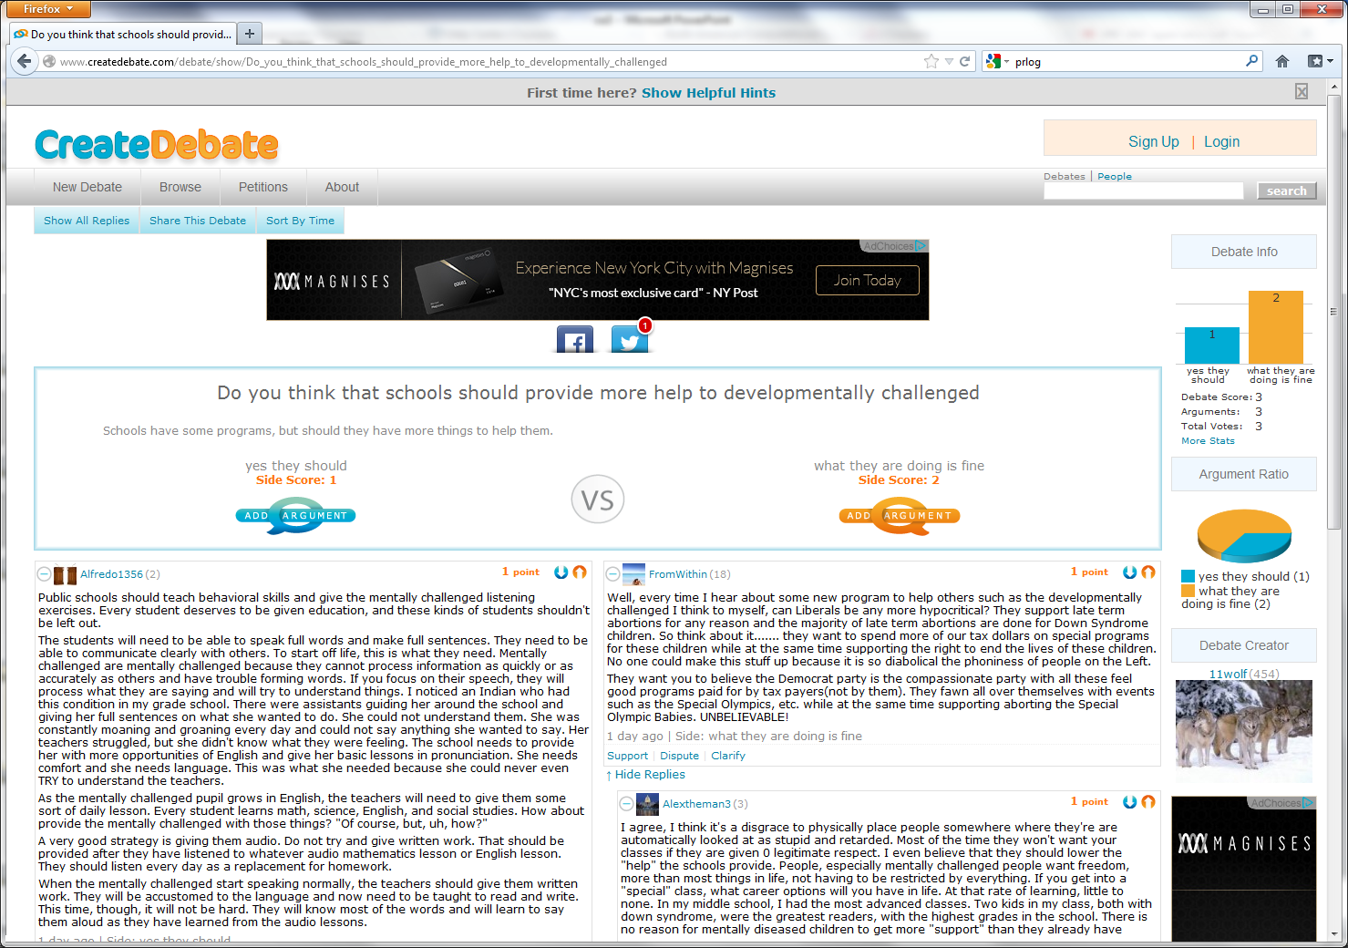
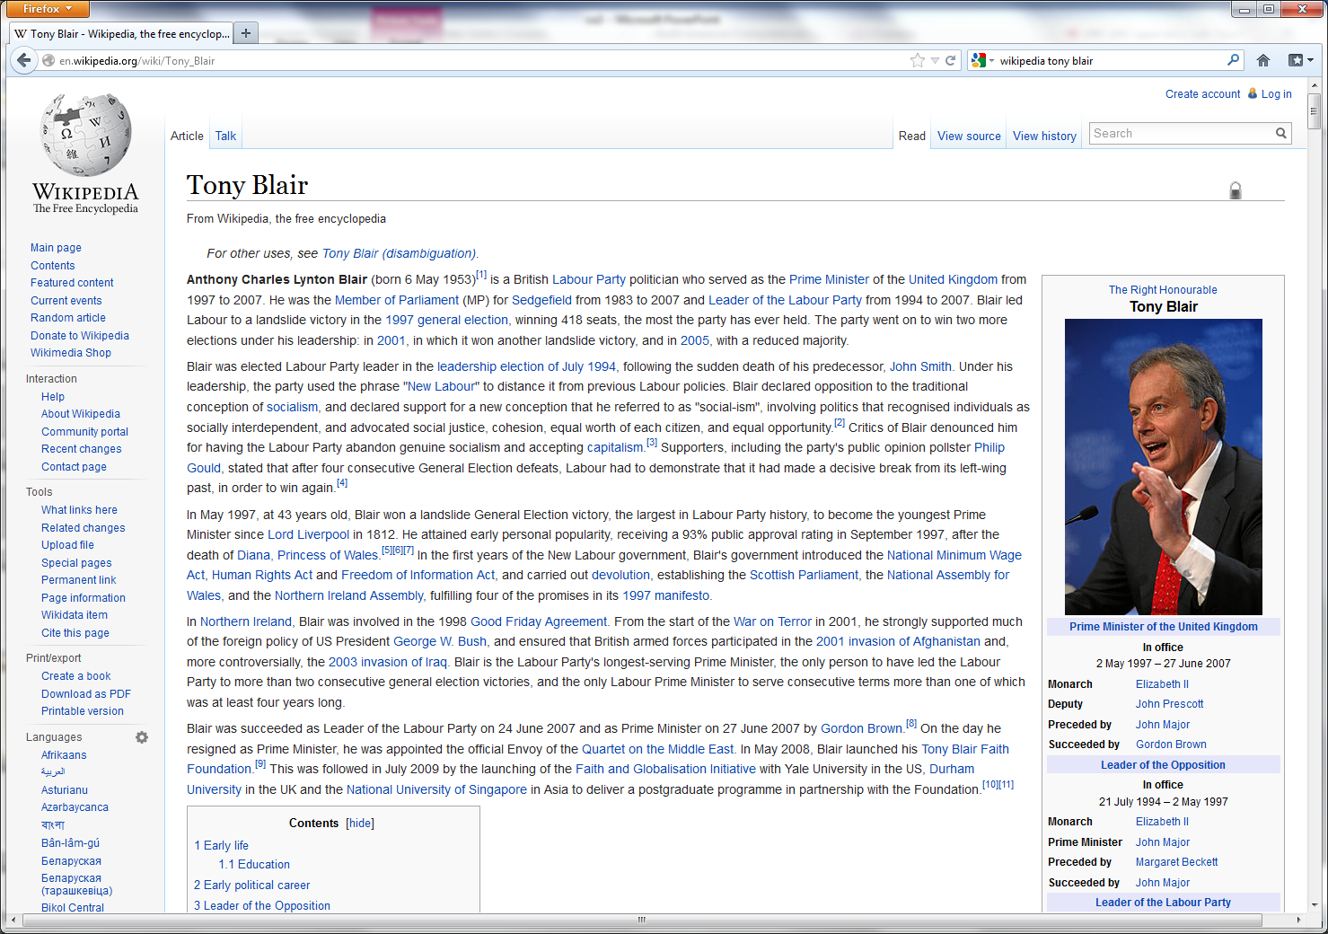
Genres of Text
Blogs, emails, press releases, chats, debates, etc.
Each presents different challenges to NLP
Notes:
Replace with other examples?

Slide 39
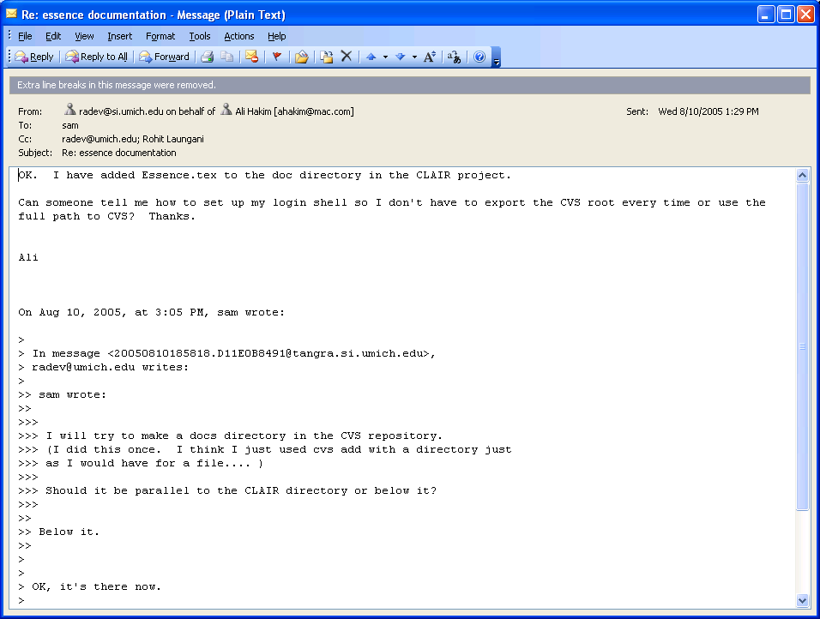
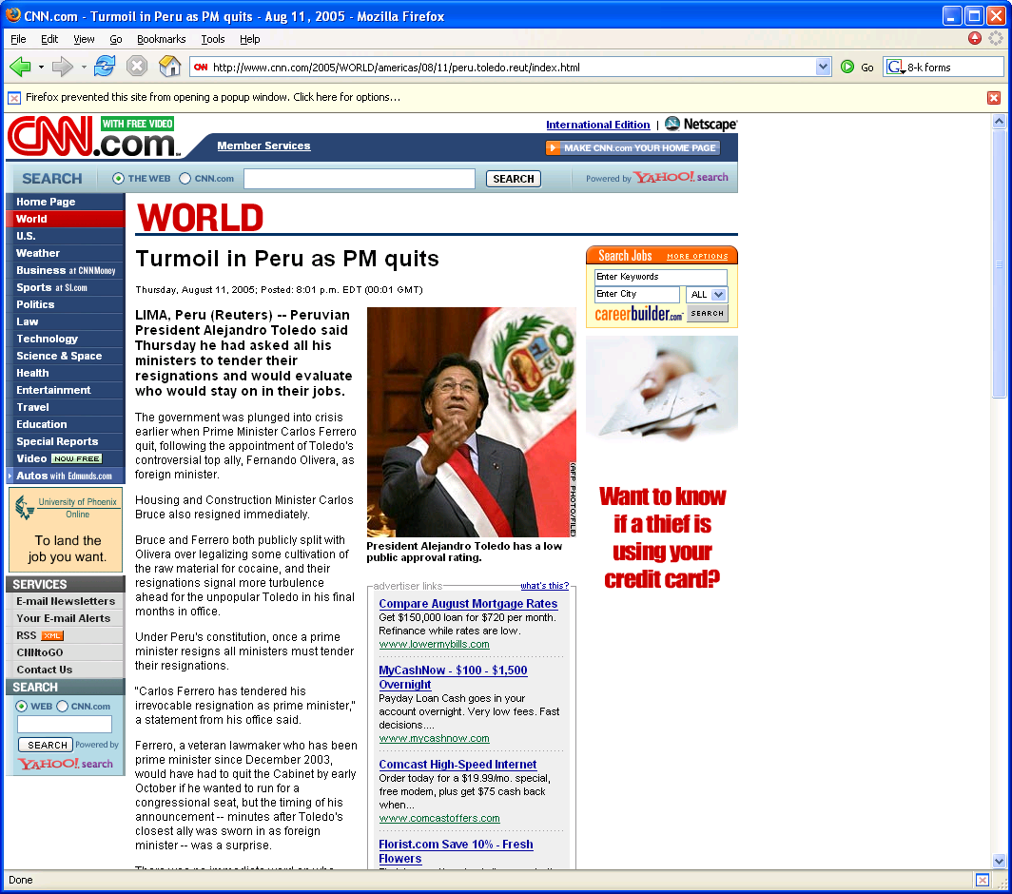
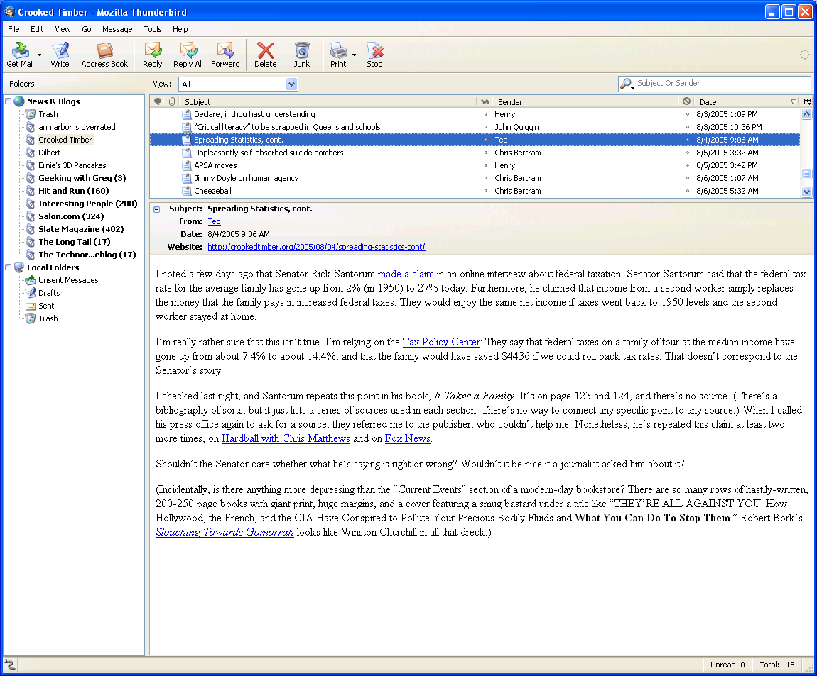
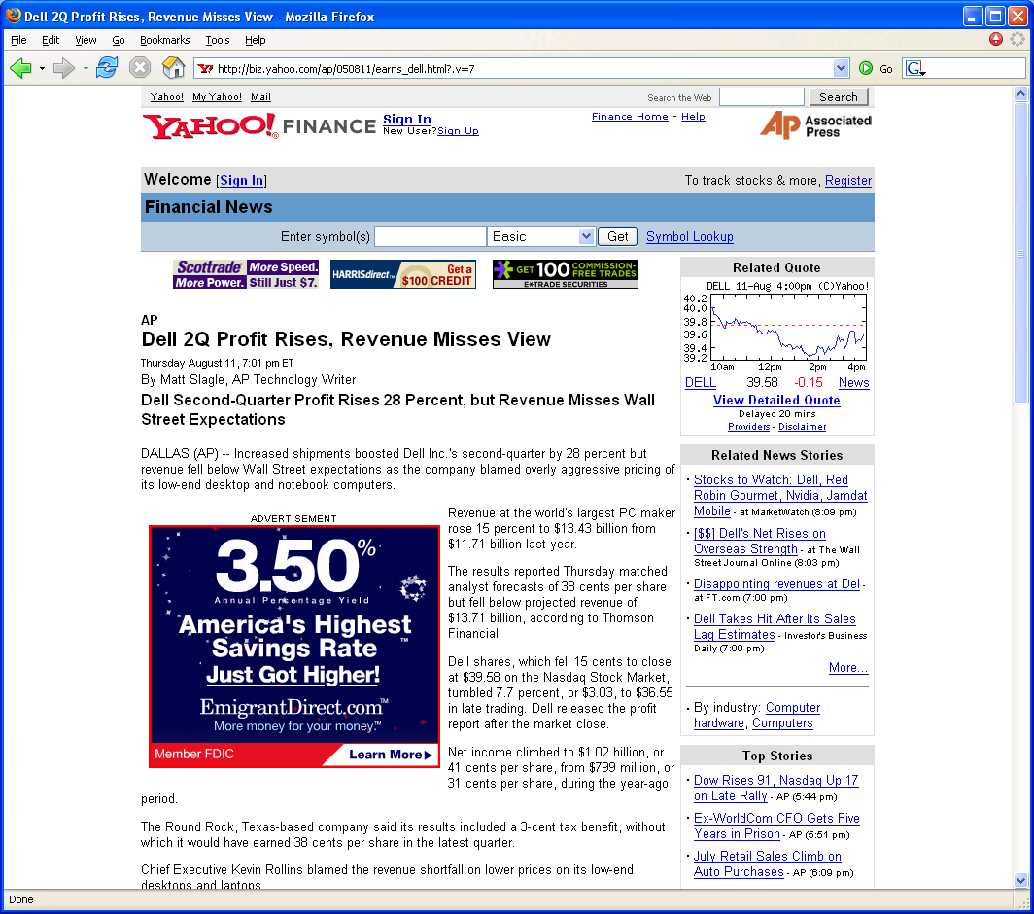

Slide 40
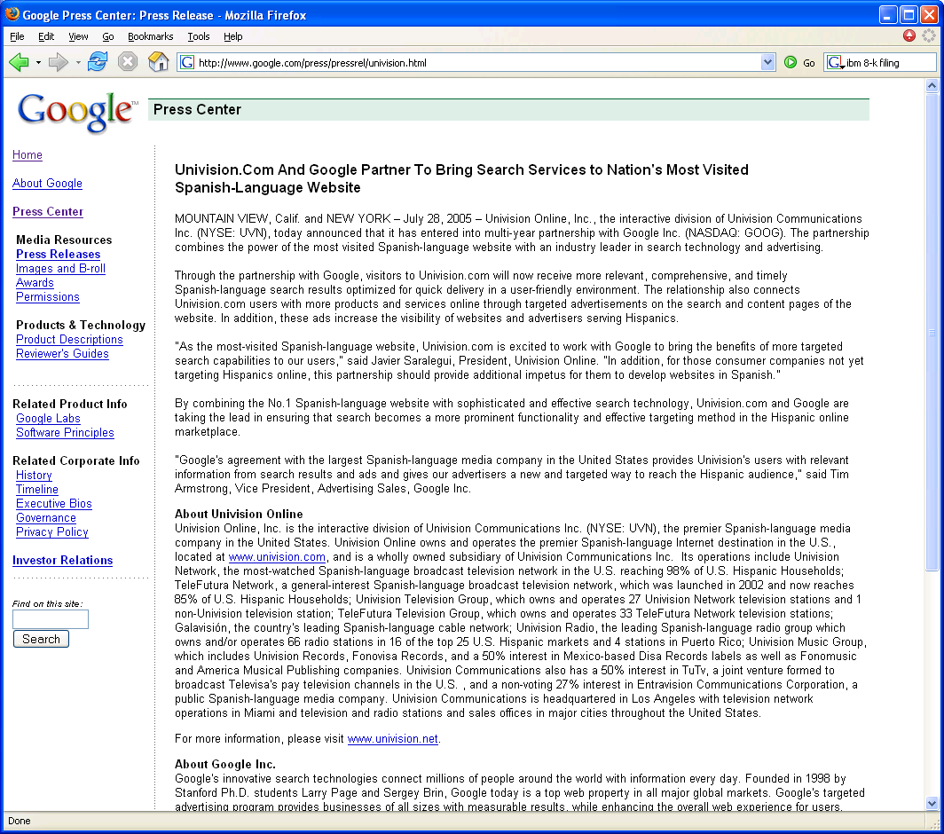

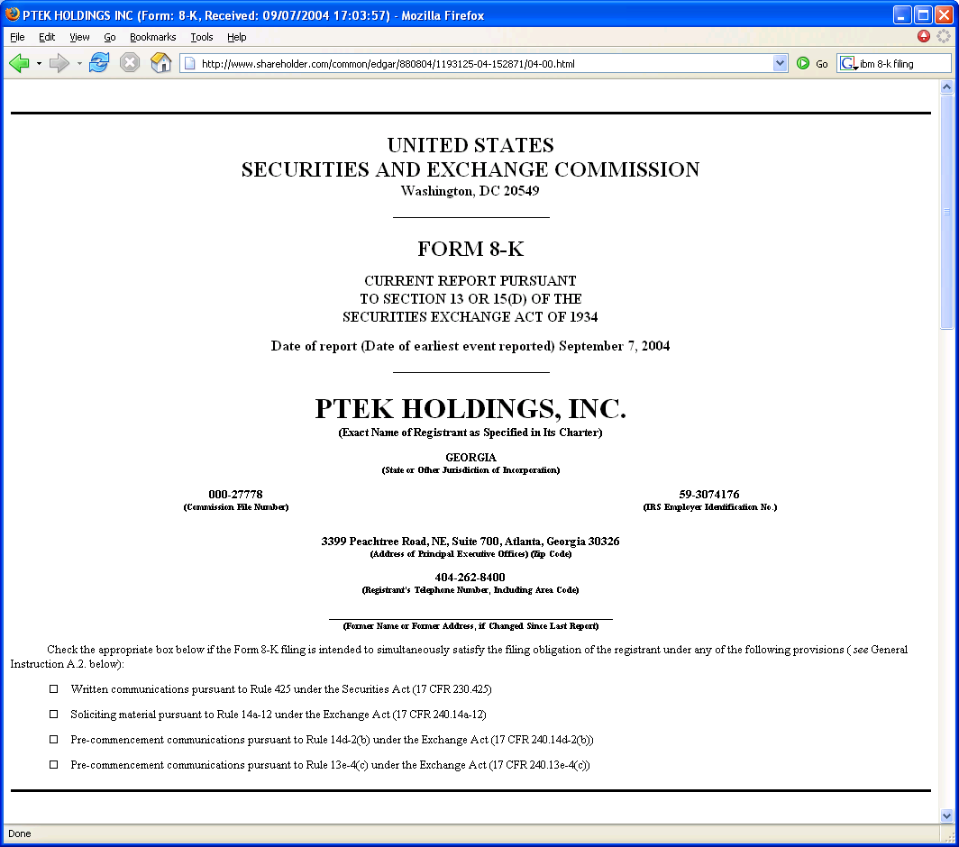
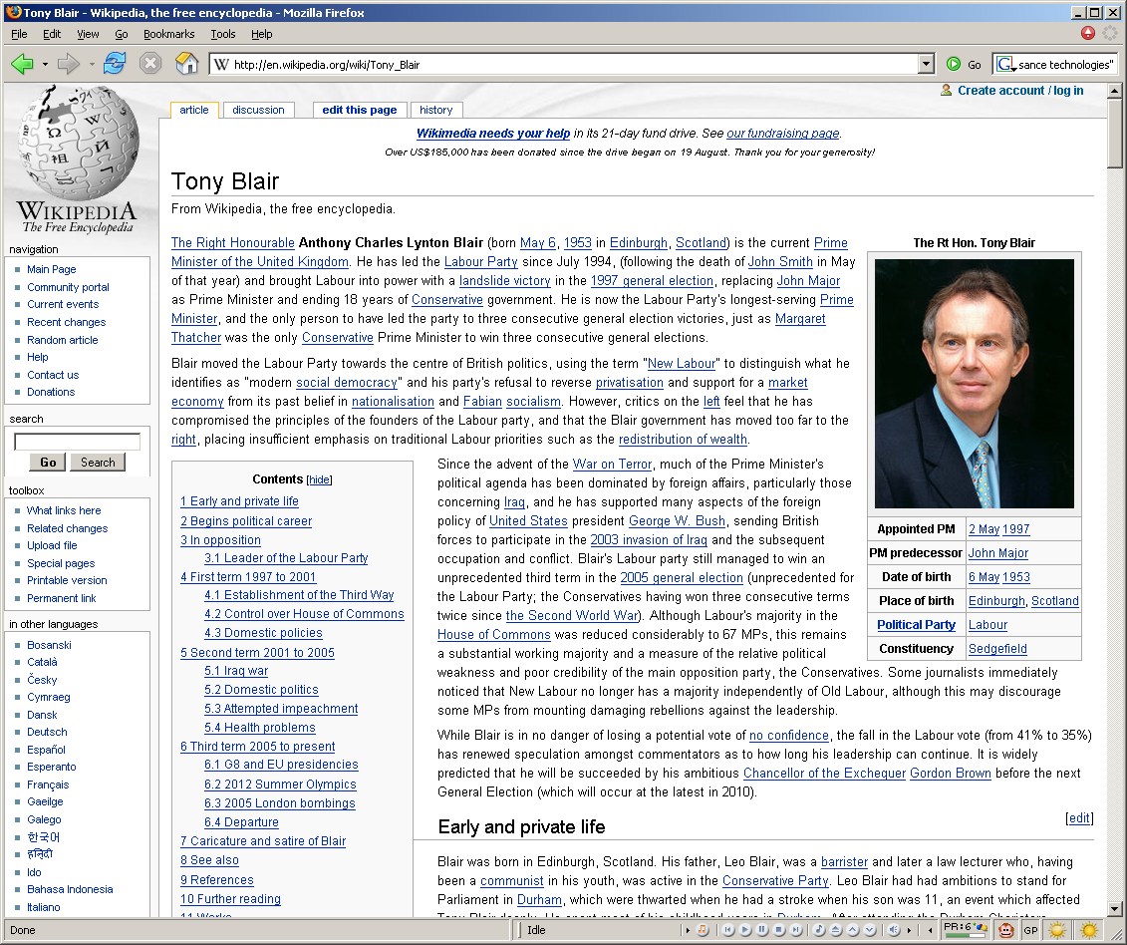

Slide 41

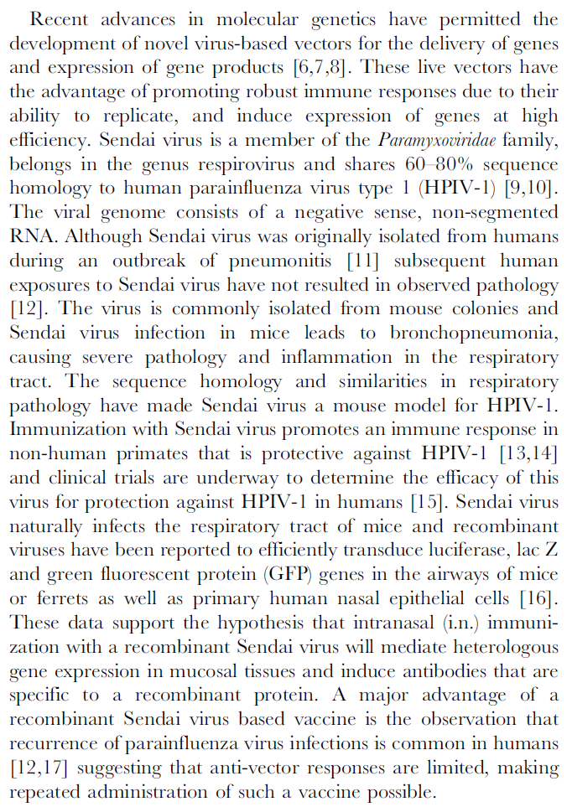
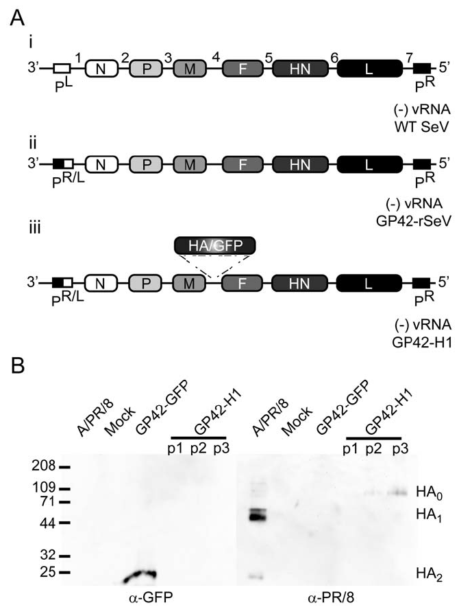
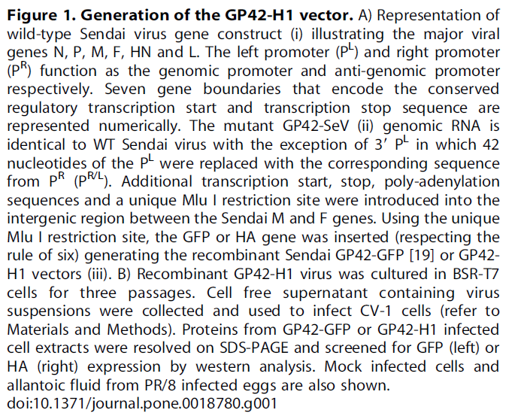
Plos ONE
DOI: 10.1371/journal.pone.0018780

Slide 42
Recent advances in molecular genetics have permitted the development of novel virus-based vectors for the delivery of genes and expression of gene products [6,7,8]. These live vectors have the advantage of promoting robust immune responses due to their ability to replicate, and induce expression of genes at high efficiency. Sendai virus is a member of the Paramyxoviridae family, belongs in the genus respirovirus and shares 60–80% sequence homology to human parainfluenza virus type 1 (HPIV-1) [9,10].
The viral genome consists of a negative sense, non-segmented RNA. Although Sendai virus was originally isolated from humans during an outbreak of pneumonitis [11] subsequent human exposures to Sendai virus have not resulted in observed pathology [12]. The virus is commonly isolated from mouse colonies and Sendai virus infection in mice leads to bronchopneumonia, causing severe pathology and inflammation in the respiratory tract. The sequence homology and similarities in respiratory pathology have made Sendai virus a mouse model for HPIV-1. Immunization with Sendai virus promotes an immune response in non-human primates that is protective against HPIV-1 [13,14] and clinical trials are underway to determine the efficacy of this virus for protection against HPIV-1 in humans [15]. Sendai virus naturally infects the respiratory tract of mice and recombinant viruses have been reported to efficiently transduce luciferase, lac Z and green fluorescent protein (GFP) genes in the airways of mice or ferrets as well as primary human nasal epithelial cells [16].
These data support the hypothesis that intranasal (i.n.) immunization with a recombinant Sendai virus will mediate heterologous gene expression in mucosal tissues and induce antibodies that are specific to a recombinant protein. A major advantage of a recombinant Sendai virus based vaccine is the observation that recurrence of parainfluenza virus infections is common in humans [12,17] suggesting that anti-vector responses are limited, making repeated administration of such a vaccine possible.
Named entities + variants (human parainfluenza virus type, HPIV-1)
Speculation (reported, suggesting)
Species (human)
Cell types (nasal epithelial cells )
Facts
References
Notes:
Surface layer
Linguistic layer
Metonymy – “The company said”
Attachment – “a year earlier”
Rhetorical/logical layer
Attribution – “according to First Call”
Pragmatic layer
Buy!?
Inferential/decision making layer
Are earning in line with analyst expectations?

Slide 43
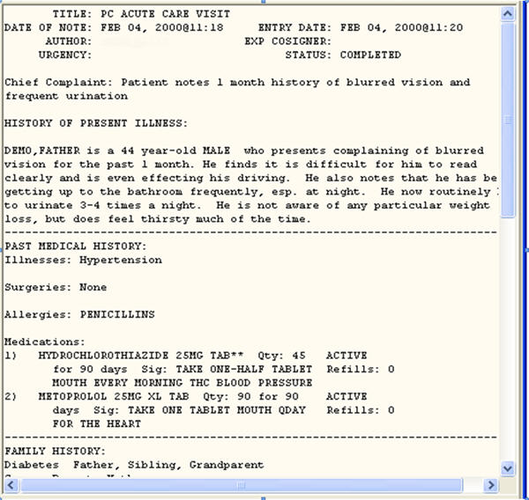
Medical Records
http://www.upassoc.org/upa_publications/jus/2009february/smelcer5.html

Slide 44
Literary Texts
Project Gutenberg (http://www.gutenberg.org/browse/scores/top)
A team of horses passed from Finglas with toiling plodding tread, dragging through the funereal silence a creaking waggon on which lay a granite block. The waggoner marching at their head saluted.
Ulysses - http://www.gutenberg.org/files/4300/4300-h/4300-h.htm
There was no possibility of taking a walk that day. We had been wandering, indeed, in the leafless shrubbery an hour in the morning; but since dinner (Mrs. Reed, when there was no company, dined early) the cold winter wind had brought with it clouds so sombre, and a rain so penetrating, that further out-door exercise was now out of the question.
Jane Eyre - http://www.gutenberg.org/files/1260/1260-h/1260-h.htm
Dorothy lived in the midst of the great Kansas prairies, with Uncle Henry, who was a farmer, and Aunt Em, who was the farmer's wife. Their house was small, for the lumber to build it had to be carried by wagon many miles. There were four walls, a floor and a roof, which made one room; and this room contained a rusty looking cookstove, a cupboard for the dishes, a table, three or four chairs, and the beds. Uncle Henry and Aunt Em had a big bed in one corner, and Dorothy a little bed in another corner. There was no garret at all, and no cellar--except a small hole dug in the ground, called a cyclone cellar, where the family could go in case one of those great whirlwinds arose, mighty enough to crush any building in its path. It was reached by a trap door in the middle of the floor, from which a ladder led down into the small, dark hole.
The Wizard of Oz - http://www.gutenberg.org/files/55/55-h/55-h.htm
Notes:
CONSIDER REMOVING

Slide 45
A Really Long Literary Sentence
Try parsing this
“Bloat is one of the co-tenants of the place, a maisonette erected last century, not far from the Chelsea Embankment, by Corydon Throsp, an acquaintance of the Rossettis' who wore hair smocks and liked to cultivate pharmaceutical plants up on the roof (a tradition young Osbie Feel has lately revived), a few of them hardy enough to survive fogs and frosts, but most returning, as fragments of peculiar alkaloids, to rooftop earth, along with manure from a trio of prize Wessex Saddleback sows quartered there by Throsp's successor, and dead leaves off many decorative trees transplanted to the roof by later tenants, and the odd unstomachable meal thrown or vomited there by this or that sensitive epicurean-all got scumbled together, eventually, by the knives of the seasons, to an impasto, feet thick, of unbelievable black topsoil in which anything could grow, not the least being bananas.“
Do you know the source?

Slide 46
Quiz Answer
“Gravity’s Rainbow” (by Thomas Pynchon), known for its use of very arcane words and complicated sentence (and plot) structure.
Another such work is “Finnegans Wake” by James Joyce.
Poetry is even more difficult.

Slide 47
Introduction to NLP
Funny Sentences

Slide 48
Silly Sentences
Children make delicious snacks
Stolen painting found by tree
I saw the Rockies flying to San Francisco
Court to try shooting defendant
Ban on nude dancing on Governor’s desk
Red tape holds up new bridges
Government head seeks arms
Cameron wins on budget, more lies ahead
Local high school dropouts cut in half
Hospitals are sued by seven foot doctors
Dead expected to rise
Miners refuse to work after death
Patient at death's door - doctors pull him through
In America a woman has a baby every 15 minutes. How does she do that?

Slide 49
Ambiguous Recommendations
Lexical ambiguity
 | For a chronically absent employee | A person like him is hard to find.
Notes:
Attribution?

Slide 50
Ambiguous Recommendations
Lexical ambiguity
 | For a chronically absent employee | A person like him is hard to find.
 | For a dishonest employee | She's an unbelievable worker.
 | For a lazy employee | You would indeed be fortunate to get this person to work for you.
 | For the office drunk | Every hour with him was a happy hour.
Notes:
Attribution?

Slide 51
Ambiguous Recommendations
Lexical ambiguity
 | For a chronically absent employee | A man like him is hard to find.
 | For a dishonest employee | She's an unbelievable worker.
 | For a lazy employee | You would indeed be fortunate to get this person to work for you.
 | For the office drunk | Every hour with him was a happy hour.
Structural ambiguity
 | For a chronically absent employee | It seemed her career was just taking off.
 | For a dishonest employee | Her true ability was deceiving.
 | For a stupid employee | I most enthusiastically recommend this candidate with no qualifications whatsoever.
 | For the office drunk | He generally found him loaded with work to do.
Scope ambiguity
 | For an employee who is not worth further consideration as a job candidate | All in all, I cannot say enough good things about this candidate or recommend her too highly.
 | For an employee who is so unproductive that the job is better left unfilled | I can assure you that no person would be better for the job.
Other
 | For a lazy employee | He could not care less about the number of hours he has to put in.
 | For an employee who is not worth further consideration as a job candidate | I would urge you to waste no time in making this candidate an offer of employment.
 | For a stupid employee | There is nothing you can teach a person like her.
From Beatrice Santorini’s collection

