Slide 1
Introduction to NLP
Parts of speech

Slide 2
Syntactic categories
Substitution test:
{
}
black
Persian
tabby
small
Nathalie likes
cats.
Open (lexical) and closed (functional) categories:
No-fly-zone
twerk
the
in
Notes:
PROVENANCE?

Slide 3
Example
The dog chased the yellow bird.
Parts of speech
  eight (or so) general types
  nouns, verbs, adjectives…

Slide 4
Nouns
Examples
  dog, tree, computer, idea
Nouns vary in
  number (singular, plural)
  gender (masculine, feminine, neuter)
  case (nominative, genitive, accusative, dative)
Case example in Latin
  Singular: puer (nominative), puerum (accusative), puerī (genitive)
  Plural: puerī (nominative), puerōs (accusative), puerōrum (genitive)
Gender example in German
  Mädchen (neuter gender)

Slide 5
Jabberwocky (Lewis Carroll)
'Twas brillig, and the slithy toves
Did gyre and gimble in the wabe:
All mimsy were the borogoves,
And the mome raths outgrabe.
What are the parts of speech for the words in bold?

Slide 6
Answers
Wabe, borogoves
  Nouns (after “the”)
brillig
  adjective?
  noun? (“noon”)
mimsy
  adjective
slighty toves
  adjective+noun?
  noun+verb? (“the bell tolls”)
mome raths outgrabe
  Adjective+noun+verb?
  Noun+verb+adverb? (“birds fly outside”)
'Twas brillig, and the slithy toves
Did gyre and gimble in the wabe:
All mimsy were the borogoves,
And the mome raths outgrabe.

Slide 7
Why is this an Important Example?
Computers see text that they don’t really understand.
They have to use some prior knowledge.
They reason probabilistically.
They use context.
The can be wrong.

Slide 8
Pronouns
Examples
  she, ourselves, mine
Pronouns vary in
  person
  gender
  number
  case (in English: nominative, accusative, possessive, 2nd possessive)
Reflexive and anaphoric forms
  herself, each other
Samantha gave her a haircut.
Samantha gave herself a haircut.

Slide 9
Determiners and Adjectives
Determiners
  Articles
    the, a
  Demonstratives
    this, that
Adjectives
  describe properties
  attributive and predicative adjectives
  agreement
    in gender, number
  comparative and superlative forms
    derivative and periphrastic
  positive form

Slide 10
Verbs
Describe
  actions, activities, and states (throw, walk, have)
English
  four verb forms
Tense
  present, past, future
Other inflection
  number (including Dual in Slovenian, Arabic), person
Forms
  gerunds and infinitive
Aspect
  progressive, perfective
Voice
  active, passive

Slide 11
Verbs
Participles, auxiliaries
Arguments:
  The dog sleeps (intransitive)
  The dog chased the cat (transitive)
  Mary gave the dog a bone (ditransitive)
Irregular verbs
  sleep, slept
Richer inflections
  e.g., French, Finnish
  cases in Russian, Greek, Tamil, Latin

Slide 12
Verb Conjugation in French
Present je vais I go tu vas you go il va he goes nous allons we go vous allez you go ils vont they go | Past je suis allé(e) I went tu es allé(e) you went il est allé(e) he went nous sommes allé(e)s we went vous êtes allé(e)s you went ils sont allé(e)s they went | Imperfect j'allais I used to go tu allais you used to go il allait he used to go nous allions we used to go vous alliez you used to go ils allaient they used to go
Conditional j'irais I would go tu irais you would go il irait he would go nous irions we would go vous iriez you would go ils iraient they would go | Future j'irai I will go tu iras you will go il ira he will go nous irons we will go vous irez you will go ils iront they will go | Subjunctive que j'aille that I go que tu ailles that you go qu'il aille that he go que nous allions that we go que vous alliez that you go qu'ils aillent that they go

Slide 13
Other Parts of Speech
Adverbs
  happily, here, never
Prepositions
  of, through, in
Particles
  Phrasal verbs
  the plane took off, take it off
Particles vs. prepositions
  She ran up a bill/hill

Slide 14
Other Parts of Speech
Coordinating conjunctions
  and, or, but
Subordinating conjunctions
  if, because, that, although
Interjections
  Ouch!

Slide 15
Sample Part of Speech Tags
NN /* singular noun */
IN /* preposition */
AT /* article */
NP /* proper noun */
JJ /* adjective */
, /* comma */
NNS /* plural noun */
CC /* conjunction */
RB /* adverb */
VB /* un-inflected verb */
VBN /* verb +en (taken, looked (passive,perfect)) */
VBD /* verb +ed (took, looked (past tense)) */
CS /* subordinating conjunction */

Slide 16
Introduction to NLP
Part of Speech Tagging

Slide 17
The POS task
Example
  Bahrainis vote in second round of parliamentary election
Jabberwocky (by Lewis Carroll, 1872)
  `Twas brillig, and the slithy toves
  Did gyre and gimble in the wabe:
  All mimsy were the borogoves,
  And the mome raths outgrabe.

Slide 18
Parts of speech
Open class:
  nouns, non-modal verbs, adjectives, adverbs
Closed class:
  prepositions, modal verbs, conjunctions, particles, determiners, pronouns

Slide 19
Penn Treebank tagset (1/2)
Tag | Description | Example
CC | coordinating conjunction | and
CD | cardinal number | 1
DT | determiner | the
EX | existential there | there is
FW | foreign word | d‘oeuvre
IN | preposition/subordinating conjunction | in, of, like
JJ | adjective | green
JJR | adjective, comparative | greener
JJS | adjective, superlative | greenest
LS | list marker | 1)
MD | modal | could, will
NN | noun, singular or mass | table
NNS | noun plural | tables
NNP | proper noun, singular | John
NNPS | proper noun, plural | Vikings
PDT | predeterminer | both the boys
POS | possessive ending | friend's

Slide 20
Penn Treebank tagset (2/2)
Tag | Description | Example
PRP | personal pronoun | I, he, it
PRP$ | possessive pronoun | my, his
RB | adverb | however, usually, naturally, here, good
RBR | adverb, comparative | better
RBS | adverb, superlative | best
RP | particle | give up
TO | to | to go, to him
UH | interjection | uhhuhhuhh
VB | verb, base form | take
VBD | verb, past tense | took
VBG | verb, gerund/present participle | taking
VBN | verb, past participle | taken
VBP | verb, sing. present, non-3d | take
VBZ | verb, 3rd person sing. present | takes
WDT | wh-determiner | which
WP | wh-pronoun | who, what
WP$ | possessive wh-pronoun | whose
WRB | wh-abverb | where, when

Slide 21
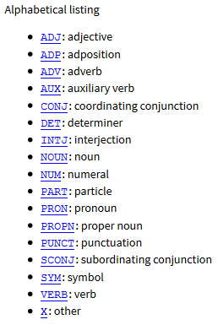
Universal POS
http://universaldependencies.org/u/pos/

Slide 22
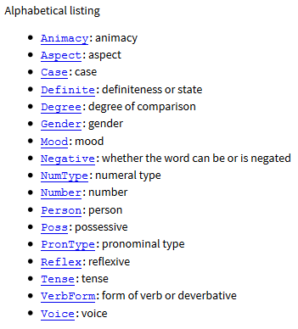
Universal Features
http://universaldependencies.org/u/feat/

Slide 23
Some Observations
Ambiguity
  count (noun) vs. count (verb)
  11% of all types but 40% of all tokens in the Brown corpus are ambiguous.
  Examples
    like can be tagged as ADP VERB ADJ ADV NOUN
    present can be tagged as ADJ NOUN VERB ADV

Slide 24
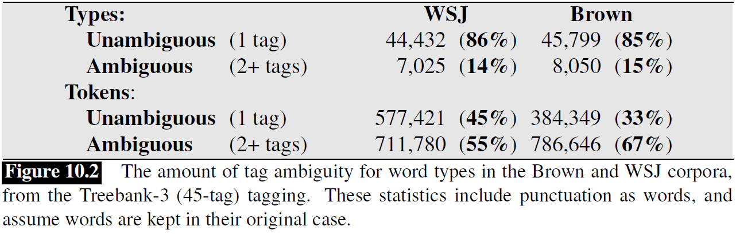
POS Ambiguity
Example from J&M

Slide 25
Some Observations
More examples:
  transport, object, discount, address
  content
French pronunciation:
  est, président, fils
Three main techniques:
  rule-based
  machine learning (e.g., conditional random fields, maximum entropy Markov models, neural networks)
  transformation-based
Useful for parsing, translation, text to speech, word sense disambiguation, etc.

Slide 26
Example
Bethlehem/NNP Steel/NNP Corp./NNP ,/, hammered/VBN by/IN higher/JJR costs/NNS
Bethlehem/NNP Steel/NNP Corp./NNP ,/, hammered/VBN by/IN higher/JJR costs/VBZ

Slide 27
Classifier-based POS Tagging
A baseline method would be to use a classifier to map each individual word into a likely POS tag
  Why is this method unlikely to work well?

Slide 28
Sources of Information
Bethlehem/NNP Steel/NNP Corp./NNP ,/, hammered/VBN by/IN higher/JJR costs/NNS
Bethlehem/NNP Steel/NNP Corp./NNP ,/, hammered/VBN by/IN higher/JJR costs/VBZ
Knowledge about individual words
  lexical information
  spelling (-or)
  capitalization (IBM)
Knowledge about neighboring words

Slide 29
Evaluation
Baseline
  tag each word with its most likely tag
  tag each OOV word as a noun.
  around 90%
Current accuracy
  around 97% for English
  compared to 98% human performance

Slide 30
Rule-based POS tagging
Use dictionary or finite-state transducers to find all possible parts of speech
Use disambiguation rules
  e.g., ART+V
Hundreds of constraints need to be designed manually

Slide 31
Example in French
<S> ^ beginning of sentence
La rf b nms u article
teneur nfs nms noun feminine singular
moyenne jfs nfs v1s v2s v3s adjective feminine singular
en p a b preposition
uranium nms noun masculine singular
des p r preposition
rivières nfp noun feminine plural
, x punctuation
bien_que cs subordinating conjunction
délicate jfs adjective feminine singular
à p preposition
calculer v verb

Slide 32
Sample Rules
BS3 BI1
  A BS3 (3rd person subject personal pronoun) cannot be followed by a BI1 (1st person indirect personal pronoun).
  In the example: “il nous faut” (= “we need”) – “il” has the tag BS3MS and “nous” has the tags [BD1P BI1P BJ1P BR1P BS1P].
  The negative constraint “BS3 BI1” rules out “BI1P'', and thus leaves only 4 alternatives for the word “nous”.
N K
  The tag N (noun) cannot be followed by a tag K (interrogative pronoun); an example in the test corpus would be: “... fleuve qui ...” (...river that...).
  Since “qui” can be tagged both as an “E” (relative pronoun) and a “K” (interrogative pronoun), the “E” will be chosen by the tagger since an interrogative pronoun cannot follow a noun (“N”).
R V
  A word tagged with R (article) cannot be followed by a word tagged with V (verb): for example “l' appelle” (calls him/her).
  The word “appelle” can only be a verb, but “l'” can be either an article or a personal pronoun.
  Thus, the rule will eliminate the article tag, giving preference to the pronoun.

Slide 33
Introduction to NLP
Statistical POS Tagging

Slide 34
Part of Speech Tagging Methods
Rule-based
Stochastic
  HMM (generative)
  Maximum Entropy MM (discriminative)
Transformation-based

Slide 35
HMM-based POS Tagging
Find tag sequence that maximizes the probability formula
  P(word|tag) * P(tag|previous n tags)
A bigram-based HMM tagger chooses the tag t_{i} for word w_{i} that is most probable given the previous tag t_{i-1} and the current word w_{i}:
  t_{i} = argmax_{j} P(t_{j}|t_{i-1},w_{i})
  t_{i} = argmax_{j} P(t_{j}|t_{i-1})P(w_{i}|t_{j}) : HMM equation for a single tag

Slide 36
HMM Tagging
T = argmax P(T|W)
  where T=t₁,t₂,…,t_{n}
By Bayes’ theorem
  P(T|W) = P(T)P(W|T)/P(W)
Thus we are attempting to choose the sequence of tags that maximizes the RHS of the equation
  P(W) can be ignored
  P(T) is called the prior, P(W|T) is called the likelihood.

Slide 37
HMM Tagging
Complete formula
  P(T)P(W|T) = ΠP(w_{i}|w₁t₁…w_{i-1}t_{i-1}t_{i})P(t_{i}|t₁…t_{i-2}t_{i-1})
Simplification 1:
  P(W|T) = ΠP(w_{i}|t_{i})
Simplification 2:
  P(T)= ΠP(t_{i}|t_{i-1})
Bigram approximation
  T = argmax P(T|W) = argmax ΠP(w_{i}|t_{i}) P(t_{i}|t_{i-1})

Slide 38
Example
The/DT rich/JJ like/VBP to/TO travel/VB ./.

Slide 39
Example
DT
NN
VBP
TO
NN
.
The
rich
like
to
travel
.
DT
NN
VBP
TO
VB
.
The
rich
like
to
travel
.

Slide 40
Maximum Likelihood Estimates
Transitions
  P(NN|JJ) = C(JJ,NN)/C(JJ) = 22301/89401 = .249
Emissions
  P(this|DT) = C(DT,this)/C(DT) = 7037/103687 = .068

Slide 41
Evaluating Taggers
Data set
  Training set
  Development set
  Test set
Tagging accuracy
  how many tags right

Slide 42
HMM POS Results
Assigning each word its most likely tag: 90%
Trigram HMM: 95% (55% on unknown words)
Tuned HMM (Brants 1998): 96.2% (86.0%)
SOTA (Bi-LSTM CRF): 97.5% (89+%)
Numbers thanks to Dan Klein and Greg Durrett

Slide 43
Remaining Errors
Words not seen with that tag in training: 4.5%
Unknown word: 4.5%
Could get right: 16% (needs parsing)
Difficult decision: 20% (“set” = VBP or VBD?)
Underspecified/unclear, gold standard inconsistent/wrong: 58% (e.g., is “discontinued” JJ or VBN)
[Manning 2011]

Slide 44
Notes on POS
New domains
  Lower performance
New languages
  Morphology matters! Also availability of training data
Distributional clustering
  Combine statistics about semantically related words
  Example: names of companies
  Example: days of the week
  Example: animals

Slide 45
Brown Clustering
Words with similar vector representations are clustered together, in an agglomerative (recursive) way
For example, “Monday”, “Tuesday”, etc. may form a new vector “Day of the week”
Published by Brown et al. [1992]

Slide 46
Example
Friday Monday Thursday Wednesday Tuesday Saturday Sunday weekends Sundays
people guys folks fellows CEOs chaps doubters commies unfortunates blokes
down backwards ashore sideways southward northward overboard aloft downwards adrift
water gas coal liquid acid sand carbon steam shale iron
great big vast sudden mere sheer gigantic lifelong scant colossal
American Indian European Japanese German African Catholic Israeli Italian Arab
mother wife father son husband brother daughter sister boss uncle
machine device controller processor CPU printer spindle subsystem compiler plotter
John George James Bob Robert Paul William Jim David Mike
feet miles pounds degrees inches barrels tons acres meters bytes
had hadn't hath would've could've should've must've might've
that tha theat
head body hands eyes voice arm seat eye hair mouth

Slide 47
Example
Input:
  this is one document . it has two sentences but the program only cares about spaces .
  here is another document . it also has two sentences .
  and here is a third document with one sentence .
  this document is short .
  the dog ran in the park .
  the cat was chased by the dog .
  the dog chased the cat .
[code by Michael Heilman: https://github.com/mheilman/tan-clustering]

Slide 48
. 1011 9
the 011 7
is 110 4
document 1110 4
dog 000 3
it 101001 2
one 11111 2
sentences 1010111 2
chased 00111 2
two 1010100 2
has 1010110 2
here 111101 2
this 1000 2
cat 0010 2
and 11110010 1
sentence 11110011 1
ran 01011 1
in 0100 1
spaces 10101011011 1
another 1010001 1
cares 101010111 1
also 1010000 1
only 10101011010 1
program 10101011001 1
was 001100 1
park 01010 1
but 10101011000 1
short 1001 1
with 111100001 1
by 001101 1
a 111100000 1
about 10101010 1
third 11110001 1
[code by Michael Heilman]

Slide 49
Notes on POS
British National Corpus
  http://www.natcorp.ox.ac.uk/
Tagset sizes
  PTB 45, Brown 85, Universal 12, Twitter 25
Dealing with unknown words
  Look at features like twoDigitNum, allCaps, initCaps, containsDigitAndSlash (Bikel et al. 1999)

Slide 50
External Link
Jason Eisner’s awesome interactive spreadsheet about learning HMMs
  http://cs.jhu.edu/~jason/papers/#eisner-2002-tnlp
  http://cs.jhu.edu/~jason/papers/eisner.hmm.xls

Slide 51
Introduction to NLP
Transformation-Based Learning

Slide 52
Transformation Based Learning
Idea: change some labels given specific input patterns
  [Brill 1995]
Example
  P(NN|sleep) = .9
  P(VB|sleep) = .1
  Change NN to VB when the previous tag is TO
Types of rules:
  The preceding (following) word is tagged z
  The word two before (after) is tagged z
  One of the two preceding (following) words is tagged z
  One of the three preceding (following) words is tagged z
  The preceding word is tagged z and the following word is tagged w

Slide 53
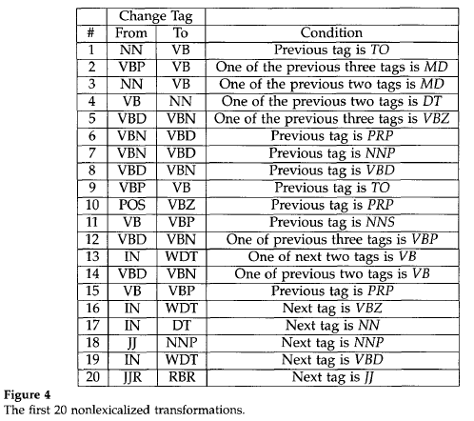
Transformation Based Tagger

Slide 54
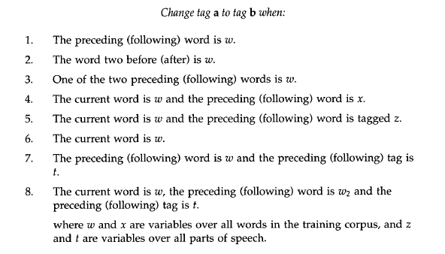
Transformation Based Tagger

Slide 55
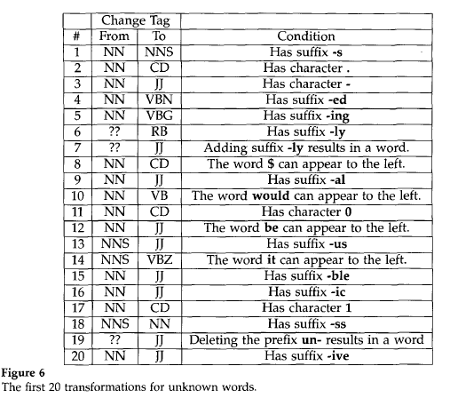
Unknown Words

