Slide 1
Introduction to Parsing

Slide 2
Parsing programming languages
#include <stdio.h>
int main()
{
int n, reverse = 0;
printf("Enter a number to reverse\n");
scanf("%d",&n);
while (n != 0)
{
reverse = reverse * 10;
reverse = reverse + n%10;
n = n/10;
}
printf("Reverse of entered number is = %d\n", reverse);
return 0;
}

Slide 3
Parsing human languages
Rather different than computer languages
Can you think in which ways?
Notes:
examples

Slide 4
Parsing human languages
Rather different than computer languages
No types for words
No brackets around phrases
Ambiguity
Words
Parses
Implied information
Notes:
examples

Slide 5
The parsing problem
Parsing means associating tree structures to a sentence, given a grammar (e.g., CFG)
There may be exactly one such tree structure
There may be many such structures
There may be none
Grammars (e.g., CFG) are declarative
They don’t specify how the parse tree will be constructed
Notes:
examples

Slide 6
Syntactic ambiguities
PP attachment
I saw the man with the telescope
Gaps
Mary likes Physics but hates Chemistry
Coordination scope
Small boys and girls are playing
Particles vs. prepositions
She ran up a large bill
Gerund vs. adjective
Frightening kids can cause trouble

Slide 7
Applications of parsing
Grammar checking
I want to return this shoes.
Question answering
How many people in sales make $40K or more per year?
Machine translation
E.g., word order – SVO vs. SOV
Information extraction
Breaking Bad takes place in New Mexico.
Speech generation
Speech understanding
Notes:
Examples

Slide 8
Parsing benchmark dataset
The Penn Treebank

Slide 9
Description
Background
From the early ‘90s
Developed at the University of Pennsylvania
(Marcus, Santorini, and Marcinkiewicz 1993)
Size
40,000 training sentences
2,400 test sentences
Genre
Mostly Wall Street Journal news stories and some spoken conversations
Importance
Helped launch modern automatic parsing methods

Slide 10
External links
Treebank-3
http://catalog.ldc.upenn.edu/LDC99T42
Original version
http://catalog.ldc.upenn.edu/LDC95T7
Tokenization guidelines
http://www.cis.upenn.edu/~treebank/tokenization.html
The American National Corpus
http://www.anc.org

Slide 11
Penn Treebank Tagset (1/2)
Tag | Description | Example
CC | coordinating conjunction | and
CD | cardinal number | 1, third
DT | determiner | the
EX | existential there | there is
FW | foreign word | d‘oeuvre
IN | preposition/subordinating conjunction | in, of, like
JJ | adjective | green
JJR | adjective, comparative | greener
JJS | adjective, superlative | greenest
LS | list marker | 1)
MD | modal | could, will
NN | noun, singular or mass | table
NNS | noun plural | tables
NNP | proper noun, singular | John
NNPS | proper noun, plural | Vikings
PDT | predeterminer | both the boys
POS | possessive ending | friend's

Slide 12
Penn Treebank Tagset (2/2)
Tag | Description | Example
PRP | personal pronoun | I, he, it
PRP$ | possessive pronoun | my, his
RB | adverb | however, usually, naturally, here, good
RBR | adverb, comparative | better
RBS | adverb, superlative | best
RP | particle | give up
TO | to | to go, to him
UH | interjection | uhhuhhuhh
VB | verb, base form | take
VBD | verb, past tense | took
VBG | verb, gerund/present participle | taking
VBN | verb, past participle | taken
VBP | verb, sing. present, non-3d | take
VBZ | verb, 3rd person sing. present | takes
WDT | wh-determiner | which
WP | wh-pronoun | who, what
WP$ | possessive wh-pronoun | whose
WRB | wh-abverb | where, when

Slide 13
Example Sentence
WSJ/12/WSJ_1273.MRG, sentence 11
Because the CD had an effective yield of 13.4 % when it was issued in 1984 , and interest rates in general had declined sharply since then , part of the price Dr. Blumenfeld paid was a premium -- an additional amount on top of the CD 's base value plus accrued interest that represented the CD 's increased market value .

Slide 14
Parsed Sentence
(S
(SBAR-PRP
(IN Because)
(S
(S
(NP-SBJ (DT the) (NNP CD))
(VP
(VBD had)
(NP
(NP (DT an) (JJ effective) (NN yield))
(PP (IN of) (NP (CD 13.4) (NN %))))
(SBAR-TMP
(WHADVP-4 (WRB when))
(S
(NP-SBJ-1 (PRP it))
(VP
(VBD was)
(VP
(VBN issued)
(NP (-NONE- *-1))
(PP-TMP (IN in) (NP (CD 1984)))
(ADVP-TMP (-NONE- *T*-4))))))))
...

Slide 15
(VP
(VBD was)
(NP-PRD
(NP (DT a) (NN premium))
(: --)
(NP
(NP
(NP (DT an) (JJ additional) (NN amount))
(PP-LOC
(IN on)
(NP
(NP (NN top))
(PP
(IN of)
(NP
(NP (DT the) (NNP CD) (POS 's))
(NN base)
(NN value))))))
(CC plus)
(NP (VBN accrued) (NN interest)))
(SBAR
(WHNP-2 (WDT that))
(S
(NP-SBJ (-NONE- *T*-2))
(VP
(VBD represented)
(NP
(NP (DT the) (NNP CD) (POS 's))
(VBN increased)
(NN market)
(NN value)))))))
(. .))
(, ,)
(NP-SBJ
(NP (NN part))
(PP
(IN of)
(NP
(NP (DT the) (NN price))
(SBAR
(WHNP-3 (-NONE- 0))
(S
(NP-SBJ (NNP Dr.) (NNP Blumenfeld))
(VP (VBD paid) (NP (-NONE- *T*-3))))))))

Slide 16
Peculiarities
Complementizers
e.g., “that”
Gaps
*NONE*
SBAR
SBAR → COMP S
E.g., “that *NONE* represented the CD’ market value”

Slide 17
tgrep
A < B A immediately dominates B A << B A dominates B A <- B B is the last child of A A <<, B B is a leftmost descendant of A A <<` B B is a rightmost descendant of A A . B A immediately precedes B A .. B A precedes B A $ B A and B are sisters A $. B A and B are sisters and A immediately precedes B A $.. B A and B are sisters and A precedes B

Slide 18
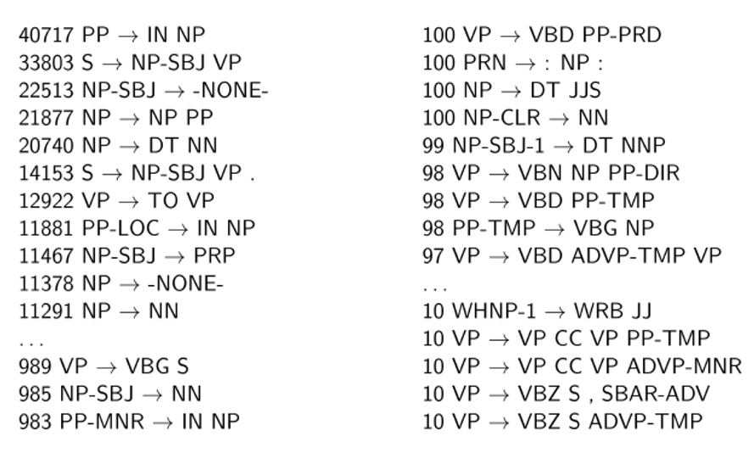
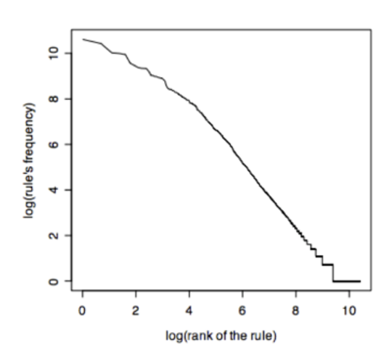
Penn Treebank Statistics

Slide 19
The use of treebanks
Disadvantages
A lot more work to annotate 40K+ sentences than to write a grammar.
Advantages
Statistics about different constituents and phenomena
Training systems
Evaluating systems
Multilingual extensions

Slide 20
Parsing Evaluation

Slide 21
Parsing Model
GEN/EVAL framework
GEN maps the input to a set of candidate parses
EVAL ranks the candidate parses
y* = argmax EVAL (X,Y)
y ∈ GEN(X)
Notes:
TODO

Slide 22
Evaluation Methodology (1/2)
Classification tasks
Document retrieval
Part of speech tagging
Parsing
Data split
Training
Dev-test
Test
Notes:
TODO

Slide 23
Evaluation Methodology (2/2)
Baselines
Dumb baseline
Intelligent baseline
Human performance (ceiling)
New method
Evaluation methods
Accuracy
Precision and Recall
Multiple references
Interjudge agreement
Notes:
TODO

Slide 24
Kappa
Agreement vs. expected agreement
P(A) is the level of agreement of the judges
P(E) is the expected probability of agreement by chance
When κ > .7 – agreement is considered high
Question
Judge agreement on a binary classification task is 60%, is this high?

Slide 25
Answer
Data
P(A) = .6
P(E) = .5
Kappa
k = .1/.5 = .2
not high

Slide 26
Parsing Evaluation
Parseval: precision and recall
get the proper constituents
Labeled precision and recall
also get the correct non-terminal labels
F1
harmonic mean of precision and recall
Crossing brackets
(A (B C)) vs ((A B) C)
PTB corpus
training 02-21, development 22, test 23
Notes:
INTRODUCE PRECISION AND RECALL

Slide 27
Evaluation Example
GOLD = (S (NP (DT The) (JJ Japanese) (JJ industrial) (NNS companies))
(VP (MD should) (VP (VB know) (ADVP (JJR better)))) (. .)
CHAR = (S (NP (DT The) (JJ Japanese) (JJ industrial) (NNS companies))
(VP (MD should) (VP (VB know)) ((ADVP (RBR better)))) (. .))
Bracketing Recall = 80.00
Bracketing Precision = 66.67
Bracketing FMeasure = 72.73
Complete match = 0.00
No crossing = 100.00
Tagging accuracy = 87.50
Notes:
DEMO!

