Slide 1
Deep Learning
Recurrent Neural Networks

Slide 2
z
z
y₂
y₂
…
y₁
y₁
x₁
x₂
x₃
x₄
x₁
x₂
x₃
x₄
the
cat

Slide 3
Recurrent Neural Networks
$h_{t}=$ $σ(W_{h}h_{t−1}+W_{x}x_{t})$
h₀
w_{h}
h₁
σ
w_{x}
x₁
Notes:
Remember our notation from earlier. X is an input, h is our hidden layer, Ws are our weights, sigma is a nonlinearity – typically a sigmoid or tanh function.

Slide 4

RNN
y₁
$h_{t}=$ $σ\left(W_{h}h_{t−1}+W_{x}x_{t}\right)$
$$y_{t}=softmax(W_{y}h_{t})$$
softmax
w_{y}
h₀
w_{h}
h₁
σ
w_{x}
x₁
Notes:
As much as we love hidden layers, we probably want some actual output, so we can apply another set of weights and a softmax to h_t to give us our predicted probabilities for y_t

Slide 5
RNN
y₃
softmax
w_{y}
h₀
w_{h}
h₁
w_{h}
h₂
w_{h}
h₃
σ
σ
σ
w_{x}
w_{x}
w_{x}
x₁
x₂
x₃
The
cat
sat
Notes:
Reason to use RNNs is you have a sequence, such as a sentence.

Slide 6
Updating Parameters of an RNN
Backpropagation through time
y₃
Cost
softmax
w_{y}
h₀
w_{h}
h₁
w_{h}
h₂
w_{h}
h₃
σ
σ
σ
w_{x}
w_{x}
w_{x}
x₁
x₂
x₃
The
cat
sat
Notes:
RNNs are supervised, so once you have your predictions y, you compare them to your correct label for the sequence. For a classification problem, you use something like categorical cross entropy, and you get a cost. You then take the gradient of the cost w.r.t. the parameters to figure out how to update your parameters.

Slide 7
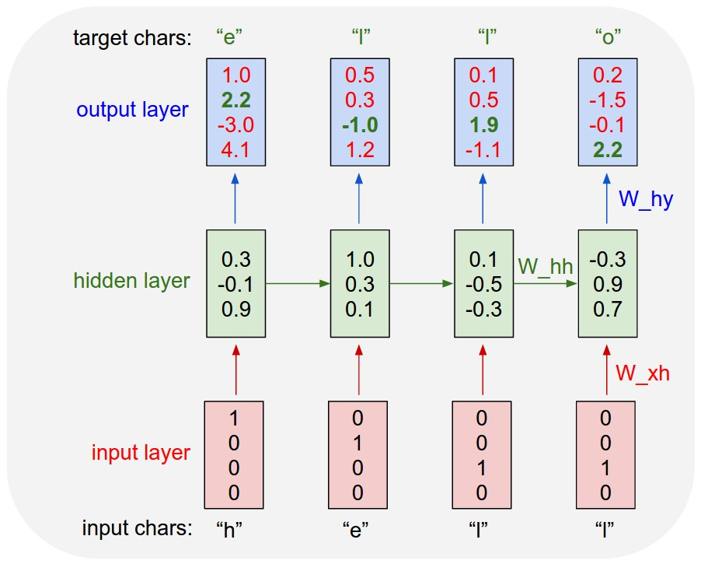
Character-based RNN
http://karpathy.github.io/2015/05/21/rnn-effectiveness/

Slide 8
Notes
RNNs are used to keep “memory”, just like finite-state automata
They can be used as generators, acceptors, transducers, etc.

Slide 9
Other Applications
Language Modeling (Mikolov 2012)
Character-level RNNs for text generation
Semantic Role Labeling:
http://www.aclweb.org/anthology/P15-1109
Dependency parsing:
http://www.aclweb.org/anthology/K/K15/K15-1015.pdf
(“producing state-of-art dependency parsing results while requiring minimal feature engineering”)

Slide 10
Deep Learning
Long Short-Term Memory Networks (LSTM) and GRUs

Slide 11
LSTM Motivation
Remember how we update an RNN?
y₃
Cost
softmax
w_{y}
h₀
w_{h}
h₁
w_{h}
h₂
w_{h}
h₃
σ
σ
σ
w_{x}
w_{x}
w_{x}
x₁
x₂
x₃
The
cat
sat
[slides from Catherine Finegan-Dollak]
Notes:
RNNs are supervised, so once you have your predictions y, you compare them to your correct label for the sequence. For a classification problem, you use something like categorical cross entropy, and you get a cost. You then take the gradient of the cost w.r.t. the parameters to figure out how to update your parameters.

Slide 12
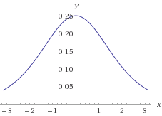
The Vanishing Gradient Problem
Deep neural networks use backpropagation.
Back propagation uses the chain rule.
The chain rule multiplies derivatives.
Often these derivatives between 0 and 1.
As the chain gets longer, products get smaller
until they disappear.
Wolfram|Alpha
Derivative of sigmoid function

Slide 13
Or do they explode?
With gradients larger than 1,
you encounter the opposite problem
with products becoming larger and larger
as the chain becomes longer and longer,
causing overlarge updates to parameters.
This is the exploding gradient problem.

Slide 14

Vanishing/Exploding Gradients Are Bad.
If we cannot backpropagate very far through the network, the network cannot learn long-term dependencies.
My dog [chase/chases] squirrels.
vs.
My dog, whom I adopted in 2009, [chase/chases] squirrels.

Slide 15
LSTM Solution
Use memory cell to store information at each time step.
Use “gates” to control the flow of information through the network.
Input gate: protect the current step from irrelevant inputs
Output gate: prevent the current step from passing irrelevant outputs to later steps
Forget gate: limit information passed from one cell to the next

Slide 16
Transforming RNN to LSTM
$u_{t}=$ $σ(W_{h}h_{t−1}+W_{x}x_{t})$
h₀
w_{h}
u₁
σ
w_{x}
x₁
Notes:
Start with the same basic structure as our RNN, but call the output vector u1 instead of h1.

Slide 17
Transforming RNN to LSTM
c₀
h₀
w_{h}
u₁
σ
w_{x}
x₁
Notes:
Now we’re going to add another vector, c, which will be our memory cell. C0 is usually initialized to all 0s, and we’ll see how c is calculated for each time-step in a moment.
Basically, we’re going to want to somehow combine c0 with u1 to get c1. There’s a temptation to apply a set of weights to each and then apply some non-linear function, but that’s what got us into this mess, so let’s not do that.

Slide 18
Transforming RNN to LSTM
c₀
c₁
f₁
$$c_{t}=f_{t}⊙c_{t−1}+i_{t}⊙u_{t}$$
+
Elementwise (Hadamard) matrix product
(array product “*” in Python)
h₀
w_{h}
u₁
σ
i₁
w_{x}
x₁
Notes:
Instead, what we’re going to do is pass u1 through our input gate i1, and pass c0 through our forget gate f1, and take their sum. When I say information is “passed through” a gate, I mean take the elementwise product of the input vector and the gate vector.

Slide 19
Transforming RNN to LSTM
c₀
c₁
f₁
$$c_{t}=f_{t}⊙c_{t−1}+i_{t}⊙u_{t}$$
+
h₀
w_{h}
u₁
σ
i₁
w_{x}
x₁
Notes:
It’s a big deal that c is calculated using a linear function.

Slide 20
Transforming RNN to LSTM
c₀
c₁
f₁
$$c_{t}=f_{t}⊙c_{t−1}+i_{t}⊙u_{t}$$
+
h₀
w_{h}
u₁
σ
i₁
w_{x}
x₁
Notes:
The gate vector will have values from 0 to 1. A gate value of 0 is closed: it doesn’t let information pass through it. A gate value of 1 lets all of the information pass through it.
At this first time step, the gates aren’t doing much, because we initialized c0 and h0 to vectors of zeros. But at the next time step, our gates give the network the option of treating the input c as a vector of zeros. So if ct is a memory of everything we’ve seen in the network up to time t, we can totally close our gate and use all 0s for ct at the next step – effectively forgetting everything and going back to our starting value for c. The gate vector will have values from 0 to 1. A gate value of 0 is closed: it doesn’t let information pass through it. A gate value of 1 lets all of the information pass through it.

Slide 21
Transforming RNN to LSTM
c₀
c₁
f₁
$f_{t}=$ $σ(W_{hf}h_{t−1}+W_{xf}x_{t})$
f₁
+
w_{hf}
σ
h₀
h₀
w_{h}
u₁
σ
w_{xf}
i₁
w_{x}
x₁
x₁
Notes:
So, where do the magic gates come from? Why, we multiply some input vectors by weights and apply the sigmoid function, of course! The forget gate gets one set of weights…

Slide 22
Transforming RNN to LSTM
c₀
c₁
f₁
$i_{t}=$ $σ(W_{hi}h_{t−1}+W_{xi}x_{t})$
+
w_{hi}
σ
h₀
u₁
h₀
w_{h}
i₁
σ
w_{xi}
i₁
w_{x}
x₁
x₁
Notes:
And the input gate gets a different set.

Slide 23
Transforming RNN to LSTM
c₀
c₁
f₁
$$h_{t}=o_{t}⊙\tanh{c_{t}}$$
+
tanh
h₀
w_{h}
u₁
h₁
σ
i₁
o₁
w_{x}
x₁
Notes:
Finally, we apply a non-linearity to our memory cell, c1, and pass that through the output gate to give us h1

Slide 24
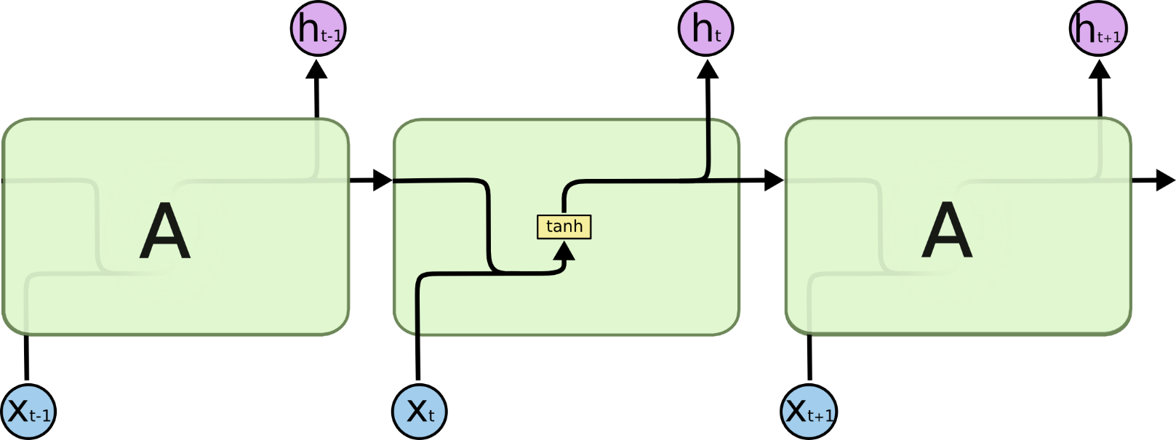

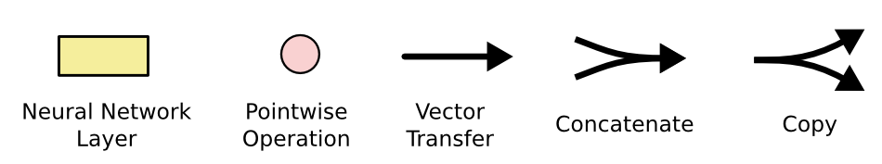
RNN
LSTM
http://colah.github.io/posts/2015-08-Understanding-LSTMs/

Slide 25
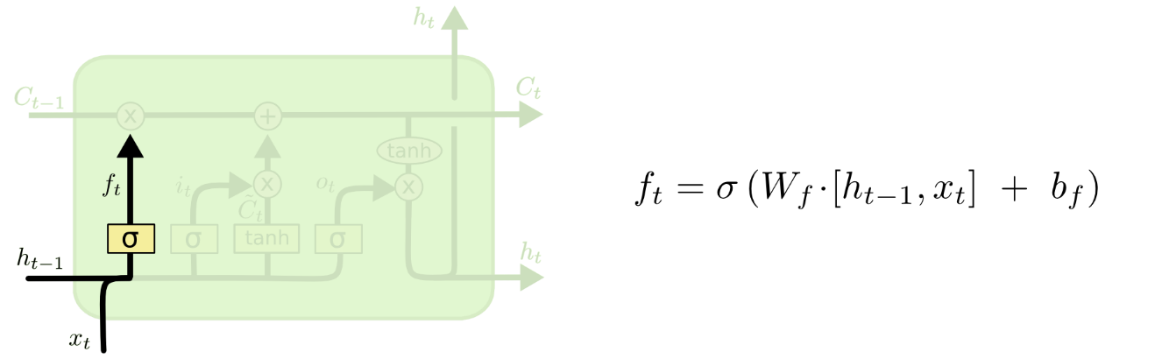
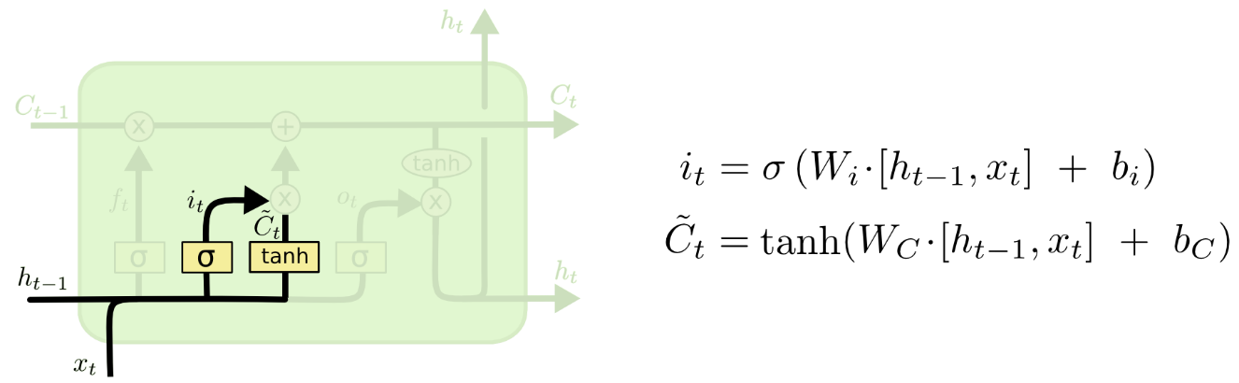
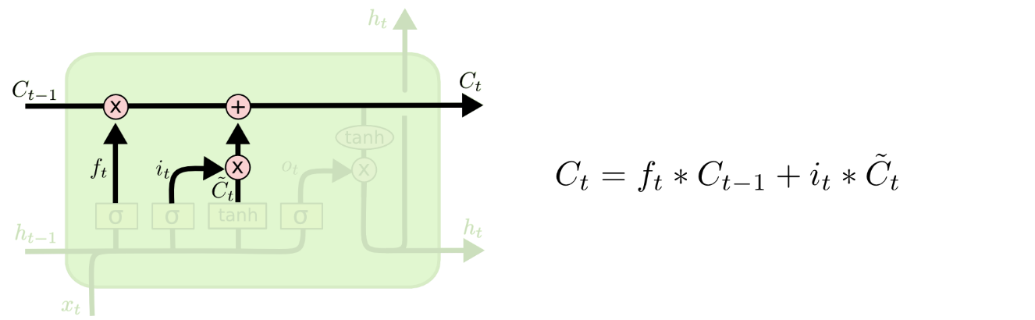
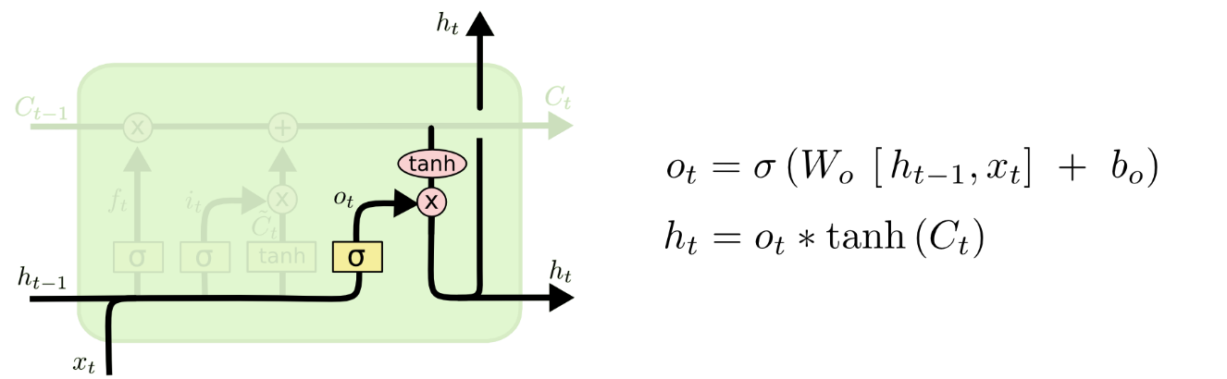

Slide 26
LSTM for Sequences
c₀
c₁
c₂
f₂
c₂
f₁
+
f₂
+
+
tanh
tanh
tanh
h₀
w_{h}
u₁
h₁
w_{h}
u₂
h₂
w_{h}
u₂
h₂
σ
i₁
o₁
σ
i₂
o₂
σ
i₂
o₂
w_{x}
w_{x}
w_{x}
x₁
x₂
x₂
The
cat
sat
Notes:
Now, we can line these up like we did with the regular RNN and start processing sequences

Slide 27

LSTM Applications
http://www.cs.toronto.edu/~graves/handwriting.html
Language identification (Gonzalez-Dominguez et al., 2014)
Paraphrase detection (Cheng & Kartsaklis, 2015)
Speech recognition (Graves, Abdel-Rahman, & Hinton, 2013)
Handwriting recognition (Graves & Schmidhuber, 2009)
Music composition (Eck & Schmidhuber, 2002) and lyric generation (Potash, Romanov, & Rumshisky, 2015)
Robot control (Mayer et al., 2008)
Natural language generation (Wen et al. 2015) (best paper at EMNLP)
Named entity recognition (Hammerton, 2003)

Slide 28
Other Architectures
Bidirectional LSTM
Concatenate two one-directional LSTMs
Stacked LSTM

Slide 29
Related Architectures: GRU
z₁
h₀
w_{h}
ĥ₁
h₁
r₁
σ
+
w_{x}
1-z₁
x₁
Chung et al. (2014) reports comparable performance to LSTM

Slide 30
Related Architectures: Tree LSTMs
f
c₀
h₀
u₂
c₂
h₂
x₂
i
o
c₁
h₁
f
Tai, Socher, Manning 2015

Slide 31
External Link
http://colah.github.io/posts/2015-08-Understanding-LSTMs/

Slide 32
Next Steps
Moving away from RNN/LSTM to other architectures, such as transformers
Later lecture
(Chris Manning) the WMT 2016 final report has 44 instances of RNN whereas the WMT 2018 report has RNN 9 times and Transformer 63 times.

