Slide 1
Thesaurus-based Word Similarity Methods

Slide 2
Thesaurus-based word similarity
Thesaurus-based word similarity methods are techniques used to measure the semantic similarity or relatedness between words based on their relationships in a structured lexical resource or thesaurus, such as WordNet, Roget's Thesaurus, or other domain-specific ontologies.
In these methods, the similarity between words is determined by considering the structural properties and relationships between the words within the thesaurus. Common relationships include synonymy, antonymy, hyponymy (is-a), and meronymy (part-of).
Some widely used thesaurus-based word similarity measures are:
path-based
information content-based

Slide 3
Quiz
Which pair of words exhibits the greatest similarity?
1. Deer-elk
2. Deer-horse
3. Deer-mouse
4. Deer-roof

Slide 4
Quiz Answer
Which pair of words exhibits the greatest similarity?
1. Deer-elk
2. Deer-horse
3. Deer-mouse
4. Deer-roof
Why?

Slide 5
Wordnet
ungulate
even-toed ungulate
equine
odd-toed ungulate
okapi
deer
giraffe
mule
ruminant
horse
zebra
elk
wapiti
caribou
pony

Slide 6
Text Similarity
Wordnet

Slide 7
Wordnet
Wordnet is a project run by George Miller (1920-2012) and Christiane Fellbaum at Princeton University.
It includes a database of words (mainly nouns and verbs but also adjectives and adverbs) and semantic relations between them.
The main relation is hypernymy, so the overall structure of the database is more tree-like (see next slide).
References:
George A. Miller (1995). WordNet: A Lexical Database for English. Communications of the ACM Vol. 38, No. 11: 39-41.
Christiane Fellbaum (1998, ed.) WordNet: An Electronic Lexical Database. Cambridge, MA: MIT Press.

Slide 8
Tree-like structure of Wordnet
ungulate
even-toed ungulate
equine
odd-toed ungulate
okapi
deer
ruminant
mule
giraffe
horse
zebra
elk
wapiti
caribou
pony

Slide 9
Wordnet Example (1/6)
The noun bar has 11 senses
1. barroom, bar, saloon, ginmill, taproom -- (a room where alcoholic drinks are served over a counter)
2. bar -- (a counter where you can purchase food or drink)
3. bar -- (a rigid piece of metal)
4. measure, bar -- (notation for a repeating pattern of musical beats; written followed by a vertical bar)
5. bar -- (usually metal placed in windows to prevent escape)
6. prevention, bar -- (the act of preventing)
7. bar -- (a unit of pressure equal to a million dynes per square centimeter)
8. bar -- (a submerged (or partly submerged) ridge in a river or along a shore)
9. legal profession, bar, legal community -- (the body of individuals qualified to practice law)
10. cake, bar -- (a block of soap or wax)
11. bar -- ((law) a railing that encloses the part of the courtroom where the the judges and lawyers sit and the case is tried)
The verb bar has 4 senses
1. bar, debar, exclude -- (prevent from entering; keep out; "He was barred from membership in the club")
2. barricade, block, blockade, block off, block up, bar -- (render unsuitable for passage; "block the way"; "barricade the streets")
3. banish, relegate, bar -- (expel, as if by official decree; "he was banished from his own country")
4. bar -- (secure with, or as if with, bars; "He barred the door")

Slide 10
Wordnet Example (2/6)
Sense 1
barroom, bar, saloon, ginmill, taproom
=> room
=> area
=> structure, construction
=> artifact, artefact
=> object, physical object
=> entity, something
Sense 2
bar
=> counter
=> table
=> furniture, piece of furniture, article of furniture
=> furnishings
=> instrumentality, instrumentation
=> artifact, artefact
=> object, physical object
=> entity, something

Slide 11
Wordnet Example (3/6)
Sense 3
bar
=> implement
=> instrumentality, instrumentation
=> artifact, artefact
=> object, physical object
=> entity, something
Sense 4
measure, bar
=> musical notation
=> notation, notational system
=> writing, symbolic representation
=> written communication, written language
=> communication
=> social relation
=> relation
=> abstraction

Slide 12
Wordnet Example (4/6)
Sense 5
bar
=> obstruction, impediment, impedimenta
=> structure, construction
=> artifact, artefact
=> object, physical object
=> entity, something
Sense 6
prevention, bar
=> hindrance, interference, interfering
=> act, human action, human activity
Sense 7
bar
=> pressure unit
=> unit of measurement, unit
=> definite quantity
=> measure, quantity, amount, quantum
=> abstraction

Slide 13
Wordnet Example (5/6)
Sense 8
bar
=> ridge
=> natural elevation, elevation
=> geological formation, geology, formation
=> natural object
=> object, physical object
=> entity, something
=> barrier
=> mechanism
=> natural object
=> object, physical object
=> entity, something

Slide 14
Wordnet Example (6/6)
Sense 9
legal profession, bar, legal community
=> profession, community
=> occupation, vocation, occupational group
=> body
=> gathering, assemblage
=> social group
=> group, grouping
Sense 10
cake, bar
=> block
=> artifact, artefact
=> object, physical object
=> entity, something

Slide 15
Familiarity and Polysemy
board used as a noun is familiar (polysemy count = 9)
bird used as a noun is common (polysemy count = 5)
cat used as a noun is common (polysemy count = 7)
house used as a noun is familiar (polysemy count = 11)
information used as a noun is common (polysemy count = 5)
retrieval used as a noun is uncommon (polysemy count = 3)
serendipity used as a noun is very rare (polysemy count = 1)

Slide 16
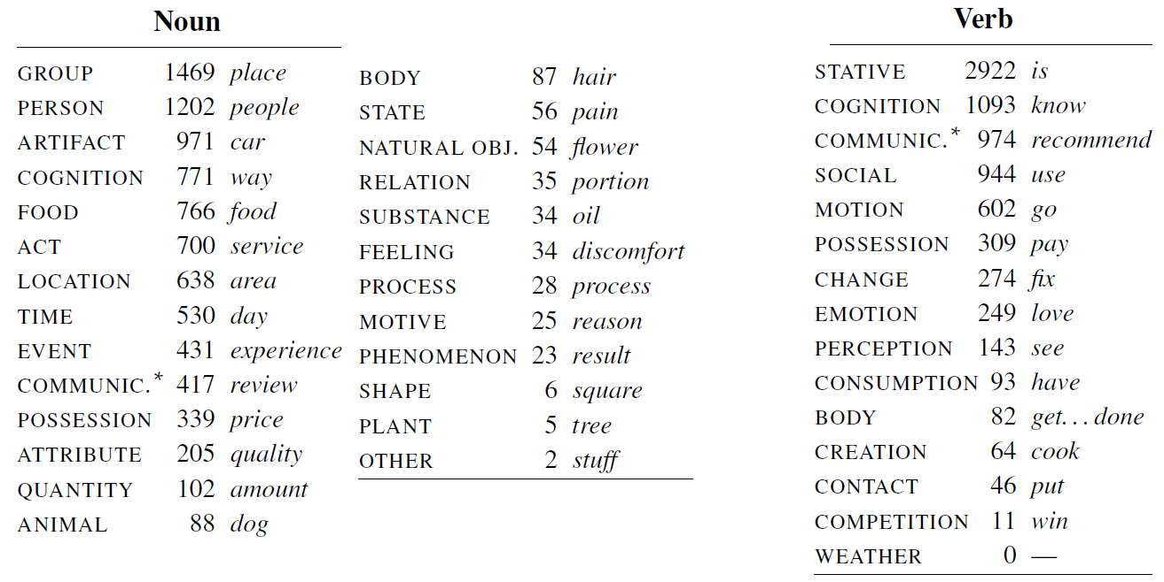
Top-Level Categories
[Example from J&M, based on Schneider and Smith 2013]

Slide 17
Text Similarity
Other Lexical Networks

Slide 18
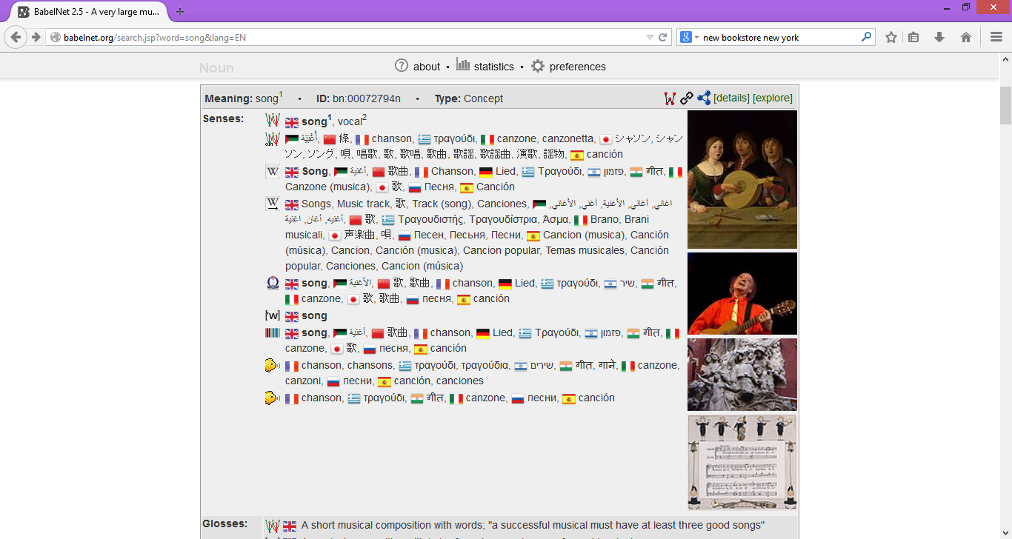
BabelNet Example

Slide 19
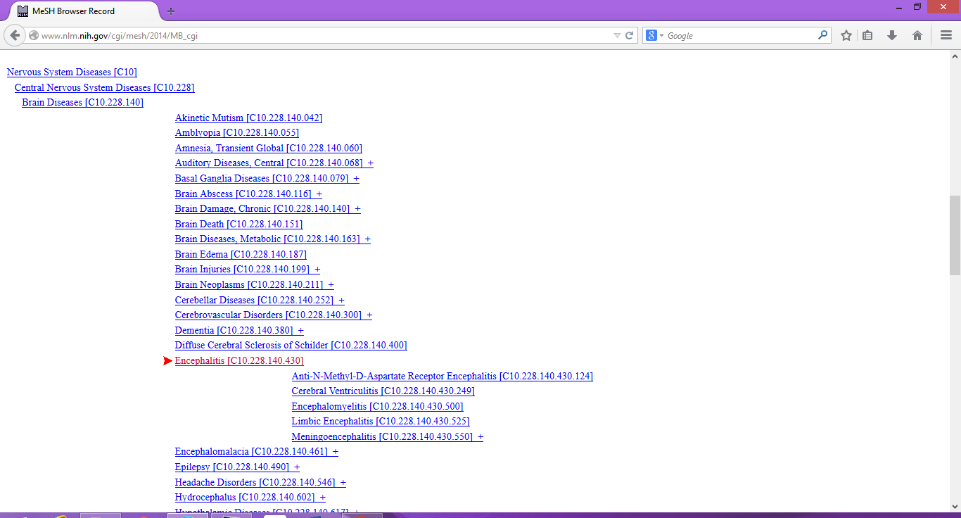
MeSH
Medical Subject Headings
http://www.nlm.nih.gov/mesh/MBrowser.html

Slide 20
External Links
EuroWordNet
http://www.illc.uva.nl/EuroWordNet/
Open Thesaurus
http://www.openthesaurus.de/
Freebase
http://www.freebase.com
DBPedia
http://www.dbpedia.org
BabelNet
http://babelnet.org
Various thesauri
https://sites.google.com/site/openrogets/

Slide 21
Path Similarity
Version 1
Sim (v,w) = - pathlength (v,w)
Version 2
Sim (v,w) = - log pathlength (v,w)
Path-based similarity measures: considering the shortest path between 2 words in the thesaurus hierarchy.
Shorter paths indicate higher similarity.
e.g., Wu-Palmer measure, Leacock-Chodorow measure, and the path length measure.
Notes:
J&M - remove

Slide 22
Problems with this Approach
There may be no tree for the specific domain or language
A specific word (e.g., a term or a proper noun) may not be in any tree
IS-A (hypernym) edges are not all equally apart in similarity space

Slide 23
Path similarity between two words
Version 3 (Philip Resnik)
Sim (v,w) = - log P(LCS(v,w))
where LCS = lowest common subsumer, e.g.,
ungulate for deer and horse
deer for deer and elk
Notes:
J&M - remove

Slide 24
Information content-based similarity
These methods factor in the information content of the concepts represented by words, which is usually derived from their frequency in a large corpus.
Higher information content indicates more specific concepts, and similarity is measured by considering the information content of the least common subsumer (the most specific concept that subsumes 包括 both words in the hierarchy).
Examples include Resnik's measure, Lin's measure, and Jiang-Conrath's measure.

Slide 25
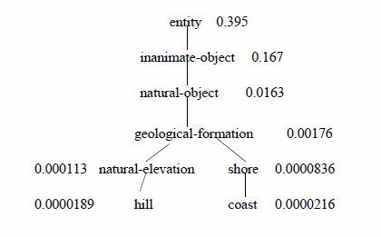

Information content
Version 4 (Dekang Lin)
Wordnet augmented with probabilities (Lin 1998)
IC(c) = -log P(c)
Sim (v,w) = 2 x log P(LCS(v,w)) / (log P(v) + log P(w))
= 0.59
Notes:
J&M - remove

Slide 26
Wordnet Similarity in NLTK
NLTK
>>> dog.lin_similarity(cat, brown_ic)
0.879
>>> dog.lin_similarity(elephant, brown_ic)
0.531
>>> dog.lin_similarity(elk, brown_ic)
0.475
Notes:
MOVE TO TEXT SIMILARITY

Slide 27
limitations of Thesaurus-based word similarity
limitations:
reliance on a manually curated resource, which may not cover all words or domains
inability to capture semantic similarity beyond the relationships defined in the thesaurus.
solutions: distributional (vector space models), such as Word2Vec, GloVe, and FastText, which can learn word representations from large-scale text corpora.

