Slide 1
Dependency Grammars

Slide 2
Dependency structure
blue
house
blue
modifier, dependent, child, subordinate
house
head, governor, parent, regent

Slide 3
Dependency Structure
Unionized workers are usually better paid than their non-union counterparts.
1 2 3 4 5 6 7 8 9 10

Slide 4
Dependency Structure
Unionized workers are usually better paid than their non-union counterparts.
1 2 3 4 5 6 7 8 9 10

Slide 5
Dependency Structure
Unionized workers are usually better paid than their non-union counterparts.
1 2 3 4 5 6 7 8 9 10

Slide 6
Dependency Structure
Unionized workers are usually better paid than their non-union counterparts.
1 2 3 4 5 6 7 8 9 10

Slide 7
Other notations
VBN
nsubjpass
prep
auxpass
advmod
advmod
NNS
VBP
RB
RBR
IN
amod
poss
JJ
NNS
poss
amod
PRP$
JJ
Unionized workers are usually better paid than their non-union counterparts.
1 2 3 4 5 6 7 8 9 10

Slide 8
Phrase Structure
S
NP
VP
VP
ADVP
PP
NP
JJ
NNS
VBP
RB
RBR
VBN
IN
PRP$
JJ
NNS
Unionized workers are usually better paid than their non-union counterparts.
1 2 3 4 5 6 7 8 9 10

Slide 9
Dependency grammars
Characteristics
Lexical/syntactic dependencies between words
The top-level predicate of a sentence is the root
Simpler to parse than context-free grammars
Particularly useful for free word order languages
Older idea compared to constituent grammars (as far back as Pāṇini (5th century BCE)

Slide 10
How to identify the heads
H=head, M=modifier
H determines the syntactic category of the construct
H determines the semantic category of the construct
H is required; M may be skipped
Fixed linear position of M with respect to H

Slide 11
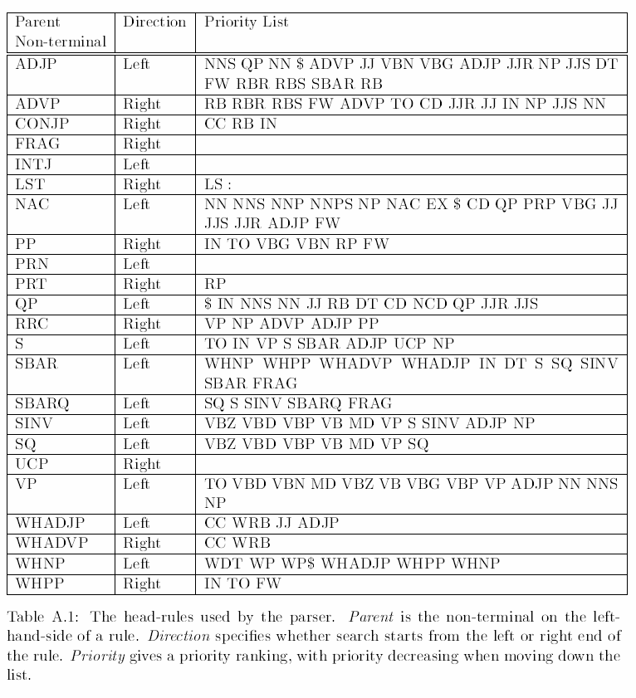
Head Rules from Collins’s Thesis
Notes:
PROVENANCE!

Slide 14
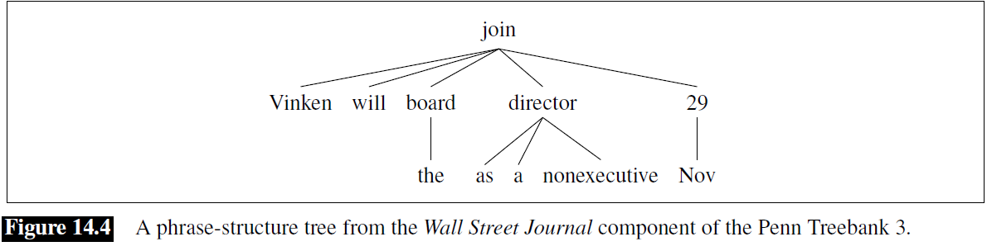

Slide 15
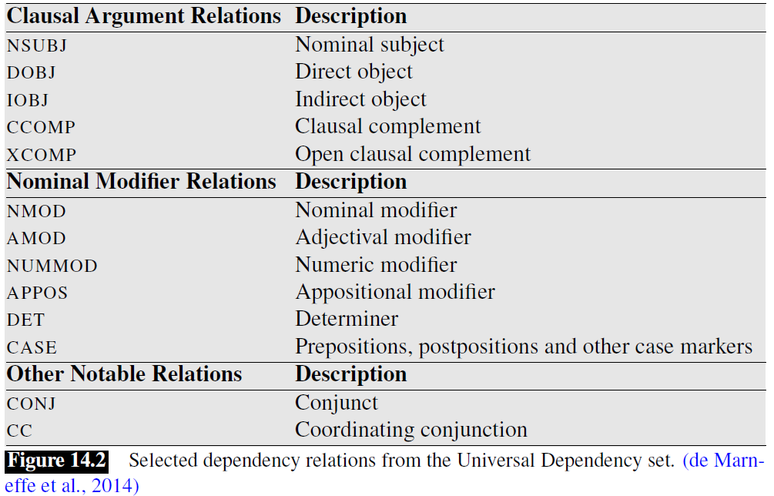

Slide 18
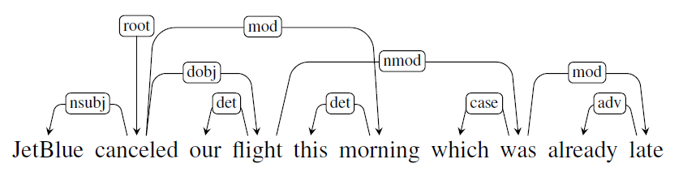

Slide 19
Non-Projectivity
Rare in English
Topicalization
Cats, I like a lot.
Extraposition
The pizza is ready with pepperoni.
Notes:
CHECK!

Slide 20
Non-projectivity
Output of Stanford parser
advmod(come-4, Where-1)
aux(come-4, did-2)
nsubj(come-4, you-3)
root(ROOT-0, come-4)
prep(come-4, from-5)
amod(year-7, last-6)
pobj(from-5, year-7)
Output of (the non-projective) MSTParser
Where
did
you
come
from
last
year
1 Where Where WRB WRB - 2 SBJ - -
2 did did VBD VBD - 0 ROOT - -
3 you you PRP PRP - 4 SBJ - -
4 come come VBP VBP - 2 VC - -
5 from from IN IN - 4 DIR - -
6 last last JJ JJ - 7 NMOD - -
7 year year NN NN - 5 PMOD - -
8 ? ? . . - 2 P - -

Slide 21
Notes
How to extend a projective method for non-projective parses
Use a SWAP operator (Nivre 2009)
Not clear what to do with conjunctions
“cats, dogs, and hamsters”
Options: “cats” or “and”

Slide 22
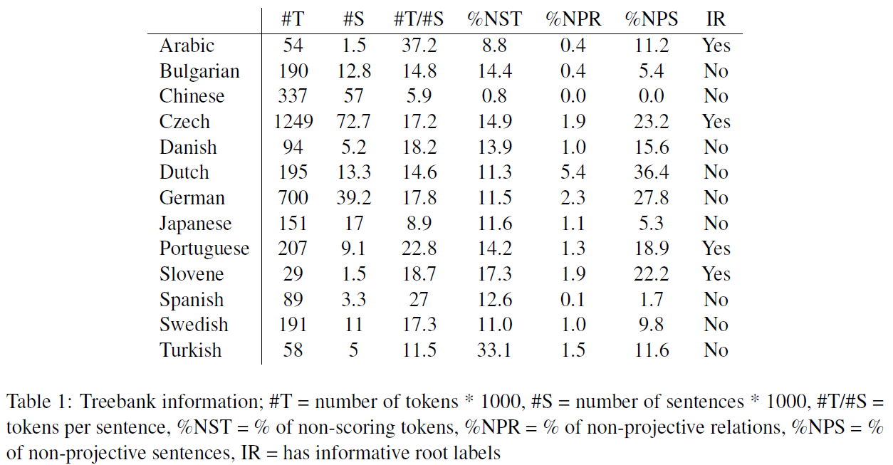
Rate of Non-Projectivity
[CoNLL-X data: Hall and Nilsson 2006]

Slide 23
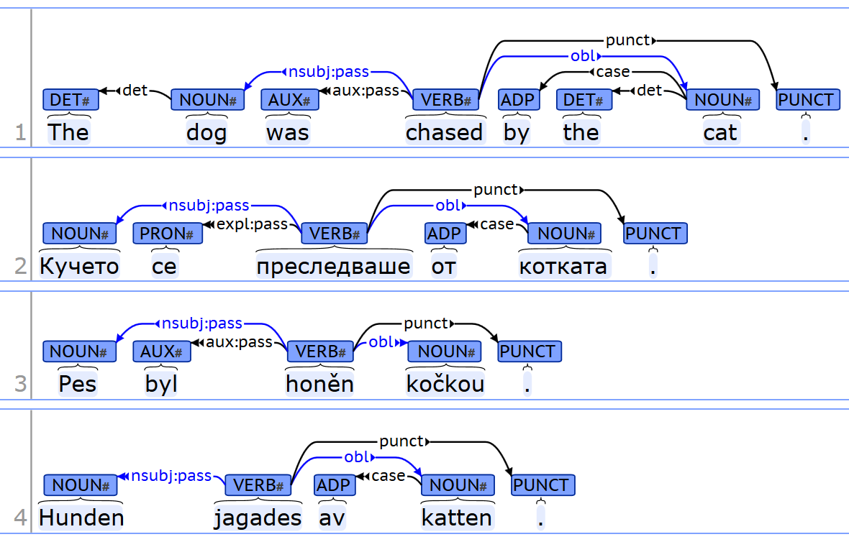
https://universaldependencies.org/

Slide 24
Introduction to NLP
Dependency Parsing

Slide 25
Motivation
Constituent parsing vs. Dependency parsing
PP attachment
CP – multiple differences between the two parse trees
DP – the difference is in just one word (preposition) that needs to be reattached
CC attachment
CP – multiple differences between the two parse trees
DP – multiple dependencies; furthermore the choice of a head is unclear: either the first N or the CC

Slide 26
Techniques (1)
Constraint-based methods
Maruyama 1990, Karlsson 1990
Example
word(pos(x)) = DET ⇒(label(X) = NMOD, word(mod(x)) = NN, pos(x) < mod(x))
A determiner (DET) modifies a noun (NN) on the right with the label NMOD.
NP-complete problem; heuristics needed
Constraint graph
For initial constraint graph using a core grammar: nodes, domains, constraints
Find an assignment that doesn’t contradict any constraints. If more than one assignment exists, add more constraints.
Notes:
CHECK!

Slide 27
Classic Techniques
Dynamic programming
CKY – similar to lexicalized PCFG, cubic complexity (Eisner 96)
nsubj
dobj
likes
→
Mary likes cats
nsubj
dobj
Mary likes cats
Notes:
REMOVE

Slide 28
Eisner 1996
Two CKY charts
one for “complete” items (head at “tall” end), there may be missing children on that side)
and one for “incomplete” items (arc from “tall” to “short” end), both sides may be missing children
Keep track whether the head is on the left or the right
hence the chart has an additional dimension of size 2 (left arc and right arc)

Slide 29


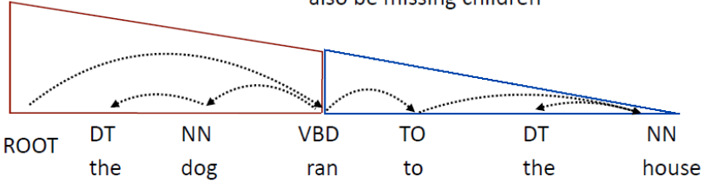
Example
Two complete items, connected with an arc turn into an incomplete item
A complete item + an incomplete item turn into a complete item
Full tree
[Example from Greg Durrrett]

Slide 30
Graph-based Dependency Parsing
McDonald et al. 2005
Dependency parsing is equivalent to search for a maximum spanning tree (MST) in a directed graph.
Efficient algorithm for finding MST for directed graphs
Chu and Liu (1965) and Edmonds (1967) give an.

Slide 31
MST Parser example
Consider the sentence “John saw Mary”
Recursively remove cycle
The Chu-Liu-Edmonds algorithm gives the MST on the right hand side (right). This is in general a non-projective tree.
9
root
10
root
30
10
9
20
saw
30
0
saw
30
John
Mary
30
John
Mary
11
3

Slide 35
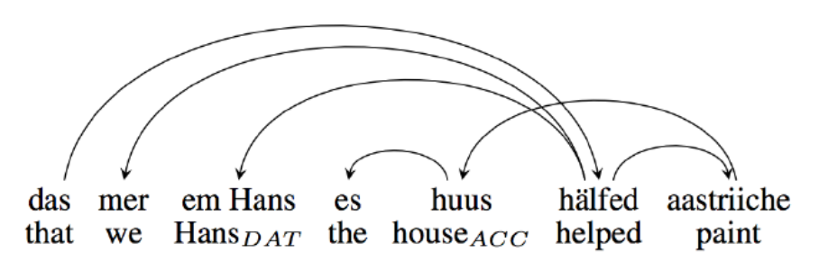
Notes
Complexity
Interestingly, MST is O(n²), compared with O(n³) for Eisner, even though MST is non-projective.
Example of a highly non-projective language
Swiss German
[example from Pitler 2013]

Slide 36
Transition-based Dependency Parsingo NLP

Slide 37
Transition-Based Parsing
Similar to shift-reduce
Produces a single (projective) tree
Data structures
Stack of partially processed (unattached) words
Input buffer
Set of dependency arcs
Attach the word on the top of the stack to the word at the current position in the buffer (or in the other direction)

Slide 38
Transition-Based Parsing
Initial configuration
Stack (including the root token w0)
Buffer (sentence)
Arcs (empty)
Goal configuration
Stack (empty)
Buffer (empty)
Arcs (complete tree)

Slide 39
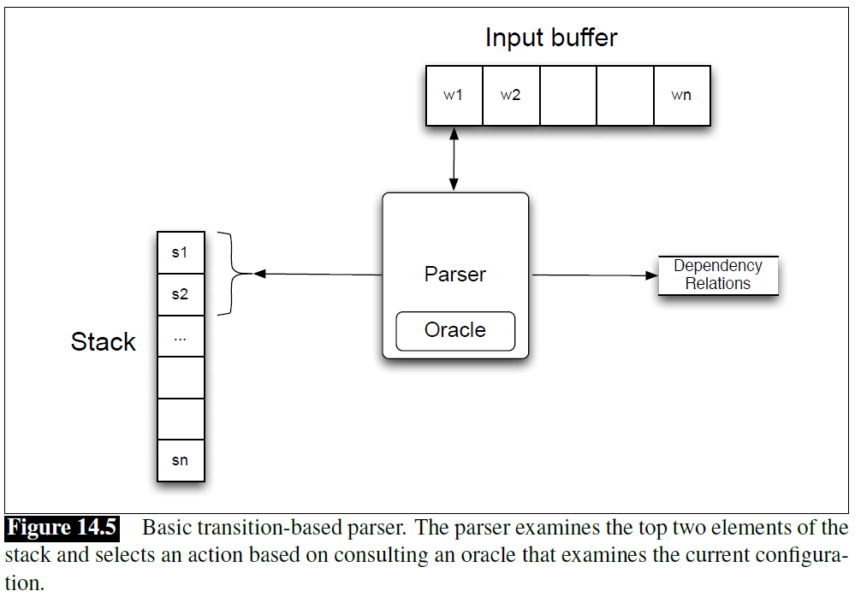
Example
“Book me the morning flight”
[Example from Jurafsky and Martin]

Slide 40
MaltParser (Nivre 2008)
The reduce operations combine an element from the stack and one from the buffer
Arc-standard parser
The actions are shift, left-arc, right-arc
Arc-eager parser
The actions are shift, reduce, left-arc, right-arc

Slide 41
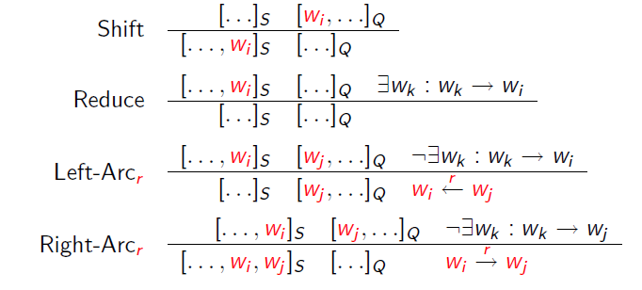
(Arc-Eager) MaltParser Actions
[Example from Nivre and Kuebler]

Slide 42
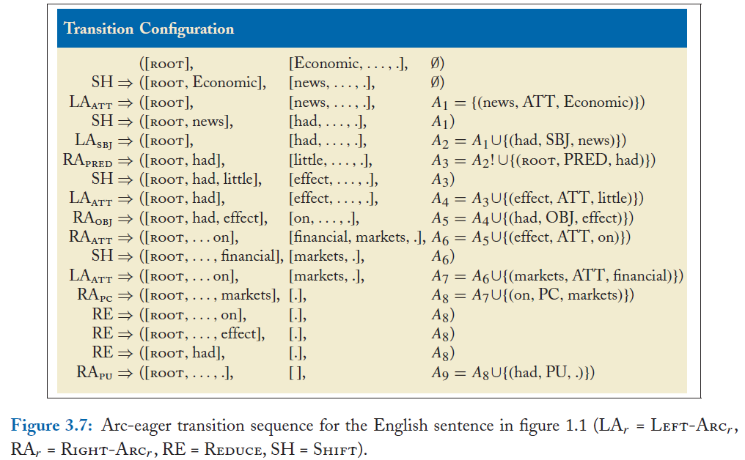
[Example from Kuebler, McDonald, Nivre]

Slide 43
Example
Example: “People want to be free”
[ROOT] [People, want, to, be, free] Ø
Shift [ROOT, People] [want, to, be, free]
LA_{nsubj} [ROOT] [want, to, be, free] A₁ = {nsubj(want, people)}
RA_{root} [ROOT, want] [to, be, free] A₂ = A₁ ∪ {root(ROOT, want)}
Characteristics
Approximate the oracle with a classifier: o(c) = argmax_{t} w.f(c,t)
There is no search in the greedy version (although beam search also works)
The final list of arcs is returned as the dependency tree
Trained on a dependency treebank
Very fast method

Slide 44
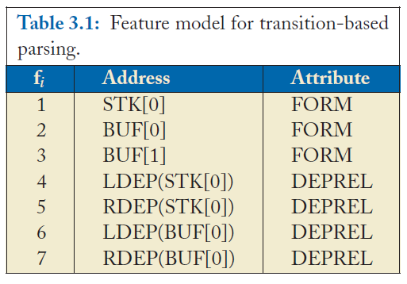
Feature Model
[Example from Kuebler, McDonald, Nivre]

Slide 45
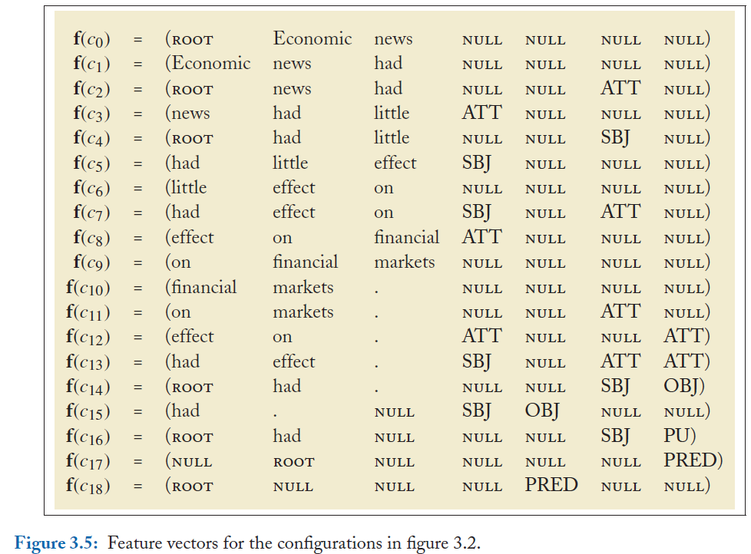
Feature Vectors
[Example from Kuebler, McDonald, Nivre]

Slide 49
Complexity
Arc-eager is O(n³) – like Eisner
Arc-standard is O(n⁵)

Slide 50
Evaluation of Dependency Parsing

Slide 52
Evaluation of Dependency Parsing
Attachment Score (Buchholz & Marsi 2006)
# correct deps/# deps (attached to the right head)
Unlabeled dependency accuracy (UAS)
Labeled dependency accuracy (LAS)
1 Unionized Unionized VBN VBN - 2 NMOD - -
2 workers workers NNS NNS - 3 SBJ - -
3 are are VBP VBP - 0 ROOT - -
4 usually usually RB RB - 3 TMP - -
5 better better RBR RBR - 4 ADV - -
6 paid paid VBN VBN - 5 AMOD - -
7 than than IN IN - 5 AMOD - -
8 their their PRP$ PRP$ - 10 NMOD - -
9 non-union non-union JJ JJ - 10 NMOD - -
10 counterparts counterparts NNS NNS - 7 PMOD - -

Slide 53
Complexity
Projective (CKY) O(n⁵)
Projective (Eisner) O(n³)
Non-projective (MST - Chu-Liu-Edmonds) O(n²)
Projective (Malt) O(n)

Slide 54
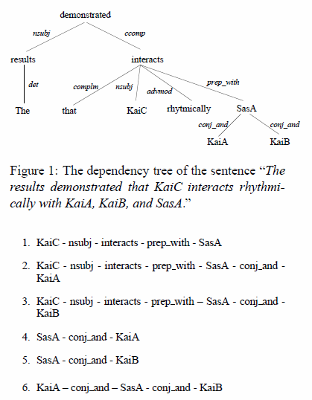
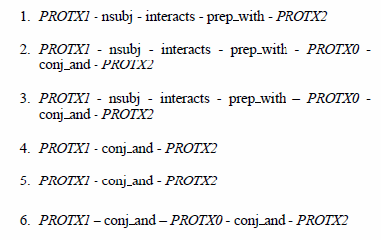
Use in Information Extraction
[Erkan et al. 2007]

Slide 55
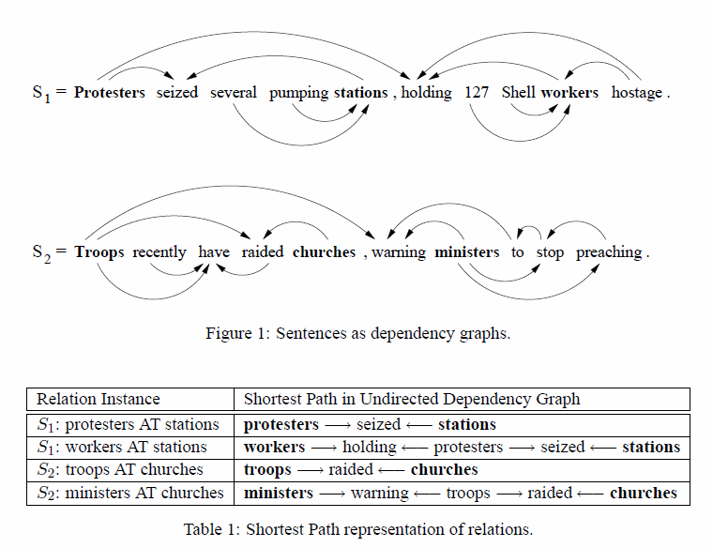
Dependency Kernels
[Bunescu and Mooney 2005]

Slide 56
External Links
http://ilk.uvt.nl/conll/
CONLL-X Shared task
http://ufal.mff.cuni.cz/pdt2.0/
Prague Dependency Treebank
http://nextens.uvt.nl/depparse-wiki/SharedTaskWebsite
http://nextens.uvt.nl/depparse-wiki/DataOverview
http://maltparser.org/
Joakim Nivre’s Maltparser
http://www.cs.ualberta.ca/~lindek/minipar.htm
Dekang Lin’s Minipar
http://www.link.cs.cmu.edu/link/
Daniel Sleator and Davy Temperley’s Link parser

Slide 57
Notes
The original versions of MSTParser and MaltParser from 2007 achieve about 81% accuracy
Highest in Japanese (91-92%)
Lowest in Arabic and Turkish (63-67%)
Non-projective parsing is harder than projective parsing

