Slide 1
Introduction to NLP
Linguistics

Slide 2
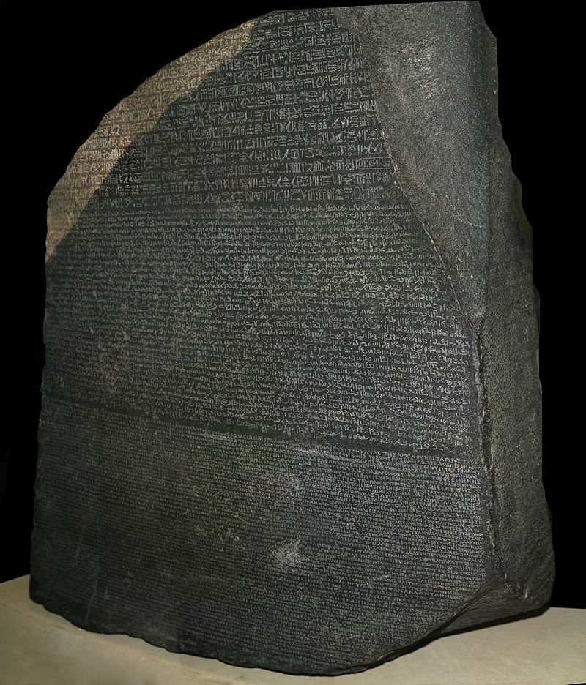
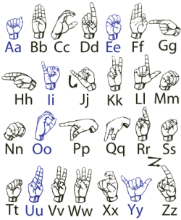
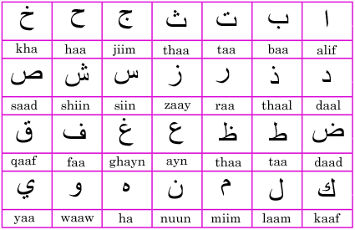
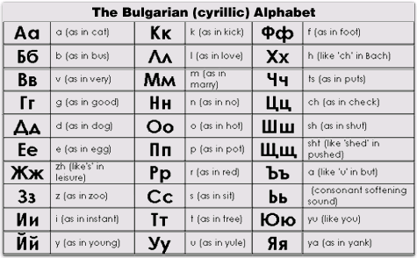
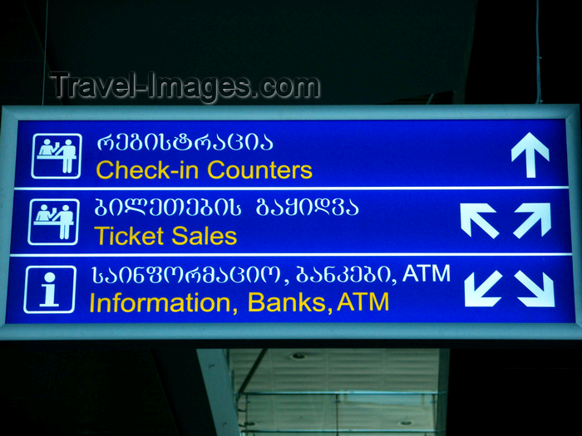
Notes:
CHECK ATTRIBUTIONS

Slide 3
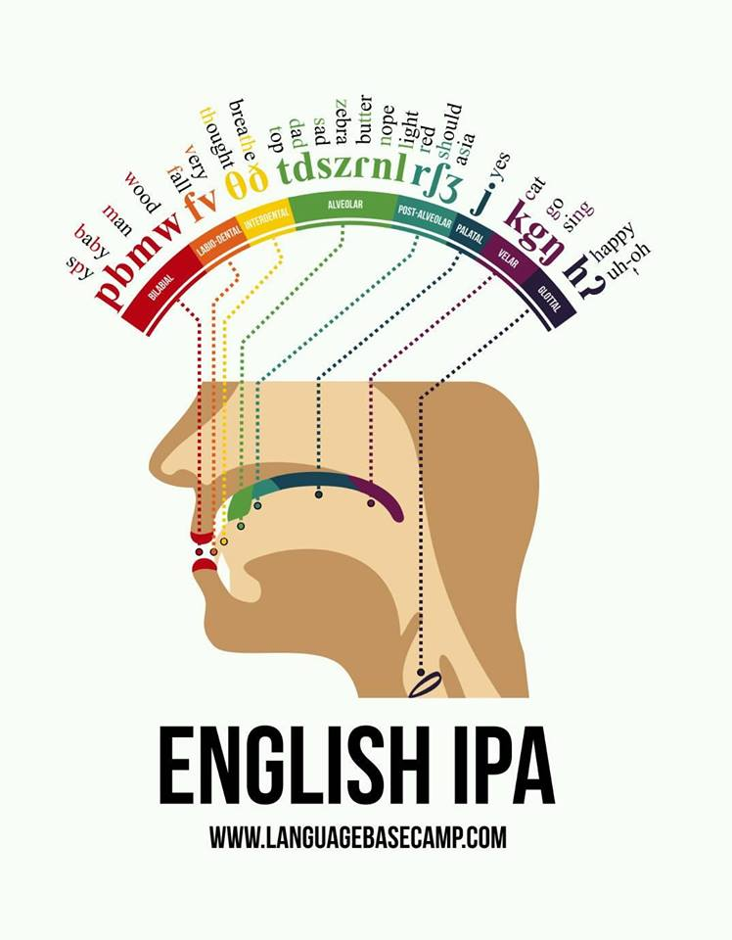
Consonants in English
Notes:
辅音字母。

Slide 4
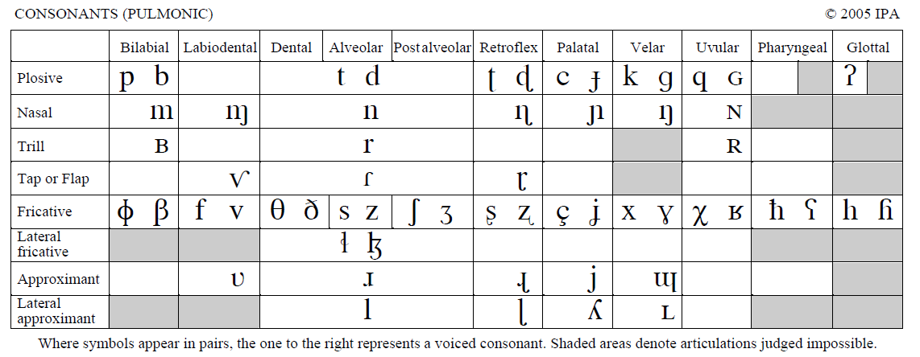
IPA Chart (consonants)
By IPA (http://www.langsci.ucl.ac.uk/ipa/ipachart.html) [CC-BY-SA-3.0 (http://creativecommons.org/licenses/by-sa/3.0)], via Wikimedia Commons

Slide 5
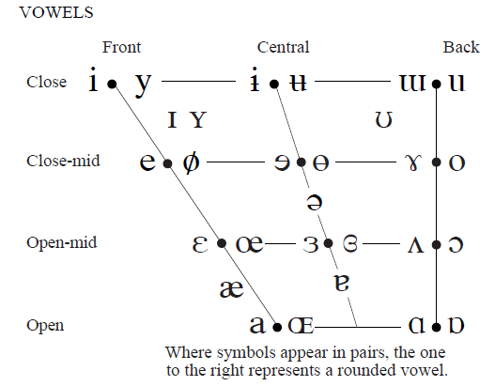
IPA Chart (vowels)
By IPA (http://www.langsci.ucl.ac.uk/ipa/ipachart.html) [CC-BY-SA-3.0 (http://creativecommons.org/licenses/by-sa/3.0)], via Wikimedia Commons
Notes:
Attribution?

Slide 6
(Many) Languages are Related
Cognates
night (English), nuit (French), Nacht (German), nacht (Dutch), nag (Afrikaans), nicht (Scots), natt (Swedish, Norwegian), nat (Danish), nátt (Faroese), nótt (Icelandic), noc (Czech, Slovak, Polish), ночь, noch (Russian), ноќ, noć (Macedonian), нощ, nosht (Bulgarian), ніч, nich (Ukrainian), ноч, noch/noč (Belarusian), noč (Slovene), noć (Serbo-Croatian), νύξ, nyx (Ancient Greek, νύχτα/nychta in Modern Greek), nox/nocte (Latin), nakt- (Sanskrit), natë (Albanian), noche (Spanish), nos (Welsh), nueche (Asturian), noite (Portuguese and Galician), notte (Italian), nit (Catalan), nuèch/nuèit (Occitan), noapte (Romanian), nakts (Latvian) and naktis (Lithuanian), all meaning "night" and derived from the Proto-Indo-European (PIE) *nókʷts, "night".
From wikipedia

Slide 7
Some Indo-European languages
Proto-Indo-European
Indo-Iranian
Hellenic
Italic
Balto-Slavic
Germanic
Sanskrit
Old Persian
Greek
Latin
Lithuanian
Russian
Polish
Old English
Old High German
Bengali
Urdu
Farsi
Romanian
French
Catalan
Modern English
German
Notes:
REDRAW

Slide 8
Some non-Indo-European Languages
Altaic
Turkish
Uralic (Finno-Ugric)
Finnish
Hungarian
Semitic
Arabic
Hebrew
Uto-Aztecan

Slide 9
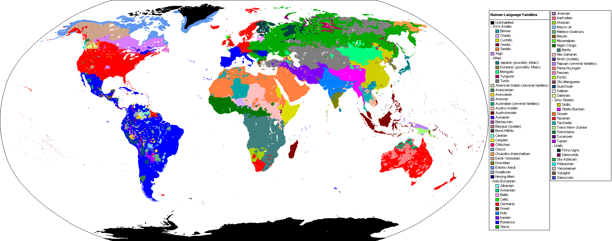
Language Families
By Industrius at English Wikipedia. Later version(s) were uploaded by Mttll at English Wikipedia. (Image:BlankMap-World.png by User:Vardion) [GFDL (www.gnu.org/copyleft/fdl.html)], via Wikimedia Commons

Slide 10
Language Diversity
Afro-Asiatic (374) Alacalufan (2) Algic (44) Altaic (66) Amto-Musan (2) Andamanese (13) Arafundi (3) Arai-Kwomtari (10) Arauan (5) Araucanian (2) Arawakan (59) Arutani-Sape (2) Australian (264) Austro-Asiatic (169) Austronesian (1257) Aymaran (3) Barbacoan (7) Basque (1) Bayono-Awbono (2) Border (15) Caddoan (5) Cahuapanan (2)
Carib (31) Central Solomons (4) Chapacura-Wanham (5) Chibchan (21) Chimakuan (1) Choco (12) Chon (2) Chukotko-Kamchatkan (5) Chumash (7) Coahuiltecan (1) Constructed language (1) Creole (82) Deaf sign language (130) Dravidian (85) East Bird’s Head-Sentani (8) East Geelvink Bay (11) East New Britain (7) Eastern Trans-Fly (4) Eskimo-Aleut (11) Guahiban (5) Gulf (4)
Harakmbet (2) Hibito-Cholon (2) Hmong-Mien (38) Hokan (23) Huavean (4) Indo-European (439) Iroquoian (9) Japonic (12) Jivaroan (4) Kartvelian (5) Katukinan (3) Kaure (4) Keres (2) Khoisan (27) Kiowa Tanoan (6) Lakes Plain (20) Language isolate (50) Left May (2) Lower Mamberamo (2) Lule-Vilela (1) Macro-Ge (32) Mairasi (3)
Maku (6) Mascoian (5)
Mataco-Guaicuru (12) Mayan (69) Maybrat (2) Misumalpan (4) Mixed language (23) Mixe-Zoque (17) Mongol-Langam (3) Mura (1) Muskogean (6) Na-Dene (46) Nambiquaran (7) Niger-Congo (1532) Nilo-Saharan (205) Nimboran (5) North Bougainville (4) North Brazil (1) North Caucasian (34) Oto-Manguean (177) Panoan (28)
Pauwasi (5) Peba-Yaguan (2) Penutian (33) Piawi (2) Pidgin (17) Quechuan (46) Ramu-Lower Sepik (32) Salishan (26) Salivan (3) Senagi (2) Sepik (56) Sino-Tibetan (449) Siouan (17) Sko (7) Somahai (2) South Bougainville (9) South-Central Papuan (22) Tacanan (6) Tai-Kadai (92) Tarascan (2) Tequistlatecan (2) Tor-Kwerba (24)
Torricelli (56) Totonacan (12) Trans-New Guinea (477) Tucanoan (25) Tupi (76) Unclassified (73) Uralic (37) Uru-Chipaya (2) Uto-Aztecan (61) Wakashan (5) West Papuan (23) Witotoan (6) Yanomam (4) Yele-West New Britain (3) Yeniseian (2) Yuat (6) Yukaghir (2) Yuki (2) Zamucoan (2) Zaparoan (7)
Ethnologue (7358 languages)

Slide 11
Language Changes
Grimm’s Law
Voiceless stops turn into voiceless fricatives
Voiced stops become voiceless stops
Voiced aspirated stops change to voiced stops or fricatives
Example 1
Ancient Greek: πούς, Latin: pēs, Sanskrit: pāda
English: foot, German: Fuß, Swedish: fot
Example 2
Ancient Greek: κύων, Latin: canis, Welsh: ci
English: hound, Dutch: hond, German: Hund

Slide 12

NACLO Problem
http://nacloweb.org/resources/problems/2012/N2012-D.pdf
http://nacloweb.org/resources/problems/2012/N2012-DS.pdf
Problem by Dragomir Radev
http://unicode.org/udhr/assemblies/first_article_all.html

Slide 13
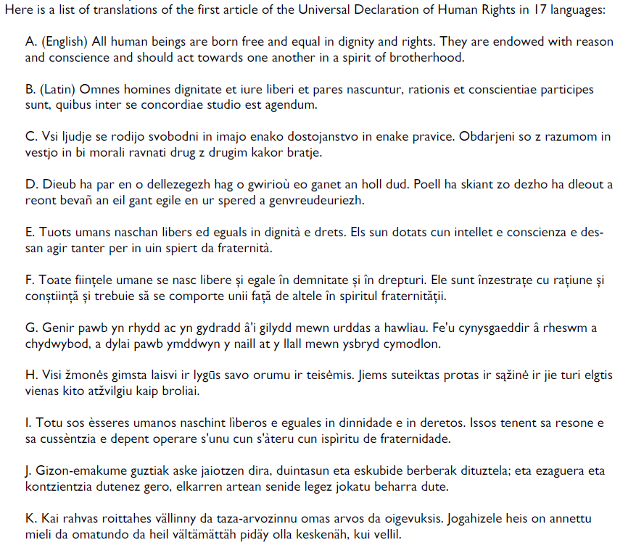

Slide 14
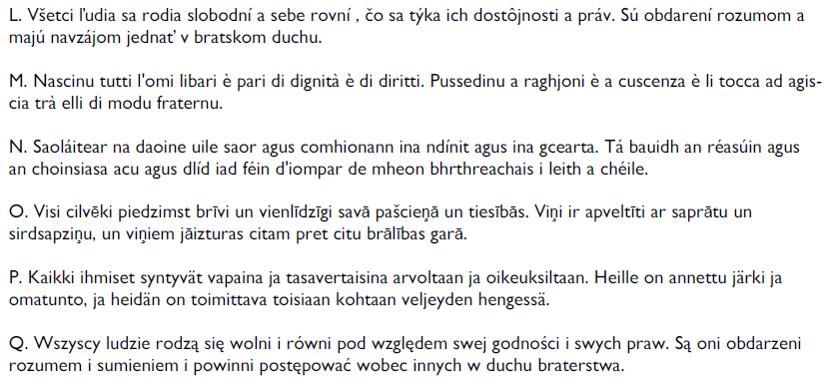

Slide 15
English
Latin
Slovenian
Breton
Romansch
Romanian
Welsh
Lithuanian
Sardinian
Basque
Karelian

Slide 16
Slovak
Corsican
Irish
Latvian
Finnish
Polish

Slide 17
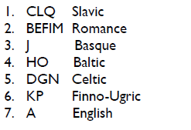
Language Families

Slide 18
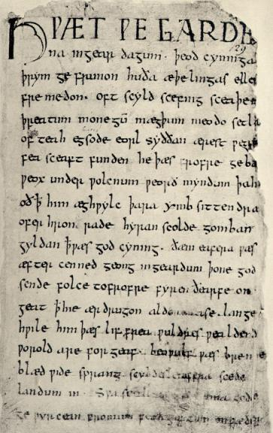
Question
Can you guess the source, language, and period of this text?

Slide 19
Answer
Beowulf
Epic poem
8th-11th Century
Old English

Slide 20
Beowulf
Hwæt! We Gardena in geardagum,
þeodcyninga, þrym gefrunon,
hu ða æþelingas ellen fremedon.
Oft Scyld Scefing sceaþena þreatum,
monegum mægþum, meodosetla ofteah,
egsode eorlas. Syððan ærest wearð
feasceaft funden, he þæs frofre gebad,
weox under wolcnum, weorðmyndum þah,
oðþæt him æghwylc þara ymbsittendra
erst (as in erstwhile) = first
Lo! the Spear-Danes’ glory through splendid achievements
The folk-kings’ former fame we have heard of,
How princes displayed then their prowess-in-battle.
Oft Scyld the Scefing from scathers in numbers
From many a people their mead-benches tore.
Since first he found him friendless and wretched,
The earl had had terror: comfort he got for it,
Waxed ’neath the welkin, world-honor gained,
Till all his neighbors o’er sea were compelled to …
http://lit.genius.com/ http://www8.georgetown.edu/departments/medieval/labyrinth/library/oe/texts/a4.1.html
http://www.gutenberg.org/files/16328/16328-h/16328-h.htm
http://www.nvcc.edu/home/vpoulakis/Translation/beowulf1.htm
http://en.wikipedia.org/wiki/File:Beowulf.firstpage.jpeg

Slide 21
ATHELING.—Prince, nobleman.
BAIRN.—Son, child.
BARROW.—Mound, rounded hill, funeral-mound.
BATTLE-SARK.—Armor.
BEAKER.—Cup, drinking-vessel.
BEGEAR.—Prepare.
BIGHT.—Bay, sea.
BILL.—Sword.
BOSS.—Ornamental projection.
BRACTEATE.—A round ornament on a necklace.
BRAND.—Sword.
BURN.—Stream.
BURNIE.—Armor.
CARLE.—Man, hero.
EARL.—Nobleman, any brave man.
EKE.—Also.
EMPRISE.—Enterprise, undertaking.
ERST.—Formerly.
ERST-WORTHY.—Worthy for a long time past.
FAIN.—Glad.
FERRY.—Bear, carry.
FEY.—Fated, doomed.
FLOAT.—Vessel, ship.
FOIN.—To lunge (Shaks.).
GLORY OF KINGS.—God.
GREWSOME.—Cruel, fierce.
HEFT.—Handle, hilt; used by synecdoche for ‘sword.’
HELM.—Helmet, protector.
HENCHMAN.—Retainer, vassal.
HIGHT.—Am (was) named.
HOLM.—Ocean, curved surface of the sea.
HIMSEEMED.—(It) seemed to him.
LIEF.—Dear, valued.
MERE.—Sea; in compounds, ‘mere-ways,’ ‘mere-currents,’ etc.
MICKLE.—Much.
NATHLESS.—Nevertheless.
NAZE.—Edge (nose).
NESS.—Edge.
NICKER.—Sea-beast.
QUIT, QUITE.—Requite.
RATHE.—Quickly.
REAVE.—Bereave, deprive.
SAIL-ROAD.—Sea.
SETTLE.—Seat, bench.
SKINKER.—One who pours.
SOOTHLY.—Truly.
SWINGE.—Stroke, blow.
TARGE, TARGET.—Shield.
THROUGHLY.—Thoroughly.
TOLD.—Counted.
UNCANNY.—Ill-featured, grizzly.
UNNETHE.—Difficult.
WAR-SPEED.—Success in war.
WEB.—Tapestry (that which is ‘woven’).
WEEDED.—Clad (cf. widow’s weeds).
WEEN.—Suppose, imagine.
WEIRD.—Fate, Providence.
WHILOM.—At times, formerly, often.
WIELDER.—Ruler. Often used of God;
WIGHT.—Creature.
WOLD.—Plane, extended surface.
WOT.—Knows.
YOUNKER.—Youth.

Slide 22
Diversity of languages
Articles
Cases (e.g., in Latin)
Puer puellam vexat
Sound systems
Glottal stop (the middle sound in “uh-oh”) - pro
Velar fricatives - articulated with the back of the tongue at the soft palate
Voiceless /x/ - used e.g., in Russian
Voiced /ɣ/ - used e.g., in Modern Greek
Social status (e.g., in Japanese)
otousan, お父さん = someone else‘s father
chichi, 父 = one’s own father
Kinship systems (e.g., in Warlpiri) – see next slide

Slide 23
NACLO Problem
Warlpiri Kinship – by Alan Chang
http://www.nacloweb.org/resources/problems/2013/N2013-O.pdf

Slide 24
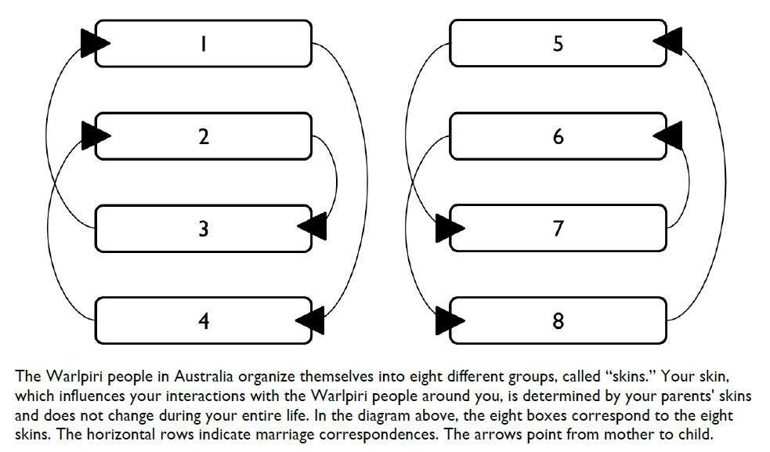

Slide 25
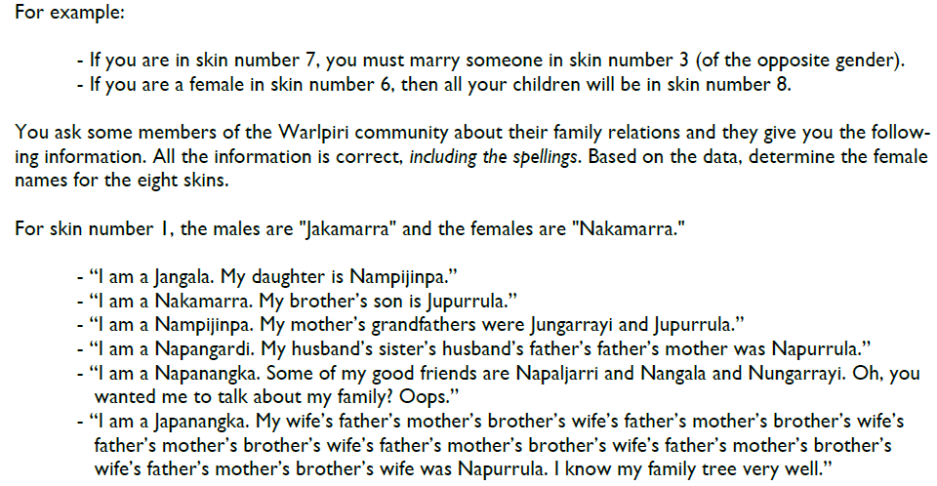

Slide 26
NACLO Solution
Warlpiri Kinship
http://www.nacloweb.org/resources/problems/2013/N2013-OS.pdf

Slide 27
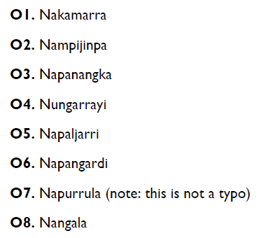

Slide 28
Language Universals
Two types
unconditional
conditional
Examples
All languages have verbs and nouns
All spoken languages have consonants and vowels
[Greenberg 1] “In declarative sentences with nominal subject and object, the dominant order is almost always one in which the subject precedes the object.“
[Greenberg 29] “If a language has inflection, it always has derivation.“

Slide 29
WALS: the World Atlas of Language Structures
http://wals.info
Feature 83A: Order of Object and Verb
by Matthew S. Dryer
OV (713 languages), VO (705), no dominant order (101)
http://wals.info/feature/83A#2/18.0/152.9
Other features:
18A Absence of common consonants (by Ian Maddieson): no bilabials (5 languages), no fricatives (49), no nasals (12)
67A Inflectional future tense (by Östen Dahl, Viveka Velupillai): yes (110), no (112)

Slide 30
Links about World Languages
Ethnologue
http://www.ethnologue.com/
Number words in many languages
http://www.zompist.com/numbers.shtml
Endangered languages
http://www.endangeredlanguages.com/
Google fights to save 3,054 dying languages
http://www.cnn.com/2012/06/21/tech/web/google-fights-save-language-mashable/index.html
Notes:
Add titles

Slide 31
Introduction to NLP
Morphology and the Lexicon

Slide 32
Mental Lexicon
What is the meaning of cat?
Its pronunciation?
Part of speech?
What is the meaning of wug?
What is the meaning of cluvious?
Compare traftful and traftless.
Morphology of these words
Intuition and productivity
“Runs”
Two interpretations
Allomorphs
cats/oxen, played/swung
Affixes

Slide 33
Derivational Morphology
Example
“er” (multiple interpretations)
What do these morphemes mean?
prefix, stem, suffix, ending
ness, able, ing, re, un, er (adj)
JJ → V + “-able”
Recursion:
unconcernednesses
Ambiguity
uncloggable vs. unbelievable
JJ
V
-able
drink

Slide 34
Answer to the Quiz
Uncloggable
unable to be clogged
able to be unclogged
Unbelievable
unable to be believed
? able to be unbelieved

Slide 35
Morphological Examples
Reduplication
amigo = friend, amimígo = friends (in Pangasinan) [Rubino 2001]
savali = he travels, savavali = they travel (in Samoan)
Templatic morphology (e.g., Semitic languages):
lmd (learn), lamad (he studied), limed (he taught), lumad (he was taught)
Circumfixes
spielen – gespielt (in German)
Pig Latin
appyhay
Verlan
“céfran”, “ripou” (from “l’envers”, “Français”, “pourri”)
Massa-freakin’-chusetts
where can you insert “freakin’” in “education”?

Slide 36
Answer to the Quiz
The “freakin’” infix is inserted
… to the left of the syllable that bears the main stress
edu-freakin’-cation
* educa-freakin’-tion
* e-freakin’-ducation
though there can be exceptions

Slide 37
More Examples
Clitics
l’enfant, cat’s cradle
Portmanteau words
motel, brunch, spork
Synthetic vs. isolating languages
Isolating languages (typically with fixed word order): English, Chinese, Bulgarian, Thai
Synthetic languages (high morpheme-per-word ratio): Inuktitut, Ainu, Basque, Lakota
Fusional vs. agglutinative languages
Agglutinative: Turkish, Hungarian, Swahili
Fusional: Lithuanian, Hebrew, Latin

Slide 38
Inflectional Morphology
Many forms
Tense, number, person, mood, aspect
Five verb forms in English
40+ forms in French
Six cases in Russian: http://www.departments.bucknell.edu/russian/language/case.html
Up to 40,000 forms in Turkish
E.g., you cause X to cause Y to … do Z)

Slide 39
Morphological Analysis
sleeps = sleep + V + 3P + SG
done = do + V + PP
Notes:
Check provenance!!

Slide 40
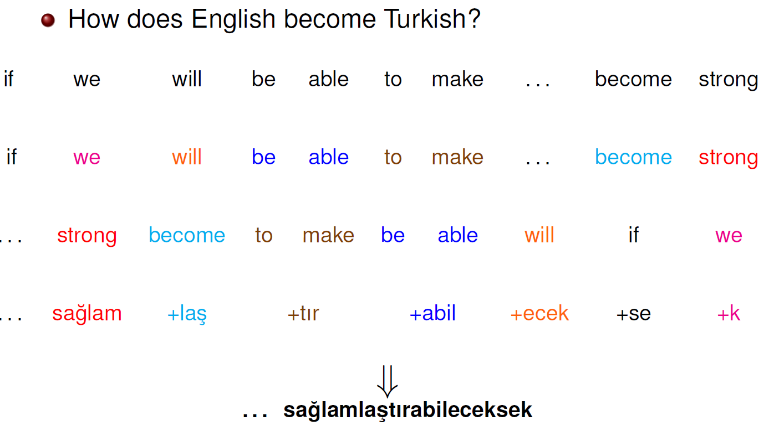
Agglutinative Languages
Slide from Kemal Oflazer
Notes:
Used with permission

Slide 41
Turkish Vowel Harmony
 | Front |  | Back
 | Unrounded | Rounded | Unrounded | Rounded
High | i | ü | ı | u
Low | e | ö | a | o
Back vowels
in the room → odada
at the door → kapıda
Front vowels
at home → evde
at the lake → gölde
on the bridge → köprüde
Notes:
http://webspace.ship.edu/cgboer/morphology.html

Slide 42
NACLO Problem
Turkish
www.nacloweb.org/resources/problems/2010/F.pdf
by Bozhidar Bozhanov

Slide 43
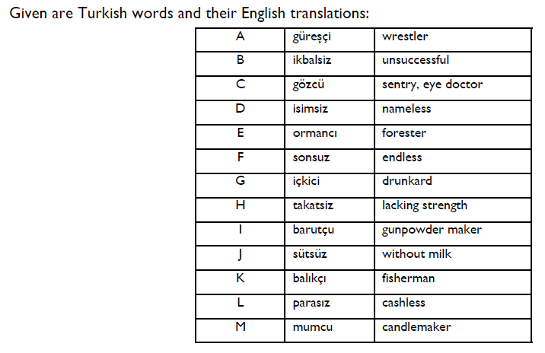

Slide 44
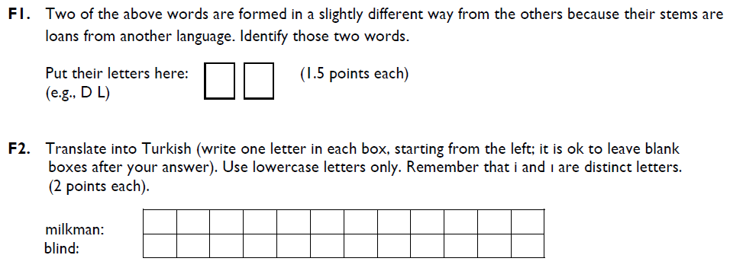

Slide 45
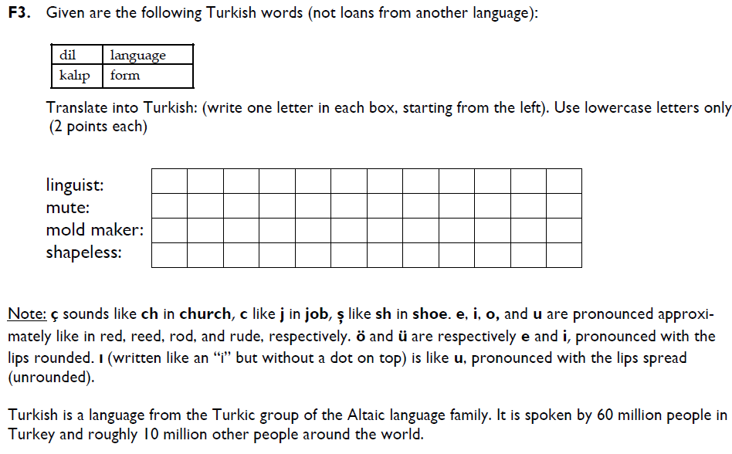

Slide 46
NACLO Solution
Turkish
www.nacloweb.org/resources/problems/2010/FS.pdf

Slide 47
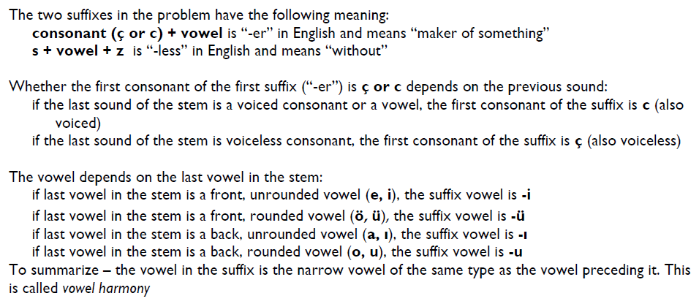

Slide 48
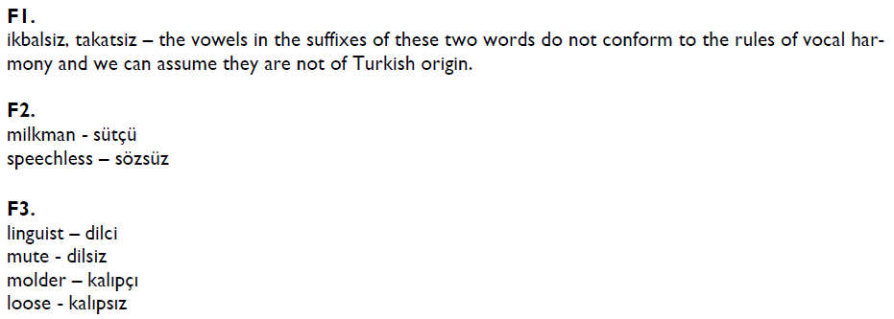

Slide 49
アメフト amefuto Ame(rican) Foot(ball)
アイスクリーム aisu kurīmu ice cream
アイドル aidoru idol
アパート apāto apartment
バイク baiku bike
バリアフリー bariafurī barrier free
コンピューター konpyūtā computer
デスク desuku desk (at a news agency)
ラマ dorama drama (on TV)
エレベーター erebētā elevator
エスカレーター esukarētā escalator
フライドポテト furaidopoteto fried potato (French fries)
グラス gurasu glass (for drinking)
ハッピーエンド happīendo happy end(ing)
ホットケーキ hottokēki hotcake (pancake)
カシューナッツ kashū nattsu cashew nut
コーヒー kōhī coffee
クラブ kurabu club
キーボード kībōdo keyboard
キャンペーン kyanpēn campaign
キャップ kyappu cap
パソコン pāsokon perso(nal) com(puter)
パーソナルコンピューターpāsonaru konpyūtā personal computer
レジュメ rejume resume
レストラン resutoran restaurant
リモコン rimokon remo(te) con(trol)
サラダ sarada salad
タバコ tabako tobacco
テレビゲーム terebigēmu television game
ゼミナール zemināru seminar
Notes:
MOVE

Slide 50
Introduction to NLP
Other Levels of Linguistic Analysis

Slide 51
Semantics
Semantics
Lexical semantics and compositional semantics
Lexical Semantics
Hypernyms, hyponyms, antonyms, meronyms and holonyms (part-whole relationship, tire is a meronym of car), synonyms, homonyms
Senses of words, polysemous words
Collocations
white hair, white wine
Idioms
to kick the bucket
Compositional Semantics
How to understand the meaning of a sentence based on the meaning of its components.

Slide 52
Pragmatics
The study of how knowledge about the world and language conventions interact with literal meaning.
Speech acts
Resolution of anaphoric relations
Modeling of speech acts in dialogue

Slide 53
Other Areas of Linguistics
Sociolinguistics
interactions of social organization and language.
Historical linguistics
change over time.
Linguistic typology
Language acquisition
L1 and L2
Psycholinguistics
real-time production and perception of language

