Slide 1
Introduction to NLP
Machine Translation

Slide 2
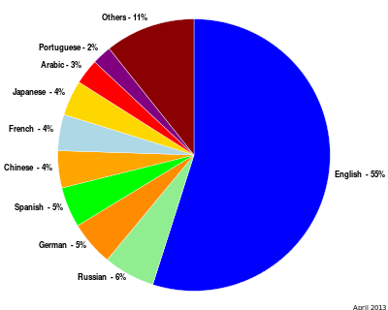
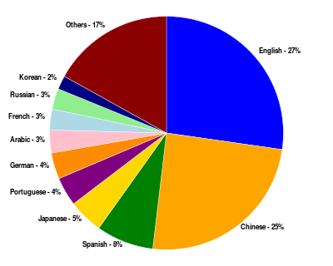
Multilingual Users
Content languages for websites Percentage of Internet users by language
http://en.wikipedia.org/wiki/Global_Internet_usage

Slide 3
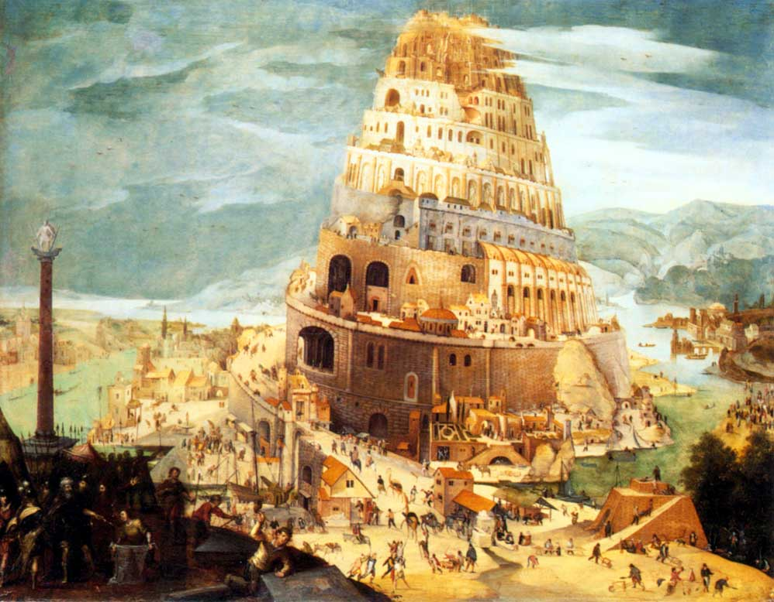
Genesis 11:1-9
[The Tower of Babel, by Pieter Bruegel the Elder, 1563]

Slide 4
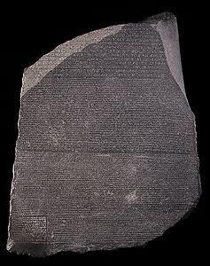
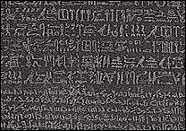
The Rosetta Stone
Carved in 196 BC in Egypt
Deciphered by Champollion in 1822
Mixture of Egyptian (hieroglyphs and Demotic) and Greek
http://www.ancientegypt.co.uk/writing/rosetta.html

Slide 5
English-Cebuano Bible Example
In the beginning God created the heaven and the earth.
Sa sinugdan gibuhat sa Dios ang mga langit ug ang yuta.
And God called the firmament Heaven.
Ug gihinganlan sa Dios ang hawan nga Langit.
And God called the dry land Earth
Ug ang mamala nga dapit gihinganlan sa Dios nga Yuta
use: co-occurrence, word order, cognates
corpora are needed
sentence alignment needs to be done first
http://en.wikipedia.org/wiki/Bible_translations_by_language

Slide 6
NACLO Problem
http://nacloweb.org/resources/problems/2012/N2012-C.pdf
http://nacloweb.org/resources/problems/2012/N2012-CS.pdf
Problem by Simon Zwarts, based on work by Kevin Knight
www.nacloweb.org

Slide 7
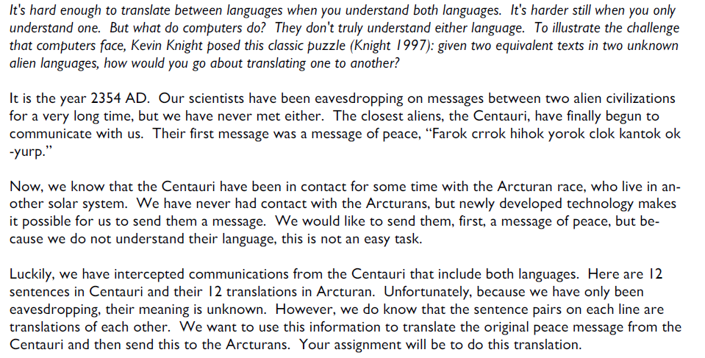
Arcturan Problem – 1/4

Slide 8
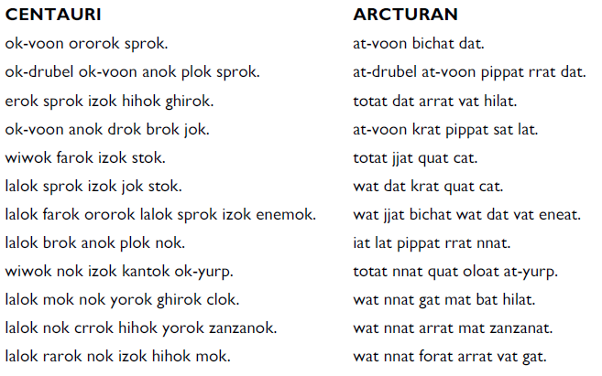
Arcturan Problem – 2/4

Slide 9
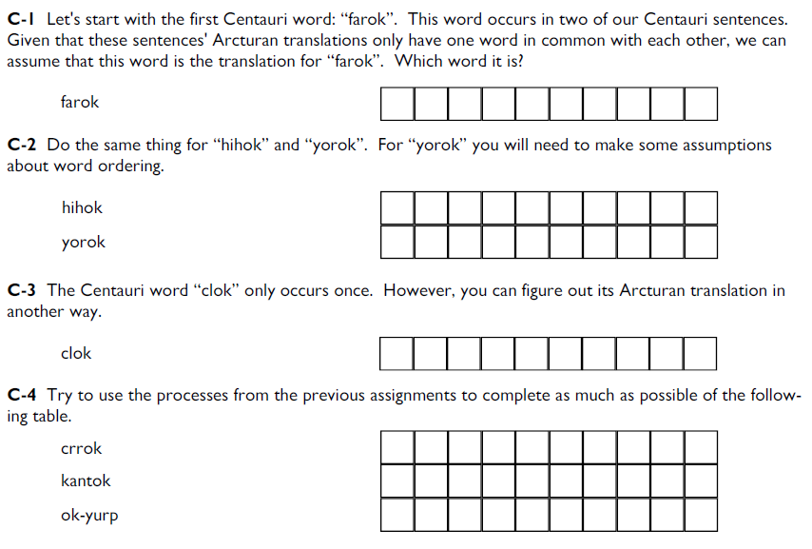
Arcturan Problem – 3/4

Slide 10
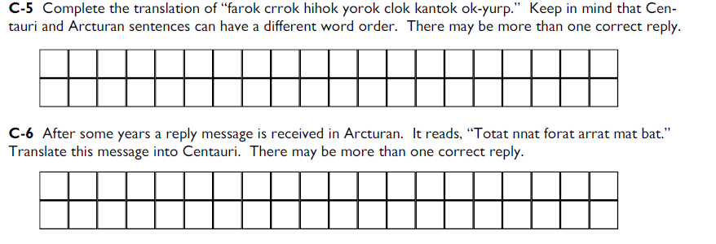
Arcturan Problem – 4/4

Slide 11
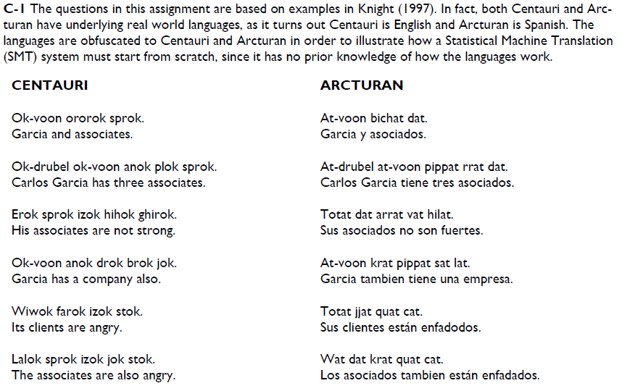
Arcturan Solution – 1/3

Slide 12
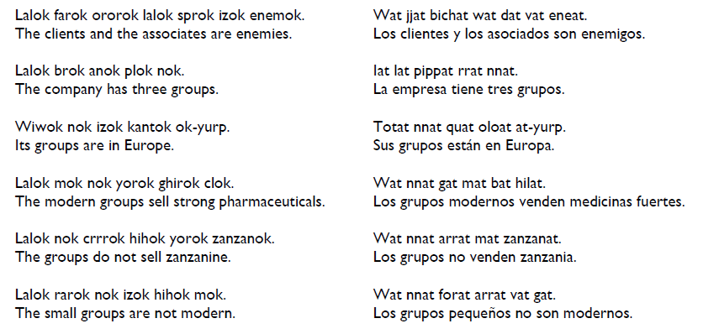
Arcturan Solution – 2/3

Slide 13
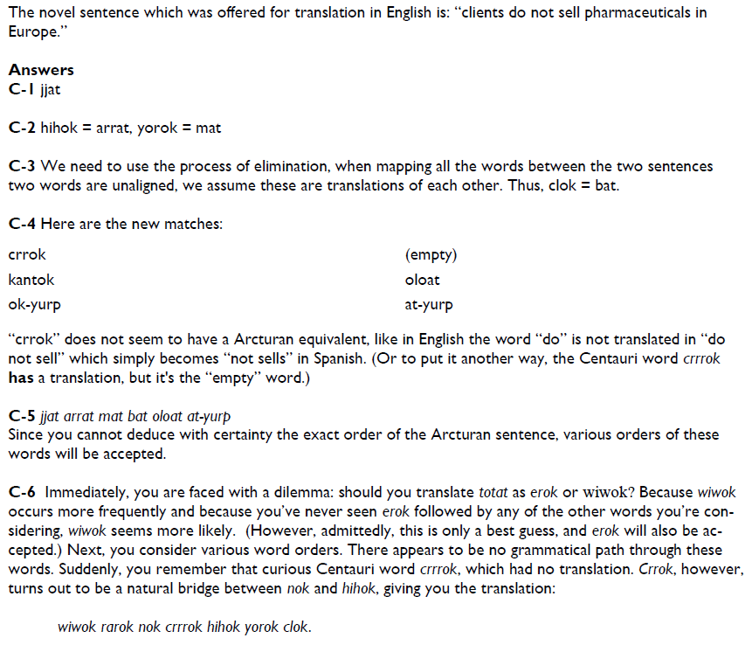
Arcturan Solution – 3/3

Slide 14
Parallel Corpora
The Rosetta Stone
The Hansards Corpus
The Bible
Europarl

Slide 15
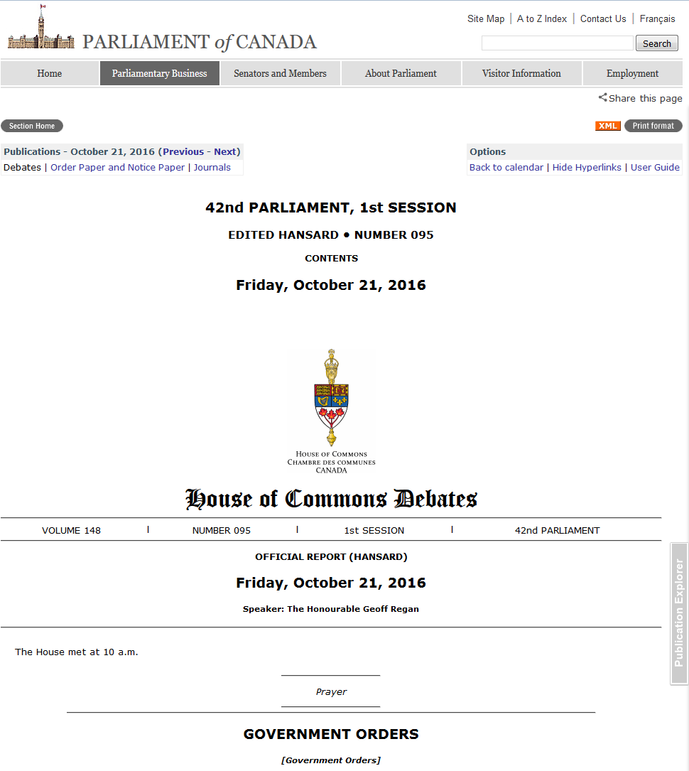

Slide 16
Hansards Example
English
<s id=960001> I would like the government and the Postmaster General to agree that we place the union and the Postmaster General under trusteeship so that we can look at his books and records, including those of his management people and all the memos he has received from them, some of which must have shocked him rigid.
<s id=960002> If the minister would like to propose that, I for one would be prepared to support him.
French
<s id=960001> Je voudrais que le gouvernement et le ministre des Postes conviennent de placer le syndicat et le ministre des Postes sous tutelle afin que nous puissions examiner ses livres et ses dossiers, y compris ceux de ses collaborateurs, et tous les mémoires qu'il a reçus d'eux, dont certains l'ont sidéré.
<s id=960002> Si le ministre voulait proposer cela, je serais pour ma part disposé à l'appuyer.

Slide 17
Language Differences (1/6)
[Example from Jurafsky and Martin]

Slide 18
Language Differences (2/6)
Word order in phrases (Fr.)
la maison bleue, the blue house
Word order in sentences (Jap.)
I like to drink coffee
watashi wa kohii o nomu no ga suki desu
I-subj coffee-obj drink-dat-rheme like
vocabulary (Sp.)
wall
pared, muro
phrases (Fr.)
play
pièce de théâtre

Slide 19
Language Differences (3/6)
Prepositions (Jap.)
to Mariko, Mariko-ni
Inflection (Sp.)
have: tengo, tienes, tenemos, tienen, tener
Lexical distinctions (Sp.):
the bottle floated out - la botella salió flotando
Brother (Jap.)
otooto (younger), oniisan (older)
They (Fr.)
elles (feminine), ils (masculine)

Slide 20
Language Differences (4/6)
Das Vorhaben verwarf die Kommission
The plan rejected the commission
OSV reading is more plausible
I saw the movie and it is good
How do we translate “it”?
[Examples from Philipp Koehn]

Slide 21
Language Differences (5/6)
Color Names
Russian:
light blue (голубой, goluboy)
dark blue (синий, siniy)
Japanese:
青 (ao) – both blue and green historically
緑 (midori) – recent addition

Slide 22
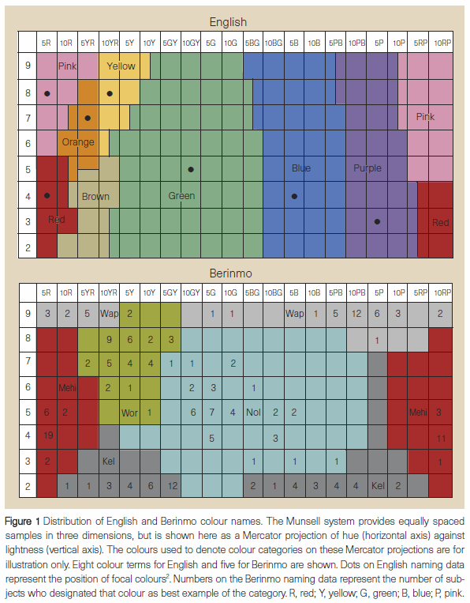
Language Differences (6/6)
Davidoff et al. 99

Slide 23
Machine Translation
Syntax in Machine Translation
(includes slides from Philipp Koehn)

Slide 24
Notes
Bilingual CKY parsing
 | e1 | e2 | e3 | e5 | e6 | e7 | e8
f1 |  |  |  |  | N/N
f2 |  |  |  | V/V
f3 |  |  | N/N
f4

Slide 25
Notes
Bilingual CKY parsing
 | e1 | e2 | e3 | e5 | e6 | e7 | e8
f1 |  |  |  |  | NP/NP
f2 |  |  |  | V/V
f3 | NP/NP
f4

Slide 26
Notes
Bilingual CKY parsing
 | e1 | e2 | e3 | e5 | e6 | e7 | e8
f1 |  |  |  | VP/VP
f2
f3 | NP/NP
f4

Slide 27
Notes
Bilingual CKY parsing
 | e1 | e2 | e3 | e5 | e6 | e7 | e8
f1 | S/S
f2
f3
f4

Slide 28
String to Tree Translation
I
semantics
semantics
syntax
syntax
phrases
phrases
F
E
(Yamada and Knight 2001)

Slide 29
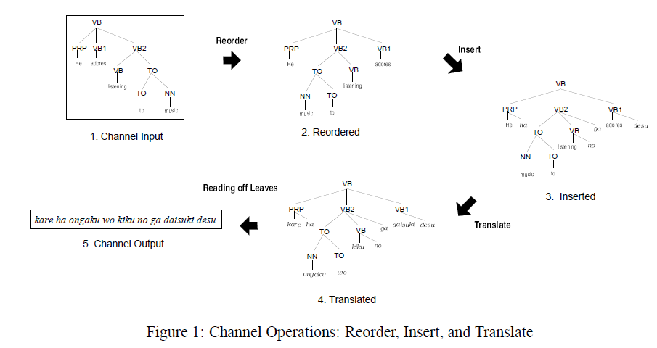
String to Tree Translation
(Yamada and Knight 2001)

Slide 30
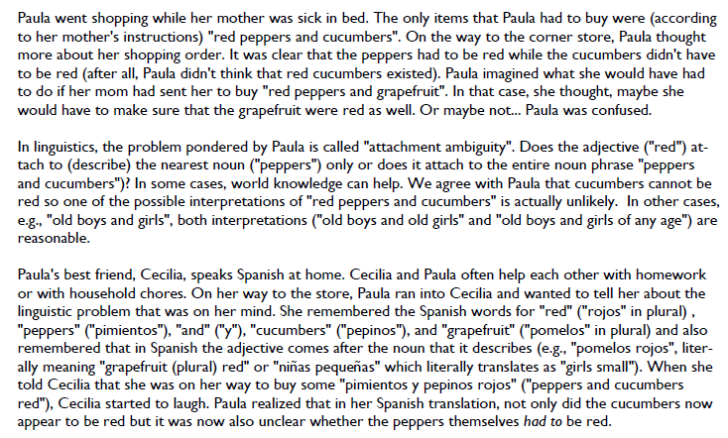
NACLO Problem #1

Slide 31
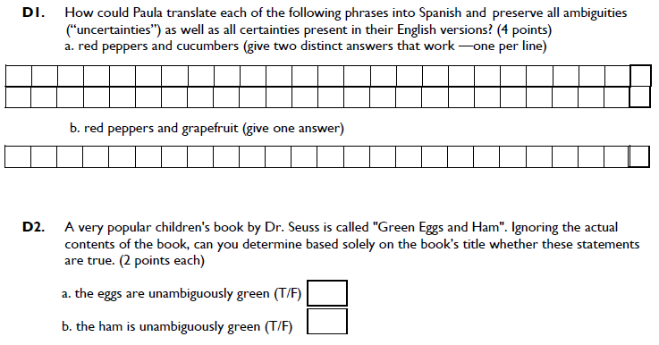
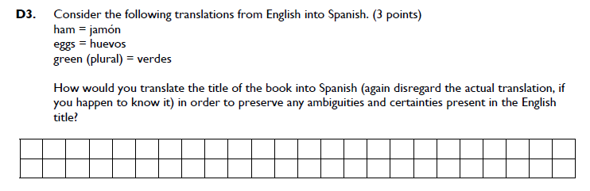

Slide 32
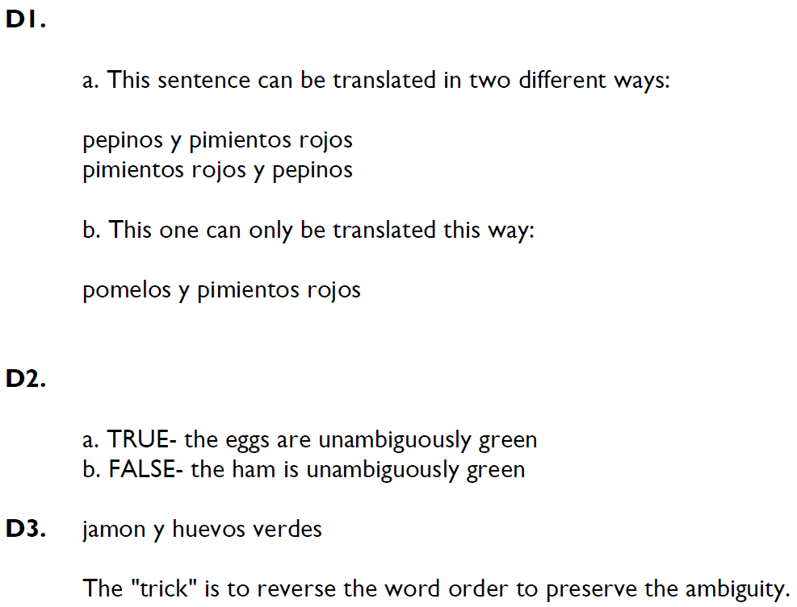
NACLO Solution #1

Slide 33
Clause restructuring (Collins et al.)
Ich werde Ihnen den Report aushaendigen … damit Sie den eventuell uebernehment koennen.
I will pass_on to_you the report, so_that you can adopt that perhaps
verb initial: that perhaps adopt can -> adopt that perhaps can
verb second: so that you adopt…can -> so that you can adopt
move subject: so that can you adopt -> so that you can adopt
particles: we accept the presidency *Particle* -> we accept the presidency
(in German, split-prefix phrasal verbs are very common, e.g., “anrufen” -> “rufen sie bitte noch einmal an” – call right back please)

Slide 34
Synchronous Grammars
Generate parse trees in parallel in two languages using different rules
E.g.,
NP -> ADJ N (in English)
NP -> N ADJ (in Spanish)
ITG (Inversion Transduction Grammar) [Wu 1995]
Don’t allow all permutations in derivations
Only <> and [ ] are allowed

Slide 35
NACLO problem #2
[Problem by Jonathan May]

Slide 36
NACLO problem #2

Slide 37
NACLO problem #2

Slide 38
NACLO solution #2

Slide 39
NACLO solution #2

Slide 40
Machine Translation
Evaluation of Machine Translation

Slide 41
Evaluation
Human judgments
adequacy
grammaticality
[expensive]
Automatic methods
Edit cost (at the word, character, or minute level)
BLEU (Papineni et al. 2002)

Slide 42
BLEU
Simple n-gram precision
log BLEU = min (0,1-reflen/candlen) + mean of log precisions
Multiple human references
Brevity penalty
Correlates with human assessments of automatic systems
Doesn’t correlate well when comparing human and automatic translations

Slide 43
Example from MTC
Chinese:
Napster执行长希尔柏斯辞职
English
Napster CEO Hilbers Resigns
Napster CEO Hilbers resigned
Napster Chief Executive Hilbers Resigns
Napster CEO Konrad Hilbers resigns
Full text
http://clair.si.umich.edu/~radev/nlp/mtc/

Slide 44
“Good” Compared to What?
Idea #1: a human translation.
OK, but
Good translations can be very dissimilar
We’d need to find hidden features (e.g. alignments)
Idea #2: other top n translations (the “n-best list”).
Better in practice, but
Many entries in n-best list are the same apart from hidden links
Compare with a loss function L
0/1: wrong or right; equal to reference or not
Task-specific metrics (word error rate, BLEU, …)
[Example from Schafer&Smith 2006]

Slide 45
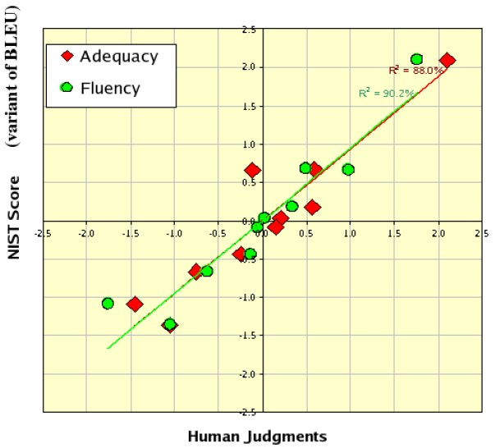
Correlation: BLEU and Humans
[Example from Doddington 2002]

Slide 46
Tools for Machine Translation
Language modeling toolkits
SRILM, CMULM
Translation systems
Giza++, Moses
Decoders
Pharaoh

Slide 47
Machine Translation
Phrase Based Translation

Slide 48
Phrase Alignment Example
Spanish to English
 | Maria | no | dio | una | bofetada | a | la | bruja | verde
Mary | XXXX
did |  | XX
not |  | XX
slap |  |  |  |  | XXXXXX
the |  |  |  |  |  |  | XX
green |  |  |  |  |  |  |  |  | XXXX
witch |  |  |  |  |  |  |  | XXXXX

Slide 49
Phrase Alignment Example
Spanish to English
 | Maria | no | dio | una | bofetada | a | la | bruja | verde
Mary | XXXX
did |  |  |  |  |  | XX
not |  | XX
slap |  |  | XXX | XXX | XXXXXX
the |  |  |  |  |  |  | XX
green |  |  |  |  |  |  |  |  | XXXX
witch |  |  |  |  |  |  |  | XXXXX

Slide 50
Phrase Alignment Example
Intersection
 | Maria | no | dio | una | bofetada | a | la | bruja | verde
Mary | XXXX
did
not |  | XX
slap |  |  |  |  | XXXXXX
the |  |  |  |  |  |  | XX
green |  |  |  |  |  |  |  |  | XXXX
witch |  |  |  |  |  |  |  | XXXXX

Slide 51
Phrase Alignment Example
Combine alignments from union
 | Maria | no | dio | una | bofetada | a | la | bruja | verde
Mary | XXXX
did |  | XX
not |  | XX
slap |  |  | XXX | XXX | XXXXXX
the |  |  |  |  |  | XX | XX
green |  |  |  |  |  |  |  |  | XXXX
witch |  |  |  |  |  |  |  | XXXXX

Slide 52
Search in Phrase Models
One segmentation out of 4096
Deshalb
haben
wir
allen
Grund
,
die
Umwelt
in
die
Agrarpolitik
zu
integrieren
One phrase translation out of 581
That is why we have
every reason
to
integrate
the environment
in
the
agricultural policy
One reordering out of 40,320
Translate in target language order to ease language modeling.

Slide 53
Search in Phrase Models
Deshalb | haben | wir | allen | Grund | , | die | Umwelt | in | die | Agrarpolitik | zu | integrieren
that is why we have |  |  | every reason |  | the environment |  |  | in | the | agricultural policy | to | integrate
therefore | have | we | every reason |  |  | the | environment | in the |  | agricultural policy , | to integrate
that is why | we have |  | all | reason | , | which | environment in |  | agricultural policy |  | parliament
have therefore |  | us | all the | reason |  | of the | environment into |  | the agricultural policy |  | successfully integrated
hence |  | , we | every | reason to make |  |  | environmental | on | the cap |  | be woven together
we have therefore |  |  | everyone | grounds for taking the |  |  | the environment | to the |  | agricultural policy is | on | parliament
so | , we |  | all of | cause | which |  | environment , | to | the cap , |  | for | incorporated
hence our |  |  | any | why | that |  | outside | at | agricultural policy |  | too | woven together
therefore , |  | it | of all | reason for | , the |  | completion | into | that agricultural policy |  | be
And many, many more…even before reordering

Slide 54
Search in Phrase Models
Many ways of segmenting source
Many ways of translating each segment
Restrict phrases > e.g. 7 words, long-distance reordering
Prune away unpromising partial translations or we’ll run out of space and/or run too long
How to compare partial translations?
Some start with easy stuff: “in”, “das”, ...
Some with hard stuff: “Agrarpolitik”, “Entscheidungsproblem”, …

Slide 55
Phrase-based Translation Models
Segmentation of the target sentence
Translation of each phrase
Rearrange the translated phrases

Slide 56
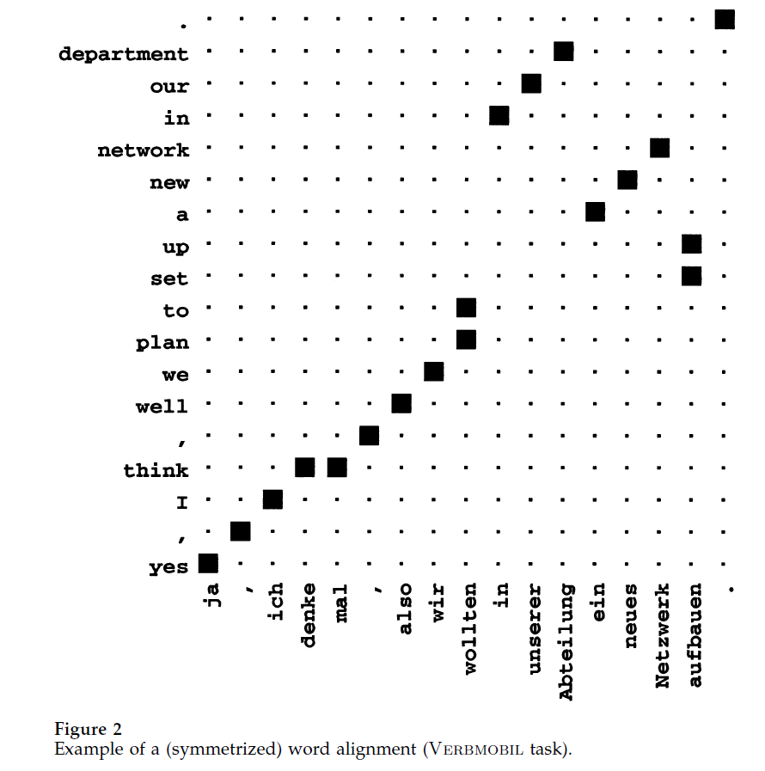
Alignment Templates

Slide 57
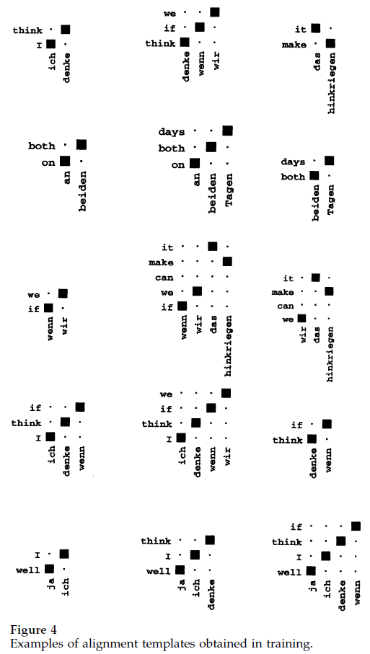
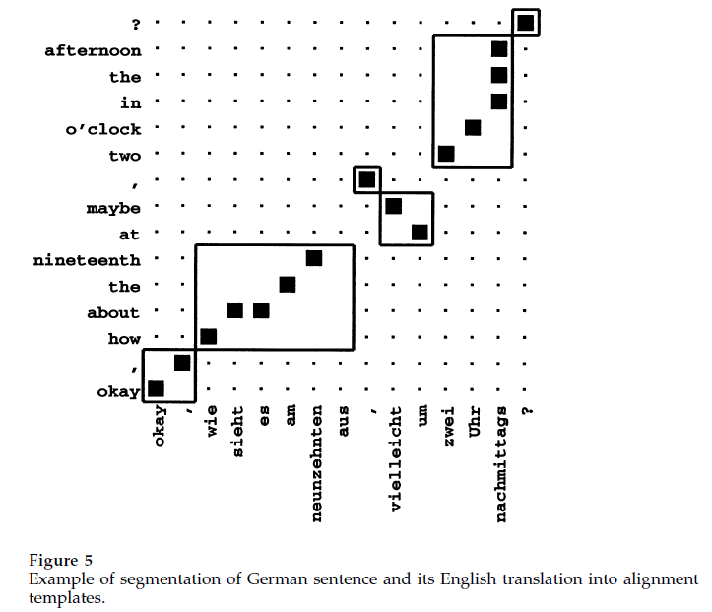
Alignment Templates
[Example from Och/Ney 2002]

