Slide 1
Introduction to NLP
Preprocessing

Slide 2
Text Preprocessing
Removing non-text
ads, javascript
Dealing with text encoding
e.g., Unicode
Sentence segmentation
later slide
Normalization
labeled/labelled, extra-terrestrial/extraterrestrial, extra terrestrial
Stemming
computer/computation
Morphological analysis
car/cars
Capitalization
Now/NOW, led/LED
Named entity extraction
USA/usa
Notes:
Poets, essayists, and novelists

Slide 3
Text Preprocessing
Types vs. Tokens
To be or not to be
Tokenization:
ALS vs. A.L.S.
Paul’s, Willow Dr., Dr. Willow, New York, ad hoc, can’t
“The New York-Los Angeles flight” vs. “Minneapolis-St.Paul”
Numbers, e.g., (888) 555-1313, 1-888-555-1313
Dates, e.g., Jan-13-2012, 20120113, 13 January 2012, 01/13/12
URLs

Slide 4
Text preprocessing
ニューヨーク (New York) は、アメリカ合衆国ニューヨーク州にある都市
Kanji, Katakana, Hiragana, Rōmaji, (numbers)
Nyūyōku wa, Amerikagasshūkoku nyūyōku-shū ni aru toshi

Slide 5
Sentence segmentation into words
金属製品製造の日立金属は１９日、世界最大手の鉄鋳物メーカー「ワウパカ ファウンドリー ホールディングス」（米国・デラウェア州）を米投資ファンドから買収し、完全子会社にすると発表した。買収額は１３億ドル（約１３３０億円）で、１０月中にも手続きを終える。
Notes:
(Google Translate) The 19th, Hitachi Metals of fabricated metal products has announced the acquisition from the United States investment fund iron castings manufacturer in the world's largest "Waupaca Foundry Holdings" the (US-Delaware), while a wholly owned subsidiary. $ 1.3 billion (about 133 billion yen), purchase price to finish the procedure also in October.
Kinzoku seihin seizō no hitachikinzoku wa 19-nichi, sekai saiōte no tetsu imono mēkā `waupaka faundorī hōrudingusu'(Beikoku Derau~Ea-shū) o Amerika tōshi fando kara baishū shi, kanzen kogaisha ni suru to happyō shita. Baishū-gaku wa 13 oku-doru (yaku 1330 oku-en) de, 10 tsuki-chū ni mo tetsudzuki o oeru.
http://www.asahi.com/articles/ASG8M5GYTG8MULFA019.html?iref=comtop_6_06

Slide 6
Word segmentation into morphemes
Arabic:
Japanese:
(kono hon ha omoi)
German:
Finanzdienstleistung = financial services
Chinese:
电视 (television) 电 (diàn = electric) 视 (shì = to look at)
كتاب
この本は重い。

Slide 7
Sentence boundary recognition
Decision trees
Features
punctuation
formatting
fonts
spacing
capitalization
case
use of abbreviations, e.g., Dr., a.m.
Example
If there is no space after a period, don’t assume that there is a sentence boundary

Slide 8
Introduction to NLP
Word Distributions

Slide 9
Word Distributions
Words are not distributed evenly!
Same goes for letters of the alphabet (ETAOIN SHRDLU), city sizes, wealth, etc.
Usually, the 80/20 rule applies
80% of the wealth goes to 20% of the people or it takes 80% of the effort to build the easier 20% of the system
more examples coming up…

Slide 10
Shakespeare
Romeo and Juliet:
And, 667; The, 661; I, 570; To, 515; A, 447; Of, 382; My, 356; Is, 343; That, 343; In, 314; You, 289; Thou, 277; Me, 262; Not, 257; With, 234; It, 224; For, 223; This, 215; Be, 207; But, 181; Thy, 167; What, 163; O, 160; As, 156; Her, 150; Will, 147; So, 145; Thee, 139; Love, 135; His, 128; Have, 127; He, 120; Romeo, 115; By, 114; She, 114; Shall, 107; Your, 103; No, 102; Come, 96; Him, 96; All, 92; Do, 89; From, 86; Then, 83; Good, 82; Now, 82; Here, 80; If, 80; An, 78; Go, 76; On, 76; I'll, 71; Death, 69; Night, 68; Are, 67; More, 67; We, 66; At, 65; Man, 65; Or, 65; There, 64; Hath, 63; Which, 60;
…
A-bed, 1; A-bleeding, 1; A-weary, 1; Abate, 1; Abbey, 1; Abhorred, 1; Abhors, 1; Aboard, 1; Abound'st, 1; Abroach, 1; Absolved, 1; Abuse, 1; Abused, 1; Abuses, 1; Accents, 1; Access, 1; Accident, 1; Accidents, 1; According, 1; Accursed, 1; Accustom'd, 1; Ache, 1; Aches, 1; Aching, 1; Acknowledge, 1; Acquaint, 1; Acquaintance, 1; Acted, 1; Acting, 1; Action, 1; Acts, 1; Adam, 1; Add, 1; Added, 1; Adding, 1; Addle, 1; Adjacent, 1; Admired, 1; Ado, 1; Advance, 1; Adversary, 1; Adversity's, 1; Advise, 1; Afeard, 1; Affecting, 1; Afflicted, 1; Affliction, 1; Affords, 1; Affray, 1; Affright, 1; Afire, 1; Agate-stone, 1; Agile, 1; Agree, 1; Agrees, 1; Aim'd, 1; Alderman, 1; All-cheering, 1; All-seeing, 1; Alla, 1; Alliance, 1; Alligator, 1; Allow, 1; Ally, 1; Although, 1;
http://www.mta75.org/curriculum/english/Shakes/indexx.html (visited in Dec. 2006)

Slide 11
Stop Words
Fact:
250-300 most common words in English account for 50% or more of a given text.
Example:
“the” and “of” represent 10% of tokens. “and”, “to”, “a”, and “in” - another 10%. Next 12 words - another 10%.
Moby Dick Ch.1:
859 unique words (types), 2256 word occurrences (tokens). Top 65 types cover 1132 tokens (> 50%).
Token/type ratio:
2256/859 = 2.63

Slide 12
Power-law Distribution
Percentage of words
Power-law
Many words with a small frequency of occurrence
A few words with a very large frequency
High skew (asymmetry)
Comparing to a normal distribution:
Many people of a medium height
Almost nobody of a very high or very low height
Symmetry
Frequency/Occurrence of words
Slide from Qiaozhu Mei

Slide 13
Scaling the Axes
linear scale
log-log scale
Long-tail on a linear scale - straight line on a log-log plot

Slide 14
Power Law Distribution
The probability of observing an item of size ‘x’ is given by
Straight line on a log-log plot
normalization constant (probabilities over all x must sum to 1)
α : scaling exponent, or power law exponent

Slide 15
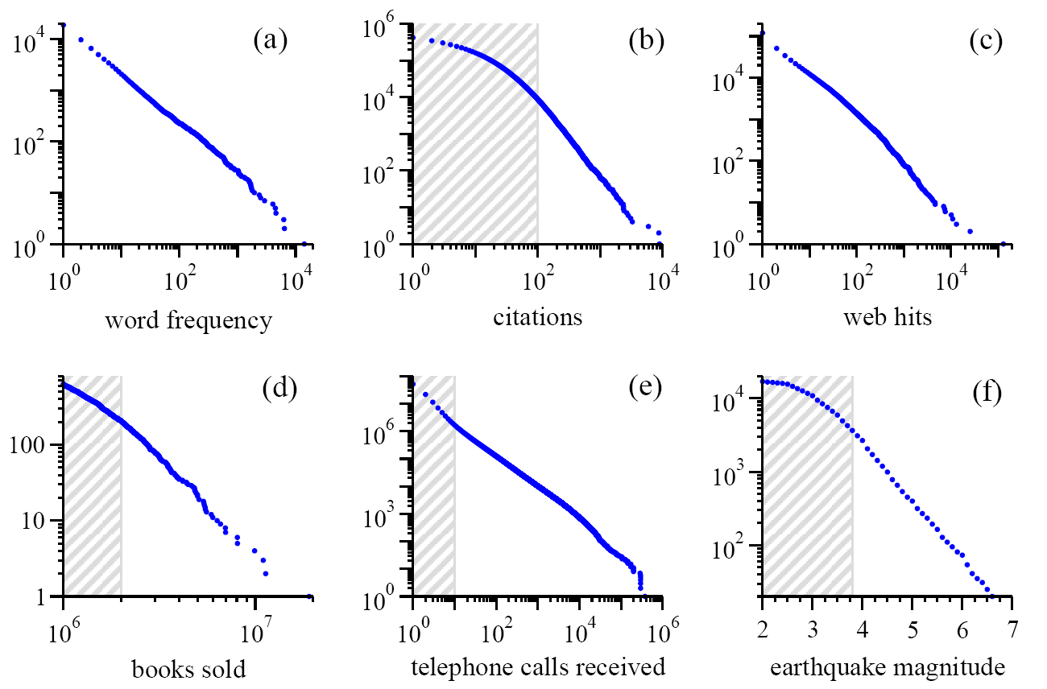
Power Laws Are Seemingly Everywhere note: these are cumulative distributions
Moby Dick
scientific papers 1981-1997
AOL users visiting sites ‘97
bestsellers 1895-1965
AT&T customers on 1 day
California 1910-1992
Source:MEJ Newman, ’Power laws, Pareto distributions and Zipf’s law’, Contemporary Physics 46, 323–351 (2005)

Slide 16
Zipf's law is fairly general!
Frequency of accesses to web pages
in particular the access counts on the Wikipedia page,
with s approximately equal to 0.3
page access counts on Polish Wikipedia (data for late July 2003)
approximately obey Zipf's law with a slope s about 0.5
Words in the English language
for instance, in Shakespeare’s play Hamlet with s approximately 0.5
Sizes of settlements
Income distributions amongst individuals
Size of earthquakes
Notes in musical performances
http://en.wikipedia.org/wiki/Zipf's_law
http://web.archive.org/web/20121101070342/http://www.nslij-genetics.org/wli/zipf/
http://www.cut-the-knot.org/do_you_know/zipfLaw.shtml

Slide 17
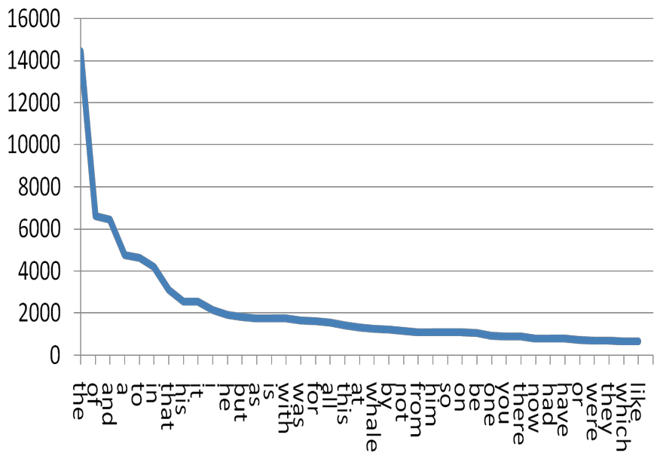
Another Way to Plot: Zipf’s Distribution
Word frequency
p(k) ~ k^{-α}
Words by rank

Slide 18
Zipf’s Law in Natural Language
– Constant ≈ 0.1 × Length of collection (in words)
– Not accurate at the tails, but accurate enough for our purposes
Rank x Frequency ≈ Constant

Slide 19
Zipf's Law
Zipf's Law: frequency of a word in a large corpus is inversely proportional to its rank in the frequency table.
the most frequent word occurs approximately twice as often as the second most frequent word, three times as often as the third most frequent word, and so on.
Zipf's Law has several implications in NLP:
Understanding language structure: It reveals the power-law distribution of word frequencies, which is a fundamental characteristic of natural languages.
Feature selection: It helps identify the most important words in a corpus
Computational efficiency: It informs the design of data structures and algorithms that exploit the skewed distribution of word frequencies, such as efficient data compression or caching strategies.

Slide 20
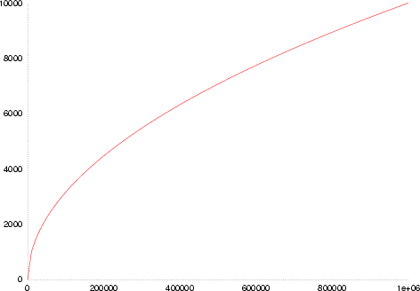
Heaps’ Law
Size of vocabulary V is proportional to the total number of words, n, raised to a power β:
V(n) = Kn^{β}
In English, K is between 10 and 100, β is between 0.4 and 0.6.
V(n)
n
http://en.wikipedia.org/wiki/Heaps%27_law

Slide 21
Heaps’ Law (cont’d)
Related to Zipf’s law: generative models
Zipf’s and Heaps’ law coefficients change with language
Alexander Gelbukh, Grigori Sidorov. Zipf and Heaps Laws’ Coefficients Depend on Language. Proc. CICLing-2001, Conference on Intelligent Text Processing and Computational Linguistics, February 18–24, 2001, Mexico City. Lecture Notes in Computer Science N 2004, ISSN 0302-9743, ISBN 3-540-41687-0, Springer-Verlag, pp. 332–335.

Slide 22
Heaps' Law has several applications in NLP:
a. Estimating vocabulary size: which is important for tasks like language modeling, where the model's complexity depends on the size of the vocabulary.
b. Analyzing language growth: It provides insights into the growth of vocabulary with respect to the size of a corpus, which is useful when comparing different languages, genres, or time periods.
c. Resource allocation: It helps allocate memory and processing resources more efficiently when building NLP models, as it informs the expected growth of the vocabulary as more data is added.

