Slide 1
Introduction to NLP
Probabilities

Slide 2
Probabilities in NLP
Very important for language processing
Example in speech recognition:
“recognize speech” vs “wreck a nice beach”
Example in machine translation:
“l’avocat general”: “the attorney general” vs. “the general avocado”
Example in information retrieval:
If a document includes three occurrences of “stir” and one of “rice”, what is the probability that it is a recipe
Probabilities make it possible to combine evidence from multiple sources in a systematic way
Notes:
CHECK EXAMPLES

Slide 3
Probabilities
Probability theory
predicting how likely it is that something will happen
Experiment (trial)
e.g., throwing a coin
Possible outcomes
heads or tails
Sample spaces
discrete (number of occurrences of “rice”) or continuous (e.g., temperature)
Events
Ω is the certain event
∅ is the impossible event
event space - all possible events

Slide 4
Sample Space
Random experiment: an experiment with uncertain outcome
e.g., flipping a coin, picking a word from text
Sample space: all possible outcomes, e.g.,
Tossing 2 fair coins, Ω ={HH, HT, TH, TT}

Slide 5
Events
Event: a subspace of the sample space
E⊆ Ω, E happens iff outcome is in E, e.g.,
E={HH} (all heads)
E={HH,TT} (same face)
Impossible event (∅)
Certain event (Ω)
Probability of Event : 0 ≤ P(E) ≤1, s.t.
P(Ω)=1 (outcome always in Ω)
P(A∪ B)=P(A)+P(B), if (A∩B)=∅ (e.g., A=same face, B=different face)

Slide 6
Example: Toss a Die
Sample space: Ω = {1,2,3,4,5,6}
Fair die:
p(1) = p(2) = p(3) = p(4) = p(5) = p(6) = 1/6
Unfair die: p(1) = 0.3, p(2) = 0.2, ...
N-dimensional die:
Ω = {1, 2, 3, 4, …, N}
Example in modeling text:
Toss a die to decide which word to write in the next position
Ω = {cat, dog, tiger, …}

Slide 7
Example: Flip a Coin
Ω : {Head, Tail}
Fair coin:
p(H) = 0.5, p(T) = 0.5
Unfair coin, e.g.:
p(H) = 0.3, p(T) = 0.7
Flipping two fair coins:
Sample space: {HH, HT, TH, TT}
Example in modeling text:
Flip a coin to decide whether or not to include a word in a document
Sample space = {appear, absence}

Slide 8
Probabilities
Probabilities
numbers between 0 and 1
Probability distribution
distributes a probability mass of 1 throughout the sample space Ω.
Example:
A fair coin is tossed three times.
What is the probability of 3 heads?
What is the probability of 2 heads?

Slide 9
Meaning of probabilities
Frequentist
I threw the coin 10 times and it turned up heads 5 times
Subjective
I am willing to bet 50 cents on heads

Slide 10
Probabilities
Joint probability: P(A∩B), also written as P(A, B)
Conditional Probability: P(B|A)=P(A∩B)/P(A)
P(A∩B) = P(A)P(B|A) = P(B)P(A|B)
So, P(A|B) = P(B|A)P(A)/P(B) (Bayes’ Rule)
For independent events, P(A∩B) = P(A)P(B), so P(A|B)=P(A)
Total probability: If A₁, …, A_{n} form a partition of S, then
P(B) = P(B∩S) = P(B, A₁) + … + P(B, A_{n}) (why?)
So, P(A_{i}|B) = P(B|A_{i})P(A_{i})/P(B) = P(B|A_{i})P(A_{i})/[P(B|A₁)P(A₁)+…+P(B|A_{n})P(A_{n})]
This allows us to compute P(A_{i}|B) based on P(B|A_{i})

Slide 11
Conditional Probability
Prior and posterior probability
Conditional probability
P(A ∩ B)
P(A|B) =
P(B)
Ω
A
B
A∩B

Slide 12
Properties of Probabilities
p(∅) = 0
P(certain event)=1
p(X) ≤ p(Y), if X ⊆ Y
p(X ∪ Y) = p(X) + p(Y), if X ∩ Y=∅

Slide 13
Conditional Probability
Six-sided fair die
P(D even)=?
P(D>=4)=?
P(D even|D>=4)=?
P(D odd|D>=4)=?
Multiple conditions
P(D odd|D>=4, D<=5)=?

Slide 14
Answers
Six-sided fair die
P(D even)=3/6=1/2
P(D>=4)=3/6=1/2
P(D even|D>=4)=2/3
P(D odd|D>=4)=1/3
Multiple conditions
P(D odd|D>=4, D<=5)=1/2

Slide 15
The Chain Rule
P(w₁,w₂,w₃…w_{n}) = ?
Using the chain rule:
P(w₁,w₂,w₃…w_{n}) =P(w₁) P(w₂|w₁) P(w₃|w₁,w₂)… P(w_{n}|w₁,w₂…w_{n-1})
This rule is used in many ways in statistical NLP, more specifically in Markov Models

Slide 16
Independence
Two events are independent when
P(A∩B) = P(A)P(B)
Unless P(B)=0 this is equivalent to saying that
P(A) = P(A|B)
If two events are not independent, they are considered dependent

Slide 17
Adding vs. Removing Constraints
Adding constraints
P(walk=yes|weather=nice)
P(walk=yes|weather=nice,freetime=yes,crowded=yes)
More accurate
But more difficult to estimate
Removing constraints (Backoff)
P(walk=yes|weather=nice,freetime=yes,crowded=yes)
P(walk=yes|weather=nice,freetime=yes)
P(walk=yes|weather=nice)
Note that it is not possible to do backoff on the left hand side of the conditional
[Example modified from Jason Eisner]

Slide 18
Random Variables
Simply a function:
The numbers are generated by a stochastic process with a certain probability distribution
Example
the discrete random variable X that is the sum of the faces of two randomly thrown fair dice
Probability mass function (pmf) which gives the probability that the random variable has different numeric values:
X: Ω → R^{n}
P(x) = P(X = x) = P(A_{x}) where A_{x} = {ω ∈ Ω : X(ω) = x}

Slide 19
Random Variables
If a random variable X is distributed according to the pmf p(x), then we write X ~ p(x)
For a discrete random variable, we have
Σp(x_{i}) = P(Ω) = 1

Slide 20
Six-sided Fair Die
p(1) = 1/6
p(2) = 1/6
etc.
P(D)=?
P(D) = {1/6, 1/6, 1/6, 1/6, 1/6, 1/6}
P(D|odd) = {1/3, 0, 1/3, 0, 1/3, 0}

Slide 21
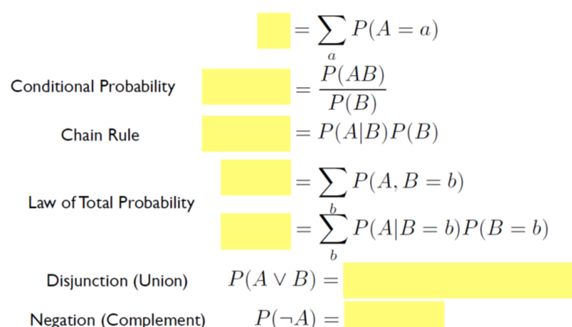
Probability Review
[slide from Brendan O’Connor]

Slide 22
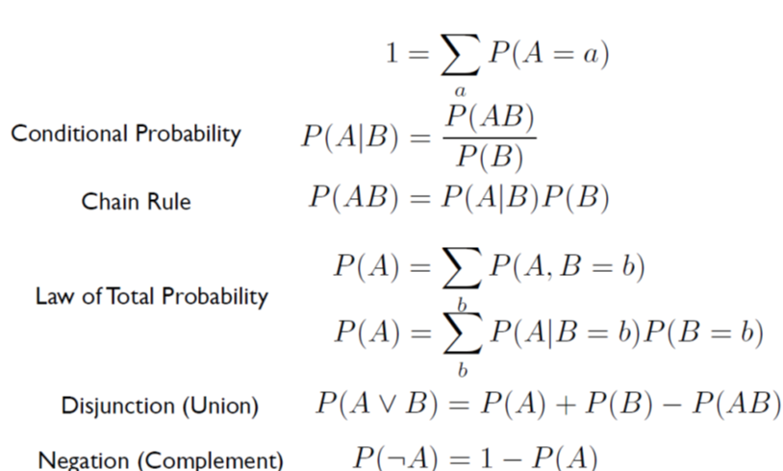
Probability Review 2/2
[slide from Brendan O’Connor]

Slide 23
Introduction to NLP
Bayes Theorem

Slide 24
Bayes Theorem
Formula for joint probability
p(A,B) = p(B|A)p(A)
p(A,B) = p(A|B)p(B)
Therefore
p(B|A) = p(A|B)p(B)/p(A)
Bayes’ theorem is used to calculate P(A|B) given P(B|A)

Slide 25
Example
Diagnostic test
Test accuracy
p(positive | ¬disease) = 0.05 – false positive
p(negative | disease) = 0.05 – false negative
So: p(positive | disease) = 1-0.05 = 0.95
Same for p(negative | ¬disease)
In general the rates of false positives and false negatives are different

Slide 26
Example
Diagnostic test with errors
P(A|B) |  | A=TEST
 |  | Positive | Negative
B=DISEASE | Yes | 0.95 | 0.05
 | No | 0.05 | 0.95

Slide 27
Example
What is p(disease | positive)?
P(disease|positive) = P(positive|disease)*P(disease)/P(positive)
P(¬disease|positive) = P(positive| ¬disease)*P(¬disease)/P(positive)
P(disease|positive)/P(¬disease|positive) = ?
We don’t really care about p(positive)
as long as it is not zero, we can divide both sides by this quantity

Slide 28
Example
P(disease|positive) / P(¬disease|positive) = (P(positive|disease) x P(disease))/(P(positive|¬disease) x P(¬disease))
Suppose P(disease) = 0.001
so P(¬disease) = 0.999
P(disease|positive) / P(¬disease|positive) = (0.95 x 0.001)/(0.05 x 0.999) =0.019
P(disease|positive) + P(¬disease|positive) = 1
P(disease|positive) ≈ 0.02
Notes
P(disease) is called the prior probability
P(disease|positive) is called the posterior probability
In this example the posterior is 20 times larger than the prior

Slide 29
Example
p(well)=0.9, p(cold)=0.05, p(allergy)=0.05
p(sneeze|well)=0.1
p(sneeze|cold)=0.9
p(sneeze|allergy)=0.9
p(cough|well)=0.1
p(cough|cold)=0.8
p(cough|allergy)=0.7
p(fever|well)=0.01
p(fever|cold)=0.7
p(fever|allergy)=0.4
Example from Ray Mooney

Slide 30
Example (cont’d)
Features: sneeze, cough, no fever
P(well|e)=(.9) * (.1)(.1)(.99) / p(e)=0.0089/p(e)
P(cold|e)=(.05) * (.9)(.8)(.3) / p(e)=0.01/p(e)
P(allergy|e)=(.05) * (.9)(.7)(.6) / p(e)=0.019/p(e)
P(e) = 0.0089+0.01+0.019=0.379
P(well|e)=.23
P(cold|e)=.26
P(allergy|e)=.50

Slide 31
Bayes Theorem
Hypothesis space: H={H₁ , …, H_{n}} Evidence: E
In text classification: H: class space; E: data (features)
If we want to pick the most likely hypothesis H*, we can drop P(E)
Posterior probability of H_{i}
Prior probability of H_{i}
Likelihood of data/evidence
if H_{i} is true
[slide from Qiaozhu Mei]

Slide 32
Getting to Statistics ...
We are flipping an unfair coin, but P(Head)=? (parameter estimation)
If we see the results of a huge number of random experiments, then
But, what if we only see a small sample (e.g., 2)? Is this estimate still reliable? We flip twice and got two tails, does it mean P(Head) = 0?
In general, statistics has to do with drawing conclusions on the whole population based on observations of a sample (data)
[slide from Qiaozhu Mei]

Slide 33
Parameter Estimation
General setting:
Given a (hypothesized & probabilistic) model that governs the random experiment
The model gives a probability of any data p(D|θ) that depends on the parameter θ
Now, given actual sample data X={x₁,…,x_{n}}, what can we say about the value of θ?
Intuitively, take your best guess of θ
“best” means “best explaining/fitting the data”
Generally, this is an optimization problem
[slide from Qiaozhu Mei]

Slide 34
Maximum Likelihood vs. Bayesian
Maximum likelihood estimation
“Best” means “data likelihood reaches maximum”
Problem: small sample
Bayesian estimation
“Best” means being consistent with our “prior” knowledge and explaining data well
Problem: how to define the prior?
[slide from Qiaozhu Mei]

Slide 35
Bayesian Estimation
Posterior:
p(θ|X)∝ p(X|θ)p(θ)
Likelihood:
p(X|θ)
X=(x₁,…,x_{N})
Prior: p(θ)
θ
θ_{α}: prior mode
θ: posterior mode
θ_{ml}: ML estimate
[slide from Qiaozhu Mei]

Slide 36

Example: An Unfair Die
It’s more likely to get a 6 and less likely to get a 1
p(6) > p(1)
How likely?
What if you toss the die 1000 times, and observe “6” 501 times, “1” 108 times?
p(6) = 501/1000 = 0.501
p(1) = 108/1000 = 0.108
As simple as counting, but principled – maximum likelihood estimate
[slide from Qiaozhu Mei]

Slide 37

What if the Die has More Faces?
Suitable to represent documents
Every face corresponds to a word in vocabulary
The author tosses a die to write a word
Apparently, an unfair die
[slide from Qiaozhu Mei]

