Slide 1
Introduction to NLP
Semantic Role Labeling

Slide 2
types
PropBank-based methods:
rely on hand-crafted rules, patterns, or heuristics.
i. SIFT (Simple Inference and Fusion Techniques)
ii. ASSERT (Automatic Statistical SEmantic Role Tagger)
Feature-based methods:
machine learning algorithms trained on features extracted from the input text to predict semantic roles.
a. Supervised learning: Decision Trees, SVM, MaxEnt
b. Unsupervised and semi-supervised learning:
i. Latent-variable models
ii. Co-training
Probabilistic graphical models:
capture dependencies between different parts of a sentence and predict semantic roles.
a. Undirected graphical models:
i. Markov Random Fields (MRF)
ii. Conditional Random Fields (CRF)
b. Directed graphical models:
i. Bayesian Networks
ii. Hidden Markov Models (HMM)
Neural network-based methods:
RNN, Transformer, BERT, GPT

Slide 3
Syntactic Variation
Last week, Min broke the window with a hammer.
The window was broken with a hammer by Min last week
With a hammer, Min broke the window last week
Last week, the window was broken by Min with a hammer
Min broke the window
The window broke
The window was broken with a hammer
SAME DEEP ROLES

Slide 4
Semantic Role Labeling
Determining
who
did what
to whom
when
where
why
how
Uses
Question answering
Machine translation
Text summarization

Slide 5
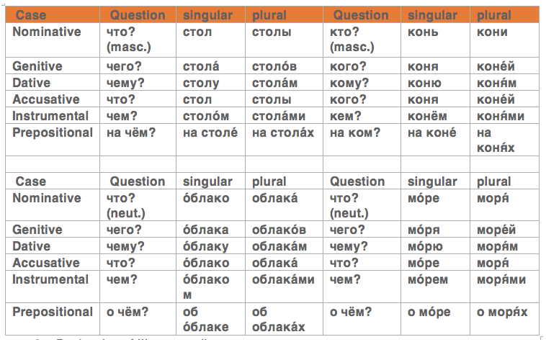
Grammatical Case
http://expressrussian.com/russian-cases/

Slide 6
Case Theory (Fillmore 1968)
Agent
Actor of an action
The musician performed a new piece
Patient
Entity affected by the action
Samantha hurt her hand
Instrument
Tool used in performing action
Min broke the window with a hammer
Beneficiary
Entity for whom action is performed
The mother bought ice cream for the children
Source
Origin of the affected entity
I got the book from my friend
Destination
Destination of the affected entity

Slide 7
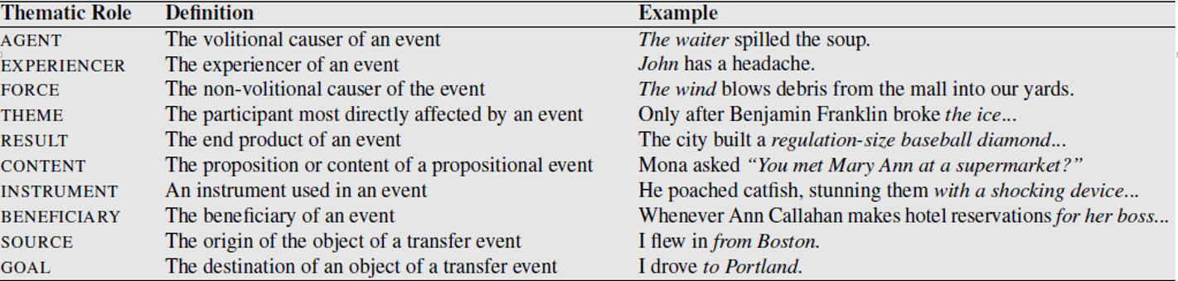
Thematic Roles
[Jurafsky and Martin book]

Slide 8
Using syntactic information
Syntactic information
“by X” for agent
“with X” for instrument
Exceptions
“by car”
“with pleasure”

Slide 9
Semantic Role Labeling (SRL) Task
Input
The teacher gave the test to the students in the morning.
Output
[The teacher]_{AGENT} gave [the test]_{OBJ} to [the students]_{RECIP} [in the morning]_{TMP}.

Slide 10
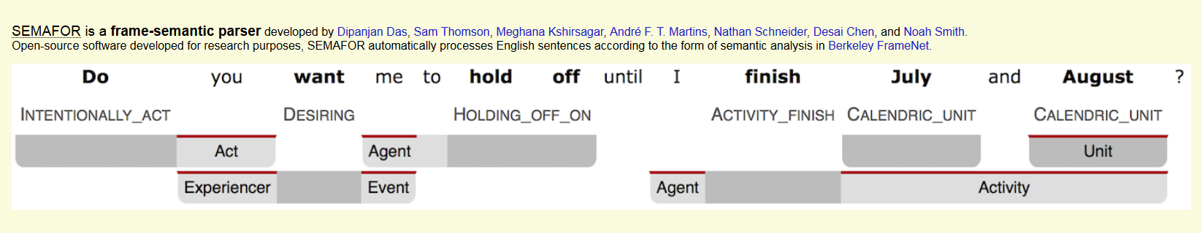
Semantic Role Labeling
http://www.cs.cmu.edu/~ark/SEMAFOR/

Slide 11
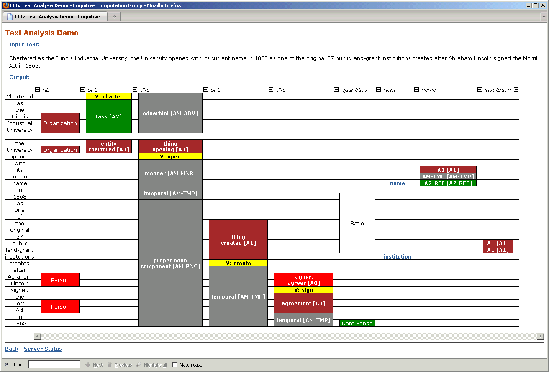
Illinois Demo
http://cogcomp.cs.illinois.edu/page/demo_view/SRL

Slide 12
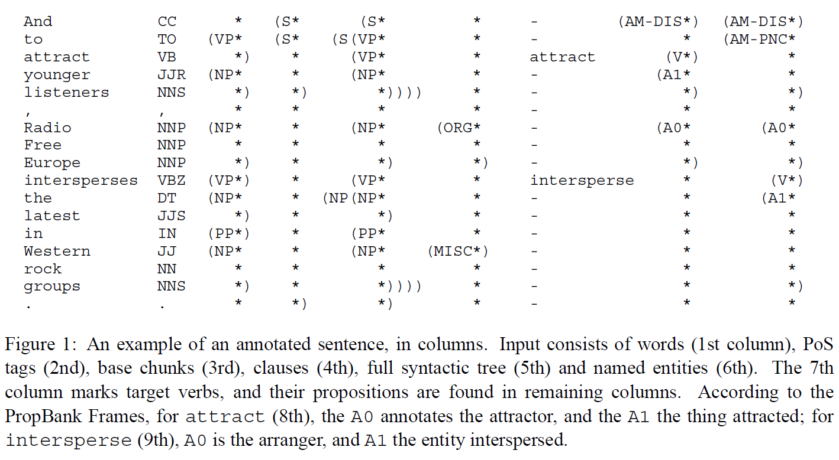
Formatted Output
[Carreras and Marquez 2005]

Slide 13
FrameNet
FrameNet
Berkeley
Chuck Fillmore
https://framenet.icsi.berkeley.edu/

Slide 14
FrameNet
Represents
Events, relations, states, entities
1,195 semantic frames
1,774 frame-to-frame relations
Example: Absorb_heat
An Entity (generally food) is exposed to a Heat_source whose Temperature may also be specified. Generally, the Entity undergoes some sort of change as a result of this process.
Bacon was frying in the pan, and a great heap of eggs already lay steaming on a plate.
If it cooks at 400 for an hour, it 'll be nothing but a pile of ash!
Links
https://framenet.icsi.berkeley.edu/fndrupal/
http://naacl.org/naacl-hlt-2015/tutorial-framenet.html

Slide 15
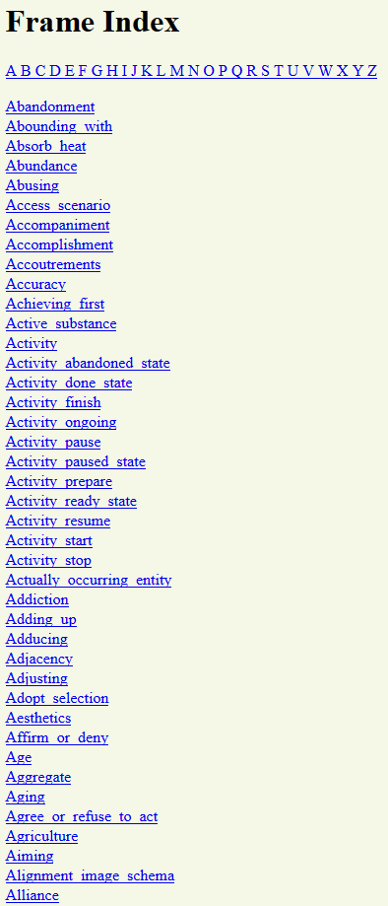
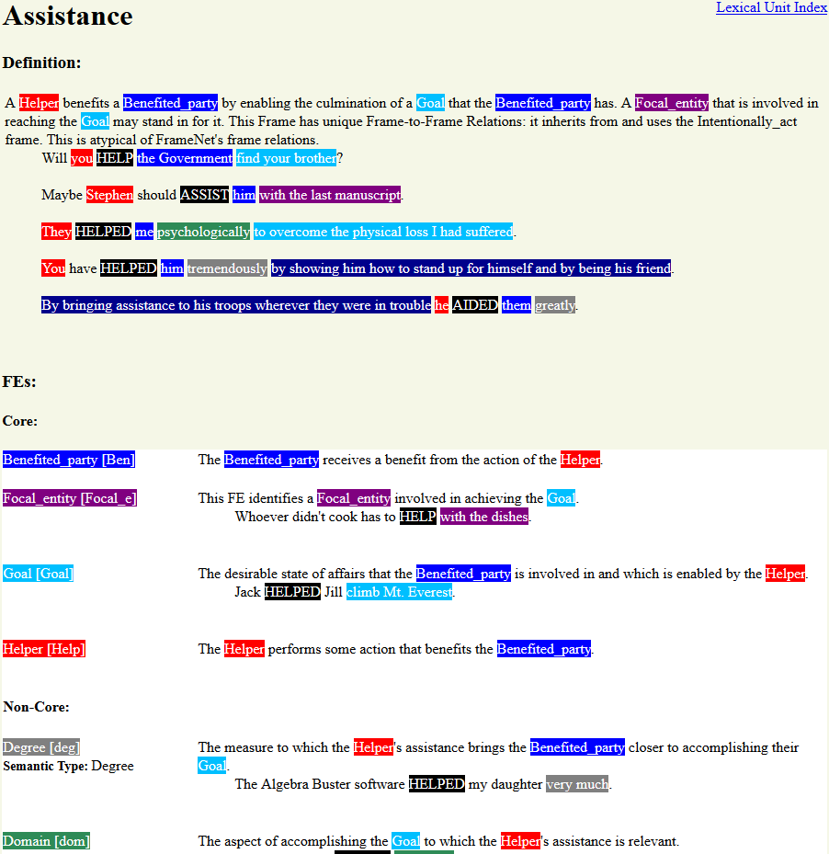

Slide 16
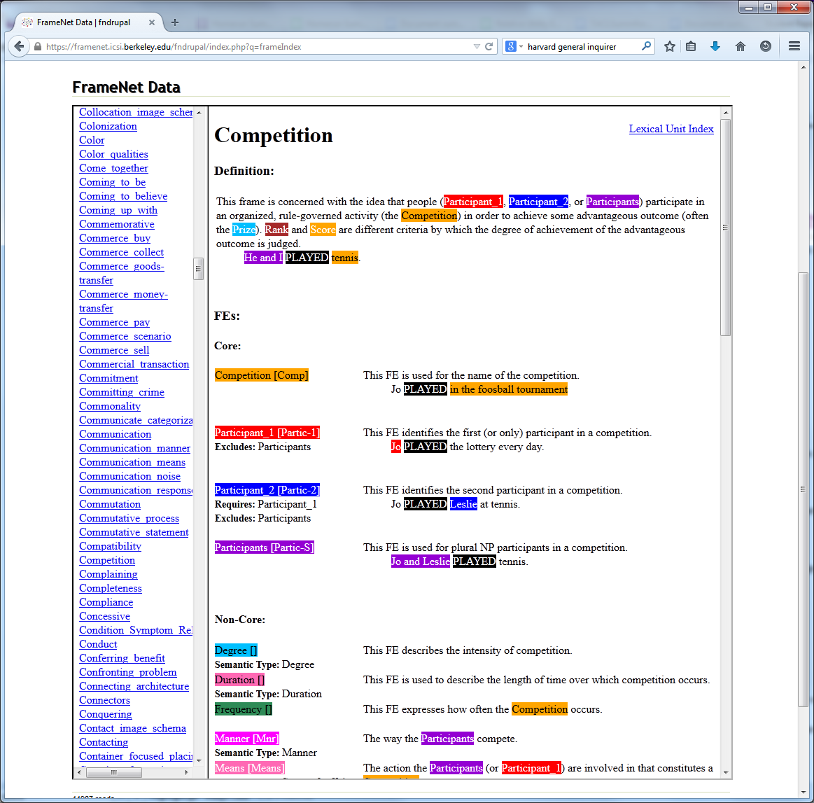
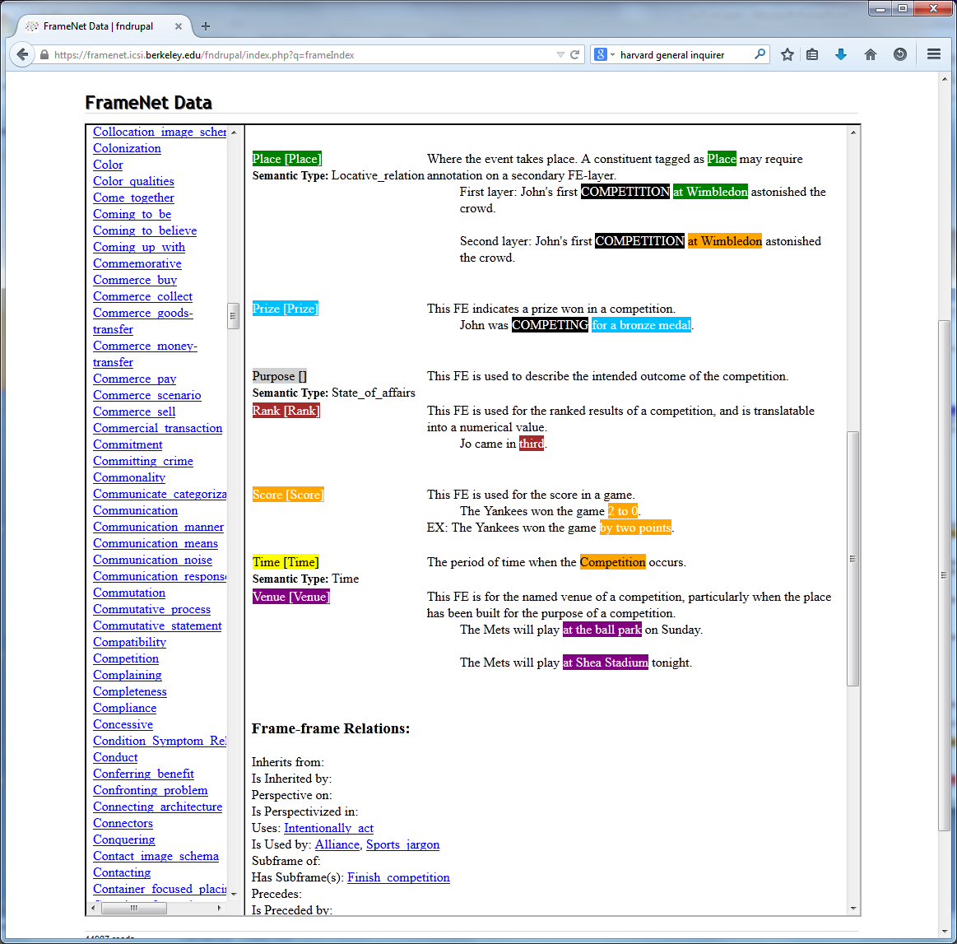

Slide 17
PropBank
PropBank
U. Colorado
Martha Palmer and others
http://verbs.colorado.edu/~mpalmer/projects/ace.html
Arg0 usually agent
Arg1 usually patient/theme
13 labels for Adjuncts (Time, Location, Manner)

Slide 18
PropBank Examples
Roleset id: break.01 , break, cause to not be whole
Roles+ Arg0: breaker (vnrole: 23.2-agent, 40.8.3-1-experiencer, 45.1-agent) Arg1: thing broken (vnrole: 23.2-patient1, 40.8.3-1-patient, 45.1-patient) Arg2: instrument (vnrole: 45.1-instrument) Arg3: pieces (vnrole: 23.2-patient2)
Example: just transitive Stock prices rallied as the Georgia-Pacific bid broke the market's recent gloom. Arg0: the Georgia-Pacific bid Rel: broke Arg1: the market's recent gloom

Slide 19
PropBank Examples
Example: with instrument
John broke the window with a rock. Arg0: John Rel: broke Arg1: the window Arg2: with a rock
Example: with pieces
John broke the window into a million pieces. Arg0: John Rel: broke Arg1: the window Arg3: into a million pieces
Example: inchoative The window broke into a million pieces. Arg1: The window Rel: broke Arg3: into a million pieces

Slide 20
Classic Papers
Gildea and Jurafsky 2002
Xue and Palmer 2004
Punakyanok et al. 2004
Pradhan et al. 2004
Yi and Palmer 2005
Marquez et al. 2005
Haghighi et al. 2005

Slide 21
Approaches
Selectional restrictions
instruments should be tools (e.g., *not* “with pleasure”)
agents and beneficiaries should be animate (e.g., not “for a reason”)
Use WordNet
“the teacher” is a person is animate
Parse node classification

Slide 22
Features Used (1)
Phrase type
Governing category
Parse tree path (e.g., N↑NP↑S↓VP↓V) – SEE NEXT SLIDE
Position (e.g., does the phrase precede or follow the predicate)
Voice
Head word
Subcategorization
Argument Set
Argument Order
List from Palmer, Gildea, and Xue 2010

Slide 23
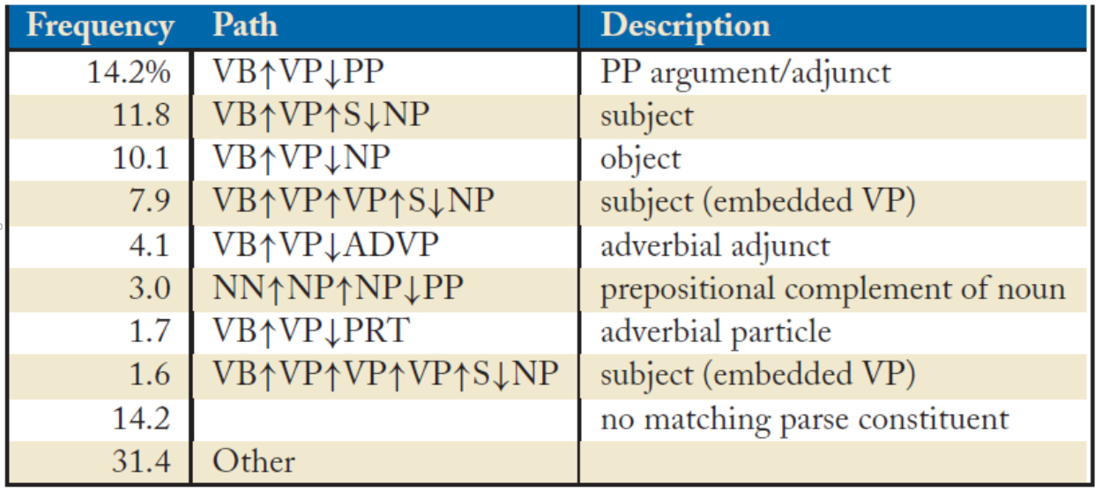
Example
[Palmer, Gildea, and Xue 2010]

Slide 24
Features Used (2)
Previous Role
Head Word Part of Speech
Named Entities in Constituents
Verb Clustering
Head Words of Objects of PPs
First/Last Word/POS in Constituent
Constituent Order
Constituent Tree Distance
Temporal Cue Words
List from Palmer, Gildea, and Xue 2010

Slide 25
Using SRL for Question Answering
[Shen and Lapata 2007]

Slide 26
Results
CONLL Shared task (since 2004)
Best performance over 80% F1 measure

Slide 27
Neural SRL
[He et al. 2018]

Slide 28
Neural SRL
[He et al. 2018]

