Slide 1
Introduction to NLP
Sentiment Analysis

Slide 2
Reviews of 1Q84 by Haruki Murakami
“1Q84 is a tremendous feat and a triumph . . . A must-read for anyone who wants to come to terms with contemporary Japanese culture.” —Lindsay Howell, Baltimore Examiner
“Perhaps one of the most important works of science fiction of the year . . . 1Q84 does not disappoint . . . [It] envelops the reader in a shifting world of strange cults and peculiar characters that is surreal and entrancing.” —Matt Staggs, Suvudu.com
Ambitious, sprawling and thoroughly stunning . . . Orwellian dystopia, sci-fi, the modern world (terrorism, drugs, apathy, pop novels)—all blend in this dreamlike, strange and wholly unforgettable epic.” —Kirkus Reviews (starred review)

Slide 3
Reviews of 1Q84 by Haruki Murakami
“1Q84 is a tremendous feat and a triumph . . . A must-read for anyone who wants to come to terms with contemporary Japanese culture.” —Lindsay Howell, Baltimore Examiner
“Perhaps one of the most important works of science fiction of the year . . . 1Q84 does not disappoint . . . [It] envelops the reader in a shifting world of strange cults and peculiar characters that is surreal and entrancing.” —Matt Staggs, Suvudu.com
Ambitious, sprawling and thoroughly stunning . . . Orwellian dystopia, sci-fi, the modern world (terrorism, drugs, apathy, pop novels)—all blend in this dreamlike, strange and wholly unforgettable epic.” —Kirkus Reviews (starred review)

Slide 4
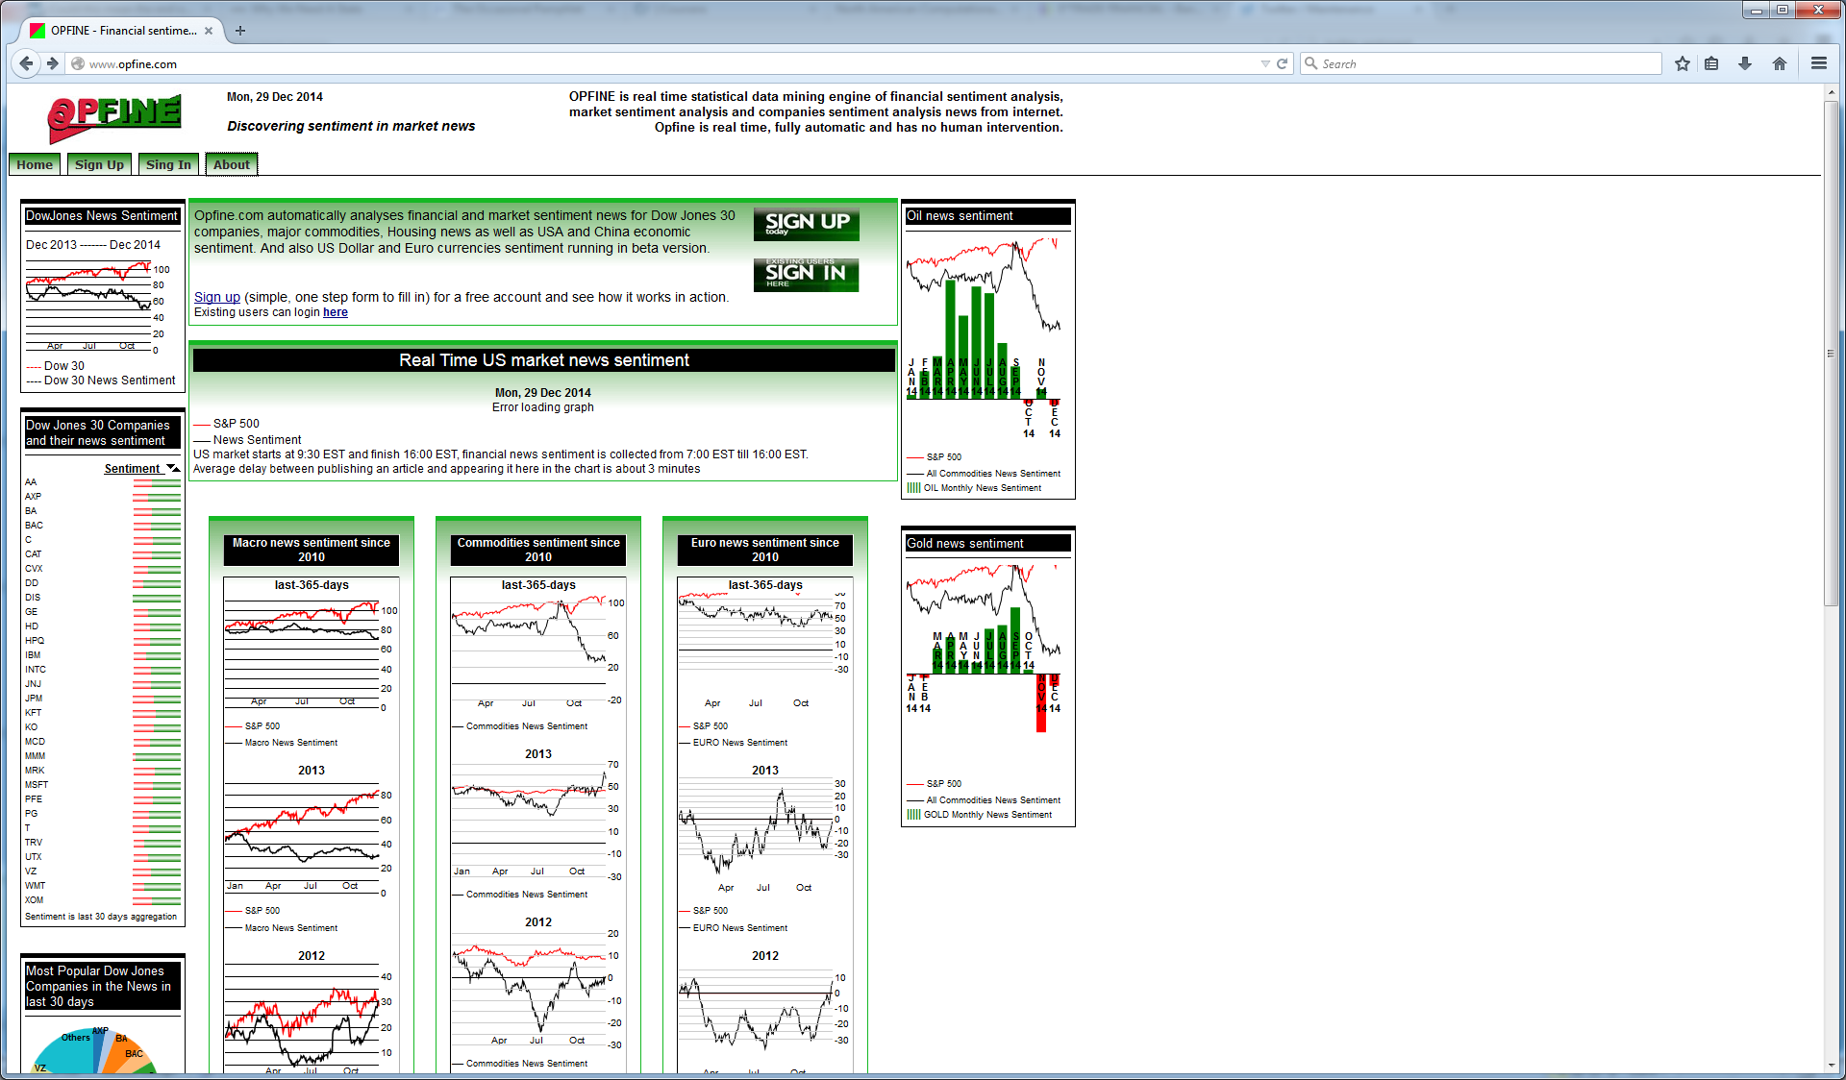
Sentiment about Companies

Slide 5
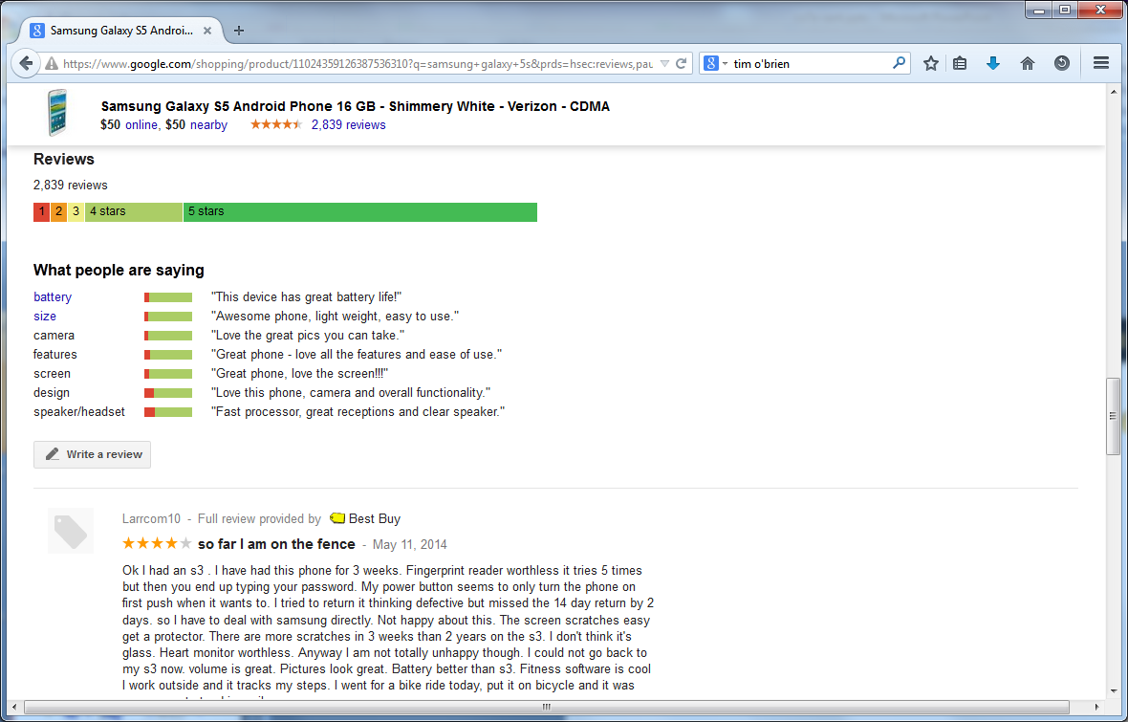
Product Reviews

Slide 6
Introduction
Many posts, blogs
Expressing personal opinions
Research questions
Subjectivity analysis
Polarity analysis (positive/negative, number of stars)
Viewpoint analysis (Chelsea vs. Manchester United, republican vs. democrat)
Sentiment target
entity
aspect

Slide 7
Introduction
Level of granularity
Document
Sentence
Attribute
Opinion words
Base
Comparative (better, slower)
Negation analysis
Just counting negative words is not enough

Slide 8
Reviews of 1Q84 by Haruki Murakami
“1Q84 is a tremendous feat and a triumph . . . A must-read for anyone who wants to come to terms with contemporary Japanese culture.” —Lindsay Howell, Baltimore Examiner
“Perhaps one of the most important works of science fiction of the year . . . 1Q84 does not disappoint . . . [It] envelops the reader in a shifting world of strange cults and peculiar characters that is surreal and entrancing.” —Matt Staggs, Suvudu.com
Ambitious, sprawling and thoroughly stunning . . . Orwellian dystopia, sci-fi, the modern world (terrorism, drugs, apathy, pop novels)—all blend in this dreamlike, strange and wholly unforgettable epic.” —Kirkus Reviews (starred review)

Slide 9
Reviews of 1Q84 by Haruki Murakami
“1Q84 is a tremendous feat and a triumph . . . A must-read for anyone who wants to come to terms with contemporary Japanese culture.” —Lindsay Howell, Baltimore Examiner
“Perhaps one of the most important works of science fiction of the year . . . 1Q84 does not disappoint . . . [It] envelops the reader in a shifting world of strange cults and peculiar characters that is surreal and entrancing.” —Matt Staggs, Suvudu.com
Ambitious, sprawling and thoroughly stunning . . . Orwellian dystopia, sci-fi, the modern world (terrorism, drugs, apathy, pop novels)—all blend in this dreamlike, strange and wholly unforgettable epic.” —Kirkus Reviews (starred review)

Slide 10
Notes
“raise” – can be negative or positive depending on the object
“very” – enhances the polarity of the adjective or adverb
http://www.theysay.io/ - claim to have 65,000 manual patterns

Slide 11
SA as a Classification Problem
Set of features
Words
Presence is more important than frequency
Punctuation
Phrases
Syntax
A lot of training data is available
E.g., movie review sentences and stars
Techniques
MaxEnt
SVM
Naive Bayes
RNN

Slide 12
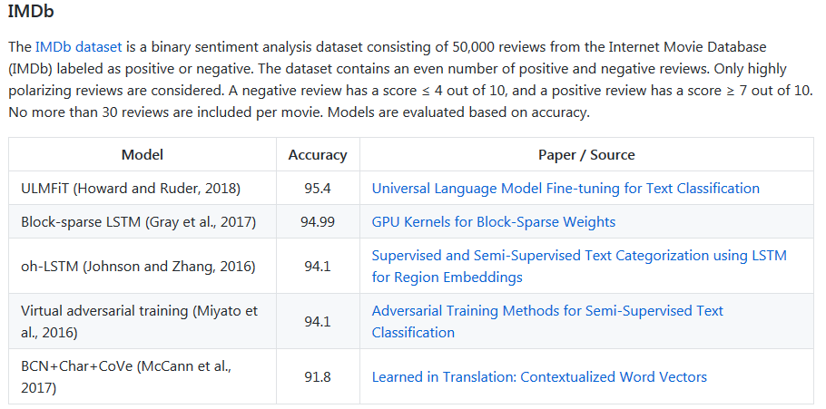
Results
https://github.com/sebastianruder/NLP-progress/blob/master/english/sentiment_analysis.md

Slide 13
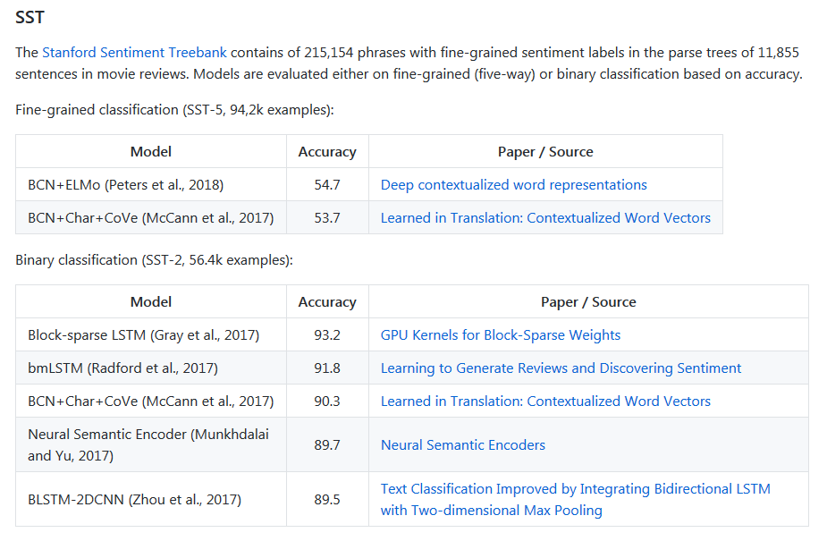
Results

Slide 14
Difficult Problems
Subtlety
Concession
Manipulation
Sarcasm and irony

Slide 15
Resources
CMU Twitter parser
http://www.ark.cs.cmu.edu/TweetNLP/

Slide 16
Introduction to NLP
Sentiment Lexicons

Slide 17
Sentiment Lexicons
SentiWordNet
http://sentiwordnet.isti.cnr.it/
General Inquirer
2,000 positive words and 2,000 negative words
http://www.wjh.harvard.edu/~inquirer/
LIWC
http://liwc.wpengine.com/
Bing Liu’s opinion dataset
http://www.cs.uic.edu/~liub/FBS/opinion-lexicon-English.rar
MPQA subjectivity lexicon
http://mpqa.cs.pitt.edu/lexicons/subj_lexicon/

Slide 18
General Inquirer
Annotations
Strong Power Weak Submit Active Passive Pleasur Pain Feel Arousal EMOT Virtue Vice Ovrst Undrst Academ Doctrin Econ@ Exch ECON Exprsv Legal Milit Polit@ POLIT Relig Role COLL Work Ritual SocRel Race Kin@ MALE Female Nonadlt HU ANI PLACE Social Region Route Aquatic Land Sky Object Tool Food Vehicle BldgPt ComnObj NatObj BodyPt ComForm COM Say Need Goal Try Means Persist Complet Fail NatrPro Begin Vary Increas Decreas Finish Stay Rise Exert Fetch Travel Fall Think Know Causal Ought Perceiv Compare Eval@ EVAL Solve Abs@ ABS Quality Quan NUMB ORD CARD FREQ DIST Time@ TIME Space POS DIM Rel COLOR Self Our You Name Yes No Negate Intrj IAV DAV SV IPadj IndAdj PowGain PowLoss PowEnds PowAren PowCon PowCoop PowAuPt PowPt PowDoct PowAuth PowOth PowTot RcEthic RcRelig RcGain RcLoss RcEnds RcTot RspGain RspLoss RspOth RspTot AffGain AffLoss AffPt AffOth AffTot WltPt WltTran WltOth WltTot WlbGain WlbLoss WlbPhys WlbPsyc WlbPt WlbTot EnlGain EnlLoss EnlEnds EnlPt EnlOth EnlTot SklAsth SklPt SklOth SklTot TrnGain TrnLoss TranLw MeansLw EndsLw ArenaLw PtLw Nation Anomie NegAff PosAff SureLw If NotLw TimeSpc
http://www.webuse.umd.edu:9090/tags
Positive: able, accolade, accuracy, adept, adequate…
Negative: addiction, adversity, adultery, affliction, aggressive…

Slide 19
Dictionary-based Methods
Start from known seeds
e.g., happy, angry
Expand using WordNet
synonyms
hypernyms
Random-walk based methods
words with known polarity as absorbing boundary

Slide 20
Automatic Extraction of Sentiment Words
Semi-supervised method
Look for pairs of adjectives that appear together in a conjunction
Vasileios Hatzivassiloglou and Kathleen R. McKeown, ACL 1997

Slide 21
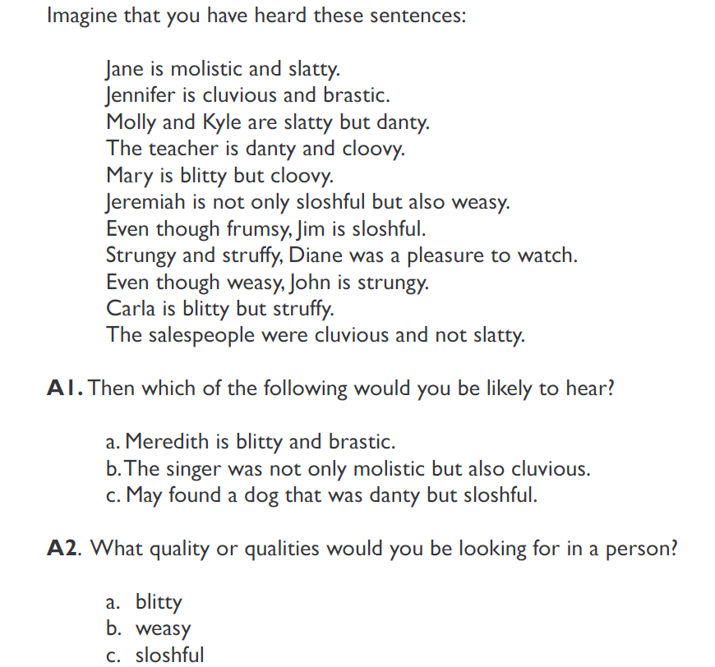
Molistic
NACLO problem (2007)

Slide 22
brastic
2
cluvious
11
molistic
3
danty
1
slatty
4
cloovy
5
blitty
10
struffy
weasy
8
9
strungy
6
sloshful
8
pleasure to watch
7
frumsy

Slide 23
PMI (Turney)
PMI = pointwise mutual information
Check how often a given unlabeled word appears with a known positive word (“excellent”)
Same for a known negative word (“poor”)

Slide 24
Datasets
http://www.cs.cornell.edu/people/pabo/movie-review-data/
http://www.cs.jhu.edu/~mdredze/datasets/sentiment/
http://help.sentiment140.com/other-resources
https://blog.cambridgespark.com/50-free-machine-learning-datasets-sentiment-analysis-b9388f79c124

