Slide 1
Statistical Machine Translation
The Noisy Channel Model

Slide 2
The Noisy Channel Model
Source-channel model of communication
Parametric probabilistic models of language and translation

Slide 3
Noisy Channel Model Applications
Text-to-text (e.g., text summarization)
Speech recognition
Spelling Correction
Optical Character Recognition
P(text|pixels) = P(text) P(pixels|text)

Slide 4
Statistics
Given f, guess e
f
e
E → F
F → E
e’
encoder
decoder
e’ = argmax P(e|f) = argmax P(f|e) P(e)
e
e
translation model
language model

Slide 5
Decoding
Find a translation that maximizes P(F|E)P(E)
NP-complete for IBM model 1
Use a phrase translation table (e.g., Koehn’s Pharaoh system, 2004)
Use A* search to find the subset of phrase translations that covers the source sentence
Combine with beam search

Slide 6


noisy channel model
Noise
Source
P(X)
Message X
Encoder
Noisy Channel
P(Y|X)
Message Y
(Noisy X)
Decoder
P(X|Y)
Reconstructed Message $\hat{X}$

Slide 7

Machine translation
Noise
Source Language model P(X)
Source sentence X
Translation model
P(Y|X)
target sentence Y
(from target
language model)
Decoder
P(X|Y)
Reconstructed source sentence $\hat{X}$

Slide 8


Speech recognition
Noise
Source
P(X)
text sequence X
Human speech production model
P(Y|X)
speech signal Y
Decoder
P(X|Y)
Reconstructed Message $\hat{X}$

Slide 9
Statistical MT
Translate from French: “une fleur rouge”?
 | p(e) | p(f|e) | p(e)*p(f|e)
a flower red
red flower a
flower red a
a red dog
dog cat mouse
a red flower

Slide 10
Statistical MT
Translate from French: “une fleur rouge”?
 | p(e) | p(f|e) | p(e)*p(f|e)
a flower red | Low
red flower a
flower red a
a red dog
dog cat mouse
a red flower

Slide 11
Statistical MT
Translate from French: “une fleur rouge”?
 | p(e) | p(f|e) | p(e)*p(f|e)
a flower red | Low
red flower a | Low
flower red a | Low
a red dog | High
dog cat mouse | Low
a red flower | High

Slide 12
Statistical MT
Translate from French: “une fleur rouge”?
 | p(e) | p(f|e) | p(e)*p(f|e)
a flower red |  | High
red flower a
flower red a
a red dog
dog cat mouse
a red flower

Slide 13
Statistical MT
Translate from French: “une fleur rouge”?
 | p(e) | p(f|e) | p(e)*p(f|e)
a flower red |  | High
red flower a |  | High
flower red a |  | High
a red dog |  | Low
dog cat mouse |  | Low
a red flower |  | High

Slide 14
Statistical MT
Translate from French: “une fleur rouge”?
 | p(e) | p(f|e) | p(e)*p(f|e)
a flower red | Low | High | Low
red flower a | Low | High | Low
flower red a | Low | High | Low
a red dog | High | Low | Low
dog cat mouse | Low | Low | Low
a red flower | High | High | High

Slide 15
Statistical Machine Translation
The IBM Models

Slide 16
Machine Translation
Word Alignment

Slide 17
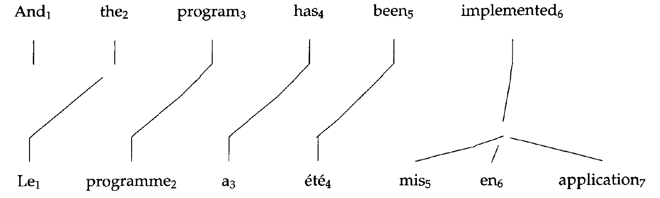
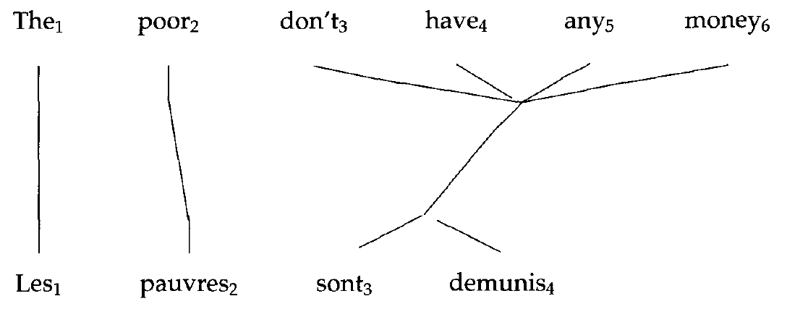
Examples
From [Brown et al. 1993]

Slide 18
Representing Word Alignments
 | le | programme | a | été | mis | en | application
0 NULL
1 and
2 the
3 program
4 has
5 been
6 implemented
Position | 1 | 2 | 3 | 4 | 5 | 6 | 7
French | le | programme | a | été | mis | en | application
Alignment | 2 | 3 | 4 | 5 | 6 | 6 | 6

Slide 19
Complexity of Alignment
Finding the optimal alignment is NP-hard
Reduction from Traveling Salesman Problem
Each word is a city
Each bigram is a distance from one city to another
Each translation is a complete tour of all cities

Slide 20
Motivation
Difficult to model p(f₁,…,f_{n})|(e₁,…,e_{m}) directly

Slide 21
Questions
If the word order is fixed
Align strings using the Levenshtein method
What about the following:
How to deal with word reorderings?
How to deal with phrases?
We need a systematic (and feasible) approach

Slide 22
Generative Story (almost IBM)
I watched an interesting play
I watched watched an interesting play play play
I watched watched an play play play interesting
J’ ai vu une pièce de théâtre intéressante

Slide 23
IBM’s EM trained models (1-5)
Word translation
Local alignment
Fertilities
Class-based alignment
Non-deficient algorithm (avoid overlaps, overflow)

Slide 24
Alignments
la
maison
bleue
la
maison
bleue
la
maison
bleue
the
blue
house
the
blue
house
the
blue
house
[1,2,3]
[1,3,2]
[1,3,3]
la
maison
bleue
la
maison
bleue
la
maison
bleue
the
blue
house
the
blue
house
the
blue
house
[1,1,1]
[2,2,2]
[3,3,3]

Slide 25
Model 1
Alignments
La maison bleue
The blue house
Alignments: [1,2,3], [1,3,2], [1,3,3], [1,1,1], etc.
A priori, all are equally likely
Conditional probabilities
P(f|A,e) = ?

Slide 26
Computing p(f|a,e)
la
maison
bleue
the
blue
house
[1,3,2]
P(f|a,e)=t(la|the) x t(bleu|blue) x t(maison|house)

Slide 27
Model 1 (cont’d)
Algorithm
Pick length of translation (uniform probability)
Choose an alignment (uniform probability)
Translate the foreign words (only depends on the word)
That gives you P(f,A|e)
We need P(f|A,e)
Use EM (expectation-maximization) to find the hidden variables

Slide 28
Model 1 (cont’d)
Length probability
Alignment probability (uniform)
Translation probability

Slide 29
Finding the Optimal Alignment

Slide 30
Training Model 1
Goal:
Learn the translation probabilities p(f|e)
EM Algorithm
Used to estimate the translation probabilities from a training corpus
Guess p(f|e) (could be uniform)
Repeat until convergence:
E-step: compute counts
M-step: recompute p(f|e)

Slide 31
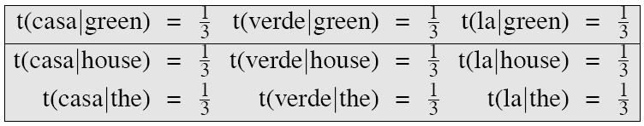
Example
Corpus:
green house the house
casa verde la casa
Uniform translation model:

Slide 32
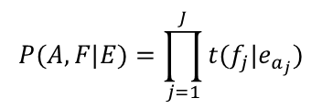
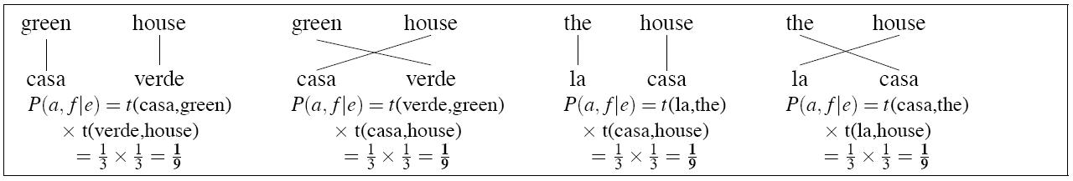
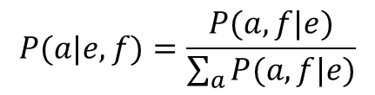
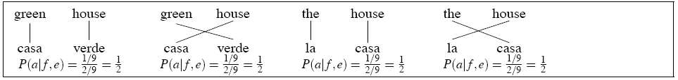
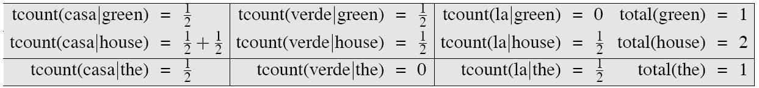
E-step 1: compute the expected counts E[count(t(f|e))] for all word pairs (f_{j},e_{aj})
E-step 1a: compute P(a,f|e) by multiplying all t probabilities using
E-step 1b: normalize P(a,f|e) to get P(a|e,f) using
E-step 1c: compute expected fractional counts, by weighting each count by P(a|e,f)

Slide 33
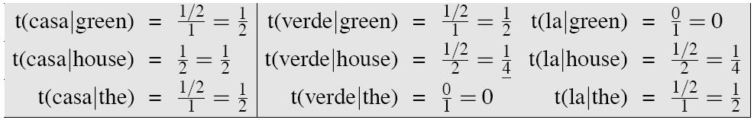
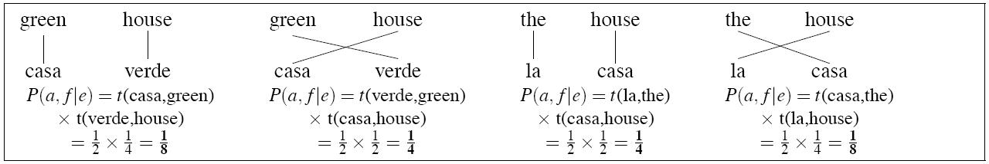
M-step 1: Compute the MLE probability params by normalizing the tcounts to sum to 1.
E-step 2a: Recompute P(a,f|e) again by multiplying the t probabilities
More iterations are needed (until convergence)

Slide 34
import itertools
corpus = [('green house','casa verde'),('the house','la casa')]
# Print corpus:
vocab1 = []
vocab2 = []
print "Sentence pairs"
for i in range(len(corpus)):
tup = corpus[i]
print i,
print '%s\t%s' % tup
vocab1 += tup[0].split()
vocab2 += tup[1].split()
# Print Vocabulary
vocab1 = list(set(vocab1))
vocab2 = list(set(vocab2))
print
print "Vocabulary"
print "Source Language:",
print vocab1
print "Target Language:",
print vocab2
print
print "EM initialization"
prob = {}
for w in vocab1:
for v in vocab2:
prob[(w,v)] = 1. / len(vocab2)
print "P(%s|%s) = %.2f\t" % (v,w,prob[(w,v)]),
print
Code by Rui Zhang

Slide 35
def E_step(prob):
print "E_step"
def compute_align(a,sent_pair):
print "\t Alignment:",
p = 1.
s = sent_pair[0].split()
t = sent_pair[1].split()
for i in range(len(a)):
w = s[i]
v = t[a[i]]
print (w,v),
p = p * prob[(w,v)]
print
print "\t p(a,f|e): %.2f" % p
return p
new_prob = {}
for w in vocab1:
for v in vocab2:
new_prob[(w,v)] = 0.
for i in range(len(corpus)):
print "Sentence Pair",i
sent_pair = corpus[i]
sent_l = len(sent_pair)
total_i = []
for a in itertools.permutations(range(sent_l)):
total_i.append(compute_align(a, sent_pair))
#normalize
#print "\tp(a,f|e):",total_i
total_i_sum = sum(total_i)
total_i = [t / total_i_sum for t in total_i]
print "\n\t Normalizing"
print "\t p(a|e,f):",total_i
print
s = sent_pair[0].split()
t = sent_pair[1].split()
cnt = 0
for a in itertools.permutations(range(sent_l)):
for j in range(len(a)):
w = s[j]
v = t[a[j]]
new_prob[(w,v)] += total_i[cnt]
cnt += 1
for w in vocab1:
total_w = 0.
for v in vocab2:
total_w += new_prob[(w,v)]
print "P(%s|%s) = %.2f\t" % (v,w,new_prob[(w,v)]),
print "total(%s) = %2.f" % (w,total_w)
return new_prob
def M_step(prob):
print "M_step"
for w in vocab1:
total_w = sum([prob[w,v] for v in vocab2])
for v in vocab2:
prob[(w,v)] = prob[(w,v)] / total_w
print "P(%s|%s) = %.2f\t" % (v,w,prob[(w,v)]),
print
return prob
for i in range(0,10):
print "step: ",i
prob = E_step(prob)
prob = M_step(prob)

Slide 36
Sentence pairs
0 green house casa verde
1 the house la casa
Vocabulary
Source Language: ['house', 'the', 'green']
Target Language: ['verde', 'casa', 'la']
EM initialization
P(verde|house) = 0.33 P(casa|house) = 0.33 P(la|house) = 0.33
P(verde|the) = 0.33 P(casa|the) = 0.33 P(la|the) = 0.33
P(verde|green) = 0.33 P(casa|green) = 0.33 P(la|green) = 0.33

Slide 37
step: 0
E_step
Sentence Pair 0
Alignment: ('green', 'casa') ('house', 'verde')
p(a,f|e): 0.11
Alignment: ('green', 'verde') ('house', 'casa')
p(a,f|e): 0.11
Normalizing
p(a|e,f): [0.5, 0.5]
Sentence Pair 1
Alignment: ('the', 'la') ('house', 'casa')
p(a,f|e): 0.11
Alignment: ('the', 'casa') ('house', 'la')
p(a,f|e): 0.11
Normalizing
p(a|e,f): [0.5, 0.5]
P(verde|house) = 0.50 P(casa|house) = 1.00 P(la|house) = 0.50 total(house) = 2
P(verde|the) = 0.00 P(casa|the) = 0.50 P(la|the) = 0.50 total(the) = 1
P(verde|green) = 0.50 P(casa|green) = 0.50 P(la|green) = 0.00 total(green) = 1
M_step
P(verde|house) = 0.25 P(casa|house) = 0.50 P(la|house) = 0.25
P(verde|the) = 0.00 P(casa|the) = 0.50 P(la|the) = 0.50
P(verde|green) = 0.50 P(casa|green) = 0.50 P(la|green) = 0.00

Slide 38
step: 1
E_step
Sentence Pair 0
Alignment: ('green', 'casa') ('house', 'verde')
p(a,f|e): 0.12
Alignment: ('green', 'verde') ('house', 'casa')
p(a,f|e): 0.25
Normalizing
p(a|e,f): [0.3333333333333333, 0.6666666666666666]
Sentence Pair 1
Alignment: ('the', 'la') ('house', 'casa')
p(a,f|e): 0.25
Alignment: ('the', 'casa') ('house', 'la')
p(a,f|e): 0.12
Normalizing
p(a|e,f): [0.6666666666666666, 0.3333333333333333]
P(verde|house) = 0.33 P(casa|house) = 1.33 P(la|house) = 0.33 total(house) = 2
P(verde|the) = 0.00 P(casa|the) = 0.33 P(la|the) = 0.67 total(the) = 1
P(verde|green) = 0.67 P(casa|green) = 0.33 P(la|green) = 0.00 total(green) = 1
M_step
P(verde|house) = 0.17 P(casa|house) = 0.67 P(la|house) = 0.17
P(verde|the) = 0.00 P(casa|the) = 0.33 P(la|the) = 0.67
P(verde|green) = 0.67 P(casa|green) = 0.33 P(la|green) = 0.00

Slide 39
step: 2
E_step
Sentence Pair 0
Alignment: ('green', 'casa') ('house', 'verde')
p(a,f|e): 0.06
Alignment: ('green', 'verde') ('house', 'casa')
p(a,f|e): 0.44
Normalizing
p(a|e,f): [0.11111111111111112, 0.888888888888889]
Sentence Pair 1
Alignment: ('the', 'la') ('house', 'casa')
p(a,f|e): 0.44
Alignment: ('the', 'casa') ('house', 'la')
p(a,f|e): 0.06
Normalizing
p(a|e,f): [0.888888888888889, 0.11111111111111112]
P(verde|house) = 0.11 P(casa|house) = 1.78 P(la|house) = 0.11 total(house) = 2
P(verde|the) = 0.00 P(casa|the) = 0.11 P(la|the) = 0.89 total(the) = 1
P(verde|green) = 0.89 P(casa|green) = 0.11 P(la|green) = 0.00 total(green) = 1
M_step
P(verde|house) = 0.06 P(casa|house) = 0.89 P(la|house) = 0.06
P(verde|the) = 0.00 P(casa|the) = 0.11 P(la|the) = 0.89
P(verde|green) = 0.89 P(casa|green) = 0.11 P(la|green) = 0.00

Slide 40
step: 3
E_step
Sentence Pair 0
Alignment: ('green', 'casa') ('house', 'verde')
p(a,f|e): 0.01
Alignment: ('green', 'verde') ('house', 'casa')
p(a,f|e): 0.79
Normalizing
p(a|e,f): [0.007751937984496124, 0.9922480620155039]
Sentence Pair 1
Alignment: ('the', 'la') ('house', 'casa')
p(a,f|e): 0.79
Alignment: ('the', 'casa') ('house', 'la')
p(a,f|e): 0.01
Normalizing
p(a|e,f): [0.9922480620155039, 0.007751937984496124]
P(verde|house) = 0.01 P(casa|house) = 1.98 P(la|house) = 0.01 total(house) = 2
P(verde|the) = 0.00 P(casa|the) = 0.01 P(la|the) = 0.99 total(the) = 1
P(verde|green) = 0.99 P(casa|green) = 0.01 P(la|green) = 0.00 total(green) = 1
M_step
P(verde|house) = 0.00 P(casa|house) = 0.99 P(la|house) = 0.00
P(verde|the) = 0.00 P(casa|the) = 0.01 P(la|the) = 0.99
P(verde|green) = 0.99 P(casa|green) = 0.01 P(la|green) = 0.00

Slide 41
corpus = [('green house','casa verde'),('the house','la casa'),('my house','mi casa')]
Sentence pairs
0 green house casa verde
1 the house la casa
2 my house mi casa
Vocabulary
Source Language: ['house', 'the', 'green', 'my']
Target Language: ['mi', 'verde', 'casa', 'la']
EM initialization
P(mi|house) = 0.25 P(verde|house) = 0.25 P(casa|house) = 0.25 P(la|house) = 0.25
P(mi|the) = 0.25 P(verde|the) = 0.25 P(casa|the) = 0.25 P(la|the) = 0.25
P(mi|green) = 0.25 P(verde|green) = 0.25 P(casa|green) = 0.25 P(la|green) = 0.25
P(mi|my) = 0.25 P(verde|my) = 0.25 P(casa|my) = 0.25 P(la|my) = 0.25
step: 0
E_step
Sentence Pair 0
Alignment: ('green', 'casa') ('house', 'verde')
p(a,f|e): 0.06
Alignment: ('green', 'verde') ('house', 'casa')
p(a,f|e): 0.06
Normalizing
p(a|e,f): [0.5, 0.5]
Sentence Pair 1
Alignment: ('the', 'la') ('house', 'casa')
p(a,f|e): 0.06
Alignment: ('the', 'casa') ('house', 'la')
p(a,f|e): 0.06
Normalizing
p(a|e,f): [0.5, 0.5]

Slide 42
Sentence Pair 2
Alignment: ('my', 'mi') ('house', 'casa')
p(a,f|e): 0.06
Alignment: ('my', 'casa') ('house', 'mi')
p(a,f|e): 0.06
Normalizing
p(a|e,f): [0.5, 0.5]
P(mi|house) = 0.50 P(verde|house) = 0.50 P(casa|house) = 1.50 P(la|house) = 0.50 total(house) = 3
P(mi|the) = 0.00 P(verde|the) = 0.00 P(casa|the) = 0.50 P(la|the) = 0.50 total(the) = 1
P(mi|green) = 0.00 P(verde|green) = 0.50 P(casa|green) = 0.50 P(la|green) = 0.00 total(green) = 1
P(mi|my) = 0.50 P(verde|my) = 0.00 P(casa|my) = 0.50 P(la|my) = 0.00 total(my) = 1
M_step
P(mi|house) = 0.17 P(verde|house) = 0.17 P(casa|house) = 0.50 P(la|house) = 0.17
P(mi|the) = 0.00 P(verde|the) = 0.00 P(casa|the) = 0.50 P(la|the) = 0.50
P(mi|green) = 0.00 P(verde|green) = 0.50 P(casa|green) = 0.50 P(la|green) = 0.00
P(mi|my) = 0.50 P(verde|my) = 0.00 P(casa|my) = 0.50 P(la|my) = 0.00
...
step: 3
...
M_step
P(mi|house) = 0.00 P(verde|house) = 0.00 P(casa|house) = 1.00 P(la|house) = 0.00
P(mi|the) = 0.00 P(verde|the) = 0.00 P(casa|the) = 0.00 P(la|the) = 1.00
P(mi|green) = 0.00 P(verde|green) = 1.00 P(casa|green) = 0.00 P(la|green) = 0.00
P(mi|my) = 1.00 P(verde|my) = 0.00 P(casa|my) = 0.00 P(la|my) = 0.00

Slide 43
corpus = [('green house','casa verde'),('the house','la casa'),('my house','mi casa'),('my houses','mis casas')]
Sentence pairs
0 green house casa verde
1 the house la casa
2 my house mi casa
3 my houses mis casas
Vocabulary
Source Language: ['house', 'the', 'green', 'my', 'houses']
Target Language: ['casa', 'la', 'mi', 'verde', 'casas', 'mis']
EM initialization
P(casa|house) = 0.17 P(la|house) = 0.17 P(mi|house) = 0.17 P(verde|house) = 0.17 P(casas|house) = 0.17 P(mis|house) = 0.17
P(casa|the) = 0.17 P(la|the) = 0.17 P(mi|the) = 0.17 P(verde|the) = 0.17 P(casas|the) = 0.17 P(mis|the) = 0.17
P(casa|green) = 0.17 P(la|green) = 0.17 P(mi|green) = 0.17 P(verde|green) = 0.17 P(casas|green) = 0.17 P(mis|green) = 0.17
P(casa|my) = 0.17 P(la|my) = 0.17 P(mi|my) = 0.17 P(verde|my) = 0.17 P(casas|my) = 0.17 P(mis|my) = 0.17
P(casa|houses) = 0.17 P(la|houses) = 0.17 P(mi|houses) = 0.17 P(verde|houses) = 0.17 P(casas|houses) = 0.17 P(mis|houses) = 0.17
step: 0
E_step
Sentence Pair 0
Alignment: ('green', 'casa') ('house', 'verde')
p(a,f|e): 0.03
Alignment: ('green', 'verde') ('house', 'casa')
p(a,f|e): 0.03
Normalizing
p(a|e,f): [0.5, 0.5]
Sentence Pair 1
Alignment: ('the', 'la') ('house', 'casa')
p(a,f|e): 0.03
Alignment: ('the', 'casa') ('house', 'la')
p(a,f|e): 0.03
Normalizing
p(a|e,f): [0.5, 0.5]

Slide 44
Sentence Pair 2
Alignment: ('my', 'mi') ('house', 'casa')
p(a,f|e): 0.03
Alignment: ('my', 'casa') ('house', 'mi')
p(a,f|e): 0.03
Normalizing
p(a|e,f): [0.5, 0.5]
Sentence Pair 3
Alignment: ('my', 'mis') ('houses', 'casas')
p(a,f|e): 0.03
Alignment: ('my', 'casas') ('houses', 'mis')
p(a,f|e): 0.03
Normalizing
p(a|e,f): [0.5, 0.5]
P(casa|house) = 1.50 P(la|house) = 0.50 P(mi|house) = 0.50 P(verde|house) = 0.50 P(casas|house) = 0.00 P(mis|house) = 0.00 total(house) = 3
P(casa|the) = 0.50 P(la|the) = 0.50 P(mi|the) = 0.00 P(verde|the) = 0.00 P(casas|the) = 0.00 P(mis|the) = 0.00 total(the) = 1
P(casa|green) = 0.50 P(la|green) = 0.00 P(mi|green) = 0.00 P(verde|green) = 0.50 P(casas|green) = 0.00 P(mis|green) = 0.00 total(green) = 1
P(casa|my) = 0.50 P(la|my) = 0.00 P(mi|my) = 0.50 P(verde|my) = 0.00 P(casas|my) = 0.50 P(mis|my) = 0.50 total(my) = 2
P(casa|houses) = 0.00 P(la|houses) = 0.00 P(mi|houses) = 0.00 P(verde|houses) = 0.00 P(casas|houses) = 0.50 P(mis|houses) = 0.50 total(houses) = 1
M_step
P(casa|house) = 0.50 P(la|house) = 0.17 P(mi|house) = 0.17 P(verde|house) = 0.17 P(casas|house) = 0.00 P(mis|house) = 0.00
P(casa|the) = 0.50 P(la|the) = 0.50 P(mi|the) = 0.00 P(verde|the) = 0.00 P(casas|the) = 0.00 P(mis|the) = 0.00
P(casa|green) = 0.50 P(la|green) = 0.00 P(mi|green) = 0.00 P(verde|green) = 0.50 P(casas|green) = 0.00 P(mis|green) = 0.00
P(casa|my) = 0.25 P(la|my) = 0.00 P(mi|my) = 0.25 P(verde|my) = 0.00 P(casas|my) = 0.25 P(mis|my) = 0.25
P(casa|houses) = 0.00 P(la|houses) = 0.00 P(mi|houses) = 0.00 P(verde|houses) = 0.00 P(casas|houses) = 0.50 P(mis|houses) = 0.50

Slide 45
step 3:
M_step
P(casa|house) = 1.00 P(la|house) = 0.00 P(mi|house) = 0.00 P(verde|house) = 0.00 P(casas|house) = 0.00 P(mis|house) = 0.00
P(casa|the) = 0.00 P(la|the) = 1.00 P(mi|the) = 0.00 P(verde|the) = 0.00 P(casas|the) = 0.00 P(mis|the) = 0.00
P(casa|green) = 0.00 P(la|green) = 0.00 P(mi|green) = 0.00 P(verde|green) = 1.00 P(casas|green) = 0.00 P(mis|green) = 0.00
P(casa|my) = 0.00 P(la|my) = 0.00 P(mi|my) = 0.50 P(verde|my) = 0.00 P(casas|my) = 0.25 P(mis|my) = 0.25
P(casa|houses) = 0.00 P(la|houses) = 0.00 P(mi|houses) = 0.00 P(verde|houses) = 0.00 P(casas|houses) = 0.50 P(mis|houses) = 0.50

Slide 46
Model 2
Distortion parameters d(i|j,l,m)
i and j are word positions in the two sentences
l and m are the lengths of these sentences
Example
q(3|2,5,6)

Slide 47
Alignments
la
maison
bleue
the
blue
house
[1,2,3]
$$p\left(a | e\right)=q\left(2 | 1,3,3\right).q\left(1 | 2,3,3\right).q(3|3,3,3)$$

Slide 48
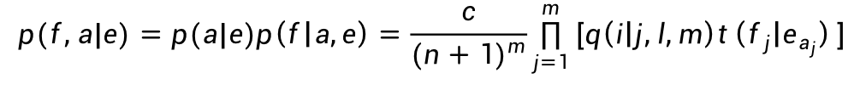
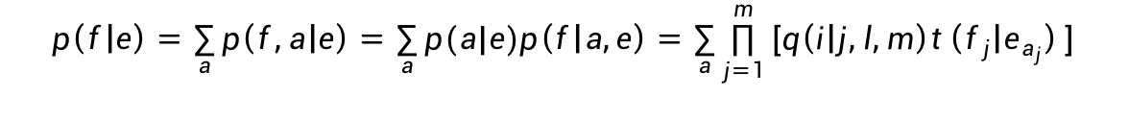
Model 2
The distortion parameters are also learned by EM
$$p(f,a|e)=p(a|e)p\left(f | a,e\right)=\frac{c}{{(n+1)}^{m}}\prod_{j=1}^{m}{[q\left(i | j,l,m\right)t\left(f_{j} | e_{a_{j}}\right)]}$$
$$p\left(f | e\right)=\sum_{a}{p\left(f,a | e\right)=\sum_{a}{p(a|e)p\left(f | a,e\right)=\sum_{a}{\prod_{j=1}^{m}{[q\left(i | j,l,m\right)t\left(f_{j} | e_{a_{j}}\right)]}}}}$$

Slide 49
Model 3
Fertility
f(φ_{i}|e)
f₀ is an extra parameter that defines φ₀
Examples
program = programme f(1|program) ≈ 1
NOUN play = pièce de théâtre f(3|play_N) ≈ 1
VERB place = mettre en place f(3|place_V) ≈ 1

Slide 50
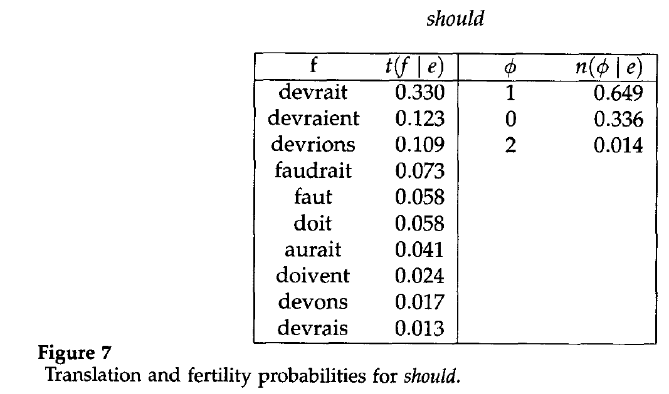
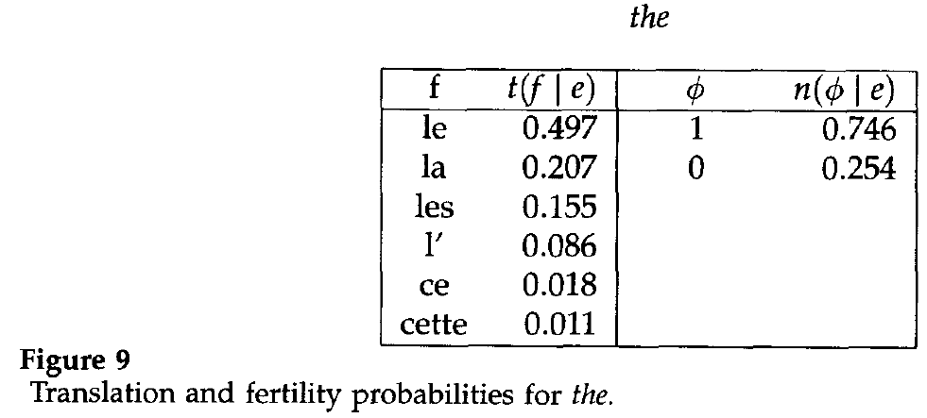
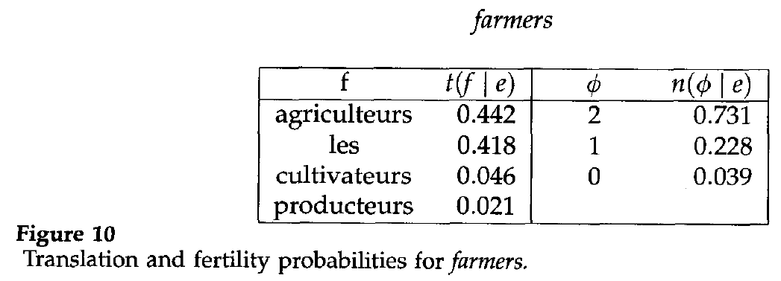
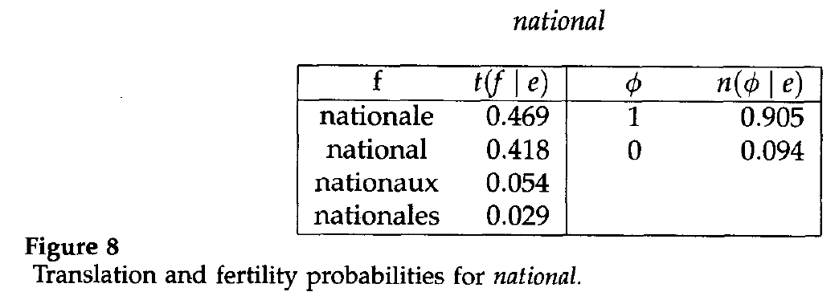
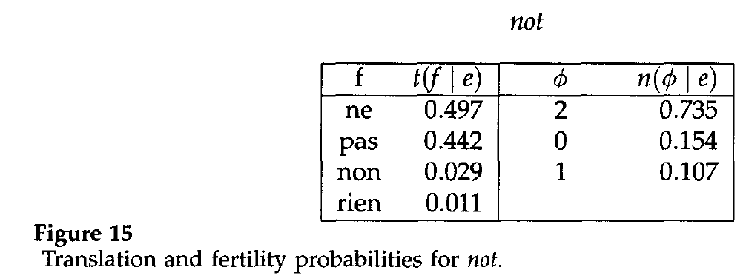
[Brown et al. 1993]

Slide 51
IBM Models 4 and 5
Model 4
Deals with relative reordering
Model 5
Fixes problems in models 1-4 that allow multiple words to appear in the same position

Slide 52
References
http://www.isi.edu/natural-language/mt/wkbk.rtf
(an awesome tutorial by Kevin Knight)
http://www.statmt.org/
(a comprehensive site, including references to the old IBM papers, pointers to Moses, etc.)

Slide 53
Machine Translation
Sentence Alignment

Slide 54
Sentence Alignment
Tokenization
Sentence alignment (1-1, 2-2, 2-1 mappings)
Church and Gale 1993
based on sentence length
similar to previous work by Brown et al. 1988

Slide 55
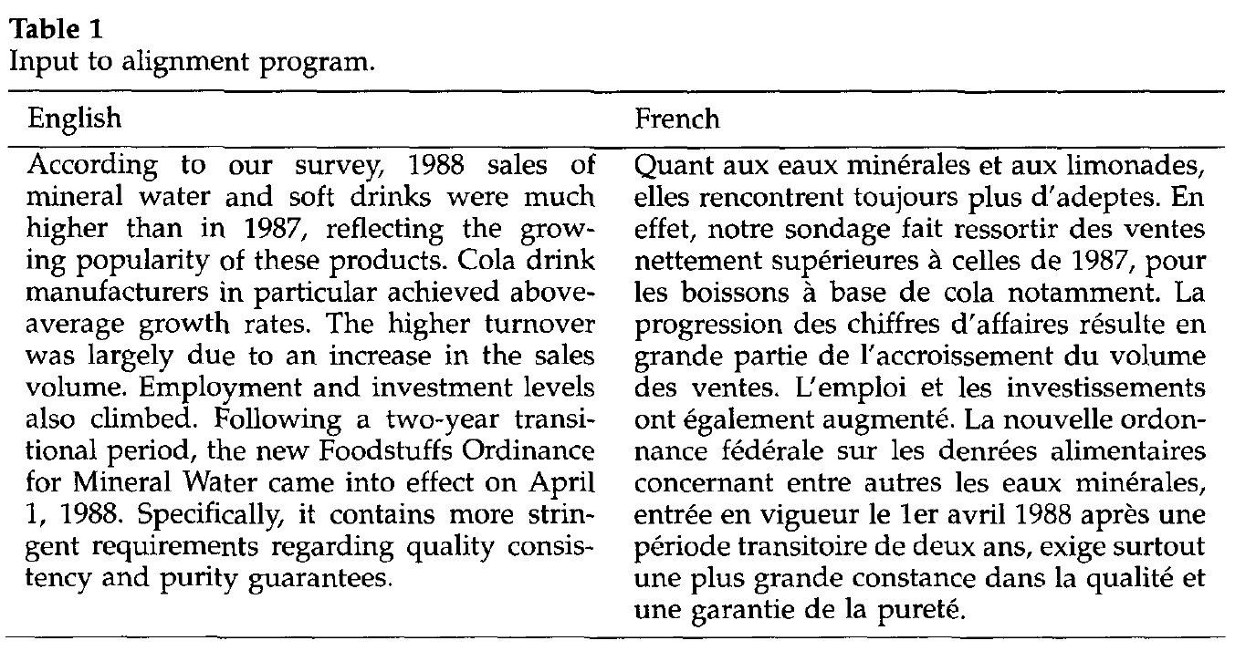

Slide 56
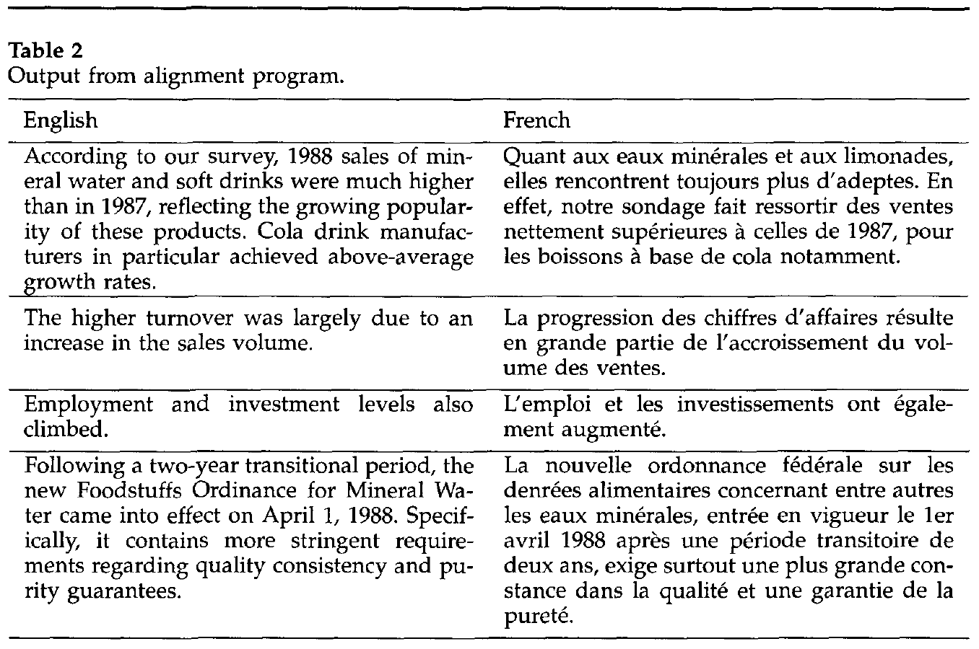

Slide 57
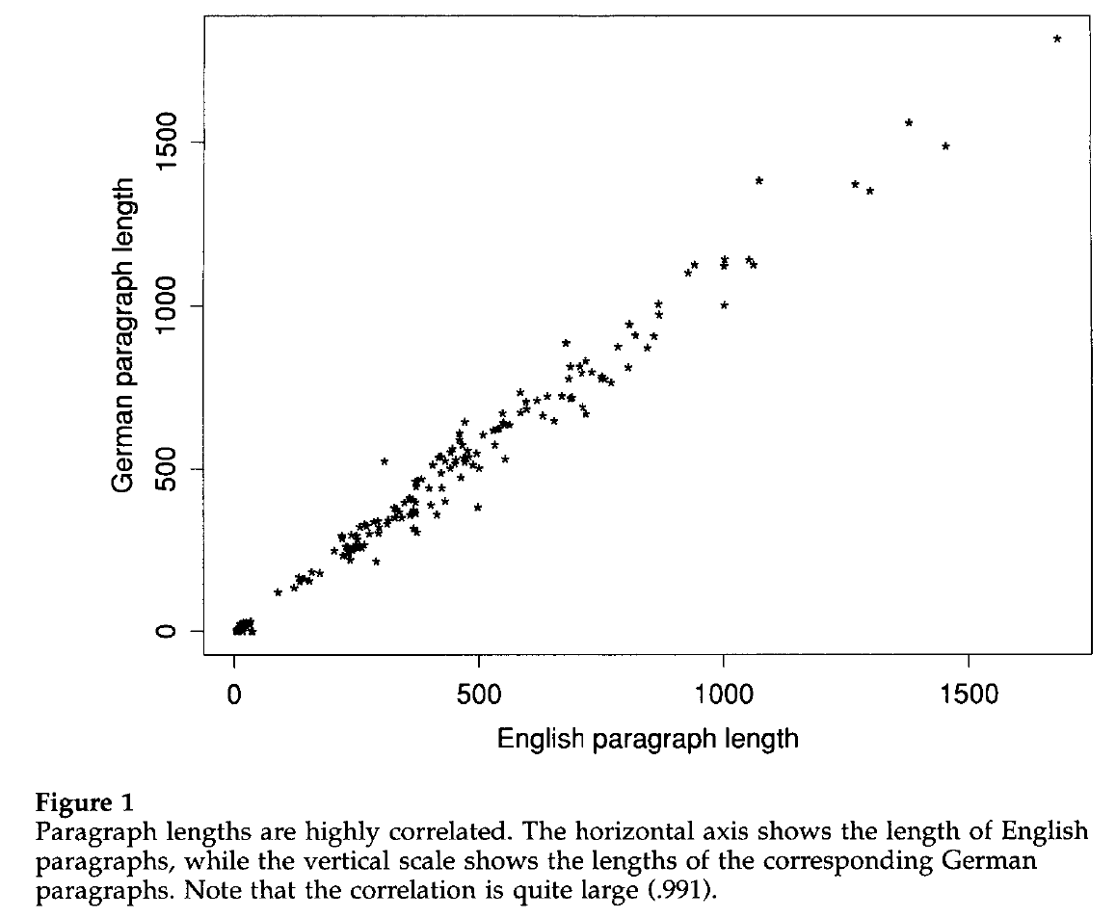
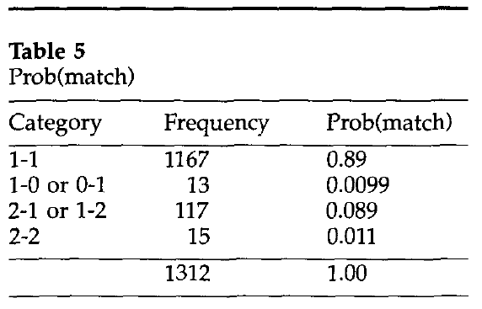
Sentence Alignment
[Church/Gale 1993]

Slide 58
NLP

