Slide 1
Summarization

Slide 2
definition
Mani and Maybury 1999:
Text summarization is the process of distilling the most important information from a text to produce an abridged version for a particular task and user

Slide 3
Genres of Summaries
headlines of a news artical 新闻标题
outlines of any document 文本大纲
abstract of a scientific article 文献摘要
snippets of a web page 网页摘要 on a search engine results page
minutes of a meeting 会议记录 key points, decisions made, actions to be taken, and who is responsible for each action.
biographies 生平
abridgments 简介 book, speech, doc
sound bites 音频节选
movie summaries 电影简介
chronologies, etc. 编年史
summary of email threads
[Mani and Maybury 1999]

Slide 4
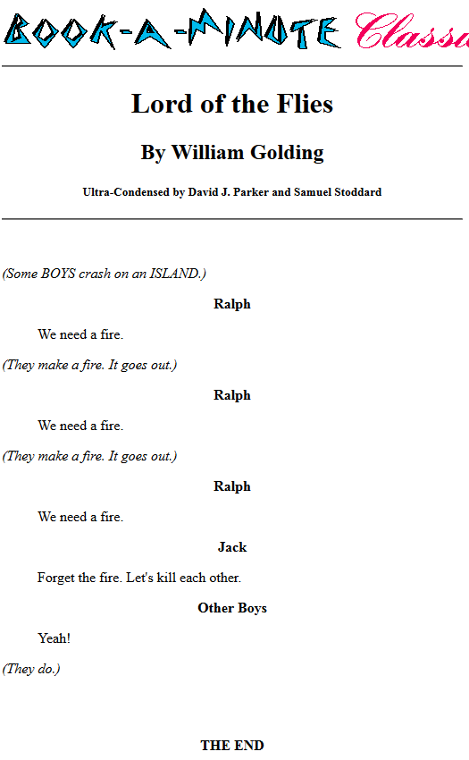
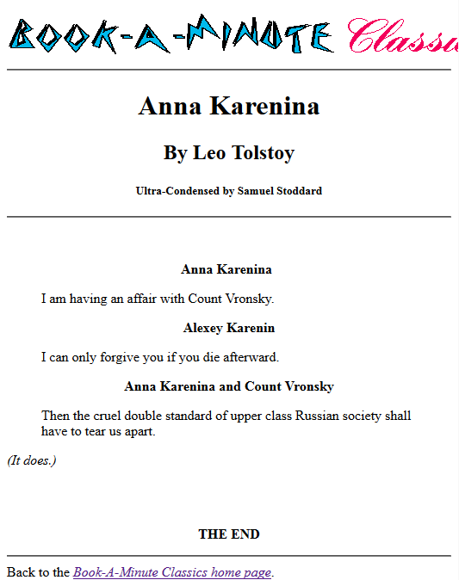
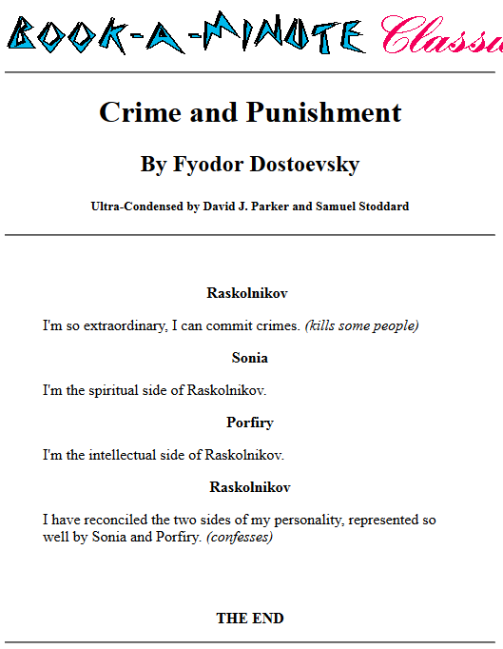
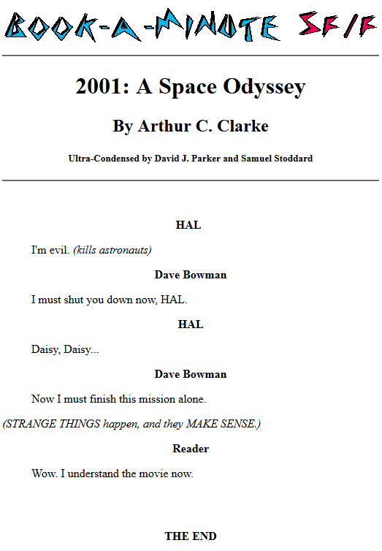

Book-summary
"Book-A-Minute" http://www.rinkworks.com/bookaminute/ is a humorous website that offers extremely condensed versions - a few lines of classic literature and popular books.

Slide 5
health guidebook
Health Benefits
Eating a diet rich in vegetables and fruits as part of an overall healthy diet may reduce risk for heart disease, including heart attack and stroke.
Eating a diet rich in some vegetables and fruits as part of an overall healthy diet may protect against certain types of cancers.
Diets rich in foods containing fiber, such as some vegetables and fruits, may reduce the risk of heart disease, obesity, and type 2 diabetes.
Eating vegetables and fruits rich in potassium as part of an overall healthy diet may lower blood pressure, and may also reduce the risk of developing kidney stones and help to decrease bone loss.
Eating foods such as vegetables that are lower in calories per cup instead of some other higher-calorie food may be useful in helping to lower calorie intake.
Nutrients
Most vegetables are naturally low in fat and calories. None have cholesterol. (Sauces or seasonings may add fat, calories, or cholesterol.)
Vegetables are important sources of many nutrients, including potassium, dietary fiber, folate (folic acid), vitamin A, and vitamin C.
Diets rich in potassium may help to maintain healthy blood pressure. Vegetable sources of potassium include sweet potatoes, white potatoes, white beans, tomato products (paste, sauce, and juice), beet greens, soybeans, lima beans, spinach, lentils, and kidney beans.
Dietary fiber from vegetables, as part of an overall healthy diet, helps reduce blood cholesterol levels and may lower risk of heart disease. Fiber is important for proper bowel function. It helps reduce constipation and diverticulosis. Fiber-containing foods such as vegetables help provide a feeling of fullness with fewer calories.
Folate (folic acid) helps the body form red blood cells. Women of childbearing age who may become pregnant should consume adequate folate from foods, and in addition 400 mcg of synthetic folic acid from fortified foods or supplements. This reduces the risk of neural tube defects, spina bifida, and anencephaly during fetal development.
Vitamin A keeps eyes and skin healthy and helps to protect against infections.
Vitamin C helps heal cuts and wounds and keeps teeth and gums healthy. Vitamin C aids in iron absorption.
Eating vegetables is healthy.

Slide 6
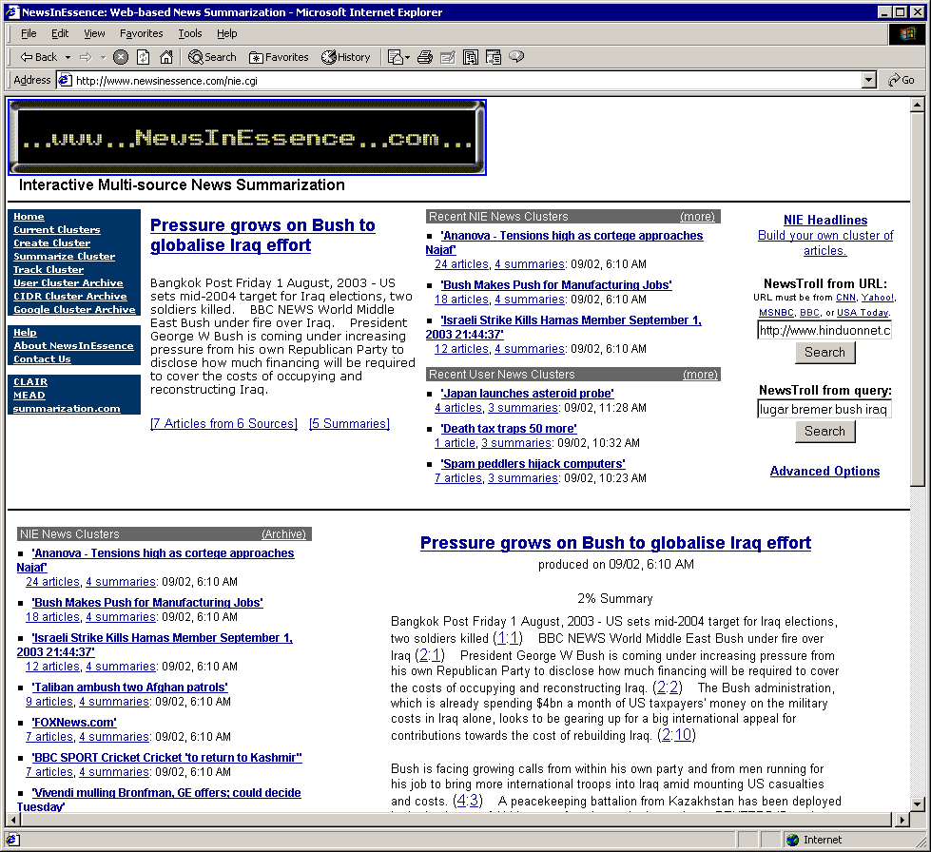
News Summarization

Slide 7
Movie Summaries
Titanic
Beginning with genuine footage of the departure of the Titanic on its fateful voyage, this epic movie tells the events of that tragic night from the perspective of fictional survivor Rose. As an old lady of 100 she recounts her story of duty, love and disaster to a salvage crew searching for a lost gem.
Winner of 11 Oscars, James Cameron's effects-driven blockbuster puts a human face on a tragedy of epic proportions by wedding the historical tale of the doomed ocean liner with a fictional romance between two of the ship's ill-fated passengers. Society girl Rose Dewitt Bukate and penniless artist Jack Dawson struggle to survive both the sinking ship -- and the wrath of Rose's wealthy fiancé.

Slide 8
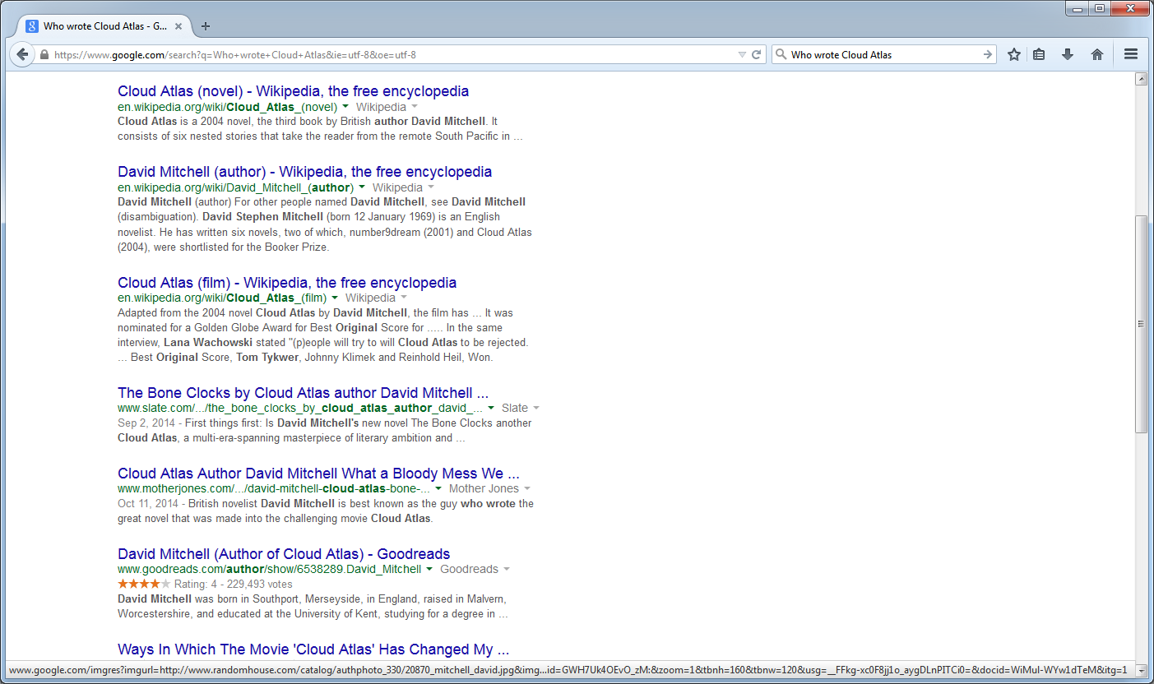
Search Engine Snippets

Slide 9
BAGHDAD, Iraq (CNN) 6 July 2004 -- Three U.S. Marines have died in al Anbar Province west of Baghdad, the Coalition Public Information Center said Tuesday. According to CPIC, "Two Marines assigned to [1st] Marine Expeditionary Force were killed in action and one Marine died of wounds received in action Monday in the Al Anbar Province while conducting security and stability operations.“ Al Anbar Province -- a hotbed for Iraqi insurgents -- includes the restive cities of Ramadi and Fallujah and runs to the Syrian and Jordanian borders. Meanwhile, officials said eight people died Monday in a U.S. air raid on a house in Fallujah that American commanders said was used to harbor Islamic militants. A senior U.S. military official told CNN the target was a group of people suspected of planning suicide attacks using vehicles. The strike was the latest in a series of raids on the city to target what U.S. military spokesmen have called safehouses for the network led by fugitive Islamic militant leader Abu Musab al-Zarqawi. A statement from Allawi said: "The people of Iraq will not tolerate terrorist groups or those who collaborate with any other foreign fighters such as the Zarqawi network to continue their wicked ways. "The sovereign nation of Iraq and our international partners are committed to stopping terrorism and will continue to hunt down these evil terrorists and weed them out, one by one. I call upon all Iraqis to close ranks and report to the authorities on the activities of these criminal cells.“ American planes dropped two 1,000-pound bombs and four 500-pound bombs on the house about 7:15 p.m. (11:15 a.m. ET), according to a statement from the U.S.-led Multi-National Force-Iraq. At least four previous air raids have targeted suspected Zarqawi safehouses in Fallujah.
Notes:
REPLACE!!!

Slide 10
type of summarization task
input: single doc vs. multiple docs
single document: a doc -> abstract/outlint/headline
Multiple document:
Redundancy avoidance: redundancy penalization term like MMR
Information ordering are based on maintaining coherence.
output: extractive, abstractive
focus: Query vs. generic
query: QA task. answer a question that need fully understanding of docs. e.g., “what is NLP?”
generic: don’t consider a particular user or a particular information need; the summary simply gives the important information in the docs

Slide 11
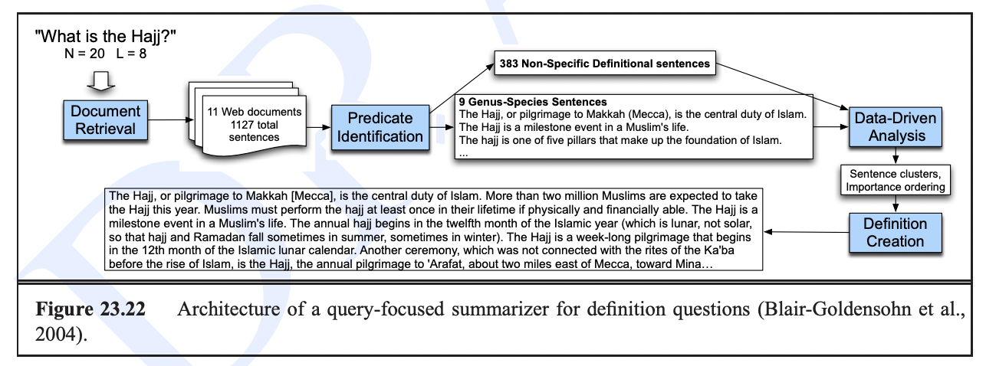
query-focused summarization task

Slide 12
type of summarization algorithm
Extractive Summarization
copy the representative sentences in docs.
baseline: first few sentences
features: position in the discourse, word informativeness, cue phrases, and sentence length.
Abstractive Summarization
create new sentences by rephrasing and condensing the text
involve natural language understanding and generation.
mimic human summarization: read and understand the content first, then convey the important information in their own words

Slide 13
history of summarization algorithm
Extractive Summarization
1950s-1960s: rule-based. Luhn (1958)
1980s-1990s: statistical. Kupiec (1995) Summons (1995) Naive Bayes classifier. Barzilay (1997). Mani (1997) Marcu (1997) Noisy Channel Berger (2000) Mead (2000) LSA (2001)
2000s: Graph-based LexRank and TextRank (2004) ROUGE
2010s:
ML: SVM DUC dataset
DL seq2seq with attention, transformer
CNN/Daily Mail dataset
Abstractive Summarization:
2000s: rule-based sentence compression and sentence fusion .
2010s: seq2seq with attention
Late 2010s-now:
Transformer-based: GPT, T5, BART.
XSum dataset: a news summarization dataset with highly abstractive summaries.

Slide 14
components of Summarization algorithm
content selection: rank sentences
information ordering: decide order of selected sentences
sentence realization.
extractive: copy selected sentences
abstractive: generate new sentences. clean up sentences (remove non-essential phrases, fuse multiple sentences into one, fix problem in coherence)

Slide 15
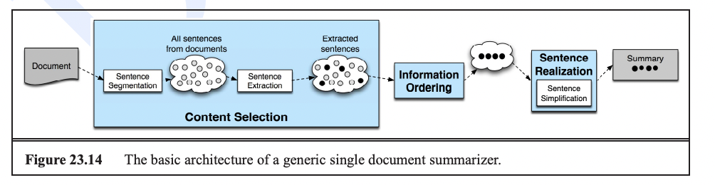
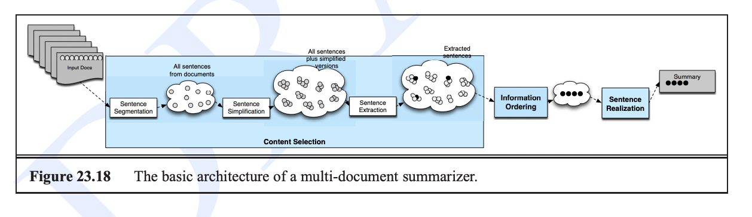
components of Summarization algorithm
single document
multiple document

Slide 16
rule-based summarization algorithm

Slide 17
Luhn (1958)
Technical documents
Stemming
Stop words are removed
Frequency of content terms
E
FREQUENCY
WORDS

Slide 18
Luhn (1958)
SENTENCE
Sentence-level significance factor
Look for concentrations of salient content terms
SIGNIFICANT WORDS
*
*
*
*
1 2 3 4 5 6 7
ALL WORDS
SCORE = 4²/7 ≈ 2.3

Slide 19
Kupiec et al. (1995)
First trainable method
20% extract
188 documents from scientific journals
Naïve Bayes classifier
New features
Sentence length (|S|>5)
Presence of uppercase words (except common acronyms)
Thematic words
Set of 26 manually fixed phrases
Sentence position in paragraph

Slide 20
Kupiec et al. (1995)
Uses Naïve Bayes classifier
Assuming statistical independence

Slide 21
Kupiec et al. (1995)
Performance:
For 25% summaries, 84% precision
For smaller summaries, 74% improvement over Lead

Slide 22
Summons (McKeown & Radev 1995)
First work on multi-document summarization
Approach
Knowledge-based
Information extraction (MUC templates)
Text generation

Slide 23
Summons (McKeown and Radev 1995)
NICOSIA, Cyprus (AP) – Two bombs exploded near government
ministries in Baghdad, but there was no immediate word of any
casualties, Iraqi dissidents reported Friday. There was no independent
confirmation of the claims by the Iraqi National Congress. Iraq’s
state-controlled media have not mentioned any bombings.
Multiple sources and disagreement
Explicit mentioning of “no information”.

Slide 24
Summons
MESSAGE: ID TST3-MUC4-0010 MESSAGE: TEMPLATE 2 INCIDENT: DATE 30 OCT 89 INCIDENT: LOCATION EL SALVADOR INCIDENT: TYPE ATTACK INCIDENT: STAGE OF EXECUTION ACCOMPLISHED INCIDENT: INSTRUMENT ID INCIDENT: INSTRUMENT TYPE PERP: INCIDENT CATEGORY TERRORIST ACT PERP: INDIVIDUAL ID "TERRORIST" PERP: ORGANIZATION ID "THE FMLN" PERP: ORG. CONFIDENCE REPORTED: "THE FMLN" PHYS TGT: ID PHYS TGT: TYPE PHYS TGT: NUMBER PHYS TGT: FOREIGN NATION PHYS TGT: EFFECT OF INCIDENT PHYS TGT: TOTAL NUMBER HUM TGT: NAME HUM TGT: DESCRIPTION "1 CIVILIAN" HUM TGT: TYPE CIVILIAN: "1 CIVILIAN" HUM TGT: NUMBER 1: "1 CIVILIAN" HUM TGT: FOREIGN NATION HUM TGT: EFFECT OF INCIDENT DEATH: "1 CIVILIAN" HUM TGT: TOTAL NUMBER
Notes:
25 slots
We add four more slots: for primary and secondary sources of the information.

Slide 25
Input: Cluster of templates
…..
T₁
T₂
T_{m}
Conceptual combiner
Domain ontology
Combiner
Planning operators
Paragraph planner
Linguistic realizer
Sentence planner
Lexicon
Lexical chooser
Sentence generator
SURGE
OUTPUT: Base summary

Slide 26
Summons
MESSAGE: ID TST-REU-0001 SECSOURCE: SOURCE Reuters SECSOURCE: DATE March 3, 1996 11:30 PRIMSOURCE: SOURCE INCIDENT: DATE March 3, 1996 INCIDENT: LOCATION Jerusalem INCIDENT: TYPE Bombing HUM TGT: NUMBER “killed: 18'' “wounded: 10” PERP: ORGANIZATION ID
MESSAGE: ID TST-REU-0002 SECSOURCE: SOURCE Reuters SECSOURCE: DATE March 4, 1996 07:20 PRIMSOURCE: SOURCE Israel Radio INCIDENT: DATE March 4, 1996 INCIDENT: LOCATION Tel Aviv INCIDENT: TYPE Bombing HUM TGT: NUMBER “killed: at least 10'' “wounded: more than 100” PERP: ORGANIZATION ID
MESSAGE: ID TST-REU-0003 SECSOURCE: SOURCE Reuters SECSOURCE: DATE March 4, 1996 14:20 PRIMSOURCE: SOURCE INCIDENT: DATE March 4, 1996 INCIDENT: LOCATION Tel Aviv INCIDENT: TYPE Bombing HUM TGT: NUMBER “killed: at least 13'' “wounded: more than 100” PERP: ORGANIZATION ID “Hamas”
MESSAGE: ID TST-REU-0004 SECSOURCE: SOURCE Reuters SECSOURCE: DATE March 4, 1996 14:30 PRIMSOURCE: SOURCE INCIDENT: DATE March 4, 1996 INCIDENT: LOCATION Tel Aviv INCIDENT: TYPE Bombing HUM TGT: NUMBER “killed: at least 12'' “wounded: 105” PERP: ORGANIZATION ID

Slide 27
Summons
Reuters reported that 18 people were killed on Sunday in a bombing in Jerusalem. The next day, a bomb in Tel Aviv killed at least 10 people and wounded 30 according to Israel radio. Reuters reported that at least 12 people were killed and 105 wounded in the second incident. Later the same day, Reuters reported that Hamas has claimed responsibility for the act.

Slide 28
Summons
If there are two templates AND the location is the same AND the time of the second template is after the time of the first template AND the source of the first template is different from the source of the second template AND at least one slot differs THEN combine the templates using the contradiction operator...

Slide 29
Summons
Change of perspective
Precondition: The same source reports a change in a small number of slots
March 4th, Reuters reported that a bomb in Tel Aviv killed at least 10 people and wounded 30. Later the same day, Reuters reported that exactly 12 people were actually killed and 105 wounded.
Notes:
Other operators: generalization, addition…
Future work: operators for including non-textual information and for generating updates

Slide 30
Summons
Contradiction
Precondition: Different sources report contradictory values for a small number of slots
The afternoon of February 26, 1993, Reuters reported that a suspected bomb killed at least six people in the World Trade Center. However, Associated Press announced that exactly five people were killed in the blast.
Notes:
Other operators: generalization, addition…
Future work: operators for including non-textual information and for generating updates

Slide 31
Summons
Refinement
On Monday morning, Reuters announced that a suicide bomber killed at least 10 people in Tel Aviv. In the afternoon, Reuters reported that Hamas claimed responsibility for the act.
Agreement
The morning of March 1st 1994, both UPI and Reuters reported that a man was kidnapped in the Bronx.
Notes:
Other operators: generalization, addition…
Future work: operators for including non-textual information and for generating updates

Slide 32
Summons
Generalization
According to UPI, three terrorists were arrested in Medellín last Tuesday. Reuters announced that the police arrested two drug traffickers in Bogotá the next day.
A total of five criminals were arrested in Colombia last week.
Notes:
Other operators: generalization, addition…
Future work: operators for including non-textual information and for generating updates

Slide 33
Mitra/Allen/Salton
Encyclopedia articles
Semantic hyperlinks
Between pairs of paragraphs with lexical similarity above a threshold
Paths linking highly connected paragraphs are more likely to contain information central to the topic of the article
…
…

Slide 34
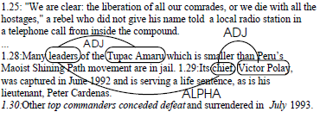
Mani/Bloedorn (1997, 1999)
Graph-based method for identifying similarities and differences between documents
Single event or sequence of events
Content entities (nodes) and relations (edges)
Relation types
SAME, ADJACENT, ALPHA (WordNet, NetOwl), COREF
Spreading activation

Slide 35
Barzilay & M. Elhadad (1997)
Lexical chains
Mr. Kenny is the person that invented the anesthetic machine which uses micro-computers to control the rate at which an anesthetic is pumped into the blood. Such machines are nothing new. But his device uses two micro-computers to achieve much closer monitoring of the pump feeding the anesthetic into the patient.

Slide 36
Barzilay and M. Elhadad (1997)
WordNet-based
Three types of relations:
extra-strong (repetitions)
strong (WordNet relations)
medium-strong (link between synsets is longer than one + some additional constraints)

Slide 37
Barzilay and M. Elhadad (1997)
Scoring chains:
Length
Homogeneity index: = 1 – (# distinct words in chain, divided by length) Score = Length * Homogeneity Score > Average + 2 * st.dev.
http://research.microsoft.com/en-us/um/people/cyl/download/papers/lexical-chains.pdf

Slide 38
Marcu (1997-1999)
Focuses on text coherence
Based on Rhetorical Structure Theory (Mann and Thompson 1988)
Nucleus+Satellite
Example: evidence
N+S combination increases reader’s belief in N
[The truth is that the pressure to smoke in junior high is greater than it will be any other time of one’s life:]_{N} [we know that 3,000 teens start smoking each day.]_{S}

Slide 39
With its distant orbit (50 percent farther from the sun than Earth) and slim atmospheric blanket, (1)
Mars experiences frigid weather conditions (2)
Surface temperatures typically average about -60 degrees Celsius (-76 degrees Fahrenheit) at the equator and can dip to -123 degrees C near the poles (3)
Only the midday sun at tropical latitudes is warm enough to thaw ice on occasion, (4)
but any liquid water formed in this way would evaporate almost instantly (5)
because of the low atmospheric pressure (6)
Although the atmosphere holds a small amount of water, and water-ice clouds sometimes develop, (7)
Most Martian weather involves blowing dust and carbon monoxide. (8)
Each winter, for example, a blizzard of frozen carbon dioxide rages over one pole, and a few meters of this dry-ice snow accumulate as previously frozen carbon dioxide evaporates from the opposite polar cap. (9)
Yet even on the summer pole, where the sun remains in the sky all day long, temperatures never warm enough to melt frozen water. (10)

Slide 40
2 Elaboration
2 Elaboration
8 Example
2 Background Justification
3 Elaboration
8 Concession
10 Antithesis
With its distant orbit (50 percent farther from the sun than Earth) and slim atmospheric blanket, (1)
Mars experiences frigid weather conditions (2)
Surface temperatures typically average about -60 degrees Celsius (-76 degrees Fahrenheit) at the equator and can dip to -123 degrees C near the poles (3)
4 5 Contrast
Although the atmosphere holds a small amount of water, and water-ice clouds sometimes develop, (7)
Most Martian weather involves blowing dust and carbon monoxide. (8)
Each winter, for example, a blizzard of frozen carbon dioxide rages over one pole, and a few meters of this dry-ice snow accumulate as previously frozen carbon dioxide evaporates from the opposite polar cap. (9)
Yet even on the summer pole, where the sun remains in the sky all day long, temperatures never warm enough to melt frozen water. (10)
Only the midday sun at tropical latitudes is warm enough to thaw ice on occasion, (4)
5 Evidence Cause
but any liquid water formed in this way would evaporate almost instantly (5)
because of the low atmospheric pressure (6)

Slide 41
2 Elaboration
2 Elaboration
8 Example
2 Background Justification
3 Elaboration
8 Concession
10 Antithesis
With its distant orbit (50 percent farther from the sun than Earth) and slim atmospheric blanket, (1)
Mars experiences frigid weather conditions (2)
Surface temperatures typically average about -60 degrees Celsius (-76 degrees Fahrenheit) at the equator and can dip to -123 degrees C near the poles (3)
4 5 Contrast
Although the atmosphere holds a small amount of water, and water-ice clouds sometimes develop, (7)
Most Martian weather involves blowing dust and carbon monoxide. (8)
Each winter, for example, a blizzard of frozen carbon dioxide rages over one pole, and a few meters of this dry-ice snow accumulate as previously frozen carbon dioxide evaporates from the opposite polar cap. (9)
Yet even on the summer pole, where the sun remains in the sky all day long, temperatures never warm enough to melt frozen water. (10)
Only the midday sun at tropical latitudes is warm enough to thaw ice on occasion, (4)
5 Evidence Cause
but any liquid water formed in this way would evaporate almost instantly (5)
because of the low atmospheric pressure (6)

Slide 42
2 Elaboration
2 Elaboration
8 Example
2 Background Justification
3 Elaboration
8 Concession
10 Antithesis
With its distant orbit (50 percent farther from the sun than Earth) and slim atmospheric blanket, (1)
Mars experiences frigid weather conditions (2)
Surface temperatures typically average about -60 degrees Celsius (-76 degrees Fahrenheit) at the equator and can dip to -123 degrees C near the poles (3)
4 5 Contrast
Although the atmosphere holds a small amount of water, and water-ice clouds sometimes develop, (7)
Most Martian weather involves blowing dust and carbon monoxide. (8)
Each winter, for example, a blizzard of frozen carbon dioxide rages over one pole, and a few meters of this dry-ice snow accumulate as previously frozen carbon dioxide evaporates from the opposite polar cap. (9)
Yet even on the summer pole, where the sun remains in the sky all day long, temperatures never warm enough to melt frozen water. (10)
Only the midday sun at tropical latitudes is warm enough to thaw ice on occasion, (4)
5 Evidence Cause
but any liquid water formed in this way would evaporate almost instantly (5)
because of the low atmospheric pressure (6)

Slide 43
2 Elaboration
2 Elaboration
8 Example
2 Background Justification
3 Elaboration
8 Concession
10 Antithesis
With its distant orbit (50 percent farther from the sun than Earth) and slim atmospheric blanket, (1)
Mars experiences frigid weather conditions (2)
Surface temperatures typically average about -60 degrees Celsius (-76 degrees Fahrenheit) at the equator and can dip to -123 degrees C near the poles (3)
4 5 Contrast
Although the atmosphere holds a small amount of water, and water-ice clouds sometimes develop, (7)
Most Martian weather involves blowing dust and carbon monoxide. (8)
Each winter, for example, a blizzard of frozen carbon dioxide rages over one pole, and a few meters of this dry-ice snow accumulate as previously frozen carbon dioxide evaporates from the opposite polar cap. (9)
Yet even on the summer pole, where the sun remains in the sky all day long, temperatures never warm enough to melt frozen water. (10)
Only the midday sun at tropical latitudes is warm enough to thaw ice on occasion, (4)
5 Evidence Cause
but any liquid water formed in this way would evaporate almost instantly (5)
because of the low atmospheric pressure (6)

Slide 44
Noisy Channel Models
Source/target language
Coding process
Noisy channel
Recovery
e
f
e*

Slide 45
Berger and Mittal 2000
Source language
full document
Target language
Summary
Gisting (OCELOT)
g* = argmax p(g|d) = argmax p(g) . p(d|g)
g
g

Slide 46
Berger & Mittal 2000
Training on 100K summary+document pairs
Testing on 1046 pairs
Use Viterbi-type search
Evaluation: word overlap (0.2-0.4)
No word ordering

Slide 47
Berger & Mittal 2000
Sample output:
Audubon society atlanta area savannah georgia chatham and local birding savannah keepers chapter of the audubon georgia and leasing

Slide 48
Carbonell and Goldstein (1998)
Maximal marginal relevance
Greedy selection method
Query-based summaries
Law of diminishing returns
C = doc collection
Q = user query
R = IR(C,Q,θ)
S = already retrieved documents
Sim = similarity metric used
MMR = argmax [ λ (Sim₁(D_{i},Q) - (1-λ) max Sim₂(D_{i},D_{j})]
D_{i}∈R\S
D_{j}∈S

Slide 49
Mead (Radev et al. 2000)
Salience-based extractive summarization
Centroid-based method
Vector space model
Features: position, length, centroid
Reranker – similar to MMR
Open source library- www.summarization.com/mead

Slide 50
Mead
Term 1
Document
Term 3
α
Centroid
Term 2

Slide 51
Mead
Input
Cluster of d documents with n sentences (compression rate = r)
Output
(n * r) sentences from the cluster with the highest scores
SCORE (s) = Σ_{i} (w_{c}C_{i} + w_{p}P_{i} + w_{f}F_{i})

Slide 52
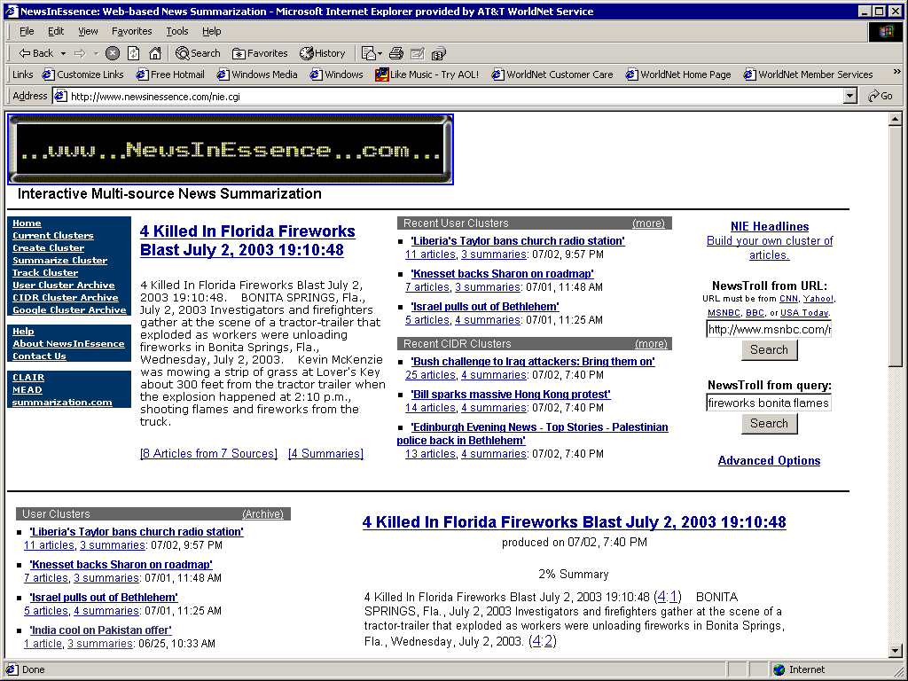
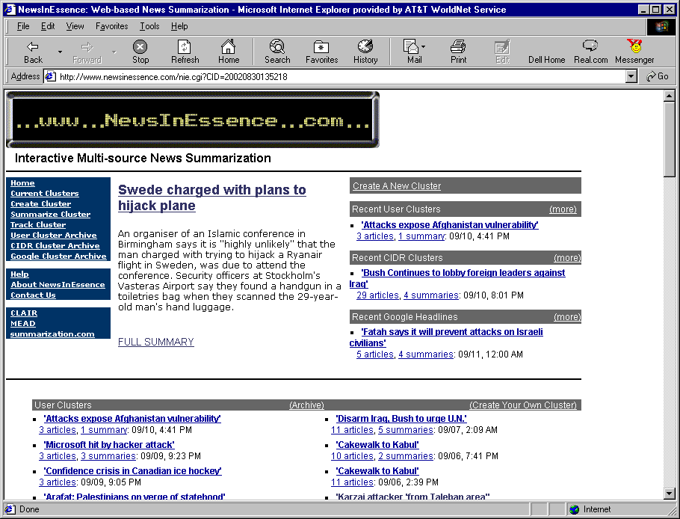
NewsInEssence (Radev et al. 2001)
Web-based multi-document news summarization system

Slide 53
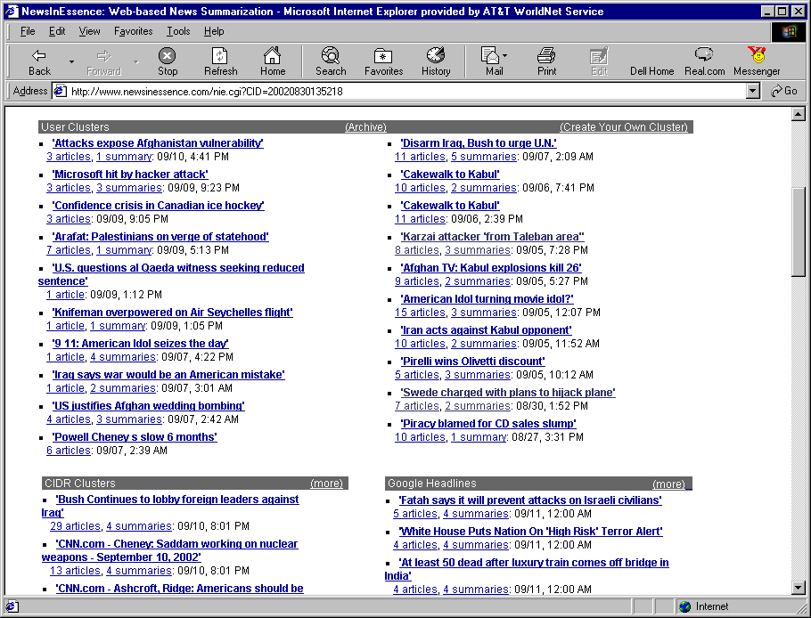
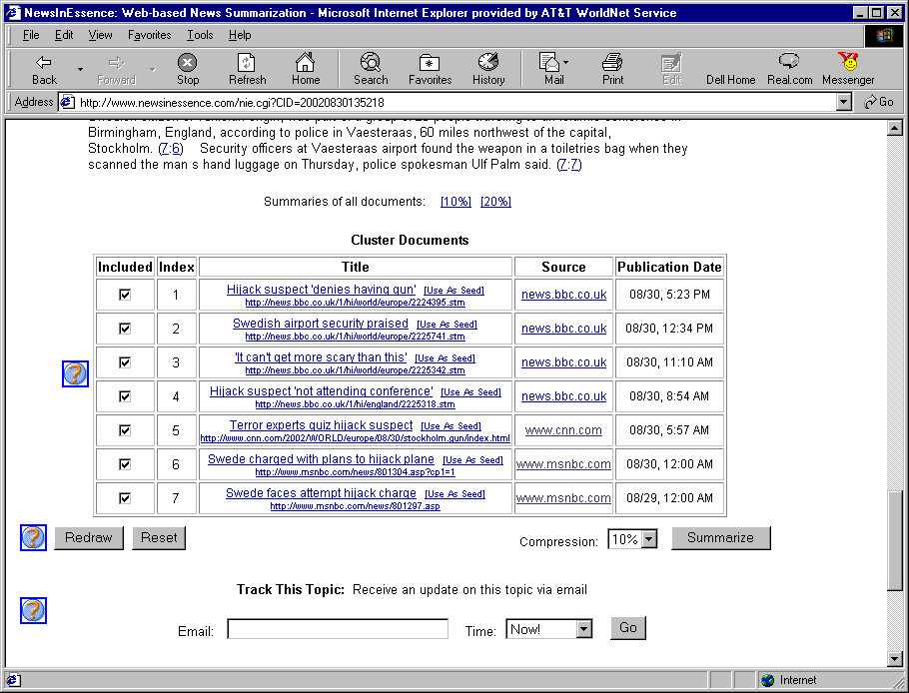
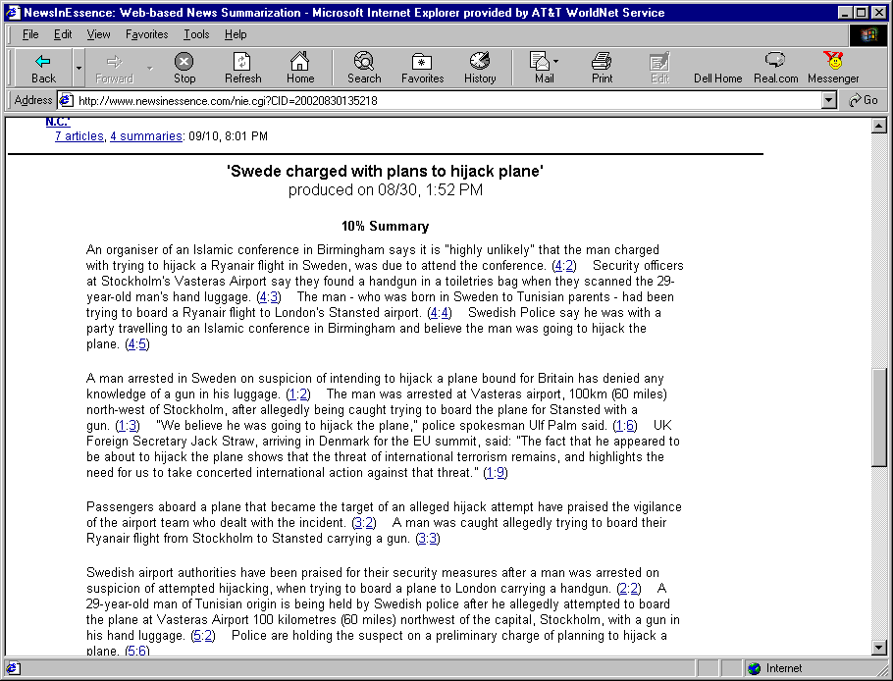
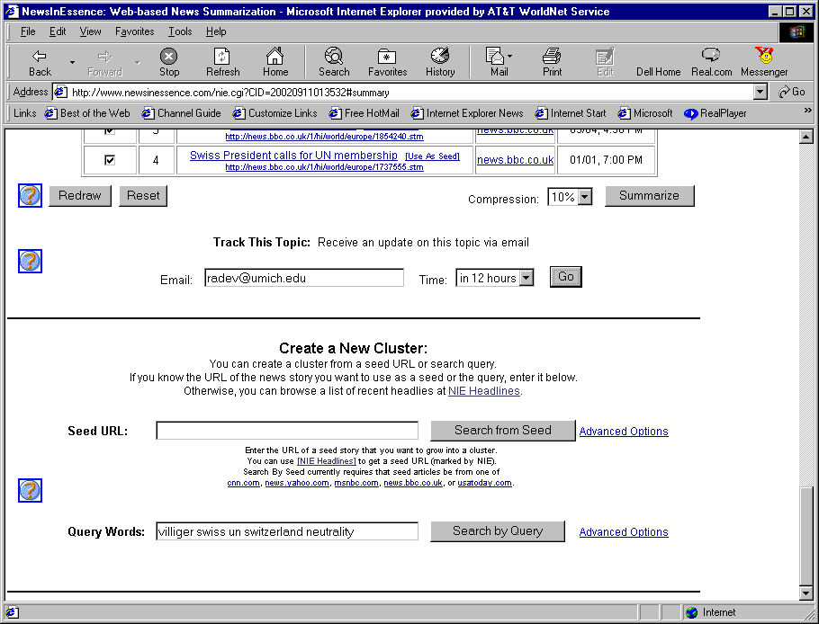

Slide 54
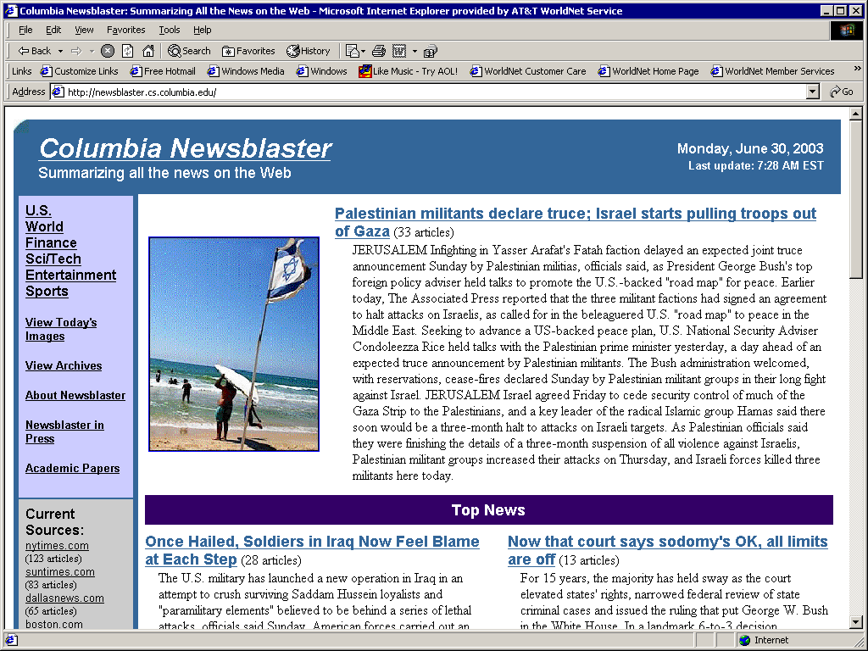
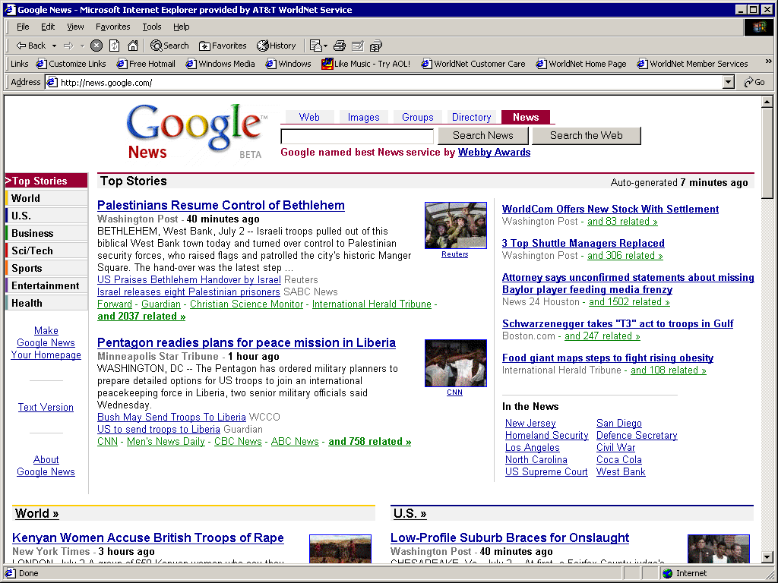
Other News Summarization Systems
Newsblaster (McKeown et al. 2002)
Google News

Slide 55
Lexrank (Erkan and Radev 2004)
Single and multi-document summarization
Lexical Centrality
Represent text as graph
Graph centrality
Graph clustering
Random walks

Slide 56
Lexrank
1 (d1s1) Iraqi Vice President Taha Yassin Ramadan announced today, Sunday, that Iraq refuses to back down from its decision to stop cooperating with disarmament inspectors before its demands are met.
2 (d2s1) Iraqi Vice president Taha Yassin Ramadan announced today, Thursday, that Iraq rejects cooperating with the United Nations except on the issue of lifting the blockade imposed upon it since the year 1990.
3 (d2s2) Ramadan told reporters in Baghdad that "Iraq cannot deal positively with whoever represents the Security Council unless there was a clear stance on the issue of lifting the blockade off of it.
4 (d2s3) Baghdad had decided late last October to completely cease cooperating with the inspectors of the United Nations Special Commission (UNSCOM), in charge of disarming Iraq's weapons, and whose work became very limited since the fifth of August, and announced it will not resume its cooperation with the Commission even if it were subjected to a military operation.
5 (d3s1) The Russian Foreign Minister, Igor Ivanov, warned today, Wednesday against using force against Iraq, which will destroy, according to him, seven years of difficult diplomatic work and will complicate the regional situation in the area.
6 (d3s2) Ivanov contended that carrying out air strikes against Iraq, who refuses to cooperate with the United Nations inspectors, ``will end the tremendous work achieved by the international group during the past seven years and will complicate the situation in the region.''
7 (d3s3) Nevertheless, Ivanov stressed that Baghdad must resume working with the Special Commission in charge of disarming the Iraqi weapons of mass destruction (UNSCOM).
8 (d4s1) The Special Representative of the United Nations Secretary-General in Baghdad, Prakash Shah, announced today, Wednesday, after meeting with the Iraqi Deputy Prime Minister Tariq Aziz, that Iraq refuses to back down from its decision to cut off cooperation with the disarmament inspectors.
9 (d5s1) British Prime Minister Tony Blair said today, Sunday, that the crisis between the international community and Iraq ``did not end'' and that Britain is still ``ready, prepared, and able to strike Iraq.''
10 (d5s2) In a gathering with the press held at the Prime Minister's office, Blair contended that the crisis with Iraq ``will not end until Iraq has absolutely and unconditionally respected its commitments'' towards the United Nations.
11 (d5s3) A spokesman for Tony Blair had indicated that the British Prime Minister gave permission to British Air Force Tornado planes stationed in Kuwait to join the aerial bombardment against Iraq.

Slide 57
Lexrank
 | 1 | 2 | 3 | 4 | 5 | 6 | 7 | 8 | 9 | 10 | 11
1 | 1.00 | 0.45 | 0.02 | 0.17 | 0.03 | 0.22 | 0.03 | 0.28 | 0.06 | 0.06 | 0.00
2 | 0.45 | 1.00 | 0.16 | 0.27 | 0.03 | 0.19 | 0.03 | 0.21 | 0.03 | 0.15 | 0.00
3 | 0.02 | 0.16 | 1.00 | 0.03 | 0.00 | 0.01 | 0.03 | 0.04 | 0.00 | 0.01 | 0.00
4 | 0.17 | 0.27 | 0.03 | 1.00 | 0.01 | 0.16 | 0.28 | 0.17 | 0.00 | 0.09 | 0.01
5 | 0.03 | 0.03 | 0.00 | 0.01 | 1.00 | 0.29 | 0.05 | 0.15 | 0.20 | 0.04 | 0.18
6 | 0.22 | 0.19 | 0.01 | 0.16 | 0.29 | 1.00 | 0.05 | 0.29 | 0.04 | 0.20 | 0.03
7 | 0.03 | 0.03 | 0.03 | 0.28 | 0.05 | 0.05 | 1.00 | 0.06 | 0.00 | 0.00 | 0.01
8 | 0.28 | 0.21 | 0.04 | 0.17 | 0.15 | 0.29 | 0.06 | 1.00 | 0.25 | 0.20 | 0.17
9 | 0.06 | 0.03 | 0.00 | 0.00 | 0.20 | 0.04 | 0.00 | 0.25 | 1.00 | 0.26 | 0.38
10 | 0.06 | 0.15 | 0.01 | 0.09 | 0.04 | 0.20 | 0.00 | 0.20 | 0.26 | 1.00 | 0.12
11 | 0.00 | 0.00 | 0.00 | 0.01 | 0.18 | 0.03 | 0.01 | 0.17 | 0.38 | 0.12 | 1.00

Slide 58
Lexrank
 | 1 | 2 | 3 | 4 | 5 | 6 | 7 | 8 | 9 | 10 | 11
1 | 1.00 | 0.45 | 0.02 | 0.17 | 0.03 | 0.22 | 0.03 | 0.28 | 0.06 | 0.06 | 0.00
2 | 0.45 | 1.00 | 0.16 | 0.27 | 0.03 | 0.19 | 0.03 | 0.21 | 0.03 | 0.15 | 0.00
3 | 0.02 | 0.16 | 1.00 | 0.03 | 0.00 | 0.01 | 0.03 | 0.04 | 0.00 | 0.01 | 0.00
4 | 0.17 | 0.27 | 0.03 | 1.00 | 0.01 | 0.16 | 0.28 | 0.17 | 0.00 | 0.09 | 0.01
5 | 0.03 | 0.03 | 0.00 | 0.01 | 1.00 | 0.29 | 0.05 | 0.15 | 0.20 | 0.04 | 0.18
6 | 0.22 | 0.19 | 0.01 | 0.16 | 0.29 | 1.00 | 0.05 | 0.29 | 0.04 | 0.20 | 0.03
7 | 0.03 | 0.03 | 0.03 | 0.28 | 0.05 | 0.05 | 1.00 | 0.06 | 0.00 | 0.00 | 0.01
8 | 0.28 | 0.21 | 0.04 | 0.17 | 0.15 | 0.29 | 0.06 | 1.00 | 0.25 | 0.20 | 0.17
9 | 0.06 | 0.03 | 0.00 | 0.00 | 0.20 | 0.04 | 0.00 | 0.25 | 1.00 | 0.26 | 0.38
10 | 0.06 | 0.15 | 0.01 | 0.09 | 0.04 | 0.20 | 0.00 | 0.20 | 0.26 | 1.00 | 0.12
11 | 0.00 | 0.00 | 0.00 | 0.01 | 0.18 | 0.03 | 0.01 | 0.17 | 0.38 | 0.12 | 1.00

Slide 59
Cosine centrality (t=0.3)
d3s3
d2s3
d3s2
d3s1
d1s1
d4s1
d2s1
d5s1
d5s2
d5s3
d2s2

Slide 60
Cosine centrality (t=0.2)
d3s3
d2s3
d3s2
d3s1
d1s1
d4s1
d2s1
d5s1
d5s2
d5s3
d2s2

Slide 61
Cosine centrality (t=0.1)
d3s3
d2s3
d3s2
d3s1
d1s1
d4s1
d2s1
d5s1
d5s2
d5s3
d2s2
Sentences vote for the most central sentence!

Slide 62
Cosine centrality (t=0.1)
d3s3
d2s3
d3s2
d3s1
d1s1
d4s1
d2s1
d5s1
d5s2
d5s3
d2s2
Sentences vote for the most central sentence!

Slide 63
Lexrank
Square connectivity matrix
Directed vs. undirected
An eigenvalue for a square matrix A is a scalar λ such that there exists a vector x≠0 such that Ax = λx
The normalized eigenvector associated with the largest λ is called the principal eigenvector of A
A matrix is called a stochastic matrix when the sum of entries in each row sum to 1 and none is negative. All stochastic matrices have a principal eigenvector

Slide 64
Lexrank
The connectivity matrix used in PageRank [Page & al. 1998] is irreducible [Langville & Meyer 2003]
An iterative method (power method) can be used to compute the principal eigenvector
That eigenvector corresponds to the stationary value of the Markov stochastic process described by the connectivity matrix
This is also equivalent to performing a random walk on the matrix

Slide 65
Lexrank
The stationary value of the Markov stochastic matrix can be computed using an iterative power method:
PageRank adds an extra twist to deal with dead-end pages. With a probability 1-ε, a random starting point is chosen. This has a natural interpretation in the case of Web page ranking
Eigenvector centrality: the paths in the random walk are weighted by the centrality of the nodes that the path connects
su = successor nodes
pr = predecessor nodes

Slide 66
Gong and Liu (2001)
Using Latent Semantic Analysis (LSA)
Single and multi-document
Each document is represented as a word by sentence matrix (row=word, column=sentence)
TF*IDF weights in the matrix
SVD: A = USV^{T}
The rows of V^{T} are independent topics
Select sentences that cover these independent topics

Slide 67
multi-document summarization
avoiding redundancy:

Slide 68
Introduction to NLP
Sentence Simplification

Slide 69
Sentence Simplification
Removing some parts of sentences
Quotes
Appositions
Adjectives and adverbs
Embedded clauses
Attribution clauses
Applications
Subtitling
Headline generation
Mobile devices
Applications for the visually impaired

Slide 70
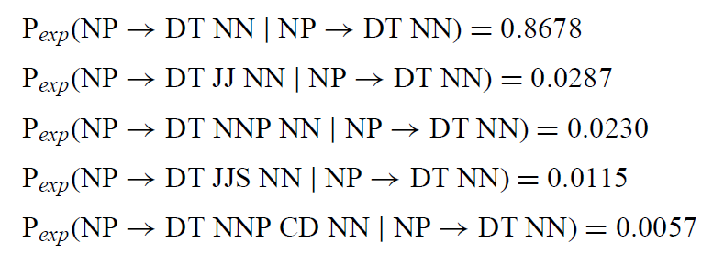
Knight and Marcu 2002
Use structured (syntactic) information
Two approaches
Noisy channel
Decision based

Slide 71
Knight and Marcu 2002
The documentation is typical of Epson quality; excellent.
Documentation is excellent.
All of our design goals were achieved and the delivered performance matches the speed of the underlying device.
All design goals were achieved.
Although the modules themselves may be physically and/or electronically incompatible, the cable-specific jacks on them provide industry-standard connections.
Cable-specific jacks provide industry-standard connections.
Beyond the basic level, the operations of the three products vary widely.
The operations of the three products vary widely.
Arborscan is reliable and worked accurately in testing, but it produces very large dxf files.
Arborscan produces very large dxf files.
Many debugging features, including user-defined break points and variable-watching and message-watching windows, have been added.
Many debugging features have been added.

Slide 72
English Wikipedia
Anthony Charles Lynton Blair (born 6 May 1953)^{[1]} is a former British Labour Party politician who served as the Prime Minister of the United Kingdom from 2 May 1997 to 27 June 2007. He was the Member of Parliament (MP) for Sedgefield from 1983 to 2007 and Leader of the Labour Party from 1994 to 2007. He resigned from all of these positions in June 2007.
Tony Blair was elected Leader of the Labour Party in the leadership election of July 1994, following the sudden death of his predecessor, John Smith. Under his leadership, the party adopted the term "New Labour"^{[2]} and moved away from its traditional left wing position towards the centre ground.^{[3][4]} Blair subsequently led Labour to a landslide victory in the 1997 general election. At 43 years old, he became the youngest Prime Minister since Lord Liverpool in 1812. In the first years of the New Labour government, Blair's government implemented a number of 1997 manifesto pledges, introducing the minimum wage, Human Rights Act and Freedom of Information Act, and carrying out regional devolution, establishing the Scottish Parliament, the National Assembly for Wales, and the Northern Ireland Assembly.
Blair's role as Prime Minister was particularly visible in foreign and security policy, including in Northern Ireland, where he was involved in the 1998 Good Friday Agreement. From the start of the War on Terror in 2001, Blair strongly supported the foreign policy of US President George W. Bush, notably by participating in the 2001 invasion of Afghanistan and 2003 invasion of Iraq. Blair is the Labour Party's longest-serving Prime Minister, the only person to have led the Labour Party to three consecutive general election victories, and the only Labour Prime Minister to serve consecutive terms more than one of which was at least four years long.
He was succeeded as Leader of the Labour Party on 24 June 2007 and as Prime Minister on 27 June 2007 by Gordon Brown.^{[5]} On the day he resigned as Prime Minister, he was appointed the official Envoy of the Quartet on the Middle East. In May 2008, Blair launched his Tony Blair Faith Foundation.^{[6]} This was followed in July 2009 by the launching of the Faith and Globalisation Initiative with Yale University in the USA, Durham University in the UK and the National University of Singapore in Asia to deliver a postgraduate programme in partnership with the Foundation.^{[7][8]}

Slide 73
Simple English Wikipedia
Anthony Charles Lyton Blair, usually called Tony Blair, is a former Prime Minister of the United Kingdom. He was born in Edinburgh. He was Prime Minister from May 1997 until June 2007 and was succeeded by the former Chancellor of the Exchequer, Gordon Brown.
As leader of the Labour party, he won three general elections in the UK, in 1997, 2001 and 2005. He is married to Cherie Booth. They met on the top deck of a double-decker bus in 1975. Cherie claimed "It was a double-decker and we went upstairs. It was completely empty and by the time we got off we knew each other better than when we'd got on. And even better the next morning. He was a very good-looking young man, tall and slim, yet broad in the shoulders. A really strong body."^{[1]}. Cherie Blair is a lawyer, who graduated from the London School of Economics with a first class honours degree. Blair himself left Oxford University with a second class degree. They have four children, Euan, Nicky, Kathryn, and Leo. There was a controversy over Blair sending his eldest son Euan to a grant-maintained school. As a result of this, Alastair Campbell discovered Blair "standing stark naked reading the Daily Mail"^{[2]}
He attributes his success in politics to a pair of lucky brogues which he wore for every single Prime Ministers Questions of his leadership. He claimed that "cheap shoes are a false economy".^{[3]}

Slide 74
Neural Summarization

Slide 75
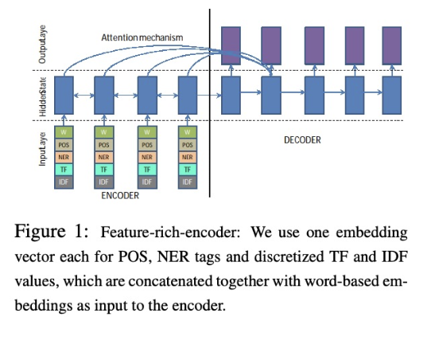
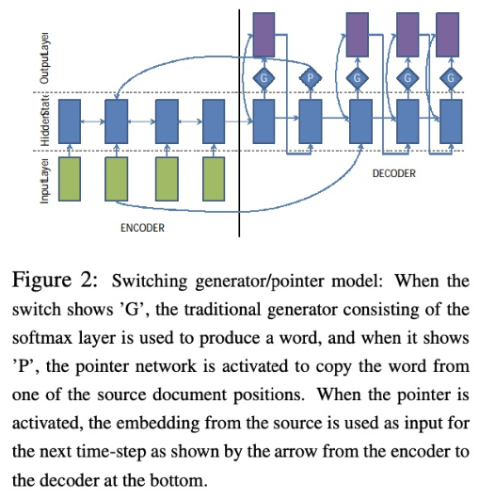
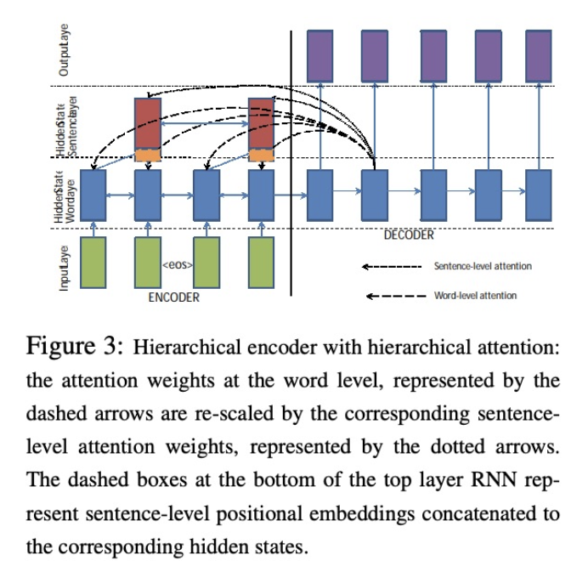
various seq2seq with attention architecture
Nallapati et al, CoNLL 2016

Slide 76
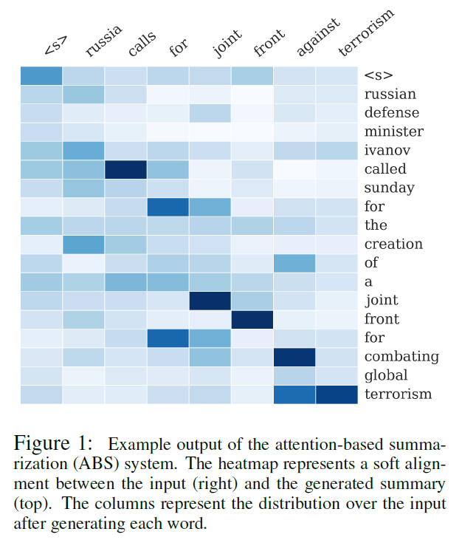
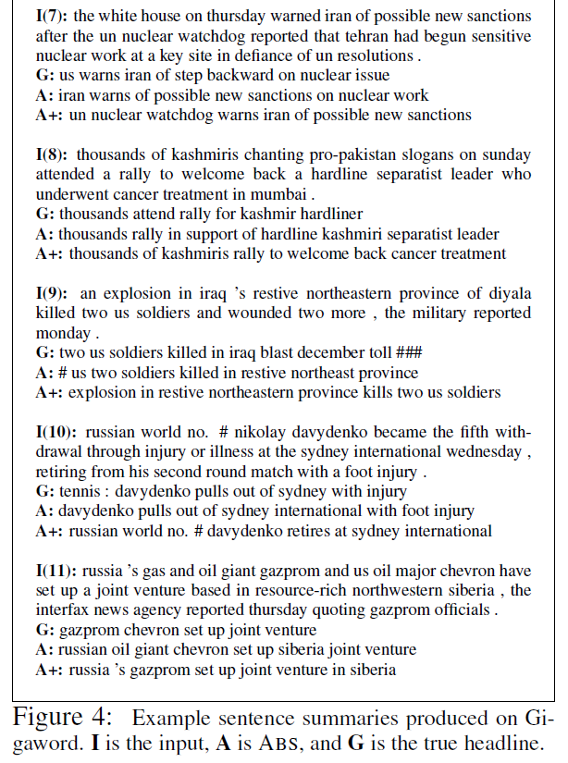
A Neural Attention Model for Abstractive Sentence Summarization
[Rush, Chopra, Weston 2015] https://arxiv.org/pdf/1509.00685.pdf

Slide 77
Neural Summarization by Extracting Sentences and Words
attention
sentence extractor
RNN
sentence reader
CNN
[Cheng and Lapata 2016]

Slide 78
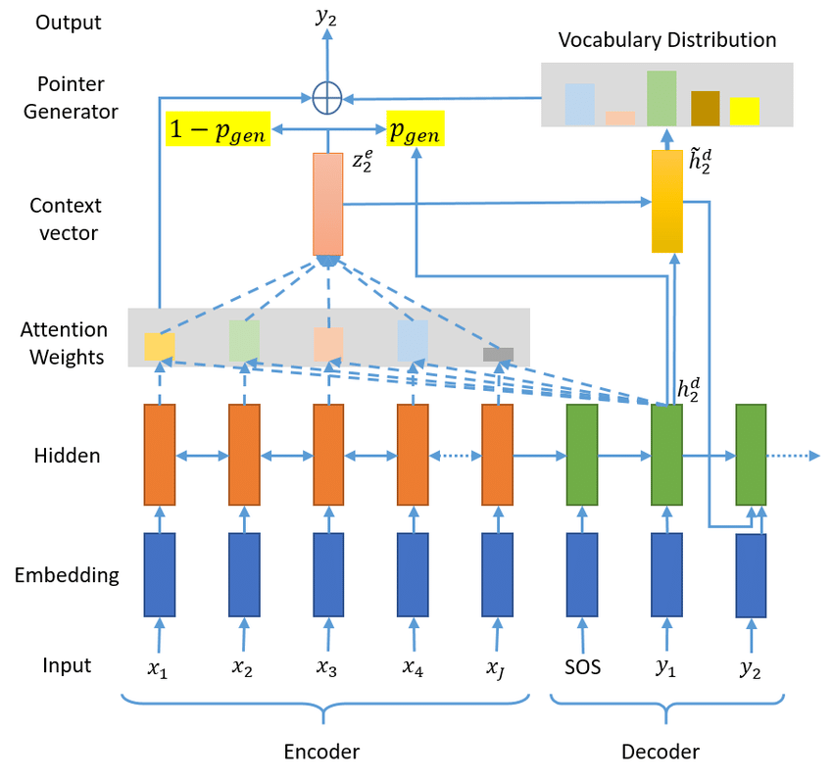
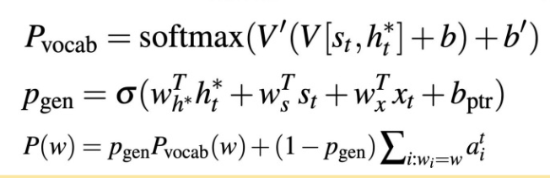
Pointer-Generator Networks
[See et al. 2017]

Slide 79
Summarization Evaluation

Slide 80
Types of evaluation methods
Extrinsic (task-based)
Can you make the same decision using the summary as with the full text, but in less time
Intrinsic (task-independent)
Comparing summaries against gold standards
ROUGE: ROUGE-n, ROUGE-L, ROUGE-S,ROUGE-SU
pyramid method

Slide 81
Evaluation Criteria
Appropriate length
Fidelity
Salience
Grammaticality
Non-redundancy
Referential well-formedness
Structure and coherence

Slide 82
Ideal Evaluation
Information content
|S|
C = Compression Ratio =
|D|
i (S)
R = Retention Ratio =
i (D)
R>C

Slide 83
Precision and Recall

Slide 84
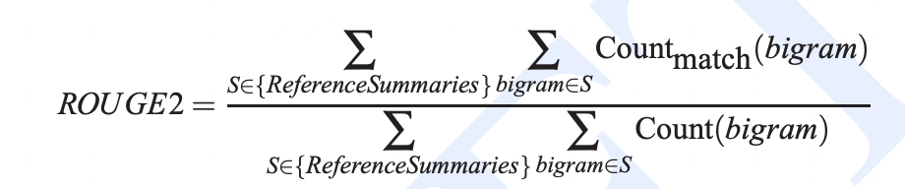
Rouge (Lin and Hovy 2003)
Characteristics
Based on Papineni et al.’s BLEU (used for Machine Translation)
R stands for Recall
Correlated with manual evaluations when averaged over many examples
Very convenient for prototyping
Variants
ROUGE-n is a measure of n-gram overlap between a summary and a set of reference summaries
ROUGE-L uses longest common subsequence instead of n-gram overlap
Disadvantage
It can be easily gamed

Slide 85
The Pyramid Method
Nenkova and Passonneau 2004
Based on Semantic Content Units (SCU)
humans label the Summary Content Units in each reference and candidate summary, and then an overlap measure is computed.
Used for multi-document summarization
Different surface realizations with equivalent meanings

Slide 86
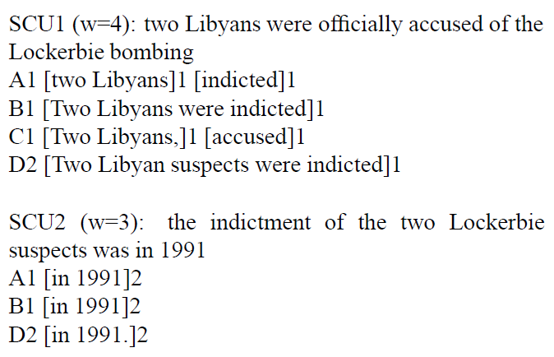
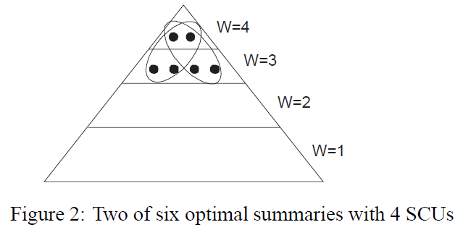
The Pyramid Method

Slide 87
Available Corpora
DUC and TAC corpora
http://duc.nist.gov
http://www.nist.gov/tac/
SummBank corpus
http://www.summarization.com/summbank
SUMMAC corpus
NY Times corpus (from LDC)

