Slide 1
Introduction to NLP
Text Classification

Slide 2
Classification
Assigning documents or sentences to predefined categories
topics, languages, users …
Input:
a document (or sentence) d
a fixed set of classes C = {c₁, c₂,…, c_{J}}
Output: a predicted class c ∈ C

Slide 3
Variants of Problem Formulation
Binary categorization: only two categories
Retrieval: {relevant-doc, irrelevant-doc}
Spam filtering: {spam, non-spam}
Opinion: {positive, negative}
K-category categorization: more than two categories
Topic categorization: {sports, science, travel, business,…}
Word sense disambiguation:{bar1, bar2, bar3, …}
Hierarchical vs. flat
Overlapping (soft) vs non-overlapping (hard)

Slide 4
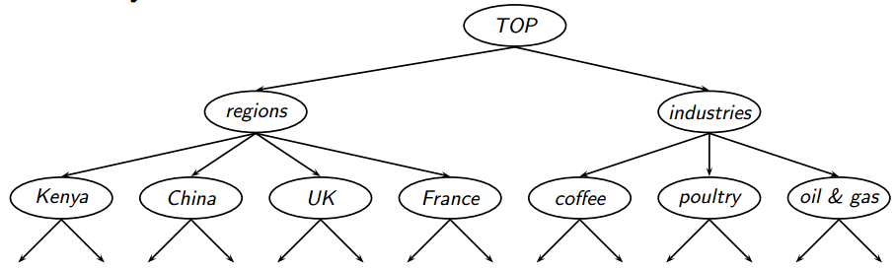
Hierarchical Classification
Image from Schütze & Krisnawati

Slide 5
Borges’s Classification
The list divides all animals into 14 categories:
Those that belong to the emperor
Embalmed ones
Those that are trained
Sucking pigs
Mermaids (or Sirens)
Fabulous ones
Stray dogs
Those that are included in this classification
Those that tremble as if they were mad
Innumerable ones
Those drawn with a very fine camel hair brush
Et cetera
Those that have just broken the flower vase
Those that, at a distance, resemble flies
Celestial Emporium of Benevolent Knowledge

Slide 6
Hand-coded Rules
Rules based on combinations of words or other features
spam: black-list-address OR (“dollars” AND “have been selected”)
Accuracy can be high
If rules carefully refined by expert
But building and maintaining these rules is expensive

Slide 7
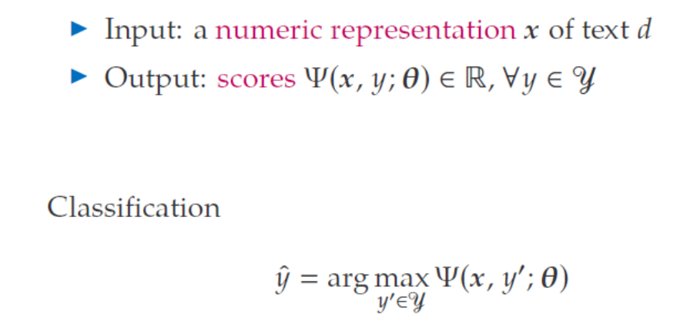
Mathematical Formulation

Slide 8
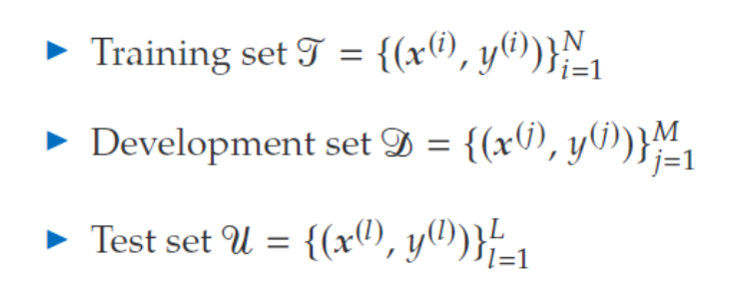
Mathematical Formulation

Slide 9
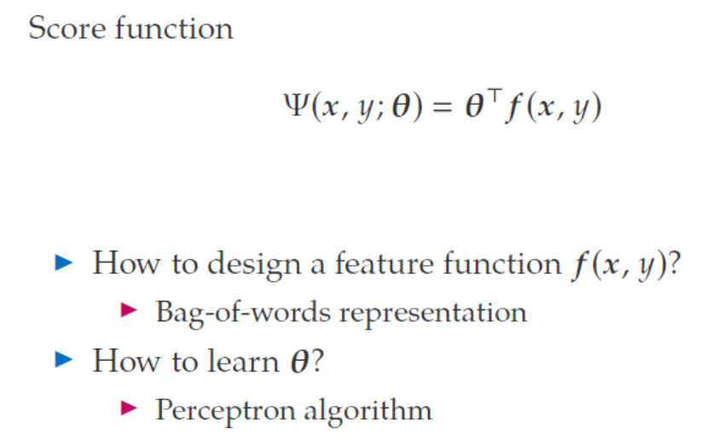
Mathematical Formulation

Slide 10
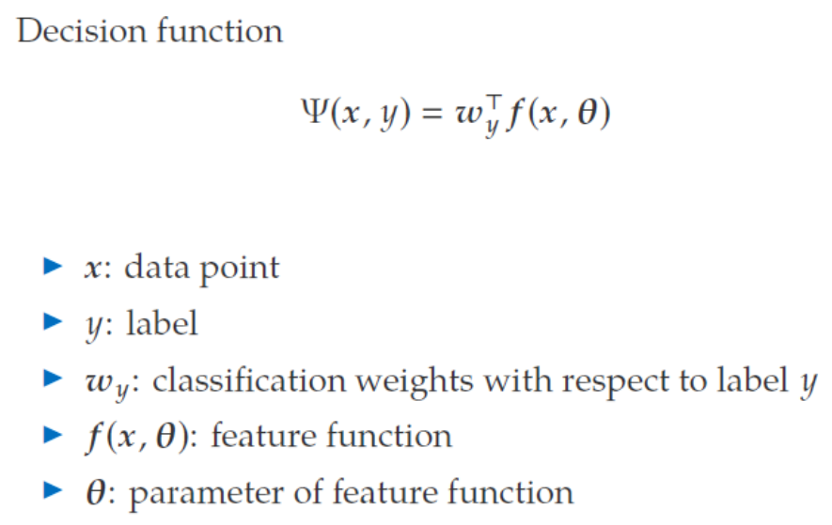
Mathematical Formulation

Slide 11
Spam Recognition
Return-Path: <*****@rediffmail.com>
X-Sieve: CMU Sieve 2.2
From: "Ibrahim Galadima" <*****@rediffmail.com>
Reply-To: galadima_esq@netpiper.com
To: *****
Subject: Gooday
DEAR SIR
FUNDS FOR INVESTMENTS
THIS LETTER MAY COME TO YOU AS A SURPRISE SINCE I HAD NO PREVIOUS CORRESPONDENCE WITH YOU
I AM THE CHAIRMAN TENDER BOARD OF INDEPENDENT NATIONAL ELECTORAL COMMISSION INEC I GOT YOUR CONTACT IN THE COURSE OF MY SEARCH FOR A RELIABLE PERSON WITH WHOM TO HANDLE A VERY CONFIDENTIAL TRANSACTION INVOLVING THE ! TRANSFER OF FUND VALUED AT TWENTY ONE MILLION SIX HUNDRED THOUSAND UNITED STATES DOLLARS US$20M TO A SAFE FOREIGN ACCOUNT

Slide 12
SpamAssassin
http://spamassassin.apache.org/
http://wiki.apache.org/spamassassin/HowScoresAreAssigned
http://spamassassin.apache.org/tests_3_3_x.html
Example features:
body Incorporates a tracking ID number
body HTML and text parts are different
header Date: is 3 to 6 hours before Received: date
body HTML font size is huge
header Attempt to obfuscate words in Subject:
header Subject =~ /^urgent(?:[\s\W]*(dollar) | .{1,40}(?:alert| response| assistance| proposal| reply| warning| noti(?:ce| fication)| greeting| matter))/i
Notes:
Open source spam filter
v.3.3.x tests are old, but the new tests change every night

Slide 13
Features for Classification
Vector-based
Words: “cat”, “dog”, “great”, “horrible”, etc.
Meta features: document length, author name, etc.
Each document (or sentence) is represented as a vector in an n-dimensional space
Similar documents appear nearby in the vector space
(more later)

Slide 14
Classification in NLP
Part of speech tagging
Sentiment analysis
Word sense disambiguation
Parsing
Optical character recognition
Spelling correction
Named entity classification

Slide 15
Introduction to NLP
Evaluation of Classification

Slide 16
Accuracy
Percentage of items correctly classified
Not a great metric for imbalanced data sets. Why?

Slide 17
The 2-by-2 contingency table
 | relevant | not relevant
selected | tp | fp
not selected | fn | tn
Notes:
precision, recall, f-measure [many have seen before]
there are two sets: CORRECT entities and SELECTED entities
2x2 contingency table, four possible outcomes
for precision & recall, you're ignoring bottom corner (where you get O right)
precision: what proportion of your guesses are correct?
note that correctness means (a) correct boundaries, and (b) correct label
recall: what proportion of true entities did you get right?
ASK STUDENTS HERE ABOUT WHY NOT TO USE ACCURACY
[note that there is typically a trade-off between precision and recall!]
[to get high precision, be very reluctant to make guesses – but then you may have poor recall]
[to get high recall, be very promiscuous in making guesses – but then you may have poor precision]

Slide 18
Precision and Recall
Precision: % of selected items that are correct
Recall: % of correct items that are selected
 | relevant | not relevant
selected | tp | fp
not selected | fn | tn
Notes:
Precision P = tp/(tp + fp)
Recall R = tp/(tp + fn)
Mention precision recall tradeoff.
precision, recall, f-measure [many have seen before]
there are two sets: CORRECT entities and SELECTED entities
2x2 contingency table, four possible outcomes
for precision & recall, you're ignoring bottom corner (where you get O right)
precision: what proportion of your guesses are correct?
note that correctness means (a) correct boundaries, and (b) correct label
recall: what proportion of true entities did you get right?
ASK STUDENTS HERE ABOUT WHY NOT TO USE ACCURACY
[note that there is typically a trade-off between precision and recall!]
[to get high precision, be very reluctant to make guesses – but then you may have poor recall]
[to get high recall, be very promiscuous in making guesses – but then you may have poor precision]

Slide 19
A combined measure: F
A combined measure that assesses the P/R tradeoff is F measure (weighted harmonic mean):
The harmonic mean is a very conservative average
People usually use balanced F1 measure
i.e., with β = 1 (that is, α = ½): F1 = 2PR/(P+R)
Notes:
a combined measure: F-measure: weighted harmonic mean between precision and recall
[why weighted? in some applications you may care more about P or R]
[why harmonic? it's conservative -- lower than arith or geo mean]
[if P and R are far apart, F tends to be near lower value]
[in order to do well on F1, need to do well on BOTH P and R]
[this way, can't beat the system by being either too reluctant or too promiscuous]
Comment: when ppl say f-measure w/o specifying beta, they mean balanced, and this is by far the most common way of doing it

Slide 20
Classic Reuters-21578 Data Set
Most (over)used data set, 21,578 docs (each 90 types, 200 toknens)
9603 training, 3299 test articles (ModApte/Lewis split)
118 categories
An article can be in more than one category
Learn 118 binary category distinctions
Average document (with at least one category) has 1.24 classes
Only about 10 out of 118 categories are large
Earn (2877, 1087)
Acquisitions (1650, 179)
Money-fx (538, 179)
Grain (433, 149)
Crude (389, 189)
Trade (369,119)
Interest (347, 131)
Ship (197, 89)
Wheat (212, 71)
Corn (182, 56)
Common categories
(#train, #test)

Slide 21
Confusion matrix c
For each pair of classes <c₁,c₂> how many documents from c₁ were incorrectly assigned to c₂?
c_{3,2}: 90 wheat documents incorrectly assigned to poultry
Docs in test set | Assigned UK | Assigned poultry | Assigned wheat | Assigned coffee | Assigned interest | Assigned trade
True UK | 95 | 1 | 13 | 0 | 1 | 0
True poultry | 0 | 1 | 0 | 0 | 0 | 0
True wheat | 10 | 90 | 0 | 1 | 0 | 0
True coffee | 0 | 0 | 0 | 34 | 3 | 7
True interest | - | 1 | 2 | 13 | 26 | 5
True trade | 0 | 0 | 2 | 14 | 5 | 10

Slide 22
Micro- vs. Macro-Averaging
If we have more than one class, how do we combine multiple performance measures into one quantity?
Macroaveraging: Compute performance for each class, then average.
Microaveraging: Collect decisions for all classes, compute contingency table, evaluate.

Slide 23
Well-known Datasets
20 newsgroups
http://qwone.com/~jason/20Newsgroups/
Reuters-21578
http://www.daviddlewis.com/resources/testcollections/reuters21578/
Cats: grain, acquisitions, corn, crude, wheat, trade…
WebKB
http://www-2.cs.cmu.edu/~webkb/
course, student, faculty, staff, project, dept, other
RCV1
http://www.daviddlewis.com/resources/testcollections/rcv1/
Larger Reuters corpus

Slide 24
Introduction to NLP
Vector Space Classification

Slide 25
Vector Space Classification
x2
topic2
topic1
x1

Slide 26
Decision surfaces
x2
topic2
topic1
x1

Slide 27
Decision trees
x2
topic2
topic1
x1

Slide 28
Classification Using Centroids
Centroid
the point most representative of a class
Compute centroid by finding vector average of known class members
Decision boundary is a line that is equidistant from two centroids.
New document on one side of the goes in one class; new document on the other side goes in the other.

Slide 29
Linear boundary
x2
topic2
topic1
x1

Slide 30
Classification Using Centroids
x2
topic2
topic1
centroid2
centroid1
x1

Slide 31
Introduction to NLP
Linear Classifiers

Slide 32
Decision Boundary

Slide 33
Decision Boundary

Slide 34
Decision Boundary

Slide 35
Decision Boundary
x

Slide 36
Decision Boundary
x
w

Slide 37
Linear Separators
Two-dimensional line:
w₁x₁+w₂x₂=b is the linear separator
w₁x₁+w₂x₂>b for the positive class
In n-dimensional spaces:
One can also add w₁=1, x₀=b (constant)
w is the weight vector
x is the feature vector
${\vec{w}}^{T}\vec{x}=\sum_{i=1}^{n}{w_{i}x_{i}}=w1x1+w2x2+…+wnx$_{n}

Slide 38
Example
w_{i} | x_{i} | w_{i} | x_{i}
0.6 | A | -0.7 | G
0.5 | B | -0.5 | H
0.5 | C | -0.3 | I
0.4 | D | -0.2 | J
0.4 | E | -0.2 | K
0.3 | F | -0.2 | L
Bias b=0 (in this example)
Sentence is “A D E H”
Its score will be
0.6*1+0.4*1+0.4*1+(-0.5)*1 = 0.9>0

Slide 39
How to Find the Linear Boundary?
Find the linear boundary = find
Many methods
E.g., Perceptron
Problem:
There are infinite number of linear boundaries if the two classes are linearly separable!
Maximum margin: Support Vector Machines (SVM)
x₂
+
+
+
+
+
+
+
+
+
-
+
+
-
+
+
-
-
-
-
-
-
-
-
-
-
-
-
-
x₁

Slide 40

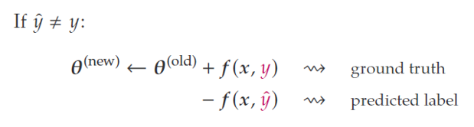
General Training Idea
Go through the training data
Predict the class y (1 or -1)
If the prediction is wrong, update θ

Slide 41
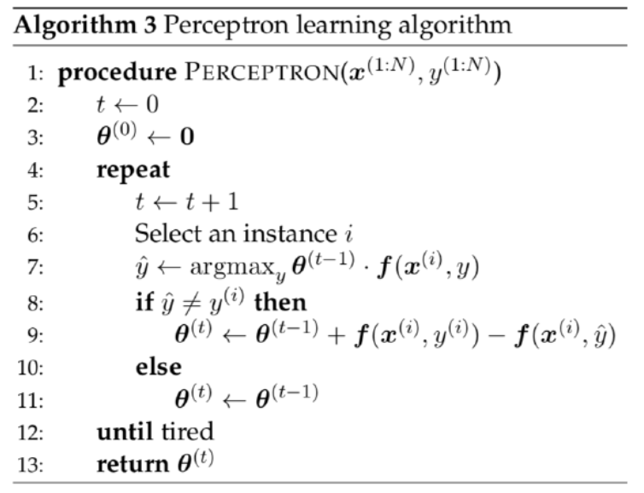
Perceptron Algorithm (preview)

Slide 42
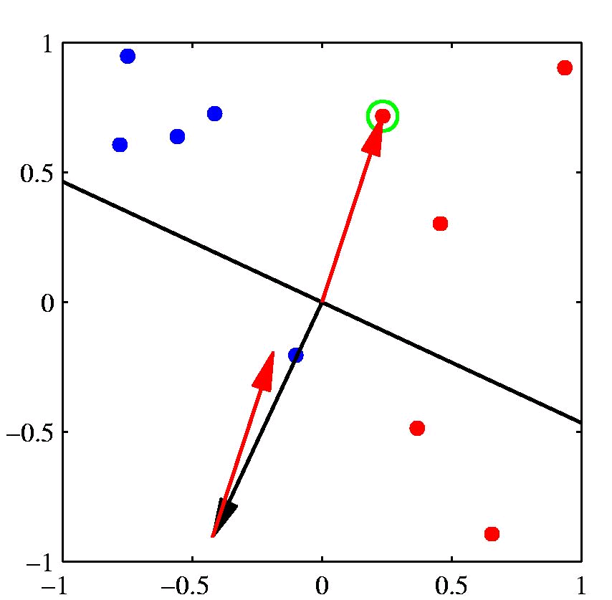
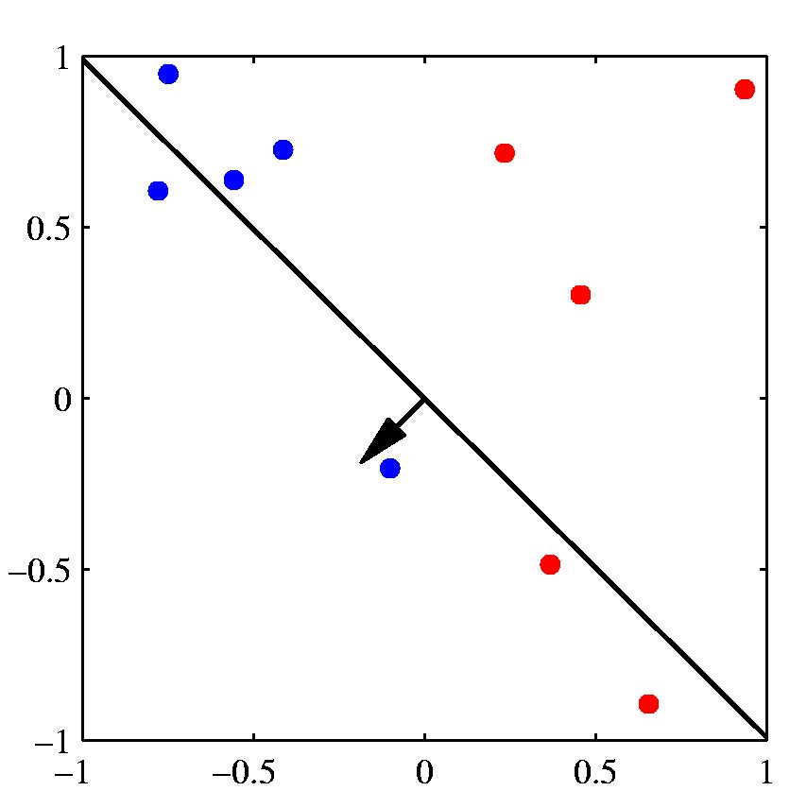
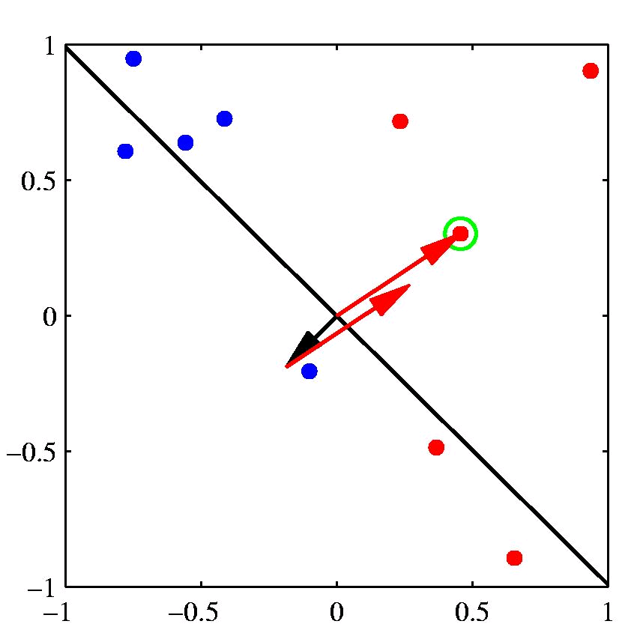
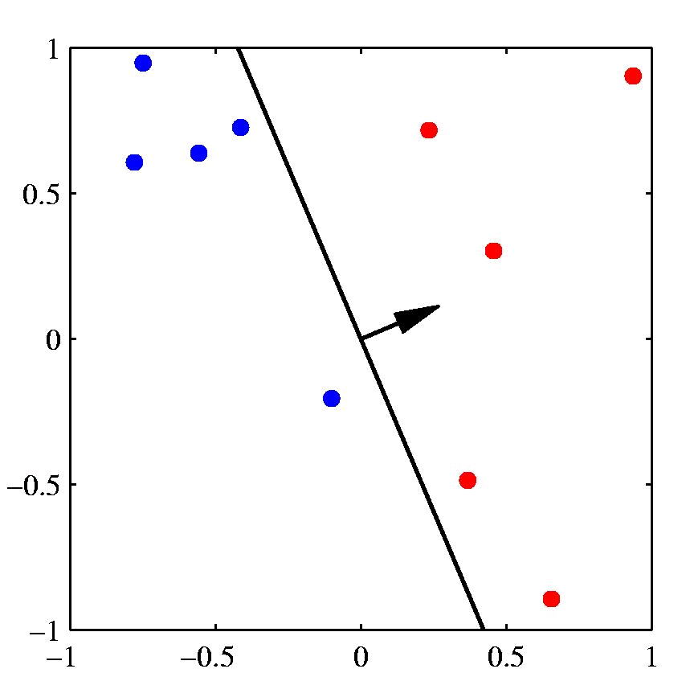
[Example: Chris Bishop]

Slide 43
Example with Interpolation
Linear interpolation for language modeling
Estimating the trigram probability P(c|ab) using P_{MLE}(c|a), P_{MLE}(c), etc.
Weights λ₁, λ₂, etc.
We may want to consider other features
E.g., POS tags of previous words, heads, word endings, etc.
General idea
Compute the conditional probability P(y|x)
P(y|x) = sum of weights*features
Label Y for a given history x in X

Slide 44
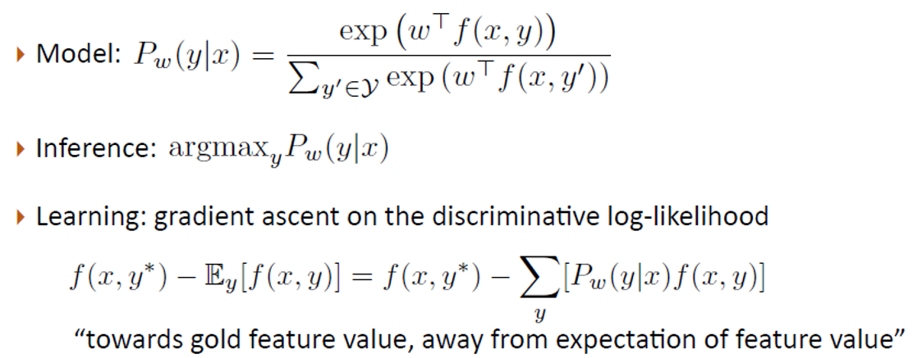
Logistic Regression (preview)
[discriminative method]
[Greg Durrett]

Slide 45
Naïve Bayes (preview)
Multinomial Naïve Bayes is a linear model
x = [1, x₁, x₂ …]
w = [log P(y), log P(w₁|y), log P(w₂|y) …]

Slide 46
Introduction to NLP
Logistic Regression

Slide 47
Combining Features
Linear interpolation for language modeling
Estimating the trigram probability P(c|ab)?
features: P_{MLE}(c|a), P_{MLE}(c), etc.
Weights: λ₁, λ₂, etc.
We may want to consider other features
E.g., POS tags of previous words, heads, word endings, etc.
General idea
Compute the conditional probability P(y|x)
P(y|x) = sum of weights*features
Label Y for a given history x in X

Slide 48
Logistic Regression
Similar to Naïve Bayes (but discriminative!)
Log-linear model
Features don’t have to be independent
Examples of features
Anything of use
Linguistic and non-linguistic
Count of “good”
Count of “not good”
Sentence length

Slide 49
Feature Templates
For each word $w
$w_count
$w_ends_in_er
$w_is_negated
$w_is_all_caps

Slide 50
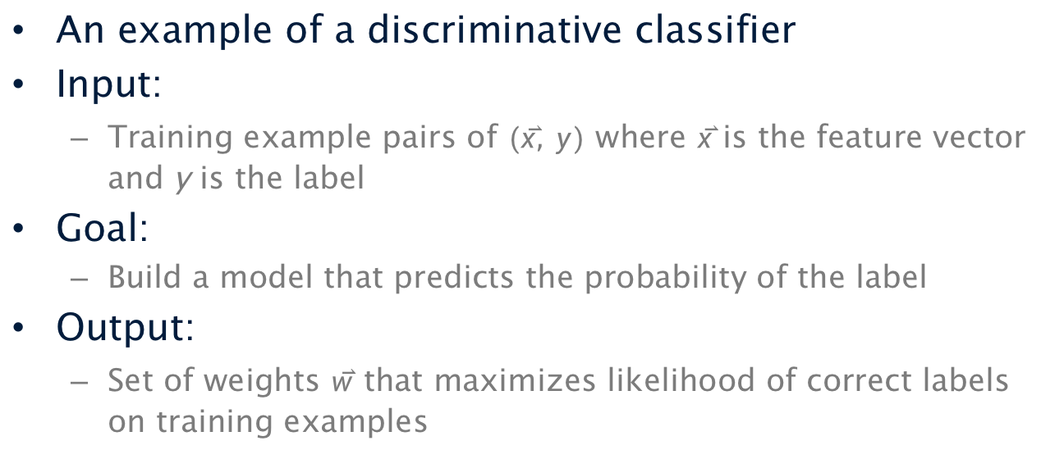
Logistic Regression
An example of a discriminative classifier
Input:
Training example pairs of $(\overset{⃑}{x}, y)$ where $\overset{⃑}{x}$ is the feature vector and y is the label
Goal:
Build a model that predicts the probability of the label
Output:
Set of weights $\overset{⃑}{w}$ that maximizes likelihood of correct labels on training examples

Slide 51
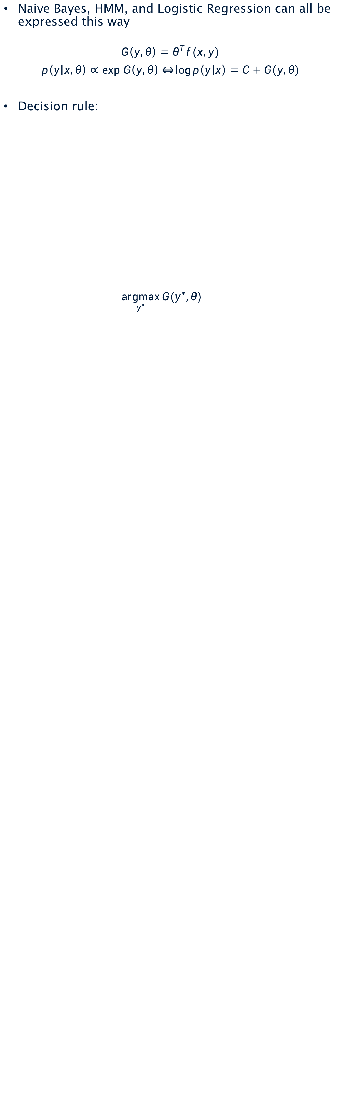
Loglinear Models
Naive Bayes, HMM, and Logistic Regression can all be expressed this way
$$G\left(y,θ\right)=θ^{T}f(x,y)$$
$p\left(y | x,θ\right)∝exp G\left(y,θ\right) \overset{⇔}{}\log{p\left(y | x\right)}=C+G(y,θ)$
Decision rule:
$\underset{y^{∗}}{argmax}{G(y^{∗},θ) }$

Slide 52
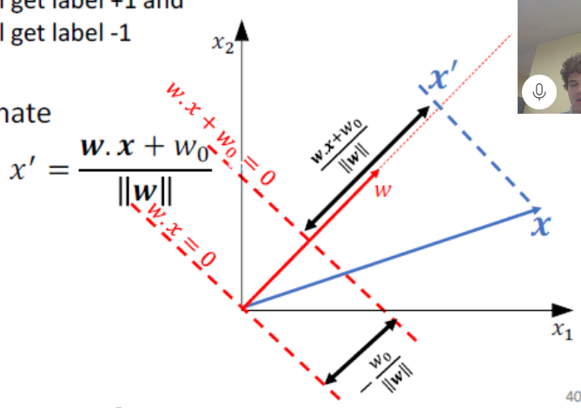
Mapping x to a 1-D coordinate
[image from Greg Shakhnarovich]

Slide 53
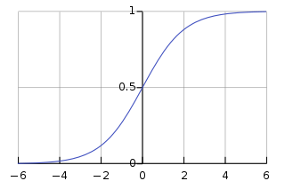


Including a Nonlinearity
Compute the feature vector x
Multiply with weight vector w
Compute the logistic function (sigmoid)
$$z=\sum{w_{i}x_{i}}$$
$$f\left(z\right)=\frac{1}{1+e^{−z}}$$

Slide 54
Examples
Example 1
x = (2,1,1,1)
w = (1,-1,-2,3)
z = 2-1-2+3=2
f(z) = 1/(1+e⁻²)
Example 2
x = (2,1,0,1)
w = (0,0,-3,0)
z = 0
f(z) = 1/(1+e⁰) = 1/2

Slide 55

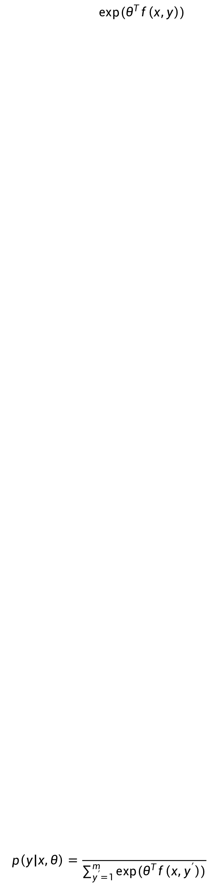

Softmax
Recall
Is this a valid probability distribution?
Yes, using softmax
$$p\left(y | x,θ\right)∝exp⁡(θ^{T}f\left(x,y\right))$$
$$p\left(y | x,θ\right)=\frac{exp⁡(θ^{T}f\left(x,y\right)) }{\sum_{y^{′}=1}^{m}{exp⁡(θ^{T}f\left(x,y^{′}\right))}}$$
$$p\left(y | x,θ\right)={softmax}_{y}(θ^{T}f\left(x,y\right))$$

Slide 56
Introduction to NLP
K-Nearest Neighbors

Slide 57
K-Nearest Neighbor Classifier
Non-parametric classifier
Keeps all training examples
Find k examples that are most similar to the new document (“neighbor” documents)
Assign the category that is most common in these neighbor documents (neighbors vote for the category)
Can be improved by considering the distance of a neighbor ( A closer neighbor has more influence)

Slide 58
Example of K-NN Classifier
(k=4)
(k=1)
?

Slide 59
k-NN Demo
http://sleepyheads.jp/apps/knn/knn.html

Slide 60
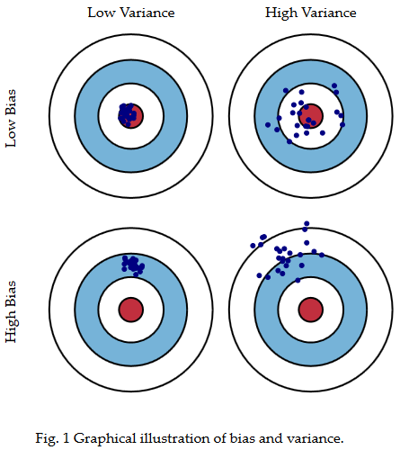
Bias-Variance Tradeoff
http://scott.fortmann-roe.com/docs/BiasVariance.html

Slide 61
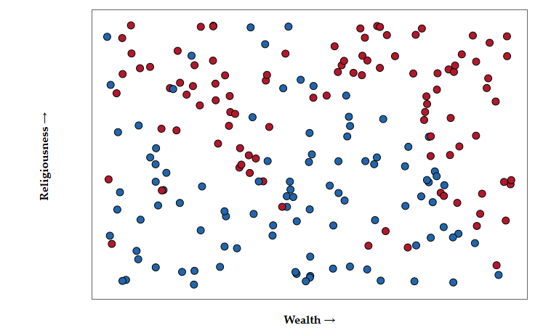
Example
http://scott.fortmann-roe.com/docs/BiasVariance.html

Slide 62
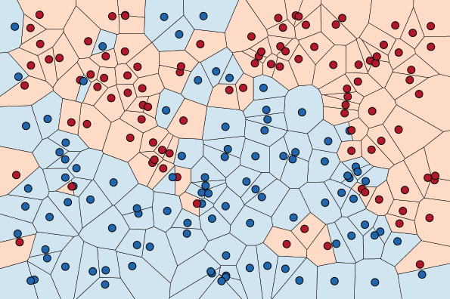
Example
http://scott.fortmann-roe.com/docs/BiasVariance.html

Slide 63
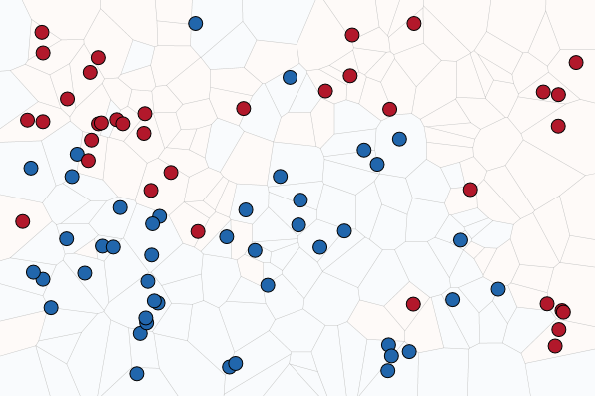
Example
http://scott.fortmann-roe.com/docs/BiasVariance.html

Slide 64
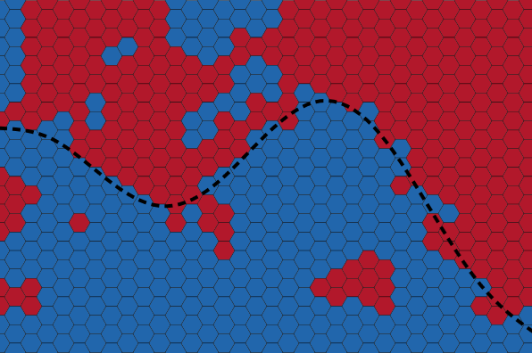
Example (n=1)
At small k's the jaggedness and islands are signs of variance.
http://scott.fortmann-roe.com/docs/BiasVariance.html

Slide 65
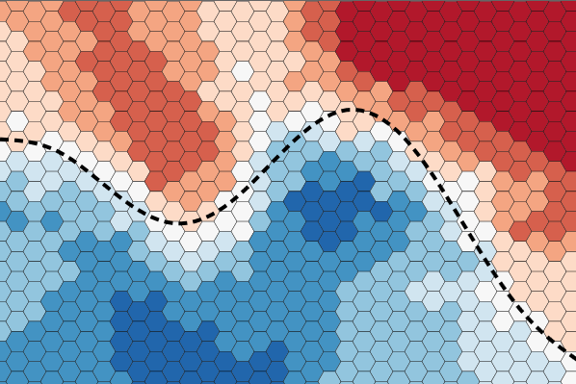
Example (n=15)
http://scott.fortmann-roe.com/docs/BiasVariance.html

Slide 66
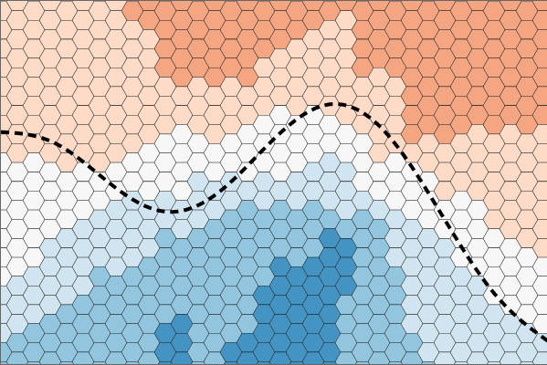
Example (n=65)
increasing k will decrease variance and increase bias
http://scott.fortmann-roe.com/docs/BiasVariance.html

Slide 67
K-Nearest Neighbor Classifier
Advantages
No training needed
Can be applied to any distance measure and document representation
Empirically effective
Disadvantages
Finding nearest neighbors has high time complexity
Imprecise when the number of examples is small, which is often true in high-dimensional spaces (neighbors cannot be trusted)

