Slide 1
Text similarity
Introduction

Slide 2
Text Similarity
Motivation
People can express the same concept (or related concepts) in many different ways. For example, “the plane leaves at 12pm” vs “the flight departs at noon”
Text similarity is a key component of Natural Language Processing
Uses in NLP
If the user is looking for information about cats, we may want the NLP system to return documents that mention kittens even if the word “cat” is not in them.
If the user is looking for information about “fruit dessert”, we want the NLP system to return documents about “peach tart” or “apple cobbler”.
A speech recognition system should be able to tell the difference between similar sounding words like the “Dulles” and “Dallas” airports.

Slide 3
Types of Text Similarity
Many types of text similarity exist:
Morphological similarity (e.g., respect-respectful)
Spelling similarity (e.g., theater-theatre)
Homophony (e.g., raise-raze-rays)
Synonymy (e.g., talkative-chatty), including across languages
Semantic similarity (e.g., cat-tabby)
Sentence similarity (e.g., paraphrases)
Document similarity (e.g., two news stories on the same event)

Slide 4
Human Judgments of Similarity
tiger cat 7.35
tiger tiger 10.00
book paper 7.46
computer keyboard 7.62
computer internet 7.58
plane car 5.77
train car 6.31
telephone communication 7.50
television radio 6.77
media radio 7.42
drug abuse 6.85
bread butter 6.19
cucumber potato 5.92
[Lev Finkelstein, Evgeniy Gabrilovich, Yossi Matias, Ehud Rivlin, Zach Solan, Gadi Wolfman, and Eytan Ruppin, "Placing Search in Context: The Concept Revisited", ACM Transactions on Information Systems, 20(1):116-131, January 2002]
http://wordvectors.org/suite.php

Slide 5
Human Judgments of Similarity
delightful wonderful A 8.65
modest flexible A 0.98
clarify explain V 8.33
remind forget V 0.87
get remain V 1.6
realize discover V 7.47
argue persuade V 6.23
pursue persuade V 3.17
plane airport N 3.65
uncle aunt N 5.5
horse mare N 8.33
[SimLex-999: Evaluating Semantic Models with (Genuine) Similarity Estimation. 2014. Felix Hill, Roi Reichart and Anna Korhonen. Preprint pubslished on arXiv. arXiv:1408.3456]

Slide 6
Automatic Similarity Computation
spain 0.679
belgium 0.666
netherlands 0.652
italy 0.633
switzerland 0.622
luxembourg 0.610
portugal 0.577
russia 0.572
germany 0.563
catalonia 0.534
Words most similar to “France”
Computed using word2vec
[Mikolov et al. 2013]

Slide 7
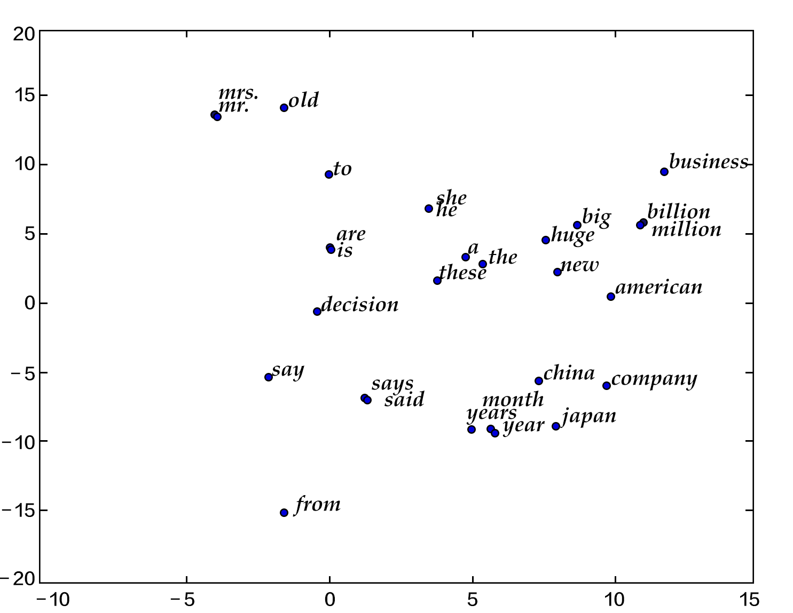

Slide 8
Natural Language Processing
Semantic Similarity

Slide 9
Synonyms and paraphrases
Example: post-close market announcements
The S&P 500 climbed 6.93, or 0.56 percent, to 1,243.72, its best close since June 12, 2001.
The Nasdaq gained 12.22, or 0.56 percent, to 2,198.44 for its best showing since June 8, 2001.
The DJIA rose 68.46, or 0.64 percent, to 10,705.55, its highest level since March 15.

Slide 10
Synonyms
Different words (and also word compounds) can have similar meanings.
tepid and lukewarm have very similar meanings and can be substituted for one another (tepid water vs. lukewarm water).
True synonyms are actually relatively rare.
even though big and large are often thought of as synonyms, consider the difference between Big Leagues and Large Leagues. ☺
The verbs sweat and perspire are also near synonyms.
However, they differ in their frequency of use and the type of text in which they are likely to appear.

Slide 11
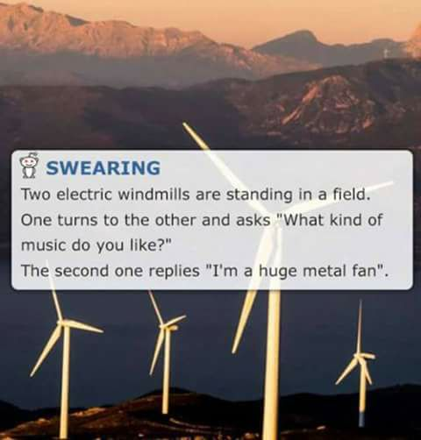
Polysemy

Slide 12
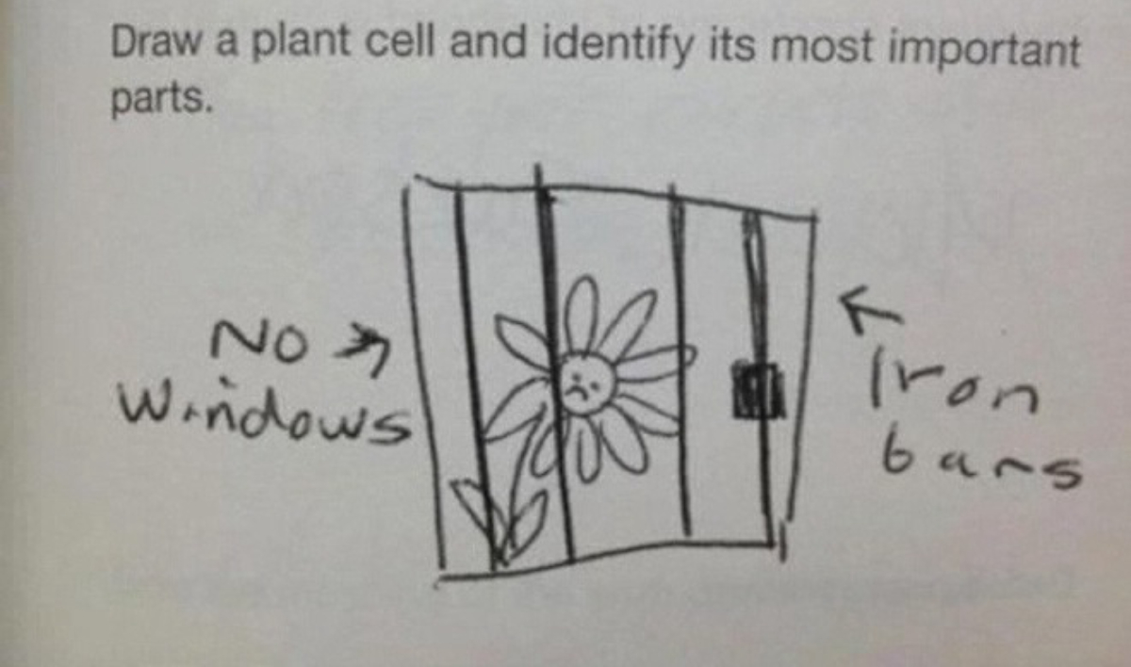
Polysemy

Slide 13
Polysemy
Polysemy is the property of words to have multiple senses.
For example, the noun book can refer to the following:
A literary work (e.g., “Anna Karenina”)
A stack of pages (e.g., a notebook)
A record of business transactions (think “bookkeeper”)
A record of bets (think “bookmaker”)
A list of buy and sell orders in a financial market

Slide 14
Polysemy
The same word can also have multiple parts of speech, each with its own set of senses. For example, the word book, as a verb can mean “make a reservation for” or “occupy”.
The different senses of the same word don’t have to be equally frequent.
Some of the senses may overlap (e.g., the first two senses of book on the previous slide). That’s partially why different dictionaries list different sets of word senses for the same word.
“My favorite books are Anna Karenina and my father’s checkbook” ☺
Some words can be highly polysemous (e.g., the verb “get” has at least 35 different meanings, according to Wordnet).

Slide 15
Other Semantic Relations
Antonymy (near opposites)
raise-lower
Hypernymy
a deer is a hypernym for elk
Hyponymy (the inverse of hypernymy)
Membership Meronymy:
a flock includes sheep (or birds)
Part Meronymy:
a table has legs

Slide 16
Synsets
Semantic relations hold between word senses, not between words.
Examples:
the antonym of hot can be either mild or cold (or unattractive) depending on the specific sense of hot.
the immediate hypernym of bar can be one of the following, among others: room, musical notation, obstruction, profession, depending on the sense of bar.
The term synset is used to group together all synonyms of the same word. If a word is polysemous, it may be associated with multiple synsets.

