Slide 1
Text Similarity
Vector Semantics

Slide 2
What does “acerola” mean?
acerola is a significant source of vitamin C.
the pulp of the acerola is very soft
acerola are now found growing in most sub-tropical regions of the world.
acerola can be eaten fresh or used to make jams or jellies.

Slide 3
Distributional similarity
Two words that appear in similar contexts are likely to be semantically related, e.g.,
schedule a test drive and investigate Honda's financing options
Volkswagen debuted a new version of its front-wheel-drive Golf
the Jeep reminded me of a recent drive
Our test drive took place at the wheel of loaded Ford EL model
“You will know a word by the company that it keeps.” (J.R. Firth 1957)

Slide 4
Basic Ideas
Represent words as vectors
For example, based on nearby words
Similar words (synonyms) should have similar representations
Different senses of the same word should have different representations
Relations should be preserved
For example, “cat”-”kitten” should be similar to “dog”-”puppy”

Slide 5
Context Features
The context features can be any of the following:
The word before the target word
The word after the target word
Any word within n words of the target word
Any word within a specific syntactic relationship with the target word (e.g., the head of the dependency or the subject of the sentence)
Any word within the same sentence
Any word within the same document

Slide 6
Example
S1: schedule a test drive and investigate Honda's financing options
S2: Volkswagen debuted a new version of its front-wheel-drive Golf
S3: the Jeep reminded me of a recent drive
S4: Our test drive took place at the wheel of loaded Ford EL model
 | schedule | test | drive | version | front | recent | model
Honda | 1 | 1 | 1
Vokswagen |  |  | 1 | 1 | 1
Jeep |  |  | 1 |  |  | 1
Ford |  | 1 | 1 |  |  |  | 1

Slide 7

Association Strength
Frequency matters
we want to ignore spurious word pairings.
however, frequency alone is not sufficient, e.g., being near the words “and” or “the is not very informative
Pointwise mutual information (PMI).
Here w is a word and c is a feature from the context
$$\text{PMI}\left(w,c\right)=\log{\frac{P(w,c)}{P\left(w\right)P(c)}}$$
Notes:
COMPLETE

Slide 8
Association Strength
Positive PMI (PPMI):
If PMI(w,c)<0, that indicates that the word and the feature are negatively associated
In PMI, negative values are replaced by zeros
Smoothing may be needed
If the vectors are probabilities
Use Kullback-Leibler Divergence
Or Jensen-Shannon Divergence
Notes:
COMPLETE

Slide 9
Text Similarity
The Vector Space Model

Slide 10
Vectors, Matrices, and Tensors
X = <x₁, x₂, …, x_{n}>: a vector of n dimensions.
x₁, …, x_{n} can take either binary values {0, 1}, or real values
Vectors and matrices provide a natural way to represent the occurrence of words in a document/query.
In text analysis, n is usually the size of the vocabulary, so each dimension corresponds to a unique word
X can be used to represent a document, or a query, or …
So x_{i} indicates either “whether the i-th word in the vocabulary appears” (binary value), or “how many times does the i-th word appear” (real value).
The entire collection is thus represented as a matrix.
How?

Slide 11
Example of Document Vectors
Doc 1= “information retrieval”
Doc 2 = “computer information retrieval”
Doc 3 = “computer retrieval”
Vocabulary: information, retrieval, computer
Doc 1 = <1, 1, 0>
Doc 2 = <1, 1, 1>
Doc 3 = <0, 1, 1>
information, retrieval, computer
1 | 1 | 0
1 | 1 | 1
0 | 1 | 1
D =
Question: Doc 4 = “retrieval information retrieval” ?

Slide 12
Documents in a Vector Space
Doc 1= “information retrieval”
Doc 2 = “computer information retrieval”
Doc 3 = “computer retrieval”
Vocabulary: information, retrieval, computer
Doc 1 = <1, 1, 0>
Term 1: information
Doc 1
Term 2: retrieval
Term 3: computer

Slide 13
Relevance as Vector Similarities
Doc 1= “information retrieval”
Doc 2 = “computer information retrieval”
Doc 3 = “computer retrieval”
Term 1: information
Doc 1
Doc 2
Term 2: retrieval
Which document is closer to Doc 1? Doc 2 or Doc 3?
What if we have a query “retrieval”?
Doc 3
Term 3: computer

Slide 14
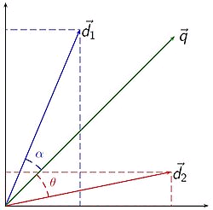
Document Similarity
Used in information retrieval to determine which document (d₁ or d₂) is more similar to a given query q.
Documents and queries are represented in the same space.
Angle (or cosine) is a proxy for similarity between two vectors

Slide 15
Distance/Similarity Calculation
The similarity/relevance of two vectors can be calculated based on distance/similarity measures
S: X, Y → (0, 1)
X: <x₁, x₂, …, x_{n}>
Y: <y₁, y₂, …, y_{n}>
S(X, Y) = ?
The more dimensions in common, the larger the similarity
What about real values?
Normalization needed.

Slide 16
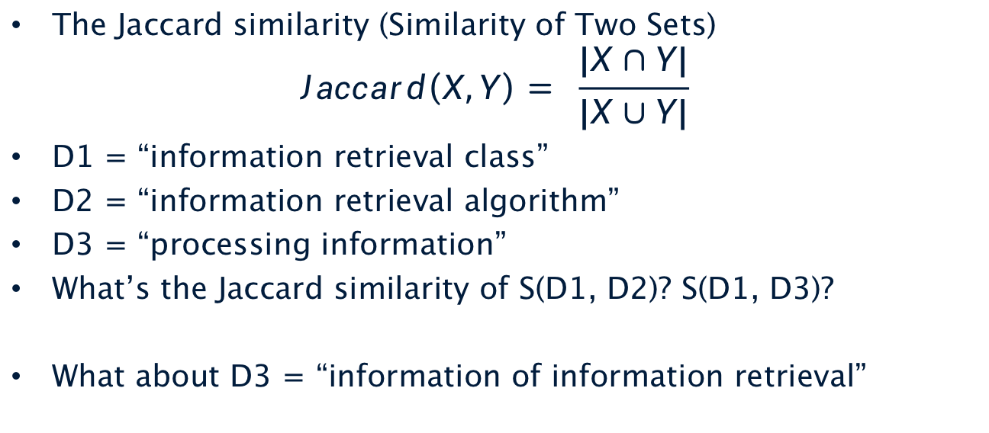
Similarity Measures
The Jaccard similarity (Similarity of Two Sets)
$$Jaccard\left(X,Y\right)= \frac{|X∩Y|}{|X∪Y|}$$
D1 = “information retrieval class”
D2 = “information retrieval algorithm”
D3 = “processing information”
What’s the Jaccard similarity of S(D1, D2)? S(D1, D3)?
What about D3 = “information of information retrieval”

Slide 17
Similarity Measures
Euclidean Distance – distance of two points
Z
X
Y

Slide 18
Similarity Measures (Cont.)
Cosine similarity: similarity of two vectors, normalized
X
Which one do you think is suitable for retrieval?
Jaccard? Euclidean? Cosine?
Y

Slide 19
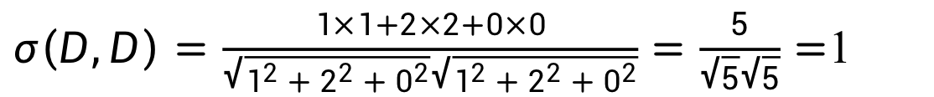
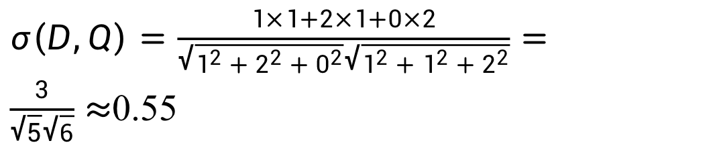
Example
What is the cosine similarity between:
D= “cat,dog,dog” = <1,2,0>
Q= “cat,dog,mouse,mouse” = <1,1,2>
Answer:
In comparison:
$σ\left(D,Q\right)=\frac{1×1+2×1+0×2}{\sqrt{1^{2}+2^{2}+0^{2}}\sqrt{1^{2}+1^{2}+2^{2}}}=\frac{3}{\sqrt{5}\sqrt{6}}≈$0.55
$σ\left(D,D\right)=\frac{1×1+2×2+0×0}{\sqrt{1^{2}+2^{2}+0^{2}}\sqrt{1^{2}+2^{2}+0^{2}}}=\frac{5}{\sqrt{5}\sqrt{5}}=$1

Slide 20
Quiz
Given three documents
D₁ = <1,3>
D₂ = <10,30>
D₃ = <3,1>
Compute the cosine scores
σ(D₁,D₂)
σ(D₁,D₃)
What do the numbers tell you?

Slide 21
Answers to the Quiz
σ(D₁,D₂) = 1
one of the two documents is a scaled version of the other
σ(D₁,D₃) = 0.6
swapping the two dimensions results in a lower similarity

Slide 22
Quiz
What is the range of values that the cosine scores can take?

Slide 23
Answer to the Quiz
Mathematically, the cosine function has a range of [-1,1]
However, when the two vectors are both in the first quadrant (since all word counts are non-negative), the range is [0,1]
For word embeddings, the range is [-1,1] (since the values don’t have to be non-negative)

Slide 24
Text Similarity
Dimensionality Reduction

Slide 25
Issues with Vector Similarity
Polysemy (sim < cos)
bar, bank, jaguar, hot
Synonymy (sim > cos)
building/edifice, large/big, spicy/hot
Relatedness (people are really good at figuring this)
doctor/patient/nurse/treatment

Slide 26
Semantic Matching
Query = “natural language processing”
Document 1 = “linguistics semantics viterbi learning”
Document 2 = “welcome to new haven”
Which one should we rank higher?
Query vocabulary & doc vocabulary mismatch!
If only we can represent documents/queries as concepts!
That’s where dimensionality reduction helps

Slide 27
Semantic Concepts
 | election | vote | president | tomato | salad
NEWS1 | 4 | 4 | 4 | 0 | 0
NEWS2 | 3 | 3 | 3 | 0 | 0
NEWS3 | 1 | 1 | 1 | 0 | 0
NEWS4 | 5 | 5 | 5 | 0 | 0
RECIPE1 | 0 | 0 | 0 | 1 | 1
RECIPE2 | 0 | 0 | 0 | 4 | 4
RECIPE3 | 0 | 0 | 0 | 1 | 1

Slide 28
Semantic Concepts
 | election | vote | president | tomato | salad
NEWS1 | 4 | 4 | 4 | 0 | 0
NEWS2 | 3 | 3 | 3 | 0 | 0
NEWS3 | 1 | 1 | 1 | 0 | 0
NEWS4 | 5 | 5 | 5 | 0 | 0
RECIPE1 | 0 | 0 | 0 | 1 | 1
RECIPE2 | 0 | 0 | 0 | 4 | 4
RECIPE3 | 0 | 0 | 0 | 1 | 1

Slide 29
Concept Space = Dimension Reduction
Number of concepts (K) is smaller than the number of words (N) or number of documents (M).
If we represent a document as a N-dimensional vector; and the corpus as an M*N matrix…
The goal is to reduce the dimensionality from N to K.
But how can we do that?

Slide 30
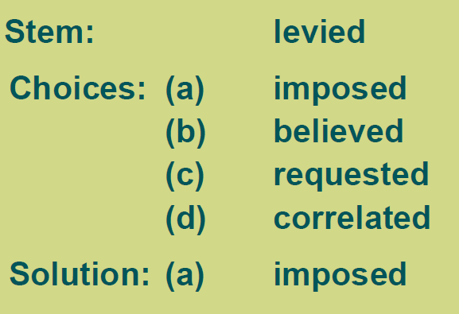
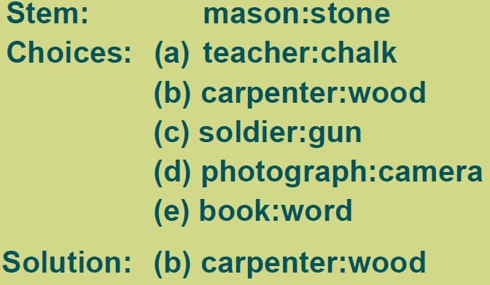
TOEFL Synonyms and SAT Analogies
Word similarity vs. analogies
Example from Peter Turney

Slide 31
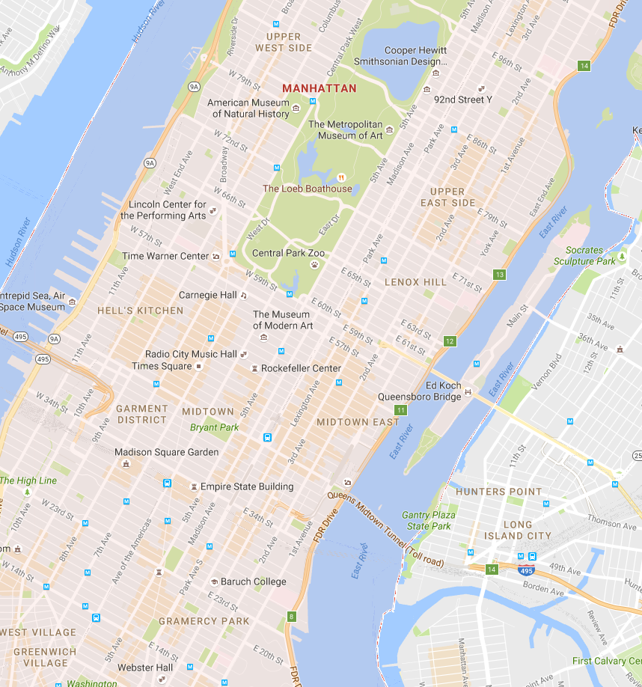

Slide 32
29 degrees

Slide 33
29 degrees

Slide 34

Vectors and Matrices
A matrix is an m x n table of objects (in our case, numbers)
Each row (or column) is a vector.
Matrices of compatible dimensions can be multiplied together.
What is the result of the multiplication below?
$$\left[\begin{matrix}1 & 2 & 4 \\ 2 & 5 & 7 \\ 4 & 9 & 14\end{matrix}\right]\left[\begin{matrix}2 \\ 1 \\ −1\end{matrix}\right]=\left[\begin{matrix} \\ \\ \end{matrix}\right]$$

Slide 35
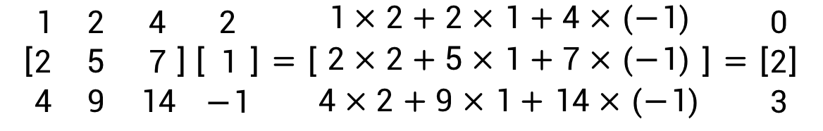
Answer to the Quiz
$$\left[\begin{matrix}1 & 2 & 4 \\ 2 & 5 & 7 \\ 4 & 9 & 14\end{matrix}\right]\left[\begin{matrix}2 \\ 1 \\ −1\end{matrix}\right]=\left[\begin{matrix}1×2+2×1+4×(−1) \\ 2×2+5×1+7×(−1) \\ 4×2+9×1+14×(−1)\end{matrix}\right]=\left[\begin{matrix}0 \\ 2 \\ 3\end{matrix}\right]$$

Slide 36
Eigenvectors and Eigenvalues
An eigenvector is an implicit “direction” for a matrix A
v (the eigenvector) is non-zero
λ (the eigenvalue) can be any complex number, in principle.
Computing eigenvalues:

Slide 37
Eigenvectors and Eigenvalues
Example:
det (A-λI) = (-1-λ)*(-λ)-3*2=0
Then: λ+λ²-6=0; λ₁=2; λ₂=-3
For λ₁=2:
Solutions: v₁=v₂

Slide 38
Matrix decomposition
If Σ is a square matrix, it can be decomposed into UΛU⁻¹, where
U = matrix of eigenvectors
Λ = diagonal matrix of eigenvalues
ΣU = UΛ
U⁻¹ΣU = Λ
Σ = UΛU⁻¹

Slide 39
Example

Slide 40
SVD: Singular Value Decomposition
A=UΣV^{T}
U is the matrix of orthogonal eigenvectors of AA^{T}
V is the matrix of orthogonal eigenvectors of A^{T}A (co-variance matrix)
The components of Σ are the eigenvalues of A^{T}A
Properties
This decomposition exists for all matrices and is unique
U, V are column orthonormal
U^{T} U = I; V^{T} V = I
Σ is diagonal and sorted by absolute value of the singular values (large to small)
Each column (row) of Σ corresponds to a principal component
If A has 5 columns and 3 rows, then U will be 5x5 and V will be 3x3

Slide 41
Example (Berry and Browne)
T1: baby
T2: child
T3: guide
T4: health
T5: home
T6: infant
T7: proofing
T8: safety
T9: toddler
D1: infant & toddler first aid
D2: babies & children’s room (for your home)
D3: child safety at home
D4: your baby’s health and safety: from infant to toddler
D5: baby proofing basics
D6: your guide to easy rust proofing
D7: beanie babies collector’s guide
Notes:
REPLACE
9 TERMS
7 DOCUMENTS

Slide 42
Example
D1: T6, T9
D2: T1, T2
D3: T2, T5, T8
D4: T1, T4, T6, T8, T9
D5: T1, T7
D6: T3, T7
D7: T1, T3
Notes:
REPLACE
9 TERMS
7 DOCUMENTS

Slide 43
Example
T1
D1
T2
D1: T6, T9
D2: T1, T2
D3: T2, T5, T8
D4: T1, T4, T6, T8, T9
D5: T1, T7
D6: T3, T7
D7: T1, T3
D2
T3
D3
T4
D4
T5
D5
T6
D6
T7
D7
T8
T9
Notes:
REPLACE
9 TERMS
7 DOCUMENTS

Slide 44
Document-Term Matrix
raw
normalized

Slide 45
SVD Decomposition
u =
[[-0.70 -0.09 0.02 -0.70 0.00 0.02 0.14 -0.00 0.00]
[-0.26 0.30 0.47 0.20 0.00 -0.25 -0.16 -0.64 0.31]
[-0.35 -0.45 -0.10 0.40 0.71 -0.01 -0.05 0.00 0.00]
[-0.11 0.14 -0.15 -0.07 -0.00 0.48 -0.84 0.00 -0.00]
[-0.26 0.30 0.47 0.20 0.00 -0.25 -0.16 0.64 -0.31]
[-0.19 0.37 -0.50 0.13 0.00 -0.23 0.03 -0.31 -0.64]
[-0.35 -0.45 -0.10 0.40 -0.71 -0.01 -0.05 -0.00 0.00]
[-0.21 0.33 0.10 0.28 0.00 0.73 0.47 -0.00 0.00]
[-0.19 0.37 -0.50 0.13 0.00 -0.23 0.03 0.31 0.64]]
v’ =
[[-0.17 -0.45 -0.27 -0.40 -0.47 -0.32 -0.47]
[ 0.42 0.23 0.42 0.40 -0.30 -0.50 -0.30]
[-0.60 0.46 0.50 -0.39 -0.05 -0.12 -0.05]
[ 0.23 -0.22 0.49 -0.13 -0.26 0.71 -0.26]
[ 0.00 0.00 0.00 0.00 -0.71 -0.00 0.71]
[-0.57 -0.49 0.25 0.61 0.01 -0.02 0.01]
[ 0.24 -0.50 0.45 -0.37 0.34 -0.35 0.34]]

Slide 46
SVD Decomposition
S =
[[ 1.58 0.00 0.00 0.00 0.00 0.00 0.00]
[ 0.00 1.27 0.00 0.00 0.00 0.00 0.00]
[ 0.00 0.00 1.19 0.00 0.00 0.00 0.00]
[ 0.00 0.00 0.00 0.80 0.00 0.00 0.00]
[ 0.00 0.00 0.00 0.00 0.71 0.00 0.00]
[ 0.00 0.00 0.00 0.00 0.00 0.57 0.00]
[ 0.00 0.00 0.00 0.00 0.00 0.00 0.20]
[ 0.00 0.00 0.00 0.00 0.00 0.00 0.00]
[ 0.00 0.00 0.00 0.00 0.00 0.00 0.00]]

Slide 47
SVD Decomposition
u*S*v’ =
[[ 0.00 0.58 0.00 0.45 0.71 0.00 0.71]
[ 0.00 0.58 0.58 0.00 0.00 0.00 0.00]
[ 0.00 0.00 0.00 0.00 0.00 0.71 0.71]
[ 0.00 0.00 0.00 0.45 0.00 0.00 0.00]
[ 0.00 0.58 0.58 0.00 0.00 0.00 0.00]
[ 0.71 0.00 0.00 0.45 0.00 0.00 0.00]
[ 0.00 0.00 0.00 0.00 0.71 0.71 0.00]
[ 0.00 0.00 0.58 0.45 0.00 0.00 0.00]]

Slide 48
Dimensionality Reduction
Low rank matrix approximation
A_{[m*n]} = U_{[m*m]}Σ_{[m*n]}V^{T}_{[n*n]}
Σ is a diagonal matrix of eigenvalues
If we only keep the largest r eigenvalues
A ≈ U_{[m*r]}Σ_{[r*r]}V^{T}_{[n*r]}

Slide 49
Rank-4 Approximation of Σ
S =
[[ 1.58 0.00 0.00 0.00 0.00 0.00 0.00]
[ 0.00 1.27 0.00 0.00 0.00 0.00 0.00]
[ 0.00 0.00 1.19 0.00 0.00 0.00 0.00]
[ 0.00 0.00 0.00 0.80 0.00 0.00 0.00]
[ 0.00 0.00 0.00 0.00 0.00 0.00 0.00]
[ 0.00 0.00 0.00 0.00 0.00 0.00 0.00]
[ 0.00 0.00 0.00 0.00 0.00 0.00 0.00]
[ 0.00 0.00 0.00 0.00 0.00 0.00 0.00]
[ 0.00 0.00 0.00 0.00 0.00 0.00 0.00]]

Slide 50
Rank-4 Approximation of A
u*S*v’ =
[[ 0.00 0.58 0.00 0.45 0.71 0.00 0.71]
[ 0.00 0.58 0.58 0.00 0.00 0.00 0.00]
[ 0.00 0.00 0.00 0.00 0.00 0.71 0.71]
[ 0.00 0.00 0.00 0.45 0.00 0.00 0.00]
[ 0.00 0.58 0.58 0.00 0.00 0.00 0.00]
[ 0.71 0.00 0.00 0.45 0.00 0.00 0.00]
[ 0.00 0.00 0.00 0.00 0.71 0.71 0.00]
[ 0.00 0.00 0.58 0.45 0.00 0.00 0.00]
u*S4*v’ =
[[-0.00 0.60 -0.01 0.45 0.70 0.01 0.70]
[-0.07 0.49 0.63 0.07 0.01 -0.01 0.01]
[ 0.00 -0.01 0.01 -0.00 0.36 0.70 0.36]
[ 0.20 0.05 0.01 0.22 0.05 -0.05 0.05]
[-0.07 0.49 0.63 0.07 0.01 -0.01 0.01]
[ 0.63 -0.06 0.03 0.53 -0.00 0.00 -0.00]
[ 0.00 -0.01 0.01 -0.00 0.36 0.70 0.36]
[ 0.22 0.25 0.43 0.23 -0.04 0.04 -0.04]
[ 0.63 -0.06 0.03 0.53 -0.00 0.00 -0.00]]

Slide 51
Rank-2 Approximation of Σ
S =
[[ 1.58 0.00 0.00 0.00 0.00 0.00 0.00]
[ 0.00 1.27 0.00 0.00 0.00 0.00 0.00]
[ 0.00 0.00 0.00 0.00 0.00 0.00 0.00]
[ 0.00 0.00 0.00 0.00 0.00 0.00 0.00]
[ 0.00 0.00 0.00 0.00 0.00 0.00 0.00]
[ 0.00 0.00 0.00 0.00 0.00 0.00 0.00]
[ 0.00 0.00 0.00 0.00 0.00 0.00 0.00]
[ 0.00 0.00 0.00 0.00 0.00 0.00 0.00]
[ 0.00 0.00 0.00 0.00 0.00 0.00 0.00]]

Slide 52
Rank-2 Approximation of A
u*S*v’ =
[[ 0.00 0.58 0.00 0.45 0.71 0.00 0.71]
[ 0.00 0.58 0.58 0.00 0.00 0.00 0.00]
[ 0.00 0.00 0.00 0.00 0.00 0.71 0.71]
[ 0.00 0.00 0.00 0.45 0.00 0.00 0.00]
[ 0.00 0.58 0.58 0.00 0.00 0.00 0.00]
[ 0.71 0.00 0.00 0.45 0.00 0.00 0.00]
[ 0.00 0.00 0.00 0.00 0.71 0.71 0.00]
[ 0.00 0.00 0.58 0.45 0.00 0.00 0.00]
u*S2*v’ =
[[ 0.14 0.47 0.25 0.39 0.55 0.41 0.55]
[ 0.23 0.27 0.27 0.31 0.08 -0.06 0.08]
[-0.14 0.12 -0.09 -0.01 0.43 0.46 0.43]
[ 0.10 0.12 0.12 0.14 0.03 -0.03 0.03]
[ 0.23 0.27 0.27 0.31 0.08 -0.06 0.08]
[ 0.25 0.24 0.28 0.31 -0.00 -0.14 -0.00]
[-0.14 0.12 -0.09 -0.01 0.43 0.46 0.43]
[ 0.23 0.24 0.27 0.30 0.03 -0.11 0.03]
[ 0.25 0.24 0.28 0.31 -0.00 -0.14 -0.00]]

Slide 53
Rank-2 Representation
u*S2 =
[[-1.10 -0.12 0.00 0.00 0.00 0.00 0.00]
[-0.41 0.38 0.00 0.00 0.00 0.00 0.00]
[-0.56 -0.57 0.00 0.00 0.00 0.00 0.00]
[-0.18 0.18 0.00 0.00 0.00 0.00 0.00]
[-0.41 0.38 0.00 0.00 0.00 0.00 0.00]
[-0.30 0.47 0.00 0.00 0.00 0.00 0.00]
[-0.56 -0.57 0.00 0.00 0.00 0.00 0.00]
[-0.33 0.42 0.00 0.00 0.00 0.00 0.00]
[-0.30 0.47 0.00 0.00 0.00 0.00 0.00]]
S2*v’ =
[[-0.26 -0.71 -0.42 -0.62 -0.74 -0.50 -0.74]
[ 0.53 0.29 0.54 0.51 -0.38 -0.64 -0.38]
[ 0.00 0.00 0.00 0.00 0.00 0.00 0.00]
[ 0.00 0.00 0.00 0.00 0.00 0.00 0.00]
[ 0.00 0.00 0.00 0.00 0.00 0.00 0.00]
[ 0.00 0.00 0.00 0.00 0.00 0.00 0.00]
[ 0.00 0.00 0.00 0.00 0.00 0.00 0.00]
[ 0.00 0.00 0.00 0.00 0.00 0.00 0.00]
[ 0.00 0.00 0.00 0.00 0.00 0.00 0.00]]

Slide 54
D1 | D2 | D3 | D4 | D5 | D6 | D7
-0.26 | -0.71 | -0.42 | -0.62 | -0.74 | -0.50 | -0.74
0.53 | 0.29 | 0.54 | 0.51 | -0.38 | -0.64 | -0.38
T1 | T2 | T3 | T4 | T5 | T6 | T7 | T8 | T9
-1.10 | -0.41 | -0.56 | -0.18 | -0.41 | -0.30 | -0.56 | -0.33 | -0.30
-0.12 | 0.38 | -0.57 | 0.18 | 0.38 | 0.47 | -0.57 | 0.42 | 0.47
D7
T3,T7
D6

Slide 55
D1 | D2 | D3 | D4 | D5 | D6 | D7
-0.26 | -0.71 | -0.42 | -0.62 | -0.74 | -0.50 | -0.74
0.53 | 0.29 | 0.54 | 0.51 | -0.38 | -0.64 | -0.38
T1 | T2 | T3 | T4 | T5 | T6 | T7 | T8 | T9
-1.10 | -0.41 | -0.56 | -0.18 | -0.41 | -0.30 | -0.56 | -0.33 | -0.30
-0.12 | 0.38 | -0.57 | 0.18 | 0.38 | 0.47 | -0.57 | 0.42 | 0.47
T1
D7
T3,T7
D6

Slide 56
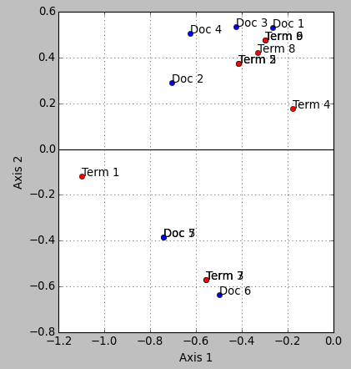

Slide 57
Example
T1
D1
T2
D1: T6, T9
D2: T1, T2
D3: T2, T5, T8
D4: T1, T4, T6, T8, T9
D5: T1, T7
D6: T3, T7
D7: T1, T3
D2
T3
D3
T4
D4
T5
D5
T6
D6
T7
D7
T8
T9
Notes:
There is no explicit link from T7 to D7, but there is a latent link

Slide 58
Semantic Concepts
 | election | vote | president | tomato | salad
NEWS1 | 4 | 4 | 4 | 0 | 0
NEWS2 | 3 | 3 | 3 | 0 | 0
NEWS3 | 1 | 1 | 1 | 0 | 0
NEWS4 | 5 | 5 | 5 | 0 | 0
RECIPE1 | 0 | 0 | 0 | 1 | 1
RECIPE2 | 0 | 0 | 0 | 4 | 4
RECIPE3 | 0 | 0 | 0 | 1 | 1

Slide 59
Semantic Concepts
 | election | vote | president | tomato | salad
NEWS1 | 4 | 4 | 4 | 0 | 0
NEWS2 | 3 | 3 | 3 | 0 | 0
NEWS3 | 1 | 1 | 1 | 0 | 0
NEWS4 | 5 | 5 | 5 | 0 | 0
RECIPE1 | 0 | 0 | 0 | 1 | 1
RECIPE2 | 0 | 0 | 0 | 4 | 4
RECIPE3 | 0 | 0 | 0 | 1 | 1

Slide 60
Adding Noise
 | election | vote | president | tomato | salad
NEWS1 | 4 | 4 | 4 | 0 | 0
NEWS2 | 3 | 0 | 3 | 0 | 2
NEWS3 | 1 | 1 | 1 | 1 | 0
NEWS4 | 5 | 5 | 3 | 0 | 0
RECIPE1 | 0 | 0 | 0 | 1 | 1
RECIPE2 | 0 | 1 | 0 | 4 | 4
RECIPE3 | 0 | 0 | 0 | 0 | 1

Slide 61
Quiz
Let A be a document x term matrix.
What is A*A’?
What about A’*A?
Notes:
EXPLAIN

Slide 62
Interpretation of SVD
Best direction to project on
The principal eigenvector is the dimension that explains most of the variance
Finding hidden concepts
Mapping documents, terms to a lower-dimensional space
Turning the matrix into block-diagonal form
(same as finding bi-partite cores)
In the NLP/IR literature, SVD is called LSA (LSI)
Latent Semantic Analysis (Indexing)
Keep as many dimensions as necessary to explain 80-90% of the data (energy)
In practice, use 300 dimensions or so

Slide 63
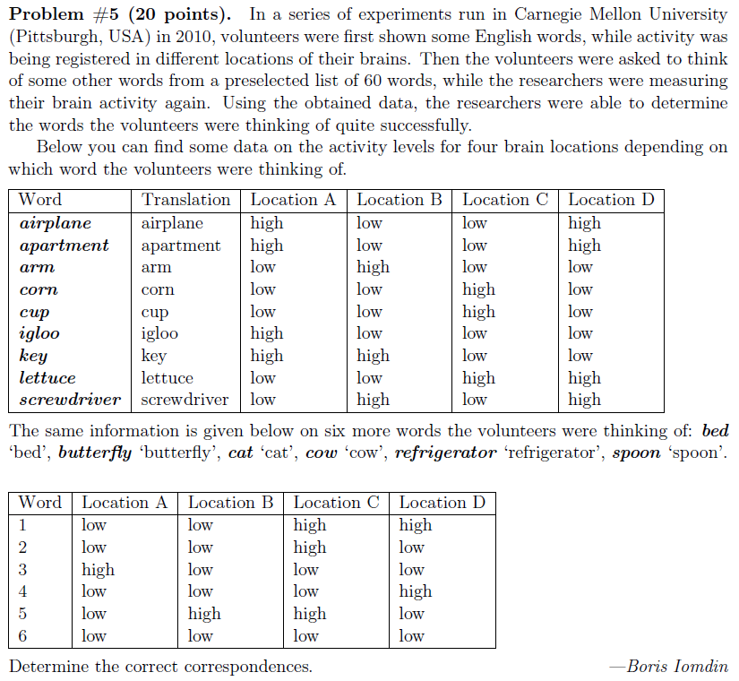

Slide 64
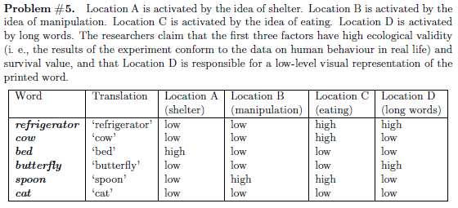

Slide 65
fMRI example
fMRI
functional MRI (magnetic resonance imaging)
Used to measure activity in different parts of the brain when exposed to various stimuli
Factor analysis
Paper
Just, M. A., Cherkassky, V. L., Aryal, S., & Mitchell, T. M. (2010). A neurosemantic theory of concrete noun representation based on the underlying brain codes. PLoS ONE, 5, e8622

Slide 66
[Just et al. 2010]

Slide 67
[Just et al. 2010]

Slide 68
[Just et al. 2010]

Slide 69
External pointers
http://lsa.colorado.edu
http://www.cs.utk.edu/~lsi
Notes:
CHECK LINKS

Slide 70
Example of LSI
A = U Λ V^{T}
retrieval
lung
CS-concept
MD-concept
data
inf
brain
Strength of CS-concept
Dim. Reduction
CS
=
x
x
MD
Term rep of concept
[Example modified from Christos Faloutsos]

Slide 71
Mapping Queries and Docs to the Same Space
q^{T}_{concept} = q^{T} V
d^{T}_{concept} = d^{T} V
CS-concept
Similarity with
CS-concept
retrieval
inf.
lung
data
brain
=
q^{T}=
d^{T}=
0 1 1 0 0
1.16 0
[Example modified from Christos Faloutsos]

