Slide 1
Deep Learning
Word Embeddings

Slide 2
Meaning of a word
How do we represent the semantics (meaning) of a word?
An image?
A symbol?
A number?
A set of numbers?
Any other ideas?

Slide 3
Possible Solutions
Wordnet
Incomplete
Subjective
Manually created
Cannot compute word similarity
One-hot vectors (based on the vocabulary)
Highly dimensional
Sparse
Don’t capture semantic similarity
Dense Vectors (based on co-occurrence)

Slide 4
Word Embeddings
Dense representations of words
Commonly used techniques
word2vec or GloVe
https://code.google.com/p/word2vec/
includes the models and pre-trained embeddings
Pre-trained is good, because training takes a lot of data
Gensim: Python library that works with word2vec
https://radimrehurek.com/gensim/
Notes:
Strictly speaking, learning word embeddings isn’t necessarily deep learning
But deep learning for NLP uses these … as do many non-deep techniques (e.g., HW3)

Slide 5
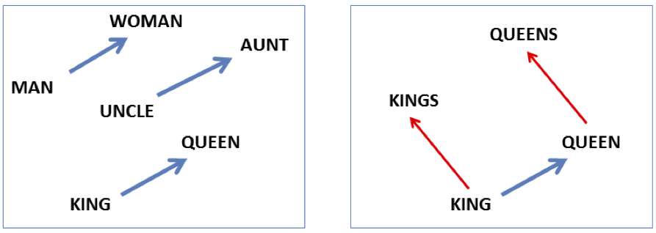

Embeddings Are Magic, Part 1
vector(‘king’) - vector(‘man’) + vector(‘woman’) $≈$vector(‘queen’)
Image courtesy of Jurafsky & Martin

Slide 6
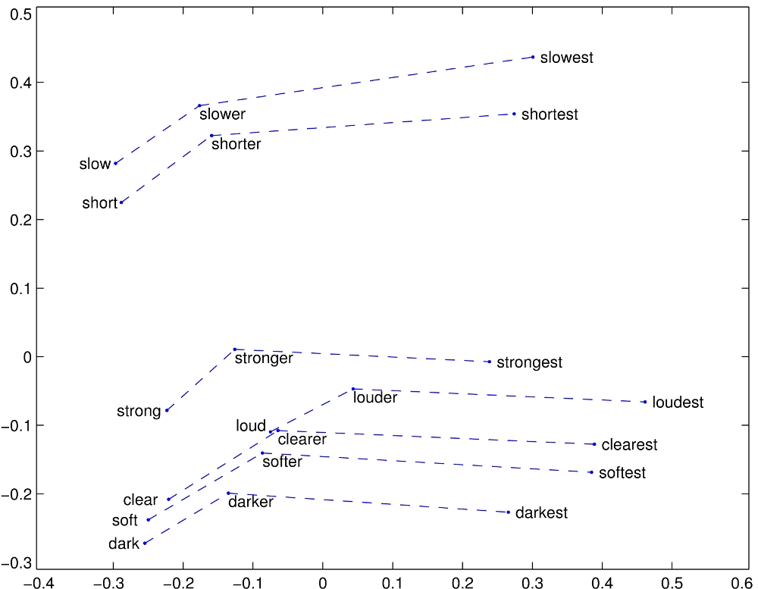
Embeddings Are Magic, Part 2
GloVe vectors for comparative and superlative adjectives
http://nlp.stanford.edu/projects/glove/images/comparative_superlative.jpg

Slide 7
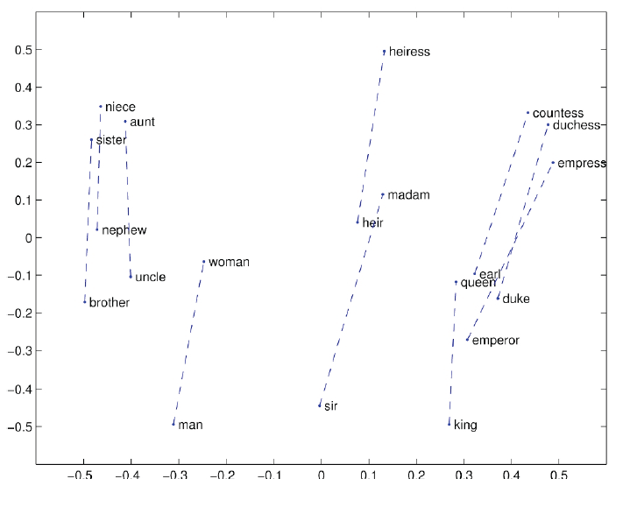
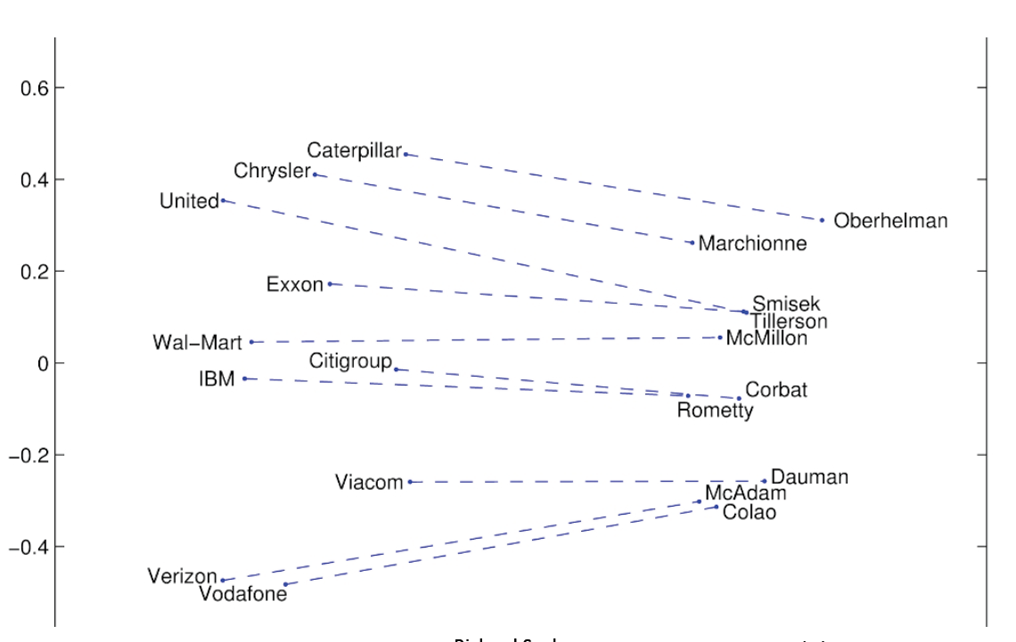
Embeddings Are Magic, Part 3
Examples from Richard Socher

Slide 8
Skip-grams
Predict each neighboring word
in a context window of 2C words
from the current word.
E.g., for C=2, we are given word w_{t} and predicting these 4 words:

Slide 9
CBOW and skipgram (Mikolov 2013)
w_{i-2}
w_{i-2}
w_{i-1}
w_{i-1}
Σ
w_{i}
w_{i}
w_{i+1}
w_{i+1}
w_{i+2}
w_{i+2}

Slide 10
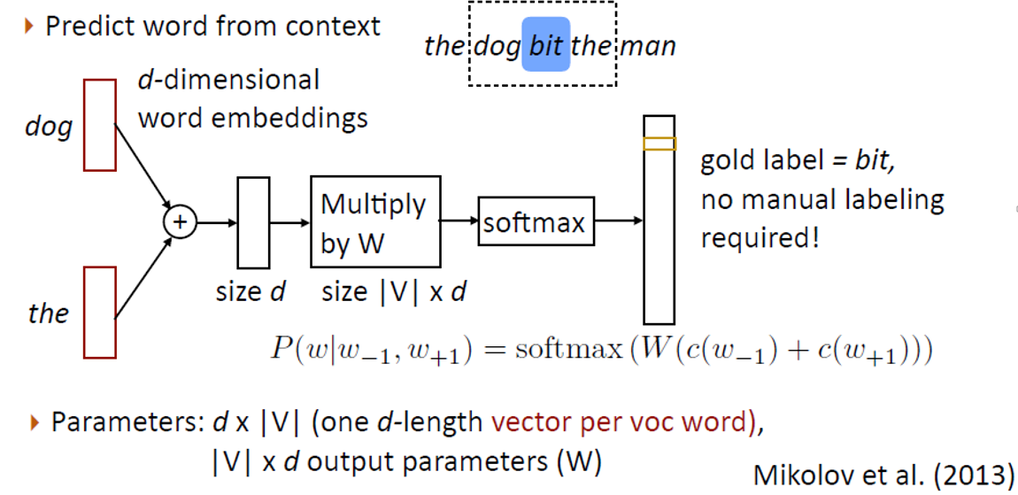
CBOW
[Greg Durrett]

Slide 11
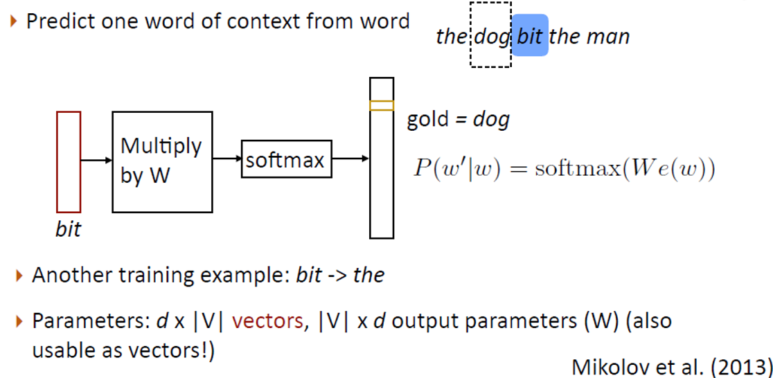
Skipgrams
[Greg Durrett]

Slide 12
Skip-grams learn 2 embeddings for each w
input embedding v, in the input matrix W
Column i of the input matrix W is the 1×d embedding v_{i} for word i in the vocabulary.
output embedding v′, in output matrix W’
Row i of the output matrix W′ is a d × 1 vector embedding v′_{i} for word i in the vocabulary.
[Jurafsky & Martin]
Notes:
Weird notation issue: Textbook calls the output matrix C, even though these are the slides intended to correspond to the textbook chapter. The risks of working with a draft.

Slide 13
Setup
Walking through corpus pointing at word w(t), whose index in the vocabulary is j, so we’ll call it w_{j} (1 < j < |V|).
Let’s predict w(t+1), whose index in the vocabulary is k (1 < k < |V |). Hence our task is to compute P(w_{k}|w_{j}).
Slide courtesy of Jurafsky & Martin

Slide 14
Skip-gram
Slide courtesy of Jurafsky & Martin
Notes:
If we take our one-hot vector and multiply it by our W matrix, that gives us a vector that we call the projection layer – it’s just the column in W that corresponds to the word we’re looking at.

Slide 15
Skip-gram
h = v_{j}
o = W’h
o = W’h
Slide courtesy of Jurafsky & Martin
Notes:
We take the dot product of this projection layer, which is sometimes called h or v_j, with W’.
This gives us a vector o of values, with one value for each word in the vocabulary.
We normalize it using a function called softmax, so that the numbers in the output vectors become probabilities. The cost function then is based on how probable the model thought the correct context words were.
CBOW, or continuous bag of words, is like backwards skipgram: given the context words, try to predict the target word.
So now we know what our input is going to be. Let’s look at some networks that use them.

Slide 16
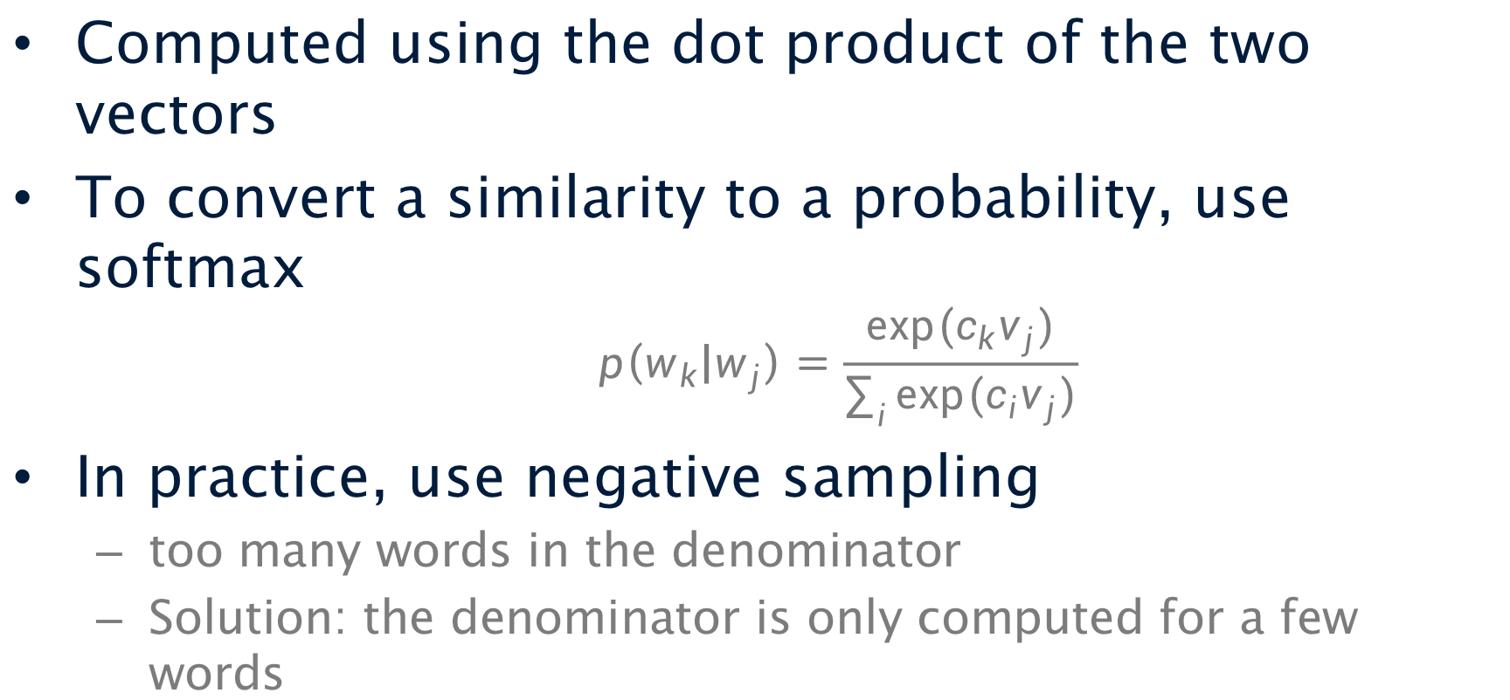
Similarity Computation
Computed using the dot product of the two vectors
To convert a similarity to a probability, use softmax
$$p\left(w_{k} | w_{j}\right)=\frac{exp⁡(c_{k}v_{j})}{\sum_{i}{exp⁡(c_{i}v_{j})}}$$
In practice, use negative sampling
too many words in the denominator
Solution: the denominator is only computed for a few words

Slide 17
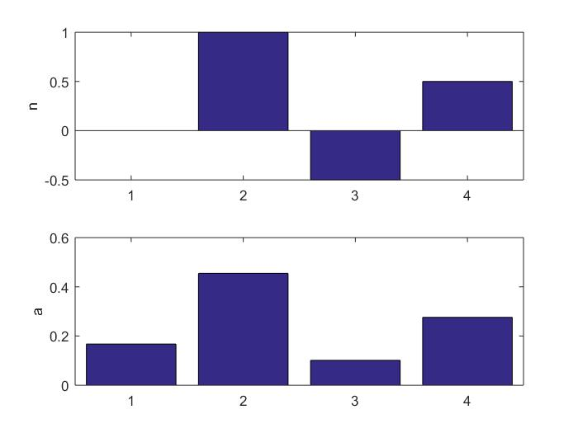
Softmax
Notes:
Jordan, M.I. (1986). Serial order: A parallel distributed processing approach.
LSTM (1997)
Predecessor to CNNs first introduced in 1980, developed in 1988, improved in 1998.

Slide 18
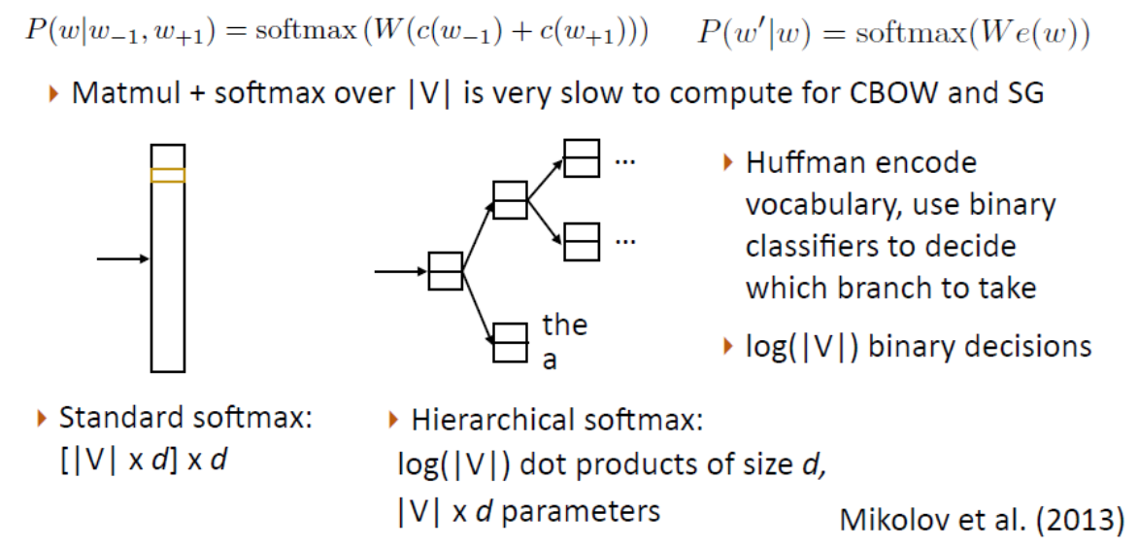
Hierarchical Softmax
[Greg Durrett]

Slide 19
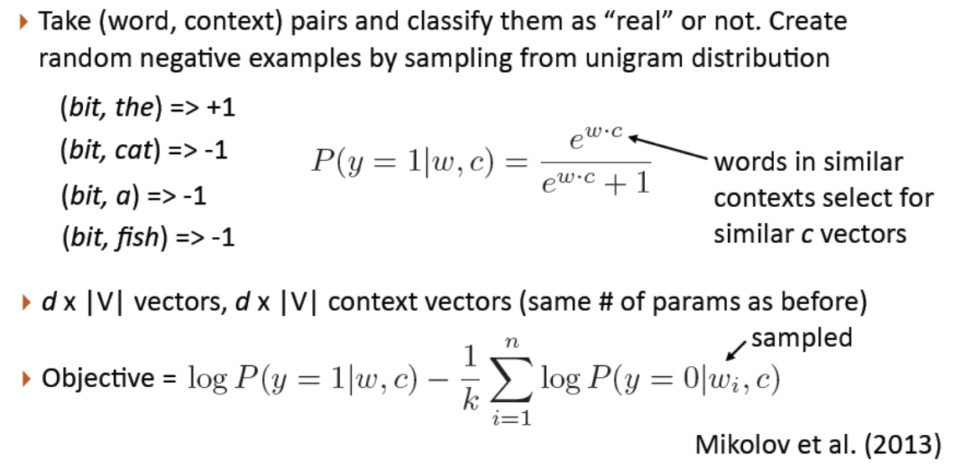
Negative Sampling
[Greg Durrett]

Slide 20
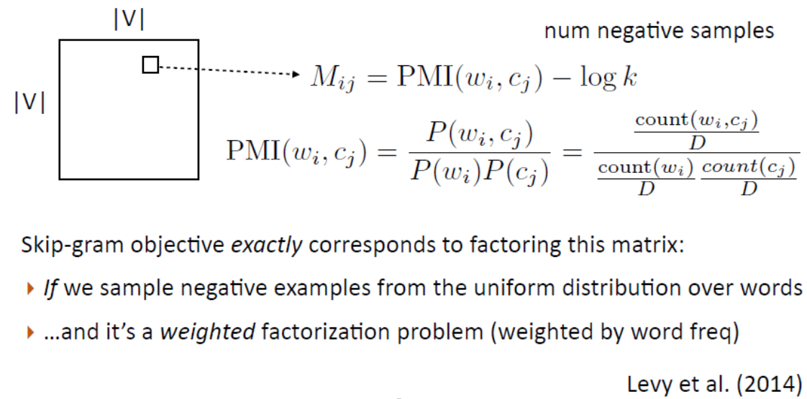
Negative Sampling
[Greg Durrett]

Slide 21
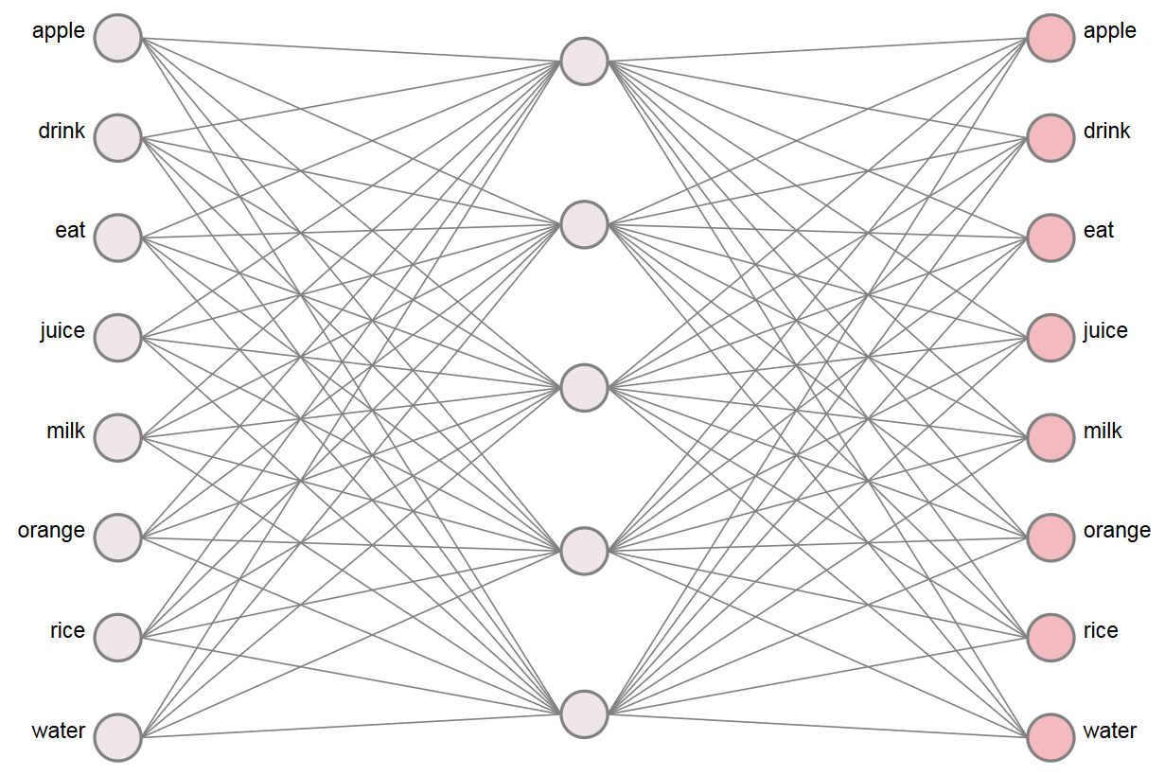
WEVI (Xin Rong)
https://ronxin.github.io/wevi/
eat|apple, eat|orange, eat|rice, drink|juice, drink|milk, drink|water, orange|juice, apple|juice, rice|milk, milk|drink, water|drink, juice|drink

Slide 22
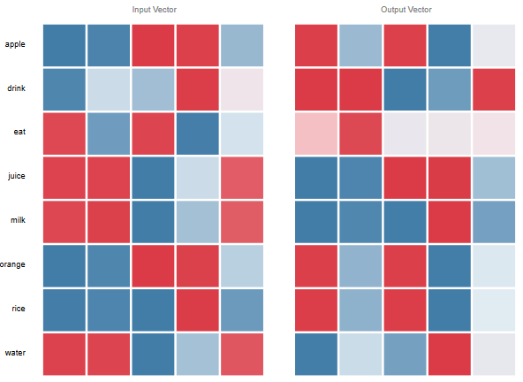
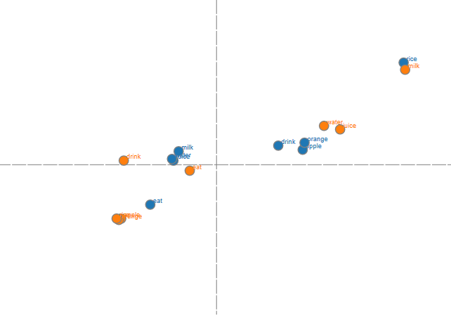

Slide 23
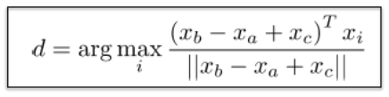
Evaluating Embeddings
Nearest Neighbors
Information Retrieval
Analogies
(a:b)::(c:?)
Minsk Belarus Rabat Morocco
Denver Colorado Sacramento California
professional professionally most mostly
Moldova Moldovan Greece Greek
https://github.com/nicholas-leonard/word2vec/blob/master/questions-words.txt

Slide 24
Similarity Data Sets
[Table from Faruqui et al. 2016]

Slide 25
[Mikolov et al. 2013]

Slide 26
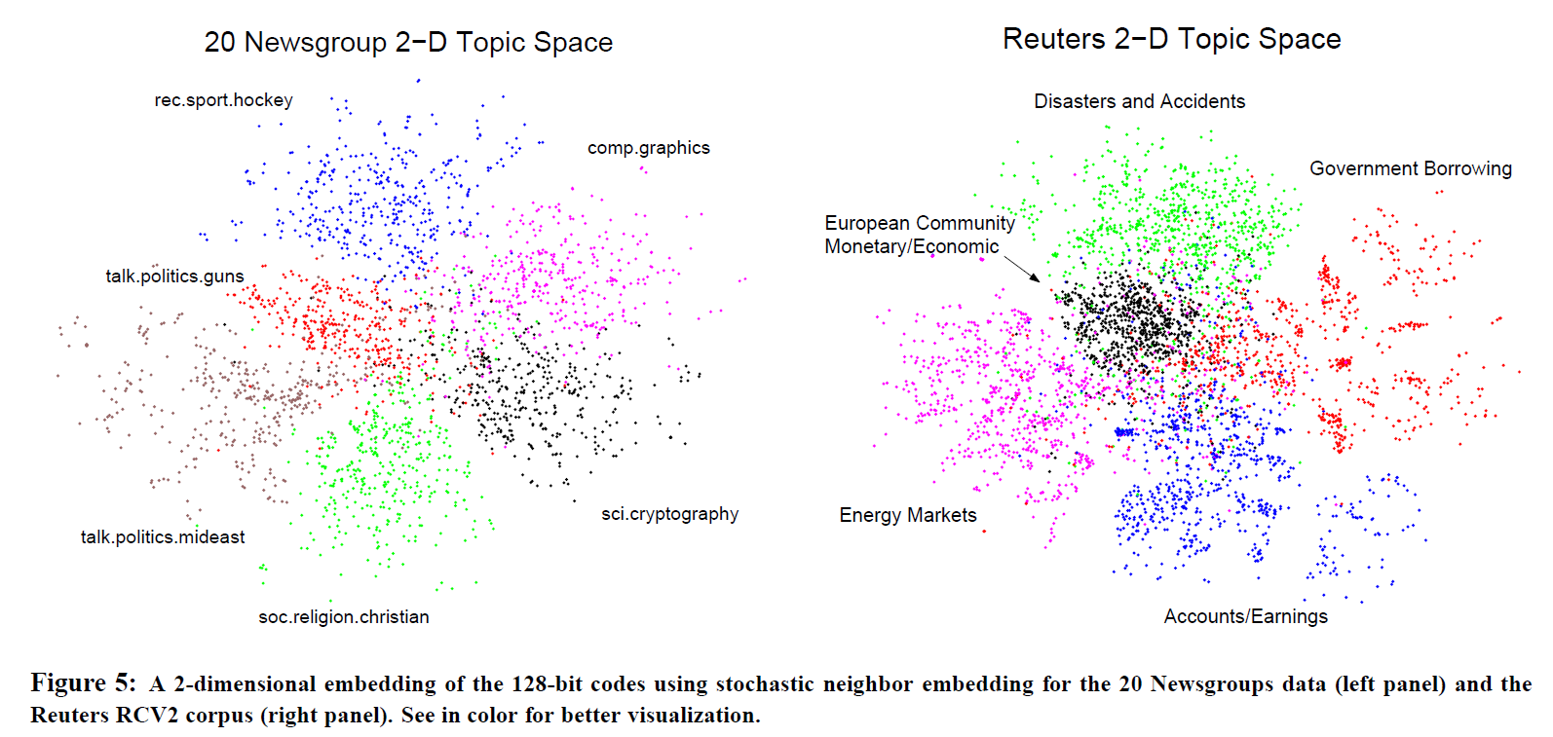
Semantic Hashing
[Salakhutdinov and Hinton 2007]

Slide 27
Multiple Senses
[Neelakantan et al. 2014]

Slide 28
[Neelakantan et al. 2014]

Slide 29
Multiple Senses
[Arora et al. 2018]

Slide 30
Retrofitting
[Faruqui et al. 2015]

Slide 31
Using Embeddings
Learning the parameters from the corpus
Use existing embeddings
Start with existing embeddings, then update

Slide 32
Notes
Word embeddings perform matrix factorization of the co-occurrence matrix
Word2vec is a simple feed-forward neural network
Training is done using backpropagation using SGD
Negative sampling for training

Slide 33
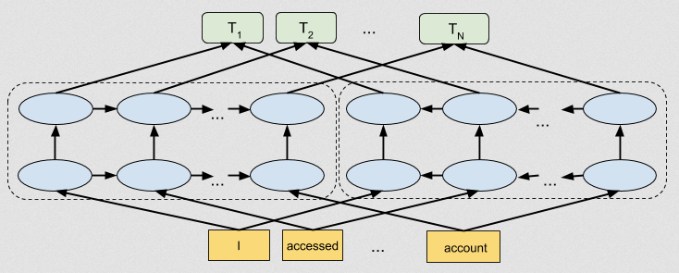
ELMo (Embeddings from Language Models)
https://ai.googleblog.com/2018/11/open-sourcing-bert-state-of-art-pre.html

Slide 34
ELMo (Embeddings from Language Models)
Useful
Models syntax and semantics as well as polysemy
Contextual
“The representation for each word depends on the entire context in which it is used. “
Deep
“The word representations combine all layers of a deep pre-trained neural network. “
Character based
“ELMo representations are purely character based, allowing the network to use morphological clues to form robust representations for out-of-vocabulary tokens unseen in training. “
https://allennlp.org/elmo [Peters et al. 2018]

Slide 35
ELMo Results
[Peters et al. 2018]

