Slide 1
Employee Data Analysis using Excel
STUDENT NAME:J.Flora
REGISTER NO:312218269
DEPARTMENT:Commerce
COLLEGE: Govt Art and Science College(RK nagar)

Slide 2
PROJECT TITLE
Employee Performance Analysis using Excel

Slide 3


AGENDA
Problem Statement
Project Overview
End Users
Our Solution and Proposition
Dataset Description
Modelling Approach
Results and Discussion
Conclusion
3/21/2024 Annual Review

Slide 4

PROBLEM STATEMENT EMPLOYEE ATTENDANCE SALARY INCREMENT

Slide 5

PROJECT OVERVIEW
.
It seems like employee presence and genders like high medium and low and salary increment this kind of things to be project overview.

Slide 6


WHO ARE THE END USERS? Employes and Employer

Slide 7

OUR SOLUTION AND ITS VALUE PROPOSITION Conditional formatting-missing filter- Remove Formula –Performance Pivot – Summary Graph – Data Visualization

Slide 8
Dataset Description Employee – kaggle 26- Features 9- Features Emp-id-num Name-text Emp Type Performance Level Gender –Male and female

Slide 9

THE "WOW" IN OUR SOLUTION
=IF(Z8>=5,"VERY HIGH",IF(Z8>=4, "HIGH", IF(Z8>=3, "MED", "LOW")))
Performance level
3/21/2024 Annual Review
9

Slide 10
MODELLING
Data Collection1.kaggle
DATA CLEANING
1.Collection of required data
2.Identify the blank cell
3.Removing the blank cell
FEATURE COLLECTION
1.Empl id
2.First name
3.Second name
4.Business unit
5.Performance level
6.Current employee rating
7.Gender
8.Employee status
PERFORMANCE LEVEL
1.Very high-5
2.High-4
3.Medium-3
4.Low-2.1
10

Slide 11
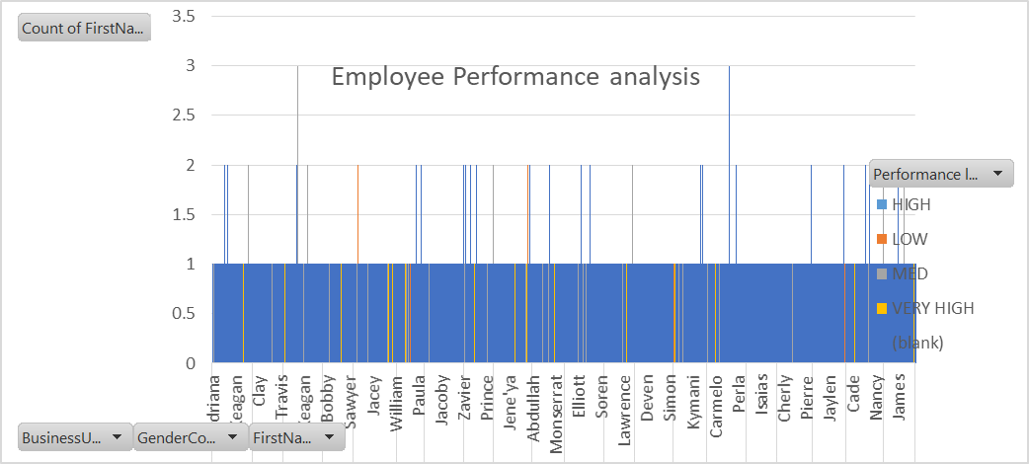
RESULTS
11

Slide 12
Conclusion We need to motivate average employee like valuable support higher Staff Motivation and Good Positive environment.

